Slide 1

eHMP OSEHRA PRESENTATION
24/Feb/2015
Version: 1.0
Submitted by: Carl Gray
Notes:
Hello and welcome to our presentation of eHMP
I will give an over view of the application and then talk about the architecture and specifically the SDK and its components the ADK and RDK.
I will wrap up the presentation with some of the current dependencies and issues that are seen with deployment in the workstation environment and the VA.
I will also give our next steps which will then lead into some time for Q and A.
This is the first time for us to present this audience to the best of my knowledge so it was a little tough deciding what to present.
Hopefully this will spur more questions and we can come back and give a more specific presentation in the areas of interest.

Slide 2
Introduction
If there is not any time for questions and answers today due to the length of the presentation please direct your questions to:
eHMPOpenSource@asmr.com
We will ensure that your questions are answered by members of our development team.

Slide 3
Overview
A key objective of the VistA Evolution Program is to enhance cross-Agency (DoD/VA) interoperability by providing all clinically relevant data at the point of care for Veterans.
eHMP is targeted to be the replacement for the CPRS application.
eHMP will accomplish this by integrating an enhanced graphical user interface, standards-based data, and integrating core clinical applications
Notes:
In 2014 Dr. Cullen gave a presentation on VistA Evolution.
A Key goal of the program was interoperability
And creating a single point of care for veterans
As such eHMP is targeted to replace CPRS as it becomes that single point of care.
eHMP has an enhanced UI and is integrated with core clinical applications.

Slide 4
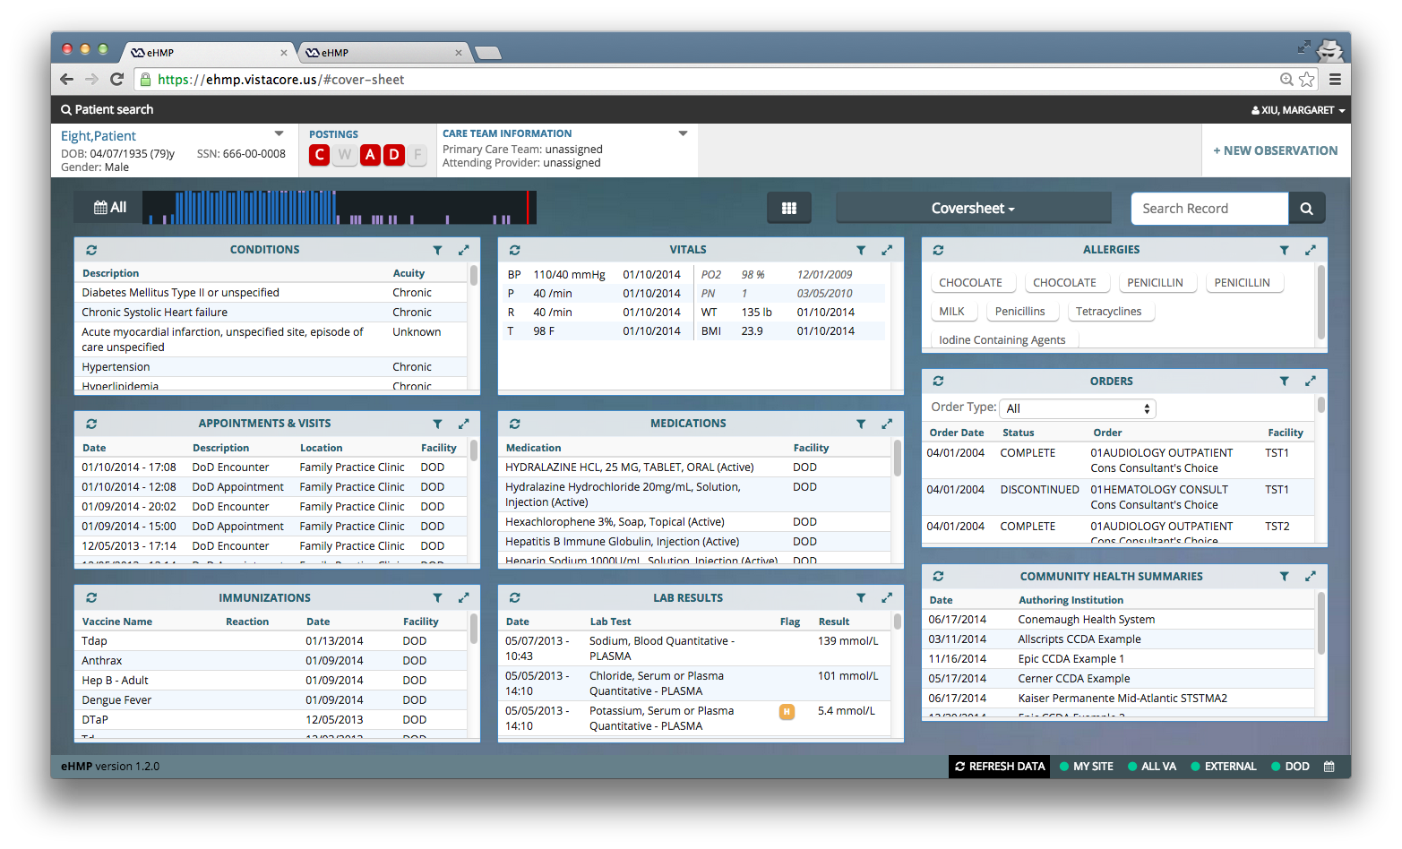
eHMP (coversheet)
Notes:
This is an example of the view that a clinician would see once logged into the eHMP application.
It shows the use of multiple applets within the single window interface.
The applets that are presented are configurable by the user depending on what the user needs to see in the workspace for their particular job responsibilities.
On this particular view you can see examples of the Immunizations, the Medications, and Allergies applets to name a few.

Slide 5
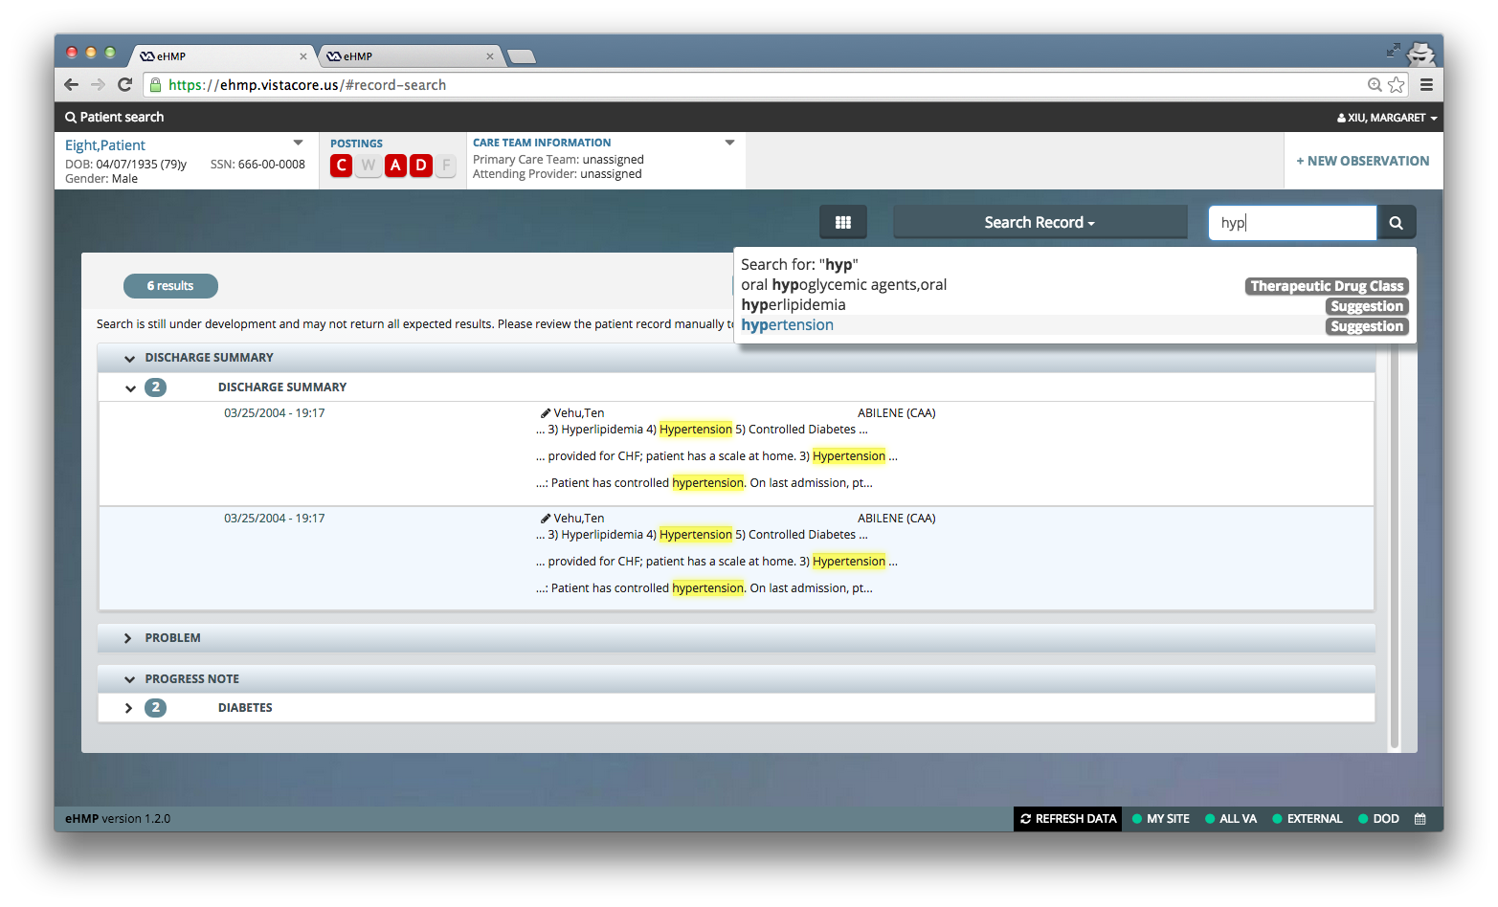
eHMP (text search)
Notes:
This view shows an example of the text search functionality.
Though we do not have a demo today, we would like to schedule one in the future if there was interest in us doing so.

Slide 6
eHMP Functional Goals
View of patient record, showing several sources of information at once
Advanced text search across patient record
Medication Review
Ability to document a clinical encounter (edit patient record, add allergies …)
Order entry
Ability to recommend interventions based upon patient record derived from clinical practices
Notes:
Here is a high level list of eHMP’s functional goals

Slide 7
eHMP Development Methodology
Using the Scaled Agile Framework (SAFe) development methodology
The development team works directly with VA stakeholders, which consists of on-the-ground doctors, technicians, SMEs, and leadership.
Notes:
As a team, we use the Scaled Agile Framework methodology. Our team is quite large so we are stressing the bounds of even this.
We strive to work very closely with the VA stakeholders in order to ensure that we are giving the functionality that they need.

Slide 8
Architecture (VX API)
eHMP utilizes VistA Exchange (VX) as its source of patient data.
VX is a standards based ReSTful web service API which provides patient data, search, authentication, access control, CCOW service, order entry, writeback, clinical decision support, and other operations needed for a clinical UI.
VX is written in JavaScript and runs on node.js
eHMP UI is developed as a Single Page Application, which is static HTML served from the web server (not dynamic web pages such as JSP, PHP, etc. No J2EE web server)
VX and eHMP UI are developed using a SDK that fulfills common cross cutting concerns.
Notes:
Single Page Application – simplifies the division of business logic between the client and server. And is conceptually similar to the CPRS client server model.

Slide 9
Architecture (VX Cache)
VX API retrieves patient data from VX Cache, which is a temporary store of patient data from the VistA sites, DoD, Community (VLER), and VLER PGD.
This allows for quick access to previously synced patients, and data is kept up-to-date using a subscription/publication from each VistA site.
VX Cache is implemented with an M JSON document database, Solr and a rich-text document store.
Patient Data in VX Cache is stored with standardized terminology codes (SCT, ICD, RxNorm, LOINC, CPT).
Notes:
The VistA Exchange Cache is where we temporarily store patient data
It provides up-to-date patient data (from VA Sites, VLER, DoD) as quickly as possible.

Slide 10
Architecture (SDK)
The SDK is comprised of:
Application Development Kit (ADK) to drive development of the client-side web application
Resource Development Kit (RDK) to drive the development of service side resources (web services) to support the web application

Slide 11
Architecture (SDK)
The SDK provides the ability to add incremental functionality to the web application through the development of applets (not to be confused JSR-286 portal or 1990's Java applets).
The SDK allows for parallel development of applets by reusing a common UI library.

Slide 12
Architecture (ADK)
Built using JavaScript, backbone.js, Marionette, Bootstrap
A mechanism to arrange these applets through app configuration into layouts called screens
Provides holistic application utilities and functions
Includes common cross cutting concerns (authentication, authorization, etc…)
Provides consistent visual themes

Slide 13
Architecture (ADK)
The ADK provides a mechanism for screen designers and application designers to:
Create a screen, choose from predefined layouts and assigning applets to regions
Provides the runtime UI shell for the application. Displays current patient, current user, provides navigation
Choose the screens that are part of the application

Slide 14
Architecture (RDK)
Developed using JavaScript, express.js
Deployed to node.js; relies on npm for package management
The RDK is responsible for:
Providing server configuration and information about the request
Providing handles to common external systems, including VX Cache and VistA(s)

Slide 15
Setting Up the Development Environment
Dependencies
The tools that are use in our internal environment for local deployment of the code are:
chef-solo (version 10.14.4)
Berkshelf (2.0.11)
Gradle (version 1.11)
Ruby (version 1.9.3p194)
Rake (10.3.2)
Vagrant and VirtualBox provider (version 1.4.3)
Java (version jdk1.7.0_72)
non-open source components are Axiomatics Policy Server (APS) and HighStocks
Notes:
Axiomatics Policy Server (APS) and HighStocks is only used in certain applets
HighStocks can be replaced in most applets by either HighCharts - AFAIK
HighStocks also has a free non commercial licence
Axiomatics Policy Server (APS) is an XACML Policy Enforement Point (PEP) and can be disabled or replaced in an OSS Environment.

Slide 16
Setting Up the Development Environment
Access to VistA
The current code base and deployment plan does require that the user have access to VistA or to a VistA test instance.
eHMP should run on any current FOIA VistA instance
Notes:
FOIA/OSEHRA instance of VistA for Open Source use

Slide 17
Setting Up the Development Environment
Toolkit
Gradle build process (wrapping Grunt and NPM tasks for JavaScript projects)
Vagrant and Chef server automation
Notes:
Vagrant and Chef for deployment

Slide 18
Deployment/Production Configuration
The current approach for deploying to VA environments, including production, is to create a “cache” of all the deployment scripts and installation artifacts that are needed. This is created within our Jenkins build pipeline and then stored on Nexus.
The cache is needed because there is no internet access at all from within the VA environments. So everything that is needed for a deployment must be available within that environment. For a deployment the cache is pulled from Nexus, uploaded to the target environment and unzipped.
Rake, chef-solo and Vagrant scripts are then used to deploy the component pieces of the application to the servers within that environment. Most of the Chef recipes and other scripts are common to both VA deployments as well as local developer deployments. The primary differences are:
Vagrantfiles which are unique to a “managed” deployment where VMs already exist vs. a VirtualBox deployment where they are created on-the-fly
“settings” files which describe the target servers
environment-specific configuration files

Slide 19
Next Steps
eHMP r1.1 Open Source code drop – March 02
Produce Install Manual to be used by Open Source community
Create more robust Open Source code drop – Late May
Work with the VA Innovations team to create an Open Source development environment

Slide 20
Questions
Questions as time permits
Notes:
We have some of the developer on the call today so if you have any SDK specific questions we will try to answer them for you.

Slide 21
Follow Up Questions
Please pose all follow up questions to:
eHMPOpenSource@asmr.com

