Slide 1

SUMMER TRAINING PROJECT REPORT
Smart Blood Donation
Emergency Matching System
A console-based C++ application that applies core Data Structures & OOP to speed up emergency blood-donor matching
Submitted by Abhin S — Reg. No. 12411257 · Group 52 · Section 324EQ
Guided by Dr. Ravi Kant Sahu
School of Computing & Artificial Intelligence, Lovely Professional University, Phagwara

Slide 2
DECLARATION
Originality & Certification
✓
I hereby certify that the project titled “Smart Blood Donation Emergency Matching System” is a genuine representation of my own work, carried out as part of the CA-PETV143 project requirement at Lovely Professional University, Phagwara, under the supervision of Professor Dr. Ravi Kant Sahu during June–July 2026. All data and insights presented in this report are the result of my own dedicated effort and are entirely original.
Name of Student:
Abhin S
Registration No.:
12411257
Group:
52
Section:
324EQ
Note: insert the scanned LPU project-completion certificate image here before presenting.
Smart Blood Donation Emergency Matching System
2

Slide 3
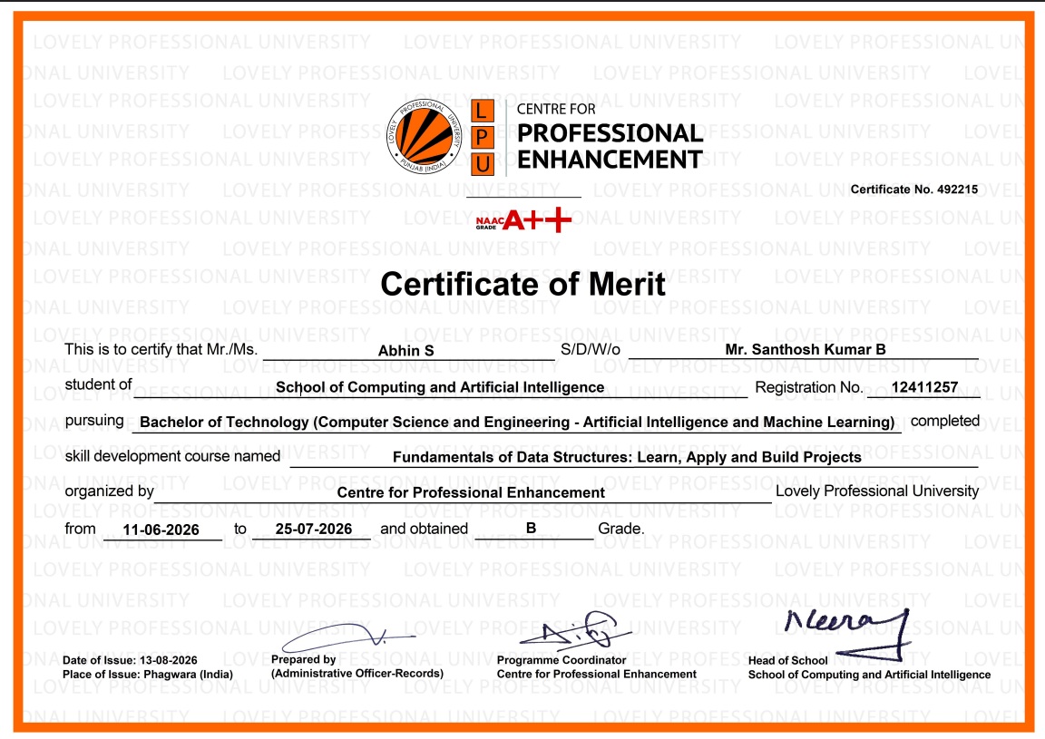

Slide 4
ABSTRACT
Why This Project Matters
4
STL data structures applied
The Problem
Hospitals and blood banks often struggle to locate suitable donors quickly during emergencies. Manual, register-based donor records make searching slow, error-prone, and risky when every minute counts.
5
functional modules
The Solution
A C++ console application that digitizes donor records and uses purpose-built data structures to register, search, prioritize, and match donors to requests in real time.
O(1)
avg. blood-group lookup
Smart Blood Donation Emergency Matching System
3

Slide 5
CHAPTER 1 · INTRODUCTION
Problem Statement & Objectives
The Problem
Key Objectives
Blood is critical during accidents, surgeries and emergencies, but donor information kept in registers is slow and scattered to search — costing precious time when it matters most.
Maintain donor information digitally
Register new blood donors quickly
Search donors instantly by blood group
Manage & prioritize emergency requests
Maintain a full donation history
Reduce time-to-find-a-donor
Apply OOP & core Data Structures
Build a friendly console interface
A digital, structured system removes this bottleneck — register, search, and match donors in seconds, not minutes.
Built as a stand-alone C++ console app — ideal for demonstrating DS/OOP concepts on a real social problem.
Smart Blood Donation Emergency Matching System
4

Slide 6
CHAPTER 1 · INTRODUCTION
Five Modules, One Workflow
1
2
3
4
5
Donor Management
Blood Request Mgmt.
Emergency Matching
Donation History
Reports
Register, search, update & delete donor records
Log hospital/patient requests with priority
Instantly match a request to an available donor
Chronological record of completed donations
Live donor counts & blood-group statistics
Smart Blood Donation Emergency Matching System
5

Slide 7
CHAPTER 1 · INTRODUCTION
Technology Stack
1
C++
2
OOP
3
STL
Core programming language for the entire application
Classes for Donor, Request, History & Managers
vector, unordered_map, priority_queue, list
4
VS Code
5
MinGW g++
6
fstream
Primary code editor for development
Compiler used to build & run the project
Permanent file-based storage of all records
Smart Blood Donation Emergency Matching System
6

Slide 8
CHAPTER 3 · IMPLEMENTATION
The Right Data Structure for Each Job
Structure | Why It's Used | Complexity
vector<Donor> | Store all donor records | Insert O(1)· Search O(n)
unordered_map<string, vector<int>> | Group donors by blood group for fast lookup | Search O(1) avg.
priority_queue<BloodRequest> | Serve emergency requests before normal ones | Insert/Remove O(log n)
list<DonationRecord> | Preserve donation order for history | Insert O(1)
A vector alone can't group donors by blood type efficiently — that's exactly what the unordered_map buys us.
Smart Blood Donation Emergency Matching System
7

Slide 9
CHAPTER 3 · IMPLEMENTATION
Project Workflow
Start Program
→
Main Menu
→
Donor / Request / Reports
→
Emergency Matching
→
Donation History
→
Save & Exit
Emergency requests jump the queue — a priority_queue guarantees the most critical case is served first.
OOP classes: Donor · BloodRequest · DonationRecord · DonorManager · RequestManager · FileManager
Smart Blood Donation Emergency Matching System
8

Slide 10
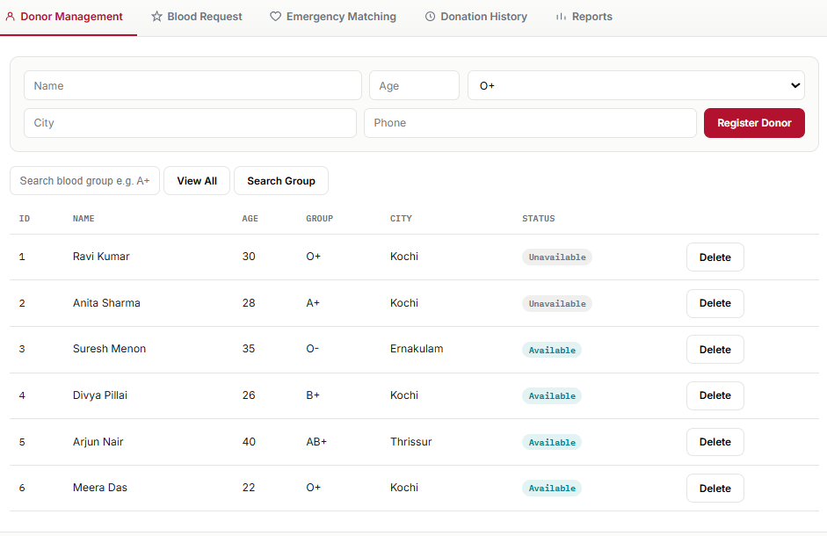
CHAPTER 4 · SCREENSHOTS
Donor Registration & Directory
Donor Management
Register a donor, view all records and search instantly by blood group via the unordered_map index.
Smart Blood Donation Emergency Matching System
9

Slide 11
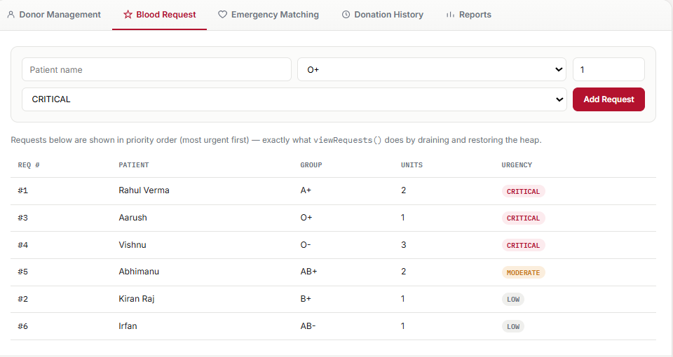
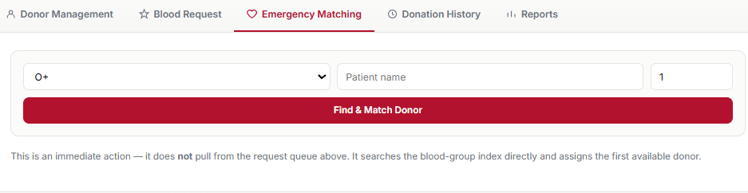
CHAPTER 4 · SCREENSHOTS
Requests & Emergency Matching
Blood Request
Emergency Matching
New requests are queued and shown in priority order — CRITICAL cases first.
Finds & assigns the first available donor for the chosen blood group instantly.
Smart Blood Donation Emergency Matching System
10

Slide 12
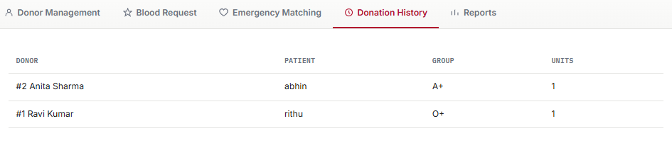
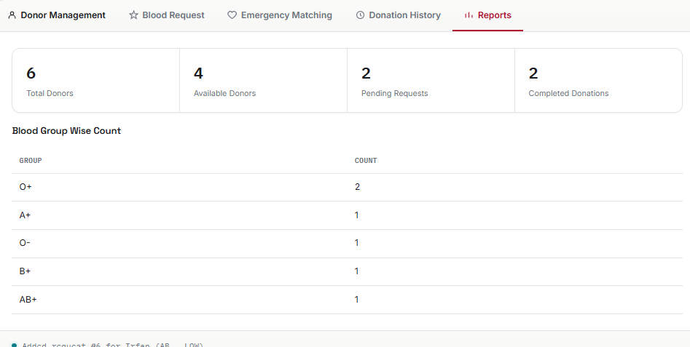
CHAPTER 4 · SCREENSHOTS
History & Live Reports
Donation History
Reports
Chronological log of completed donations, maintained using a list.
Live totals: donors, availability, pending requests and blood-group-wise counts.
Smart Blood Donation Emergency Matching System
11

Slide 13
CHAPTER 5 · FUTURE SCOPE
Where This Project Can Go Next
1
Graphical Interface
2
Database Integration
3
Compatibility Matching
Move from console to a Qt / desktop UI
Replace flat files with MySQL / SQLite
Suggest compatible donors, not just exact matches
4
Hospital & Bank Network
5
Eligibility Tracking
6
SMS / Email Alerts
Multi-location blood-bank management
Auto-track donor waiting periods
Notify matching donors instantly
Smart Blood Donation Emergency Matching System
12

Slide 14
CONCLUSION
Data Structures, Applied to Save Time — and Lives
Delivers real functionality: registration, search, emergency matching, history & reports
Demonstrates vector, unordered_map, priority_queue and list solving real problems
Strengthens OOP, file handling, and STL fundamentals through hands-on build
Provides a solid, extensible foundation for a production-grade system
Thank you — Questions Welcome

