Slide 1
IBM University Engagement Project Submission
“Exploring the Power of Agentic AI with IBM Granite and LangFlow”

Slide 2

Project Tile – []
Domain of Project – [ like Agriculture / Education / Healthcare / … ]
Student Name | Recent Passport Photo | Email ID | Mobile number [WhatsApp]
ABHINA SUDHI |  | abhinasudhi777@gmail.com | 8848081067

Slide 3
Problem Statement -
Problem Statement : AI-Based RF Interference Detection Assistant
The Challenge
Radio Frequency (RF) interference can degrade wireless communication systems such as Wi-Fi, Bluetooth, IoT, satellite, and cellular networks. Identifying interference sources requires manual analysis of RF signal data using specialized equipment, making the process time-consuming and complex..
The Objective
Build an AI-Based RF Interference Detection Assistant that intelligently analyzes RF signal data, detects abnormal signal behavior, identifies potential interference sources, and recommends effective mitigation strategies.
The solution should provide:
RF Signal Analysis
Analyze RF measurement reports, including Frequency, RSSI, Noise Floor, Signal-to-Noise Ratio (SNR), Channel Utilization, and other signal parameters to detect abnormalities.
Interference Source Detection
Identify possible RF interference sources such as Wi-Fi channel overlap, Bluetooth devices, microwave ovens, neighboring access points, IoT devices, cordless phones, and electromagnetic noise.
Mitigation Recommendation
Recommend practical solutions including channel optimization, antenna repositioning, frequency band switching, transmit power adjustment, interference filtering, and network optimization.
Spectrum Interpretation
Interpret spectrum analyzer readings and explain signal characteristics in simple engineering language.
Visualization Dashboard
Display RF signal health, detected issues, interference alerts, confidence scores, and recommended corrective actions through an interactive dashboard.

Slide 4
Proposed Solution -
Proposed Solution: AI-Based RF Interference Detection Assistant
The proposed solution is an AI-powered RF Interference Detection Assistant developed using IBM watsonx Orchestrate, IBM Granite Models, and Retrieval-Augmented Generation (RAG) to automate RF signal analysis and troubleshooting.
The system uses a knowledge base containing RF communication concepts, spectrum analyzer fundamentals, wireless networking guidelines, and RF troubleshooting documents. Using RAG, the assistant retrieves relevant technical information and combines it with IBM Granite's reasoning capabilities to provide accurate interference analysis.
The solution consists of four major modules:
RF Signal Analysis Agent
Analyzes RF signal parameters including Frequency, RSSI, Noise Floor, SNR, Channel Utilization, and Signal Strength to detect abnormal signal behavior.
Interference Detection Agent
Identifies probable RF interference sources using signal characteristics and ranks possible causes based on likelihood.
Mitigation Recommendation Agent
Suggests practical engineering solutions including channel optimization, antenna alignment, device relocation, frequency switching, and RF noise reduction techniques.
Knowledge Retrieval Agent
Retrieves relevant RF communication concepts, troubleshooting procedures, and best practices from the knowledge base using Retrieval-Augmented Generation (RAG).
The assistant presents all analysis results through an interactive dashboard showing signal quality, detected issues, confidence level, and recommended corrective actions.

Slide 5
Technology Used
• IBM watsonx Orchestrate – Build and deploy the AI agent.
• IBM Granite Model (Granite-3.3-8B-Instruct) – Natural language understanding, reasoning, and RF analysis.
• IBM Cloud – Secure cloud platform for deploying the AI solution.
• Retrieval-Augmented Generation (RAG) – Retrieve RF knowledge from uploaded documents before generating responses.
• Knowledge Base – RF Fundamentals, Spectrum Analysis, Wi-Fi Troubleshooting, RF Interference Guides, and RF Measurement Dataset.
.

Slide 6
Langflow/Orchestrate component Used -
Chat Input – Accepts RF signal reports and user queries.
IBM watsonx AI Agent – Processes RF signal information using IBM Granite.
IBM Granite Model – Granite-3.3-8B-Instruct for reasoning and technical explanation.
Knowledge Base Component – Retrieves RF communication documents using RAG.
Chat Output – Displays RF analysis, interference sources, mitigation strategies, and explanations.
File Component – Stores RF measurement reports and RF knowledge documents.

Slide 7

Role of Agentic AI in the solution
Role of Agentic AI RF Interference Detection Assistant
Agentic AI enables the RF Interference Detection Assistant to function as an intelligent engineering assistant rather than a traditional chatbot.
Multiple AI capabilities work together to analyze RF measurements, retrieve relevant technical knowledge, identify interference sources, recommend mitigation strategies, and explain engineering concepts in an understandable manner.
Using IBM Granite Models and Retrieval-Augmented Generation (RAG), the assistant provides context-aware recommendations based solely on the uploaded RF knowledge base, ensuring reliable and explainable responses
.
The system reduces manual troubleshooting effort, accelerates RF diagnostics, and improves wireless network performance through intelligent automation.

Slide 8
Novelty and Uniqueness
• AI-powered RF troubleshooting instead of manual spectrum analysis.
• Retrieval-Augmented Generation (RAG) ensures technically accurate responses from trusted RF documentation.
• Intelligent ranking of possible interference sources.
• Automatic mitigation recommendations for communication engineers.
• Engineering-friendly explanations for complex RF measurements.
• Interactive dashboard showing RF health and signal quality.
• Scalable solution built using IBM watsonx Orchestrate and IBM Granite.

Slide 9
Git Hub Link
Repository Name: AI-Based RF Interference Detection Assistant
Github URL:
https://github.com/AbhinaSudhi/-AI-Based-RF-Interference-Detection-Assistant
·
·
·

Slide 10
Future Scope
1.Real-Time Spectrum Analyzer Integration
Integrate the assistant with live RF measurement equipment and Software Defined Radio (SDR) devices for real-time interference detection.
2. Predictive RF Analytics
Use machine learning to predict future RF interference, optimize wireless network performance, and provide proactive maintenance recommendations.
This content matches the structure, headings, and style of the IBM template while being tailored specifically to your AI-Based RF Interference Detection Assistant project.
·
·
·

Slide 11
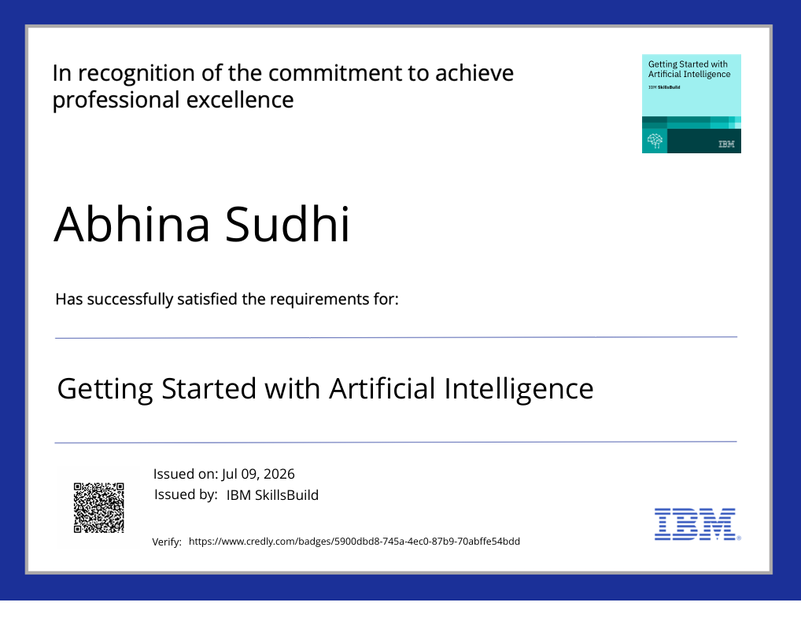
Certificates Earned:

Slide 12
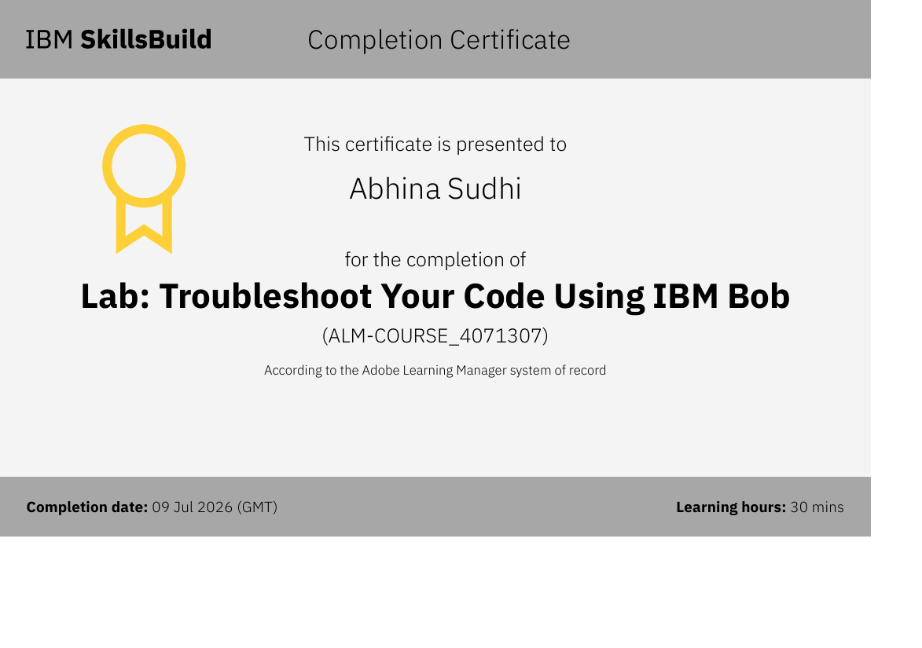
Certificates Earned:​

Slide 13


