Slide 1
Team Spotify
Final Presentation

Slide 2
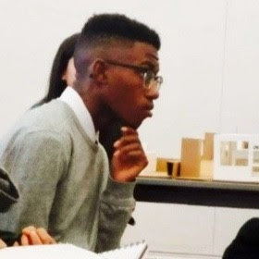

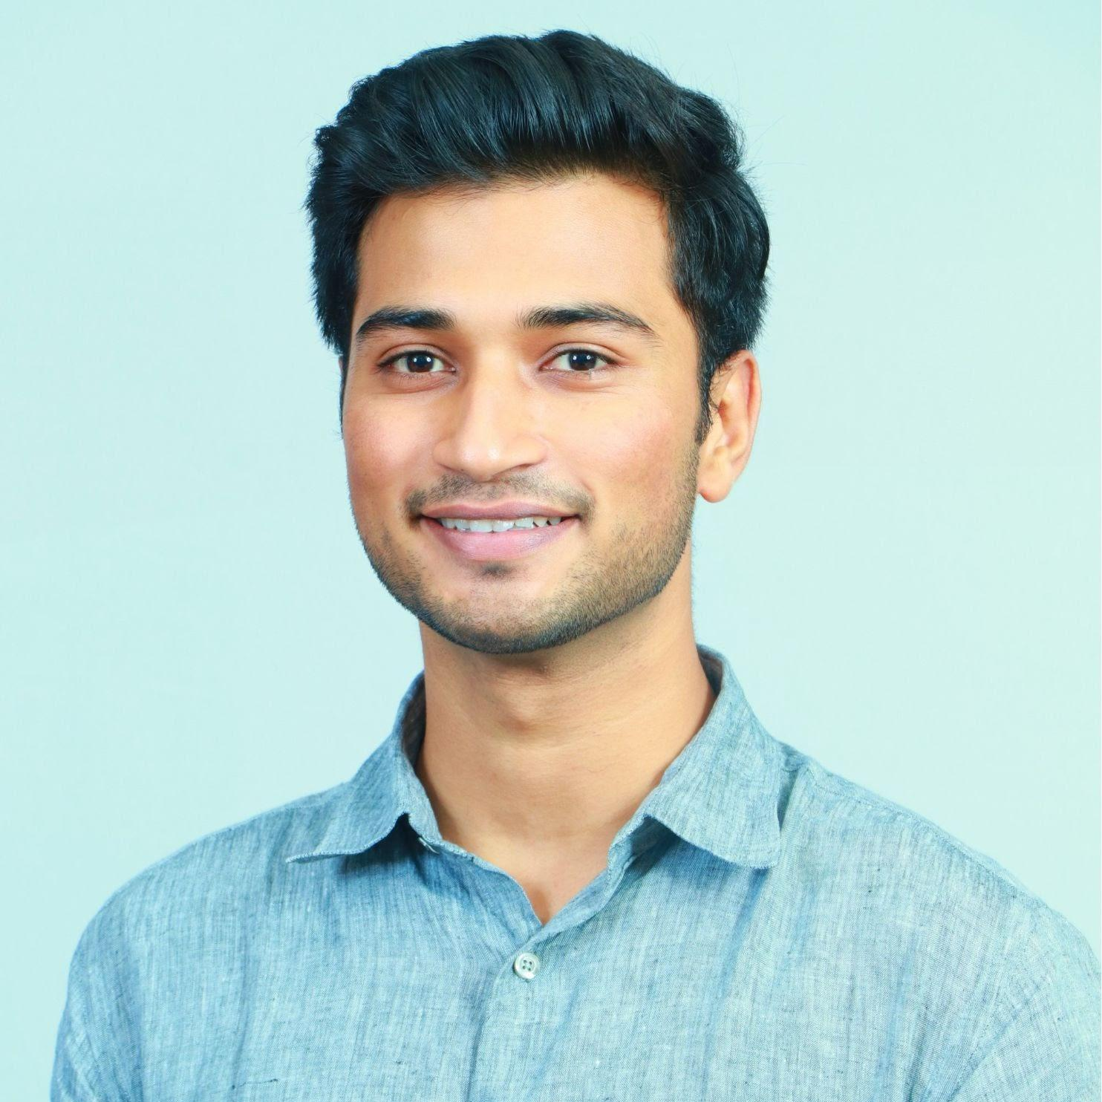

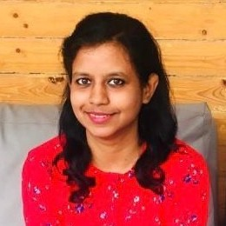
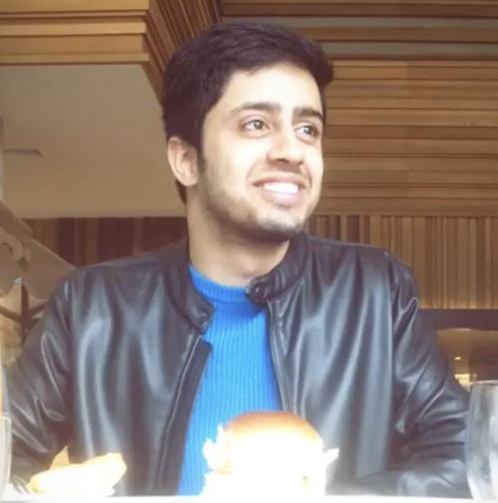
The Team
Cameron Drayton
Fanny Tashia
Abhinaav Singh
Lee-Ann Shaw
Preeti Kumari
Rohan Paliwal

Slide 3
Agenda
Research Goal
What we did? (Midterm Recap)
What we are doing now? (2nd Phase)-additional research we did
Analysis (Findings around current research goal)
Feasibility and Implementation (Risks, Mitigations, Next Steps-further analysis/Recommendations specific to Ken)

Slide 4
Research Goals
How can we make Spotify Podcast popular among Gen-Z?
Spotify has a big number of Podcast Titles and Talents.
Which one of these talents would gather more Gen-Z audience?

Slide 5
Recap
Our team comes up with a Gen-Z persona as follows:
TRAITS
Age : 16-24
Gender : Mostly Male
Location : USA
Uses : Instagram, Facebook, YouTube, TikTok, Snapchat, twitter
BEHAVIOURS
Sports Enthusiasts
Follow pop culture
Bibliophiles
ROLES
Students
Digital Natives
Youtubers/Influencers
Gamers
Entrepreneurs
LGBTQ+ allies

Slide 6
What we are doing now?
Talent analysis
We leverage on Spotify’s handles in Instagram and Twitter to see which Podcast Talents gains Gen-Z attention.
Does it fit our Gen-Z persona?

Slide 7
What we are doing now?
Where did it happen?
How about when??
Looked at different podcasters on different social media platforms such as Twitter and Instagram.
The goal is to learn about what podcasts Gen-Z are keen on listening to.
Podcast gain attention when they have guest talk about specific influencer.
Podcast can gain popularity if the content
Podcast gain attention due to cultural trends/ ex- Black Friday, Seasonal

Slide 8
Findings
Society and Culture
Joe Rogan Experience
4D with Demi Lovato
That was fun with Addison
Armchair Expert
Renegades Podcast
Music
The Bridge Podcast
Off the records with DJ Akademiks
Dolly Parton America
Sports
Called Game
The Ringer podcasts
Stay Hot
FIFA PlayOn
Spinsters
Pop Culture (Entertainment, Games, Celebrities)
Dissect Podcast
Misfits
Conan O’Brien Needs a Friend
Podcast Beyond - IGN’s PlayStation Show
Higher Learning

Slide 9
Other Things we learned about Gen-Z preferences
Gen-Z has interest on issues such as:
Mental Health
Mayim Bialik’s Breakdown
Therapy for Black Girls
LGBTQIA+
The Two Princes Podcast
Jemele Hill is Unbothered
Diverse Culture
Higher Learning with Van Lathan and Rachel Lindsay
Sunstorm with Alicia Garza & Ai-jen Poo
Notes:
This is inline with our Gen-Z personas back from midterm

Slide 10
What Spotify Wants to Improve
The podcast talents we saw earlier are mostly has famous podcast talent, Spotify wants more talent that is more Organic
What we did next?
We learned from the podcasts are already thriving (topics, interest) and use social media to find other talents that shares the same interests and topics
Notes:
This is inline with our Gen-Z personas back from midterm

Slide 11
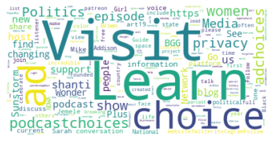
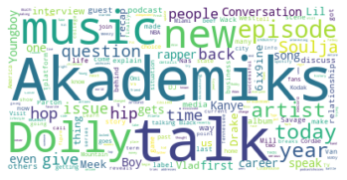
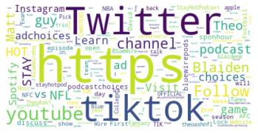
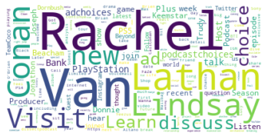
Top Keywords
Society and Culture
Music
Sports
Pop Culture (Entertainment, Games, Celebrities)

Slide 12
Results
Popular Podcasts
Undiscovered Podcasts
Promoted by Spotify
Untapped Opportunity

Slide 13
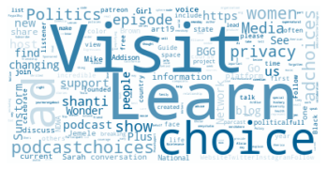
Results : Society & Culture
Popular Podcasts
Untapped Talent
Joe Rogan Experience
4D with Demi Lovato
That was fun with Addison
Armchair Expert
Renegades Podcast
Internet Party
Out The Box Podcast
PlanBri Uncut

Slide 14
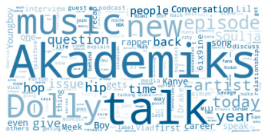
Results : Music
Popular Podcasts
Untapped Talent
The Bridge Podcast
Off the records with DJ Akademiks
Dolly Parton America
Well Disguised
She Will Rock You Podcast
The Itch Rock Radio & Podcast
Great Song Podcast

Slide 15
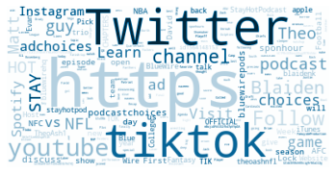
Results : Sports
Popular Podcasts
Untapped Talent
Called Game
The Ringer podcasts
Stay Hot
FIFA PlayOn
Spinsters
Too Much Dip
The College Football & Basketball Experience
Underground Sports Philadelphia
The Clapper Report

Slide 16
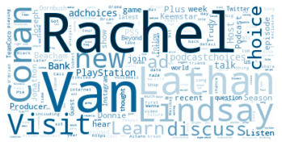
Results : Pop Culture
Popular Podcasts
Untapped Talent
Dissect Podcast
Misfits
Conan O’Brien Needs a Friend
Podcast Beyond - IGN’s PlayStation Show
Higher Learning
Made You a Mixtape
The Dungeon Masters Dojo
Take Your Shoes Off w/ Rick Glassman
Amazing Pop Culture Podcast

Slide 17
Results
Society and Culture
Internet Party
Out The Box Podcast
PlanBri Uncut
Music
Well Disguised
She Will Rock You Podcast
The Itch Rock Radio & Podcast
Great Song Podcast
Sports
Too Much Dip
The College Football & Basketball Experience
Underground Sports Philadelphia
The Clapper Report
Pop Culture (Entertainment, Games, Celebrities)
Made You a Mixtape
The Dungeon Masters Dojo
Take Your Shoes Off w/ Rick Glassman
Amazing Pop Culture Podcast

Slide 18
Results
Other Podcast Talents:
Mental Health
20TIMinutes
The Plug sessions
LGBTQIA+
Thanks For Coming! A Rupaul’s Drag Race Podcast
Diverse Culture
Kwality Kontent
I Just Wanna Talk
Notes:
This is inline with our Gen-Z personas back from midterm

Slide 19
Feasibility & Implementation
How to implement this for the future?

Slide 21
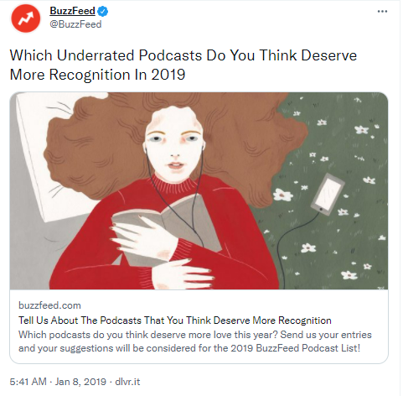
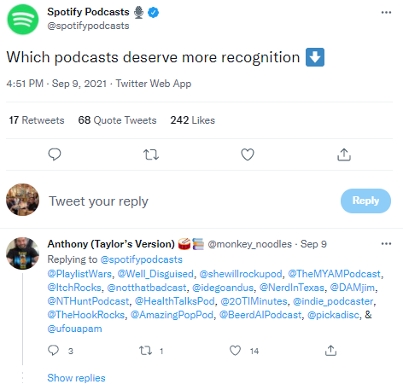
Using Social Media to Learn about Gen-Z preferences
Notes:
This is inline with our Gen-Z personas back from midterm

Slide 22
Results Might Give Insights of Gen-Z’s interest shift
For example:
For sport, Spotify promotes Podcast that discuss American Football or Basketball, however, results shows considerable number of audience suggested Podcast that discuss about Hockey
For music, most of the Music Podcast that is promoted by Spotify are talking about Hip Hop, however results shows audience also favors Podcast that discuss other music genre, such as Rock

Slide 23
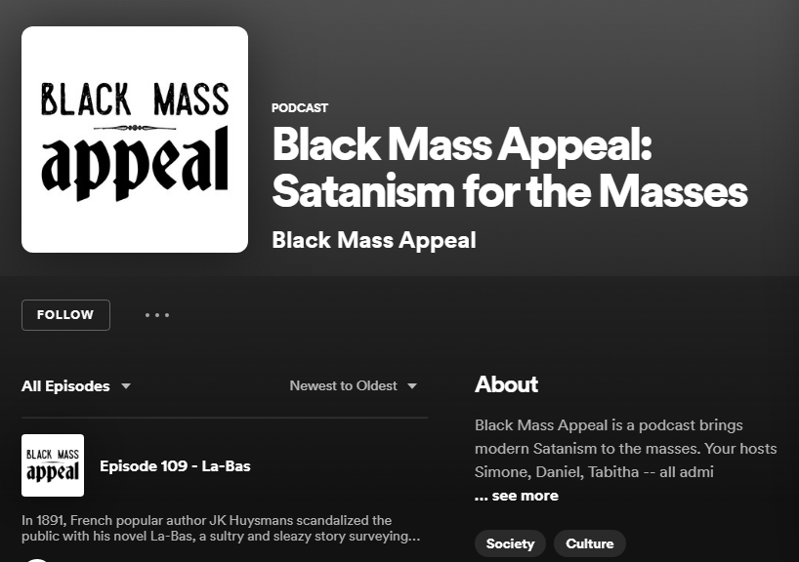
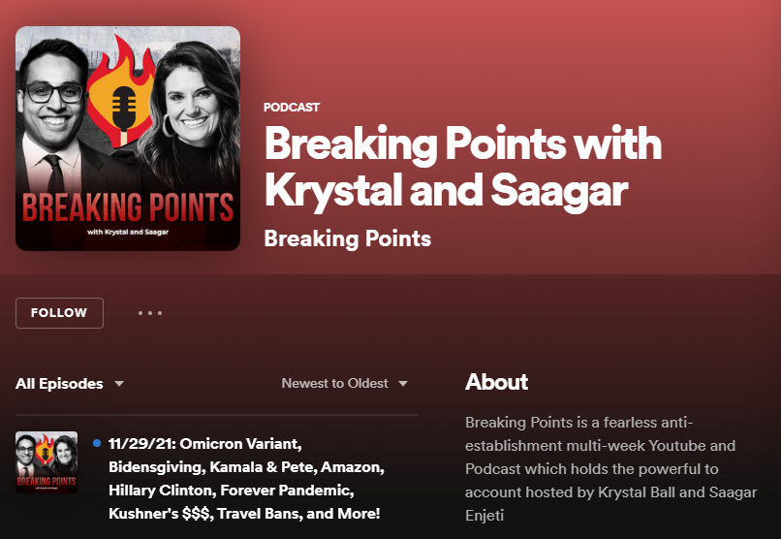
Analysis needs to be checked regularly

Slide 24
Next Steps for Further Analysis
How new artists like Cordae is coordinating with old artists in the current paradigm.
Volume of social conversation between artists of two different generations ex. Jungle and Cordae
Reasons why young and new artists are more popular than the old ones?

Slide 25
Recommendations to Spotify
Spotify should tweet more probing questions about underrated podcasts in order to generate user conversation
Find more “Indie” podcasters that Gen Z supports
Obtain popular guests based on the seasonality of trends (e.g Halloween, Black Friday, Superbowl)

Slide 26
Risks and Mitigations
Not representative of a region’s demographics → analysis of users’ date of creation and timestamp
“80% of tweets come from top 10% of most active users” -PEW Research Center
Bad actors a.k.a Bots
Bots can be hard to detect, and they can skew data due to their frequency of using topic specific, keywords
Notes:
Tweets by bots can be hard to detect, especially with small sample sizes. Yet they can skew your data, just as they are occasionally intended to purposively skew the conversation.
https://towardsdatascience.com/limitations-of-twitter-data-94954850cacf

Slide 27
Risks and Mitigations
Twitter user demographics are skewed → Risk in finding the exact Gen-Z user base as a lot of users create fake accounts on social media and this makes difficult to find the exact age bracket of the users.
Notes:
Tweets by bots can be hard to detect, especially with small sample sizes. Yet they can skew your data, just as they are occasionally intended to purposively skew the conversation.
https://towardsdatascience.com/limitations-of-twitter-data-94954850cacf

