Slide 1



Trithon 2026
Theme: Innovative improvement in Agriculture / Healthcare / Environment/Energy/ Education using AI/ ML/ DL / LLM Technologies
Team Name : Smart Kissan
Problem Statement Title : AI-Based Crop Disease Detection & Smart Farming Advisory System
Team Leader Name :
Institute Name :ITER, SOA University
Team Lead Contact Number:

Slide 2
The Overview :
Smart Kissan is an AI-powered smart farming platform that enables farmers to detect crop diseases instantly using leaf images and receive intelligent, weather-aware treatment recommendations in real time.
Core Technologies Used:
Deep Learning (CNN) for leaf disease classification
Smart Decision Engine for pesticide & dosage calculation
Weather Intelligence API for spray timing optimization
LLM-based multilingual advisory system (Hindi & English)
Smart Irrigation Control Module
The platform is mobile-friendly and designed specifically for rural farmers.

Slide 3
The Problem :
Agriculture in India faces major challenges:
Difficulty in early and accurate disease detection
Incorrect pesticide usage leading to crop loss
Limited access to agricultural experts in rural areas
Language barriers in digital farming tools
Unpredictable weather affecting spray decisions
As a result, farmers depend on guesswork or local advice, often leading to financial loss and reduced productivity. There is a strong need for an intelligent, affordable, and real-time AI-based farming assistant.

Slide 4
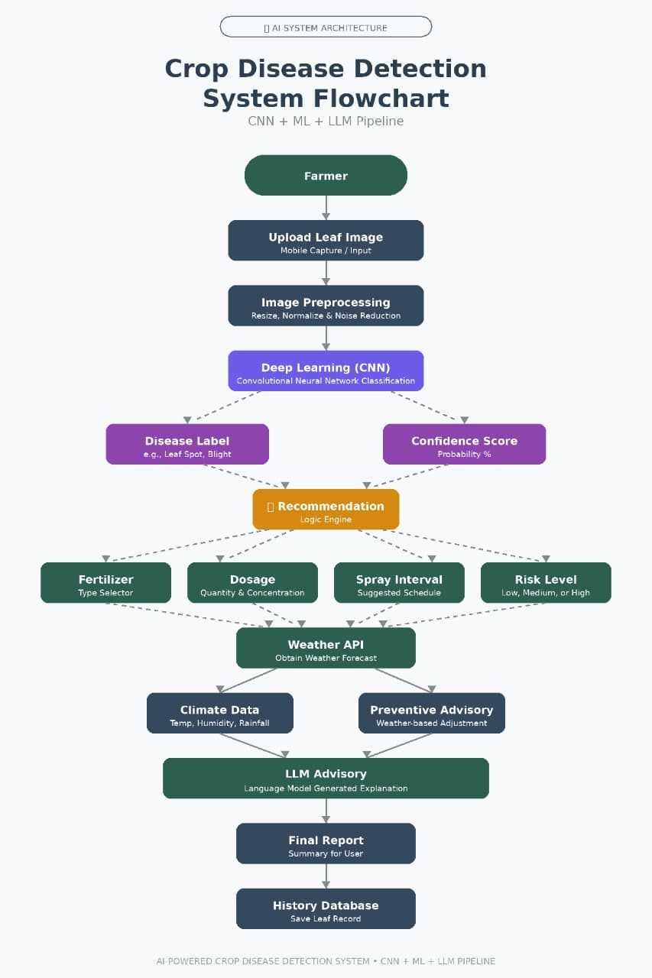
Solution Suggested:
Smart Kissan provides:
1.AI-Based Leaf Disease Detection
Farmer uploads infected leaf image
CNN model predicts disease type
Calculates infection percentage & risk level
2. Smart Pesticide & Dosage Recommendation
Suggests suitable pesticide
Provides exact dosage (e.g., 40ml per 15L tank)
Recommends spray interval
3. Weather-Integrated Advisory System
Uses real-time temperature & humidity data
Optimizes spray timing
Prevents spraying before rainfall

Slide 5
Solution Suggested(Continued):
4. Multilingual AI Assistant (LLM-Based)
Supports Hindi & English
Answers crop & weather-related queries
Gives simple farmer-friendly guidance
5. Smart Irrigation Control Module
Auto pump based on soil moisture
Manual override option
Tank level & system status monitoring

Slide 6





Technology Stack :
1. Frontend: ▪ HTML, CSS, JavaScript ▪ Responsive & Mobile-Friendly UI
2. Backend: ▪ Python (Flask / FastAPI) ▪ REST API Architecture
3. AI & Deep Learning: ▪ TensorFlow ▪ You Only Look Once ▪ Image Preprocessing & Classification
4. Deep Learning Model:
▪ Transfer Learning-based CNN

Slide 7



Technology Stack :
5. LLM Integration: ▪ DeepSeek-V3 (Multilingual Advisory Generator) ▪ Hindi & English Support
6. APIs Used: ▪ OpenWeather API (Real-Time Weather Data) ▪ Geolocation API (Location-Based Services)
7. • Database: ▪ Firebase / MySQL ▪ User History & Analytics Storage

Slide 8
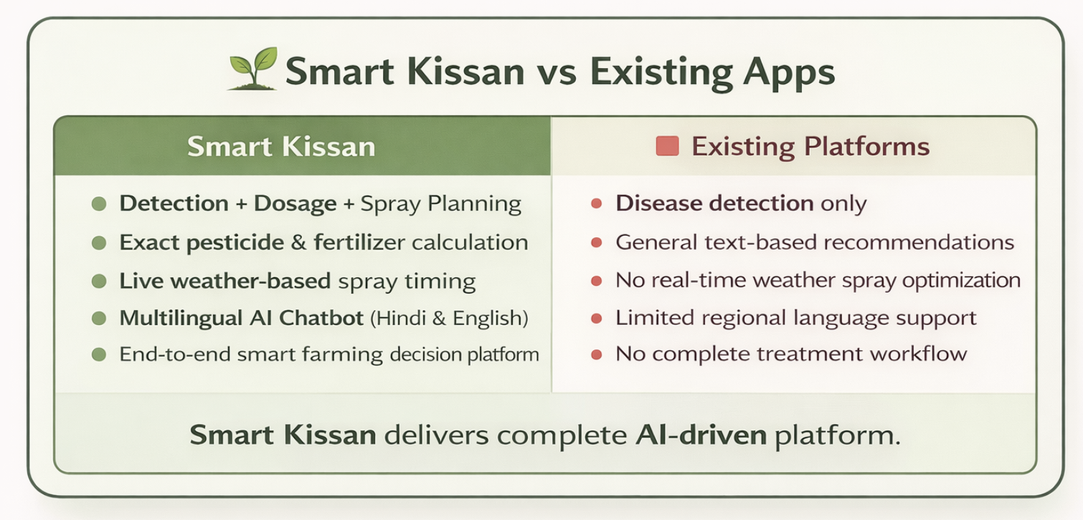
Whether similar solution exist ?

Slide 9
Whether similar solution exist ?(Continued):
What Makes Smart Kissan Different?
• Complete end-to-end system: Detection → Severity → Recommendation → Advisory • Provides exact pesticide dosage and spray interval • Integrates real-time weather data for smart spray decisions • Multilingual AI assistant (Hindi & English support) • Unified decision-support platform in one single interface.

Slide 10
Your novelty, either in tech or otherwise :
Our Innovation & Novelty:
1.Technical Innovation
• Integrated AI + Deep Learning + LLM Architecture • Infection severity percentage calculation (not just disease name) • Precision dosage recommendation system • Real-time weather-based spray optimization • LLM-powered multilingual explainable advisory
2. Practical Innovation
• Smart irrigation (Auto + Manual pump control) • Farmer-friendly simple interface • Lightweight design for low-end smartphones • Complete detection-to-treatment workflow in one platform

Slide 11
How can you monetize the solution?
Revenue & Business Model:
🔹 Freemium Model (B2F – Direct to Farmers)
• Basic disease detection – Free • Advanced advisory & detailed insights – Subscription-based • Weather-integrated smart recommendations – Premium feature
🔹 Premium Analytics (For Large Farmers)
• Crop health history tracking • Infection trend analysis • Farm performance insights

Slide 12
How can you monetize the solution?
🔹 B2B & Institutional Partnerships
• Collaboration with fertilizer & agri-input companies • Integration with FPOs & cooperatives • Custom dashboard solutions for agri-organizations
🔹 Government & Agri-Tech Integration
• Integration with government agriculture schemes • Data-driven decision support for policy programs

Slide 13
What is your stability and growth plan?
Phase 1 (0–6 Months):
Launch Minimum Viable Product (MVP)
Collect user feedback
Improve model accuracy
Phase 2 (6–12 Months):
Expand crop database
Add soil analysis integration
Add voice input for illiterate farmers

Slide 14
What is your stability and growth plan?
Phase 3 (1–2 Years):
• Launch Android application • Partner with agri-cooperatives & FPOs • Integrate satellite-based crop monitoring • Develop AI-powered smart sprinkling hardware integration
Long-Term Vision:
• Build a scalable Agri-AI ecosystem combining software + intelligent automation

Slide 15
How can you generate revenue in the first 24 months?
Year 1 (0–12 Months):
• Target 5,000 premium users • Subscription: ₹199/month • Estimated revenue: ₹12–15 Lakhs annually • Focus on Tier-2 & Tier-3 farmer adoption
Year 2 (12–24 Months):
• Scale to 25,000+ users • Introduce B2B agri-company partnerships • Offer analytics dashboards for agri-cooperatives • Estimated revenue: ₹60–80 Lakh

Slide 16
How can you generate revenue in the first 24 months?
Additional Revenue Streams:
• Sponsored agri-product recommendations • Fertilizer & pesticide brand partnerships • Government agri-tech grants & innovation funding

Slide 17
Video links about your project:
Participants are requested to upload their project explanation video or PDF to YouTube or Google Drive and submit the shared link.
YouTube link (If any):- Google drive link (If any) :- Pdf Link(If any):-
Extra Link(If any):-

Slide 18
Team Details (with mail and phone number):
 | Name | Gender (M/F) | Email id | Mobile no.
Team Leader
Team Member
Team Member
Team Member
Team Member
Team Member
Mentor/Guide

Slide 19
Conclusion
• Empowering farmers with affordable AI-driven agricultural support • Early disease detection to reduce crop loss • Precise fertilizer & spray recommendations • Multilingual intelligent advisory system • Moving from traditional farming to data-driven smart agriculture
Smart Kissan is building the future of intelligent farming.

