Slide 1


SMART INDIA HACKATHON 2025
SmartKissan
Problem Statement ID – SIH25015
Problem Statement Title- Intelligent Pesticide Sprinkling System Determined by the Infection Level of a Plant
Theme- Agriculture, FoodTech & Rural Development
PS Category- Hardware
Team ID-
Team Name- SmartKissan

Slide 2
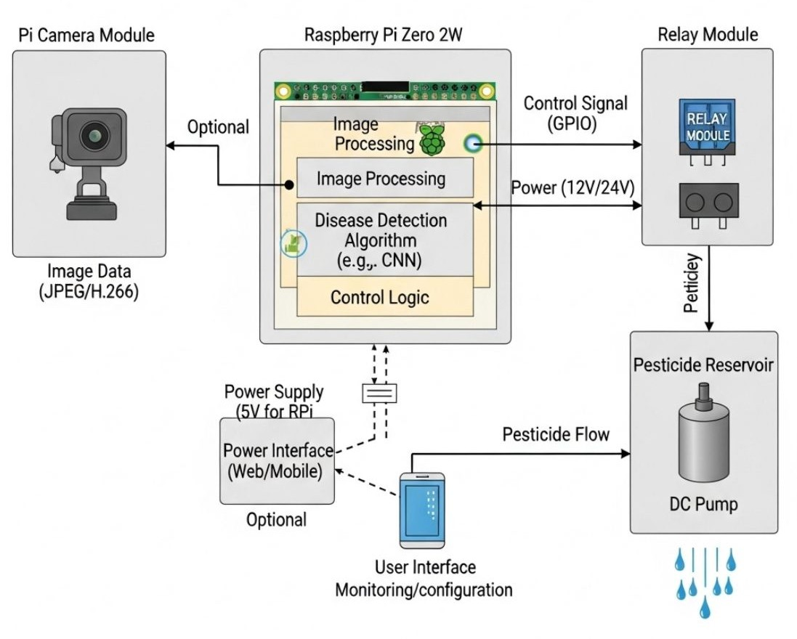
IDEA TITLE
SmartKissan
The Problem
SYSTEM ARCHITECTURE
₹52,000 crores - Annual crop loss due to pests in India.
30% pesticide overuse - Farmers spray entire field blindly.
12 million hectares of soil contaminated.
40% early infections missed by manual inspection.
Proposed Solution
Edge AI-powered detection – Edge AI-powered cameras capture plant images and detect infection in real-time.
Targeted Sprinkling – Field divided into sections; sprinklers spray only on infected zones.
Prototype Demonstration – Raspberry Pi Zero 2W + Pump + Nozzle + Tray showing full cycle
(Camera → AI → Decision → Spray).
Innovation & Uniqueness
Zone-based targeting - Field divided into 4 smart sections
30-second response - Detection to spray action
70% pesticide reduction - Spray only where needed

Slide 3
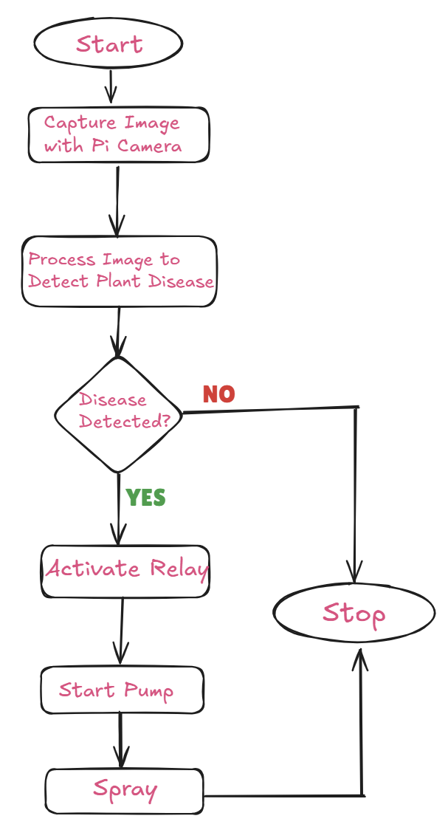


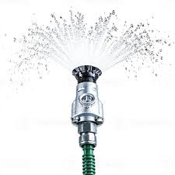
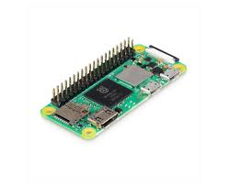

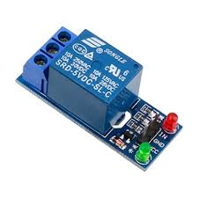

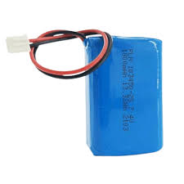
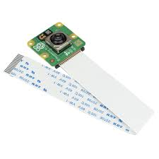


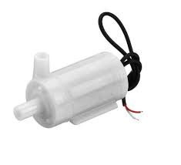
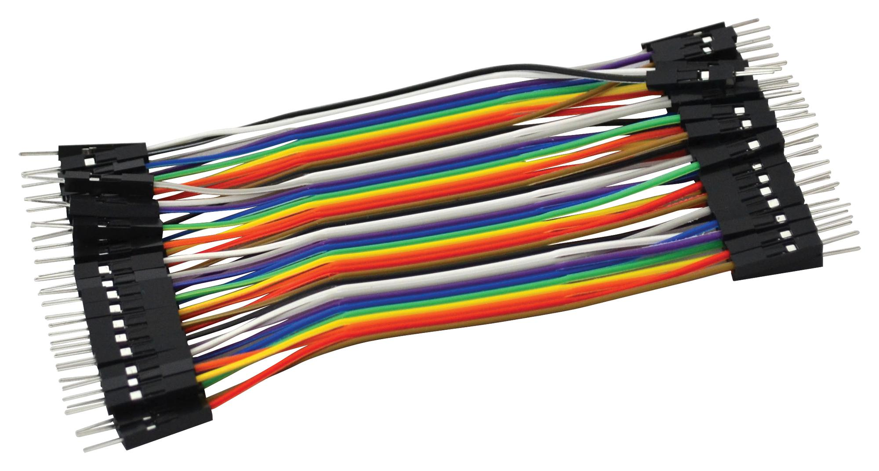




TECHNICAL APPROACH
SmartKissan
Technology Stack
FLOWCHART
Components Used:
Raspberry Pi Zero 2W, 32 GB SD Card, Pi Camera Module 2, Camera Ribbon, Jumper Wires
5V Relay Module, 6V DC Pump, Nozzle, 5V Battery, Pi Power Supply, Plastic Tray
Process Flow:
Image Preprocessing → resize + normalize captured image.
TensorFlow Lite Model (CNN classifier) → detects plant condition: Healthy / Mild / Severe infection.
Decision Logic →
Healthy → No spray
Mild → Spray 10 ml
Severe → Spray 30 ml
Safety Checks → water level OK? flow within expected range?.

Slide 4
FEASIBILITY AND VIABILITY
SmartKissan
Feasibility & Viability
Use Cases
Prototype Cost: ₹15,000 (full setup for 1 acre)
Installation: 4 hours with plug-and-play design
Training Required: 2-hour farmer workshop
Maintenance: Remote diagnostics + local technician
Scalability: Low-cost, scalable hardware prototype deployable from small farms to large agricultural fields.
Small Farms & Greenhouses → Affordable solution for local farmers.
Agricultural Institutes → Training tool for precision farming research.
Large Farms → Multiple units for full-field coverage & automation.
Government Schemes → Smart agriculture, subsidy-driven adoption.
Agri-Tech Companies → Integration into existing precision farming systems.
Integration-Ready → Compatible with existing agri-tech platforms, enabling adoption by FPOs and cooperatives.
Challenges & Solutions
Challenge | Solution
Weather damage | IP65 weatherproof housing
Different crops | Transfer learning (2-day training)
Network issues | Offline edge computing
False positives | Dual verification (AI + sensors)
Business Potential
B2F (Business to Farmer): Direct sales ₹15,000/unit
B2B: Bulk orders to FPOs, cooperatives
Government: PM-KISAN scheme integration

Slide 5
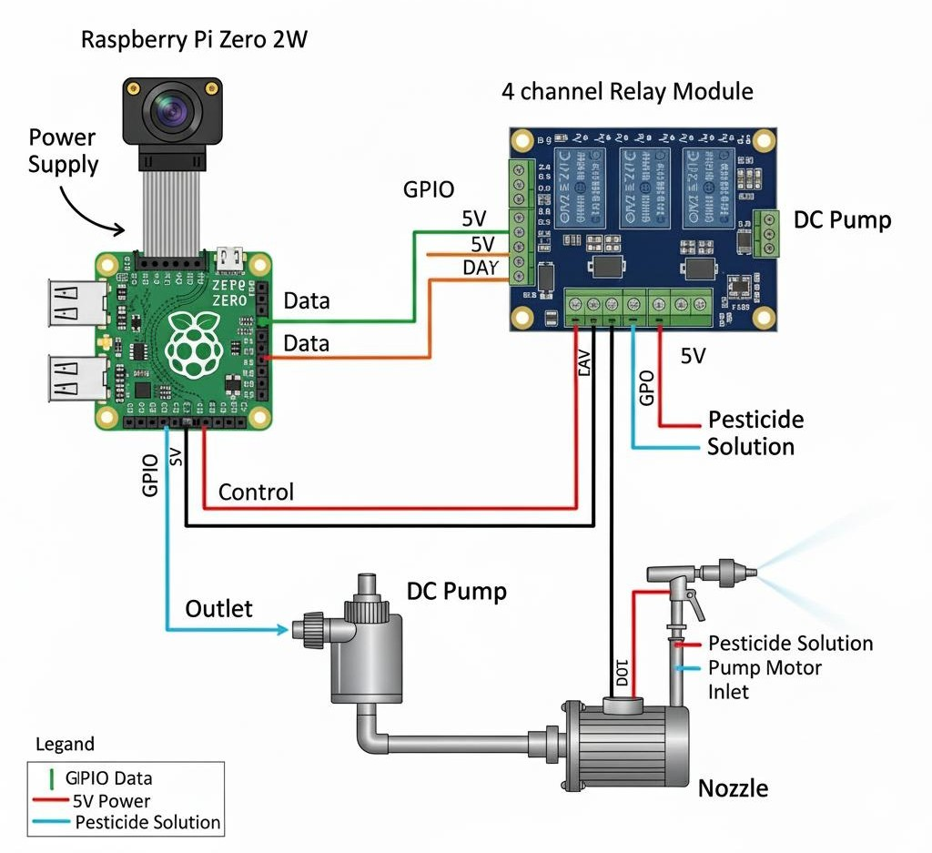
IMPACT AND BENEFITS
SmartKissan
System Design
Benefits of the Solution:
Social & Health - Safer farming, reduced farmer exposure to harmful chemicals.
Economic – Saves cost by reducing pesticide wastage , increases yield efficiency
Environmental – Sustainable farming : less soil/water pollution, eco-friendly agriculture
Sustainable Smart Farming – Promotes sustainable smart farming with AI-driven decision support for pesticide use.
Potential Impact on the Target Audience
Farmers – Cost savings, improved yield, healthier working conditions.
Communities – Sustainable practices leading to safer food and cleaner environment.
Government & Policy Makers – Supports smart agriculture and food security goals.

Slide 6
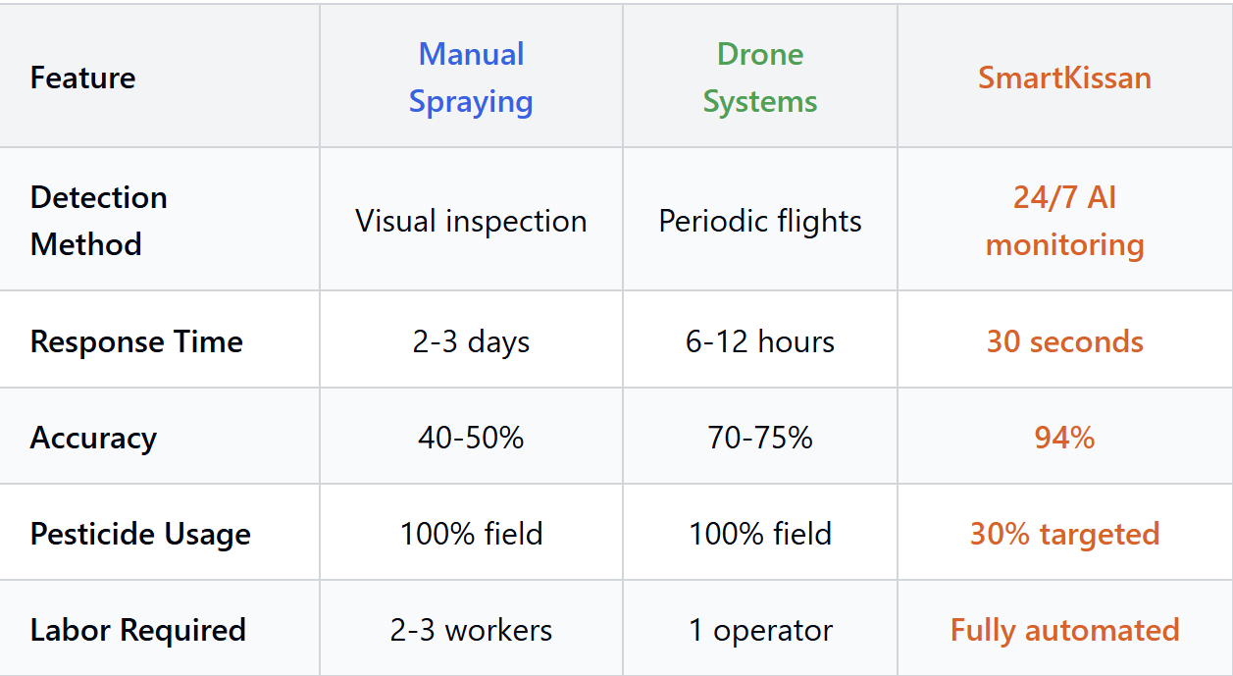
RESEARCH AND REFERENCES
SmartKissan
Comparison with Existing Systems
Government Reports
EPA (2021). Emerging Agricultural Technologies Report. EPA Office of Pesticide Programs
ICAR (2024). Smart Agriculture Technologies Guidelines. New Delhi
FAO (2023). Agricultural Pesticide Application Guidelines. Rome
FAO/ICAR Data
FAO (2023). International Code of Conduct on Pesticide Management
FAO (2023). Pesticide Application Technology Guidelines
ICAR (2023). Smart Agriculture Technologies for Disease Management. Ranchi
IEEE Papers
Sunil, C. K., et al. (2022). Cardamom Plant Disease Detection Using EfficientNetV2. IEEE Access, 10, 789-804
Zhang, L., et al. (2024). Real-time Disease Detection and Automated Pesticide Application. IEEE Trans. Automation Science, 21(3), 1245-1258

