Slide 1

Applied Internet of Things(CSE 2198) Project Presentation on Intelligent Home Automation System Using Hand Gesture Recognition and Raspberry Pi for Seamless Control.
Presented By :- Group 9
Presented by
Mr. Sourav Chakrabarty
Mr. Abhinab Kumar Das
Mr. Sagar Choudhury
Supervisor
Dr. Biswaranjan Swain
Dr. Bhanja Kishore Swain
Department of Computer Science and Engineering (IOT)
Institute of Technical Education & Research (ITER)
Siksha ‘O’ Anusandhan Deemed to be University, Bhubaneswar
May, 2025

Slide 2
Contents
Introduction
Literature Survey
Design Scheme
Testing, Analysis, And Evaluation
Socio-economic Issues Associated With The Project
Engineering Tools And Standards
Conclusion

Slide 3
Introduction
Imagine being able to control your home appliances just by your Hand Gesture.
There is :-
-NO SWITCHES
-NO VOICE COMMAND
-NO REMOTE
Our project is all about controlling home appliances using hand gestures. We use a Raspberry Pi Zero 2w and a camera to recognize hand gestures. The goal is to make home controlling devices easier and cost-effective, touchless home automation system

Slide 4
Literature Survey
Project Uniqueness
Most existing smart home and gesture control systems rely on high-end boards or cloud-based solutions
(Han et al., 2015).
Our project is different:
Uses Raspberry Pi Zero 2W — low-cost and compact
Relies on hand gestures — no apps or voice commands
Minimal internet dependency — only for model downloads or updates
This makes our system affordable, simple, and ideal for hands-free control.

Slide 5
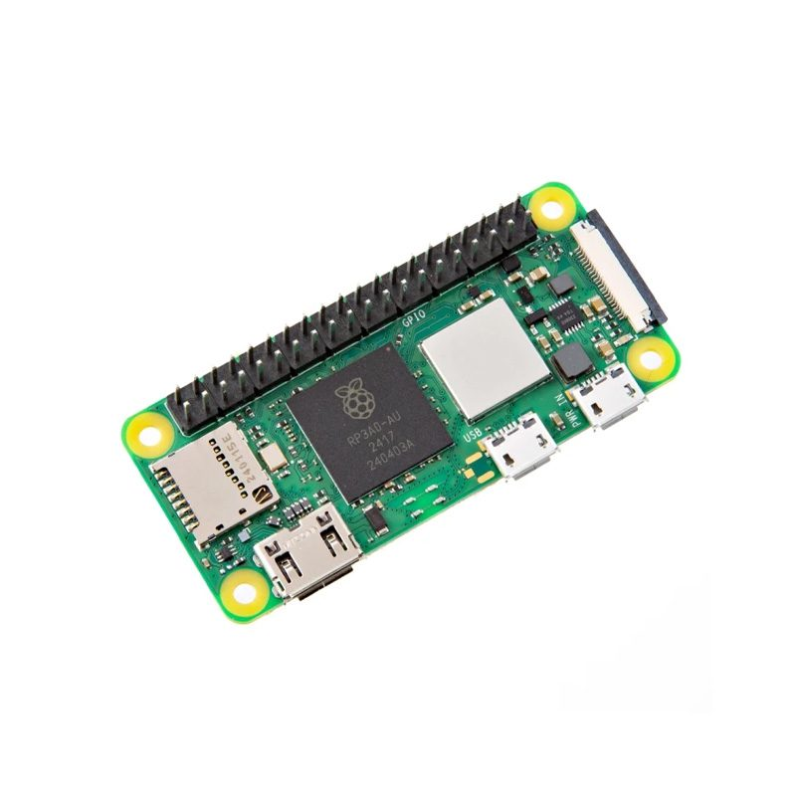
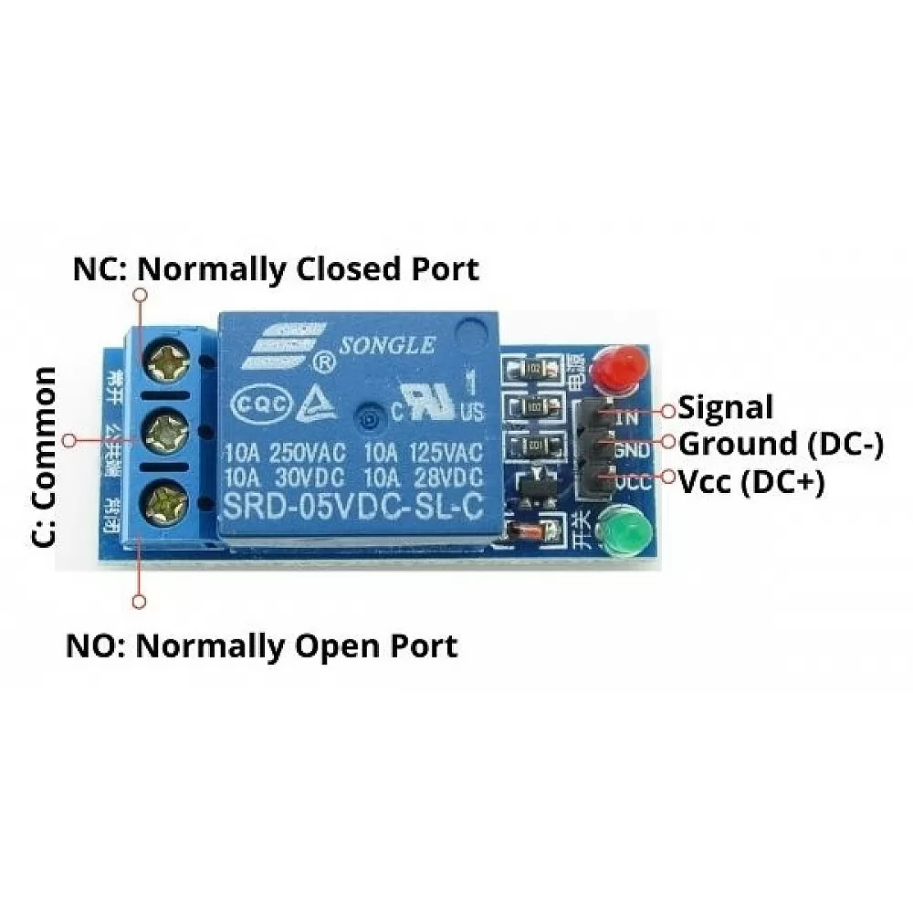
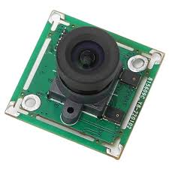

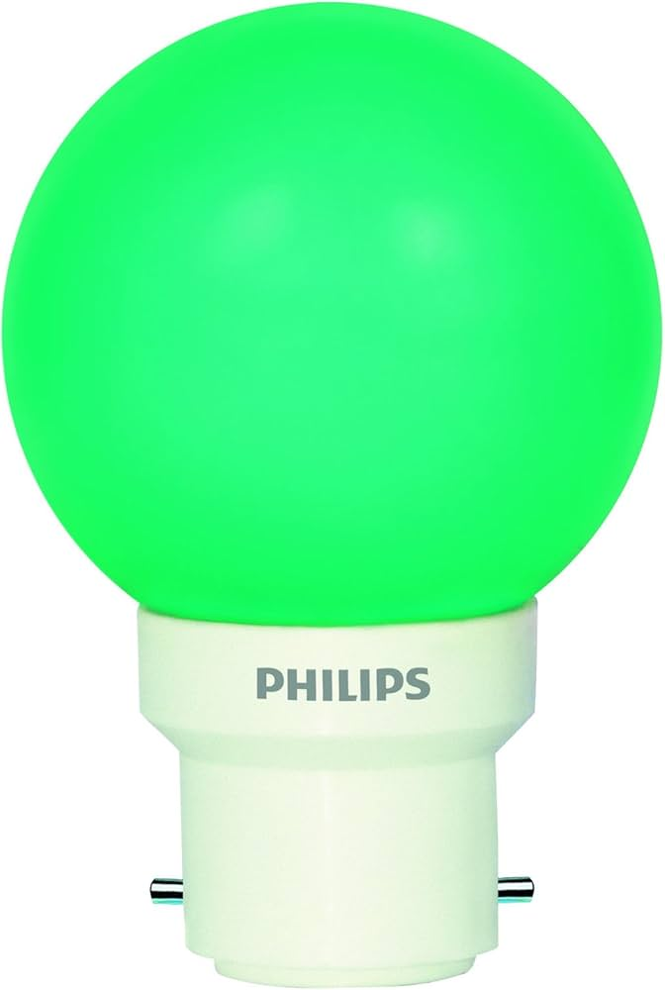


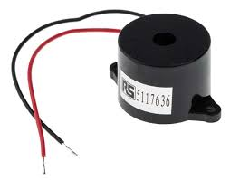
Design Scheme
Tools Used:
Hardware: Raspberry Pi Zero 2w, Pi Camera Module, Relay Module , Breadboard , Motor Fan, Light And Buzzer.
Software: Python, OpenCV, CVZone, Mediapipe.

Slide 6
Design Scheme
How Our System Works
Gesture Capture: A camera continuously monitors the user's hand and captures real-time gestures.
Gesture Recognition: The captured image is processed by a machine learning model running on the Raspberry Pi Zero 2W. The model analyzes the input and identifies predefined hand gestures.
Action Execution: Upon recognizing a valid gesture, the system sends a control signal to a relay module, which is used to switch a connected device ON or OFF accordingly

Slide 7
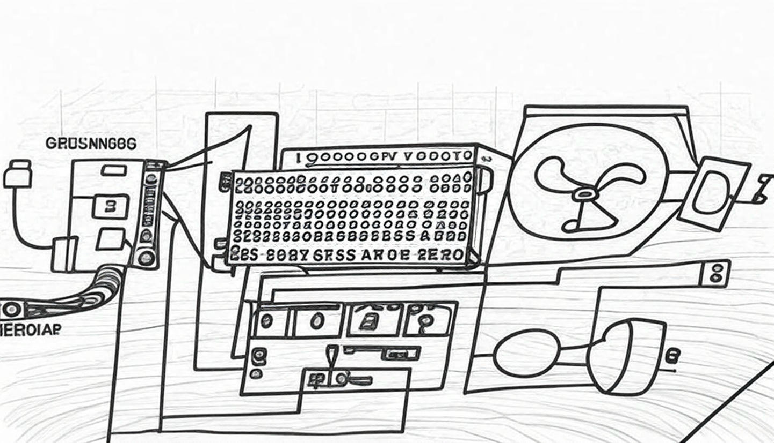
Design Scheme
Abhinab
Sourav
Sagar

Slide 8
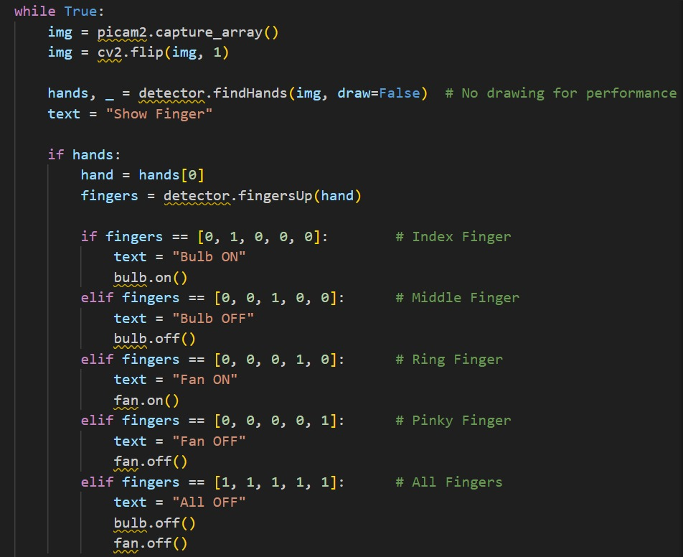
CODE
Abhinab
Sourav
Sagar

Slide 9
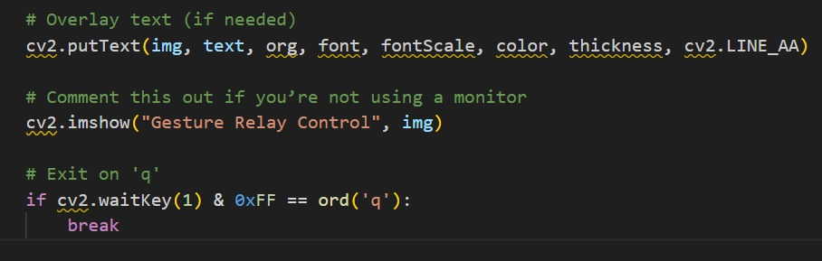
CODE
Abhinab
Sourav
Sagar

Slide 10
Testing (Breadboard Implementation)
System Testing Summary
Platform: Raspberry Pi Zero 2W
Setup: Breadboard-based prototype
Setup Confirmation
Physical Pin 18 (GPIO 24): Connected to the relay module’s input (e.g., IN2 or another input pin) to control the bulb.
Physical Pin 16 (GPIO 23): Connected to the relay module’s IN1 to control the fan.
Relay Module: Likely a 5V or 3.3V relay module (common for Raspberry Pi projects). Ensure the relay is compatible with the Pi’s 3.3V GPIO logic levels. Some relays require a 5V signal, which may need a level shifter or transistor to avoid damaging the Pi.
Power: The relay module’s VCC is likely connected to the Pi’s 5V pin (e.g., physical pin 2 or 4), and GND is connected to a ground pin (e.g., physical pin 6).
Devices: The bulb and fan are connected to the relay’s output terminals (NO/NC for normally open/ normally closed operation).

Slide 11
Testing (Problems Encountered)
Performance Observations:
Processing Power: Limited; device overheats under load, leading to thermal throttling and reduced performance.
Response Time: Gesture recognition takes approximately 4 – 5 seconds.
Accuracy: Gestures are recognized 70 – 80% of the time under normal lighting.
Lighting Sensitivity: Performance degrades significantly in low-light conditions.
Gesture Complexity: System performs reliably only with simple gestures.

Slide 12
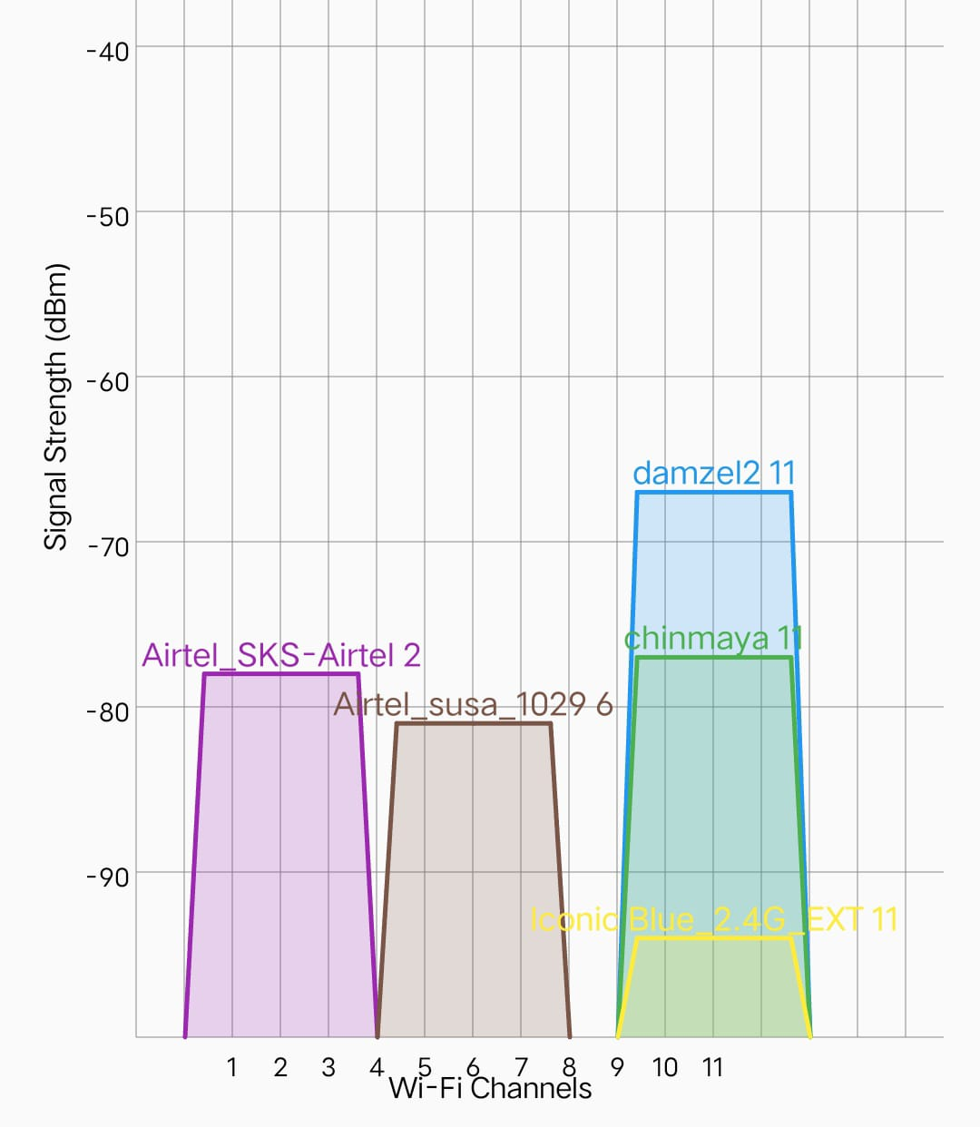
Testing(Using Graph)
Interference : Due to network interference raspberry pi zero 2w struggles to connect through headless method
Abhinab
Sourav
Sagar

Slide 13
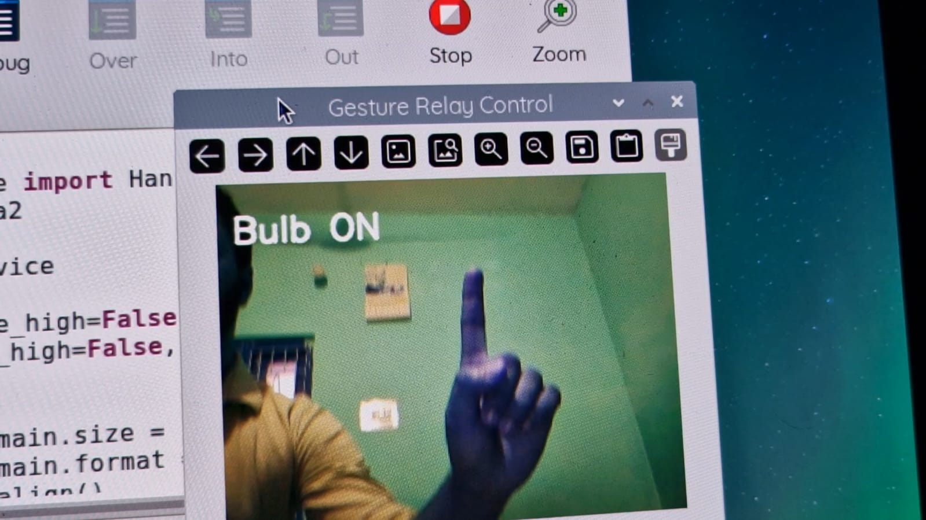
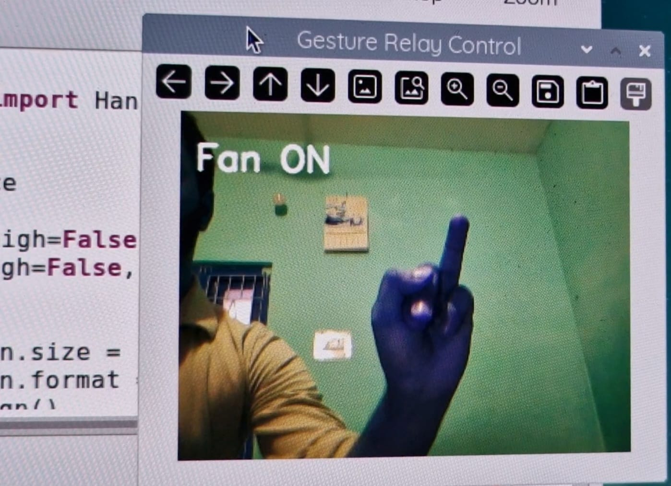
Testing
If the gesture is known,
it sends a signal to turn a device ON or OFF using a relay.

Slide 14
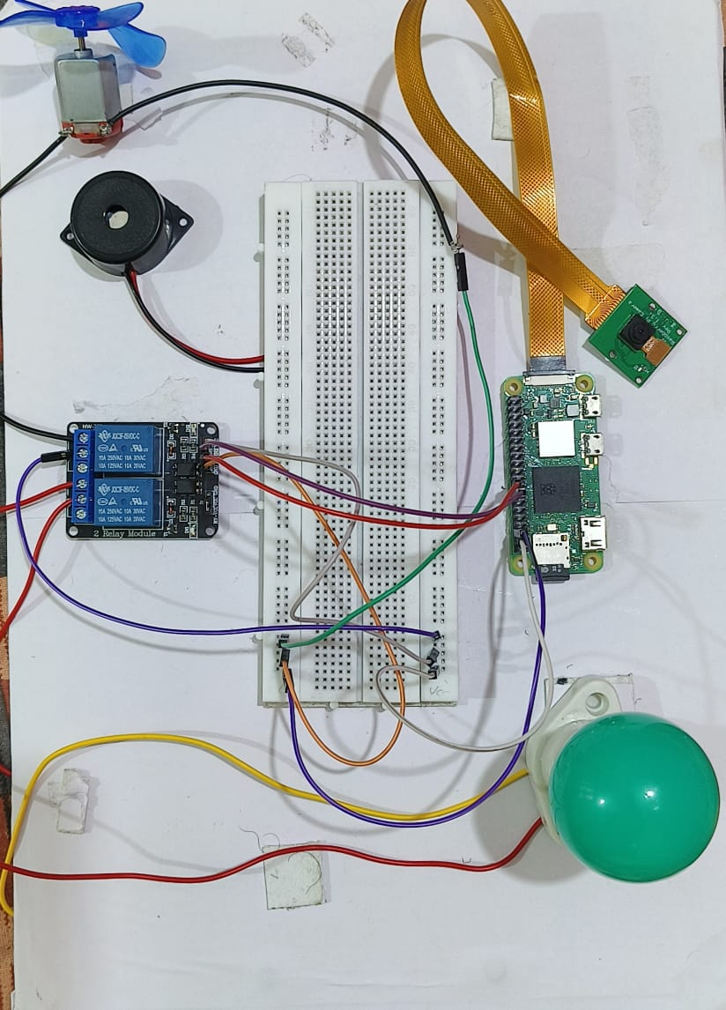
Results, Analysis and Evaluation
Raspberry pi Zero 2W
Pi Camera Module
Bulb
BreadBoard
DC Motor
Abhinab
Sourav
Sagar
Buzzer
(Optional)
5V Relay Module

Slide 15
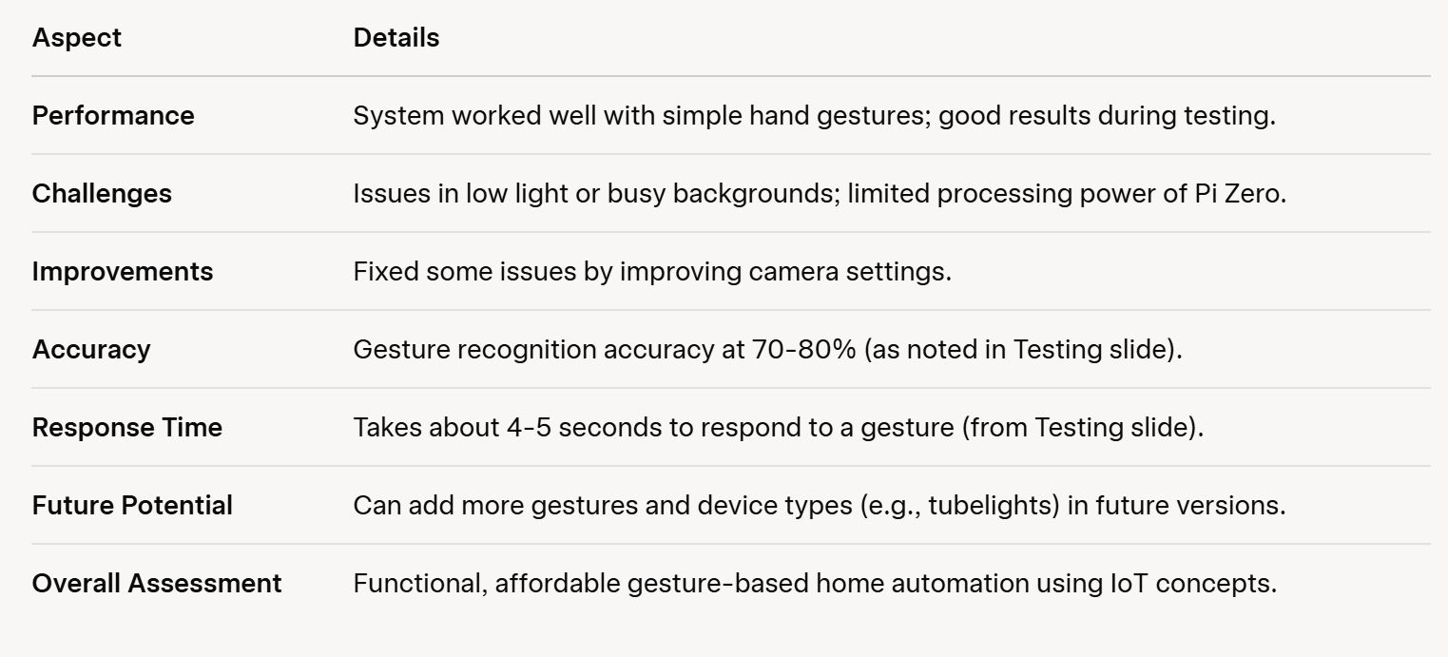
Results, Analysis and Evaluation

Slide 16
Socio-economic Issues Associated With The Project
.
Inclusivity And Accessibility :
-Useful for people with speech, motor, or cognitive disabilities
-No need for language or reading—easy for all to use.
Cost Analysis:
-Total cost under Rs. 3000 makes it suitable for low-income and rural areas.
Privacy Concerns
-Uses on-device processing to protect data.
-Ensures data anonymization and encrypted control signals.
Sustainability
-Low-Power devices save energy
-Modular Design supports repair and reuse.
It promotes contactless technology,which became essential after COVID-19.

Slide 17
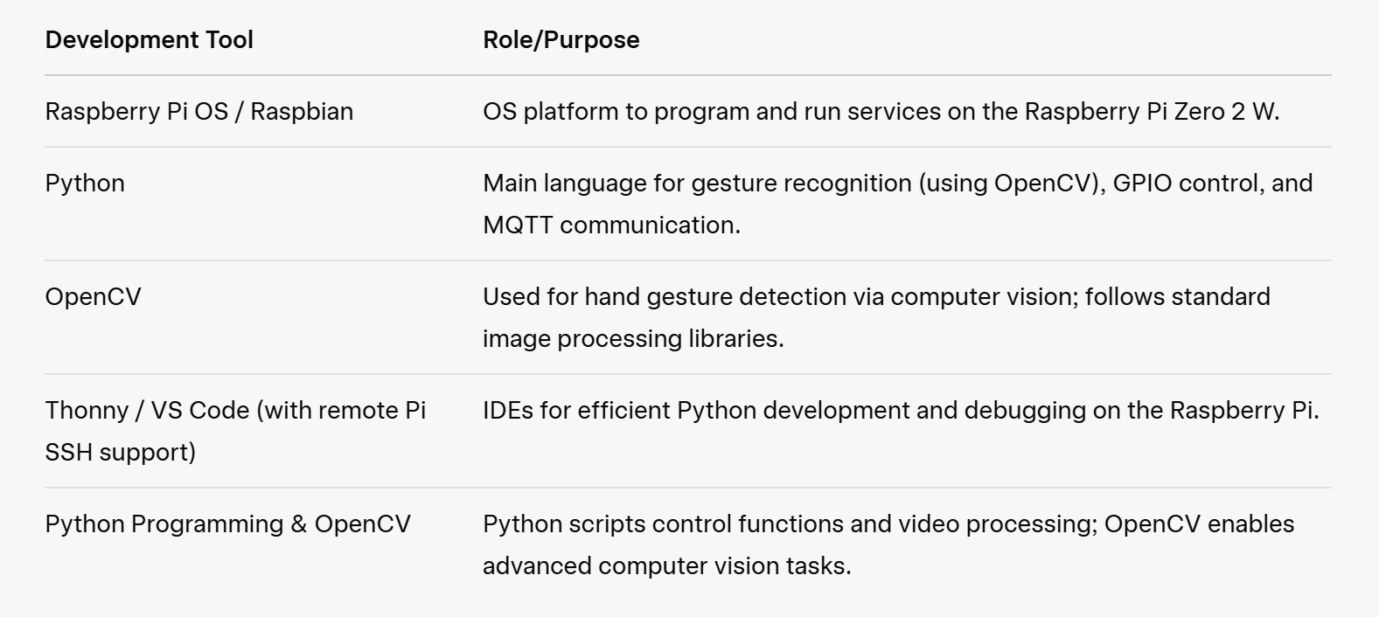
Engineering Tools And Standards

Slide 18
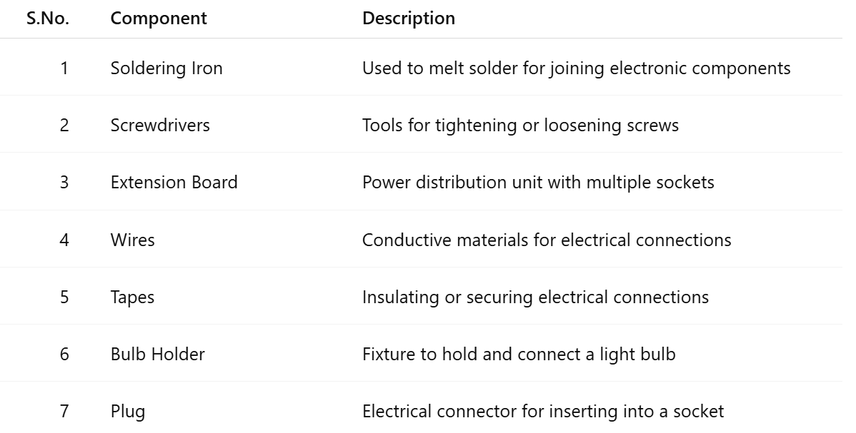
Engineering Tools And Standards

Slide 19
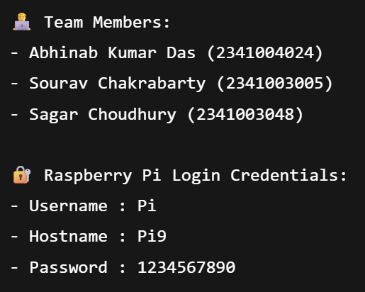
Conclusion
This project shows how we can use hand gestures to control home appliances easily using a small and affordable Raspberry Pi Zero 2w. It makes controlling devices simple and hands-free, improving convenience at home. Although there are some challenges, like working in different lighting conditions, this system has a lot of potential to make our homes smarter and more user-friendly.

Slide 20
References
Academic Source Han, S. N., Lee, G. M., & Crespi, N. (2015). Semantic context-aware service composition for building automation system. IEEE Transactions on Industrial Informatics.
DOI: 10.1109/TII.2014.2336594
Practical Project References
Gesture Controlled Home Automation Using Raspberry Pi
https://www.hackster.io/news/gesture-controlled-home-automation- with-
raspberry- pi-2f6bcb5e2180
Smart Home Automation with Raspberry Pi and Python – Instructables instructables.com/.../Home-Automation-With-Raspberry-Pi
Gesture Controlled Home Automation Using OpenCV & Raspberry Pi – Circuit Digest circuitdigest.com/.../gesture-controlled-home-automation
How to Build a Smart Home With Raspberry Pi – MakeUseOf makeuseof.com/.../raspberry-pi-smart-home-guide

Slide 21

/.

Slide 22

THANK YOU

