Slide 1
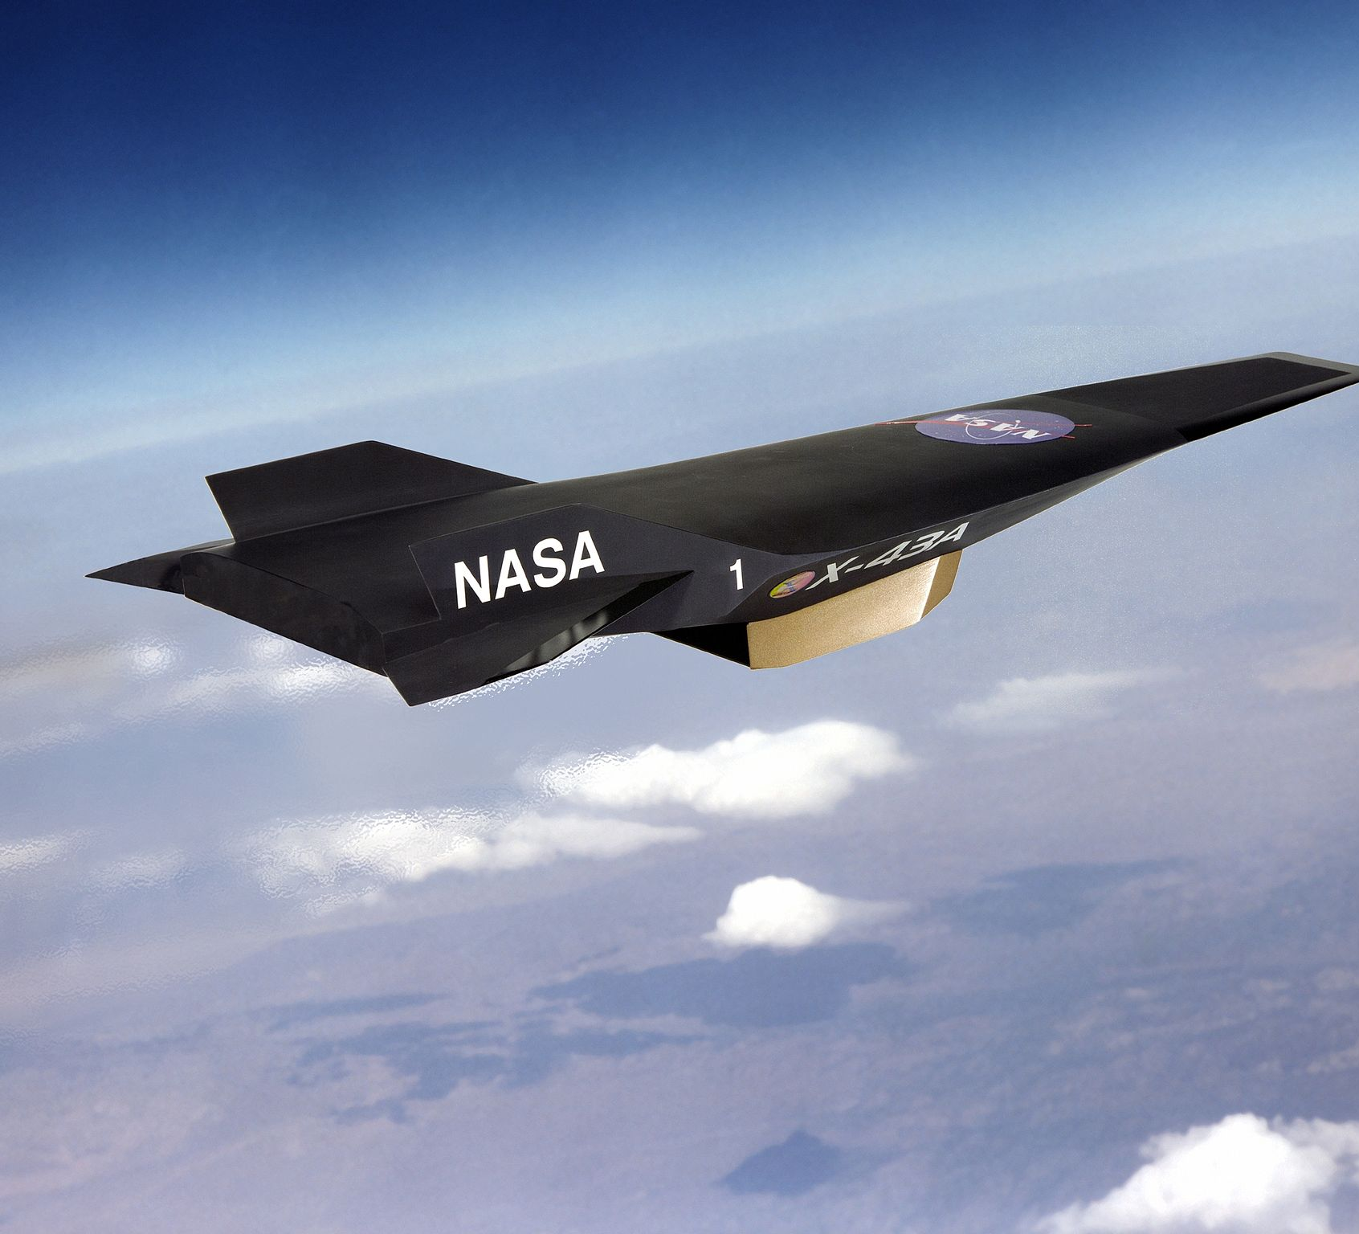
Effect of Partially-Ionized Fuel on Mixing and Combustion of Transverse Jet in Supersonic Cross-flow
Muhammad Suleman Mahmood (msm6), Abhinab Paul Choudhury (chodhry4), Yu Jia (yujia2)
12/06/2016

Slide 2

Outline
Background
Plasma-Assisted Combustion
Inside the Cube
Plasma Chemistry
Our Design
Current Status
Future Work
Q&A

Slide 3
Background
Research on supersonic combustion
Applications in aerospace and defense industries
Hard due to
Small residence time of the flow
Different timescales for Reactions and flow
Requires High Performance Computation to simulate and study
Computational Fluid Dynamics(CFD)

Slide 4
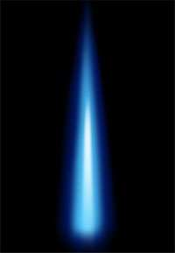
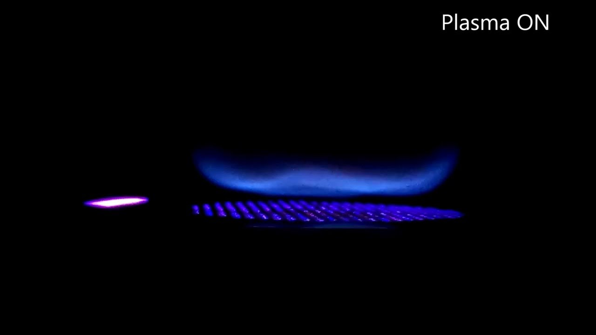
Plasma Assisted Combustion

Slide 5
Inside the Cube
Computational Fluid Dynamics(CFD)
Deal with flows, i.e. fluids(liquids or gases) in motion
Chemical Reactions
Various Forces and Interactions within the cube
Ideal Gas Law
Flux Calculations
Kinetics
Time-stepping using Euler forward methods
Test : Sod Shock Tube, a common test for density-based finite volume schemes

Slide 6
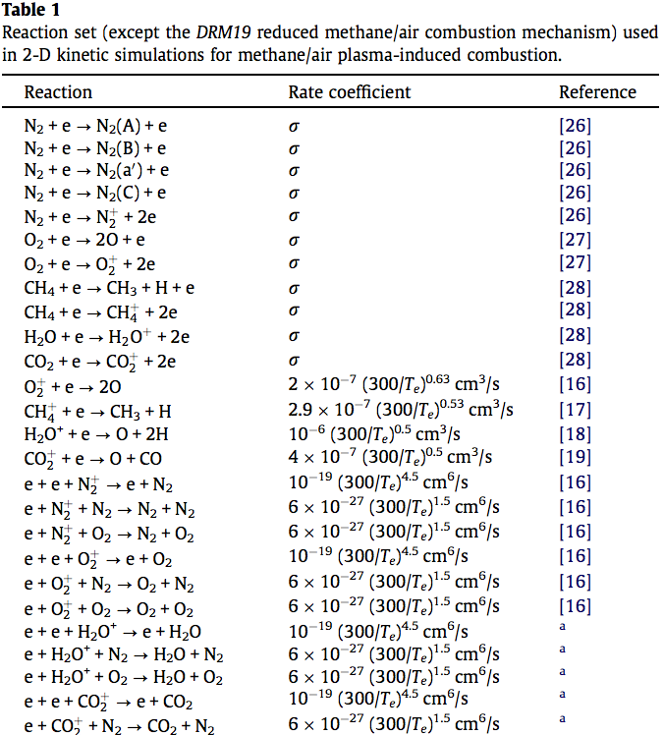
Plasma Chemistry
Neutrals interact with electrons
Creation of radicals and charged particles
Creation of excited molecules
Short-circuit chemical pathways
Reduces ignition time

Slide 7
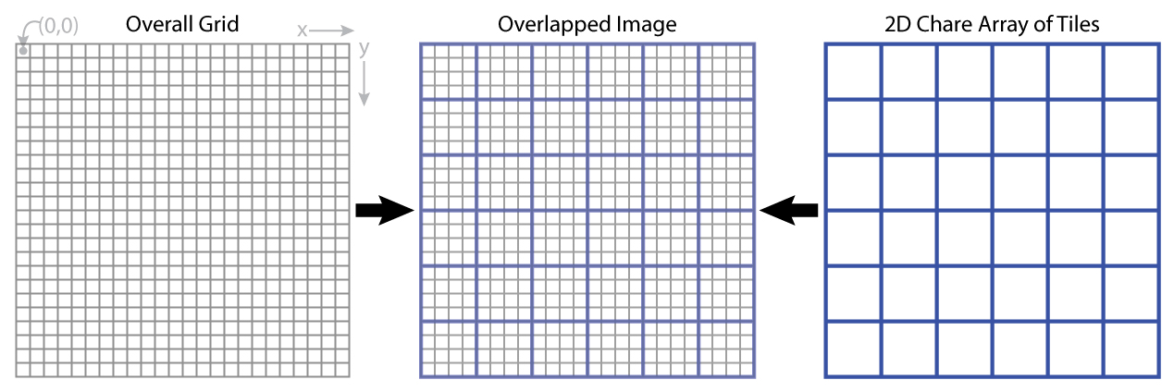
Our Design
Finite Volume Method
Each Region, Two Chares:
Flux Chare: Calculates Inviscid Flux
Cell Chare: Calculates Primary variables
Interfaces (Chare Array) among regions
Cell Chare
Flux Chare

Slide 8
Our Design (cont’d)
Transient Solver : Time-stepping using Euler forward method
Flow Object: density , velocity in three dimensions, Energy, a list of chemical species concentration
Flow objects are contained in Cell Chares
Iteration until a specific time
Sub-iteration for chemical reactions

Slide 9
Current Status
Tested Inviscid Flow code for Sod Shock Tube
Chemical Reactions implemented

Slide 10
Future Work
Projections - Load Balancer analysis
Timeline analysis
Eurler vs RK4 methods performance

Slide 11
Any Questions?

