Slide 1
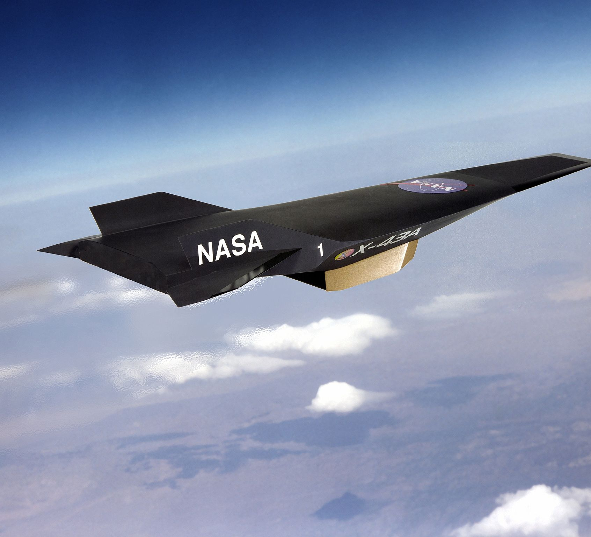
Simulation of Plasma Combustion in a Plasma Propulsion Engine
Muhammad Suleman Mahmood (msm6), Abhinab Paul Choudhury (chodhry4), Yu Jia (yujia2)
12/05/2016

Slide 2
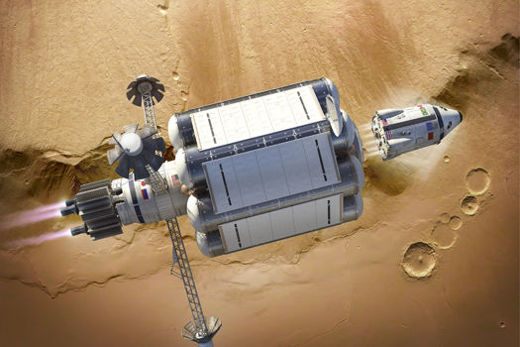
Outline
Background
Plasma Combustion and basic principles
Program Design
Experiments & Analysis
Q&A

Slide 3
Background
Research on supersonic combustion is surging: Plasma Propulsion Engine
Applications in aerospace and defense industries
Hard due to
High velocity of freestream
Small residence time of the flow
Complicated Reactions and Interactions within the engine
Requires High Performance Computation to simulate and study
Computational Fluid Dynamics(CFD)

Slide 4
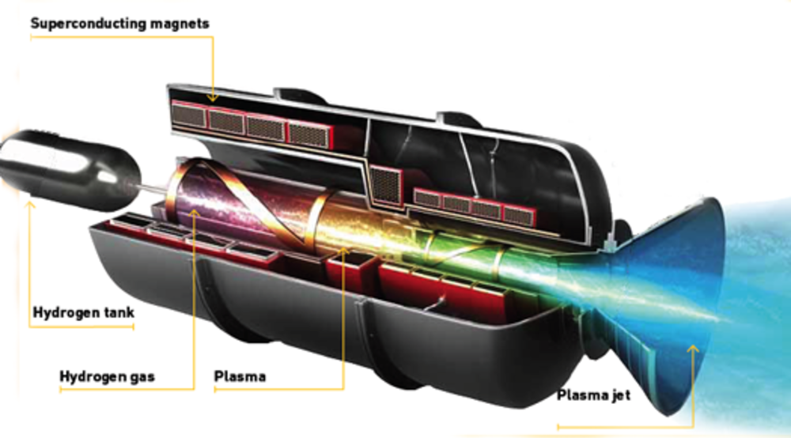
Plasma Combustion

Slide 5
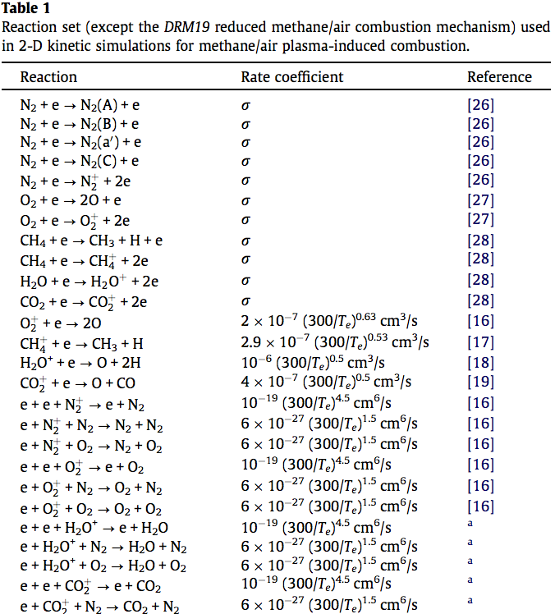
Inside the Cube
Computational Fluid Dynamics(CFD)
Deal with flows, i.e. fluids(liquids or gases) in motion
Chemical Reactions
Various Forces and Interactions within the cube
Ideal Gas Law
Inviscid Flux
Kinetics
…...
Analyzing using Runge-Kutta Methods
Test against Sod Shock Tube, a common test for computational fluids

Slide 6
Add whatever you want to say about Plasma Combustion

Slide 7
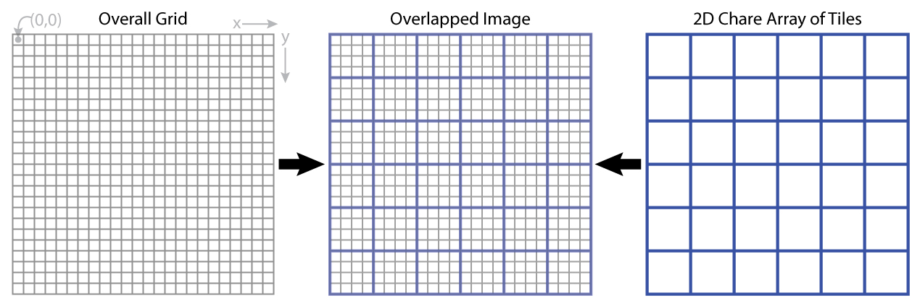
Our Design
5 Point Stencil
Each Region, Two Chares:
Flux Chare: Description words ?????????????
Cell Chare: Description words ?????????????
Interfaces (Chare Array) among regions
Cell Chare
Flux Chare

Slide 8
Out Design (cont’d)
Flow Object: density rho, velocity in three dimensions, Energy, a list of chemical species
Flow objects are contained in Cell Chares
Millions of iterations
Add more design details….....................

Slide 9
Experiments

Slide 10
Projections – Load Balancer

Slide 11
Timeline - Analysis

Slide 12
Any Questions?

