Slide 1

SECTION : I
3Φ Induction Motor
1.A machine which converts electrical energy into mechanical energy is called an induction motor.
2.IM can operated two modes
a)Motoring mode (N<Ns)
b)Generating mode (N>Ns)
3.IM is called Asynchronous speed.At ‘Ns’ it cann’t convet any electrical power or
mechanical power.
4.By synchronous m/c can produce electrical power or mech power only at Ns system.
T/F (Transformer) | I.M (Induction Motor)
1) Stator winding (Primary) | 1) The rotor winding (secondary winding)
2) A.C generated to with short circuit rotating secondary | 2) Rotor is always rotating and always short ckt. short ckt rotating secondary
3) T/F does not change freq. | 3) freq (I.M) power transform from stator to rotor at different freq.
4) Magnetic ckt is continuous, magnetic ckt (no air gap) | 4) Magnetic ckt is composite magnetic ckt (having air gap)
Notes:
2

Slide 2
SECTION : I
Synchronous Generator | Induction Generator
1) Generate electrical power at Ns speed | 1) Speed N > Ns
2) Ns speed means N = Ns
3) Const speed = synchronous speed
4) Generally used const speed prime mover | 2) In order to produce synchronous speed variable speed prime mover used
5) (steam turbine, diesel engine) | 3) e.g. wind mill or fluctuating prime mover
6) large hydro turbine by using governor arrangement we can get const speed prime mover | 4) Low & head hydropower station
 | 5) less than 30 meter head has variable speed prime mover
Notes:
2

Slide 3
SECTION : I
→ Induction motor has shunt type characteristic
→ Induction motor can be replaced by D.C shunt motor as same characteristic
Production of rotating magnetic field in 3φ system :
When ever 3φ winding are physically displaced by 120° (in space) electrical and being fed from 3φ current which are also displaced by 120° electrical and with respect to time angle ωt then the resultant mmf will constant amplitude and its vector will have max value of mmf to any phase and is rotating at synchronous speed will be produced in the air gap.
→ condition should be satisfy :- For rotating field in 3φ system
There is physically displacement of 120° electrical between 3φ winding
There must be time displacement of 120° electrical between the 3φ current flowing through the winding
Why rotating magnetic field is not available in 1φ ?
As the 1φ winding is not displaced physical 120° displacement.
→ 3 phase winding displaced 120° space angle
→ 3φ supply with time angle varying ωt = ωt
120°
%3CmxGraphModel%3E%3Croot%3E%3CmxCell%20id%3D%220%22%2F%3E%3CmxCell%20id%3D%221%22%20parent%3D%220%22%2F%3E%3CmxCell%20id%3D%222%22%20parent%3D%221%22%20style%3D%22ellipse%3BwhiteSpace%3Dwrap%3Bhtml%3D1%3Baspect%3Dfixed%3B%22%20value%3D%22%22%20vertex%3D%221%22%3E%3CmxGeometry%20height%3D%2290%22%20width%3D%2290%22%20x%3D%22470%22%20y%3D%22250%22%20as%3D%22geometry%22%2F%3E%3C%2FmxCell%3E%3CmxCell%20id%3D%223%22%20edge%3D%221%22%20parent%3D%221%22%20source%3D%222%22%20style%3D%22endArrow%3Dnone%3Bhtml%3D1%3Brounded%3D0%3BexitX%3D0%3BexitY%3D1%3BexitDx%3D0%3BexitDy%3D0%3B%22%20value%3D%22%22%3E%3CmxGeometry%20height%3D%2250%22%20relative%3D%221%22%20width%3D%2250%22%20as%3D%22geometry%22%3E%3CArray%20as%3D%22points%22%3E%3CmxPoint%20x%3D%22515%22%20y%3D%22295%22%2F%3E%3C%2FArray%3E%3CmxPoint%20x%3D%22450%22%20y%3D%22300%22%20as%3D%22sourcePoint%22%2F%3E%3CmxPoint%20x%3D%22510%22%20y%3D%22250%22%20as%3D%22targetPoint%22%2F%3E%3C%2FmxGeometry%3E%3C%2FmxCell%3E%3CmxCell%20id%3D%224%22%20edge%3D%221%22%20parent%3D%221%22%20source%3D%222%22%20style%3D%22endArrow%3Dnone%3Bhtml%3D1%3Brounded%3D0%3BexitX%3D1%3BexitY%3D1%3BexitDx%3D0%3BexitDy%3D0%3B%22%20value%3D%22%22%3E%3CmxGeometry%20height%3D%2250%22%20relative%3D%221%22%20width%3D%2250%22%20as%3D%22geometry%22%3E%3CArray%20as%3D%22points%22%3E%3CmxPoint%20x%3D%22510%22%20y%3D%22295%22%2F%3E%3C%2FArray%3E%3CmxPoint%20x%3D%22530%22%20y%3D%22350%22%20as%3D%22sourcePoint%22%2F%3E%3CmxPoint%20x%3D%22515%22%20y%3D%22295%22%20as%3D%22targetPoint%22%2F%3E%3C%2FmxGeometry%3E%3C%2FmxCell%3E%3C%2Froot%3E%3C%2FmxGraphModel%3E
Notes:
2

Slide 4
SECTION : I
a phase = Nph cosθ
physical location
b phase = Nph cos(θ − 120°)
c phase = Nph cos(θ − 240°)
ia = Im cosωt
ib = Im cos(ωt − 120°)
ic = Im cos(ωt − 240°)
Fa = Nph cosθ · Im cosωt
= Fm cosθ · cosωt
Fb = Nph cos(θ − 120°) Im cos(ωt − 120°)
= Nph Im cos(θ − 120°) cos(ωt − 120°)
Fc = Nph cos(θ − 240°) Im cos(ωt − 240°)
= Nph Im cos(θ − 240°) cos(ωt − 240°)
FR = Fa + Fb + Fc
Resultant mmf
3
FR= ────Fm cos(θ −wt)
2
The resultant mmf is rotating with respect to space.
So it is called rotating magnetic field.
Notes:
2

Slide 5
SECTION : I
To check balance 3ϕ system
IA = IB = IC = 1.5 A
Ib = Ic = IA
Ia = 1.5 A
Ib = Ic = 1.5 A
IC = IB = IA
The load is balanced one half operates at (0.8 lag) and another half operates at (0.6 lag)
(kVA) rating = 15 kVA
15 kVA = 5 kVA (3ϕ)
Cosϕ and another half operates at
(0.6 lag)
p
I = ──────────
√3 VL cosϕ
15000
I = ─────────────────
√3 × 415 × 0.8
I = 26.1 A
Notes:
2

Slide 6
SECTION : I
15000
I = ───────────────────
√3 × 415 × 0.6
I= 34.8 A
Vector Diagram
(Phasor diagram showing VR, VB, VY, IR, IB, IY, N/BM, 30+ϕ, 30-ϕ, θ, IC, IA, IB)
Utilization factor = actual connection path to rated path
866.6% of two units
Different in one unit
NI = √2 another unit
No choice for scale consider then
the utilization factor is 92.8%
Utilization factor = (kVA) scale
Available kVA
3 V I
UF = ───────────
2 V I
UF = 0.866
13 kV I
VI = ─────────────
15
VI = 0.925
VI = 92.8 %
Notes:
2

Slide 7
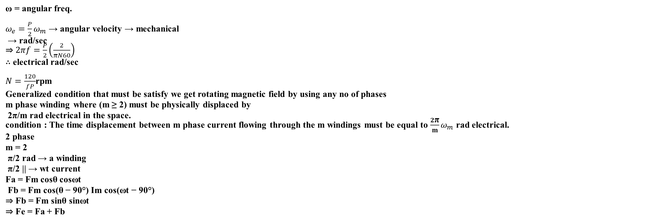
SECTION : I
Parallel operation of Transformers:
The parallel operation of two or more similar transformers improves the reliability of power supply.
Parallel operation improves the M of the system.
Cost of stand by to be reduced.
Necessary condition :
To meet the properly connected with regard to polarity.
mmf or travelling mmf. it is not stationary.
⇒ we determine the space of resultant mmf wave.
Remember for P poles of machine , there
pairs of poles
magnetic field rotate through
2f
──── rps
p
f = cycles of current
Ns (synchronous speed) =
2f
—— =
P rps
$$\frac{120f}{P}$$
ω = angular freq.
$ω_{e}=\frac{P}{2}ω_{m}$ → angular velocity → mechanical
→ rad/sec
⇒ $2πf=\frac{P}{2}\left(\frac{2}{πN60}\right)$
∴ electrical rad/sec
$N=\frac{120}{fP}$rpm
Generalized condition that must be satisfy we get rotating magnetic field by using any no of phases
m phase winding where (m ≥ 2) must be physically displaced by
2π/m rad electrical in the space.
condition : The time displacement between m phase current flowing through the m windings must be equal to $\frac{2\text{π}}{m}ω_{m}$ rad electrical.
2 phase
m = 2
π/2 rad → a winding
π/2 || → wt current
Fa = Fm cosθ cosωt
Fb = Fm cos(θ − 90°) Im cos(ωt − 90°)
⇒ Fb = Fm sinθ sinωt
⇒ Fe = Fa + Fb
Notes:
2

Slide 8

SECTION : I
π/2 || → wt current
Fa = Fm cosθ cosωt
Fb = Fm cos(θ − 90°) Im cos(ωt − 90°)
⇒ Fb = Fm sinθ sinωt
⇒ Fe = Fa + Fb
Double field Revolving theory
Fa = Fm cosθ cosωt
forward rotating mmf due to Fa⁺
(backward rotating mmf)
(but opposite direction)
Rotating Ns
Rotating Nr
phase a
fb = Fm cos(θ − 120°) cos(ωt − 120°)
= $F_{a}=\frac{F_{m}}{2}cos\left(θ−ωt\right)+\frac{F_{m}}{2}cos\left(θ+ωt−240\right)$
= fb⁺ + fb⁻
(Ns) (Nr)
phase c
fc = Fm cos(θ − 240°) cos(ωt − 240°)
= $\frac{F_{m}}{2}cos\left(θ−ωt\right)+\frac{F_{m}}{2}cos\left(θ+ωt−120\right)$
= fc⁺ + fc⁻
Resultant backward mmf = 0
Resultant forward mmf = ?
Lower Image
Of 2Φ
φf φb
Tc → ← Tb
Net T = 0 (No starting torque)
But 3Φ
φf φb → absent
↓
Tf Tb → absent
Net T = Tf
So self starting
$$F_{a}=\frac{F_{m}}{2}cos\left(θ−ωt\right)+\frac{F_{m}}{2}cos\left(θ+ωt\right)$$
Notes:
2

Slide 9
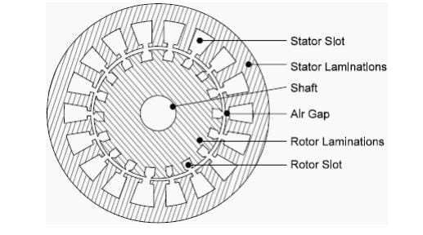
SECTION : I
According to double field revolving theory, a rotating m.m.f due to 3Ø phases can be divided into two opposite rotating m.m.f both rotating opposite direction. But in synchronous speed.
All the 3 forward rotating m.m.f due to 3 phase or 2 phase phase combined that gives rise a resultant forward rotating m.m.f in the air gap. The backward rotating m.m.f due to 3Ø are displaced 120° apart. Therefore they are added to zero. That means a 3Ø system only produces a rotating m.m.f forward. And backward m.m.f is cancelled. So only forward flux is present, backward flux is absent.
Construction Detail
Stator
Rotor
Air gap
Rotating part
Stator :
Stator = Silicon steel is used.
CRGO used in transformer.
Slot :
Open type
Semi open
Completely close type slot
Open type :
Former wound coils (former type slot) → Easily access
Low leakage reactance
Distribution of the stator winding gives more air gap flux
So excitation current required is more
Non uniform reluctance → So flux distribution is non uniform
Harmonic flux is present → So vibration, more losses, operation is not smooth
Narrow open type :
Used small former wound coil whose dia is less than old
Average air gap is reduced → Core gap loss
The flux is more uniform than harmonic flux is less
Operation smooth and silent, vibration reduced
Leakage flux is small → So starting torque more
Semi closed type :
More labour required as it is hard to insert winding
The average air gap is minimum → It is cost
Flux distribution is uniform as air gap is uniform
Harmonic torque is less, less noise
Yoke :
It is made of laminated steel
Used as protection cover
Magnetic path for flux
Notes:
2

Slide 10

Slot Shape and Flux Distribution
Flux distribution is uniform, as air gap is uniform.
Harmonic torque is less, So less noise.
Open slot | Semi-closed slot | Closed slot
1) Ie (magnetizing / exciting current) > | Ie > | Ie
2) cosφ₀ (net loss pf) < | cosφ₀< | cosφ₀ (loss pf)
3) Xₗ < | Xₗ < | Xₗ
(leakage flux is less as air gap is more)
4) Noise > | Noise > | Noise

Slide 11
Effect of Slot Type on Reactance, Stability and SCR
As open type slot requires more magnetizing component of current and also the operation is not smooth and salient.
The open slot type are not preferred for IM, Only semi closed or completely closed type slots are preferred.
Open type slots are generally preferred in synchronous Machines and also in DC Machines.
In practical, semi closed slots are preferred.
↑ Steady state stability ∝ 1/Xs ↓ (Xs decreases)
↑ Rigidity factor ∝ 1/Xs ↓
↓ Xs = Xa + Xl ↓
↑ Short Circuit Ratio ∝ 1/Xs ↓

Slide 12
Practical Preference of Slot Types in Electrical Machines
Commutation is increased in a direct current machine.
In a direct current machine, commutation delay occurs due to inductance.
This delay causes more sparking.
Therefore, to improve commutation, open slots are used in the armature of a direct current machine. As a result, armature reaction is decreased.
Number of Poles – Determination:
If two consecutive conductors or coils carry current in opposite directions, then pole formation occurs between them.
On the other hand, if two consecutive conductors or coils carry current in the same direction, then pole formation does not occur between them.

Slide 13
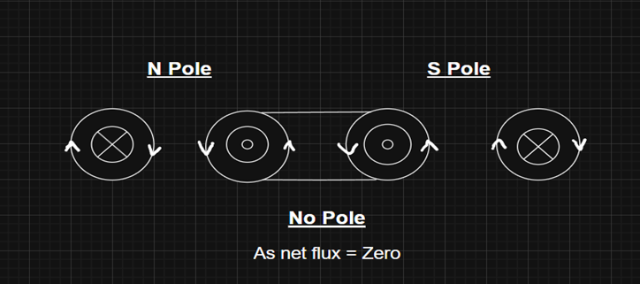
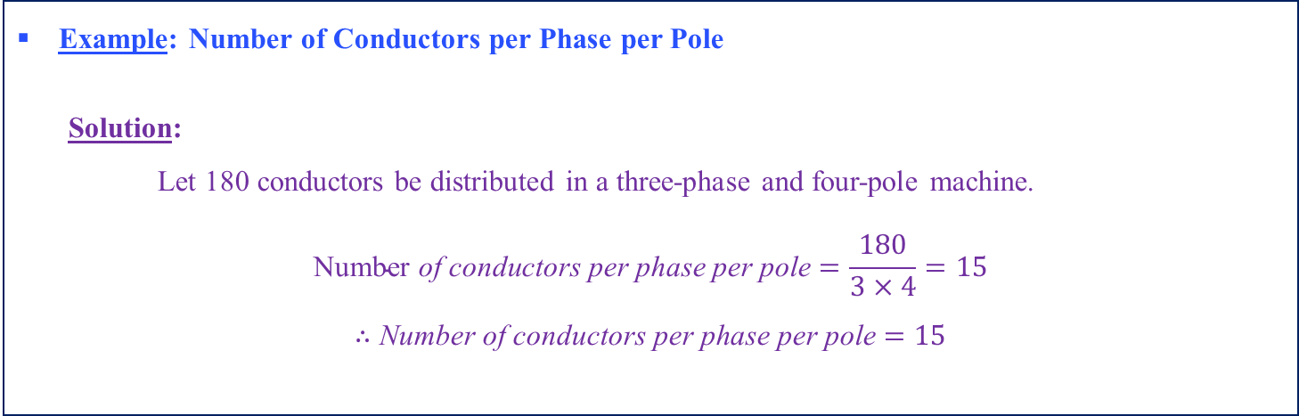
Pole Formation and Number of Conductors per Phase per Pole
Example: Number of Conductors per Phase per Pole
Solution:
Let 180 conductors be distributed in a three-phase and four-pole machine.
$$\text{Number} \text{of} \text{conductors} \text{per} \text{phase} \text{per} \text{pole}=\frac{180}{3×4}=15$$
$$∴\text{Number} \text{of} \text{conductors} \text{per} \text{phase} \text{per} \text{pole}=15$$

Slide 14
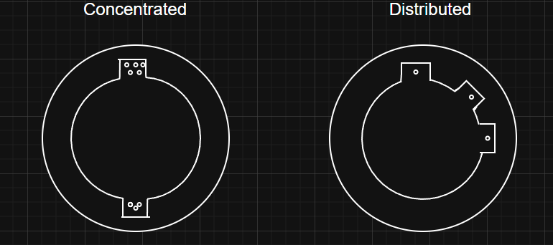
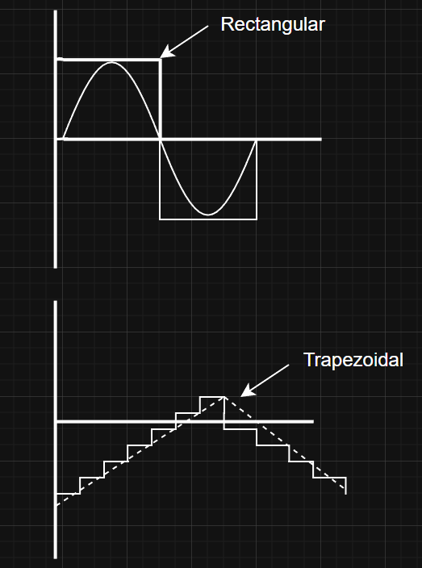
Concentrated and Distributed Winding – Air Gap MMF
If 15 conductors are placed in a single slot is called Concentrated winding.
If 15 conductors are placed in different slots then it is called Distributed winding.
The shape of air gap mmf produced with concentrated
winding is rectangular which is very much deviated
from desired sinusoidal wave.
The shape of air gap mmf produced with distributed
winding produced is at stepped view with an
approximate or trapezoidal view and this is very much
near to desired sinusoidal space mmf wave.

Slide 15


Concentrated Winding and Resultant EMF
Concentrated Winding
In a concentrated winding, the electromotive forces induced in phases a, b, and c are in space phase.
The resultant electromotive force is obtained by the arithmetic sum of the phase electromotive forces.
Hence, the resultant electromotive force is:
Distributed Winding
In a distributed winding, the phase electromotive forces are spatially displaced.
The resultant electromotive force is obtained by the vector sum of the phase electromotive forces.
Therefore, the resultant electromotive force is:
As a result, the electromotive force per phase is reduced.
$$E_{a}+E_{b}+E_{c}$$
$$E_{r}=E_{a}+E_{b}+E_{c} \left(\text{vector} \text{sum}\right)$$

Slide 16
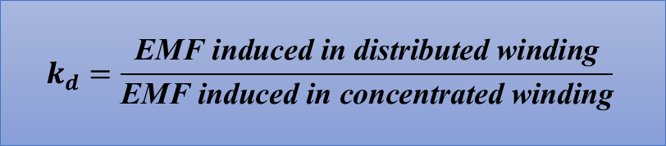

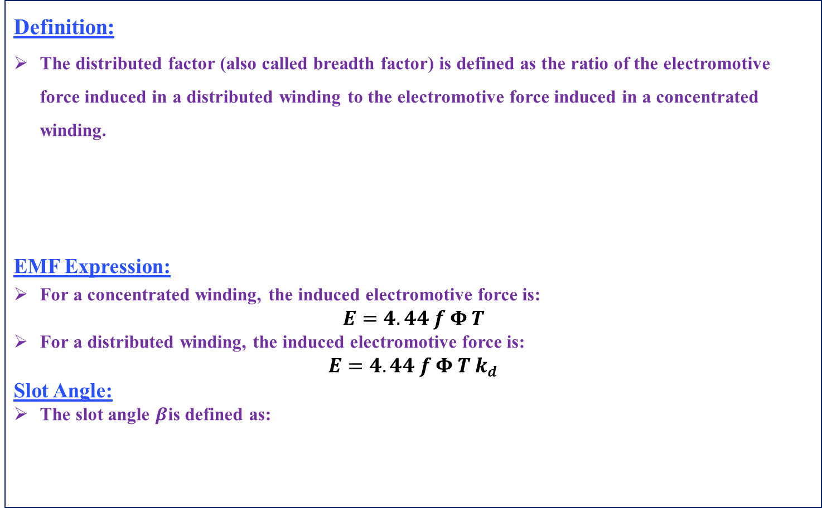
Distributed Factor (kd​)
Definition:
The distributed factor (also called breadth factor) is defined as the ratio of the electromotive force induced in a distributed winding to the electromotive force induced in a concentrated winding.
EMF Expression:
For a concentrated winding, the induced electromotive force is:
$$E=4.44 f Φ T$$
For a distributed winding, the induced electromotive force is:
$$E=4.44 f Φ T k_{d}$$
Slot Angle:
The slot angle $β$is defined as:
$$k_{d}=\frac{\text{EMF} \text{induced} \text{in} \text{distributed} \text{winding}}{\text{EMF} \text{induced} \text{in} \text{concentrated} \text{winding}}$$
$$β=\frac{{180}^{∘}}{\text{slots} \text{per} \text{pole}}$$

Slide 17
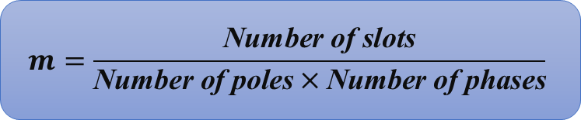
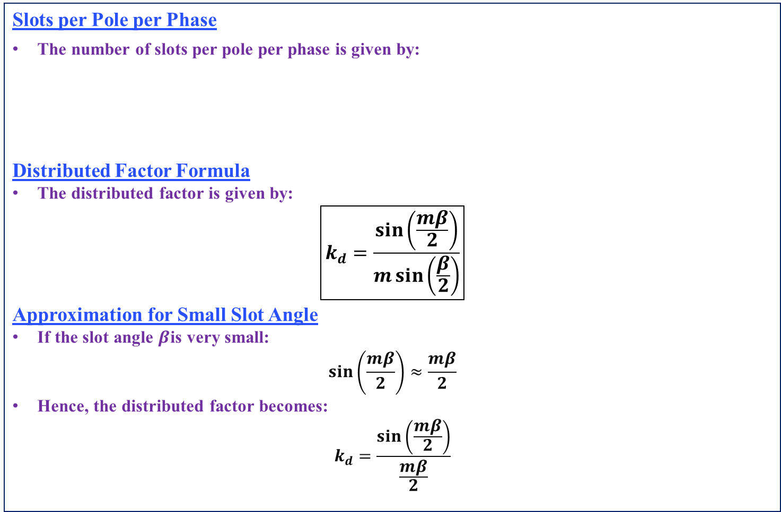
Effect of Distribution on Harmonics and EMF
Slots per Pole per Phase
The number of slots per pole per phase is given by:
Distributed Factor Formula
The distributed factor is given by:
$$\boxed{k_{d}=\frac{\sin\left(\frac{mβ}{2}\right)}{m\sin\left(\frac{β}{2}\right)}}$$
Approximation for Small Slot Angle
If the slot angle $β$is very small:
$$\sin\left(\frac{mβ}{2}\right)≈\frac{mβ}{2}$$
Hence, the distributed factor becomes:
$$k_{d}=\frac{\sin\left(\frac{mβ}{2}\right)}{\frac{mβ}{2}}$$
$$m=\frac{\text{Number} \text{of} \text{slots}}{\text{Number} \text{of} \text{poles}×\text{Number} \text{of} \text{phases}}$$

Slide 18

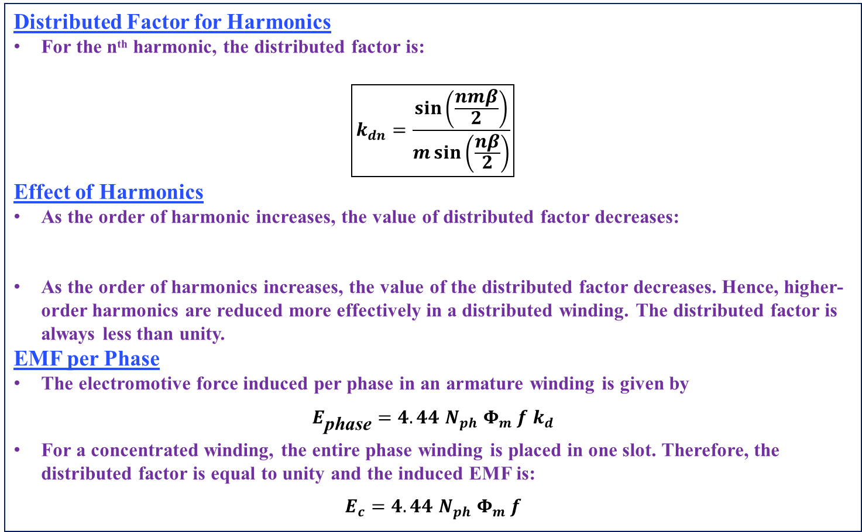
Effect of Harmonics on Distribution Factor
Distributed Factor for Harmonics
For the nᵗʰ harmonic, the distributed factor is:
$$\boxed{k_{dn}=\frac{\sin\left(\frac{nmβ}{2}\right)}{m\sin\left(\frac{nβ}{2}\right)}}$$
Effect of Harmonics
As the order of harmonic increases, the value of distributed factor decreases:
As the order of harmonics increases, the value of the distributed factor decreases. Hence, higher-order harmonics are reduced more effectively in a distributed winding. The distributed factor is always less than unity.
EMF per Phase
The electromotive force induced per phase in an armature winding is given by
$$E_{\text{phase}}=4.44 N_{ph} Φ_{m} f k_{d}$$
For a concentrated winding, the entire phase winding is placed in one slot. Therefore, the distributed factor is equal to unity and the induced EMF is:
$$E_{c}=4.44 N_{ph} Φ_{m} f$$
$$k_{df}>k_{d5}>k_{d7}$$

Slide 19
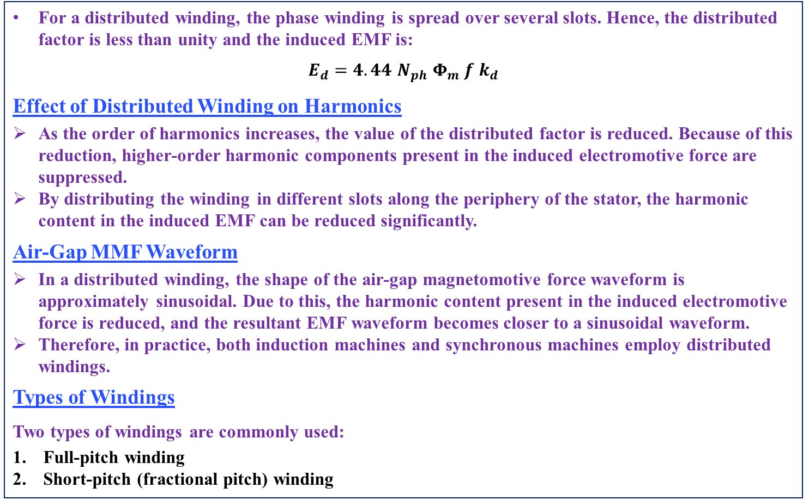
Advantages of Distributed Winding
For a distributed winding, the phase winding is spread over several slots. Hence, the distributed factor is less than unity and the induced EMF is:
$$E_{d}=4.44 N_{ph} Φ_{m} f k_{d}$$
Effect of Distributed Winding on Harmonics
As the order of harmonics increases, the value of the distributed factor is reduced. Because of this reduction, higher-order harmonic components present in the induced electromotive force are suppressed.
By distributing the winding in different slots along the periphery of the stator, the harmonic content in the induced EMF can be reduced significantly.
Air-Gap MMF Waveform
In a distributed winding, the shape of the air-gap magnetomotive force waveform is approximately sinusoidal. Due to this, the harmonic content present in the induced electromotive force is reduced, and the resultant EMF waveform becomes closer to a sinusoidal waveform.
Therefore, in practice, both induction machines and synchronous machines employ distributed windings.
Types of Windings
Two types of windings are commonly used:
Full-pitch winding
Short-pitch (fractional pitch) winding

Slide 20
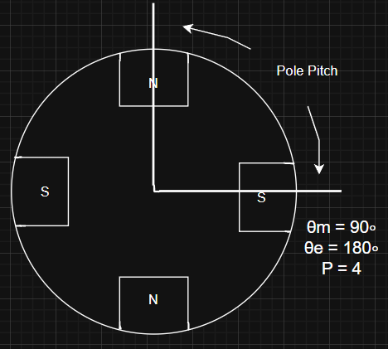

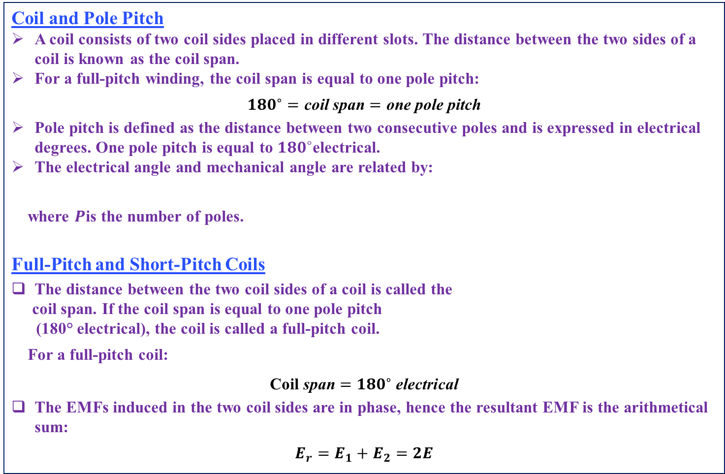
Full Pitch and Short Pitch Winding
Coil and Pole Pitch
A coil consists of two coil sides placed in different slots. The distance between the two sides of a coil is known as the coil span.
For a full-pitch winding, the coil span is equal to one pole pitch:
$${180}^{∘}=\text{coil} \text{span}=\text{one} \text{pole} \text{pitch}$$
Pole pitch is defined as the distance between two consecutive poles and is expressed in electrical degrees. One pole pitch is equal to ${180}^{∘}$electrical.
The electrical angle and mechanical angle are related by:
where $P$is the number of poles.
Full-Pitch and Short-Pitch Coils
The distance between the two coil sides of a coil is called the
coil span. If the coil span is equal to one pole pitch
(180° electrical), the coil is called a full-pitch coil.
For a full-pitch coil:
$$\text{Coil} \text{span}={180}^{∘} \text{electrical}$$
The EMFs induced in the two coil sides are in phase, hence the resultant EMF is the arithmetical sum:
$$E_{r}=E_{1}+E_{2}=2E$$
$$θ_{e}=\frac{P}{2} θ_{m}$$

Slide 21
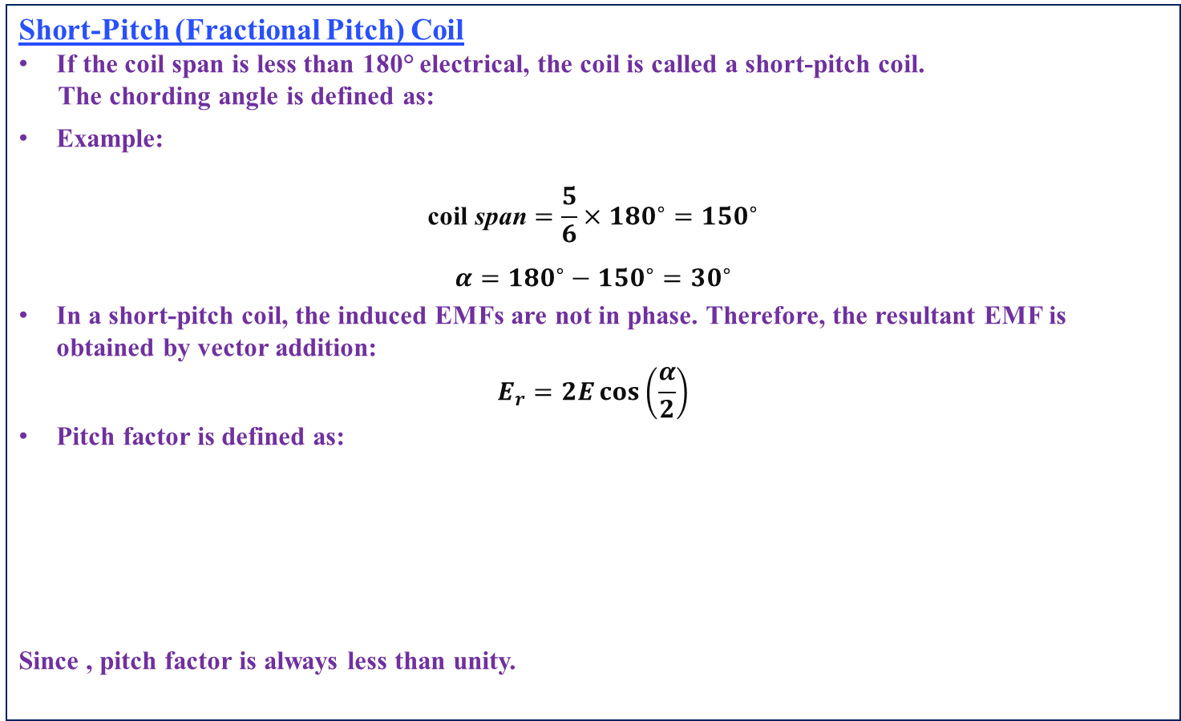


Pitch Angle, Coil Span and Electrical Degrees
Short-Pitch (Fractional Pitch) Coil
If the coil span is less than 180° electrical, the coil is called a short-pitch coil.
The chording angle is defined as:
Example:
$$\text{coil} \text{span}=\frac{5}{6}×{180}^{∘}={150}^{∘}$$
$$α={180}^{∘}−{150}^{∘}={30}^{∘}$$
In a short-pitch coil, the induced EMFs are not in phase. Therefore, the resultant EMF is obtained by vector addition:
$$E_{r}=2E\cos\left(\frac{α}{2}\right)$$
Pitch factor is defined as:
Since , pitch factor is always less than unity.
$$α={180}^{∘}−\text{coil} \text{span}$$
$$k_{p}=\frac{\text{EMF} \text{in} \text{short}\text{−}\text{pitch} \text{coil}}{\text{EMF} \text{in} \text{full}\text{−}\text{pitch} \text{coil}}$$
$$k_{p}=\cos\left(\frac{α}{2}\right)$$

Slide 22
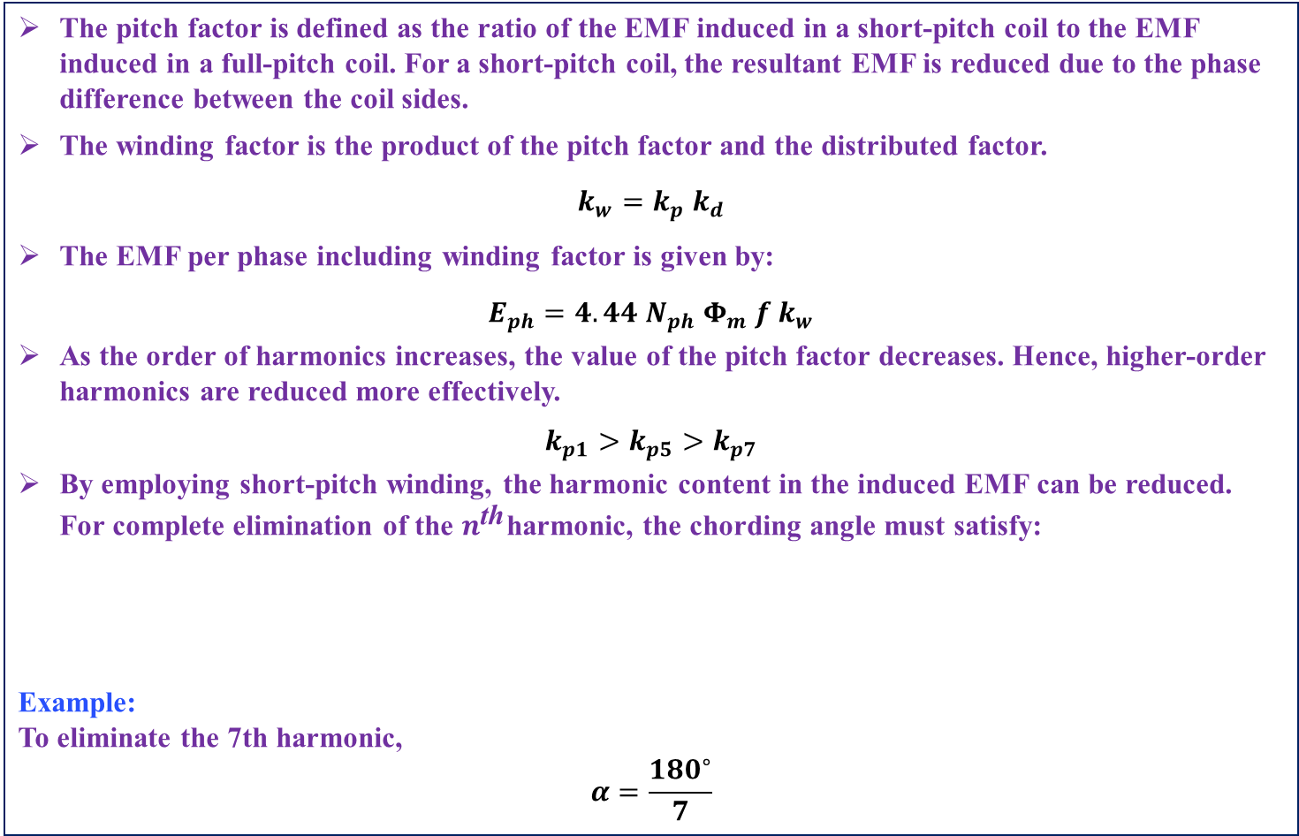

Pitch Factor, Winding Factor and Harmonic Reduction
The pitch factor is defined as the ratio of the EMF induced in a short-pitch coil to the EMF induced in a full-pitch coil. For a short-pitch coil, the resultant EMF is reduced due to the phase difference between the coil sides.
The winding factor is the product of the pitch factor and the distributed factor.
$$k_{w}=k_{p} k_{d}$$
The EMF per phase including winding factor is given by:
$$E_{ph}=4.44 N_{ph} Φ_{m} f k_{w}$$
As the order of harmonics increases, the value of the pitch factor decreases. Hence, higher-order harmonics are reduced more effectively.
$$k_{p1}>k_{p5}>k_{p7}$$
By employing short-pitch winding, the harmonic content in the induced EMF can be reduced. For complete elimination of the $n^{\text{th}}$harmonic, the chording angle must satisfy:
Example: To eliminate the 7th harmonic,
$$α=\frac{{180}^{∘}}{7}$$
$$α=\frac{{180}^{∘}}{n}$$

Slide 23
Harmonic Elimination using Short-Pitch (Chorded) Winding
For a given chording angle, only one harmonic is eliminated. However, by properly choosing the chording angle, any desired harmonic can be eliminated from the system.
Short-pitch coils are also preferred because they provide saving of copper due to reduced overhang. However, to produce the same amount of EMF, the number of turns must be increased, which slightly increases copper loss. Even then, the reduction in overhang makes short-pitch coils economical.
In practice, armature windings are short-pitched and distributed. By employing short-pitch winding, the amount of copper required for the winding is reduced when compared to full-pitch winding.
Construction and Frequency of Rotor in Induction Motor:
The rotor is one of the important parts of an induction motor. Based on construction, rotors used in induction motors are classified into two types: squirrel cage rotor and wound rotor (slip-ring induction motor).
Squirrel Cage Rotor
In a squirrel cage rotor, the rotor conductors are made of high-conductivity forged copper or aluminum. These conductors are placed in rotor slots and are short-circuited at both ends by end rings, forming a closed circuit.
Since the rotor bars are permanently short-circuited, external resistance cannot be added to the rotor circuit.

Slide 24
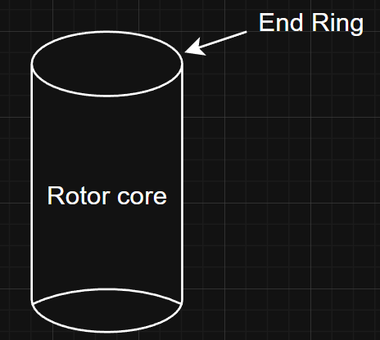
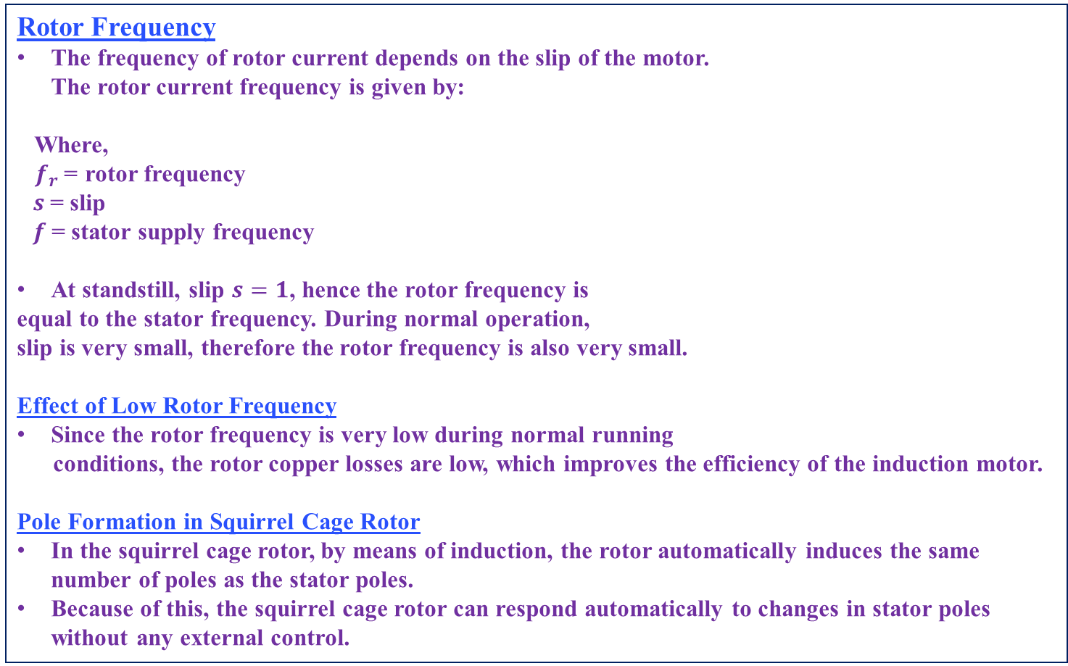

Construction and Features of Squirrel Cage Rotor
Rotor Frequency
The frequency of rotor current depends on the slip of the motor. The rotor current frequency is given by:
Where, $f_{r}$= rotor frequency $s$= slip $f$= stator supply frequency
At standstill, slip $s=1$, hence the rotor frequency is
equal to the stator frequency. During normal operation,
slip is very small, therefore the rotor frequency is also very small.
Effect of Low Rotor Frequency
Since the rotor frequency is very low during normal running
conditions, the rotor copper losses are low, which improves the efficiency of the induction motor.
Pole Formation in Squirrel Cage Rotor
In the squirrel cage rotor, by means of induction, the rotor automatically induces the same number of poles as the stator poles.
Because of this, the squirrel cage rotor can respond automatically to changes in stator poles without any external control.
$$f_{r}=sf$$

Slide 25

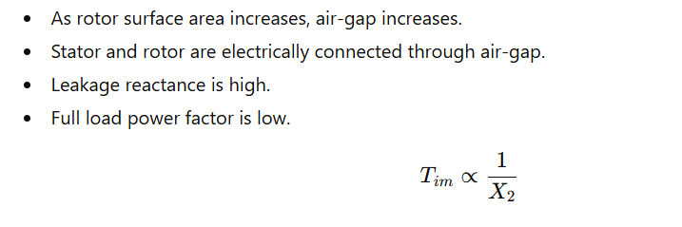
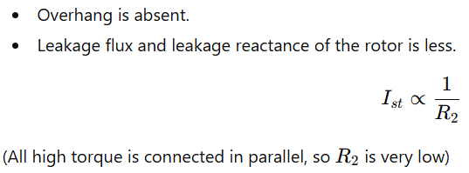
Slip Ring Induction Motor
Overhang Effect

Slide 26
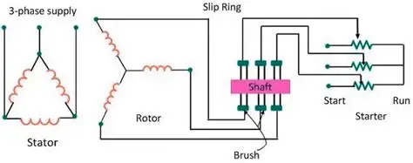
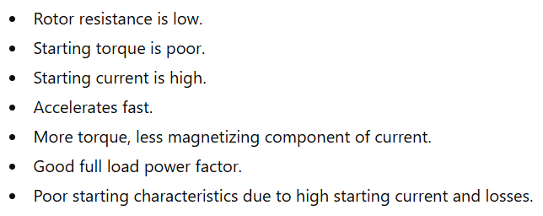
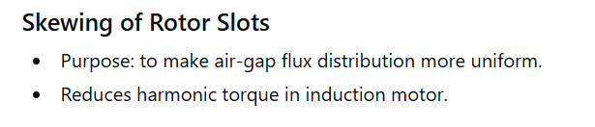
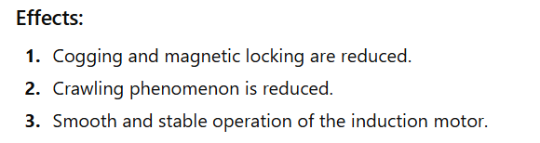
Squirrel Cage Rotor – Characteristics

Slide 27
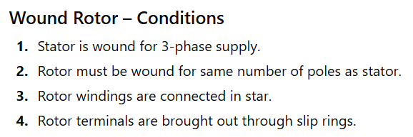
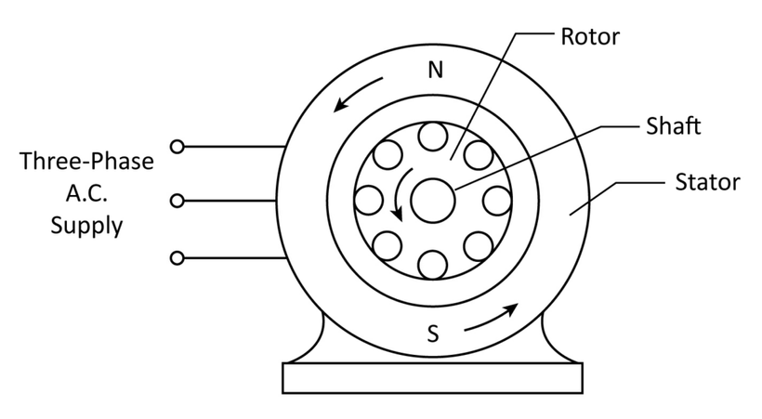
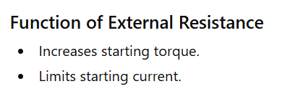


Induction Motor Speed Relations
Rotor rotates in same direction as stator rotating magnetic field but at less than synchronous speed.Hence called asynchronous speed.
At synchronous speed:

Slide 28
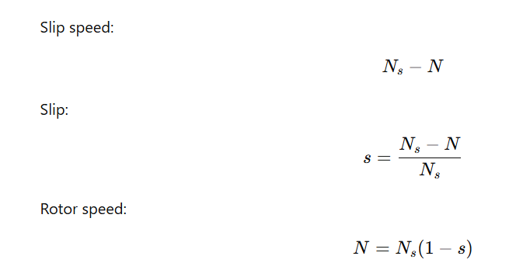

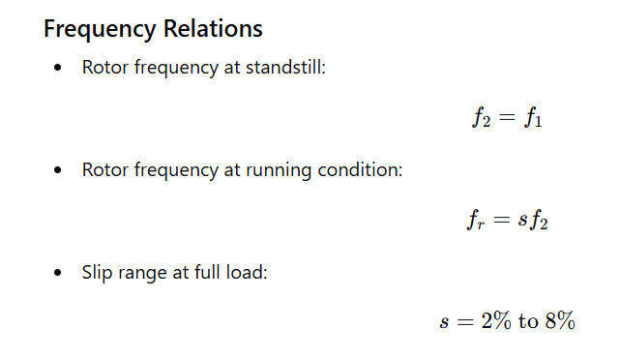
Rotor Induced EMF

Slide 29
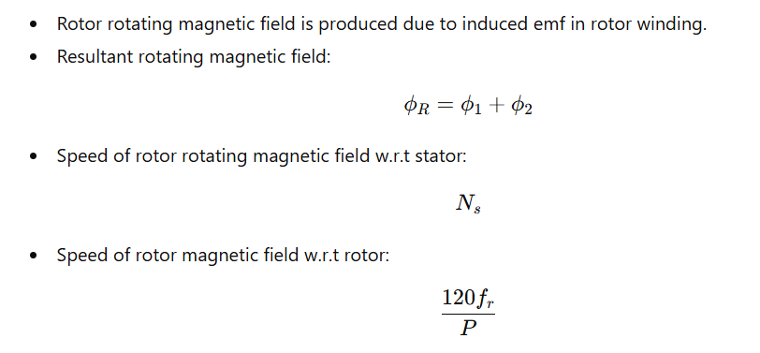
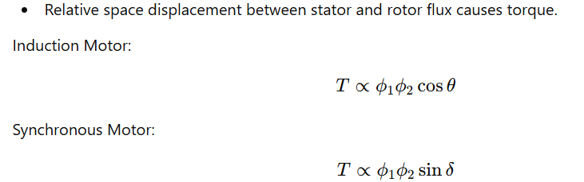
Rotating Magnetic Field
Torque Production

Slide 30
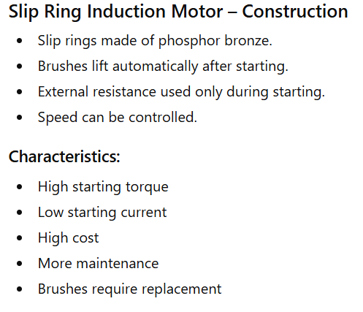
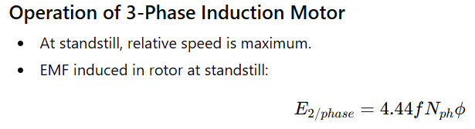

Slide 31
