Slide 1

Simulation of Fermi Hubbard Model using Scalable Quantum Circuit
MTP Presentation (PH57026)
[Autumn 2024]
By
Abhinaba Pahari
Roll No : 23PH40001
Supervisor : Prof. Sonjoy Majumder
Department of Physics, IIT Kharagpur

Slide 2
Introduction
Simulation of many body systems is a profound topic of interest in Condensed Matter Physics and Atomic, Molecular Physics.
Quantum Computers are promising tool for this because they operate based on the principles of quantum mechanics, which align closely with the nature of quantum systems.
Fermi Hubbard Model is a strongly corelated system of electrons which describes Phase transitions like metal-insulator transitions, magnetic ordering, and superconductivity.
Scalable Circuit Approach : Scalable Quantum Circuit referes to a quantum circuit where we can build a n-qubit circuit from (n-1) qubit circuit.
Ground State finding of a system is crucial for exploring Low Temperature behaviour of a system. We use Exact Diagonalization and Variational Quantum Eigensolver.

Slide 3
Outline
Time Evolution
Results
Fermi Hubbard Model
Scalable Quantum Circuit for Time Evolution
1
2
3
4
5
6
Jordan Wigner Mapping
Ground State Finding
Future Aspects and Conclusion

Slide 4
Role of Quantum Computer
For a system of n particles, the state space requires 2^n complex coefficients to describe all possible configurations.
For example: A 5-particle system requires 2^5 = 32 coefficients.
A 50-particle system requires around 10^15 coefficients, making it infeasible to handle on classical computers as the memory and computation demands quickly exceed realistic limits.
Quantum Computers Handle This Naturally.
A quantum computer uses qubits, which are themselves quantum systems capable of existing in superposition. The state of n qubits can directly represent a n-dimensional quantum state.
Unlike classical bits, which can only hold a single value (0 or 1) at a time, qubits can encode both values simultaneously, thanks to superposition. This allows them to represent all possible states of the system inherently, without needing to explicitly store coefficients.

Slide 5
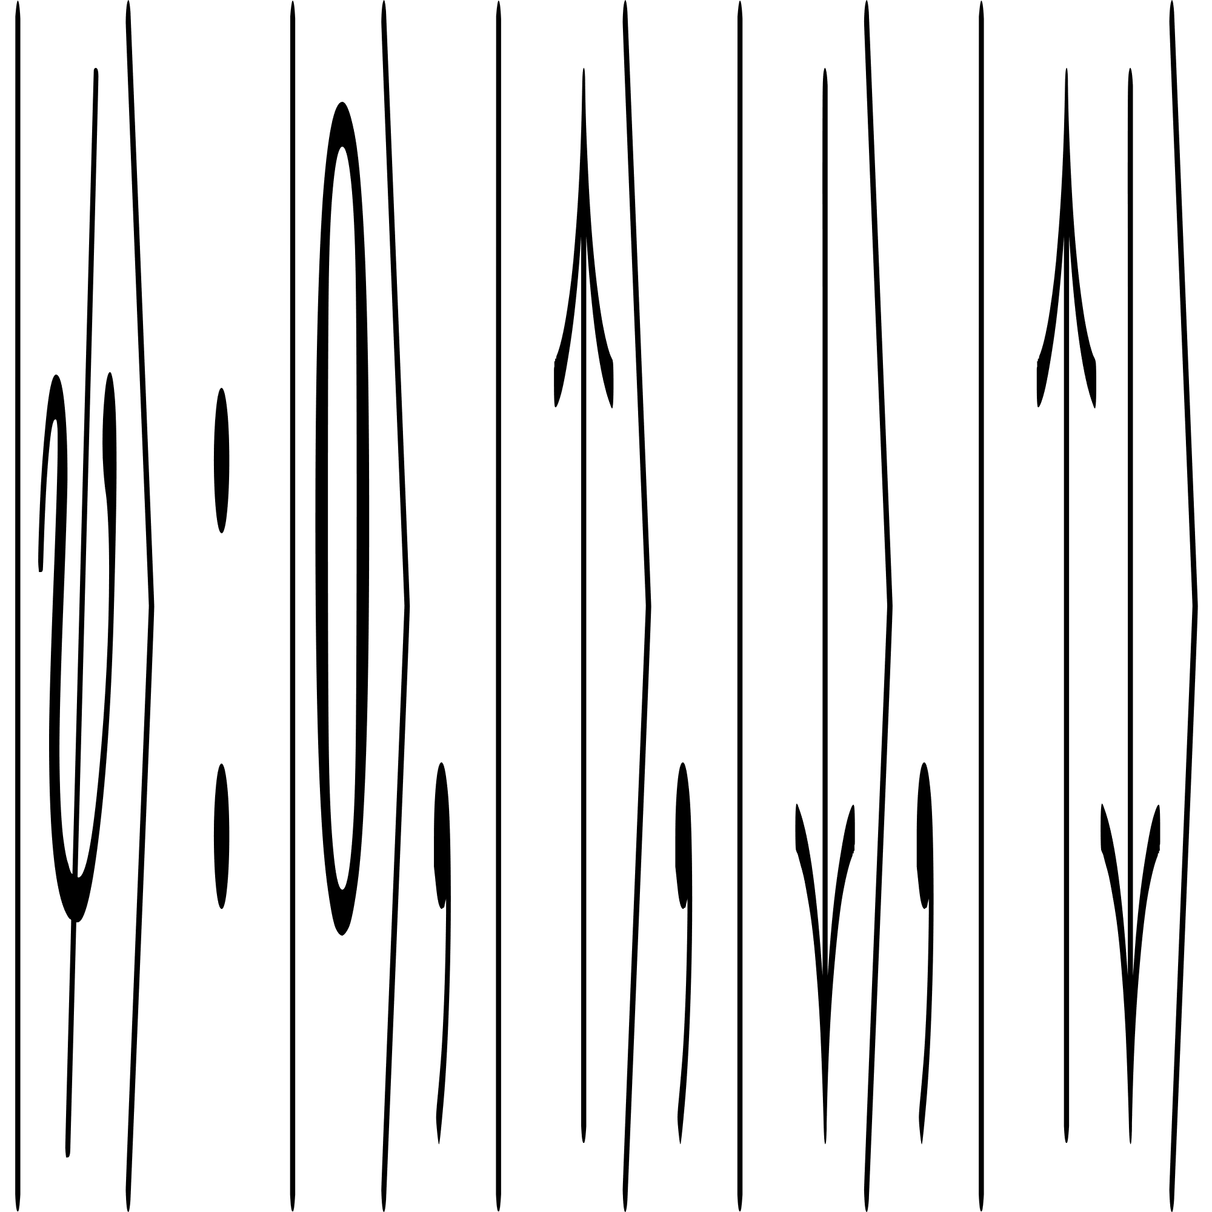
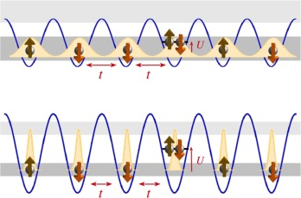
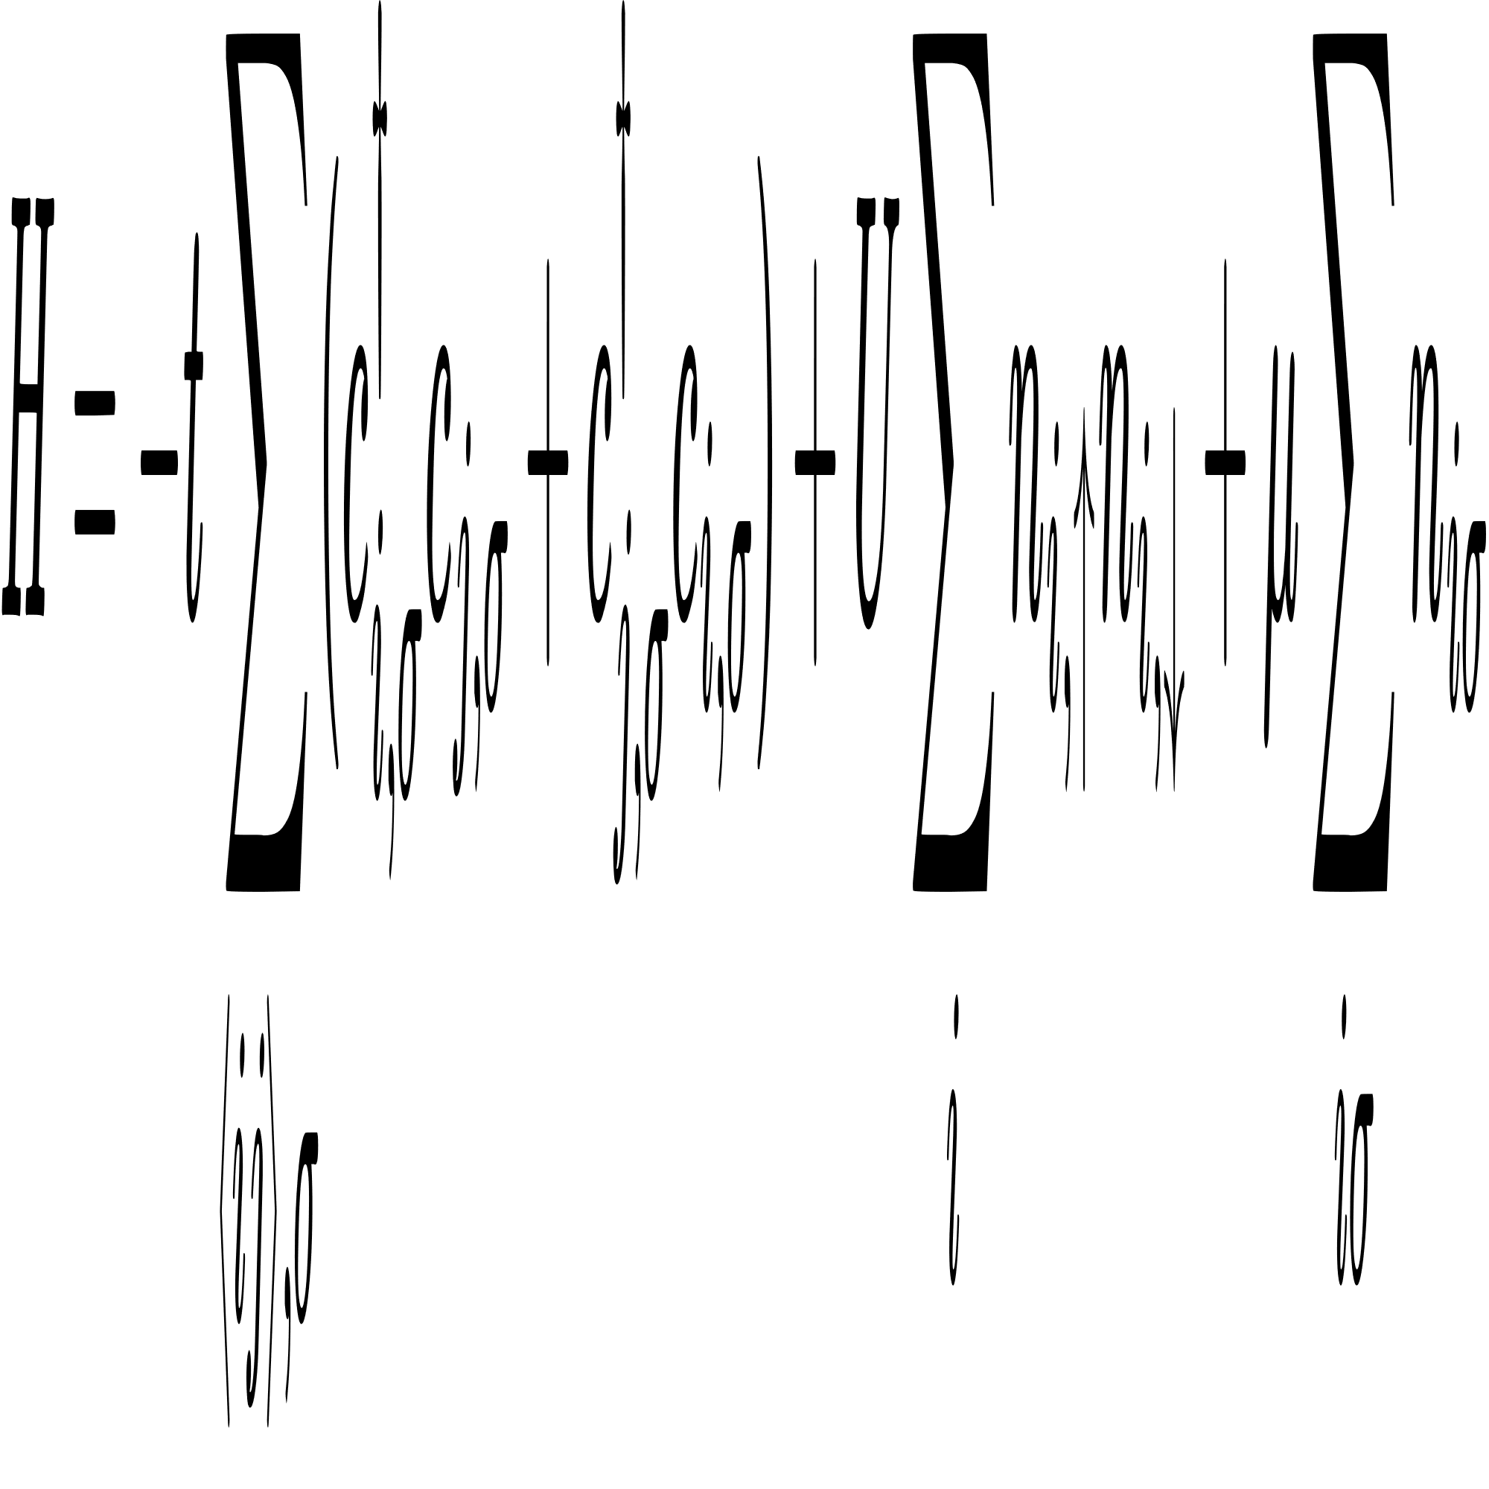
Fermi Hubbard Model
It was introduced to model the behavior of correlated electrons in solid. Electrons can “hop” between neighboring lattice sites without interacting.
Electrons at the same site (one spin up and other spin down) can interact with each other.
Each site can be in one of the following states :
The Hubbard Hamiltonian
Hopping Term
(K.E.)
Self Interaction
(P.E.)
Chemical
Potential Term
The last term is often not used because it does’nt change for a given number of particles.

Slide 6
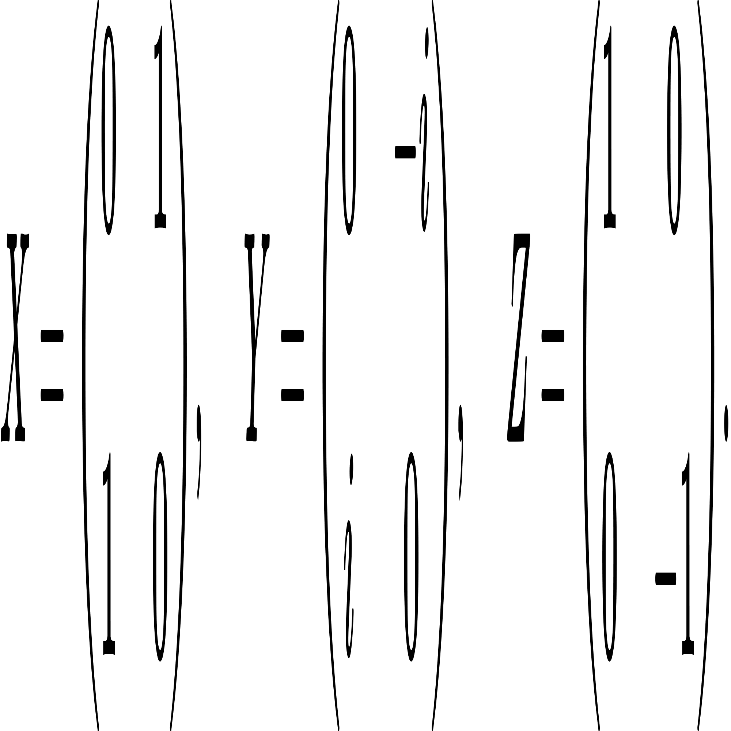
Jordan Wigner Mapping
To simulate any quantum system on a quantum computer, it is necessary to represent it in the quantum computer's basis i.e. QUBITS.​
Besides transformation of state vector to qubit space we also require to transform the operators that act on the state to operators that operate on qubits.​
Jordan Wigner Transformation
Fermionic Wavefunction
Qubit Wavefunction
Fermionic Operators
Qubit Operators ( Pauli X,Y,Z gates)

Slide 7
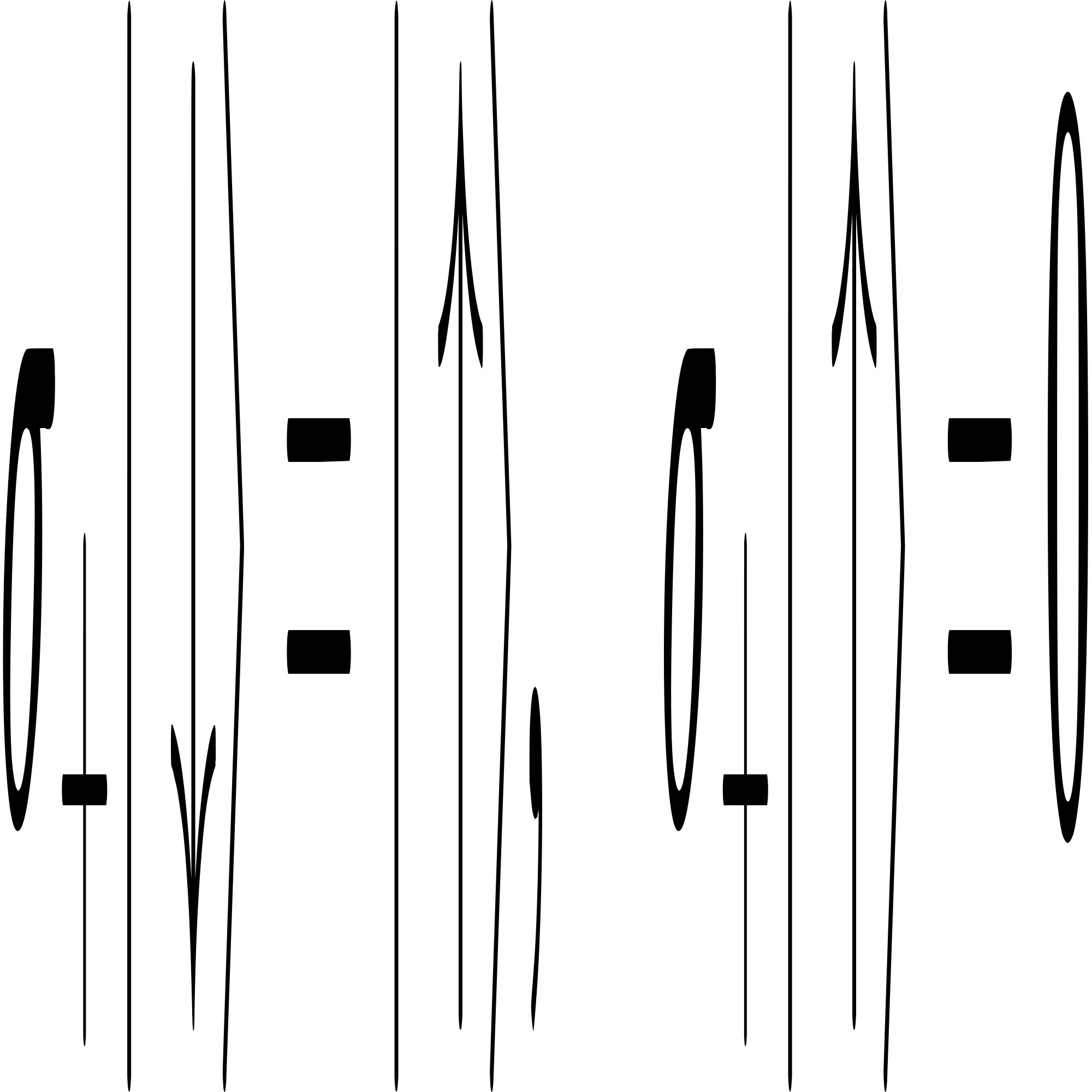
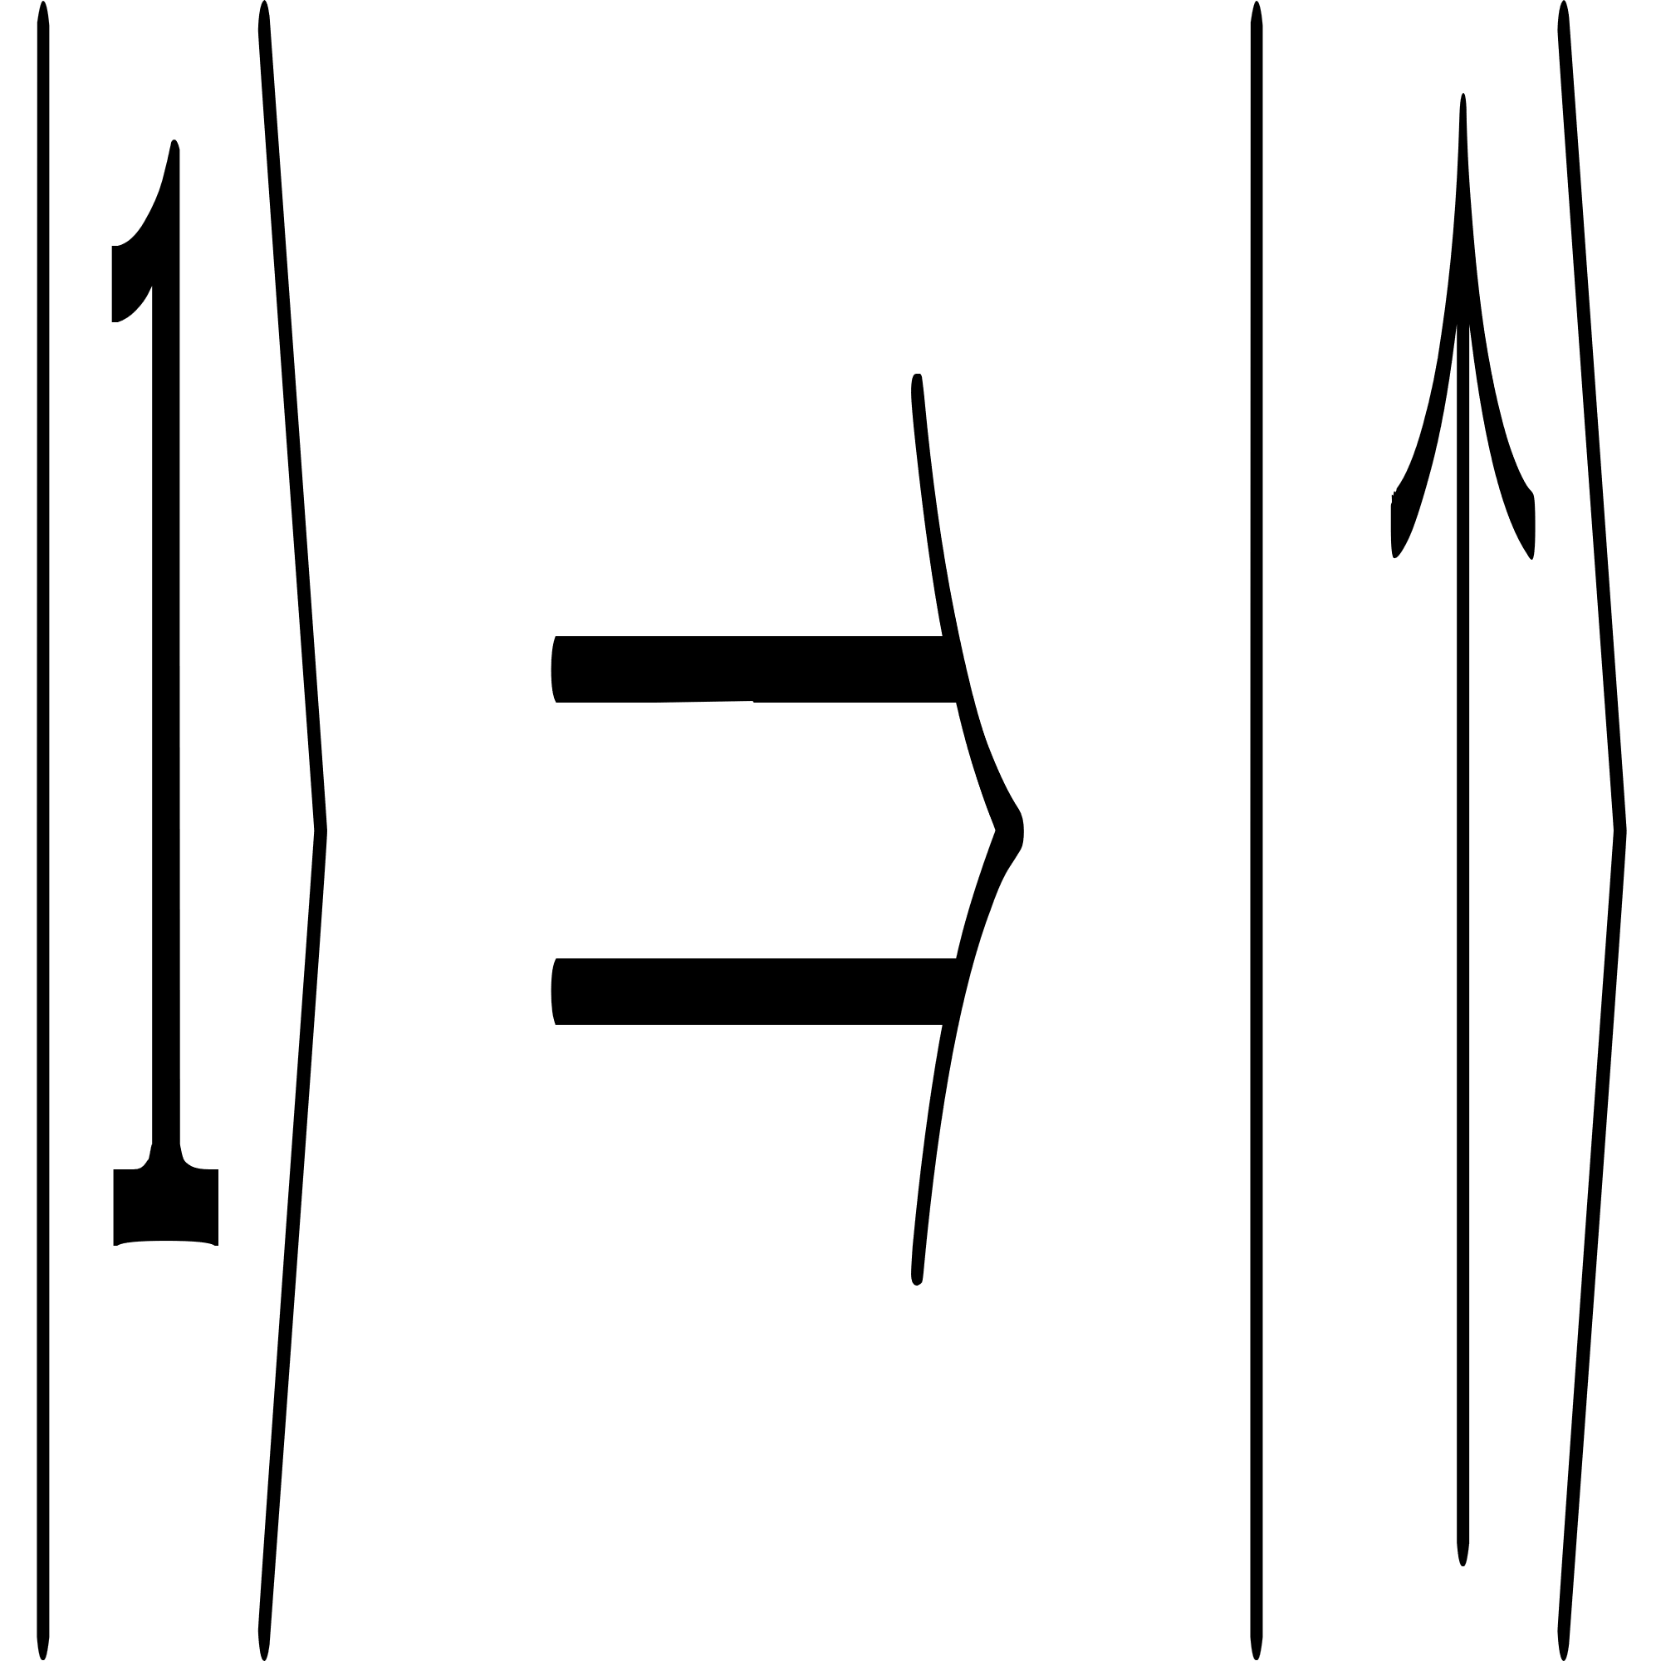
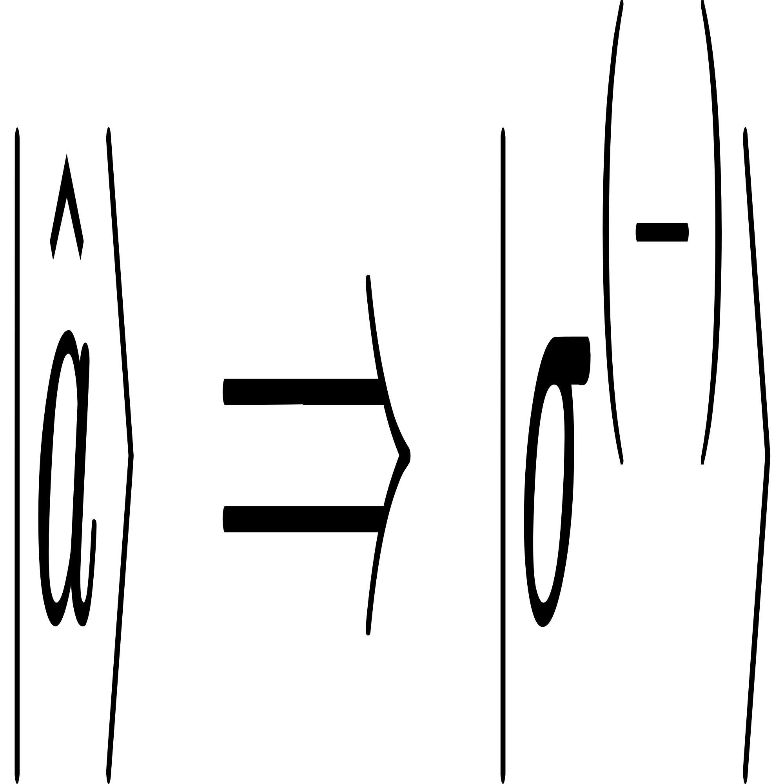
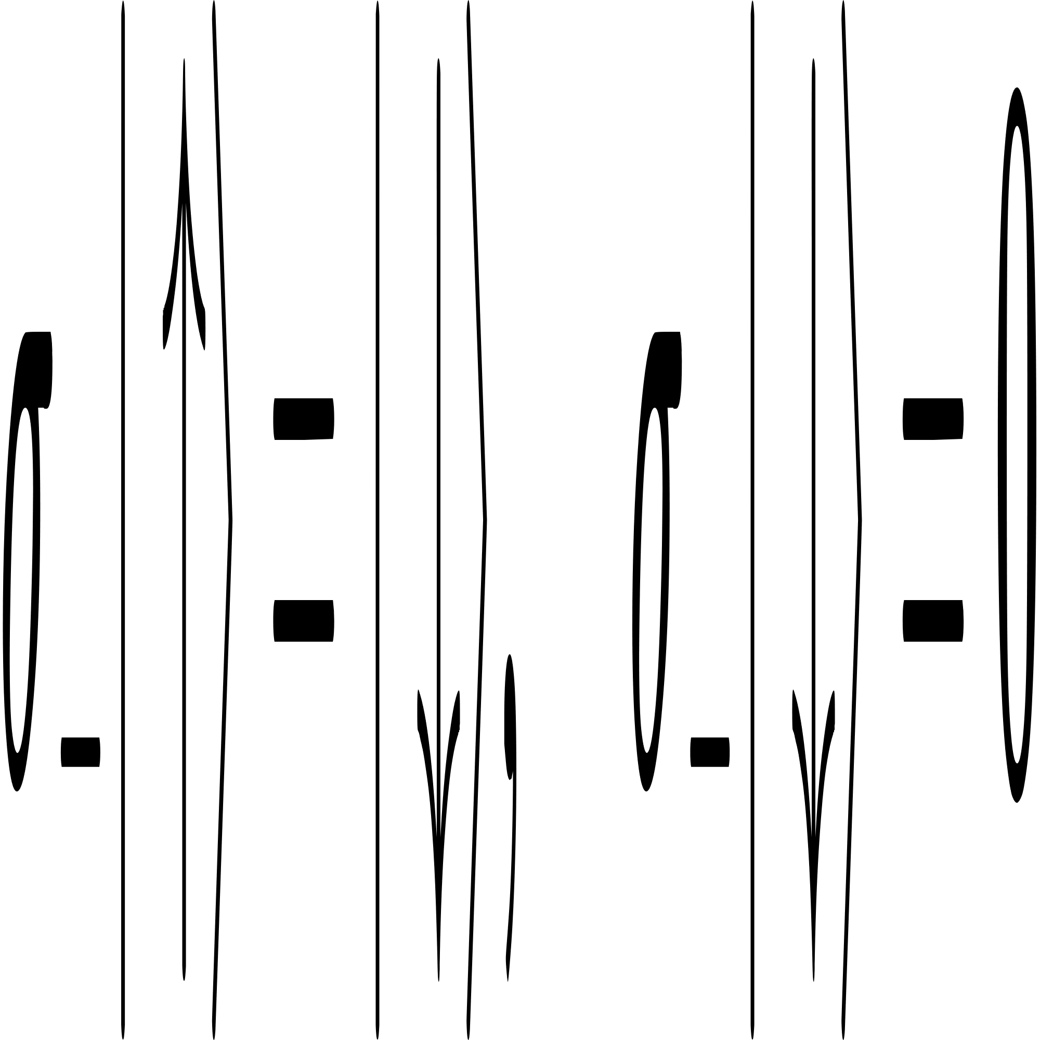
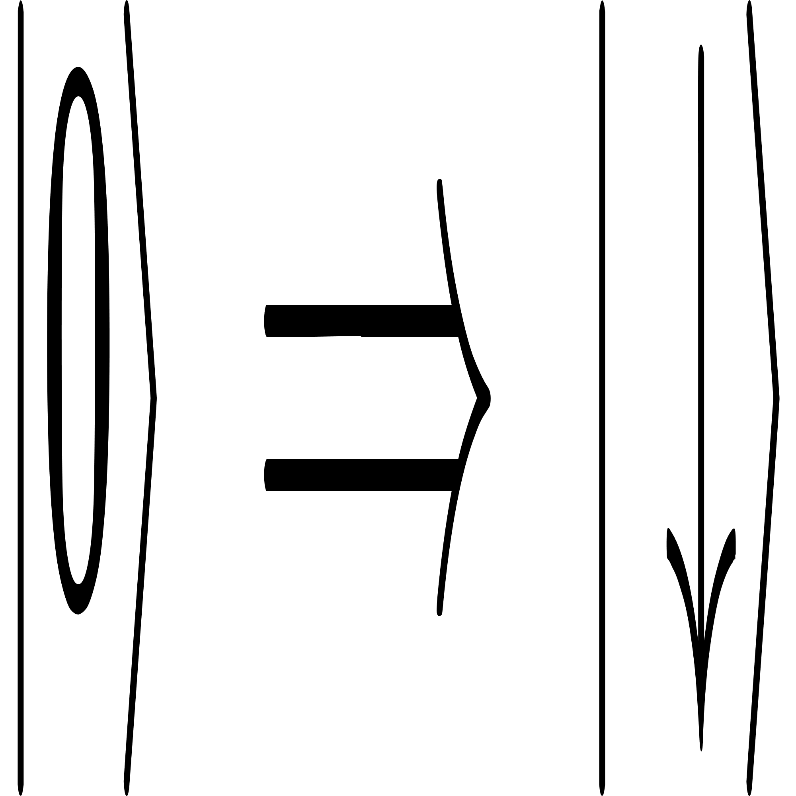
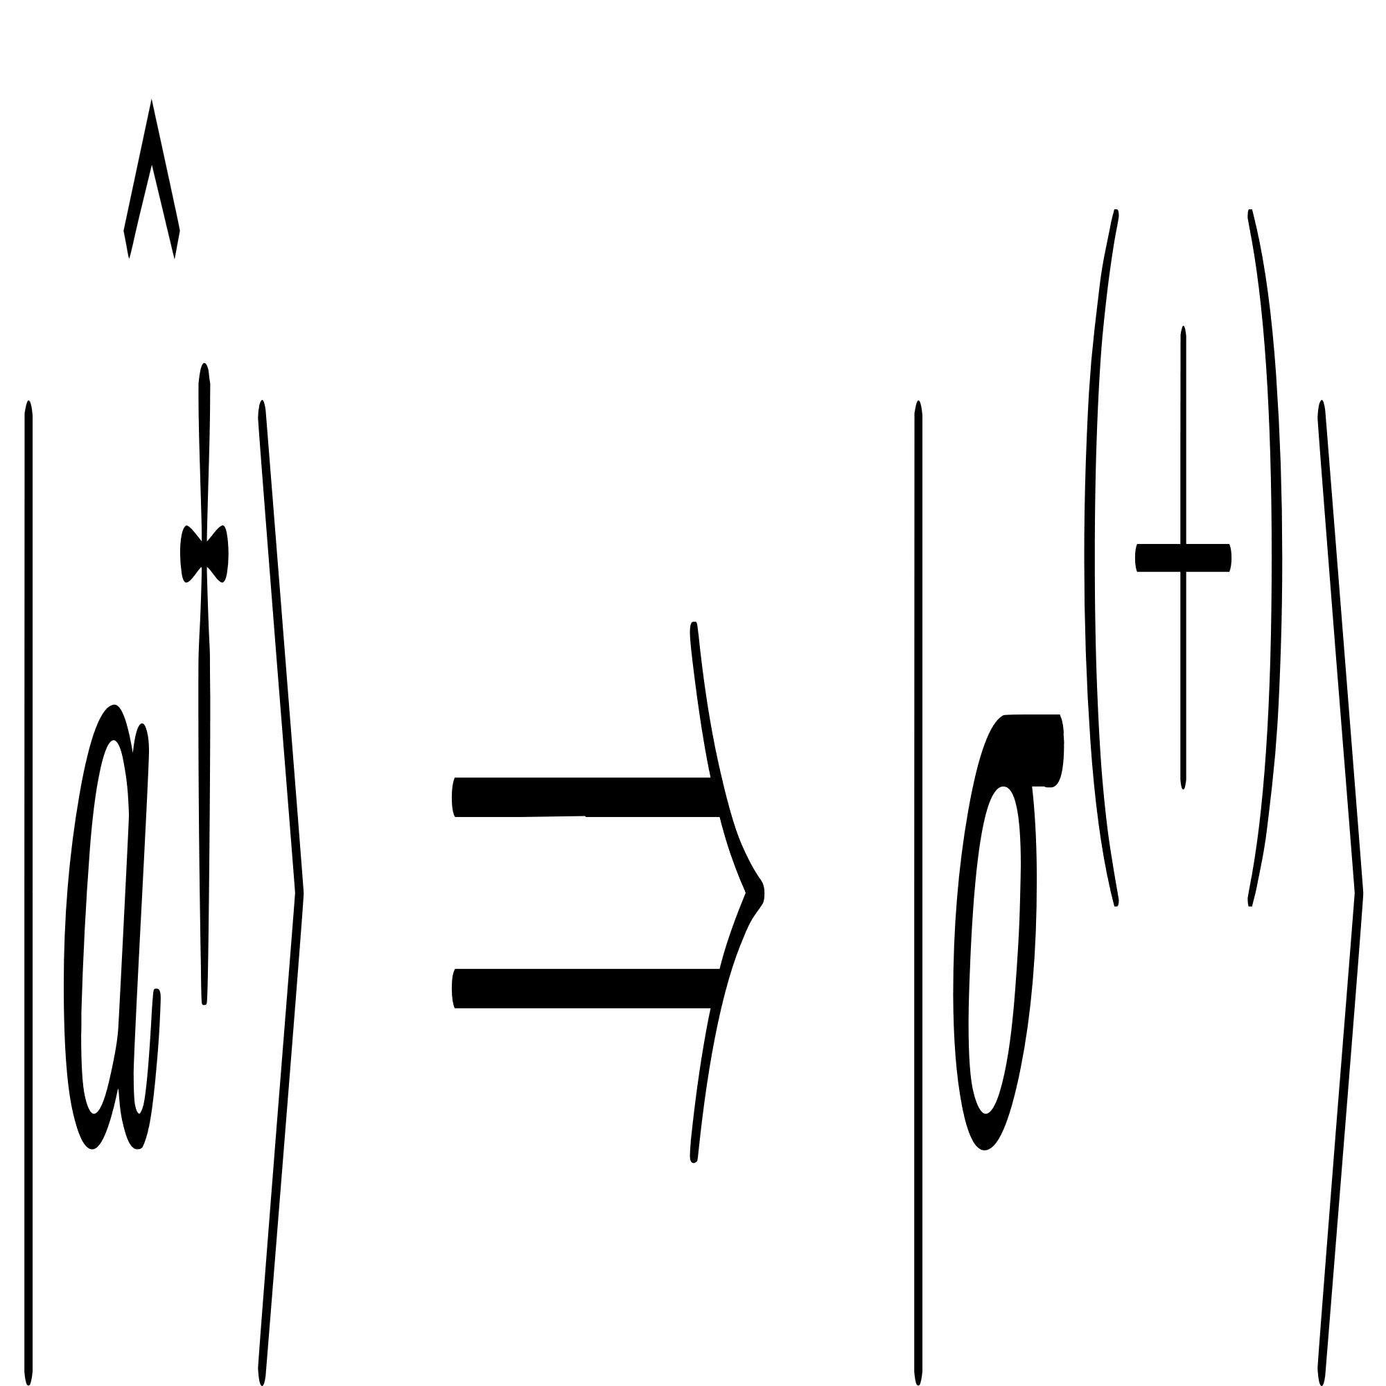
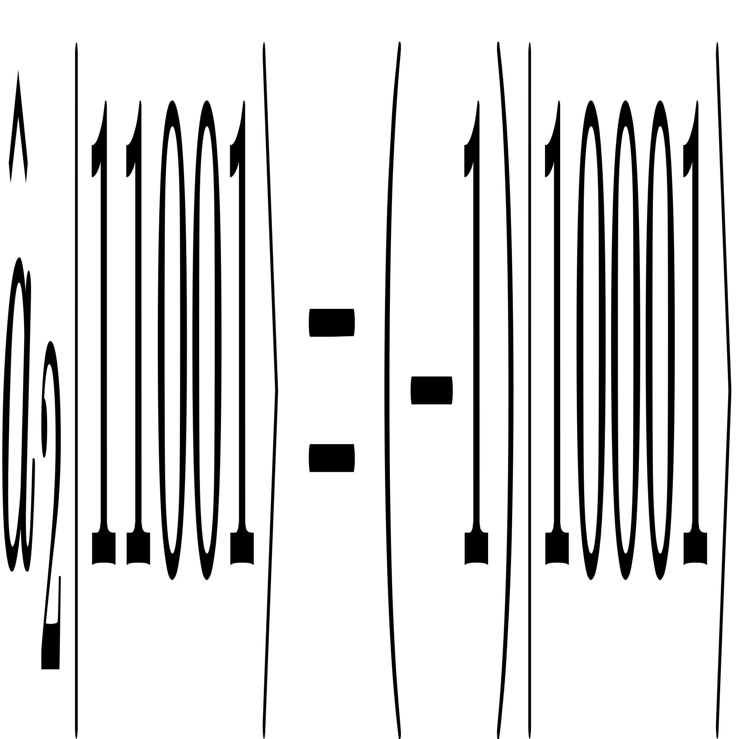
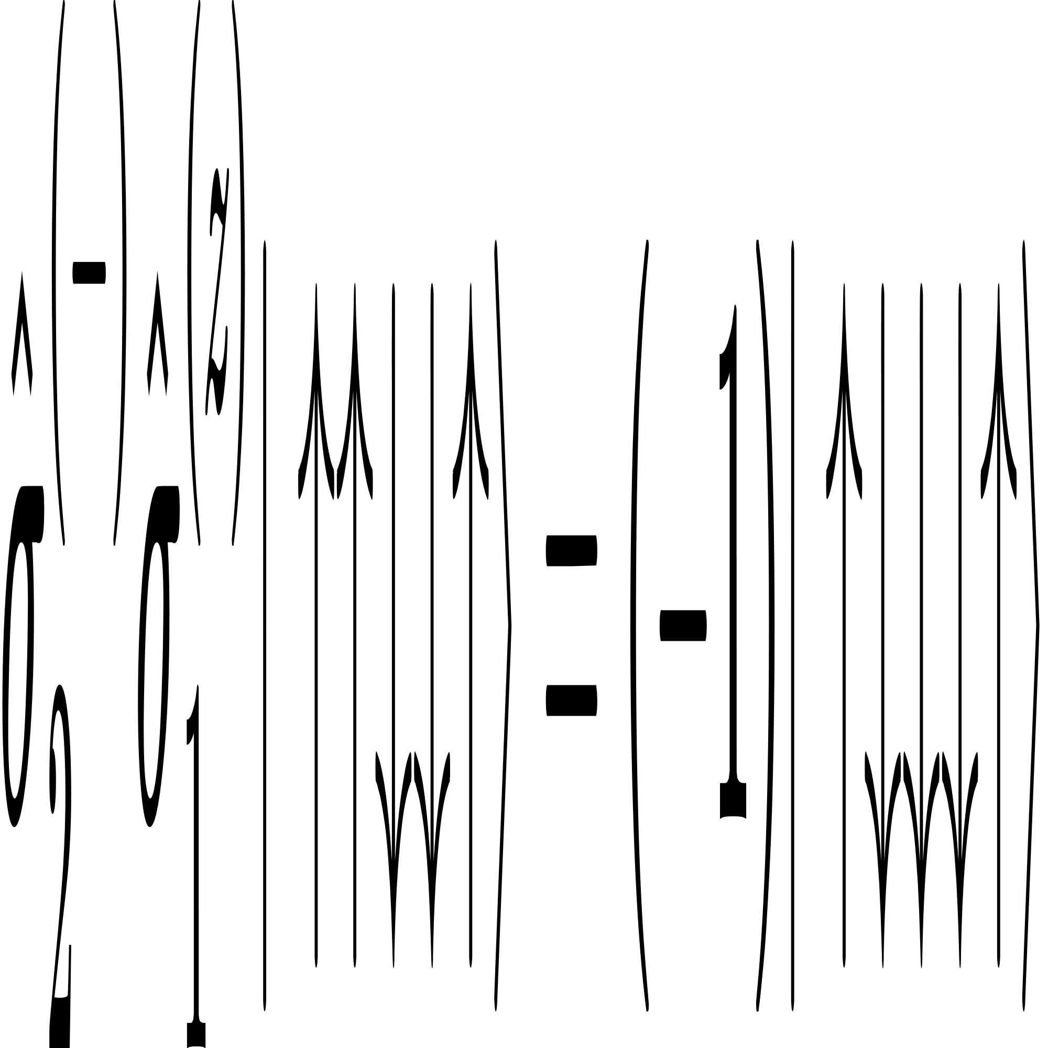
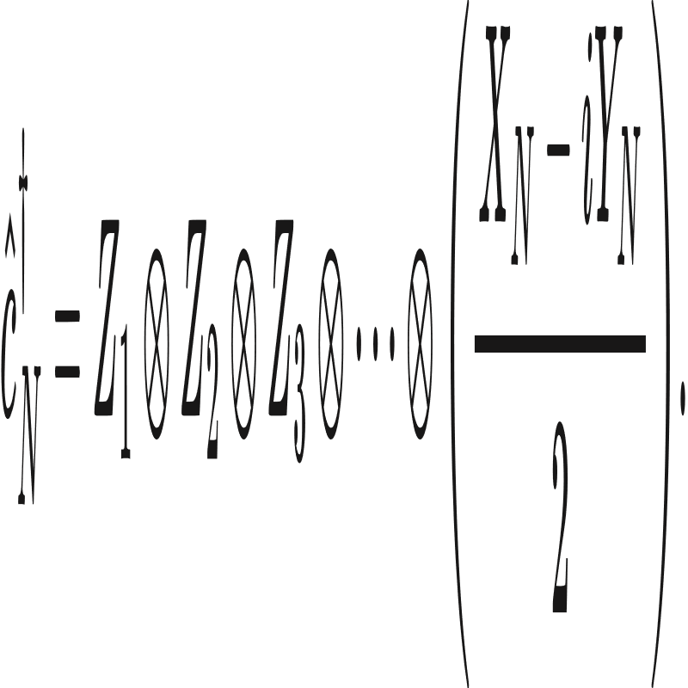
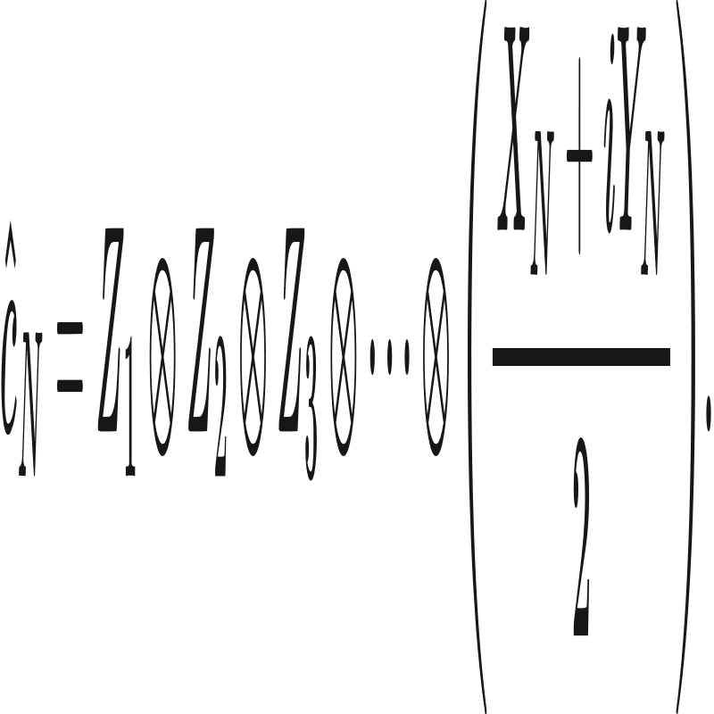
Jordan Wigner Mapping
* Fermionic Wavefunction is anti-symmetric
Mapping Operators to Qubit System :
Each Site in Hubbard Model can maximum hold 2 electrons.
The System is a 3 site 1 dimensional chain
We require 3*2 = 6 qubits

Slide 8
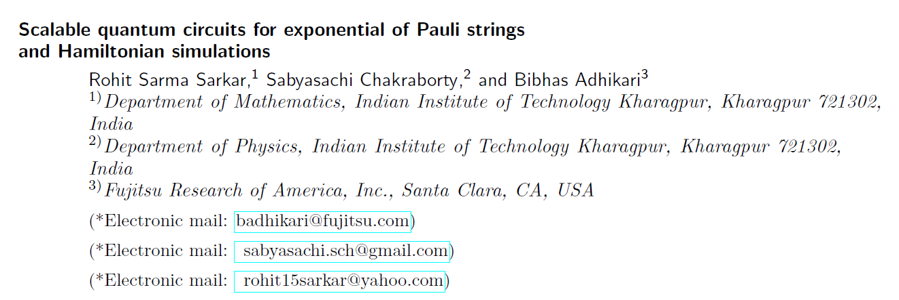
Scalable Quantum Circuit
Scalability is Important !
Scalable Circuit means that quantum circuits for (n + 1) qubit systems can be constructed from n-qubit circuits by adding additional quantum gates and the extra qubit.
Implementable on low-connected quantum hardware e.g IBM’s quantum hardware IBMQX2.
For Circuit design, it uses only 1-qubit rotation gates and minimally connected CNOT gates.

Slide 9
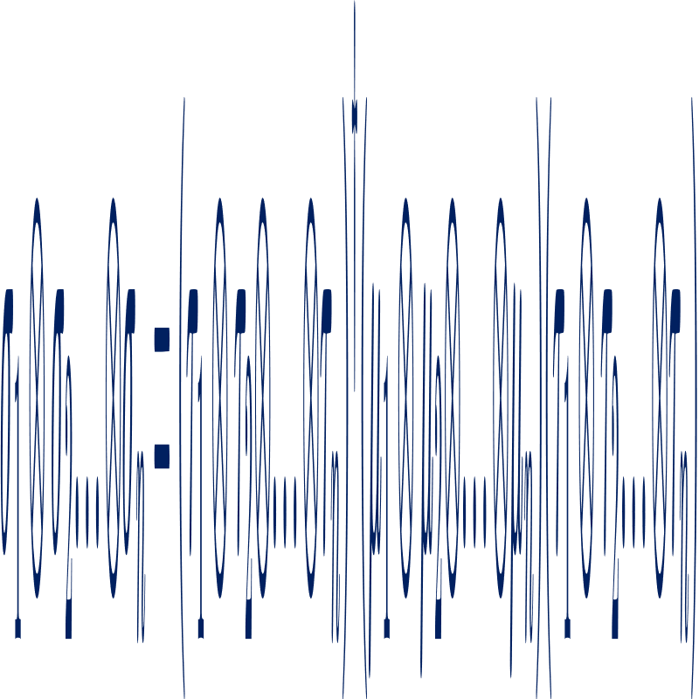
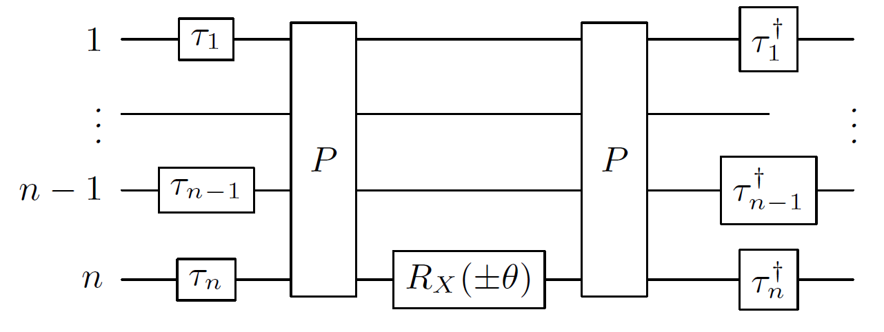
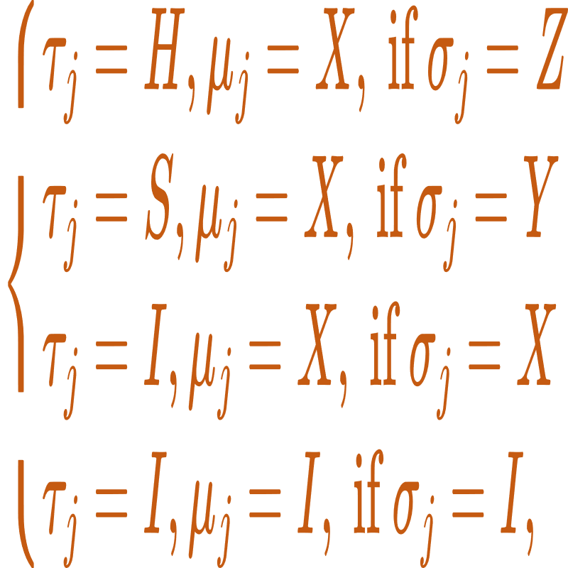
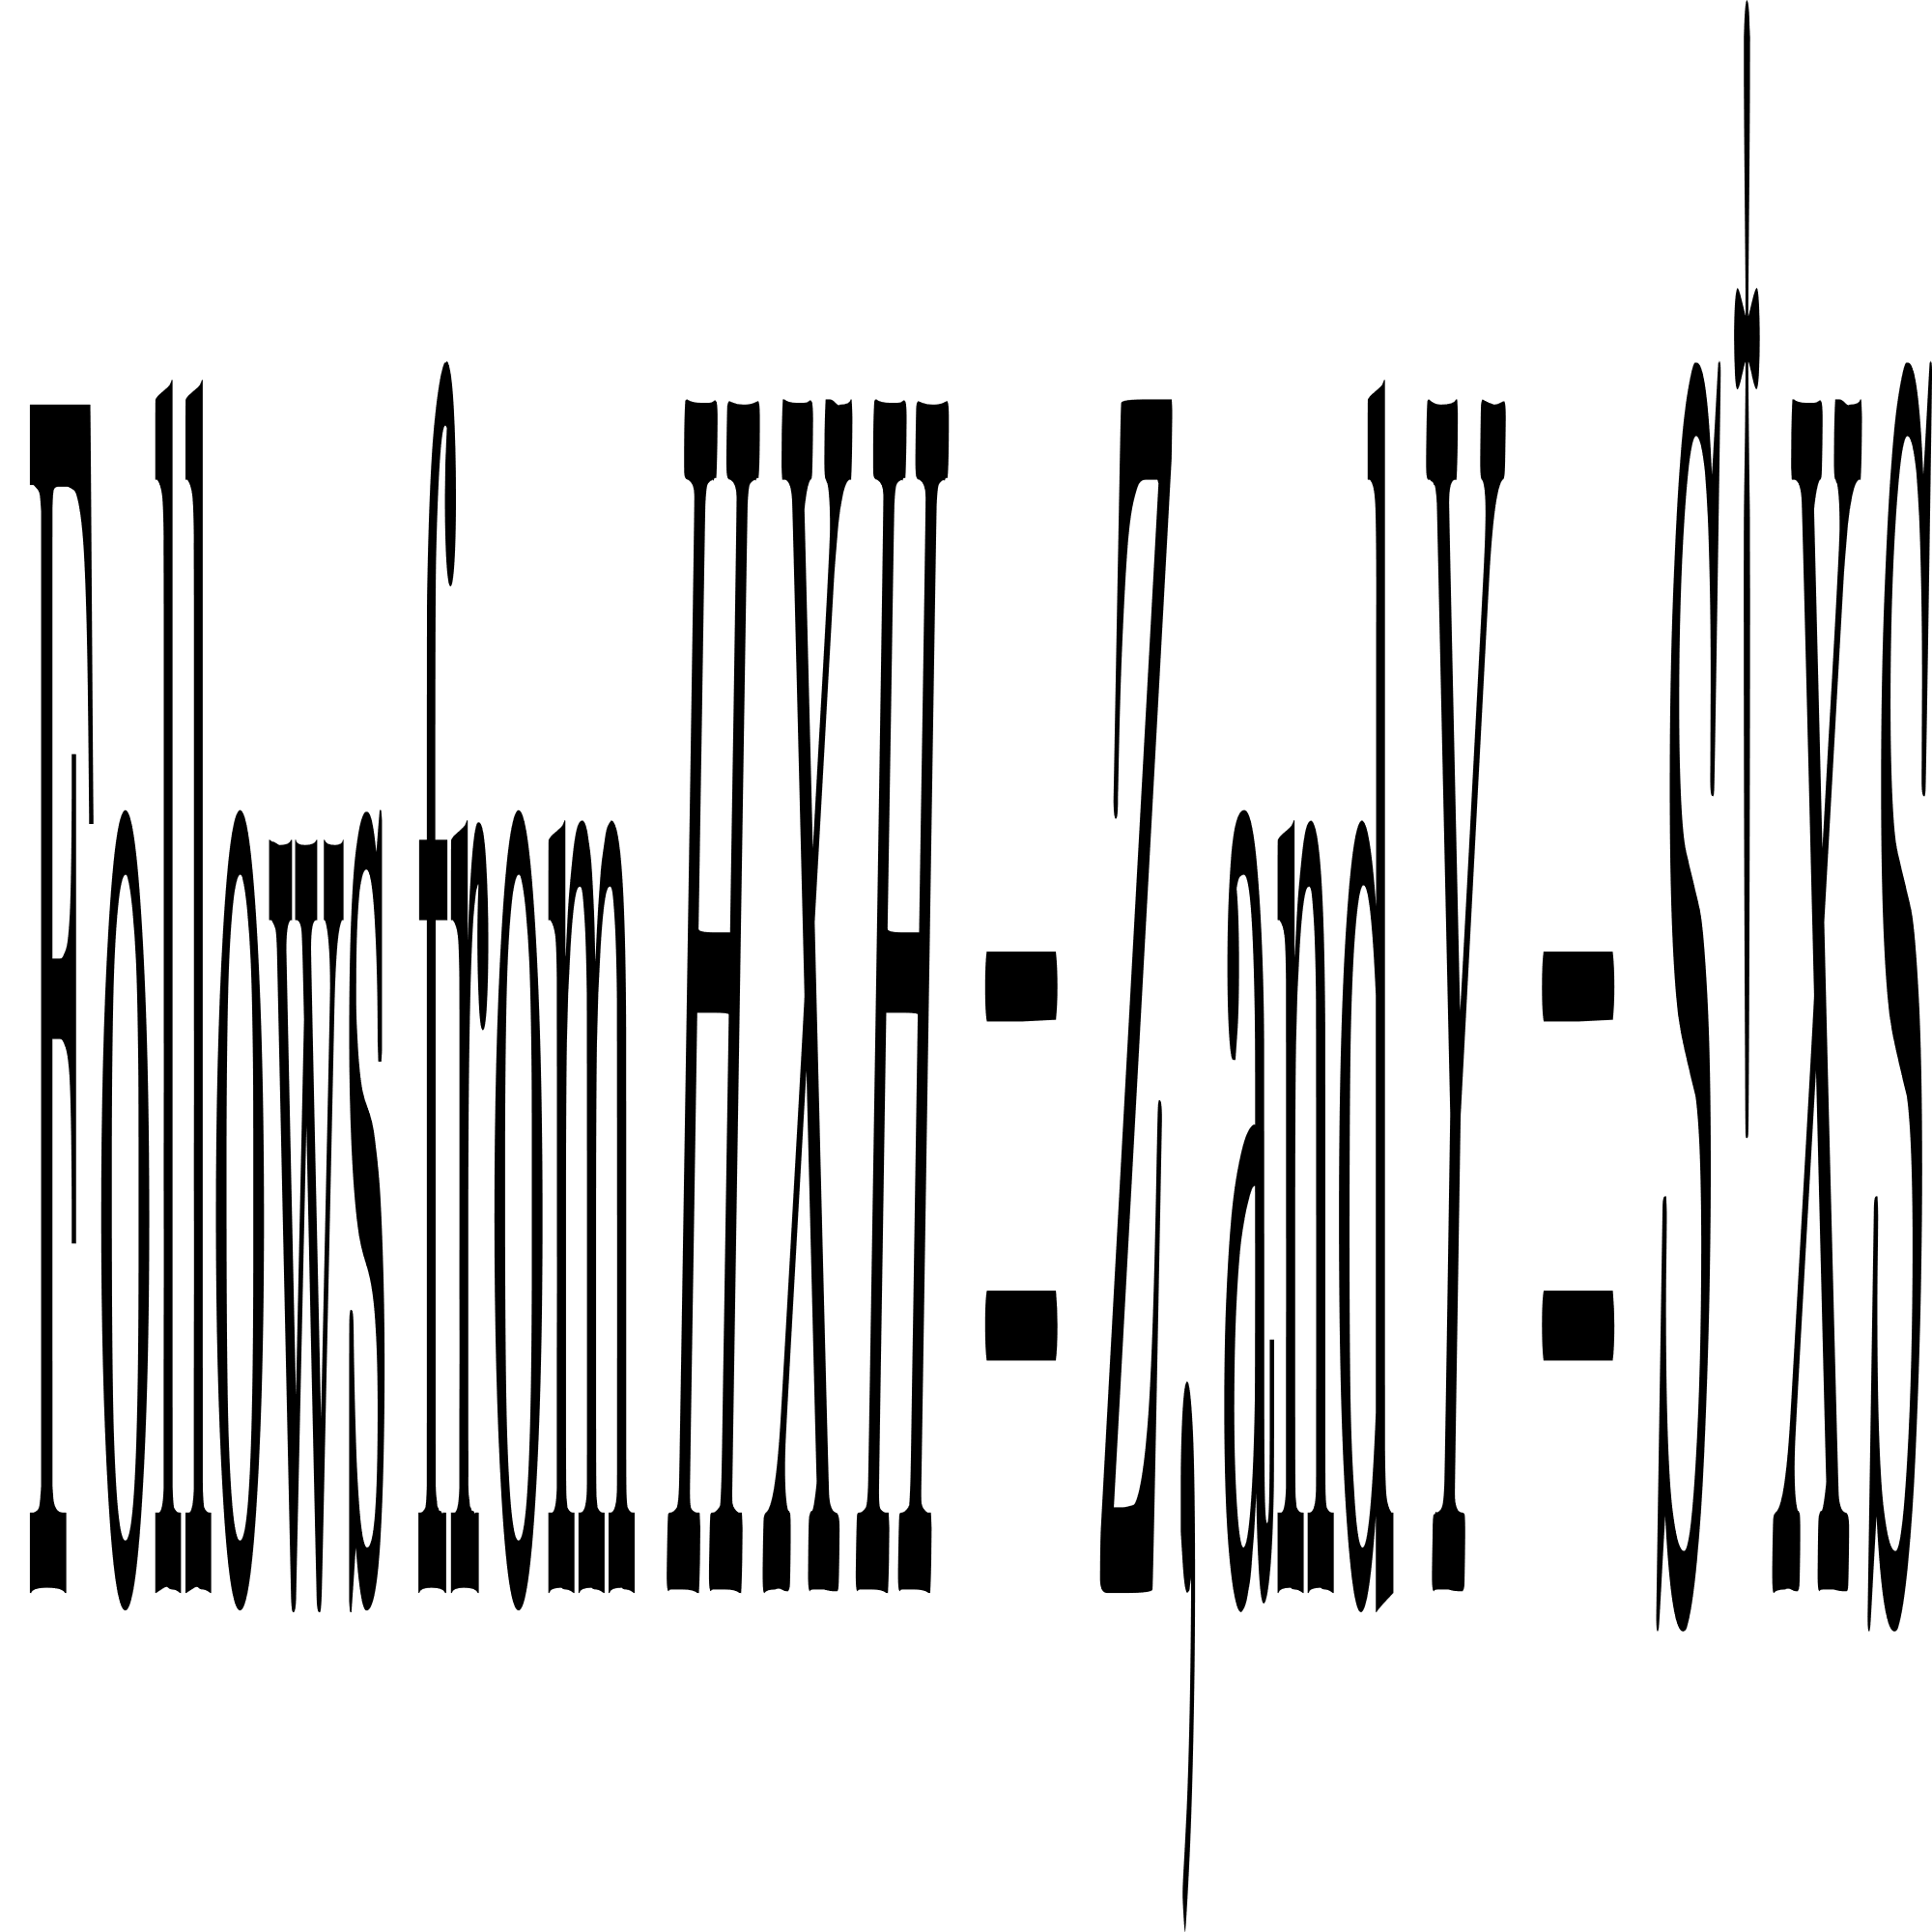
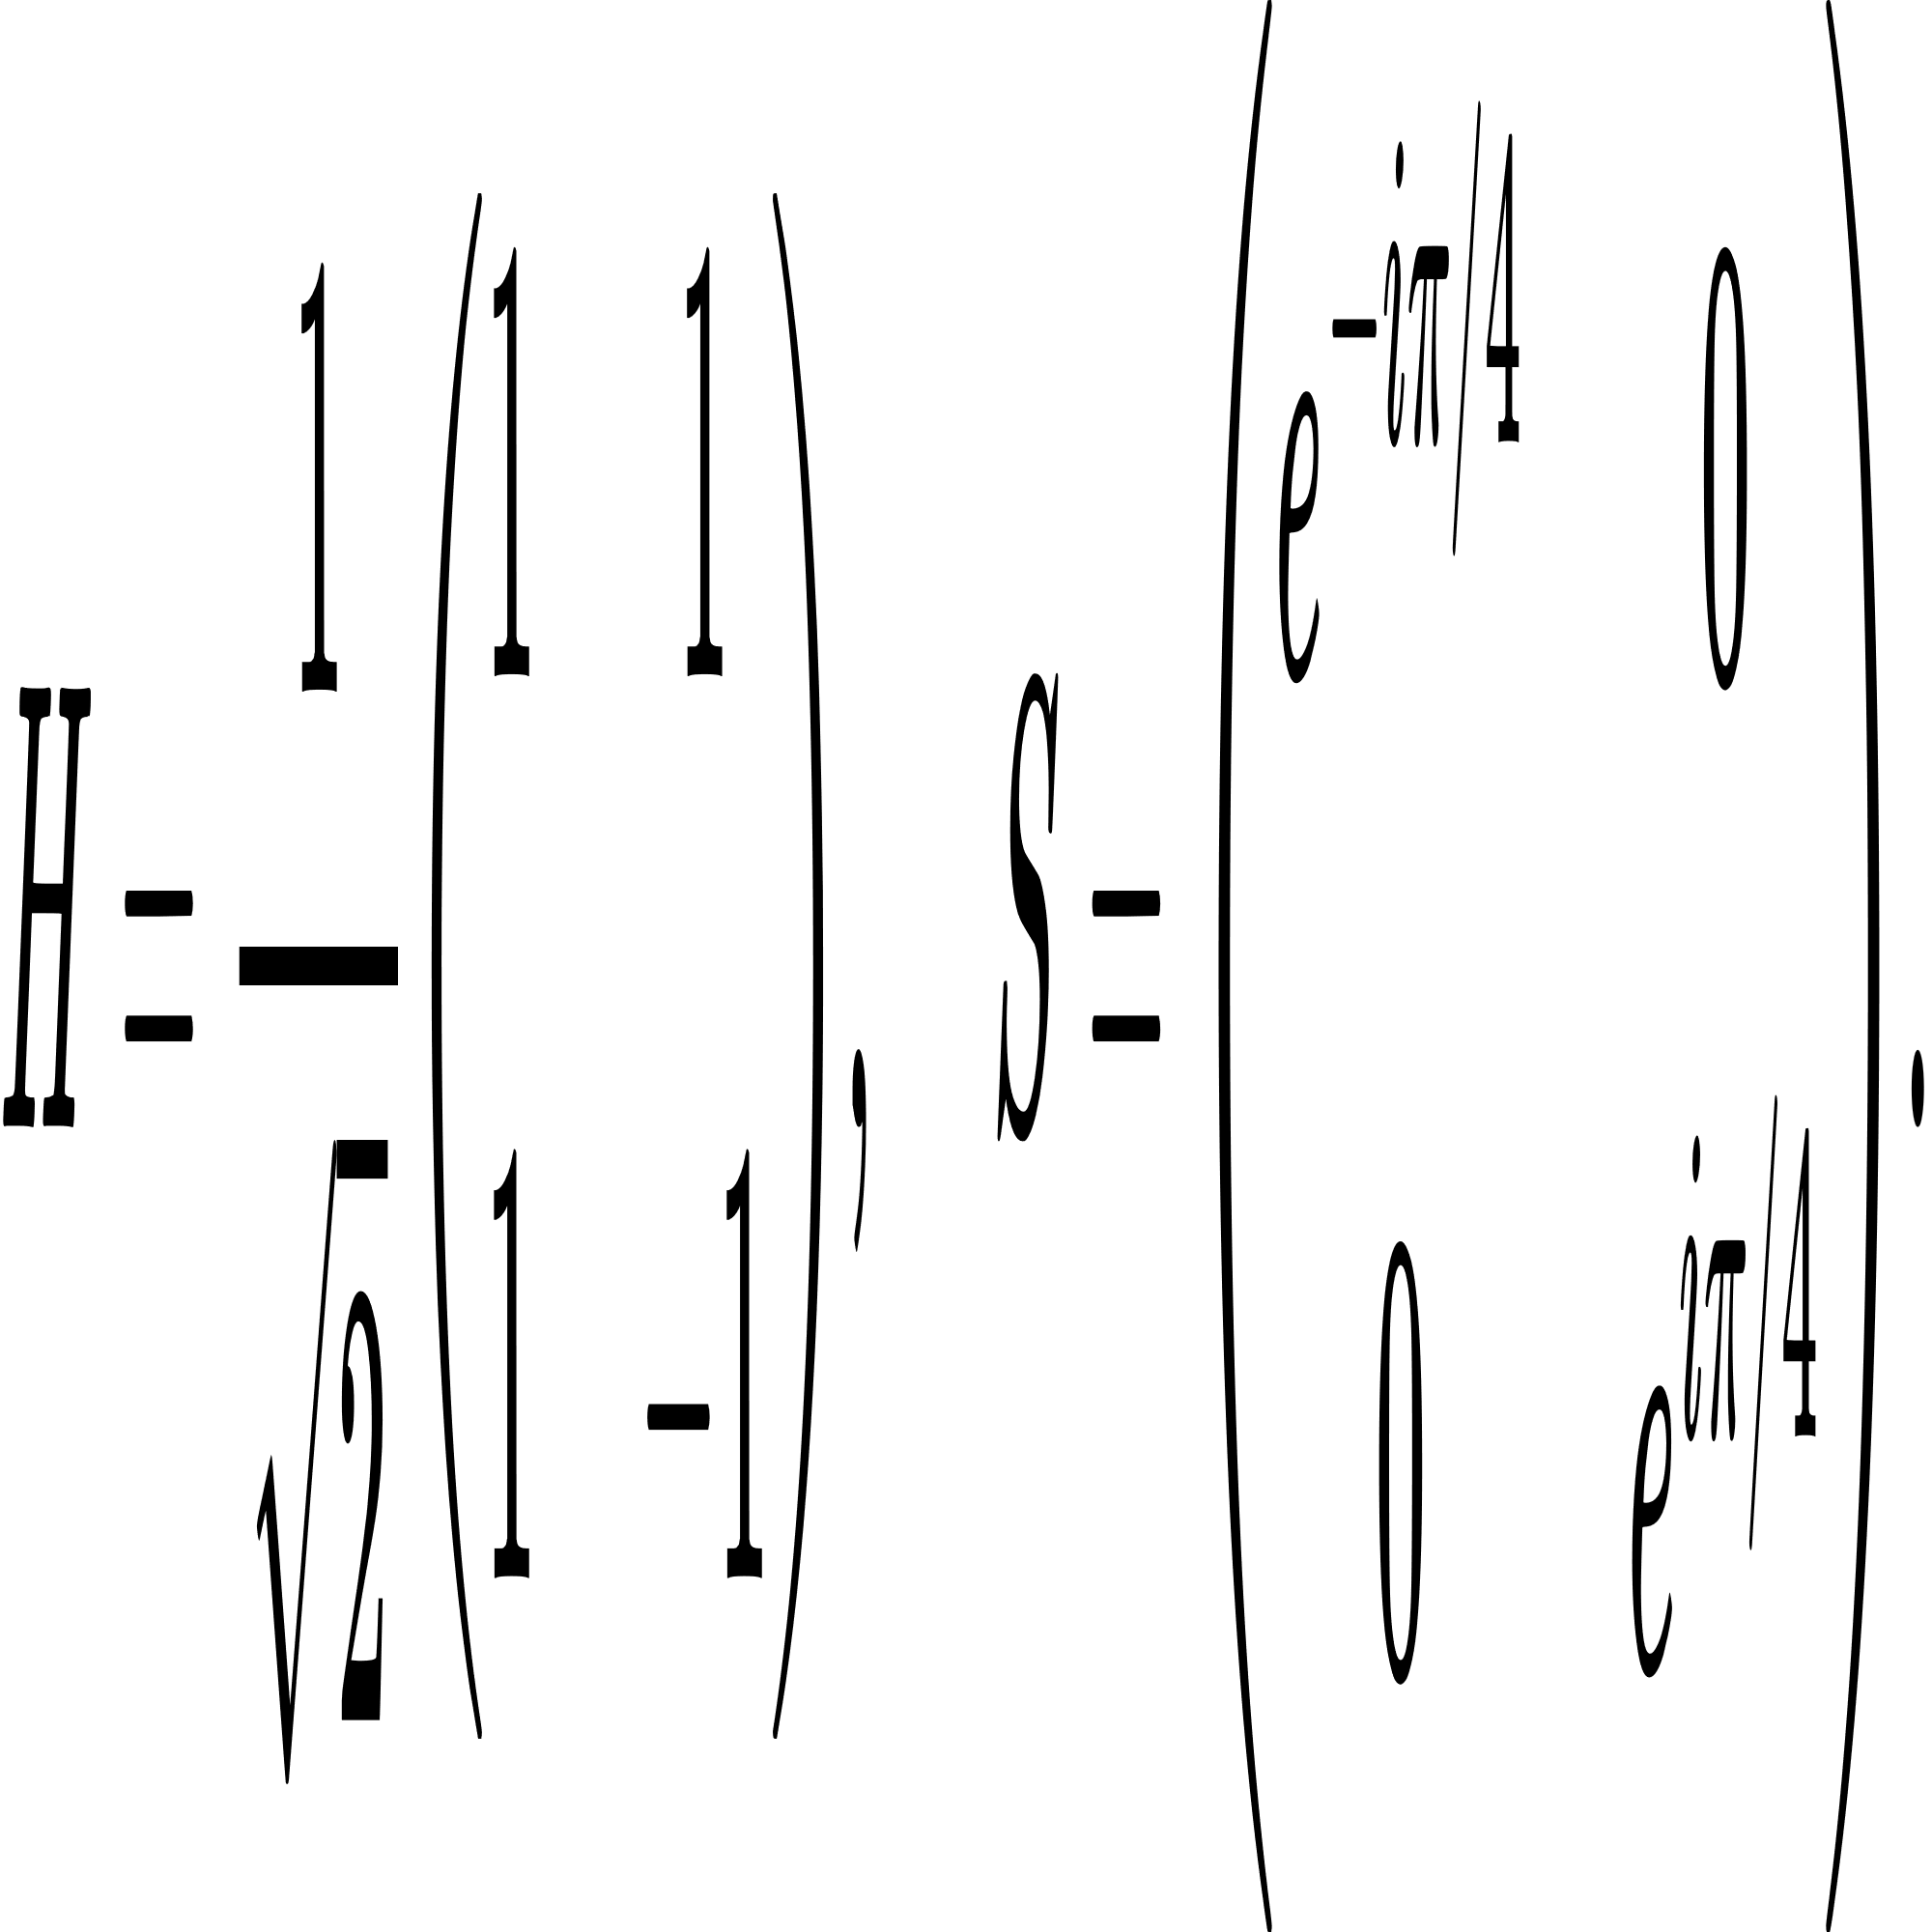

Scalable Quantum Circuit
1. For any n qubit Pauli string :
Where,
P : Permutation Operators (Collection of CNOT gates) depending on specific Strings
2.

Slide 10
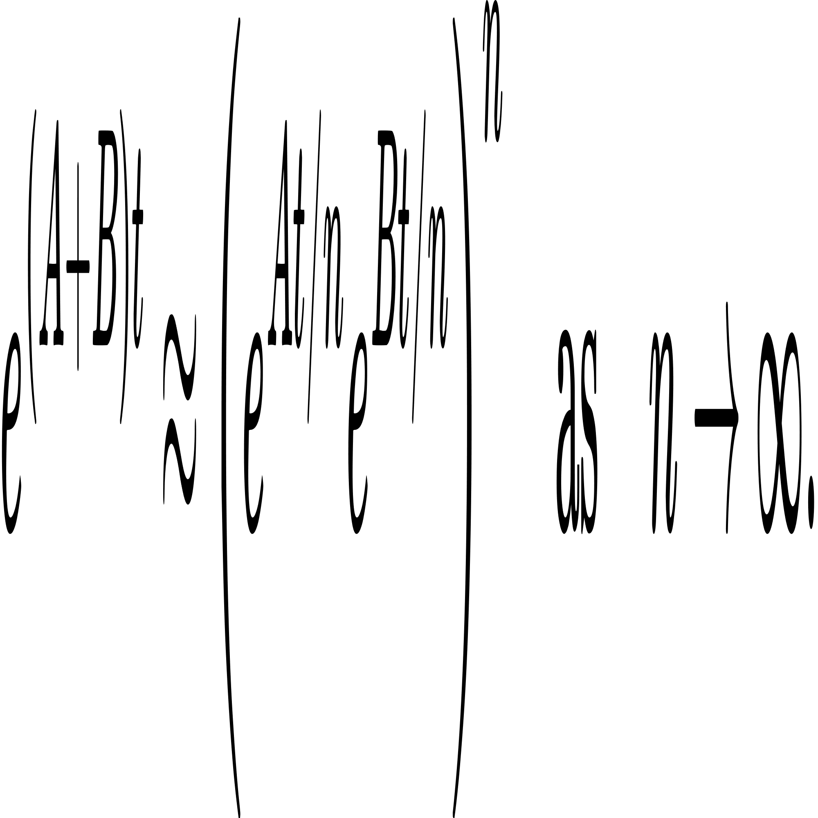
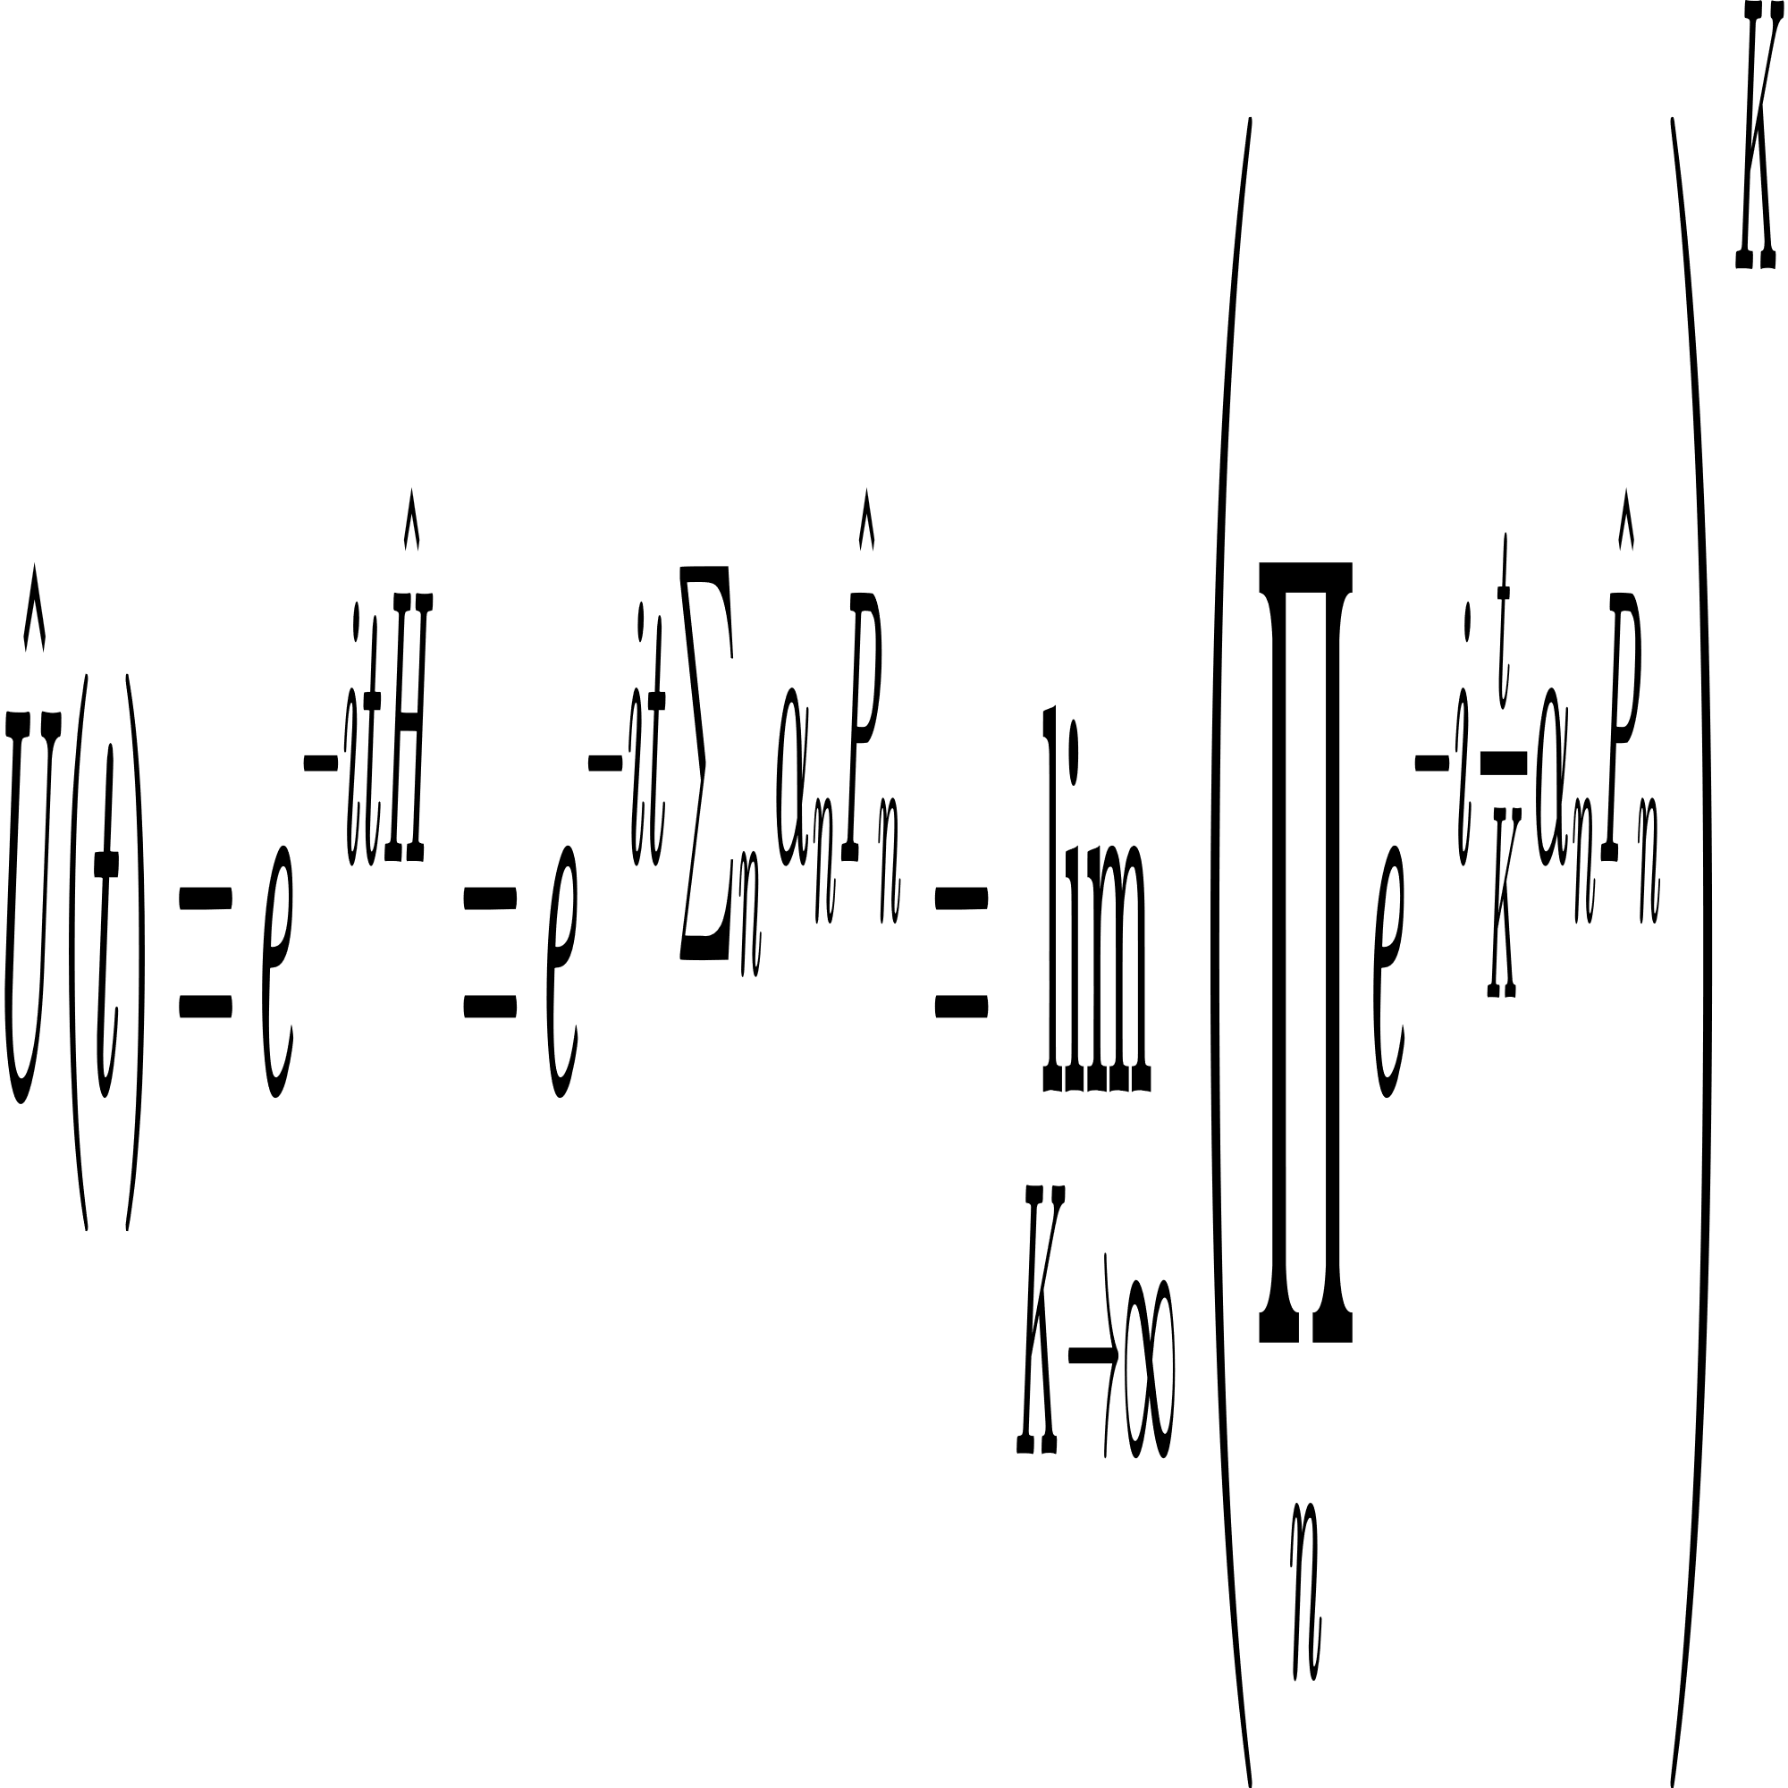
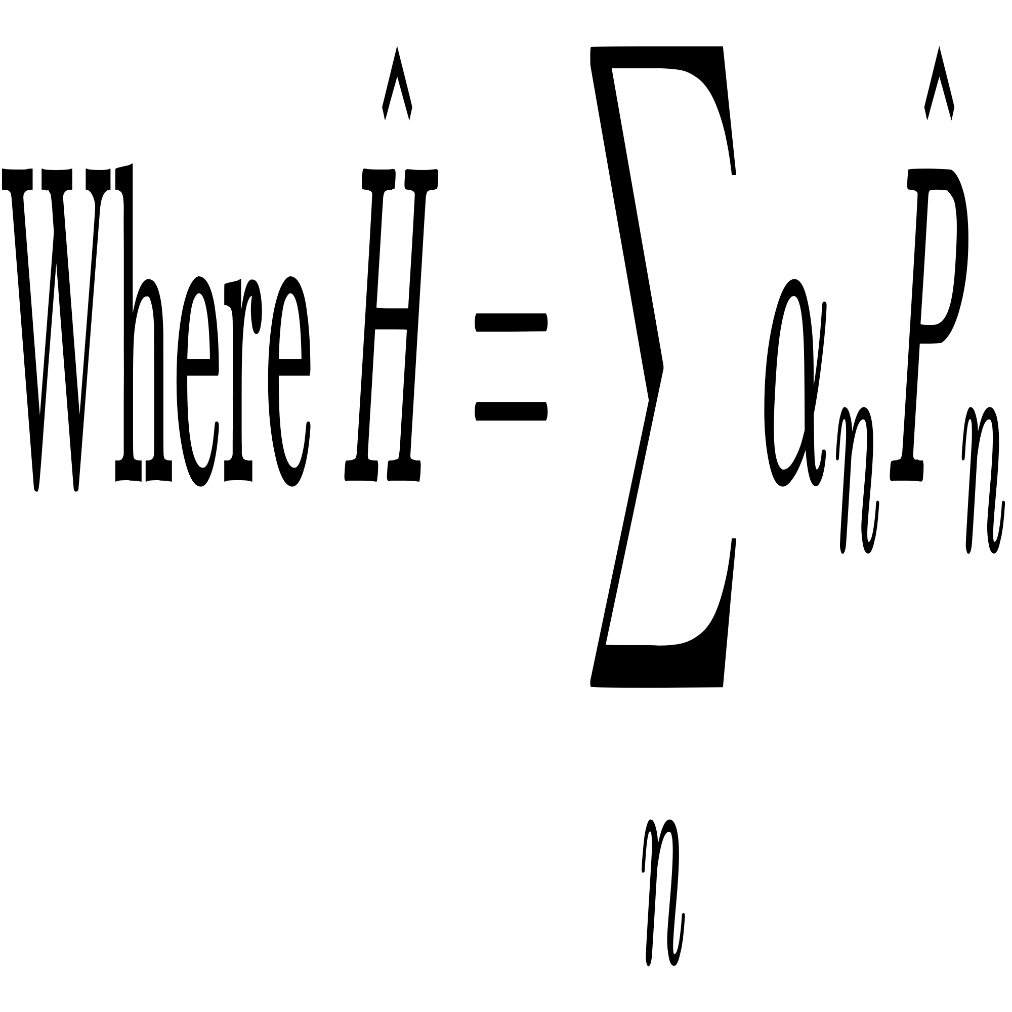
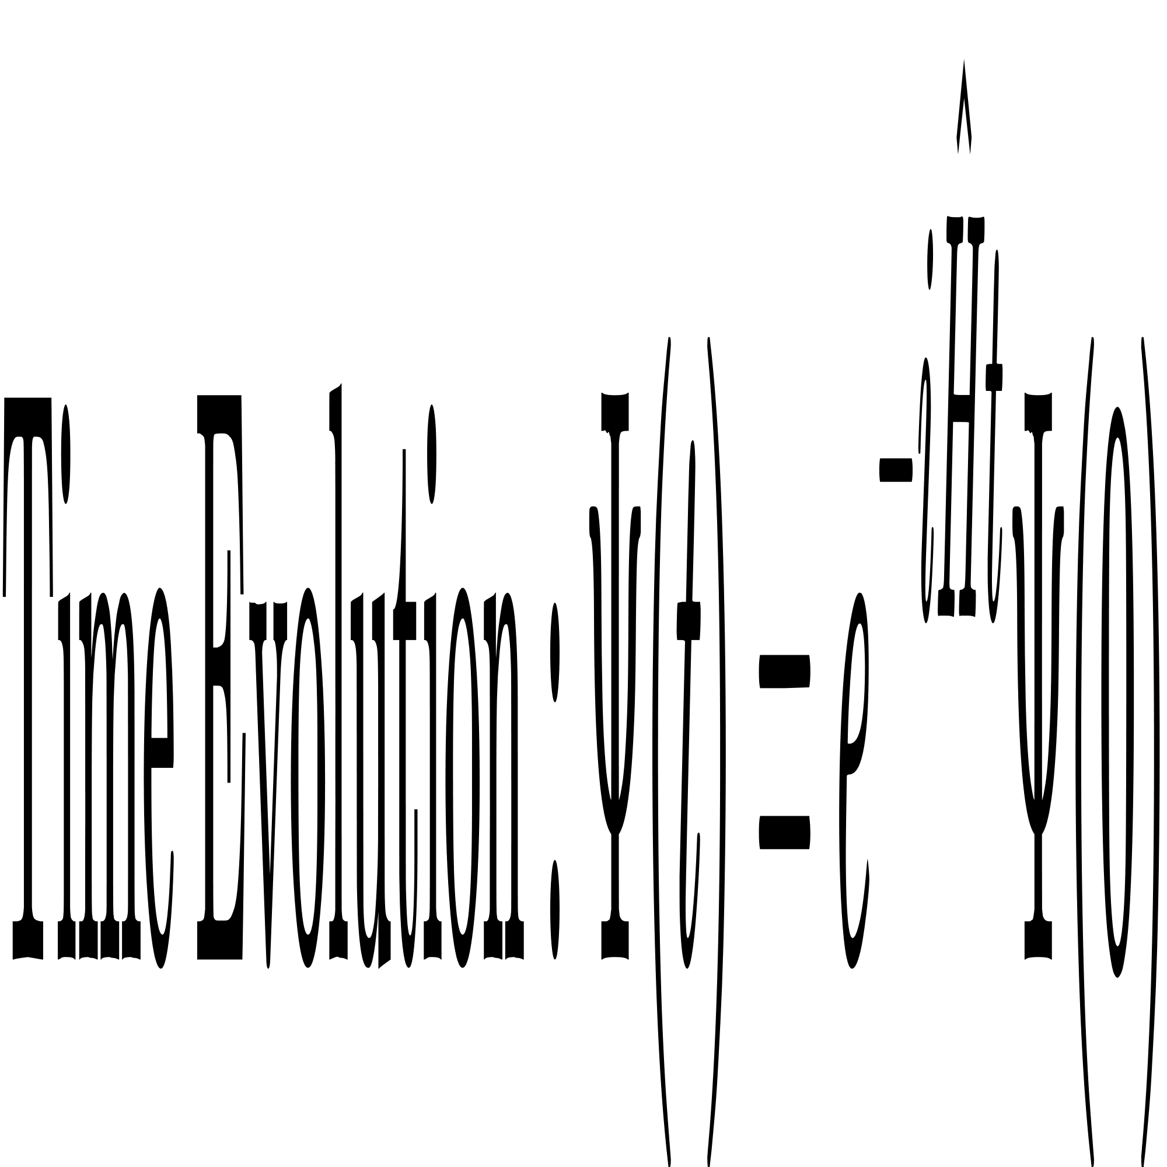
Time Evolution
The Trotter-Suzuki decomposition approximates the exponential of a sum of non-commuting operators. For two operators A and B, it is expressed as:
The Hamiltonian is composed of sum of Pauli Strings with different coefficients. So the time evolution operator :

Slide 11
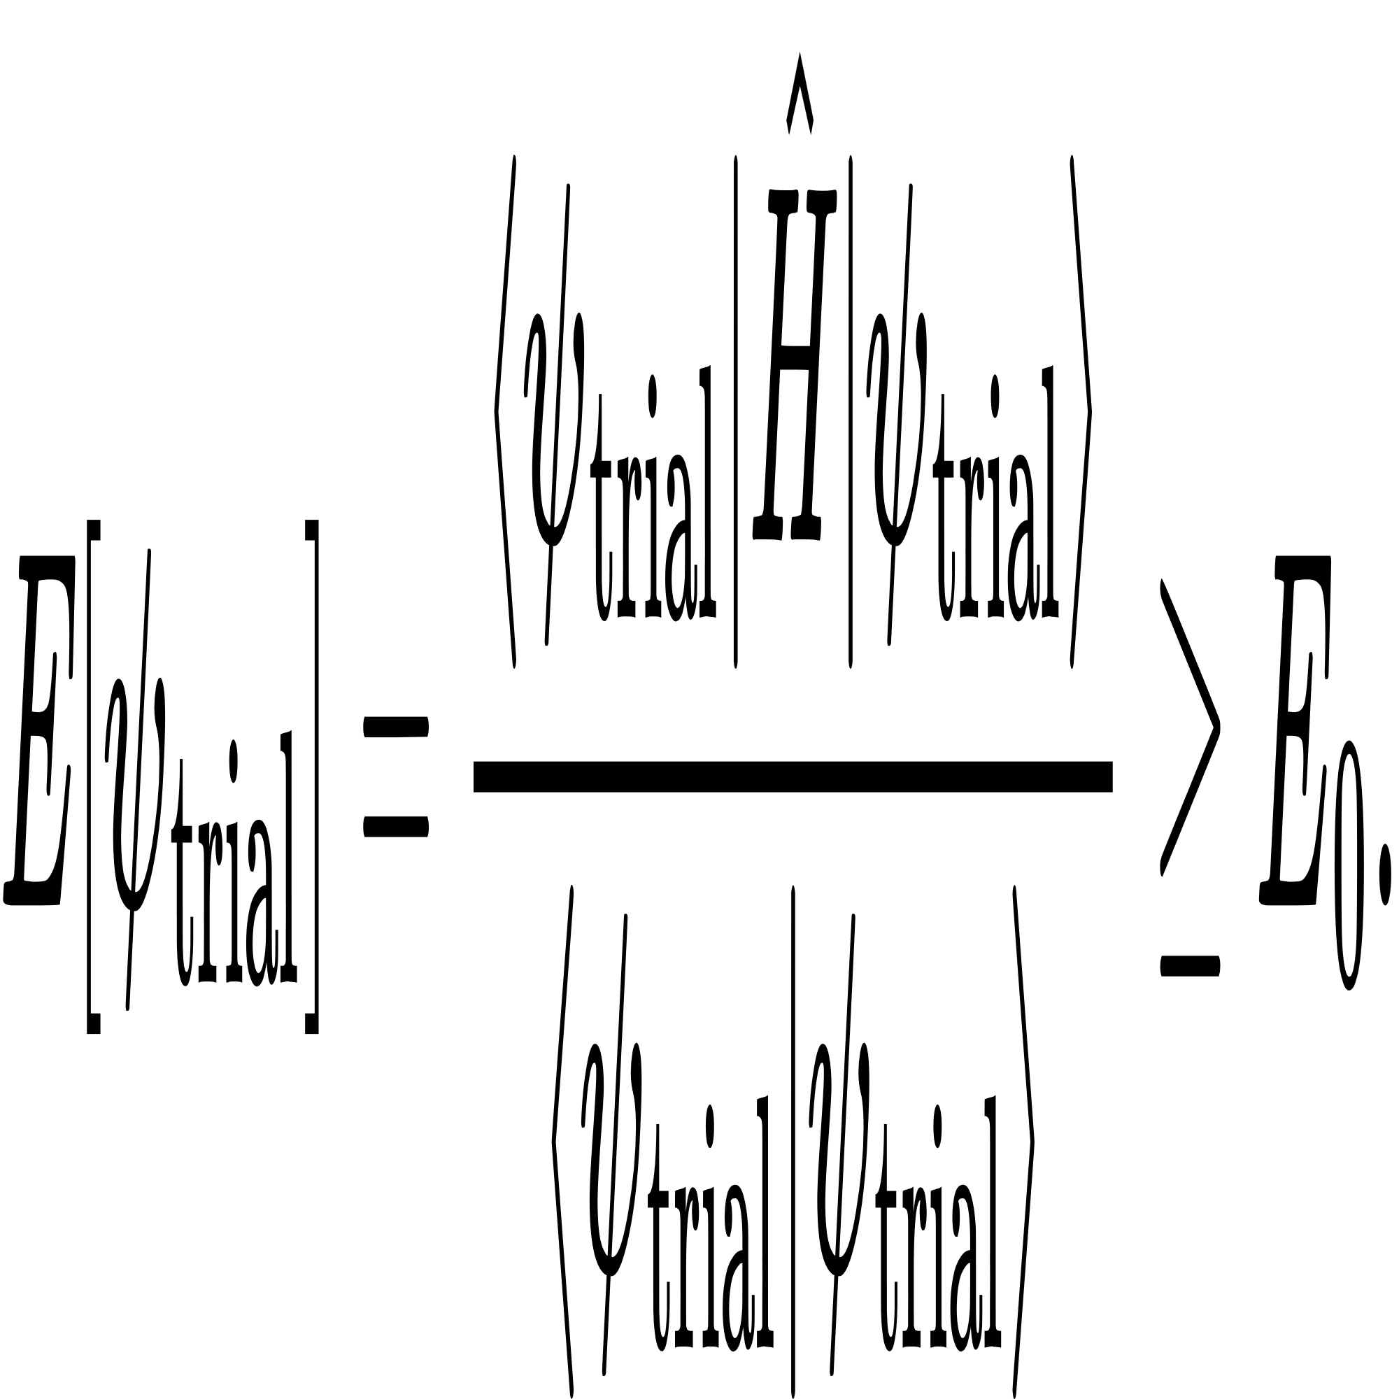
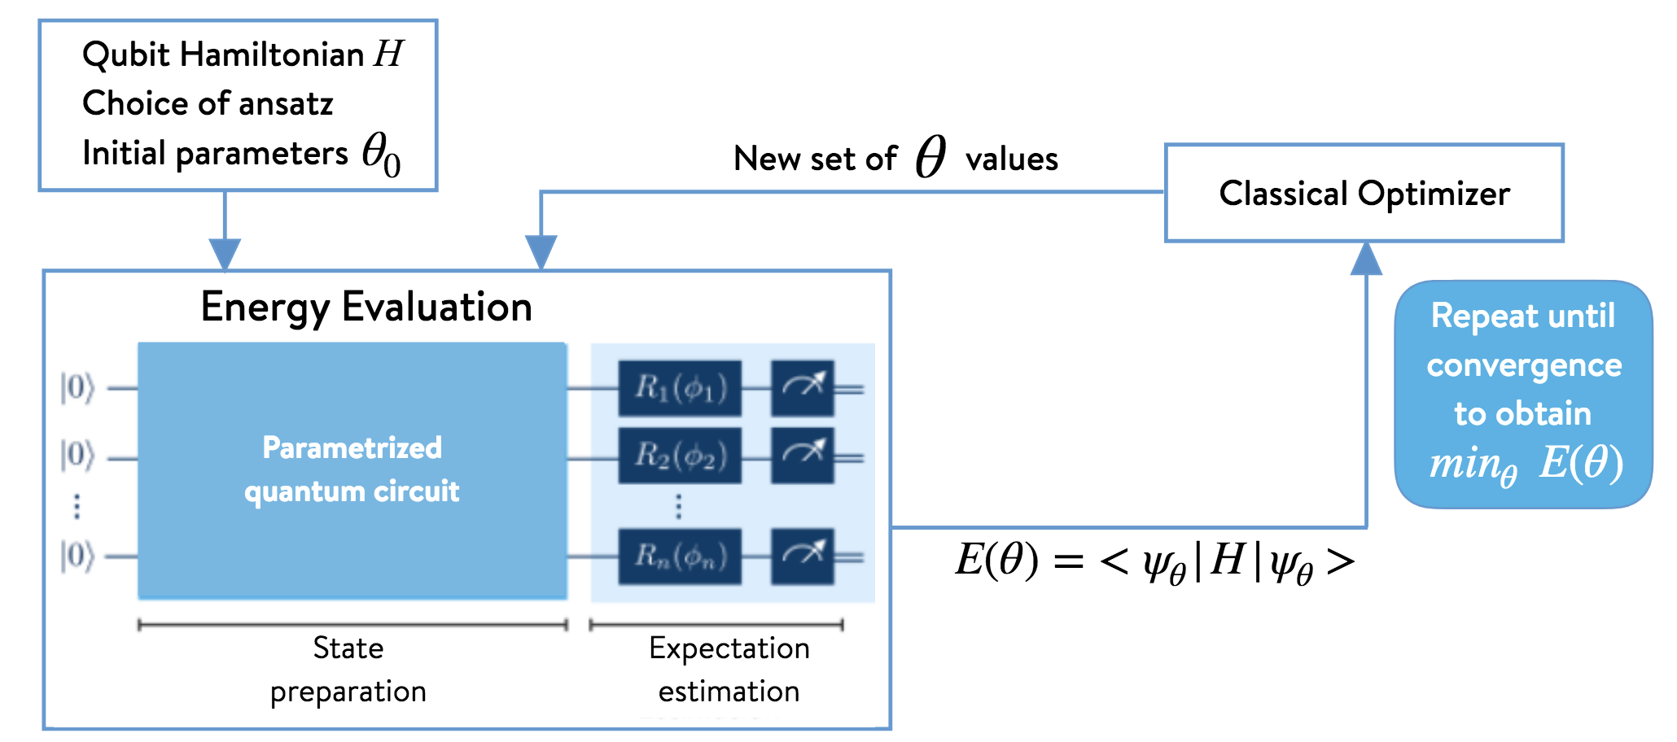
Ground State
For Ground State evaluation, we use Variational Quantum Eigensolver and Exact Diagonalization.
VQE is based on Variational Principle :

Slide 12
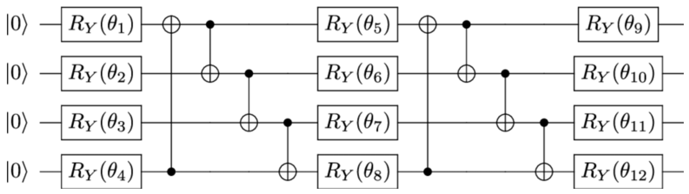
VQE & Exact Diagonalization
As we are working on a relatively small system, we can compare the results obtained by VQE with results obtained from Exact Diagonalization of the Hamiltonian
VQE Ansatz : The VQE Ansatz used for the problem is the Standard TwoLocal Ansatz.
FIG : Two Local Ansatz

Slide 13

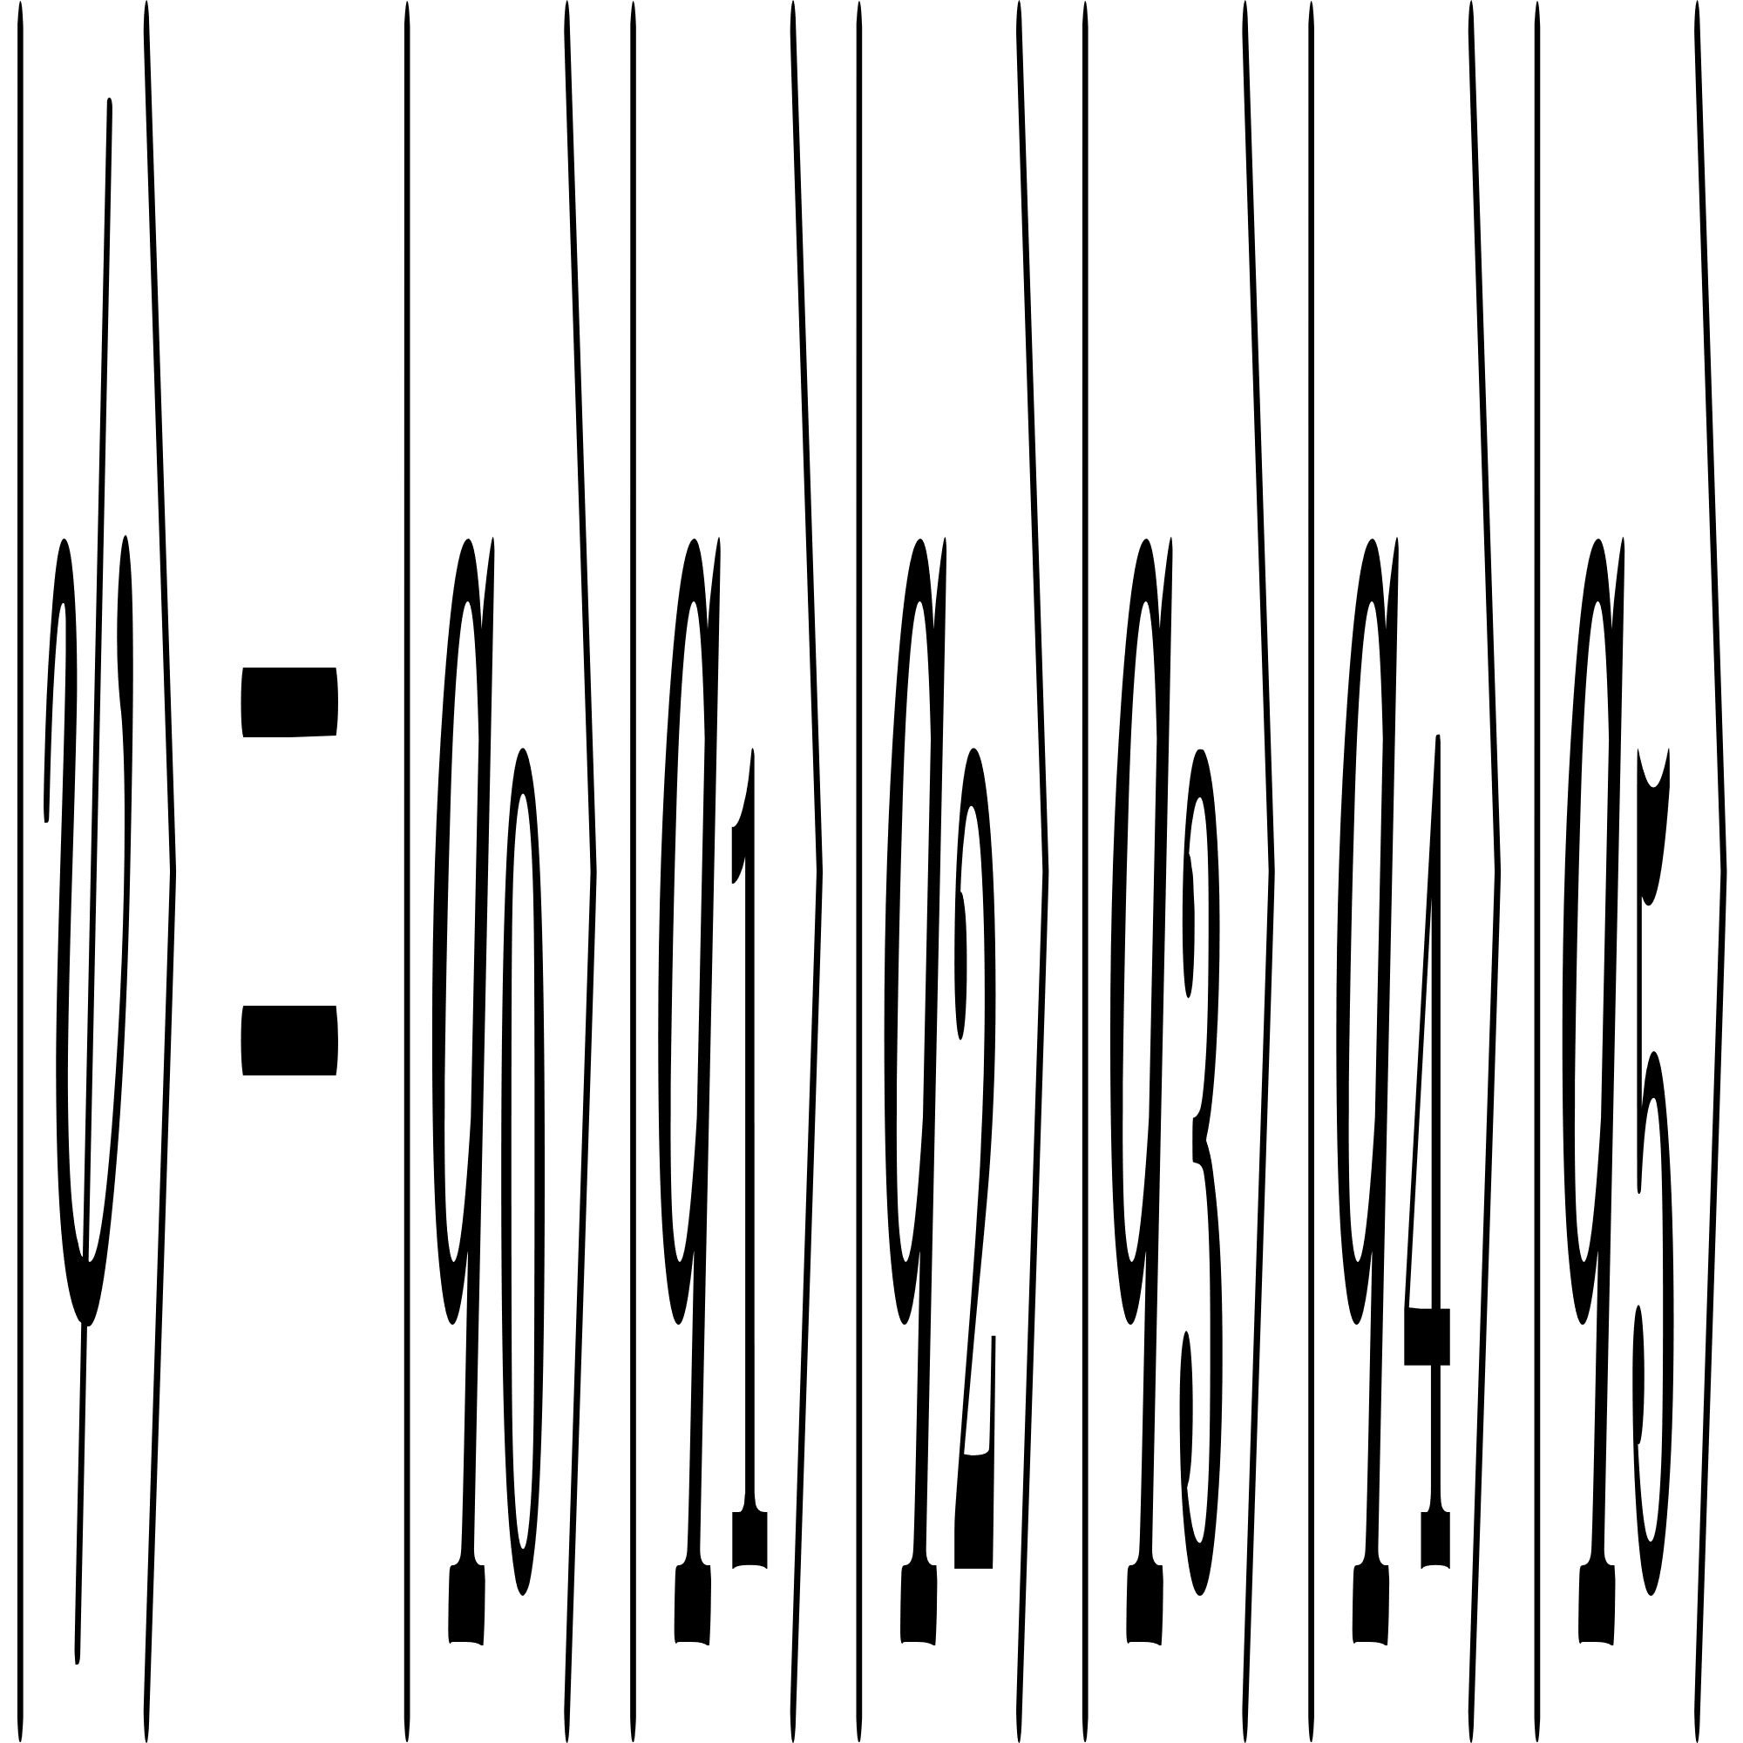
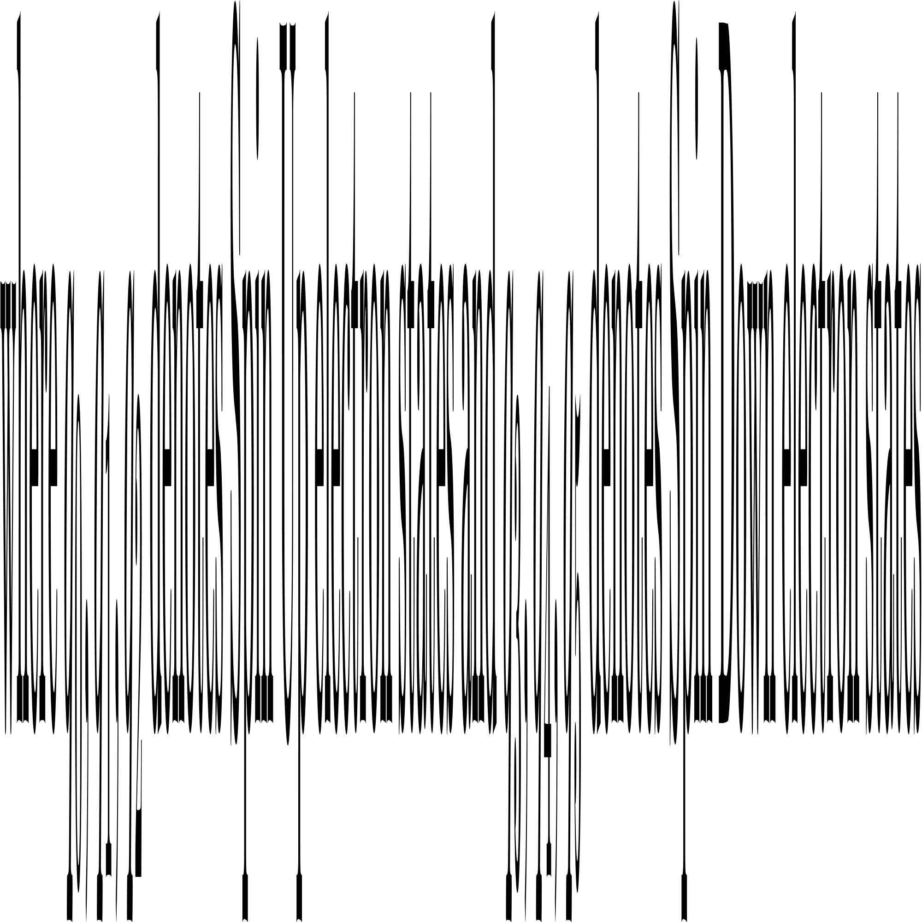
Application
We used IBM’s Qiskit Framework for Simulations.
Mapping : Each site in the 3-site chain is represented by two qubits, one for each spin, and the wavefunction is represented as
Mapping the Hamiltonian to Qubit system we obtain the Pauli Strings corresponding to the Hamiltonian.
For t = 2 & U = 2 :
[ [1.5, 'IIIIII'], [-0.5, 'IIIIIZ'], [-1.0, 'IIIIXX'], [-1.0, 'IIIIYY'], [-0.5, 'IIIIZI'], [-1.0, 'IIIXXI'], [-1.0, 'IIIYYI' [-0.5, 'IIIZII'], [-0.5, 'IIZIII'], [0.5, 'IIZIIZ'], [-1.0, 'IXXIII'], [-1.0, 'IYYIII'], [-0.5, 'IZIIII'], [0.5, 'IZIIZI'], [-1.0, 'XXIIII'], [-1.0, 'YYIIII'], [-0.5, 'ZIIIII'], [0.5, 'ZIIZII'] ]
Now let’s see some of the circuits........

Slide 14
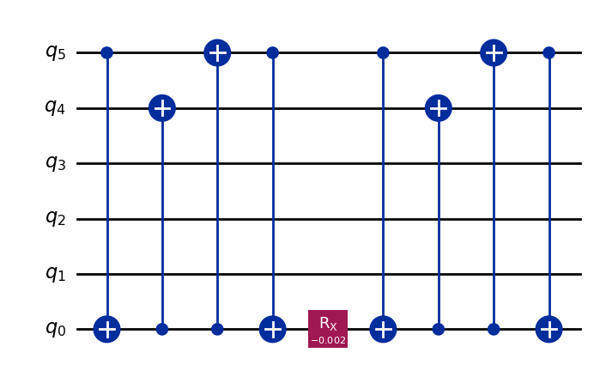
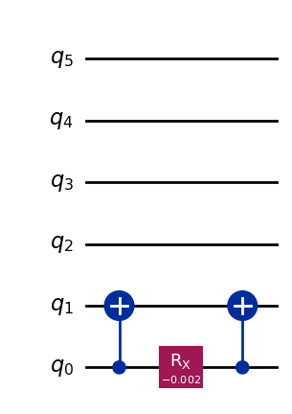
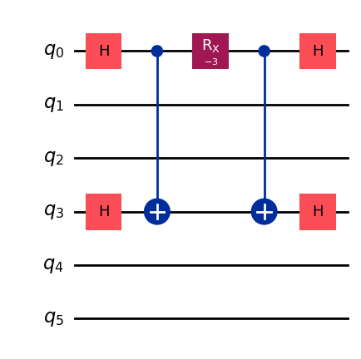
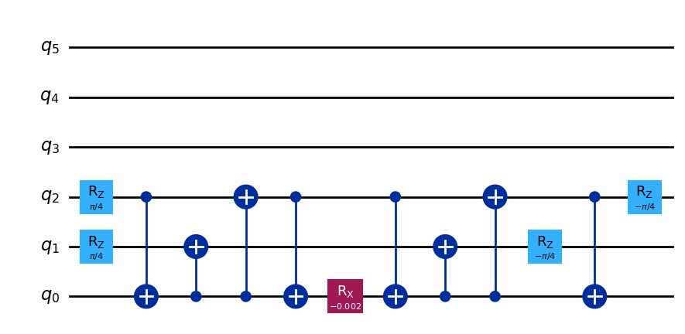
XXIIII
IIIIXX
IIIYYI
IIZIIZ

Slide 15
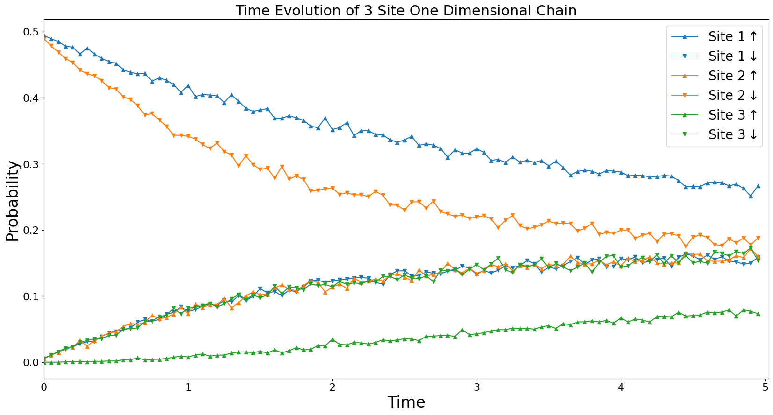
Results (Time Evolution)
t = 2 ; U = 2 ; N_up = 1, N_down = 1

Slide 16
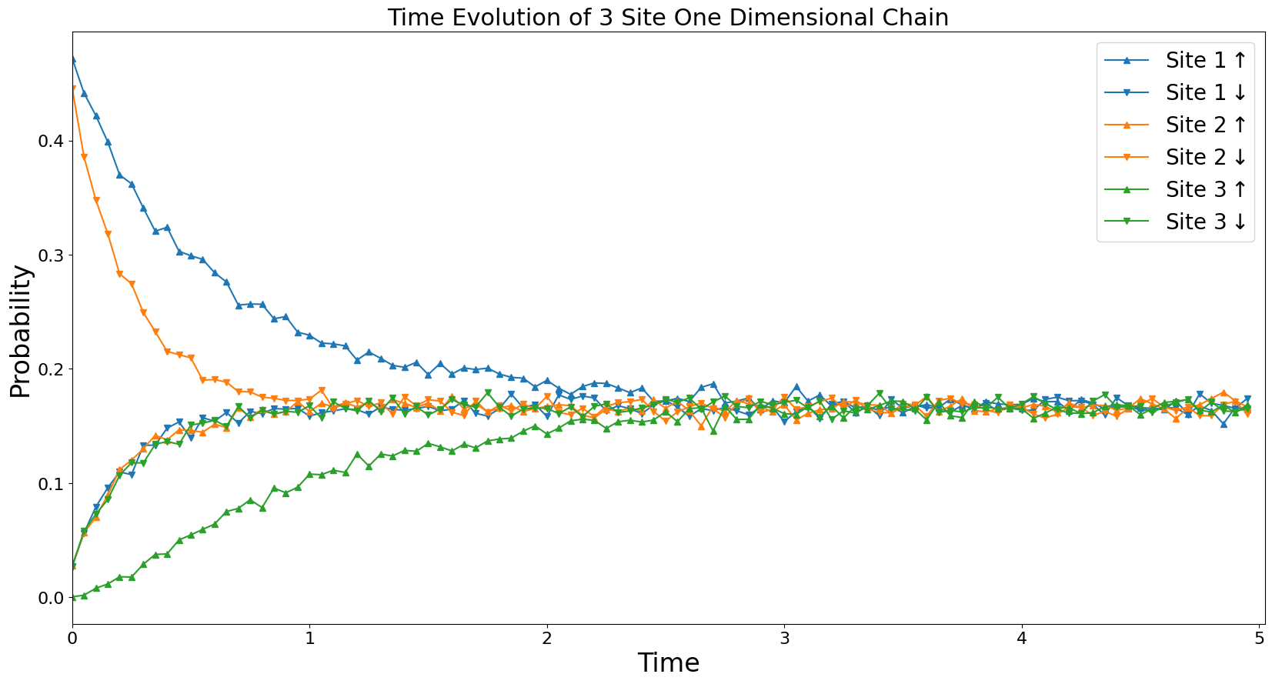
Time Evolution
t = 5 ; U = 2 ; N_up = 1, N_down = 1

Slide 17
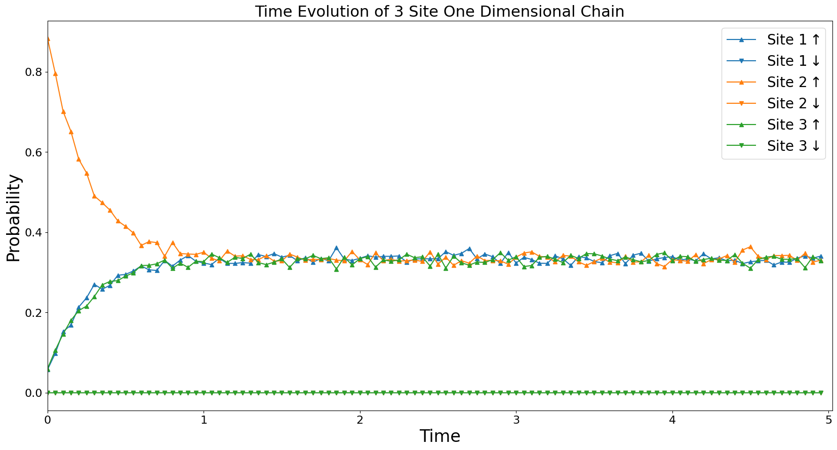
Results
t = 5 ; U = 2 ; N_up = 1, N_down = 0

Slide 18
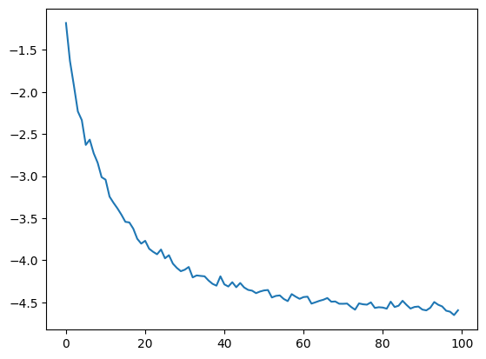
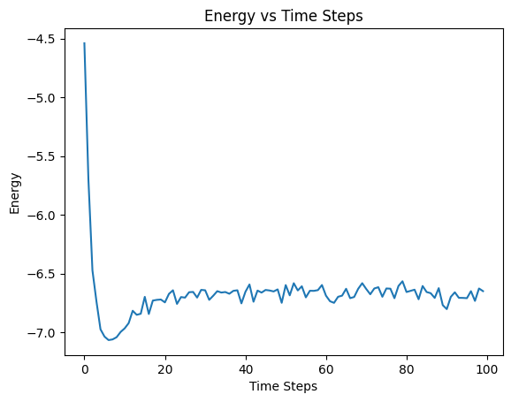
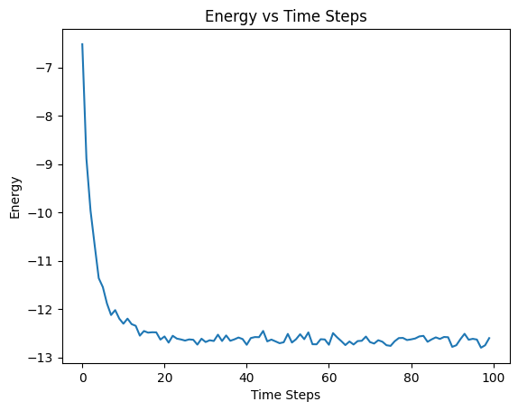
Results
Energy vs Time Steps
t = 5 ; U = 2 ;
N_up = 1, N_down = 1
Energy
Time Steps
t = 2 ; U = 2 ;
N_up = 1, N_down = 0
t = 2 ; U = 2 ;
N_up = 1, N_down = 1

Slide 19
Ground State
U = 1
t | VQE Value | Exact Value
1 | -2.4143371979407973 | -2.5079027713765565
2 | -5.136480969471321 | -5.310041275768474
3 | -7.9275827348250205 | -8.129265449421528
4 | -10.927723801407403 | -10.953015751171044
5 | -13.731722500762391 | -13.778613800545113
6 | -16.484464929236626 | -16.605145580947013
7 | -19.172344623574038 | -19.43221442828915
8 | -22.111744129670626 | -22.259620442080937
9 | -24.662907077525304 | -25.087251961624006
10 | -27.733616790958788 | -27.915041723242485

Slide 20
Ground State
t = 1
Self Term (U) | VQE Energy | Exact Energy
H.P.(t) | VQE Energy | Exact Energy
1 | -2.4732191463401605 | -2.5079027713765565
2 | -2.246834189936342 | -2.279452315768611
3 | -2.0561725920373507 | -2.117176177051358
4 | -1.9676804745649968 | -2.0000000000000075
5 | -1.8953083026965632 | -1.9132441962164446
6 | -1.7980233379939954 | -1.8472734917475302
7 | -1.7425936253846727 | -1.795831523312723
8 | -1.6634071613340767 | -1.754807491400075
9 | -1.7000170971279048 | -1.7214425080556355
10 | -1.6503544369990435 | -1.6938398392065253

Slide 21
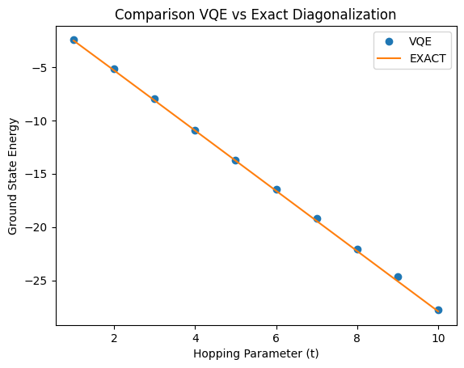
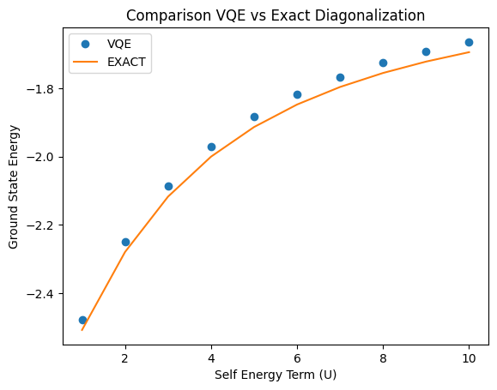
Ground State Energy

Slide 22
Conclusion & Future Aspects
We see that energy values from VQE almost matches with Exact Values.
The choice of Ansatz is very important for simulations. Among all the widely used ansatzes we see that TwoLocal gives the best result.
The main goal in future will be to modify the Scalable Circuit Architecture to implement Imaginary Time Evolution to find ground State of the system.
The Hubbard Model can further be applied to complex lattices like triangular, honeycomb lattice in 2D etc to observe their ground state properties and their dynamics.
Simulation of Bose Hubbard model can also be carried out using Scalable Quantum Circuits.

Slide 23
References
Scalable quantum circuits for exponential of Pauli strings and Hamiltonian simulations : Rohit Sarma Sarkar, Sabyasachi Chakraborty, Bibhas Adhikari
Quantum circuit architecture for Pauli strings exponentials : Saad Yalouz
Observing ground-state properties of the Fermi-Hubbard model using a scalable algorithmon a quantum computer : Stasja Stanisic et. al.
Elementary Introduction to Hubbard Model : A. Georges, G. Kotliar
https://www.ibm.com/quantum/qiskit

Slide 24
Acknowledgement
I am grateful to my guide Prof. Sonjoy Majumder for his constant guidance and motivation throughout the Project.
Special Thanks to Mr. Sabyasachi Chakraborty, Research Scholar, Dept. of Physics, IIT Kharagpur for being helpful and supportive in the project.
Thank You
Codes available @ https://github.com/abhinabakgp/masters_project

