Slide 1
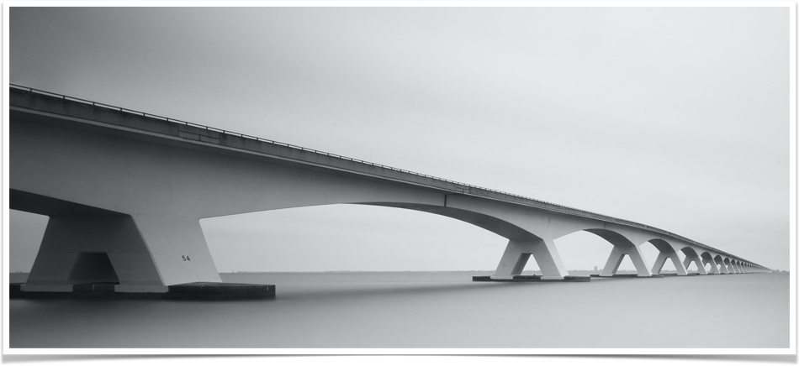
PREDICTING THE SEVERITY
OF ACCIDENT
Abhinand G K
The Project aim to understand the factors which play a role in the severity of accidents using Machine Learning Models.

Slide 2
Problem Understanding
Traffic accidents are a significant source of deaths, injuries, property damage, and a major concern for public health and traffic safety. Accidents are also a major cause of traffic congestion and delay.
The world as a whole suffer due to car accidents. Accurate predictions of severity can provide crucial information for emergency responders to evaluate the severity level of accidents, estimate the potential impacts, and implement efficient accident management procedures. Effective management of accident is crucial to mitigating accident impacts and improving traffic safety and transportation system efficiency.

Slide 3
Data Analysis
We have used U.S countrywide car accident dataset
The accident data are collected from February 2016 to June 2020, using two APIs that provide streaming traffic incident (or event) data.
Currently, there are about 3.5 million accident records in this dataset.
There were 3513637 accident records in this dataset. There were some missing data, because of lack of record keeping.

Slide 4
Exploratory Data Analysis
The characteristics data set contains information on the time, place, and weather and lighting conditions and type of intersection where it occurred.
An initial analysis of the data was performed for the selection of the most relevant features for this problem, reducing the size of the dataset and avoiding redundancy.
With this process the number of features was reduced from 38 to 20.

Slide 5
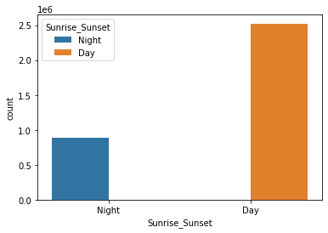
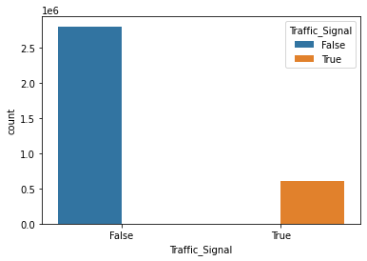
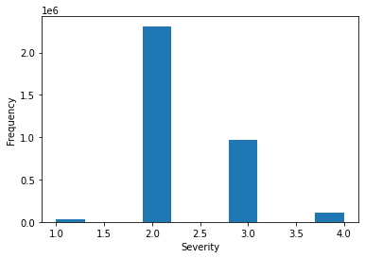
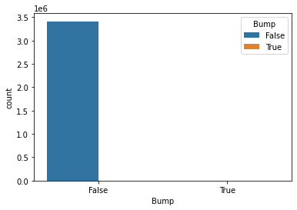
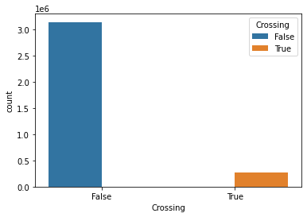

Slide 6
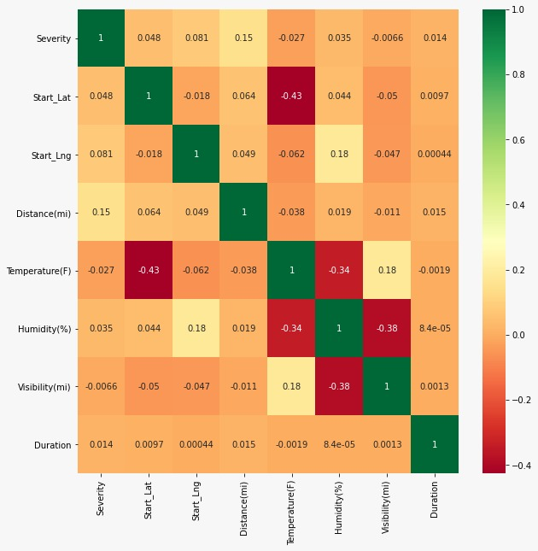

Slide 7
Features
Severity | Shows the severity of the accident, a number between 1 and 4, where 1 indicates the least impact on traffic (i.e., short delay as a result of the accident) and 4 indicates a significant impact on traffic (i.e., long delay).
Distance(mi) | The length of the road extent affected by the accident.
State | Shows the state in address field.
Temperature(F) | Shows the temperature (in Fahrenheit).
Visibility(mi) | Shows visibility (in miles).
Weather_Condition | Shows the weather condition (rain, snow, thunderstorm, fog, etc.)
Traffic_Calming | A POI annotation which indicates presence of traffic_calming in a nearby location.
Stop | A POI annotation which indicates presence of stop in a nearby location.
Station | A POI annotation which indicates presence of station in a nearby location.
Roundabout | A POI annotation which indicates presence of roundabout in a nearby location.
Railway | A POI annotation which indicates presence of railway in a nearby location.
No_Exit | A POI annotation which indicates presence of no_exit in a nearby location.
Junction | A POI annotation which indicates presence of junction in a nearby location.
Give_Way | A POI annotation which indicates presence of give_way in a nearby location.
Crossing | A POI annotation which indicates presence of crossing in a nearby location.
Bump | A POI annotation which indicates presence of speed bump or hump in a nearby location.
Amenity | A POI annotation which indicates presence of amenity in a nearby location

Slide 8
Predictive Modeling
Different classification algorithms have been tuned and built for the prediction of the level of accident severity.
These algorithms provided a supervised learning approach predicting with certain accuracy and f1 score. These two properties have been compared in order to determine the best suited algorithm for this problem.
Here preprocessing is done by standard scaler tool from scikitlearn library. After that the sample data is split into train and test data set in the ratio 80:20.

Slide 9
K-Nearest Neighbour
The K-nearest neighbours (KNN) algorithm is a type of supervised machine learning algorithms. KNN is extremely easy to implement in its most basic form, and yet performs quite complex classification tasks.
Here KNN is implemented with Python's Scikit-Learn library.
f1 score: 0.67519080668298
Accuracy score: 0.6754

Slide 10
Decision Trees
Decision Trees (DTs) are a non-parametric supervised learning method used for classification and regression.
The goal is to create a model that predicts the value of a target variable by learning simple decision rules inferred from the data features
f1 score: 0.67519080668298
Accuracy score: 0.6754

Slide 11
Logistic Regression
Logistic regression is a fundamental classification technique.
It belongs to the group of linear classifiers and is somewhat similar to polynomial and linear regression.
Logistic regression is fast and relatively uncomplicated, and it’s convenient for you to interpret the results.
Although it’s essentially a method for binary classification, here it is applied to multi-class problems as one verses other method.
f1 score: 0.6720916706047082
Accuracy score: 0.6774341492949696

Slide 12
Support Vector Machine (SVN)
Support vector machines (SVMs) are a set of supervised learning methods used for classification, regression and outliers detection.
The advantages of support vector machines are Effective in high dimensional spaces, Still effective in cases where number of dimensions is greater than the number of samples,
Uses a subset of training points in the decision function (called support vectors), so it is also memory efficient, Versatile: different Kernel functions can be specified for the decision function.
f1 score: 0.6774341492949696
Accuracy_score: 0.67319

Slide 13
Result
Algorithm | f1-score | Accuracy score
K-Nearest Neighbour(K=7) | 0.6720916706047082 | 0.67088
Decision Trees | 0.67519080668298 | 0.6754
Logistic Regression | 0.6720916706047082 | 0.67088
Support Vector Machine (SVN) | 0.6774341492949696 | 0.67207

Slide 14
Conclusions
In this study, I analyzed the relationship between various features and Traffic Accident Severity
These models can be very useful effective in management of accident, mitigating accident impacts and improving traffic safety accidents and thus the enhancement of road safety.
It is a major concern to societies due to the losses in human lives and the economic and social costs.
It could help identify the severity and it help to improve road transportation system efficiency.

