Slide 1
Digital Twin-Driven Deep Reinforcement Learning
for Energy-Aware CNC Milling Parameter Optimization
ME6324, AI in Manufacturing | Course Project Report
Abhinand • Department of Mechanical Engineering • IIT Madras
Git Revision: d76603b • All results reproducible from committed artifacts

Slide 2
Problem: Dynamic Cutting Parameter Optimization in CNC Face Milling
Choose spindle speed (n), feed (f_r), depth of cut (a_p) pass-by-pass to balance:
🎯 Productivity
Maximize Material Removal Rate: MRR = v_c · a_p · f_r
⚡ Energy Efficiency
Minimize total electrical energy per part (idle + cutting)
📏 Surface Quality
Finished roughness R_a ≤ 1.6 μm (ISO 1302)
🔧 Tool Life
Flank wear V_B ≤ 0.3 mm; avoid catastrophic breakage
Traditional fixed parameters from handbooks cannot adapt to tool wear, material variation, or geometry changes.

Slide 3
Approach: Physics-Grounded Digital Twin + Deep RL
🏭 Digital Twin
🤖 DRL Agent (PPO)
🔬 Experimental Rigor
Speed-dependent cutting energy: k_c(v_c) = k_c0 (v_c/v_ref)^m
Extended Taylor tool wear, anchored on a published tool life
Empirical surface roughness regression
Stochastic tool breakage
Domain randomization per episode
One Gymnasium environment for a part, one for a batch
Energy-aware reward: 100·(w₁·MRR − w₂·Energy) + progress − penalties
Conditioned policy: one model covers the full frontier
PPO with VecNormalize, 4 parallel envs, CPU training
100-scenario Monte Carlo with 95% CIs
Ablation: 7 energy weights × 3 seeds, weight pinned
5 classical baselines (incl. receding-horizon)
Robustness: 3 regimes against the controller
Regime map: the noise crossover against the controller
Batch: one tool cuts ten parts
Reward sensitivity: the objective form and scale
Transfer experiment
Full reproducibility

Slide 4
Positioning Against the Reference Papers
Capability | Mo et al. (2025) J. Manuf. Process 156 | Wang et al. (2025a) J. Manuf. Syst. 78 | This Work
Dynamic optimization | ✓ | ✓ | ✓
Tool wear in the state | ✓ | ✗ | ✓
Roughness constraint | ✓ | ✗ | ✓
Energy as an objective | ✗ | ✗ | ✓
Speed-dependent k_c | ✗ | ✗ | ✓
Domain randomization | ✗ | ✗ | ✓
Conditioned policy | ✗ | ✗ | ✓
Transfer experiment | ✗ | ✗ | ✓
Receding-horizon baseline | ✗ | ✗ | ✓
Robustness vs a controller | ✗ | ✗ | ✓
Noise crossover vs that controller | ✗ | ✗ | ✓
Monte Carlo (100 scenarios) | ✗ | ✗ | ✓
Interactive workstation | ✗ | ✗ | ✓
Mo et al.: PPO over a mixed action space (tool change + parameters); the state carries V_B, breakage and R_a; objectives are quality and efficiency.
Wang et al.: MATD3 for batch milling; objectives are dimensional quality and machining time.
Key differentiator: neither reference treats energy as an objective. The speed-dependent k_c is what creates a genuine energy/throughput trade-off, and one conditioned policy covers the whole frontier in a single run. None of the three carries a Taylor wear model, so the wear coefficient here is anchored on a published tool life.

Slide 5
Digital Twin Physics (MillingDT/config/physics.py)
Cutting Speed
v_c = π D n / 1000 [m/min]
💡 Key Insight
Material Removal Rate
MRR = v_c · a_p · f_r [mm³/min]
With m=0.6:
Cutting energy RISES with speed
Idle energy FALLS with speed
Part energy has INTERIOR MINIMUM
Energy weight w₂ selects operating point
Without it (m=0): both objectives push to
MAX speed → no trade-off at all
Wear: C_wear = 1.0e-2, anchored on a
published tool life (about 9 parts per tool)
Validated by a unit test on the part energy
Flank Wear Rate
ΔV_B = C_wear · v_c^α · f_r^β · a_p^γ · t_cut
Surface Roughness
R_a = k₁ f_r² + k₂ V_B + k₃ / v_c
Specific Cutting Energy
k_c(v_c) = k_c0 (v_c / v_ref)^m ← KEY: creates trade-off
Total Power
P_total = P_idle + k_c(v_c) · MRR
Energy per Pass
E_pass = P_total · t_cut

Slide 6
One Gymnasium Environment: MillingDTEnv-v1
State & Action
Reward & Randomization
Two registrations:
• MillingDTEnv-v1 (env.ENV_ID), 200-step limit, 11-D
• MillingDTBatchEnv-v1 (env.BATCH_ENV_ID), 13-D
• The weight and the material are inputs, not tasks
Observation (11-D, always the same shape):
0-7: V_B, κ_rem, prev n, f_r, a_p, MRR/MRR_max,
R_a, tool-broken flag
8-10: the context: w₂, C_wear [0.6,1.4], k₁ [0.8,1.2]
Action: continuous [-1,1]³ → clipped → machine envelope
Reward per step:
r = 100·(w₁·MRR/MRR_max − w₂·E_pass/E_ref)
+ 20·Δ(stock removed)
− 50·1[V_B > V_B_safe] − 100·1[broken]
− 50·1[finishing pass ∧ R_a > R_a_safe] − 0.05
+200 for a part finished in spec, +≤5 Pareto margin
w₁ = 1 − w₂; safety limits 0.255 mm and 1.36 μm
breakage p = 0.3·wear factor·(load factor)² above 0.15 mm
THE SCALE IS A DESIGN DECISION: the objective term is
worth about 50 points per part, a quarter of a part
Domain Randomization (--randomize):
• Workpiece: κ_total [2,15], D [40,150], L_cut [50,200]
• Material/Tool: C_wear [0.6,1.4]×, k₁,k₂,k₃ [0.8,1.2]× nominal
• Initial wear: V_B0 ~ U[0, 0.8]·V_B_max
• Energy weight drawn U[0,1] per episode
• Same tables for training + Monte Carlo eval
E_ref recomputed per scenario from its own D, L_cut, k_c

Slide 7
Reinforcement Learning: PPO (Stable-Baselines3)
Parameter | Value
Policy | MlpPolicy (2×256 hidden)
Learning rate | 3×10⁻⁴ (linear schedule)
n_steps | 2048
Batch size | 64
n_epochs | 10
γ (discount) | 0.99
GAE λ | 0.95
Clip range | 0.2
Entropy coeff | 0.02 (keeps the policy exploring)
VecNormalize | norm_obs=True, norm_reward=True
Envs / Device | 4 (SubprocVecEnv) / CPU (2.5× faster than GPU)
Training Runs
1️⃣ Production policy: 1M steps, seed 42
--randomize --randomize-weight
→ results/run_PPO_seed42/
2️⃣ Ablation grid: 7 weights × 3 seeds = 21 policies
w₂ ∈ {0.0, 0.2, 0.4, 0.5, 0.6, 0.8, 1.0}
seeds {42, 43, 44}, 150k steps each
weight PINNED at training, evaluated at that
same weight
3️⃣ Batch-aware policy: 1M steps on MillingDTBatchEnv-v1
4️⃣ Noisy-measurement policy: 1M steps, --obs-noise 0.05
Heartbeat callback: queue signal every 1000 steps
→ stall detection in run_experiments.py

Slide 8
Results: Production Policy, Monte Carlo Sweep (100 Scenarios)
Metric | Mean | Std | 95% CI
MRR (mm³/min) | 1608.5 | 550.7 | [1499.2, 1717.8]
Energy/part (kJ) | 66.4 | 48.0 | [56.9, 75.9]
Cycle time (s) | 11.4 | 6.9 | [10.1, 12.8]
Max R_a (μm) | 1.610 | 0.178 | [1.575, 1.645]
Max V_B (mm) | 0.1407 | 0.0672 | [0.1274, 0.1540]
Constraint | Rate | 95% CI
R_a viol., worst pass | 55.0% | [45.2, 64.8]%
R_a viol., finished surface | 4.0% | [0.2, 7.8]%
R_a above safety limit, worst | 87.0% | [80.4, 93.6]%
R_a above safety limit, finished | 4.0% | [0.2, 7.8]%
Flank wear violations (V_B > 0.3) | 0.0% | [0, 0]%
Tool breakage | 6.0% | [1.3, 10.7]%
Parts completed in spec | 94.0%
✅ Key Findings
• A much more aggressive operator than under the old reward: 1608.5 mm³/min against 1205.2, and 11.4 s per part against 20.3 s
• The price is paid in the tool and in the part quality: 6.0% tool breakage and 4.0% of the finished surfaces outside the roughness limit
• The roughing passes are rough: 87% of the worst passes are above the safety margin, 55% above the hard limit
• Wear is not the binding constraint on a single part (0% violations, mean 0.1407 mm); it binds on the aggregate of a batch
• Mean operating point: 7907 RPM, 0.318 mm/r, 2.07 mm, 4.0 passes

Slide 9
Energy Weight Ablation: Empirical Pareto Frontier
w₂ | MRR (mm³/min) | Energy (kJ) | Cycle (s) | n (RPM) | f_r (mm/r) | Frontier
0.0 | 1397.1±14.8 | 70.4±0.1 | 14.8 | 7998 | 0.299 | ✗ dominated
0.2 | 1456.9±14.6 | 70.0±0.1 | 13.8 | 7992 | 0.299 | ✗ dominated
0.4 | 1524.9±40.2 | 69.3±0.2 | 13.0 | 7896 | 0.296 | ✗ dominated
0.5 | 1556.6±9.7 | 69.1±0.2 | 12.7 | 7859 | 0.296 | ✓
0.6 | 1519.8±36.4 | 68.3±0.4 | 13.1 | 7638 | 0.296 | ✓
0.8 | 1224.4±11.3 | 63.0±0.2 | 15.4 | 6573 | 0.292 | ✓
1.0 | 918.5±14.9 | 57.2±0.2 | 20.1 | 5382 | 0.292 | ✓
📊 Frontier Analysis
• From w₂ = 0.5 to w₂ = 1.0 the removal rate falls 41% (1557 → 919 mm³/min) and the energy falls 17% (69.1 → 57.2 kJ): the trade-off is asymmetric
• The energy is bought with a lot of removal rate, and with time (12.7 → 20.1 s); the spindle speed falls with the weight (7859 → 5382 RPM)
• Dominated points (w₂ = 0.0, 0.2, 0.4) remove less for more
• Each policy has its weight pinned at training and evaluated at that same weight; 3 seeds, 50 scenarios each

Slide 10
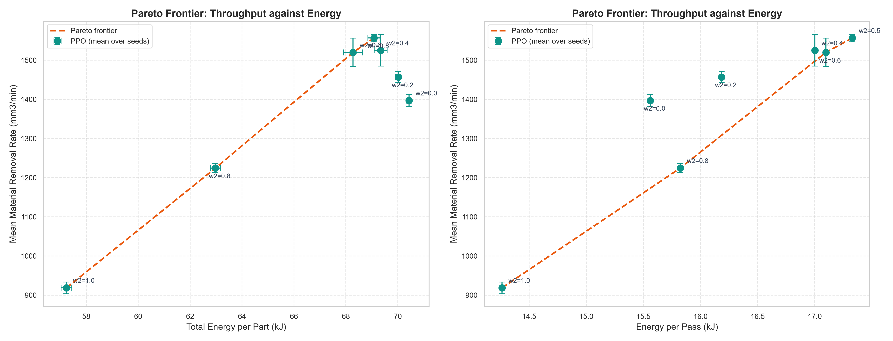
Ablation Frontier: Removal Rate against Energy
How to read this
Seven pinned-weight policies, three seeds each. The four non-dominated points are joined into the frontier: w₂ = 0.5, 0.6, 0.8 and 1.0, and the three dominated points sit off it. Left: the energy of a part. Right: the energy of a pass, which the reward charges.

Slide 11
One Policy Against 21 Policies
w₂ | MRR, one policy | MRR, per weight | MRR gap | Energy, one policy | Energy, per weight | Energy gap
0.0 | 1475.9 | 1397.1 | +5.6% | 68.4 | 70.4 | −2.9%
0.2 | 1518.0 | 1456.9 | +4.2% | 65.8 | 70.0 | −6.1%
0.4 | 1608.5 | 1524.9 | +5.5% | 66.4 | 69.3 | −4.2%
0.5 | 1630.3 | 1556.6 | +4.7% | 66.0 | 69.1 | −4.4%
0.6 | 1540.8 | 1519.8 | +1.4% | 65.5 | 68.3 | −4.0%
0.8 | 1114.5 | 1224.4 | −9.0% | 57.9 | 63.0 | −8.0%
1.0 | 720.4 | 918.5 | −21.6% | 51.7 | 57.2 | −9.7%
🎯 Result (the previous claim has reversed)
• Over the weights from 0.0 to 0.6 the single policy removes 1.4% to 5.6% more material for 2.9% to 6.1% less energy
• At w₂ = 0.8 and w₂ = 1.0 it is behind by 9.0% and 21.6% of the removal rate
• The weight in the observation is a weaker signal than a dedicated policy where the trade-off is steepest
• The same policy swept at runtime: MRR 1475.9 (w₂ = 0.0) → 720.4 (w₂ = 1.0), energy 68.4 → 51.7 kJ, spindle 8000 → 4111 RPM

Slide 12
Baseline Comparison (50 Episodes, Nominal Condition, w₂ = 0.4)
Policy | Reward | MRR (mm³/min) | Energy (kJ) | Cycle (s)
Constant high | 10.0 | 1099.6 | 17.8 | 4.3
NSGA-II static | 5.1 | 732.9 | 18.8 | 6.4
Rule based | 3.3 | 719.8 | 18.8 | 6.6
Receding-horizon | 253.5 | 725.5 | 19.0 | 6.7
Constant safe | −1882.9 | 1.6 | 385.7 | 768.0
Analysis
• Same 50 episodes of the nominal condition for all six policies, at w₂ = 0.4
• Three of the four static policies finish outside the roughness safety limit (1.56 μm against 1.36 μm): no completion bonus, the finishing penalty, so they land near zero
• Constant-Safe stays inside the limit (0.26 μm) but needs 768 s and 385.7 kJ per part: −1882.9
• Receding-horizon is the strongest baseline, +253.5, and the only classical policy that finishes every part in spec
• It pays for that with throughput: 725.5 mm³/min and 6.7 s against 1099.6 mm³/min and 4.3 s

Slide 13
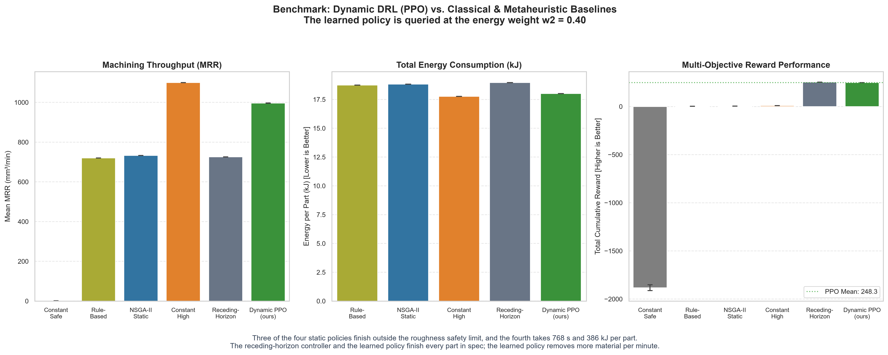
Policy Comparison: Six Policies, Same 50 Episodes
How to read this
The three fast static policies land near zero: they finish outside the roughness safety limit, so they are paid no completion bonus and are charged the finishing penalty. Constant-Safe stays inside but needs 768 s and 385.7 kJ per part. The comparison that matters is the receding-horizon controller against the learned policy, the only two with a positive reward.

Slide 14
Robustness Against the Classical Controller
Regime | Arm | Reward | Std | MRR | kJ | s | Broken | Done
Controller has every advantage | Receding-horizon | 248.9 | 79.5 | 1318.2 | 68.9 | 17.1 | 3% | 96%
 | PPO | 233.6 | 79.7 | 1608.5 | 66.4 | 11.4 | 6% | 94%
Material model is wrong | Receding-horizon | 63.5 | 117.1 | 1306.9 | 71.0 | 23.3 | 2% | 95%
 | PPO | 226.9 | 88.3 | 1604.2 | 66.3 | 11.5 | 6% | 94%
Wear measurement is noisy | Receding-horizon | 181.3 | 185.9 | 1300.4 | 74.2 | 31.1 | 4% | 91%
 | PPO trained with noise | 213.6 | 87.3 | 1554.2 | 66.9 | 12.0 | 6% | 94%
Same 100 randomized scenarios at w₂ = 0.4 in every row. The regime changes what the CONTROLLER is given, not what the policy is given.
🎯 The central result of the work
• Inside a perfect digital twin the two methods are comparable: 248.9 against 233.6, and the gap of 15 is inside the noise (the standard error of the mean is about 8 for both arms)
• The learned policy is the better throughput operator: 22% more material per minute, a third less time, 3.7% less energy, at twice the tool breakage
• The advantage appears where the controller's information advantage disappears: a wrong model of the material (63.5 against 226.9) and a noisy wear measurement (181.3 against 213.6). The regime map on the next slides puts a number on it
• About nine of those fifteen points are the reward's artifact: the controller cuts the part in 5.85 passes against 4.00 and is paid for every pass
• Fairness: both arms are the general ones, neither is trained for the noise, and the noise is tilted against the policy, which reads it on both measured quantities while the controller reads it on the wear alone

Slide 15
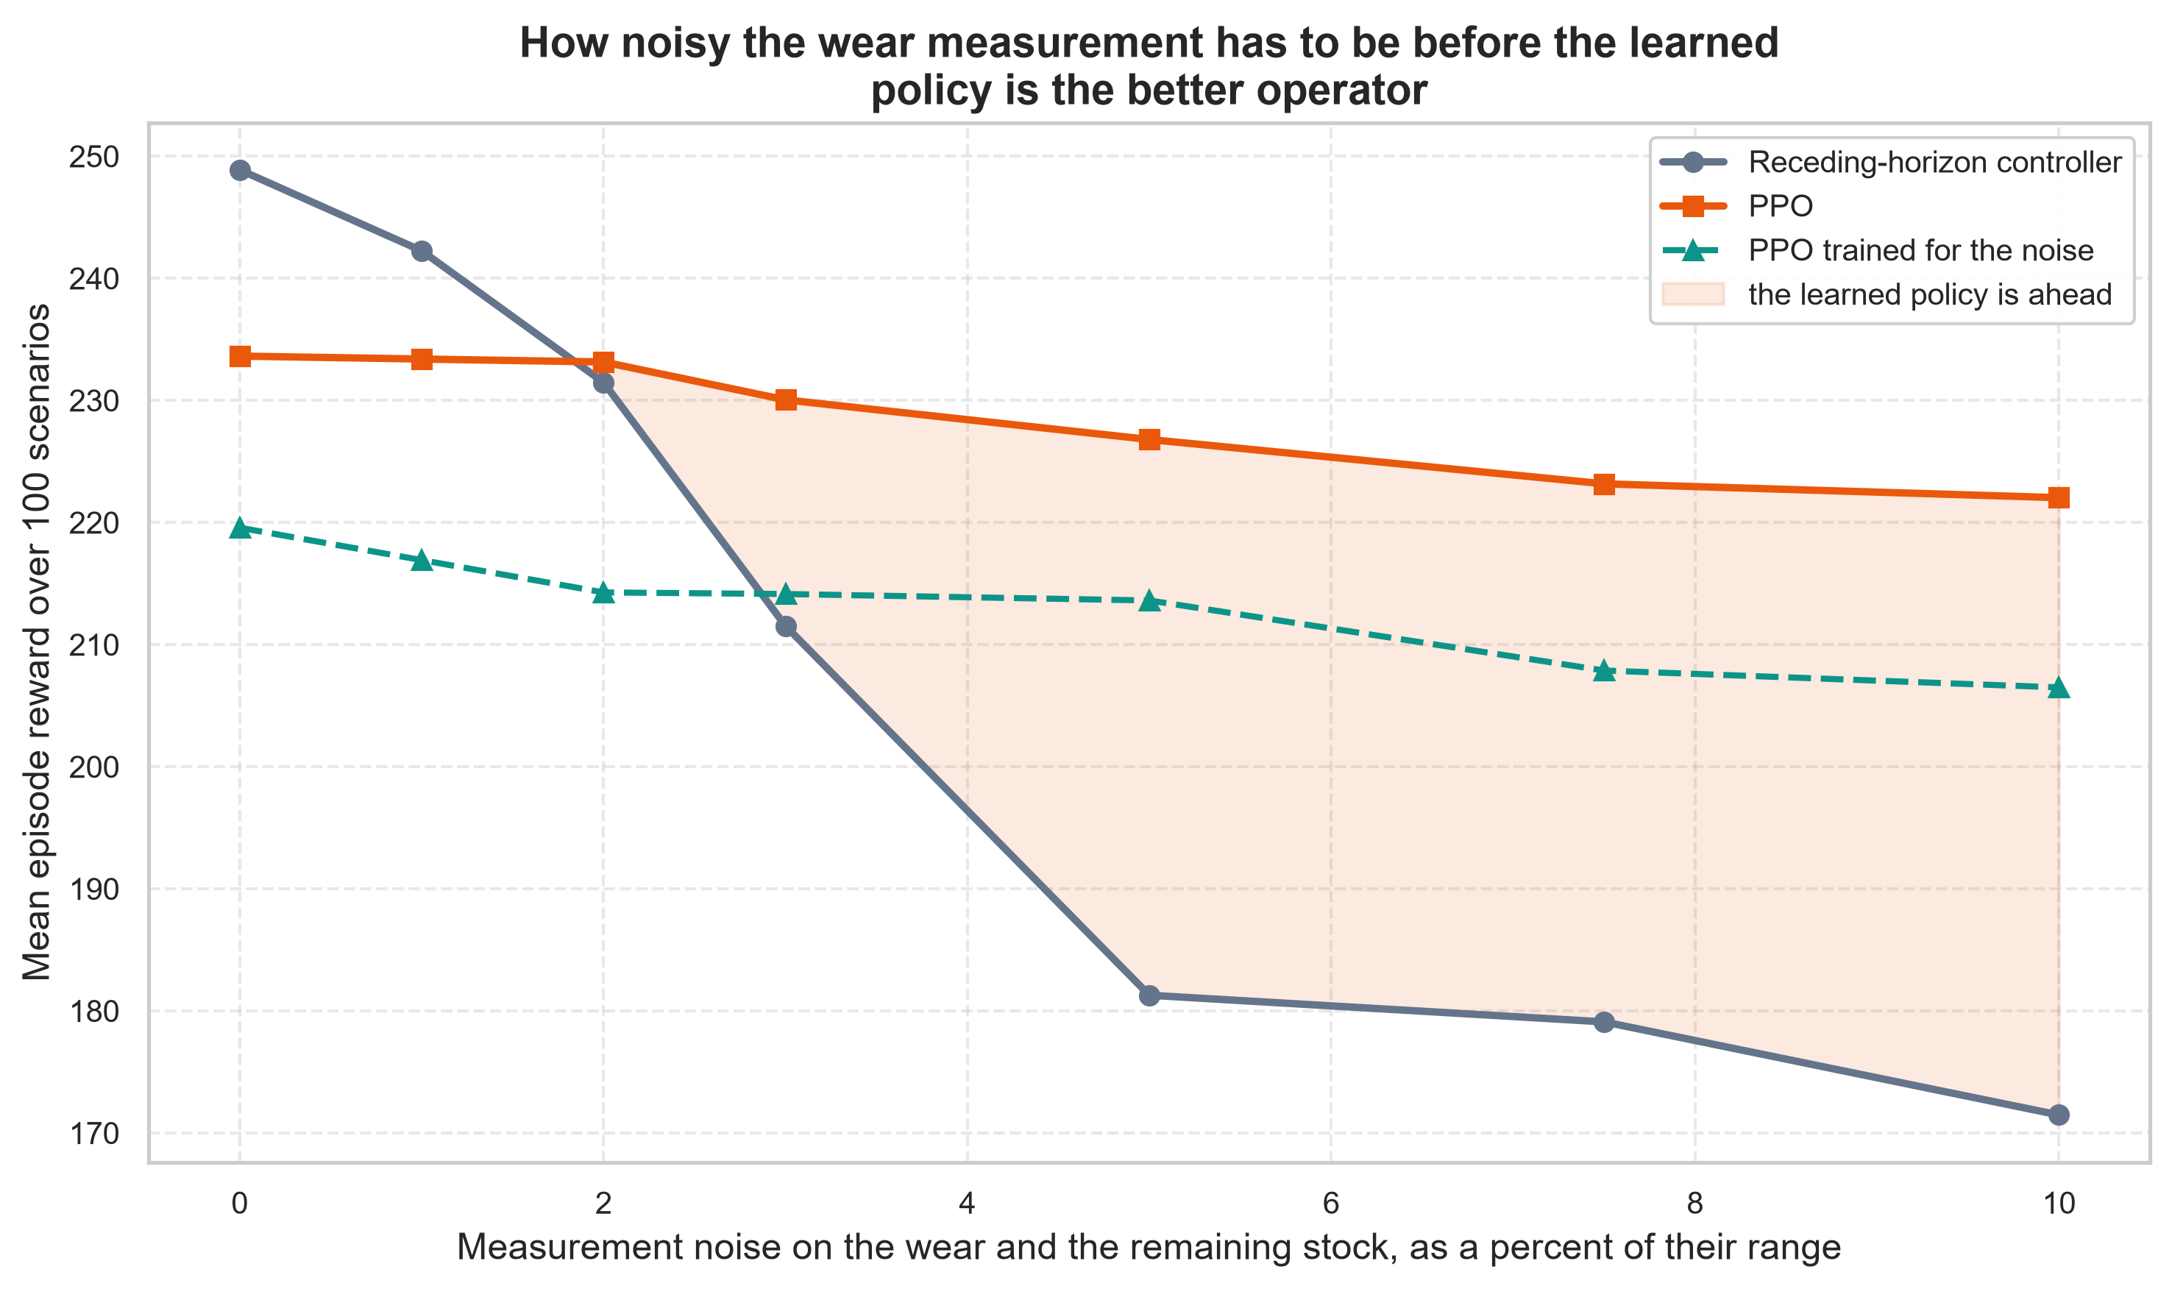
The Regime Map: How Noisy the Wear Measurement Has to Be
Measurement noise | Receding- horizon | PPO | PPO trained for the noise | PPO ahead by
0.0% | 248.9 | 233.6 | 219.6 | −15.3
1.0% | 242.3 | 233.4 | 216.9 | −8.9
2.0% | 231.5 | 233.1 | 214.3 | +1.7
3.0% | 211.5 | 230.0 | 214.1 | +18.5
5.0% | 181.3 | 226.8 | 213.6 | +45.5
7.5% | 179.1 | 223.2 | 207.9 | +44.1
10.0% | 171.5 | 222.0 | 206.5 | +50.6
Mean episode reward over the same 100 randomized scenarios at w₂ = 0.4. The noise is a fraction of the range of the flank wear and of the remaining stock. The last column is the general policy's reward minus the controller's.
The crossover is at about 2% of the range of the wear measurement
• Below it the classical controller is the better operator, above it the learned policy is: a plant that can measure the flank wear to better than 2% of its range has the better controller, one that cannot has the better policy
• The controller's curve falls away and the policy's is nearly flat, and the gap reaches 50.6 reward points at 10% noise

Slide 16
The Regime Map: How to Read It
Three readings
• The crossover is at about 2% of the range of the wear measurement. Below it the classical controller is the better operator, above it the learned policy is. That is the actionable form of the whole result.
• The two degrade differently. The controller falls from 248.9 to 171.5, a 31% loss, because a noisy wear reading makes its plan violate the limits and break tools. The policy falls from 233.6 to 222.0, a 5% loss, because a perturbed observation perturbs its action slightly. A model-based controller has a cliff, a learned policy has a slope.
• Training for the noise does not pay. The policy trained with the noise is below the general policy at every noise level, including the 5% it was trained for, where it scores 213.6 against 226.8. Its robustness comes from training across a distribution of scenarios.
The fairness decisions
• Both arms of the headline comparison are the general ones, neither is trained for the noise.
• The noise is tilted against the policy: the controller is given a noisy reading of the flank wear, the measurement it depends on, while the policy receives the noise on the flank wear and on the remaining stock.
• The noise-trained policy is a third, clearly labelled arm and not the headline, because a controller can also be prepared for a noisy instrument by widening its safety margin, and that is a design choice rather than a training one.
• Of the two degraded regimes the noise test is the fairer one, because the noise is a property of the instrumentation and not of the method.

Slide 17
Reward Sensitivity: How the Reward Pays for a Rate
The reward pays the removal rate of every pass, so the total credit grows with the number of passes a plan takes: a plan that cuts the same part in more, shallower passes is paid more for it. On the same 100 scenarios at w₂ = 0.4, measured by experiments/reward_sensitivity.py, the controller takes 5.85 passes against the policy's 4.00 and collects 27% more objective credit (+0.413 against +0.326) for the same material.
Objective scale | Shipped form (sum of the per-pass rates) |  |  | Alternative form (material against energy)
 | Controller | Policy | Gap | Controller | Policy | Gap
5 | 209.7 | 202.6 | +7.1 | 208.2 | 201.6 | +6.5
20 | 215.9 | 207.5 | +8.3 | 209.7 | 203.4 | +6.3
50 | 228.3 | 217.3 | +10.9 | 212.9 | 207.1 | +5.8
100 | 248.9 | 233.6 | +15.3 | 218.2 | 213.2 | +5.0
200 | 290.1 | 266.2 | +23.9 | 228.7 | 225.3 | +3.4
400 | 372.7 | 331.5 | +41.2 | 249.9 | 249.6 | +0.2
1000 | 620.2 | 527.2 | +93.0 | 313.2 | 322.6 | -9.4
4000 | 1857.9 | 1506.0 | +352.0 | 630.1 | 687.4 | -57.4
Three checks and the consequence
• The objective scale is not the lever: the controller leads at every scale from 5 to 4000 and the gap grows from 7.1 to 352.0 points, so the sign never flips
• The part level alternative was implemented and rejected: it removes the pass count from the accounting (5.0 points at the scale of 100 against 15.3, and the policy ahead by 9.4 at 1000 and 57.4 at 4000), but the material a part gives up is fixed by its stock, so the throughput weight would be inert
• A correct form is not obvious: a rate cannot be accumulated over a part without becoming a volume, so a reward has to price the cycle time directly or compare the part's average rate to a reference at the end of the part
• Consequence: the ideal case reads as a tie, not a win. The policy is ahead on the physical metrics and behind on the breakage, and the reward as shipped carries the artifact, documented rather than hidden

Slide 18
Batch Against the Part: One Tool, Ten Parts
Arm | Batch reward | Std | Reward/part | Tool changes | Batch time (s) | Batch energy (kJ)
PPO, batch aware | 1817.0 | 477.8 | 166.8 | 0.63 | 113.1 | 610.4
PPO, per part | 1709.9 | 366.1 | 169.4 | 0.83 | 114.7 | 674.3
Receding-horizon, per part | 1859.9 | 328.8 | 173.7 | 0.83 | 207.5 | 692.0
How to read this
• A batch is ten parts cut with one tool. The tool is replaced when it breaks or reaches its wear limit, and the replacement costs 500 reward units against the 200 a finished part is worth
• The observation is the eleven features of the part plus the tool life left and the fraction of the batch still to cut (MillingDTBatchEnv-v1, 13-D)
• The batch context is worth 24% fewer tool changes and 9.5% less energy at the same completion: 0.63 tool changes against 0.83, and 610.4 kJ against 674.3 kJ. It also collects more batch reward, 1817.0 against 1709.9
• The per-part controller gets the highest batch reward, 1859.9, and buys it with the machine time: 207.5 s for the batch against the batch-aware policy's 113.1 s, about 1.8 times the machine time for a reward that is 2.4% higher
• It solves one part at a time, so it cannot price a tool change against the parts that follow it

Slide 19
Controller Initialization: Method and Result
Question: does a policy that starts from the controller end up better than the expert it started from?
Method
Metric | Receding-horizon controller | PPO from scratch | PPO initialized from controller
Mean episode reward | 248.9 | 233.6 | 119.8
Reward std | 79.5 | 79.7 | 178.7
MRR (mm³/min) | 1318.2 | 1608.5 | 1274.9
Energy per part (kJ) | 68.9 | 66.4 | 81.5
Cycle time (s) | 17.1 | 11.4 | 42.6
Ra viol., finished | 2% | 4% | 4%
Flank wear violations | 1% | 0% | 9%
Tool breakage | 3% | 6% | 4%
Parts completed | 96% | 94% | 87%
1. Record the controller on 2000 episodes
2. Fit a supervised actor (2x256, Tanh) by
regression on those trajectories
3. Copy the fitted weights into a fresh PPO policy
4. Train with the production budget (1M steps),
evaluate on 100 scenarios at w₂ = 0.4
MillingDT/agent/controller_init.py
experiments/controller_experiment.py
Same 100 scenarios, same energy weight w₂ = 0.4
The initialized arm is the only one that exceeds the flank wear limit (9%)

Slide 20
Controller Initialization: What It Shows
The initialization is now harmful
The result reversed
• The initialized policy scores 119.8 against the from-scratch policy's 233.6, a gap of 113.8, more than fourteen times the standard error of the mean
• The clone starts the policy at the controller's conservative operating point, and with the wear constraint binding that conservatism is expensive
• It cuts a part in 42.6 s against 17.1 s and 11.4 s, and spends 81.5 kJ against 66.4 kJ
• It is the only arm that exceeds the flank wear limit (9%)
• The earlier revision found the initialization harmless: it made the policy more consistent and did not change the reward
• That was the reward not counting the cost of the slow operating point
• With the throughput counted, the initialization is what the measurement says it is
• What stays is the record and clone machinery, not the initialization itself
What the work claims
Inside a perfect digital twin the learned policy and the model-based controller are comparable: the policy is ahead on the physical metrics and behind on the breakage, and the gap the reward does show is partly the reward's artifact. Its advantage appears where the controller's information advantage disappears: the crossover is at about 2% of the wear measurement's range.

Slide 21
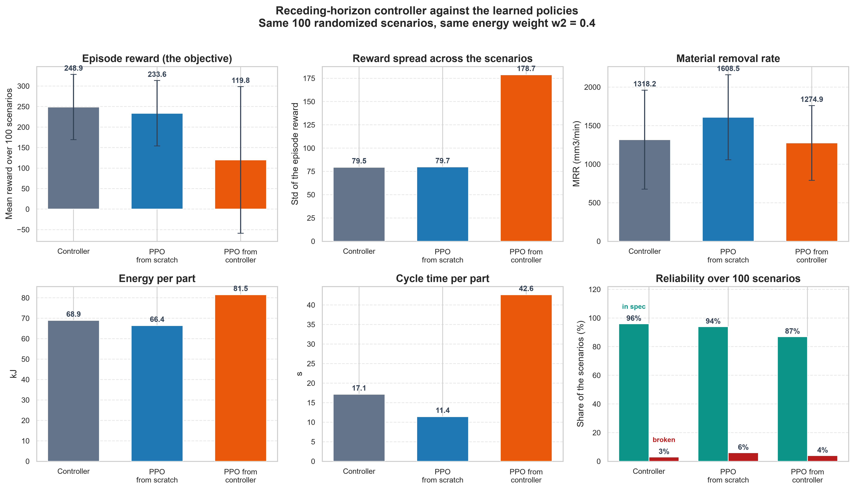
Controller Initialization: The Three Arms
How to read this
Six panels at slide size, so the values are in the table. The initialized arm sits 114 points below the from-scratch arm on the reward, and its spread of 178.7 is more than twice the spread of the other two: the initialization does not buy consistency any more, it buys variance.

Slide 22
Transfer Experiment: Cross-Material Adaptation
🎯 Target material (harder alloy, same machine): k₁ × 1.25, k₂ × 1.30, C_wear × 2.0. The source policy was trained for 300,000 steps on the nominal material; the adaptation budget on the target is 50,000 steps.
Arm | Mean reward | R_a violations (worst pass) | R_a violations (finished surface) | Parts completed
Source policy, zero shot | 168.5 | 100.0% | 6.7% | 86.7%
Source policy, fine tuned (50k) | 101.9 | 26.7% | 0.0% | 86.7%
Trained on the target from scratch (50k) | 101.9 | 26.7% | 0.0% | 86.7%
Production policy, zero shot | 190.1 | 100.0% | 10.0% | 90.0%
⚠ How to read this
• The production policy was trained across a distribution of materials with the material context in its observation, so the harder material is inside its training distribution and it needs no adaptation at all
• It scores the highest reward (190.1) and completes 90.0% of the parts; its worst pass violates the roughness limit in every scenario, and its finished surface in 10.0% of them
• Adaptation repairs the roughness and costs more than it gains: fine tuning the nominal-trained policy for 50,000 steps, or training on the target from scratch, both cut the worst-pass violations to a quarter and land at 101.9 against the source policy's 168.5 zero shot
• The target alloy wears the tool twice as fast, and a policy that slows down for that trades away more throughput than it gains in specification

Slide 23
Interactive Digital Twin Workstation (Streamlit)
📐 2D Stock Depletion
Cylindrical billet cross-section; pass-by-pass cutout; remaining κ, a_p; tool engagement diagram
📊 Micro-Topography
Feed-mark cusp profile: y_cusp(x) ≈ x²/(8r_ε) + noise; ISO 1302 R_a overlay with 1.6 μm ceiling
📝 G-Code Generator
ISO 6983 Fanuc/Siemens compliant; emits exact PPO parameter sequence; tool/diameter aware
⚔️ Multi-Controller
Side-by-side: PPO vs NSGA-II vs Rule-Based vs Constant-High; live telemetry overlay
⚡ Cached Loading
@st.cache_resource loads 1M-step PPO model once per session
Launch: streamlit run app.py

Slide 24
Software Engineering: Reproducibility & Quality
Architecture & Reproducibility
Test Coverage & Quality
Architecture:
MillingDT/ → config, env (part + batch), agent
(controller init), baselines, sim, utils
experiments/ → train, eval, ablation, baselines,
transfer, controller, robustness, regime
map, batch, reward sensitivity, pipeline
viz/ → shared plotting utilities
results/ → one directory per run
Reproducibility:
• Global seeding (Python, NumPy, PyTorch, CUDA)
• Shared scenario tables (train = eval)
• experiments/summarize_results.py regenerates RESULTS.md
• All randomness deterministic given seed
• Centralized constants and paths (MillingDT/config/)
Testing (45 tests):
• 24 env tests: clipping, truncation, soft norm, 11-D
observation, constants, overrides, energy norm, Gym
checker, randomization, scenario scales, context
(weight, material, belief), observation noise, speed
dependence, energy minimum, reward golden values
• 11 batch env tests: the 13-D observation, the tool
life and the batch left, the wear carried over, the
tool change, the batch reward, the seeded reproducibility
• 5 integration, 3 callback, 2 training
Code Quality:
• No unused imports (AST verified)
• Conventional commits, clean git history

Slide 25
Discussion: What Worked, Limitations, Future Work
✅ What Worked
⚠️ Limitations
🚀 Future Work
Speed-dependent k_c creates genuine trade-off
The reward scale decides the operating point: 50 points per part
Domain randomization → 94% completion
One policy covers the range, ahead over w₂ = 0.0 to 0.6
Training across materials makes the adaptation unnecessary
Receding-horizon = strong, fair baseline (184.3 → 248.9)
Robustness: comparable inside a perfect twin, and the advantage appears where the controller's information runs out
The regime map puts a number on it: the crossover is at about 2% of the range of the wear measurement
Measuring the reward found the artifact: the credit grows with the number of passes
Batch context: 24% fewer tool changes, 9.5% less energy
Inside a perfect twin the two methods are comparable: 248.9 against 233.6, the gap inside the noise, and about nine of those points are the reward's artifact
The learned policy is the better throughput operator, at twice the tool breakage
The crossover at 2% is a property of this controller, this reward and this noise model
Initializing from the controller is now harmful: 119.8 against 233.6
The reward pays a rate per pass, so the credit grows with the number of passes: the bias is in the reward, and the scale is not the lever
The wear tool life varies by only a factor of a few across the envelope
Ablation uses 150k steps/weight (vs 1M production); sim-only, no real calibration yet
A reward that pays a rate correctly: price the cycle time directly, or compare the part's average rate to a reference at the end of the part
Publish the sensitivity of any comparison to the reward form, as it is here
Compare against a restricted controller (is the gap an information gap?)
Measure the crossover under a controller prepared for a noisy instrument, and on the noise of a real instrument
Sim-to-real: calibrate on machine data, add noise/delay
True multi-objective RL (Pareto-conditioned, hypervolume)
Online adaptation: runtime w₂ optimizer for energy budget
Batch-level planning: optimize the whole batch, not a part

Slide 26
Conclusion
🏭 Digital Twin: speed-dependent cutting energy, tool wear, roughness, breakage; the wear coefficient is anchored on a published tool life
🤖 Two environments: the part (11-D) and the batch of ten parts cut with one tool (13-D), both with domain randomization
📊 One production policy (1M steps): the energy weight is a runtime query, not a retrain
🔬 Monte Carlo (100 scenarios, 95% CIs), ablation frontier, sweep against the 21 per-weight policies
⚔️ Five classical baselines on the same 50 episodes; the receding-horizon controller is the strongest at +253.5
🛡️ Robustness: comparable inside a perfect twin (248.9 against 233.6, the gap inside the noise and partly the reward's artifact); the controller collapses to 63.5 and 181.3, the policy holds at 226.9 and 213.6
🗺️ Regime map: the crossover between the two operators is at about 2% of the range of the wear measurement. Below it the classical controller is the better operator, above it the learned policy is
⚖️ Reward sensitivity: the reward pays a rate per pass, so the credit grows with the pass count; the controller collects 27% more credit for the same material
📦 Batch: the batch context is worth 24% fewer tool changes and 9.5% less energy; the per-part controller needs 207.5 s against 113.1 s
🧬 Controller init: the result reversed, the initialization is now harmful (119.8 against 233.6)
🔄 Transfer: the production policy needs no adaptation; the nominal-trained one does
🖥️ Interactive workstation and full reproducibility: every result table from committed artifacts by one script
Key Scientific Finding: The speed-dependent specific cutting energy creates a genuine energy/throughput trade-off. Across the frontier the removal rate falls 41% while the energy of the part falls 17%, and one conditioned policy reaches that whole frontier at runtime. Against a model-based controller the claim is a boundary, not an advantage: inside a perfect digital twin the two methods are comparable, and the learned policy is the better operator once the wear measurement is noisier than about 2% of its range.

Slide 27
Reproducibility: All Commands Run from Project Root
Tests
pytest tests/ -v
Production policy
python -m experiments.train_rl --steps 1000000 --seed 42 --randomize --randomize-weight
One pinned weight
python -m experiments.train_rl --steps 150000 --seed 42 --randomize --w2 0.6
Noisy measurement
python -m experiments.train_rl --obs-noise 0.05 --run-name PPO_noisystate_seed42
Batch policy
python -m experiments.train_rl --env-id MillingDTBatchEnv-v1 --run-name PPO_batch_seed42
Ablation grid
python -m experiments.train_rl_ablation --steps 150000 --scenarios 50 --slots 7
Monte Carlo eval
python -m experiments.evaluate --scenarios 100
Weight sweep
python -m experiments.evaluate --sweep-weight --scenarios 100
Compare with per-weight policies
python -m experiments.evaluate --compare-only
Classical baselines
python -m experiments.run_baselines
Transfer experiment
python -m experiments.transfer_experiment 300000 50000
Controller initialization
python -m experiments.controller_experiment 1000000 2000
Robustness experiment
python -m experiments.robustness_experiment
Regime map
python -m experiments.regime_map
Batch experiment
python -m experiments.batch_experiment
Reward sensitivity
python -m experiments.reward_sensitivity
Regenerate RESULTS.md
python -m experiments.summarize_results
Launch workstation
streamlit run app.py
Full pipeline
python -m experiments.run_pipeline --steps 1000000 --ablation_steps 150000

Slide 28
Thank You
Questions & Discussion
Repository: G:/My Drive/IITM/AI in Mfg
All code, data, results, and documentation in the repository
ME6324, AI in Manufacturing • IIT Madras

