Slide 1


Web Development

Slide 2
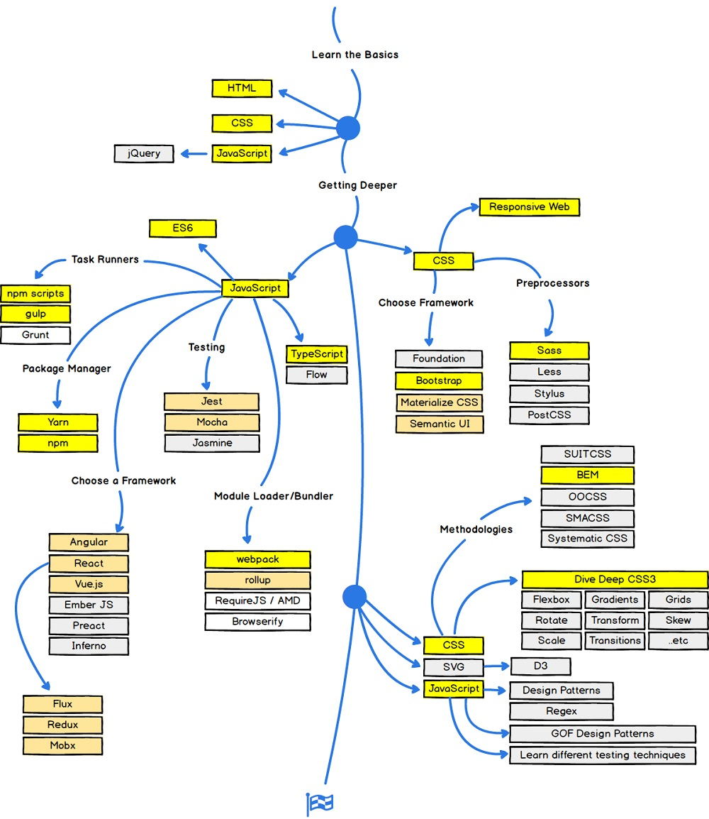
Road Map to becoming a Web Developer

Slide 3




Accesing a WebPage

Slide 4
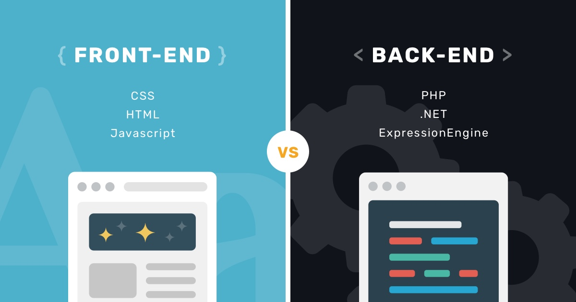

Slide 5
Webpage
HTML
CSS
Java Script
Front End
Back End
PHP
Python
Java
Ruby

Slide 6
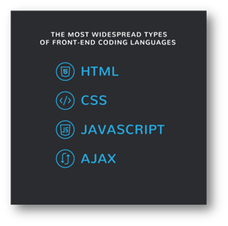
THE TOP BACK-END CODING LANGUAGES
PHP
Python
Ruby
JAVA

Slide 7
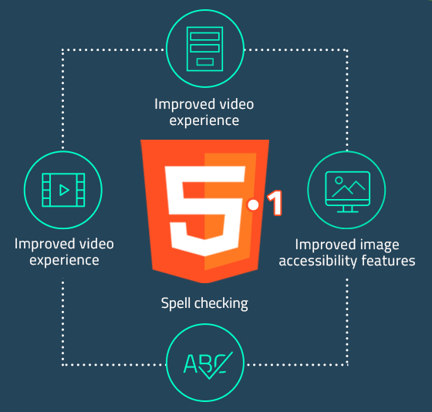
Why HTML 5? HTML CheatSheet

Slide 8
Let's Get Started!

Slide 9
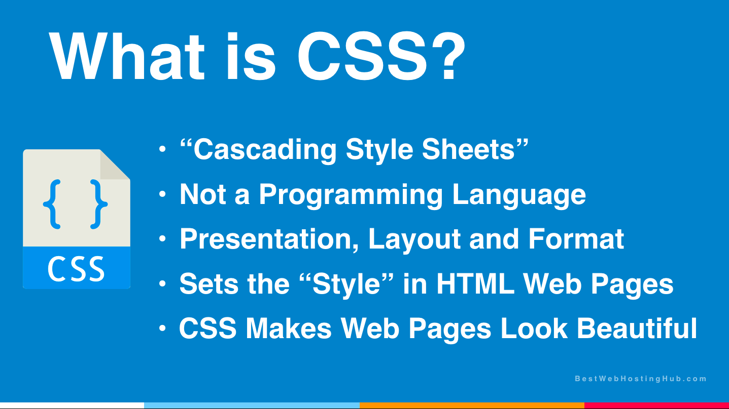

Slide 10
CSS inserting methods
Inline CSS
Internal CSS
External CSS

Slide 11
Classes and Id
Class used to address multiple elements at once
Id accesses only one element at a time

Slide 12
CSS Colors
Names
HTML5 Color Names
Hexadecimal
RGB (red,green,blue)
HSL (hue,saturation,lightness)
RGBA (red,green,blue,alpha(0-10))
HSLA

Slide 13
CSS Backgrounds
background-color: ;
background-image: url(' ');
Properties
repeat/no-repeat
attachment

Slide 14

Box Model

Slide 15
Height/Width Property
Height: ;
Width: ;
Max-height: ;
Max-width: ;
Min-height: ;
Min-width: ;

Slide 16
Additional
Nav Bar
Image Gallery
Counters
Borders
Transition
Animations
Overlays
CheatSheet

Slide 17
Responsive Webpages

Slide 18
What is Java Script?
Programming Language for the Web.
Update and change both HTML and CSS.
Calculate, manipulate and validate data.
JavaScript CheatSheet

Slide 19
Event Listener()
Adding an event listener:
element.addEventListener(event, function, useCapture);
Function:
function myFunction() { alert ("Hello World!"); }
HTML5 DOM Events:
https://www.w3schools.com/jsref/dom_obj_event.asp

Slide 20
Resources:
https://www.w3schools.com/whatis/whatis_sql.asp
https://www.w3schools.com/css/default.asp

Slide 21
Assignment:
Team Assignment:
Each member designs one page of the Rotaract website
Each team member will design a page individually
The best WebPages will be used for the next Rota-Year
Deadline for Submission: 27th May, 2020
Certificates will be provided only on Submission of the webpage

