Slide 1

LINEAR INTEGRATED
CIRCUITS PROJECT
(Police Lights using 555 Timer IC)
Simulation
Submitted By
Abhinandan (2K19/EE/010)
Under the supervision of
Prof. Pragati kumar

Slide 2
TABLE OF CONTENTS
ABSTRACT
INTRODUCTION
COMPONENT LIST
555 TIMER IC IN ASTABLE MODE
4017 DECADE COUNTER
CIRCUIT DIAGRAM/SIMULATION
WORKING OF THE CIRCUIT
LEARNING
REFERENCE

Slide 3
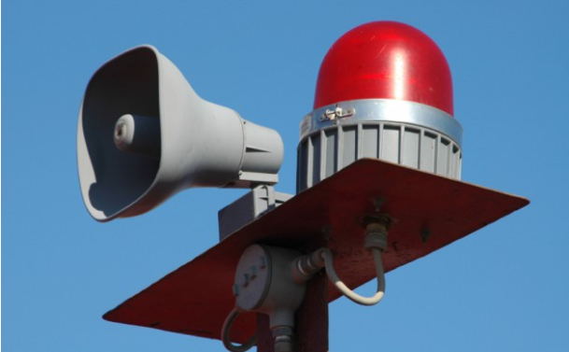
ABSTRACT
In this project, I will show you how to design
Police Lights using 555 Timer IC and CD4017
Counter IC. This circuit simulates the police
car lights by alternately flashing the LEDs.
This circuit flashes Red LEDs for three times
and Blue LEDs for three times and this
flashing action repeats continuously.

Slide 4
INTRODUCTION
Police Lights are flashing lights which are a type of emergency vehicle lighting. You can also find similar flashing lights in ambulances, fire department, military vehicles etc. They are visually captivating and often convey the state of urgency of their task to the other road users. In this project, we will just take the visual aspect of the police lights and implement them in our own way. The circuit uses 555 timer and a decade counter IC CD4017. Here, the 555 timer runs in Astable mode. Decade counter 4017 counts the incoming pulses and activates its outputs i.e. for the first pulse Q0 becomes high and for second pulse Q1 becomes high and so on again for 10th pulse Q0 state becomes high.

Slide 5
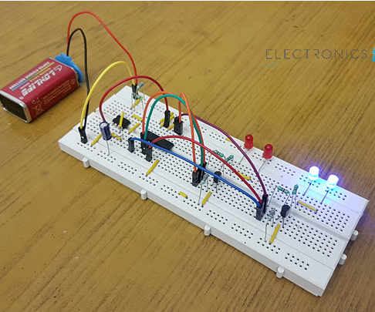
COMPONENT LIST
555 Timer IC
4017 Decade Counter IC
Oscilloscope
Diodes
3KΩ Resistor
1 Variable Resistor
10µF Capacitor
Blue LEDs
Red LEDs
5V battery
Connecting wires

Slide 6
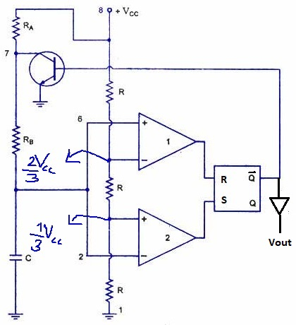
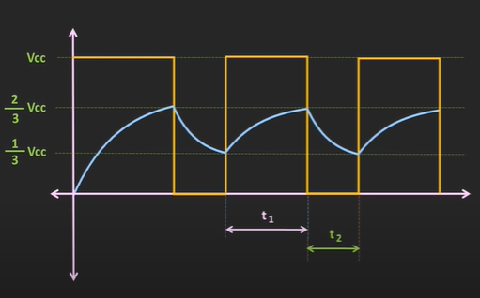
555 Timer IC in Astable Mode
Vcap(t) = Vf+(Vi-Vf)e^(-t/RC)
t1 = 0.693(Ra+Rb)C
t2 = 0.693(Rb)C
T = t1 + t2
= 0.693(Ra+2Rb)C
Duty Cycle = t1/T
= (Ra+Rb)/(Ra+2Rb)
Not equal to 50%
Because capacitor charge with both Ra and Rb but discharge with only Rb Therefore , Duty Cycle not equal to 50%

Slide 7
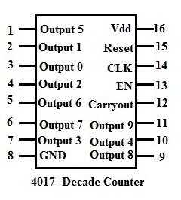
4017 Decade Counter
Pin Name | Pin | Description
VDD | 16 | Supply Voltage
GND | 8 | Ground
Q0- Q9 | 1-7&9-11 | Qx is high when the counter is x
CO | 12 | Carry Out. Goes high after ten clock pulses
CI | 13 | Enable/Clock Inhibit
CLK | 14 | Clock Input. Increases the counter with one
MR | 15 | Reset

Slide 8
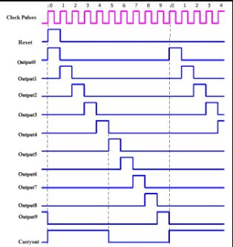
The Carry-out (CO) pin - goes from low to high when the counter reaches 10 and resets back to 0. It stays high for 5 clock pulses, then goes low again.
Enable pin/Clock Inhibit pin - IC is enabled when the pin is active low. In order to disable or switch off the IC,this pin should be connected to active high input.When this pin is active high ,it ignores the clock signals.
Reset pin - Reset pin should be connected to ground in order to reset the circuit.

Slide 9
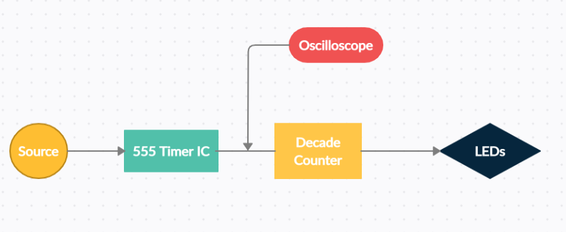
BLOCK DIAGRAM

Slide 10
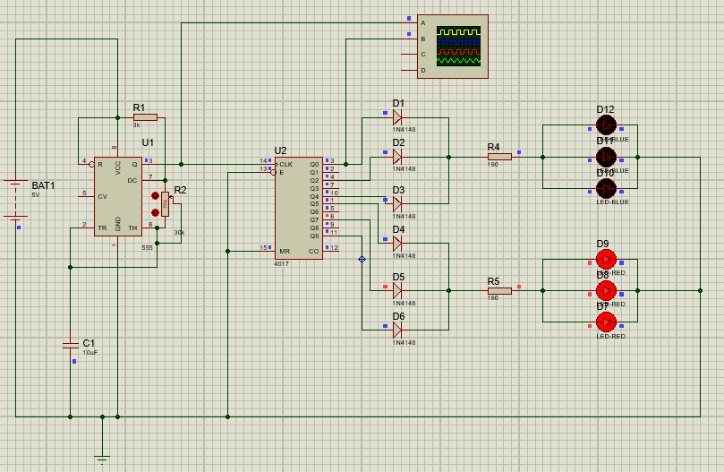
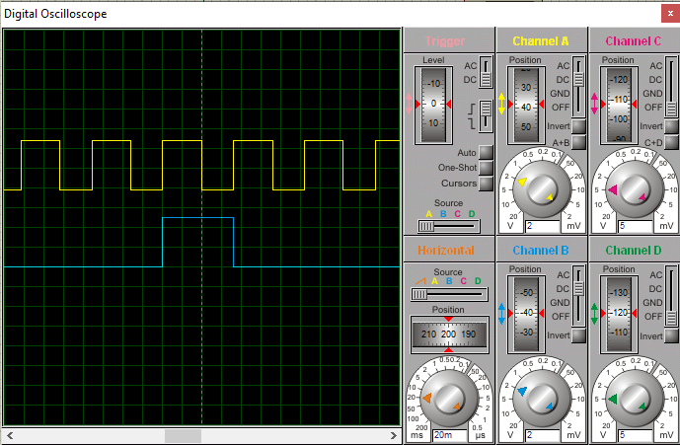
Circuit Diagram/Simulation

Slide 11
WORKING OF THE CIRCUIT
Here 555 timer produces continuous pulses via pin 3. The width of these pulses can be varied by varying the resistance (R1,R2 ) or capacitance (C1). These pulses are given as input to the decade counter. For every incoming pulse the output state of the decade counter is get incremented.
For 1st pulse – Q0 high – blue led’s glow
For 2nd pulse – Q1 high (no connection) – all led’s off
For 3rd pulse – Q2 high – blue led’s glow
For 4th pulse – Q3 high – all led’s off
For 5th pulse – Q4 high – blue led’s glow
For 6th pulse – Q5 high – red led’s glow , blue led’s off
Hence blue led’s flashes for 3 times.
For 7th pulse – Q6 high – all led’s off
For 8th pulse – Q7 high – red led’s glow
For 9th pulse – Q8 high – all led’s off
For 10th pulse – Q9 high – red led’s glow
For 11th pulse – Q0 high – blue led’s glow, red led’s off
Hence, red LEDs flash for 3 times. This process repeats continuously.

Slide 12
LEARNING
Through this project, I was able to learn a lot of things and understand them better with the simulation. Making a complete circuit using 555 timer IC and 4017 decade counter from scratch which taught various things like how 555 timer produces pulse wave , the ways 4017 counter work. I learned how changes in resistance and capacitance can change the time period of a pulse wave.
Lastly, I explored the new software proteus and saw how they are different from other softwares.
In the end, I would like to say that we learnt a great deal of new things from this project

Slide 13
REFERENCE
https://www.electronics-tutorials.ws/waveforms/555_timer.html
https://www.elprocus.com/ic-4017-pin-configuration-application/
https://mechatrofice.com/circuits/ic-4017-decade-counter
https://www.youtube.com/watch?v=iDZMbfOa3Jc
Many More to Read.
Thank You

