Slide 1
Embedded Software Engineering Exercise - 01
Nikhil Ganapathy Manjapura

Slide 2
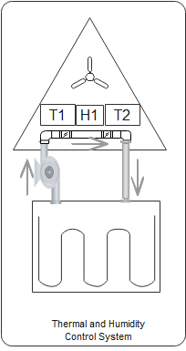
Thermal and Humidity control System in Crew cabin
System to maintain ambient environment for cabin crew.
Ideal temperature, humidity and pressure inside the cabin must be maintained for Crew survival.

Slide 3
Characteristics
Hard Real Time System
Failure of sensor, actuator shall be indicated immediately, so that further action can be taken.
Reactive System and real time system
Based on sensor input alter fan and coolant pump speeds. Reactive to the inner environment of the cabin.
Continuous Systems
Sensor and actuators parameters shall be monitored, used in control logic and to be stored in the memory for further analysis continuously.

Slide 4
Dependable System
Entire system depends on sensor and actuator parameters threshold.
Emergency stop button to stop the mission.
Distributed Systems
Following operations shall be distributed.
Monitoring
Control logic/algorithm
Memory Management

Slide 5
Thank You

