Slide 1
Airbag System
An airbag is a large nylon bag which inflates and deflates very rapidly in the event of a severe crash.
The driver’s airbag is housed in the center pad of the steering wheel and the passenger’s airbag usually in the upper left of the dash. Additional airbags are also present near the top left and right handles to prevent injury in the case of a roll-over.
Jithin George

Slide 2
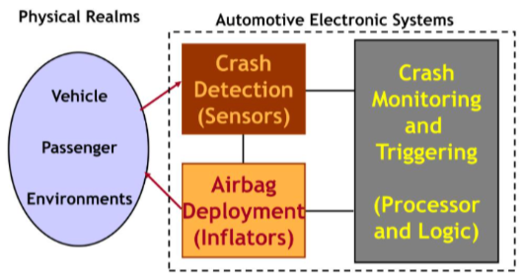
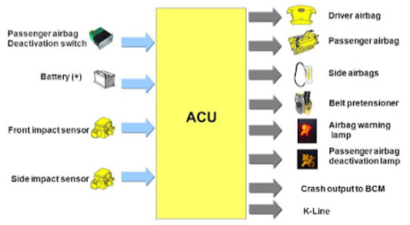
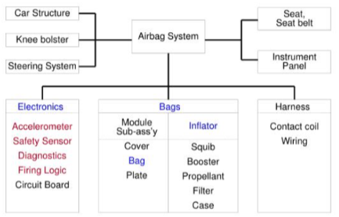
High-level Architecture
Image from
https://www.researchgate.net/figure/A-simple-architecture-of-an-airbag-system-communicating-with-a-collision-sensor_fig1_265514227
https://www.slideserve.com/Gabriel/se0501update

Slide 3
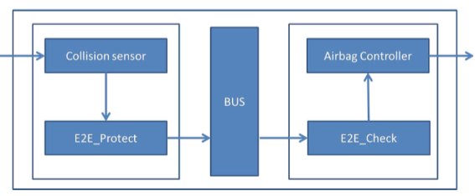
Reactive system
The airbag’s deployment is controlled by trip sensors that continuously poll the occurrence and severity of a crash. This acts as the interrupt input. A host of other factors such as vehicle speed and angle of impact are also taken into consideration.
When the controller determines that the airbag should be deployed, the system triggers an inflator unit that burns chemicals very rapidly to produce large volumes of inert gas to inflate the bag.
Additional safety precautions such as activating seatbelt pretensioners and logging deployment using warning lamps and diagnostic constructs are also performed.

Slide 4
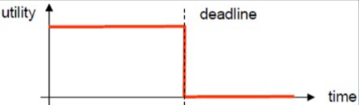
Real-Time System
The decision to deploy an airbag in a frontal crash is made within 15 - 30 ms (hard deadline) after the onset of the crash.
Both the driver and passenger airbags are fully inflated within approximately 60 - 80 ms (hard deadline) after the first moment of vehicle contact.
Periodic tasks are used to monitor sensor health and other vital aspects.
The trip sensors in-turn trigger asynchronous tasks to deploy airbags.
Decision deadline: 30ms
Deployment deadline: 100ms
Task: Periodic/Aperiodic

Slide 5

Discrete System
The modern airbag system is discrete over time - it has hard set inputs and deadlines upon which it acts.
The decision for airbag deployment is taken after considering a multitude of factors such as collision angle, collision intensity, current vehicle speed, seatbelt state etc, all of them having pre-determined discrete values to trigger deployment.
The accompanying set of outputs alongside the airbag actuator activation is also discrete - airbag deflation, activating seatbelt tensioners, recording freeze frames, logging DTCs - all of them are distinctly discrete actions.

Slide 6
Dependable System
Reliability
Airbag systems use highly reliable sensors and controllers that ensure high reliability.
Availability
Head units are designed such that bus access to critical systems are prioritized, ensuring high availability.
Safety
Modern systems are often encrypted using HSMs in the main processor. In the absence of HSM, software based crypto modules are often used to ensure transactional safety (inbound/outbound).
Airbag systems are classified as ASIL-D (highest classification of initial hazard - injury risk) under ISO 26262 (Functional Safety).
Security
Airbag systems often have a mechanical failsafe that triggers automatically in the case of an electronic failure.

Slide 7
Distributed System
Airbag systems are highly concurrent:
It consists of multiple ECUs working in tandem to realize mutliple functionalities - collision detection, seatbelt control, health monitoring, active diagnostics, etc.
The airbag ECU also concurrently processes multiple inputs and outputs to maintain high precision for hard deadline adherence.
Failure in one system does not mean multiple failures - the system contains efficiently designed failsafe modes that ensure failures are independent. In case of critical functionality failures, the driver is notified with visual cues.

