Slide 1
Embedded Software Engineering Exercise - 01
Team
Abhinandan Dinakar
Jithin George
Nikhil Ganapathy Manjapura
Shreya Manasali

Slide 2
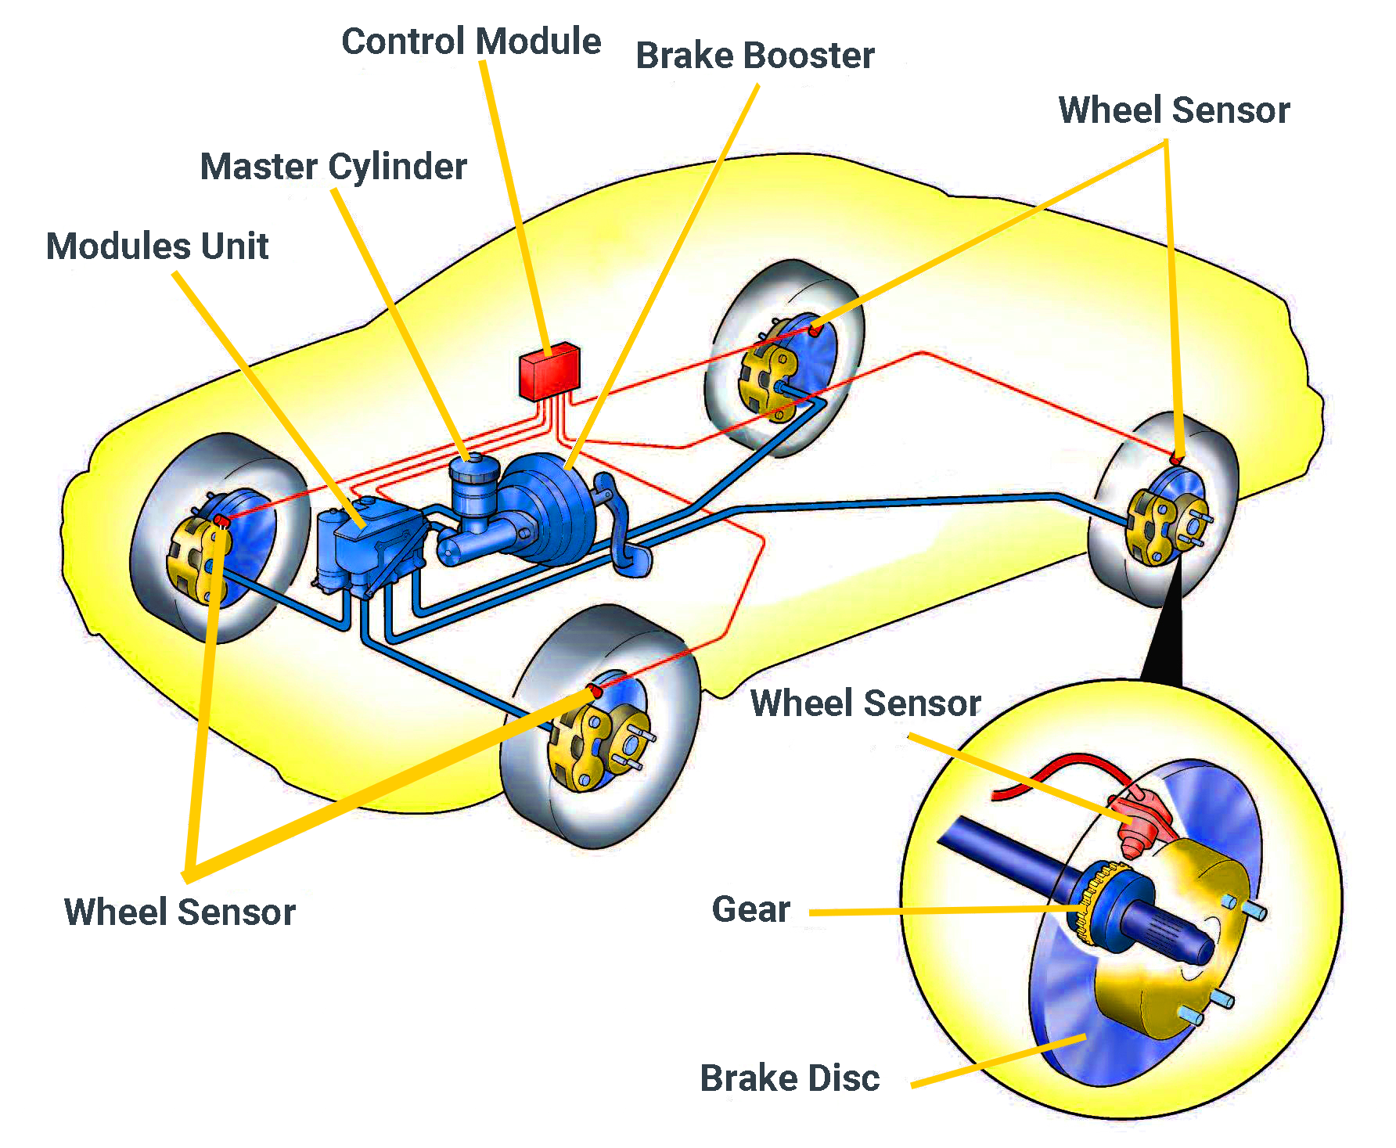
ABS (Anti-lock Braking System)
An anti-lock braking system (ABS) is a safety anti-skid braking system used on aircraft and on land vehicles, such as cars, motorcycles, trucks, and buses.
ABS operates by preventing the wheels from locking up during braking, thereby maintaining tractive contact with the road surface and allowing the driver to maintain more control over the vehicle.

Slide 3
Characteristics
Hard Real Time System
A hard real-time system is a system in which most timing constraints are hard. If deadline is missed then it can lead to catastrophic consequences.
Reactive System
Continuous interaction with transmission output speed sensor to activate the anti-lock brakes by making the vehicle downshift the transmission or shut down part of the engine.
Dependable System
Helps prevent wheels from locking up – possibly allowing the driver to steer to safety.
Availability
The ability of the system to deliver services when requested.
Reliable
The feature should be working properly and alert the component malfunction.
Safety
Automotive Safety Integrity Level (ASIL) - D

Slide 4
Thank You

