Slide 1
ESE – SEMESTER PROJECT
Prof. Dr. Stefan Henkler
Team Heisenberg
Team
Abhinandan Dinakar
Nikhil Ganapathy Manjapura
Shreya Manasali

Slide 2
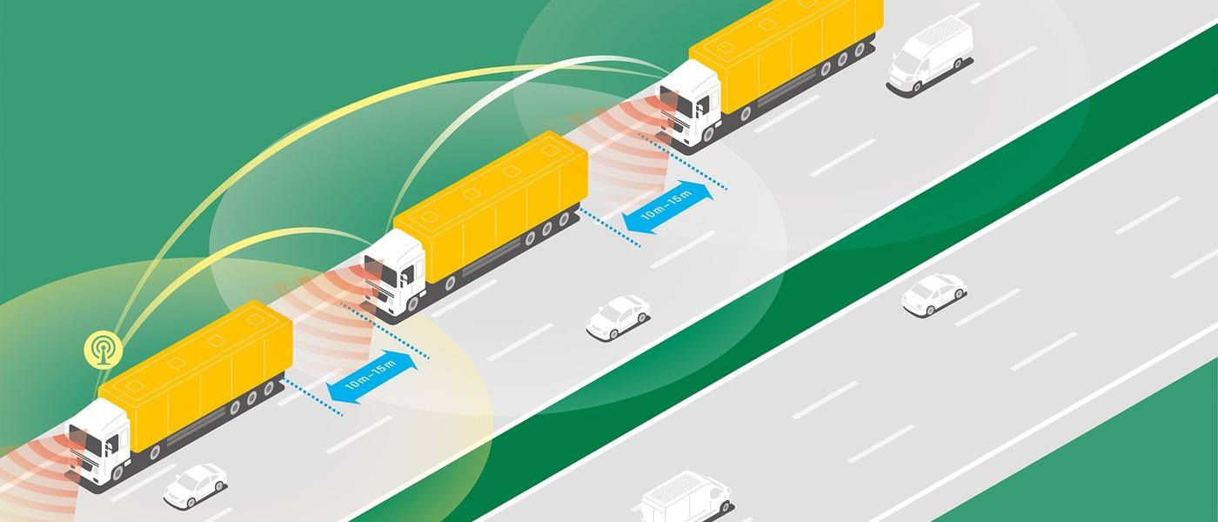
What is Truck Platooning?

Slide 3
Pros and Cons of Platooning
Pros
Less number of drivers required.
Capability to allow many trucks or other vehicles to accelerate or brake simultaneously and maintain constant gap between them.
Platooning eliminates reacting distance needed for human reaction.
Cons
Initial costs are high.
Prone to system failures.
Driver would feel less in control of following trucks.

Slide 4
Requirements

Slide 5
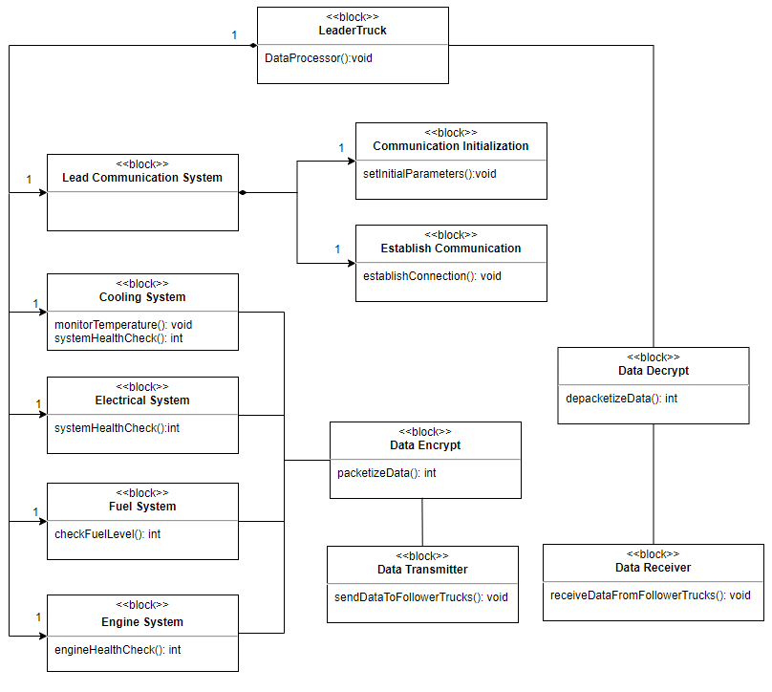
Block Diagram
Lead Truck

Slide 6
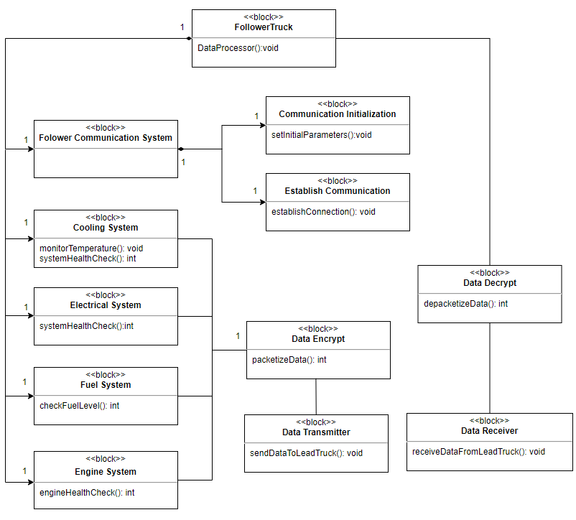
Block Diagram
-Follower Truck

Slide 7
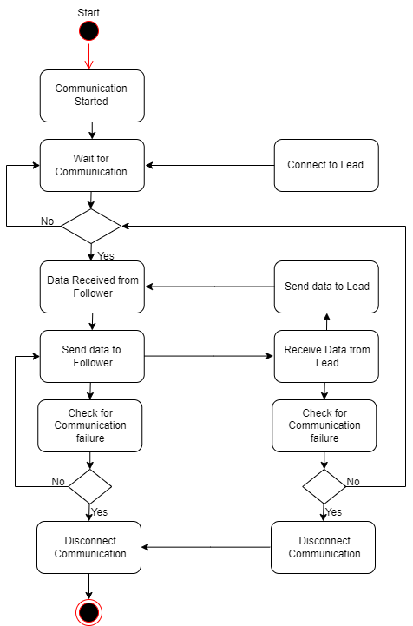
Activity Diagram -1

Slide 8
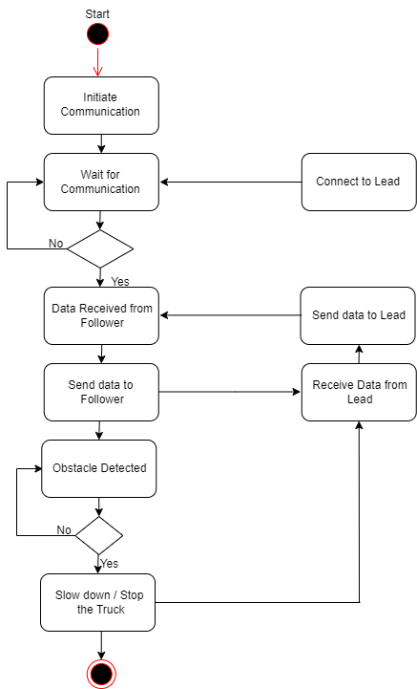
Activity Diagram -2

Slide 9
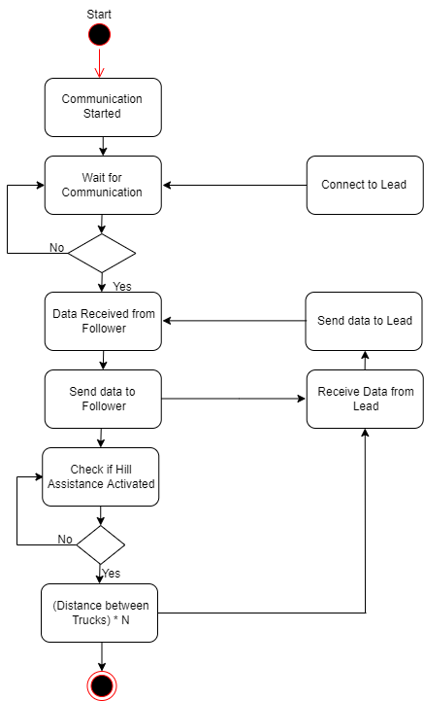
Activity Diagram -3

Slide 10
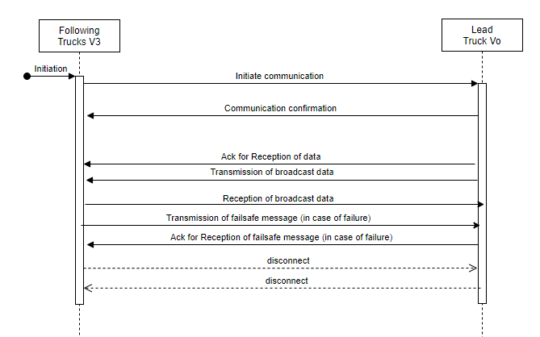
Sequence Diagram

Slide 11
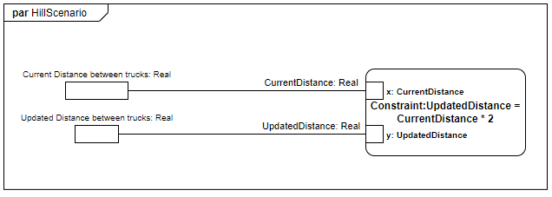
Parametric Constraints Diagram
Hill Scenario

Slide 12
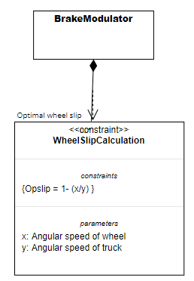
Brake Modulator

Slide 13
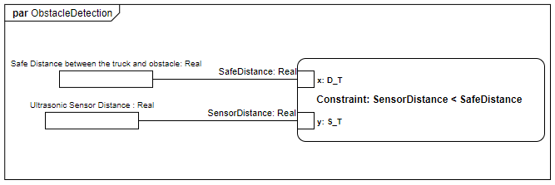
Obstacle Detection

Slide 14
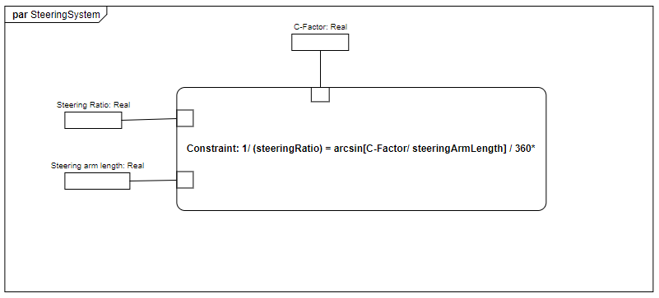
Steering Control

Slide 15
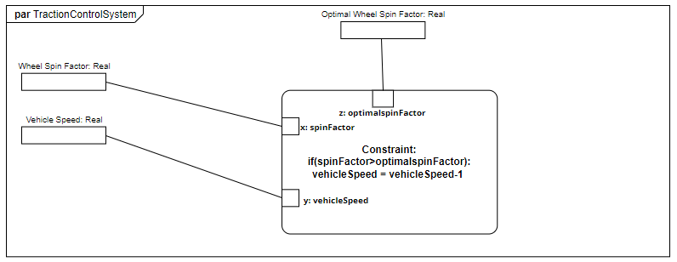
Traction Control

Slide 16
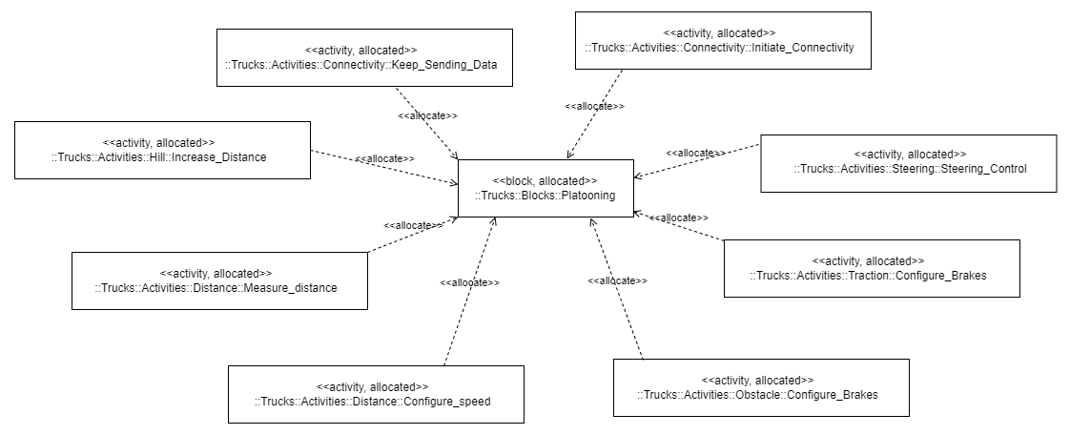
Allocation Diagram
Fig 2. Allocation Diagram

Slide 17
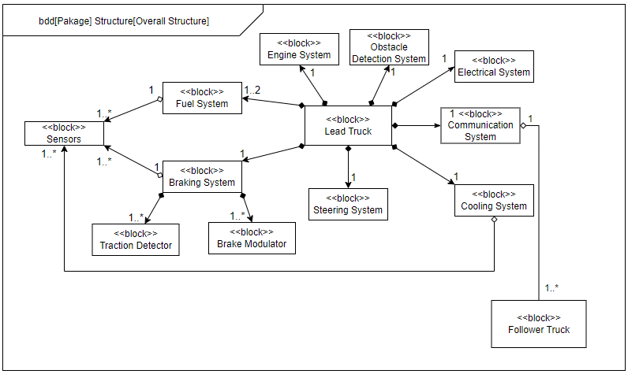
Main Block Diagram

Slide 18
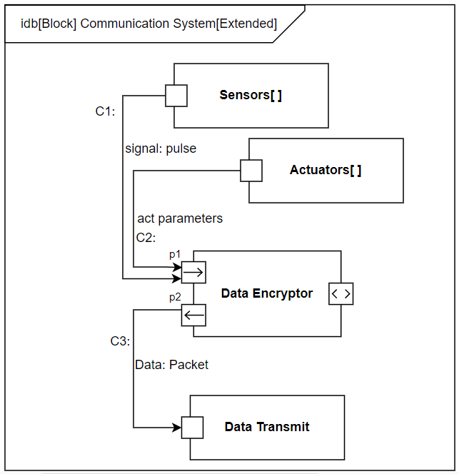
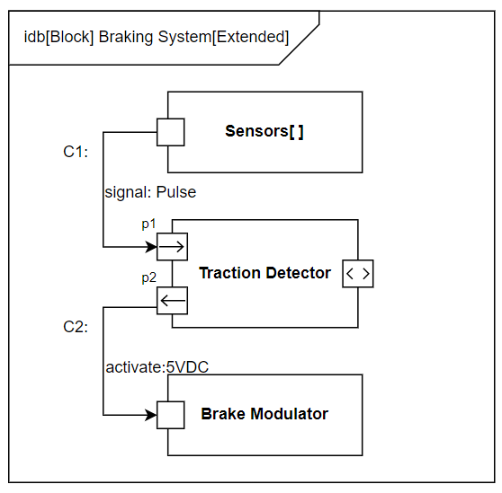
Internal Block Diagram

Slide 19
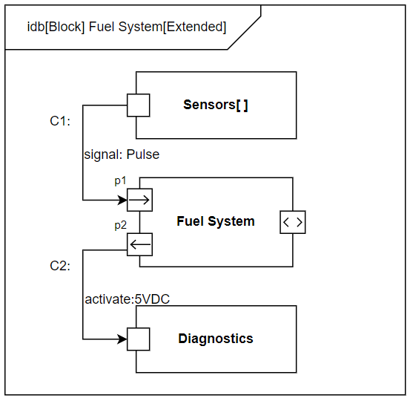
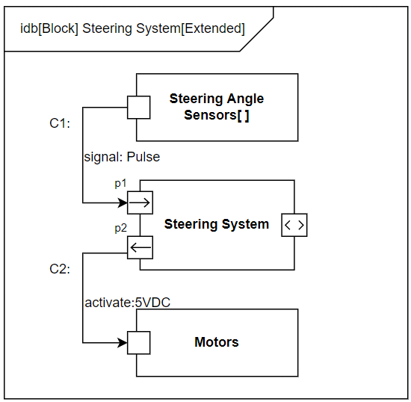
Internal Block Diagram

Slide 20
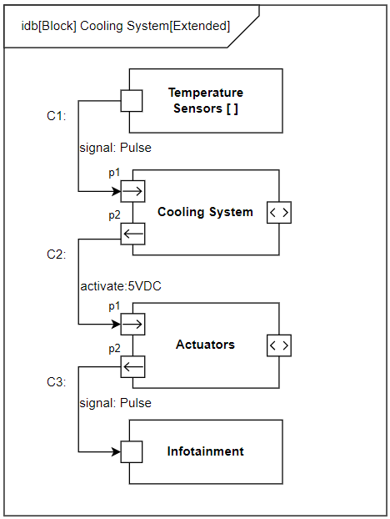
Internal Block Diagram

Slide 21
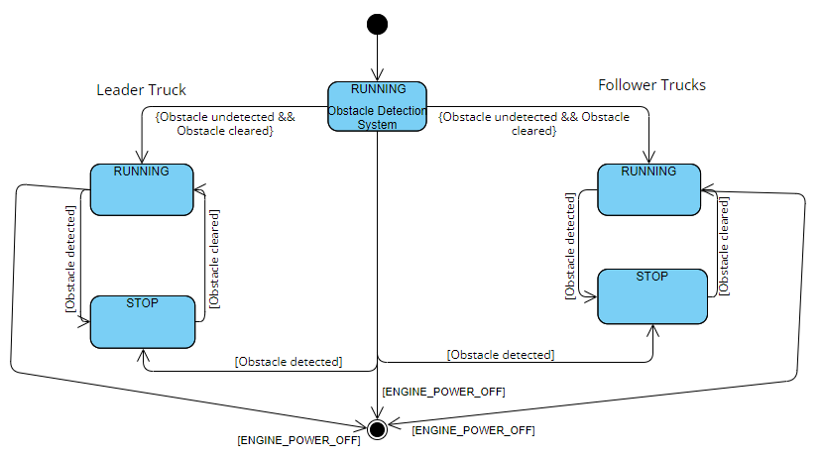
State Machines
Obstacle Detection

Slide 22
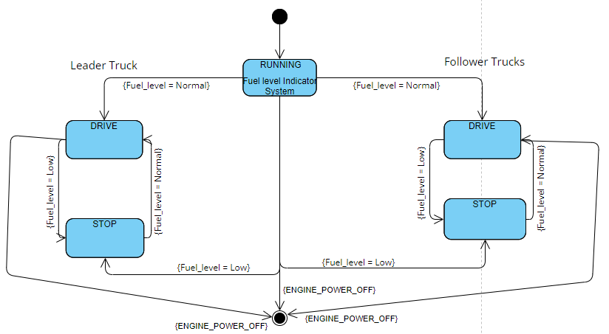
Fuel level indicator

Slide 23
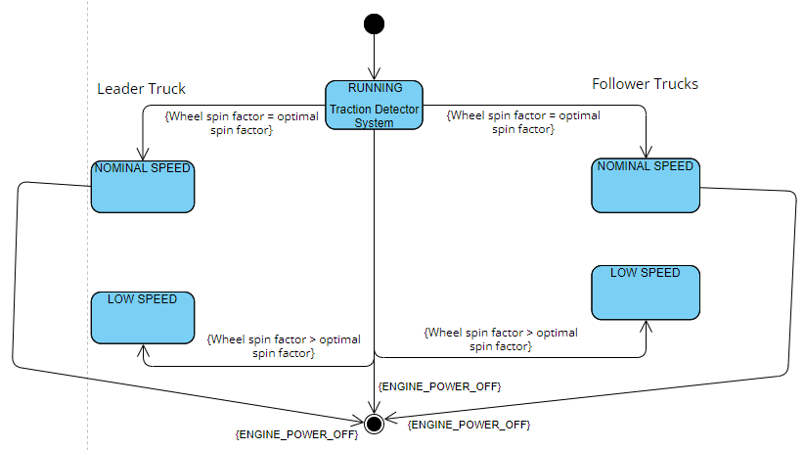
Traction Control

Slide 24
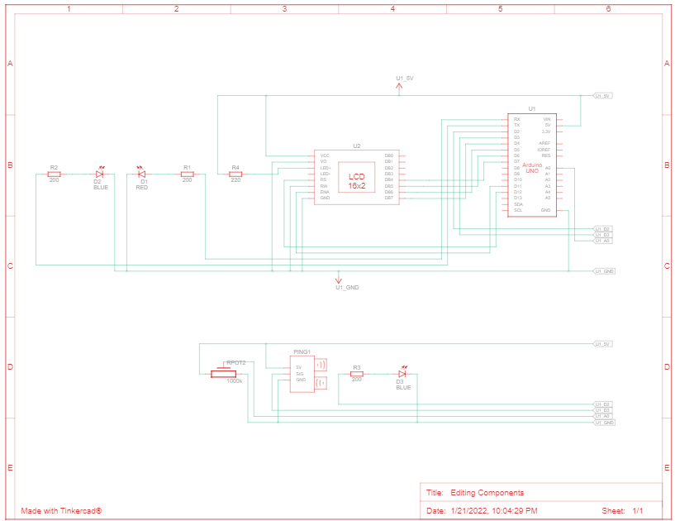
Tinkercad- Arduino

Slide 25
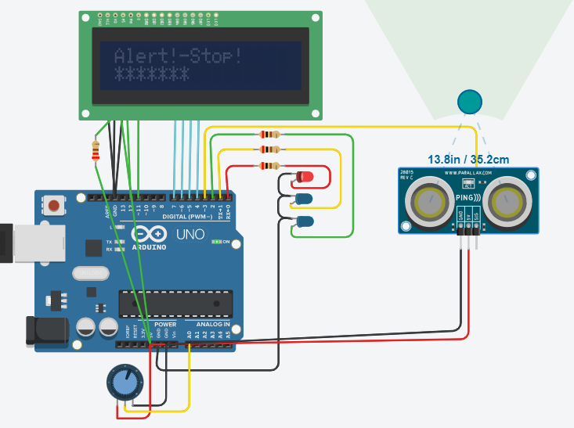
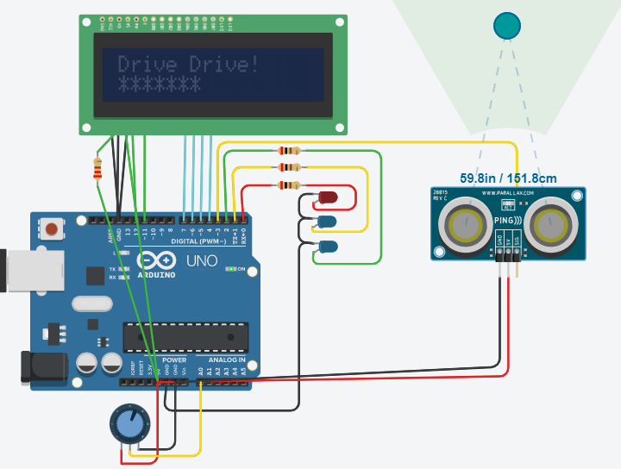
Simulations

Slide 26

Scheduling (using pycpa)
Tasks defined for Obstacle Detection System:
T1: Monitoring the obstacles by emitting sound waves
T2: Sending the notification to the trucks
Worst and Best response timings

Slide 27
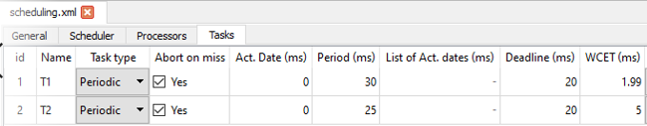
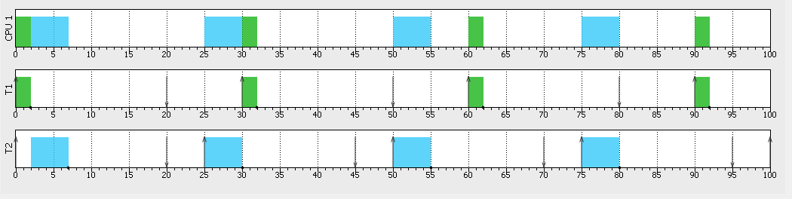
EDF and RM scheduling
EDF Timing diagram:

Slide 28
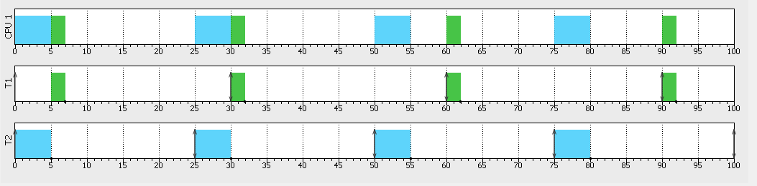
RM Timing diagram:

Slide 29
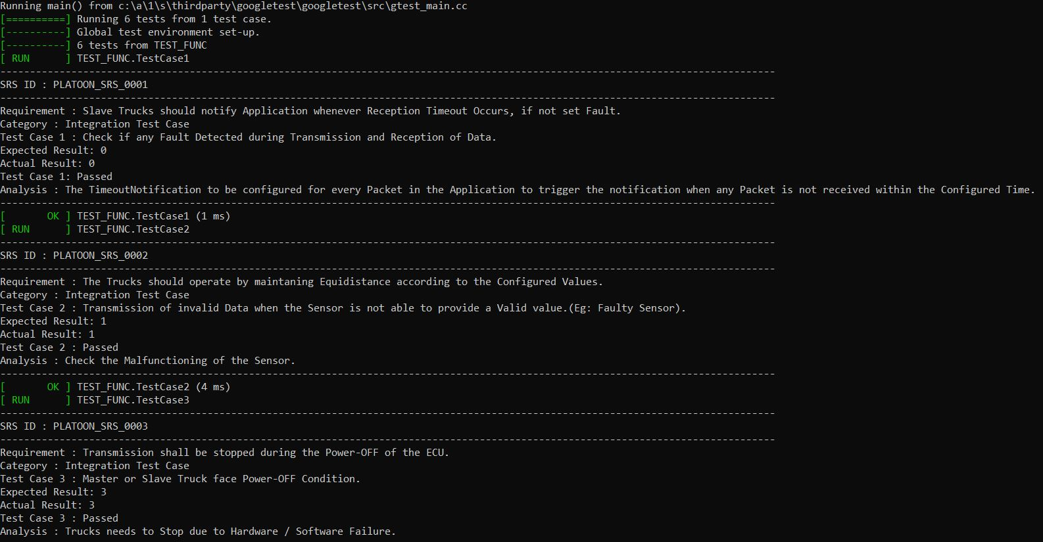
Unit Testing

Slide 30
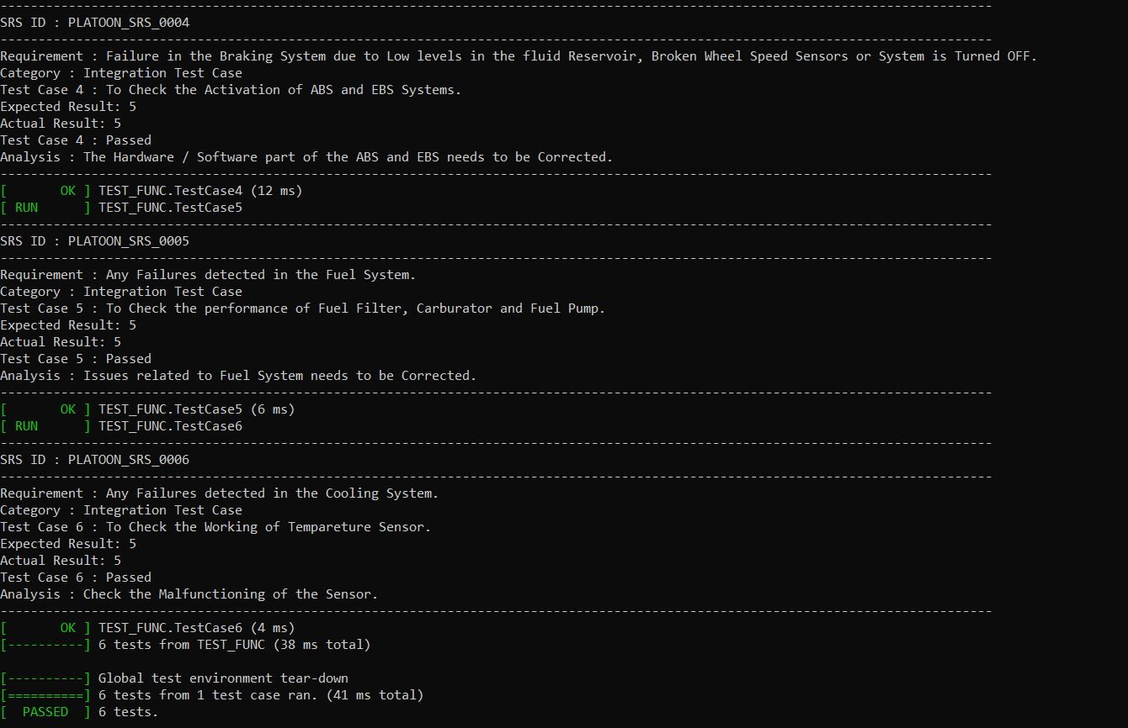
Unit Testing

Slide 31
Thank You

