Slide 1

INTERNSHIP | Training
INTERNSHIP & PROJECT
PRESENTATION
E-Commerce Product Management System
Industrial Training in .NET Full Stack Development
Student: Abhinandan Sah
Reg. No.: 12202699
Program: B.Tech CSE (2022–2026)
Company: Capgemini Technology Services
Lovely Professional University | 17 Dec 2025 – 20 May 2026

Slide 2
About Capgemini Technology Services
Global IT Consulting & Services Leader
Capgemini specializes in digital transformation, cloud services, application development, automation, cybersecurity, and enterprise modernization.
Headquarters: Paris, France | India HQ: Navi Mumbai
Internship Role: Analyst / A4
Mentor: Ravleen Kaur (Senior Manager)
Core Values
Innovation
Integrity
Client-Centricity
Excellence
Collaboration
Continuous Learning

Slide 3
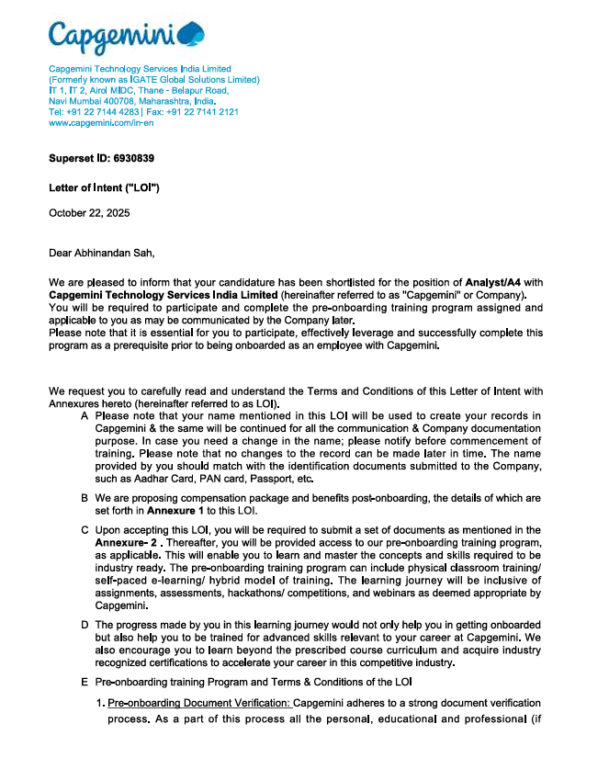

Slide 4
TRAINING & LEARNING SUMMARY
Backend Technologies
✓ .NET Core & ASP.NET Core
✓ REST API Development
✓ Entity Framework Core
✓ Authentication & Authorization
Frontend Technologies
✓ Angular Framework
✓ TypeScript
✓ Routing & Reactive Forms
✓ JWT Authentication
Database Concepts
✓ SQL Server
✓ Database Design
✓ CRUD Operations
✓ Transactions & ACID Properties
Software Engineering
✓ Microservices Architecture
✓ API Gateway Pattern
✓ RabbitMQ Messaging
✓ Agile Development
Project Implemented: BoltCart (E-Commerce Product Management System) Full-stack microservices with auth, product catalog management, inventory control, pricing, approval workflows, media management, user administration, and operational reporting.

Slide 5
Project Overview – BoltCart
The E-Commerce Product Management System (BoltCart) is a scalable, microservices-based web platform that automates product catalog management, inventory control, pricing, approval workflows, media management, user administration, and operational reporting.
Microservices
Event-Driven
Full-Stack
Secure
5 independently deployable services with API Gateway
Asynchronous communication via RabbitMQ + MassTransit
Angular 21 frontend + ASP.NET Core (.NET 10) backend
JWT auth, refresh tokens, role-based access control

Slide 6
Problem Statement & Objectives
Problem
Objectives
Tightly coupled monolithic architectures
Digitize & automate product catalog management
Poor scalability & inconsistent product data
Build scalable microservices architecture
No centralized catalog or inventory control
Implement JWT auth & role-based access
Weak authentication & authorization
Automate approval workflows via event messaging
Delayed product approval workflows
Develop responsive Angular frontend
Difficult audit tracking across modules
Gain enterprise-level full-stack development skills

Slide 7
System Architecture – Microservices
Client (Browser / Mobile)
API Gateway (Ocelot :7292)
Identity API
(Auth · JWT)
Catalog API
(Products · Categories)
Workflow API
(Pricing · Approval)
Reporting API
(Audit · Reports)
IdentityDb
CatalogDb
WorkflowDb
ReportingDb
RabbitMQ – Async Event Bus

Slide 8
Technologies Used
Backend Framework
ASP.NET Core (.NET 10)
Authentication
JWT Authentication
Programming Language
C#
Message Queue
RabbitMQ + MassTransit
Frontend Framework
Angular 21
Logging
Serilog
Database
SQL Server
Testing / Docs
NUnit · Postman · Swagger
ORM
Entity Framework Core
Version Control
Git & GitHub
API Gateway
Ocelot

Slide 9
Key Features & Modules
User Auth & Roles
Product Catalog
Inventory & Pricing
JWT login, refresh tokens, role-based access, password reset
Create / manage products, categories, variants, SKU generation
Stock updates, pricing control, availability monitoring
Workflow & Approval
API Gateway
Event Messaging
Draft → Pending → Approved → Published lifecycle
Centralized routing, CORS, exception handling via Ocelot
Async RabbitMQ events between services (publish / consume)
Admin & Reports
Media Management
Angular Frontend
Dashboard analytics, user management, audit trail, reporting
Product image upload, metadata, media association
Standalone components, lazy loading, route guards, signals

Slide 10
Description of Work Done
1. Requirement Analysis
2. Architecture Planning
Analyzed case study; identified user roles, workflows, auth & reporting needs
Designed microservices layout; selected Ocelot Gateway & RabbitMQ messaging
3. Backend Development
4. Frontend Development
Built REST APIs in ASP.NET Core; JWT auth, EF Core migrations, Serilog logging
Angular 21 – standalone components, signals, route guards, HTTP interceptors
5. Database Design
6. RabbitMQ Integration
Database-per-service with SQL Server; entity relations & migrations
Product status events, user count updates; MassTransit publish/consume
7. API Gateway Config
8. Testing & Debugging
Ocelot routing, CORS policies, gateway-level exception handling
Swagger, Postman API tests; NUnit unit tests; end-to-end integration testing

Slide 11
Learning Outcomes & Skills Gained
Technical Skills
Professional Growth
Enterprise microservices architecture
Structured project documentation
ASP.NET Core / .NET 10 backend APIs
Analytical & architectural thinking
Angular 21 – signals, standalone components
Time management & sprint planning
JWT + refresh token authentication
Debugging large-scale applications
RabbitMQ event-driven communication
Industry-standard version control (Git)
Entity Framework Core Code-First
Professional communication & reporting
SQL Server database management
5
5+
30+
API Gateway (Ocelot) configuration
REST API design & Swagger documentation
Microservices
Built
Months
Duration
REST API
Endpoints
NUnit testing & Serilog logging

Slide 12
CONCLUSION
Key Takeaways
Developing BoltCart from scratch delivered deep hands-on exposure to enterprise-grade full-stack engineering. The project reinforced microservices design, event-driven communication, secure API development, and responsive frontend development — skills directly aligned with industry demands.
Built 5 independently deployable microservices
Implemented secure JWT auth & refresh token flow
Integrated RabbitMQ for async service communication
Developed complete Angular 21 product management UI
Practiced full SDLC: design → dev → test → document
Strengthened analytical thinking & problem-solving skills

Slide 13
Thank You

