Slide 1


E-Commerce Product Management System
Student Name: Abhinandan Sah

Slide 2
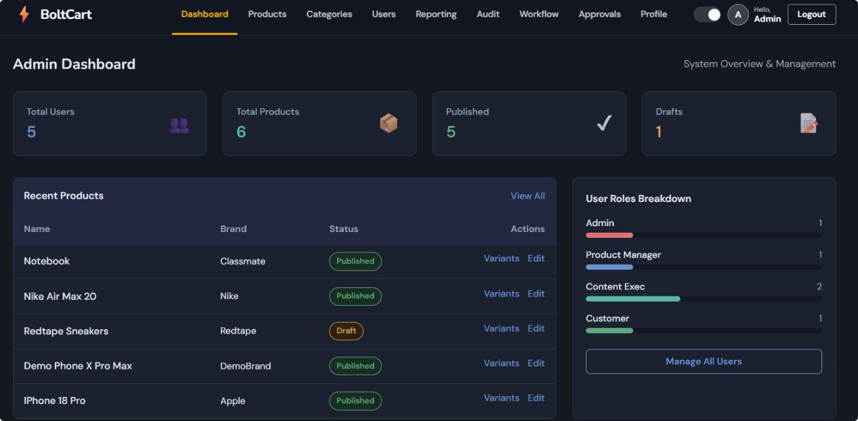
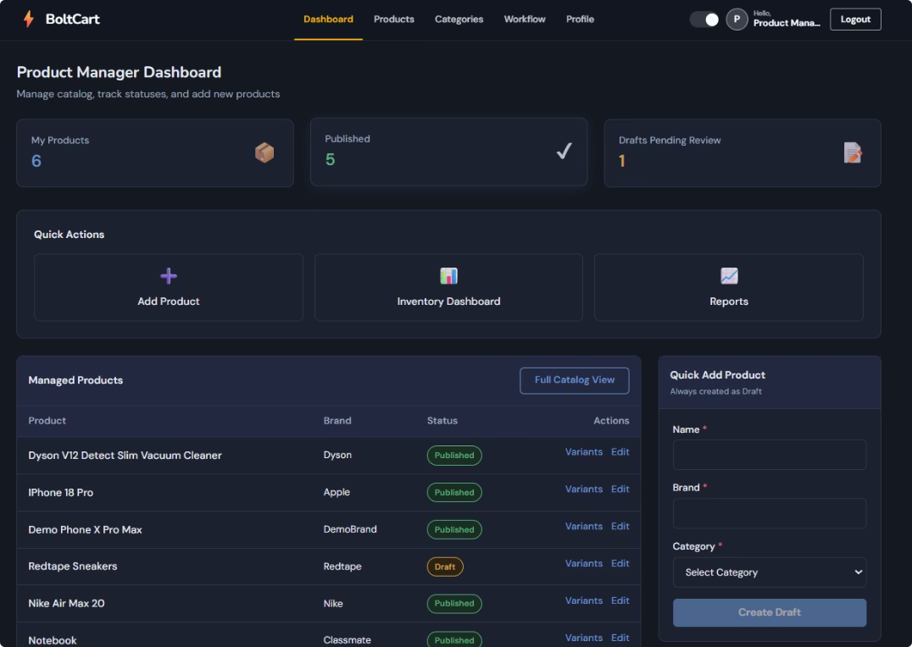
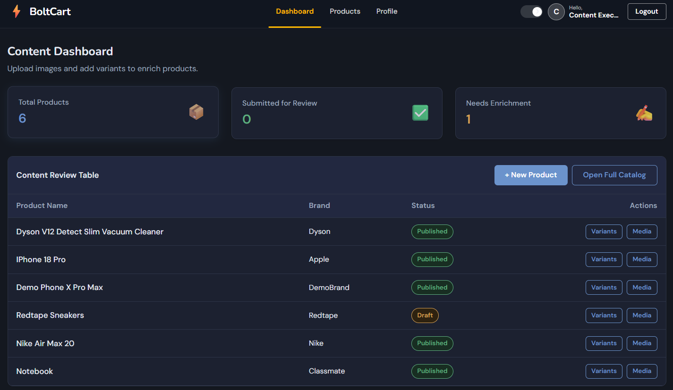

Project Overview
A comprehensive product management platform designed for modern e-commerce operations. The system provides structured management of product data, approval workflows, inventory tracking, and detailed reporting capabilities.
Core Features
Products, categories, and variants management
Media asset handling
Pricing and inventory control
Multi-stage approval workflows
Dashboard and audit trail
Role-Based Access
Four distinct user roles: Admin, Product Manager, Content Executive, and Customer.

Slide 3

Problem and Solution
Problem
Product data requires structured, centralized management across multiple stakeholders.
Solution
Angular UI with role-specific dashboards and data management modules.
Problem
Approval workflow needed before product publishing to ensure quality control.
Solution
Product approval module with multi-stage review and approval processes.
Problem
Managers need reporting and inventory visibility for decision-making.
Solution
Reporting API with dashboard KPIs, CSV export, and inventory tracking.
Problem
Admins need user and audit control for security and compliance.
Solution
Identity API with user management and audit trail for important actions.

Slide 4





High-Level Architecture
User / Browser
Angular Frontend Application
API Gateway
Ocelot Gateway with JWT Validation
Backend Services
Identity.API, Catalog.API, Workflow.API, Reporting.API
Message Broker
RabbitMQ with MassTransit
Data Storage
SQL Server Databases
Services communicate through the API Gateway and publish events via RabbitMQ for reporting and audit purposes.

Slide 5
Backend Services
Service
Responsibility
Identity.API
User authentication, registration, JWT tokens, refresh tokens, user management, and role-based authorization
Catalog.API
Product catalogue management, categories, variants, media assets, and automatic SKU generation
Workflow.API
Pricing rules, inventory tracking, product submission for review, and multi-stage approval workflows
Reporting.API
Dashboard KPIs, comprehensive reports, CSV export functionality, and complete audit trail recording
Gateway.API
Request routing, JWT validation, CORS handling, and Swagger UI aggregation for all services

Slide 6
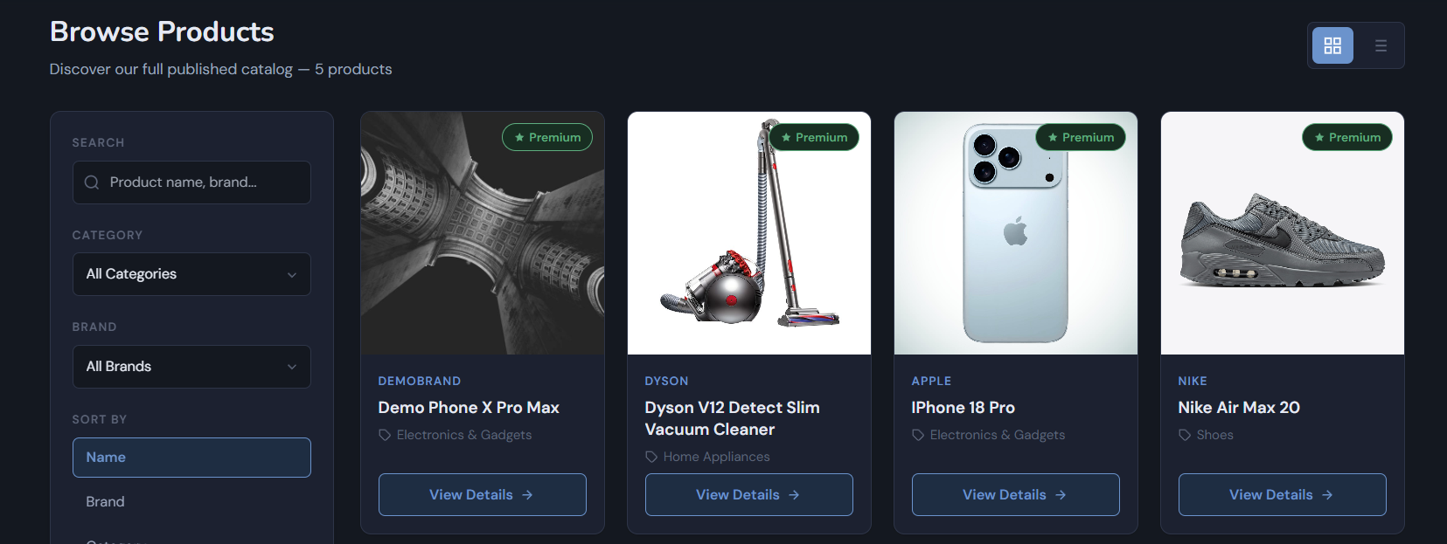






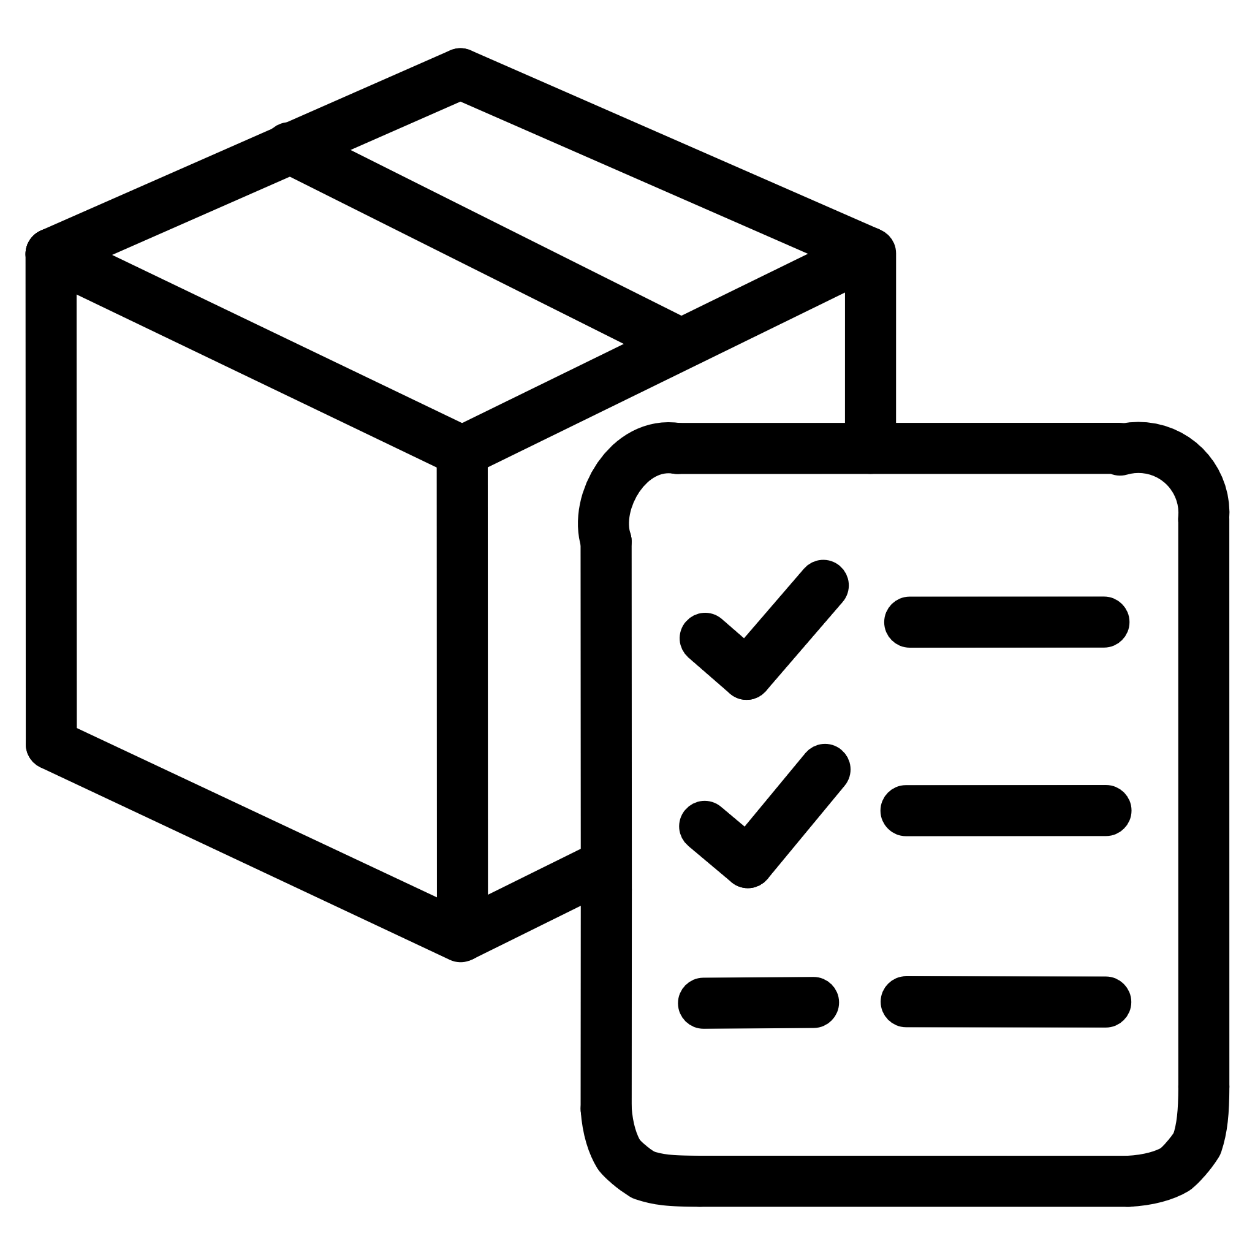





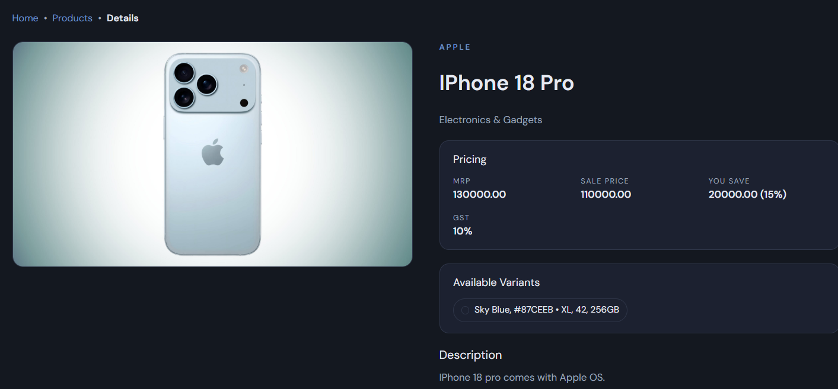




Frontend Modules
Auth
Dashboard
Login and registration
Overview and metrics
Storefront
Inventory
Product browsing
Stock tracking
Catalog
Reporting
Product management
Analytics and exports
Workflow
Audit
Approval processes
Action logging

Slide 7
Role-Based Access Control
Role
Access
Admin
User management, approval workflows, reporting, audit trail, full system administration
Product Manager
Product creation and editing, pricing configuration, inventory management, reporting access
Content Executive
Product content management, media assets, product submission for review
Customer
Product browsing, catalogue access, profile management

Slide 8





Key Business Flows
Authentication Flow
Login
Identity API
User credentials
Validation
JWT Issued
Role Dashboard
Token generation
Access granted
Product Approval Flow
Create Product
Submit Review
Draft status
Pending approval
Admin Review
Update Reporting
Approve or reject
Audit logged

Slide 9
Database and Testing Overview
Database Contexts
Testing Strategy
IdentityDbContext: Users, RefreshTokens, PasswordResetTokens
CatalogDbContext: Products, Categories, ProductVariants, MediaAssets
WorkflowDbContext: Prices, Inventories, Approvals
ReportingDbContext: ProductReports, DashboardSnapshots, AuditLogs
NUnit framework for comprehensive testing
Unit tests for service logic
Tests for repositories and controllers
Moq for dependency mocking
EF Core InMemory for test databases

Slide 10












Project Highlights and Conclusion
Microservice Architecture
JWT Authentication
Angular Frontend
Modular backend services with clear separation of concerns
Secure token-based authentication with refresh functionality
Role-based dashboards with responsive design
Approval Workflow
Reporting Module
Audit Trail
Multi-stage product review and publishing process
Real-time KPIs, analytics, and CSV exports
Complete action logging for compliance

Slide 11
Thank You

