Slide 1

Model of Pandemic Progression
Team Rothschild
Vishal Kumar Singh (24M0742)
Abhinandan Kumar (24M0788)
Aman Sharma (24M2106)
CS752- System Dynamics
Under the guidance of
Prof. Om P Damani

Slide 2
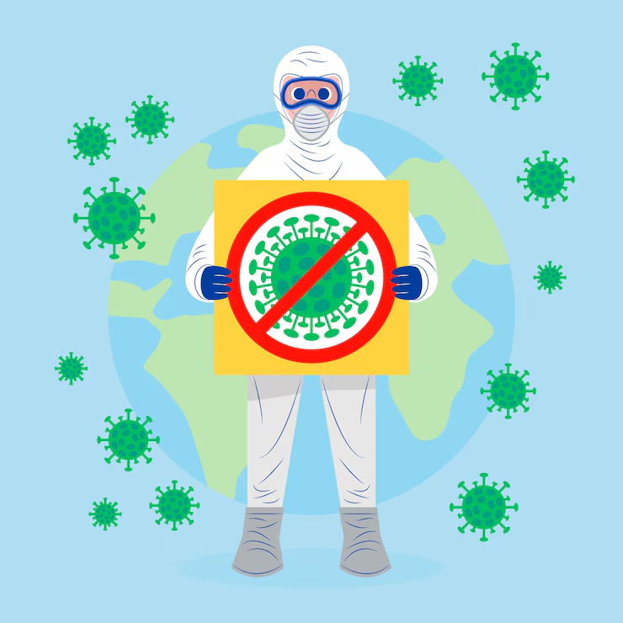
Introduction
1
A pandemic is a global disease outbreak that spreads rapidly and affects millions, like COVID-19, Influenza etc..
Pandemic outcomes are shaped by multiple factors — infection spread, public behavior, government policies, and delays in response.
System Dynamics helps model these complex interactions using feedback loops, stocks, and flows.
This project builds a realistic pandemic model to simulate infection, vaccination, fear, testing, recovery, and mortality.
The model helps test different strategies (like lockdowns or mass vaccination) to support better decision-making during pandemics.

Slide 3
Problem Statement
2
Uncontrolled infection spread due to delayed detection and limited testing capacity.
Public fear and behavior (e.g., social distancing, panic) change based on perceived threat — often ignored in simple models.
Healthcare overload, where hospitals run out of capacity, increasing mortality.
Delayed government response (lockdowns, vaccination) affects outcomes but is hard to predict.
Lack of tools to test “what-if” scenarios and predict the impact of different strategies in advance.

Slide 4

Objective of Our Model
3
Simulate disease spread by factoring in real-life elements like fear, testing, vaccination, and human behavior.
Analyze the impact of actions such as lockdowns, testing, and early vaccination on infections, recoveries, and deaths.
Incorporate delays and feedback loops (e.g., slow testing or heightened fear) for a more accurate, realistic model.
Test "what-if" scenarios to help leaders and health experts predict the most effective strategies before real-world implementation

Slide 5
Model Boundary & Assumptions
4
Closed group – No one enters or leaves the population.
One disease – Only the pandemic virus is considered.
Equal contact – Everyone can meet and spread the virus equally.
No groups – No age, location, or health differences.
Fixed rates – Infection, recovery, and death rates stay the same.
Hospital or recovery gives immunity – Vaccination or recovery gives full protection.

Slide 6
Stocks & Their Roles
5
Healthy Vaccinated People: Lower risk of infection may still get infected if vaccine efficacy fails.
Healthy Non-Vaccinated People: Primary source of new infections.
Infected: May recover, die, or get diagnosed.
Identified Infection: Confirmed cases, isolated or treated, may recover or die.
Recovered: Gained immunity no longer contribute to transmission.
Deaths: Death cause by pandemic.

Slide 7
Flows & Roles
6
Infection Flow – Healthy people become sick after contact with someone infected.
Recovery Flow – Sick people get better and move into the recovered group.
Death Flow – Some sick people die from the disease and leave the system.
Vaccination Flow – Healthy people get vaccinated and become protected.
Testing Flow – Sick people are identified through testing, helping with treatment and isolation.

Slide 8
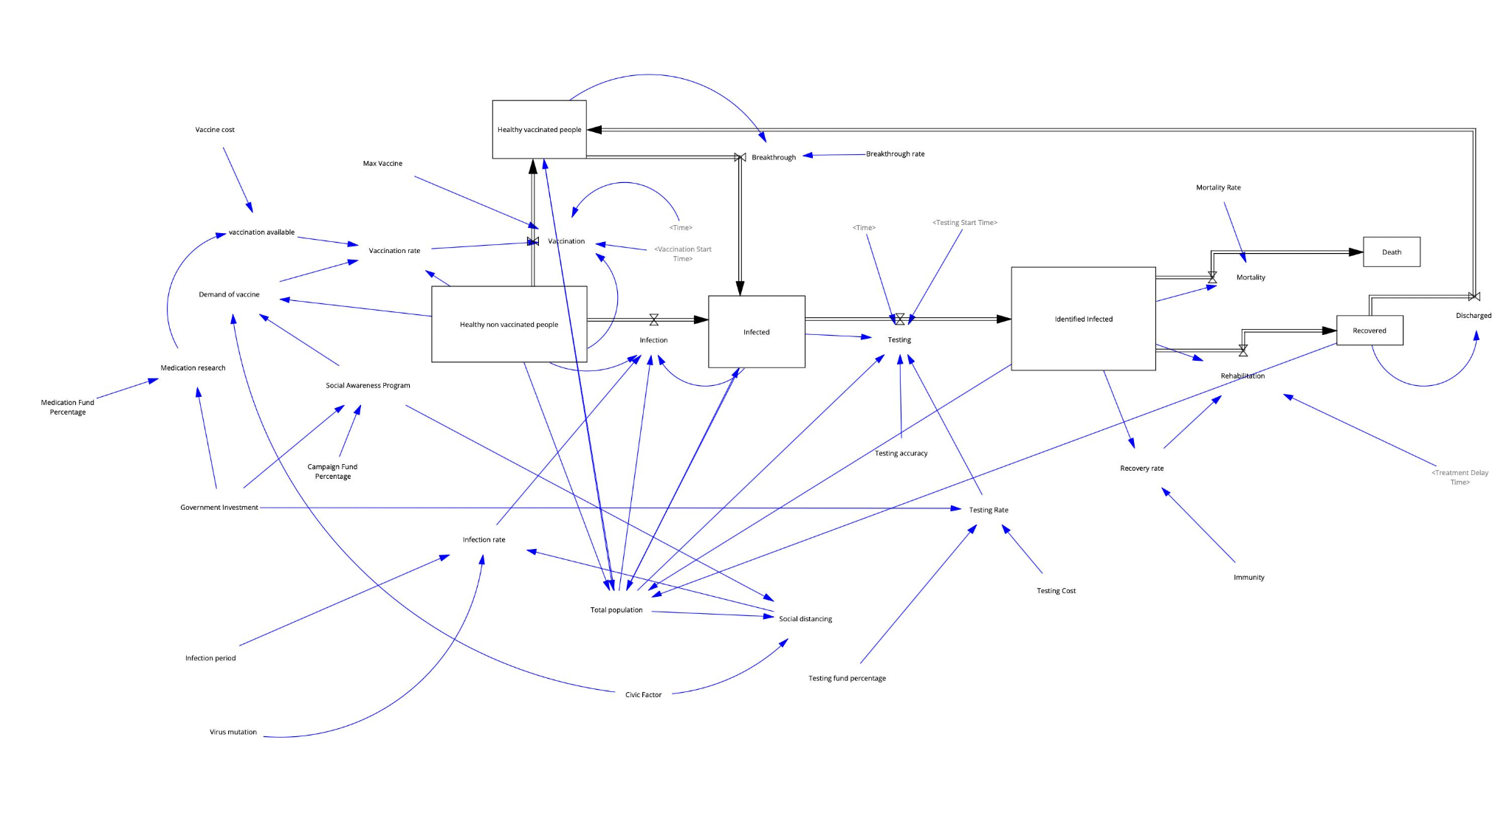
Our Pandemic Model
7

Slide 9
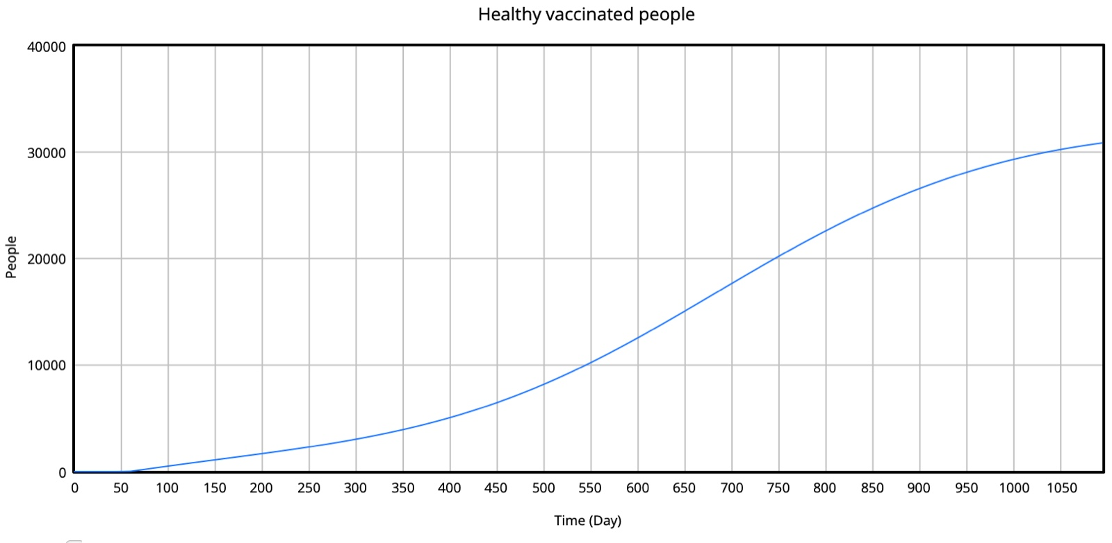
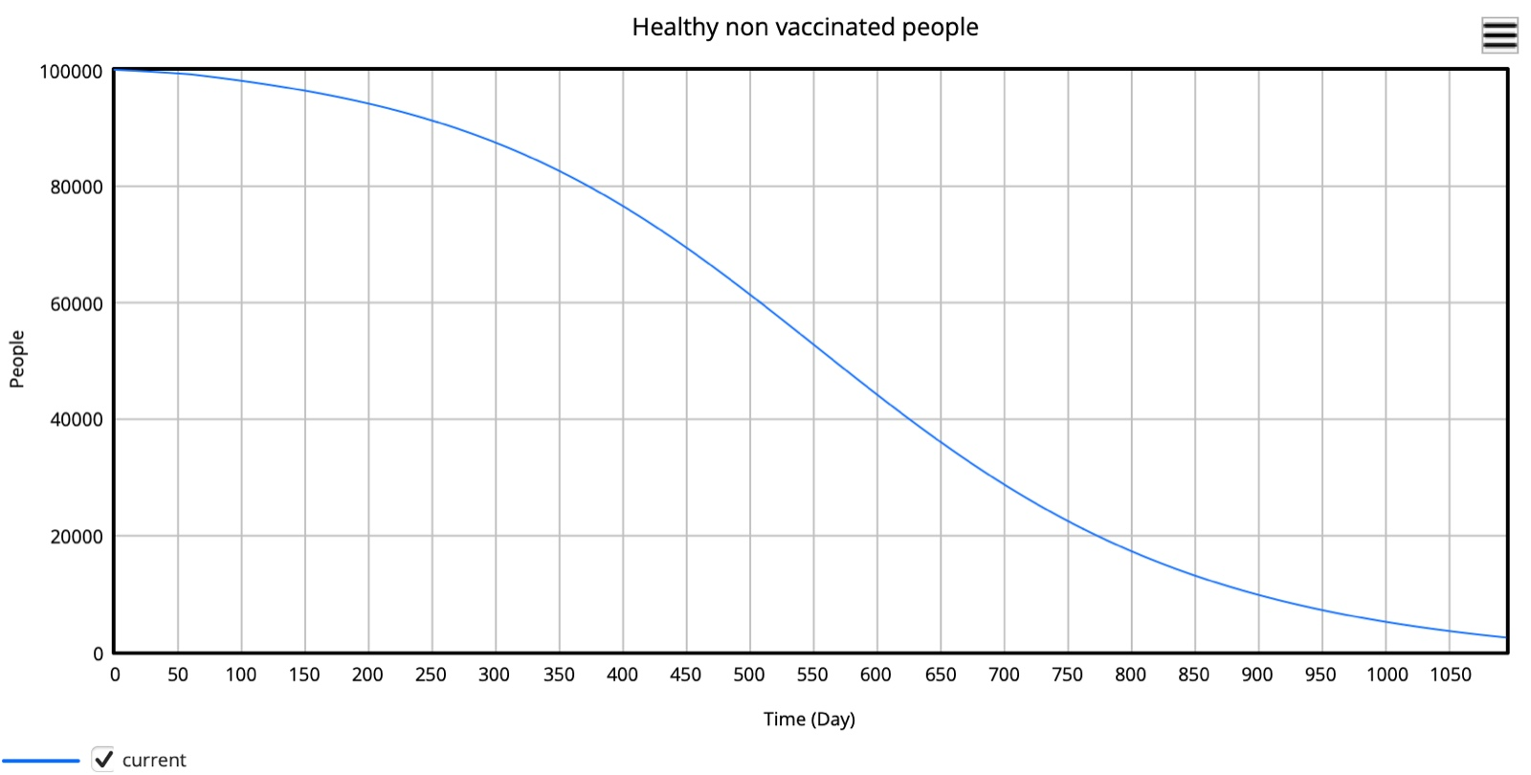
Simulation Trends
8
Vaccinated vs. Unvaccinated Population
Vaccinated People
Non-Vaccinated People

Slide 10
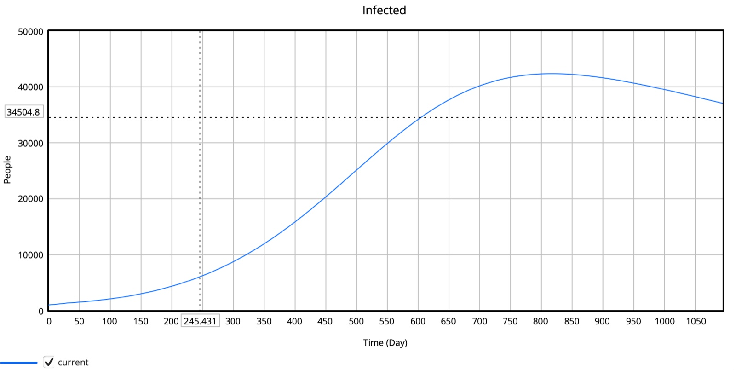
Simulation Trends
9
Infected Population Graph
Infected

Slide 11
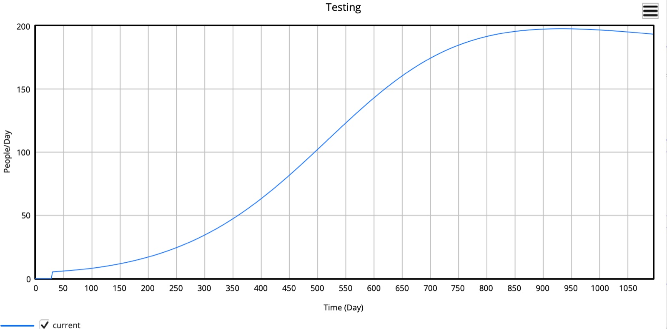
Simulation Trends
10
Testing Rate

Slide 12
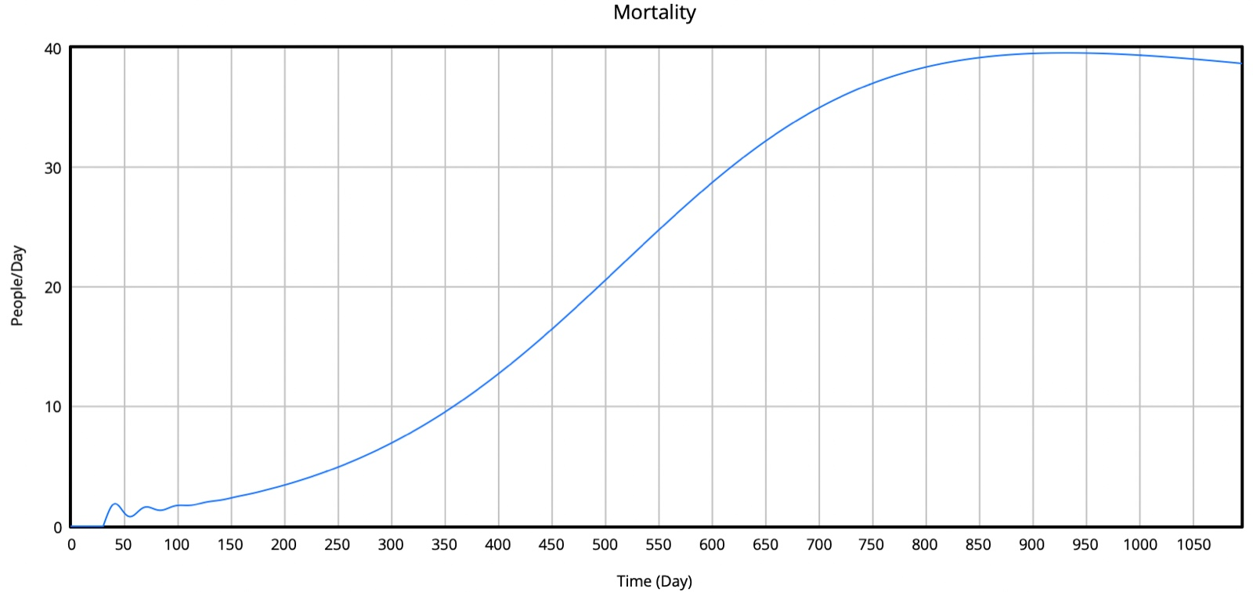
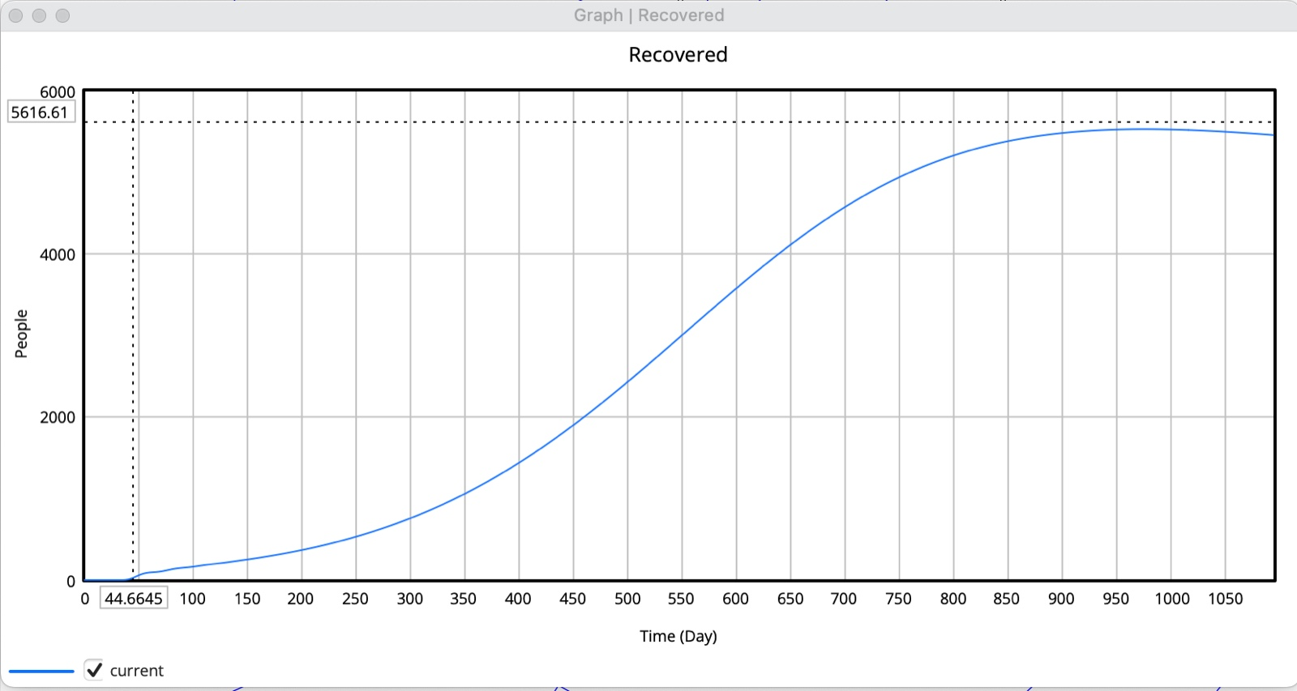
Simulation Trends
11
Mortality vs Recovered
Mortality
Recovered

Slide 13
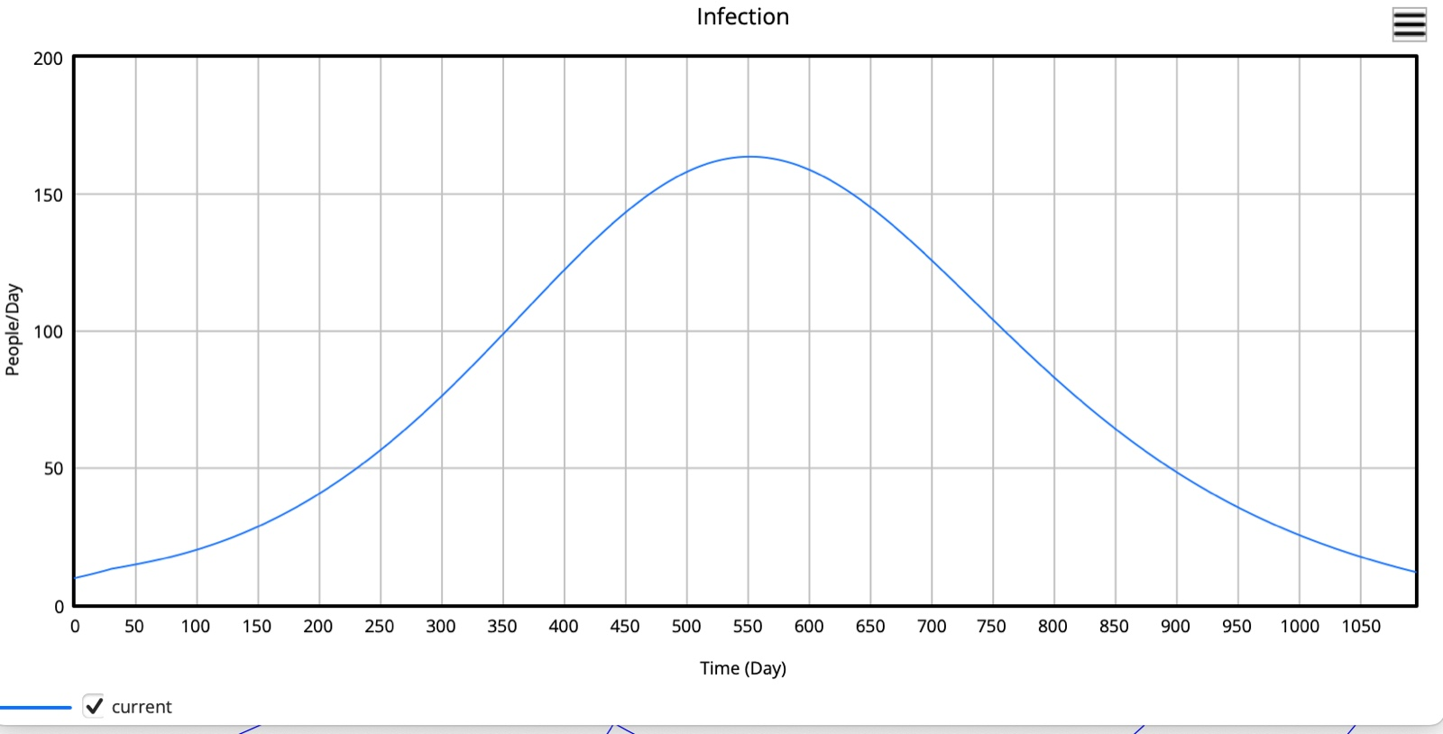
Simulation Trends
12
Infection Trend

Slide 14
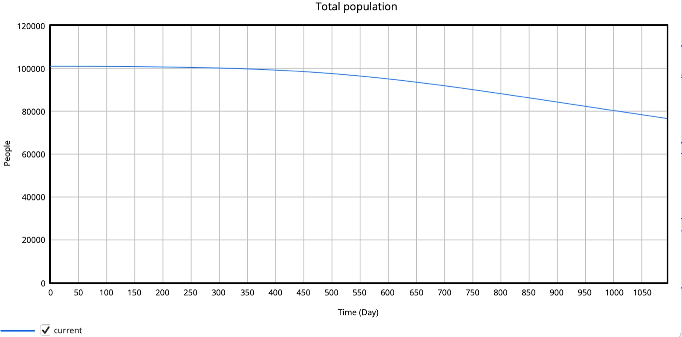
Simulation Trends
13
Total Population

Slide 15
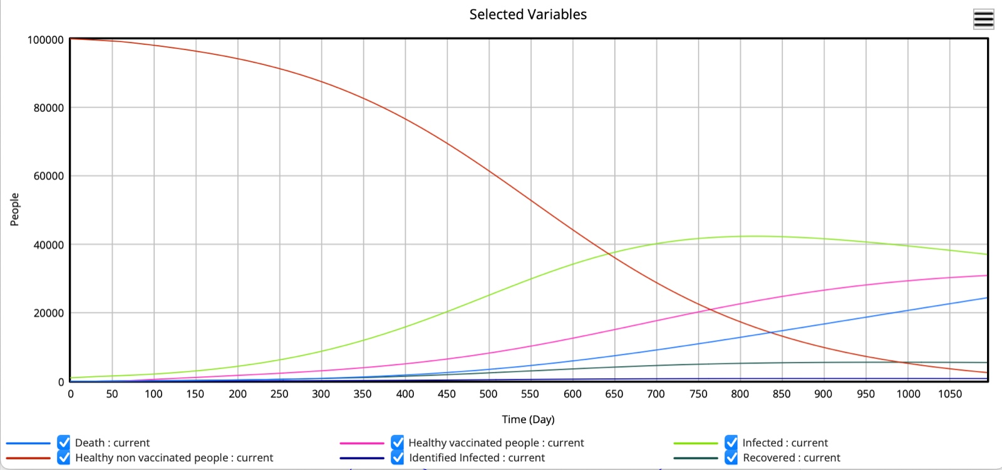
Simulation Trends
14
Comparison Graph

Slide 16
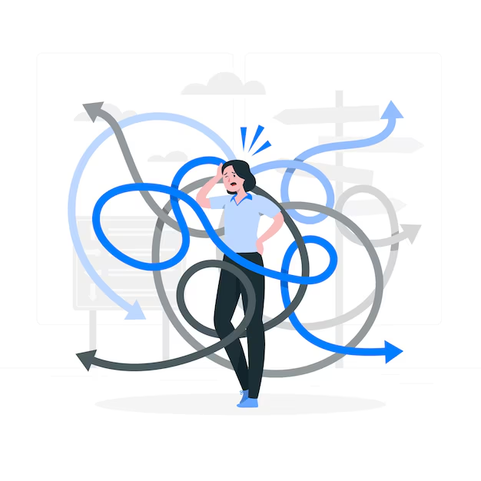
Challenges Faced
15
Model Complexity: Moving from a simple SIR model to a detailed one (with vaccination, deaths, etc.) made the design harder.
Parameter Sensitivity: Small changes in numbers led to big differences in the results, causing instability.
Flow Logic Issues: Setting up correct flows between different groups was tricky and prone to mistakes.
Learning the Software: Understanding how to use Vensim effectively took time and practice.

Slide 17

Identified Solution
16
Step-by-step Modeling: We made small parts of the model first (like infection and recovery) and joined them later.
Tested with Different Values: We changed parameters like infection rate to see how the model behaves.
Checked with Graphs: We used Graphs to make sure all flows between groups were correct.
Practiced with Software: We learned the tool (Vensim) by trying simple examples and watching tutorials.

Slide 18
Conclusion
17
Insight into Disease Dynamics: The model helps understand how pandemics spread and how vaccination impacts the population.
Testing Policy Strategies: It simulates how different interventions like lockdowns and vaccines affect infection rates.
Real-World Reflection: Despite data gaps, the model mirrors key trends seen in actual pandemics.
Supports Decision-Making: It aids policymakers by testing different scenarios for effective pandemic management

Slide 19
18
Reference
Government of India. (n.d.). Arogya Setu App – COVID-19 tracker. MyGov. Retrieved from hhttps://www.mygov.in/aarogya-setu-app/
Mutanga, S. S., Ngungu, M., Tshililo, F. P., & Kaggwa, M. (2021). Systems dynamics approach for modelling South Africa's response to COVID-19: A “what if” scenario. Journal of Public Health Research, 10(1), 1897. https://doi.org/10.4081/jphr.2021.11897
Venkateswaran, J., & Damani, O. (2020). Effectiveness of testing, tracing, social distancing and hygiene in tackling COVID-19 in India: A system dynamics model. Center for Policy Studies, IIT Bombay.
IIT Bombay. (n.d.). Institute logo. Retrieved from https://www.iitb.ac.in/

Slide 20
19
THANK YOU

