Slide 1

Probabilistic Fracture Simulation of Materials
Submitted to
Prof Rajib Chowdhary
Submitted by
Abhinandan Sharma
Enrollment number
20523001
Civil Engineering Department, IIT Roorkee

Slide 2

Introduction
based on the crack tip stress and strain fields and the non-linear fracture mechanics have been developed. Their applications to the studies of fracture initiation and stable crack growth may differ because of the difference in the basic postulates of various fracture theories.
This seminar topic focuses on :
The Fundamentals of the fracture mechanics
computational methodology on furthering the understanding of fundamental fracture phenomena.
The methodology for probabilistic fracture mechanics analysis (PFM)
The current numerical approaches to the solution of fracture mechanics problems.

Slide 3
Fundamental Basis Of Fracture Mechanics
At the fracture initiation of a cracked brittle solid in the condition of fixed grip, the release rate of the stored strain energy equals or exceeds the dissipative surface energy rate.
γ, the surface energy per unit area;
For Fracture initiation for brittle materials ∂U_{ε}/∂a ≥ ∂U_{s}/∂a, U_{ε} and U_{S} are strain energy and surface energy; and a, crack length.
K characterizes crack tip stresses, strains and displacements forms the fundamental basis of the linear elastic fracture mechanics rather than the global energy balance.
Recently crack tip stress, strain and displacement fields can be characterized by J, which is a contour independent integral or rate of potential energy change during the cracking process in a non-linear elastic solid. J has been widely used to study non-linear fracture mechanics.

Slide 4
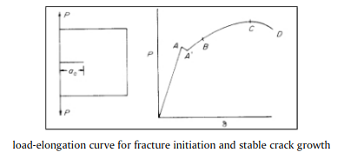
Defining Fracture
The “crack” suddenly starts to propagate internally at A.
The increased crack length increases the compliance of the specimen and causes the sudden load drop from A to A’.
As the load increases, the crack continues its internal growth.
At B, the crack front at the specimen surface starts to move forward, and the crack continues to grow in a “stable”manner to the maximum load C.
D is the point of final separation,
fracture mechanics studies the fracture initiation at A and the stable crack growth from A’ to B and onwards.
Often the point of fracture initiation is not so clearly defined as shown in the figure. In this case, certain degree of arbitrariness has to be introduced in order to define fracture initiation. Fracture can be defined in terms of the above described macrofeatures or in terms of the micro-structural features such as fracture of brittle inclusions, etc

Slide 5

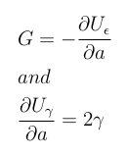
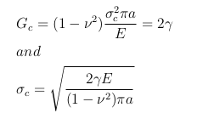

Griffith Criterion
Griffith proposed the criterion of brittle fracture based on the principle of global energy balance.
where U _{ε} is the strain energy and U _{γ} is the surface energy.
which is constant. For a small crack in a large plate, we have, at fracture.
U_{γ} is surface energy; U_{ε} is strain energy; and U_{p} is plastic work
γ, the surface energy per unit area;
.

Slide 6
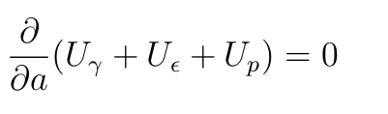
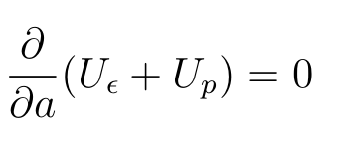

Global Energy Balance Theory
rp= plastic zone
At fracture we have:
It is known that U_{γ} ≪ U_{p} . Neglect U_{γ} , we get:
The relation between work dissipation U p and crack lengh ”2a” can be found. The classic plasticity theory shows, r_{p} ∝ a , and U_{p} ∝ r_{p}² which gives
U_{γ} is surface energy; U_{ε} is strain energy; and U_{p} is plastic work.

Slide 7
Global Energy Balance Theory
The experimental evidences that demonstrate the failure of the global energy balance are well known. But they have not been recognized as such. Figure shows the thickness effects on fracture toughness. The fracture toughness varies from 40 MPa√m for K_{Ic} , to the maximum value of 107 MPa√m. The strain energy release rates of the two limiting cases of plane strain and plane stress states differ by a factor of (1 − ν² ).v is Poisson’s ratio. The difference is approximately 10%. If the plastic energy dissipation rate is constant, the difference in fracture toughnesses should not be more than 10%.
But there can be vast differences in the experimental and the theoritical data
In order to explain the observed experimental phenomena, it is necessary to resort to the difference in the state of crack tip stress field. The lower plastic energy dissipation rate in the state of plane strain is caused by the triaxial state of tensile stress, which causes reductions in effective stress, plastic deformation, and plastic energy dissipation; and it causes an increase in maximum tensile stress and an earlier fracture initiation.

Slide 8
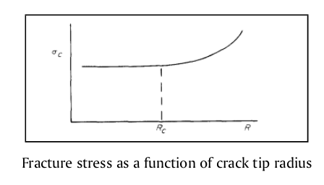
Sharp Notch Analysis
All crack tips are “blunted,” so sharp notches and cracks can be considered as equivalents.
The fracture stress of a notched specimen depends on notch root radius, R.
We will consider sharp elleptical notches in large plates under tensile loading in a direction perpendicular to the major axis.When a solid contains a sharp notch of initial root radius Ri , the radius increases with the applied load. If the root radius increment, ∆R is much larger than R_{i} , the fracture stress σ_{c} is independent of R_{i} . If the size of the fracture process zone, ρ_{F} is much larger than R_{i} , σ_{c} will also be independent of R_{i} . In our analysis, we assume R is always less than R_{c}

Slide 9
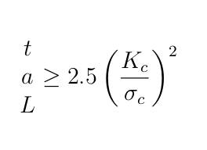
The Theory Of K-characterization
Under the condition of small scale yielding, SSY, K characterizes the crack tip stresses and strains even within r_{p} .
The crack tip σ_{ij} and ε_{ij} are not only affected by the planar dimensions of “a” and “L”. They are also strongly affected by the specimen thickness, t.The size requirements needed to satisfy the condition of SSY and that of plane strain are
Let us illustrate this with two samples of different geometry but they are loaded to the same K-value. These samples are made of the same material and have the same thickness.

Slide 10
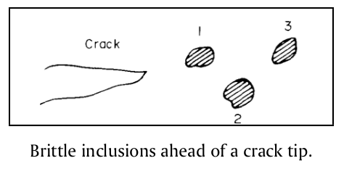
Fracture Process Zone
They contain brittle and ductile phases, inclusion particles, grain boundaries, etc. Fracture initiation in a cracked solid is often in the interior of a specimen, where the high tensile stress exists at the locations of brittle and weak materials.
The fracture at inclusion I increases the stress at inclusion 2, and the increased stress causes the fracture of inclusion 2. Ductile fracture takes place between the brittle particles. If the brittle inclusions are large and closely spaced, it may cause an avalanche effect, one particle fracturing rapidly after the other. The fracturing process stops when the crack is out of the zone of the high tensile stress in the plane strain triaxial state of tension. The crack extension could be sizable and could cause noticeable load drop. This is the well known phenomenon of pop-in and is a local instability. Hence, K_{lc} is the result of a local instability phenomenon, not a global instability.
Materials are inhomogeneous
They contain brittle and ductile phases, inclusion particles, grain boundaries, etc. Fracture initiation in a cracked solid is often in the interior of a specimen, where the high tensile stress exists at the locations of brittle and weak materials.
Once a local fracture is initiated, it spreads out. For example, local fracture may start at inclusion 1 (Figure below).

Slide 11
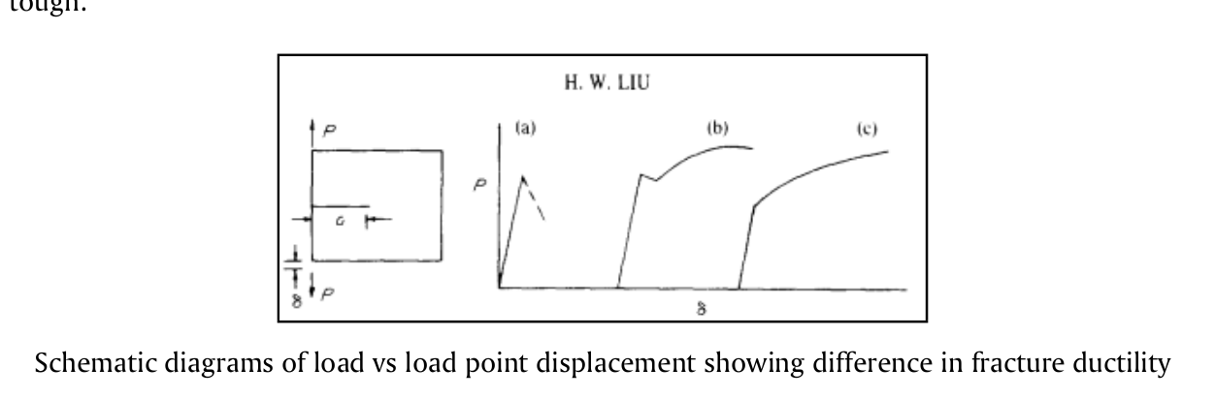
Fracture Toughness And Fracture Ductility
The initiated local fracture will continue to propagate. The extent of fracture propagation varies according to the “brittleness” of the material. The fracturing processes can be classified in three categories.
(1) Once initiated, the localized fracture will continue to grow rapidly across the specimen without further increase in σ∞ or K. It is very brittle .
(2) Once initiated, the localized fracture will continue to grow to a sizable extent in a rapid manner while σ∞ and K drop. After the initial fracture, it needs to increase K in order to continue to grow further. Fracture is initiated in the interior in the plane strain region, and the initial fracturing process will stop when the crack is out of the zone of triaxial state of tension.
(3) If fracture initiation is caused by brittle particles and if the brittle particles are small and far apart, once the local fracture is initiated, it needs a considerable amount of plastic deformation to grow across the regions

Slide 12
Numerical Methods For Solution Of Fracture Problems
Employment of the finite difference operators results in a system of algebraic equations for the discrete nodal values of the field variable. The finite difference method can be used to discretize both space and time. The finite difference method is difficult to use for irregularly shaped domains or for problems involving singularities, because the fine meshing required near a singularity cannot easily be reduced for the rest of the domain
This approach yields excellent solutions; however, it requires an extensive analytic formulation which is different for each new problem. The method is quite useful, nonetheless, for establishing benchmark solutions to compare with other methods as the degree of accuracy can be guaranteed. The method is only applicable to elasticity problems (without non-linearities). For three-dimensional problems, the derivation of the integral equations becomes quite laborious.
Finite difference method is the oldest technique for the solution of boundary value problems. The method directly involves the solution of the governing differential system in an approximate manner by subdividing the domain of interest into a connected series of discrete points called nodes. These nodes are the sampling points for the solution and are linked using the finite difference operators to the governing equations.
Integral equation methods basic approach employed involves an analytic formulation of the elasticity problem to the point of a singular integral equation. The singularity is then extracted and the result is a non-singular integral equation which can be solved quite accurately with any number of techniques.

Slide 13
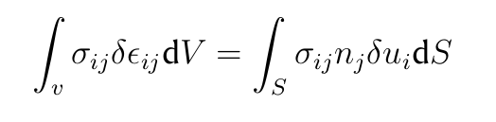
Numerical Methods For Solution Of Fracture Problems
Boundary Integral Equation Method (BIEM) is a numerical approach to the solution of linear boundary value problems with known Green’s function solutions. The boundary of the domain of interest is discretized using ”elements” which are interconnected at discrete points called nodes.
Finite Element Method is the most widely employed numerical method for fracture mechanics problems. The formulation of the FEM is based on a variational statement of the governing physics. For the problems of linear elasticity, the Principle of Virtual Work, given by

Slide 14
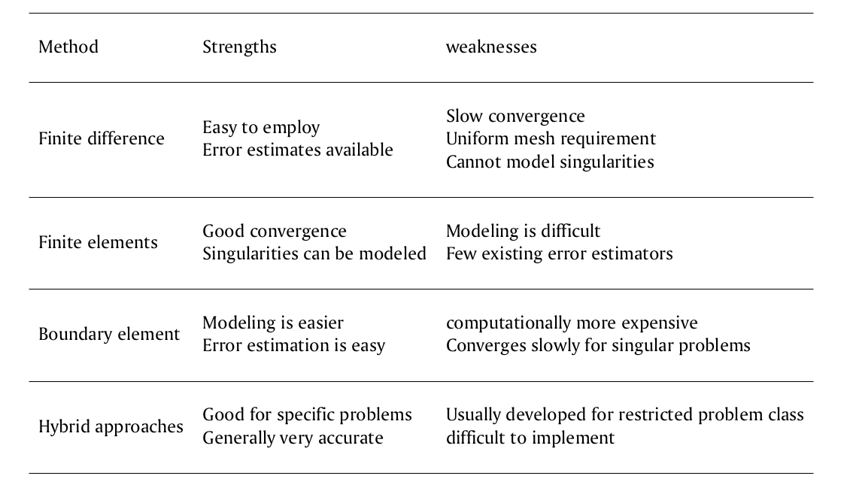
Numerical Methods For Solution Of Fracture Problems

Slide 15
Probabilistic Fracture Mechanics
Many factors contribute to reliability and these often change both systematically and at random. In the past, structures have been designed using a simple factor of safety approach to calculate a safe lifetime over which the applied loads will be sustained. Each variable in the equations governing the operation of the system was given a reasonable value drawn from past results or even just human intuition, and a predicted life obtained. This was then divided by a factor of safety which reduced it to give a ’safe’ maximum operating life. It was conceivable that this is unrealistically conservative but simple.
One approach is to use historical data from past failures and non-failures to evaluate the reliability of current productions.
An alternative approach has been sought, namely the development and application of engineering models based on an understanding of the failure modes and statistical distributions of the controlling parameters.Ideally, a combination of the two methods is necessary so that past experience and results plus specially designed laboratory tests can be used to obtain statistical distributions which best fit these data, but also, hopefully provide predictions about altered or new systems.
The problem is divided in:
1. The basic problem: The two main considerations are the distribution of (1)crack-like defects introduced during the fabrication of a structure and (2)the critical crack length distribution for the material under service conditions. From a failure point of view, it is importanl to know how this distribution compares with that of the critical crack size, which is controlled by the material properties, and applied loading. The probability of failure is then given by the probability of interaction of the actual crack or flaw a_{i} , and a critical crack length a_{c}.
2. Further considerations: Closely linked with the as fabricated flaw size distribution is the role played by non-destructive testing in detecting defects which may, or may not, be repaired.
In situations where fatigue cracking occurs, the defect distribution will tend to alter with the number of applied cycles.
the latter being controlled primarily by the fracture toughness.
,In general, there is a lack of data for the initial distribution of defects in a structure so the distribution is often assumed to be lognormal or exponential
This problem may be reduced by in-service inspection at fixed intervals of time, and by repairing the defects so found.

Slide 16
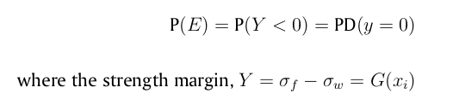
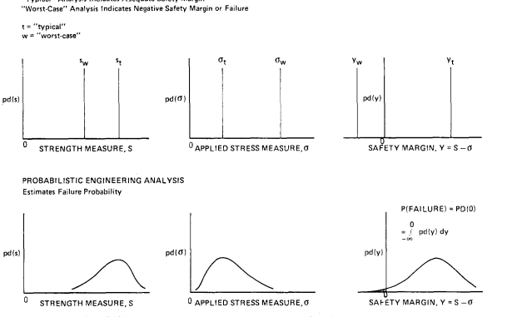
Statistical Basis Of PFM
In the probabilistic treatment, the random variations are described using distributions of values for the parameters rather than one deterministic value. The distribution may be thought of as a curve combining the possible values and the likelihood (probability) they will occur. The introduction of distributions of values necessarily complicates an analysis, but the end result is likely to be more accurate and hence of more use. In some cases, neat analytical expressions for the reliability are impossible and numerical approximations are required. Approximate interactive algebraic procedures are used to determine an estimate of the failure probability ( = 1 - reliability), whereas in the latter, the approximation is at a later stage, after all the exact probabilistic expressions have been obtained for the complete system; this ibe justified by the improvement gained.s, of course, much harder, and the work involved may not be justified by the improvement gained.
with i = 1.....n_{x} , depends on input variables that at affect component stress or strength or both. An alternative definition in terms of a strength ratio Y = σ_{f} /σ_{w} is equally valid and leads to P(E)=P((Y )< 1)
The basis of PFM is the simple axiom that a given mode of failure event E will occur when the stress σ_{w} associated with the failure mode exceeds the mode governing strength σ_{f} . The probability of failure mode E is given by

Slide 17
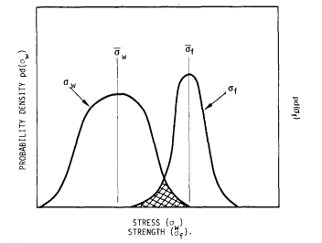
Statistical Basis Of PFM
Here, G is a concise deterministic summary of all prior engineering experience, models, and assumptions. If the engineering analysis does not lead to an obvious functional form, G may be obtained from standard least- squares fitting of the engineering data or by the repetitive analysis procedure.the x_{i} are most realistically described as random variables X_{i} rather than single assigned deterministic values. Statistical interpretation of the X_{i} results in the interpretation of strength margin as a random variable. The statistical interpretation also allows the analyst to quantify his uncertainty of the engineering model G based on judgement, and his previous record of predictive success and failure. This error quantification is done by introducing one or more additional X_{i} to serve as ’error terms’. The cumulative distribution functions of the X_{i} , represented b

Slide 18
PFM by using Monte Carlo simulation and Scaled Boundary Finite Element Method
In PFM, the sensitivity of the stress intensity stresses are more often than not required to predict the reliability or probability of fracture initiation.
For Monte Carlo simulation (MCS) method , uncertainties in the applied load, material properties, and crack geometry are modeled as random variables described by specific probability distribution functions.
The scaled boundary finite-element method is employed to investigate the shape sensitivity of the stress intensity factors of a crack to the size and orientation of the crack. Only a single boundary mesh is required. The variation of the crack size and orientation can be represented by simply changing the position of the crack tip without the need for remeshing the boundary.
For each of the Monte Carlo samples, the SIFs, which are sensitive to the randomness of the variables, are computed. The resulting SIFs are compared with the material toughness to evaluate whether failure will occur.
Therefore, the repetitive deterministic analysis is made simple, elegant, and highly efficient as compared to most other numerical methods. Thus, it becomes feasible to use the brute force MCS method for the reliability analysis of a cracked structure.

Slide 19
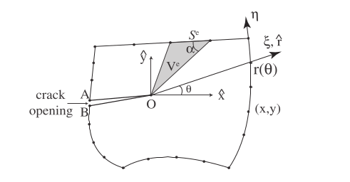
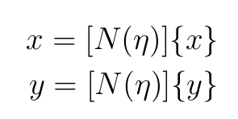
Scaled Boundary Finite Element Method
The boundary is discretized with line elements. The nodal coordinates at the boundary are denoted {x} and {y}, with shape functions [N (η)] in the local coordinate η . Thus for any point on the boundary the Cartesian coordinates (x, y), can be interpolated by
The geometry of the domain satisfies the scaling requirement, i.e., the whole boundary of the domain is directly visible from the crack tip.
Problems of more complex geometry can be divided into such smaller subdomains. The scaling center O is selected at the crack tip.
Without loss of generality, the origin of the Cartesian coordinates x̂ and ŷ is defined at the scaling center.

Slide 20
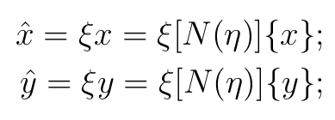
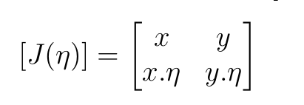
Scaled Boundary Finite Element Method
The coordinates of any point within the domain (x̂, ŷ) can then expressed as:
where the scaling factor ξ takes the value of 0 at the scaling center and 1 on the boundary.
ξ and η are called the scaled boundary coordinates.
To avoid the Jacobian of the scaled boundary coordinate transformation approaching zero, the acute angle formed by a radial line and the boundary should not be too small.

Slide 21

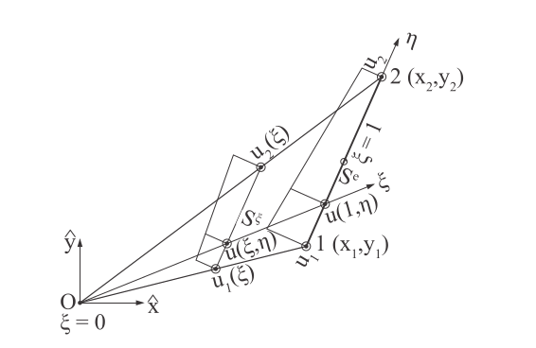
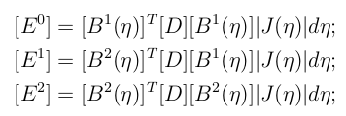
Scaled Boundary Finite Element Method
Applying a weighted residual technique in the η direction leads to the following scaled boundary finite element equation in displacement
The global coefficient matrices [E⁰], [E¹]and [E²]
are obtained by assembling the element coefficient
matrices same manner as for the stiffness matrices
where [D] is the elasticity matrix. where [B¹(η)] and [B²(η)] describe the strain-displacementt
As shown in Figure below for a single 2-node element, nodal displacement functions u(ξ) are introduced along the radial lines passing through the scaling center O and a node on the boundary. Along the circumferential direction η , the displacements is obtained by interpolating the nodal displacement functions

Slide 22

Scaled Boundary Finite Element Method
The displacement functions u(ξ) are expressed as
where [S_{i} ](i = 1, 2, ..., N ) are diagonal blocks of the real Schur matrix, [Ψ_{i}^{(u)} ] the corresponding displacement modes and c integration constants, which are determined from the displacements on the boundary u(ξ = 1)

Slide 23
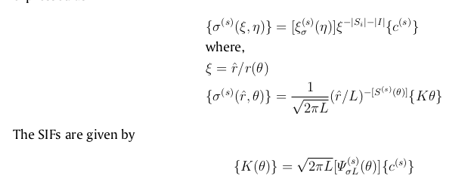
Scaled Boundary Finite Element Method
When the real parts of the eigenvalues of a diagonal block [S_{i}] are between -1 and 0, the matrix power function leads to a stress singularity. The diagonal block is denoted as [S^{(s)} ] (superscript (s) for singular) and −1 < λ[S^{(s)}] < 0 applies. The corresponding displacement modes and integrationconstants are denoted as [Ψ^{(s)}] and {C^{(s)}}Their contribution to stresses vanishes when the limit ξ→0 is performed and thus are not needed for the definition of stress intensity factors. The singular stress field is expressed as
Evaluation of stress intensity factors:

Slide 24

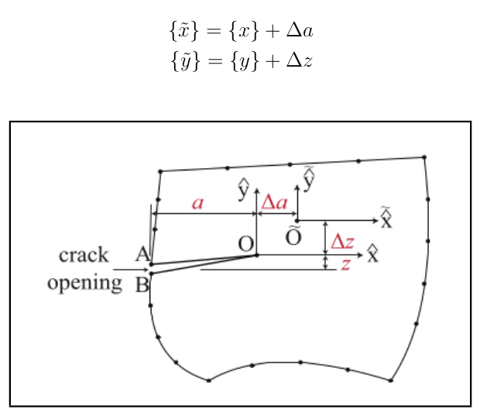
Scaled Boundary Finite Element Method
Shape sensitivity:

Slide 25
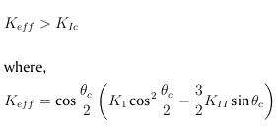
Fracture Failure Criteria
Mode-I failure: During fracture, the material can be associated with its own characteristic resistance to fracture known as the ’fracture toughness’ K_{Ic} such that the crack will grow under Mode-I loading when
Mixed-Mode Failure: The failure criteria can be simplified, for 2D Mixed-Mode loading, as

Slide 26
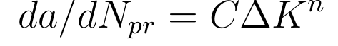

Monte-Carlo Simulation
where C, n are empirically determined constants, a is the radius of a circular crack in the fracture plane, ∆K is the range of stress intensity factor, and N_{pr} is the number of fatigue cycles.
For the case of a buried circular crack remote from the surface and extending through the uniform tensile stress field, we have
where ∆σ is the range of stress If these equations are combined and integrated, the following expression for fatigue life N_{pr} is obtained:
We now consider a buried elliptical crack of fracture plane area A_{i} = πcb where c ≤ b are the major and minor semi-axes of the elliptical projection of the flaw on the fracture plane. The results of a more advanced analysis, shows that eq. is reasonably accurate for the elliptical crack, with b/c≪40, as well as the circular crack of equal area for which eq. is derived. For the purpose of the PFM analysis below, we compact the notation and take the logarithm of eq. to obtain
The deterministic fracture mechanics problem:
Assume a high toughness material with crack growth relation given by
Range of Stress Intesity is given by
From this we get number of cycles as,
Now we compact and take the logrithmic equation

Slide 27

Monte-Carlo Simulation
Distributions of the input random variables C, ∆σ, A_{i} :
The relationship is obtained from Cr-Mo -V steel crack growth data and is used to compute median crack growth rates in in./cyc. For this steel the mean yield stress is σ̄ = 85ksi. The above assumptions can be compacted into the notation
The probabilistic stress distribution shown is formulated from three assumptions. These are
(1) log-normality;
(2) 95% of the spindle material, by volume, will encounter ∆σ < 0.80σ̄ _{y};
(3) 95% of the material volume will encounter ∆σ > .25σ̄ _{y}. Finally we assume the flaw size
distribution that is used to determine A_{i} obeys the relation log A_{i} = N (−0.9586, 0.750).
that is, log C is a normal random variable with median and mean μ_{c} = log(6.76X10 −11 ) and standard deviation S_{c} . For the example, we further assume a log-normal stress variation of log ∆σ=N̄ (1.5799, 0.1535), which means that Ao has a median value of 38 ksi with 0.1535 standard deviation on log σa due to stress gradients, and spindle-to-spindle design and usage variations.

Slide 28

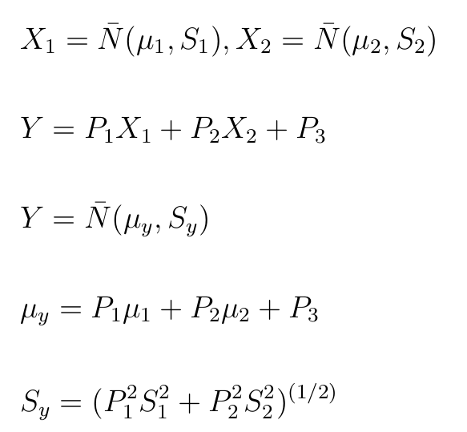
Monte-Carlo Simulation
The probabilistic analysis: We assume that each rotor spindle must endure the equivalent of 3000 cycles in service, where each cycle comprises a cold start-up, operation and shut- down. The assumption of constant usage allows a simple definition of Y such as
S standard deviations

Slide 29
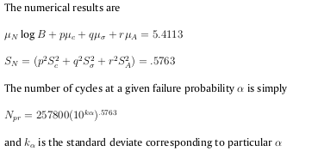
Monte-Carlo Simulation

Slide 30
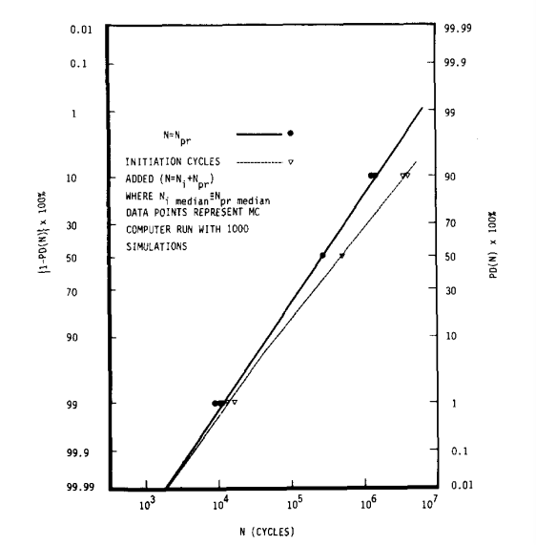
Monte-Carlo Simulation
Probabilistic addition of crack initiation cycles:
The MC program can be utilized to investigate the effect of non-zero initiation life N_{i} on total fatigue life. For example, the total fatigue life can be written as
where N_{i} is proportional to D

Slide 31
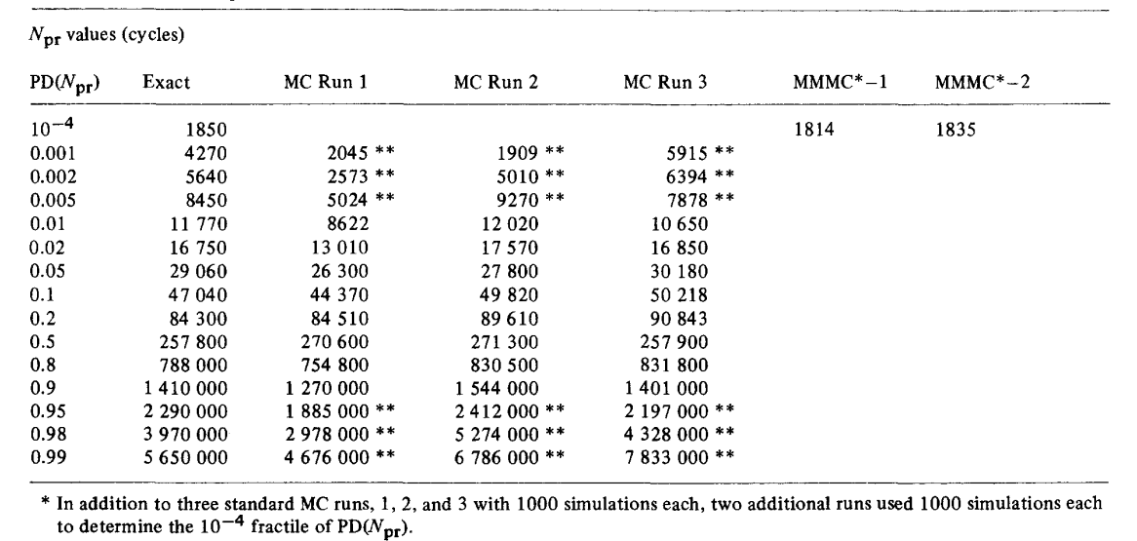
Monte-Carlo Simulation

Slide 32
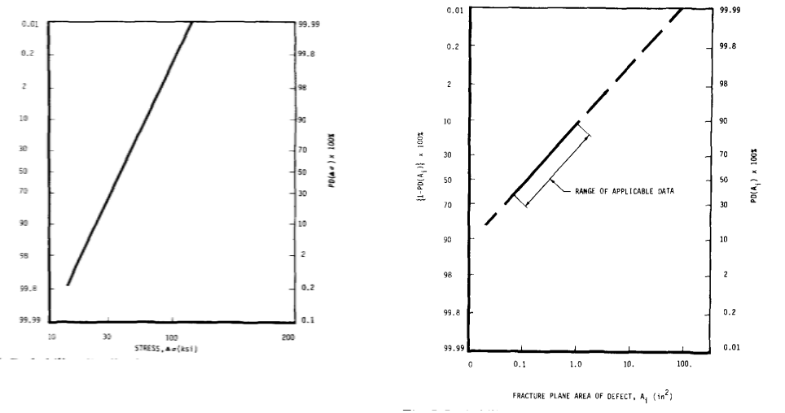
Monte-Carlo Simulation
Distributions of the input random variables C, ∆σ, A_{i} :
The relationship is obtained from Cr-Mo -V steel crack growth data and is used to compute median crack growth rates in in./cyc. For this steel the mean yield stress is σ̄ = 85ksi. The above assumptions can be compacted into the notation
The probabilistic stress distribution shown is formulated from three assumptions. These are
(1) log-normality;
(2) 95% of the spindle material, by volume, will encounter ∆σ < 0.80σ̄ _{y};
(3) 95% of the material volume will encounter ∆σ > .25σ̄ _{y}. Finally we assume the flaw size
distribution that is used to determine A_{i} obeys the relation log A_{i} = N (−0.9586, 0.750).
that is, log C is a normal random variable with median and mean μ_{c} = log(6.76X10 −11 ) and standard deviation S_{c} . For the example, we further assume a log-normal stress variation of log ∆σ=N̄ (1.5799, 0.1535), which means that Ao has a median value of 38 ksi with 0.1535 standard deviation on log σa due to stress gradients, and spindle-to-spindle design and usage variations.

Slide 33
Conclusion
Fracture initiation and stable crack growth are local fracture phenomena. Therefore, in order to apply the energy principle, the variation of the local crack tip stresses and strains and the associated detailed fracture process have to be taken into consideration
A probabilistic fracture mechanics (PFM) analysis is often necessary in order to achieve accurate estimates of reliability of structural components and to study the effects on reliability of systematic and stochastic variation in controlling parameters.
To enhance future PFM applications, data collection efforts should seek to quantify the variational characteristics and the uncertainties of the studied parameters. In this manner, a data base of input parameter probability distributions can be formed to facilitate future PFM and other engineering probability and risk analyses.
For structural components with two or more interrelated failure modes, such as yielding and brittle failure, PFM is required to minimize the component failure probability due to all modes. For example, no single value of mean stress or yield-related safety factor, such as might be specified as part of conventional engineering practice, suffices to minimize yielding and fracture failures for all combinations of mean stress and flaw size.
To enhance future PFM applications, data collection efforts should seek to quantify the variational characteristics and the uncertainties of the studied parameters. In this manner, a data base of input parameter probability distributions can be formed to facilitate future PFM and other engineering probability and risk analyses.

Slide 34
Thank You

