Slide 1



Grant Proposal for Project Name
Organization Name

Slide 2

Introduction
This seminar topic focuses on :
The Fundamentals of the fracture mechanics based on the crack tip stress and strain fields and the non-linear fracture mechanics have been developed. Their applications to the studiesof fracture initiation and stable crack growth may differ because of the difference in the basic postulates of various fracture theories.
The impact of computational methodology on furthering the understanding of fundamental fracture phenomena. The current numerical approaches to the solution of fracture mechanics problems.
The methodology for probabilistic fracture mechanics analysis (PFM) of structural components with crack-like imperfections. Details are given for the development and application of both a simple nomographic method and a basic numerical tool for PFM application

Slide 3
Fundamental Basis Of Fracture Mechanics
At the fracture initiation of a cracked brittle solid in the condition of fixed grip, the release rate of the stored strain energy equals or exceeds the dissipative surface energy rate. ∂U_{ε} /∂a ≥ ∂U_{s} /∂a = 2γ, where U _{d} and U_{S} are strain energy and surface energy; γ, the surface energy per unit area; and a, crack length.γ is constant for a given material. Assuming a constant dissipative rate of plastic energy Γ , Irwin and Orowan extended the energy criterion to metallic solids, where plastic deformation takes place at crack tips.
The crack tip elastic stresses, strains and displacements are characterized by the stress intensity factor, K.K characterizes crack tip stresses, strains and displacements forms the fundamental basis of the linear elastic fracture mechanics rather than the global energy balance. So, recently crack tip stress, strain and displacement fields can be characterized by J, which is a contour independent integral.J is also the rate of potential energy change during the cracking process ina non-linear elastic solid. J has been widely used to study non-linear fracture mechanics.

Slide 4
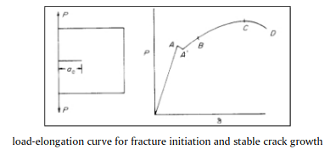
Defining Fracture
Figure shows a cracked sample and its load P vs load point displacement,δ. The “crack” suddenly starts to propagate internally at A. The increased crack length increases the compliance of the specimen and causesthe sudden load drop from A to A’. As the load increases, the crack continues its internal growth. At B, thecrack front at the specimen surface starts to move forward, and the crack continues to grow in a “stable”manner to the maximum load C. D is the point of final separation, fracture mechanics studies the fracture initiation at A and the stable crack growth from A’ to B and onwards. Often the point of fracture initiation is not so clearly defined as shown in the figure. In this case, certain degree of arbitrariness has to be introduced in order to define fracture initiation. Fracture can bedefined interms of the above described macrofeatures or in terms of the micro-structural features such as fracture of brittle inclusions, etc

Slide 5

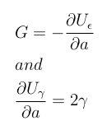
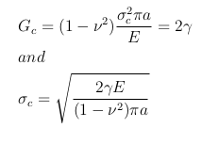

Griffith Criterion
Griffith proposed the criterion of brittle fracture based on the principle of global energy balance.
where U _{ε} is the strain energy and U _{γ} is the surface energy.
which is constant. For a small crack in a large plate, we habbve, at fracture.

Slide 6
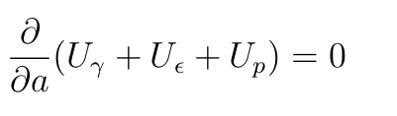
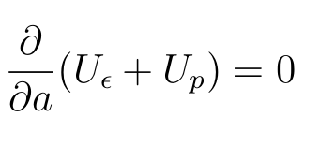
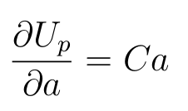

Global Energy Balance Theory
At fracture we have:
U γ is surface energy; U_{ε} is strain energy; and U_{p} is plastic work. It is known that U_{γ} ≪ U_{p} . Neglect U_{γ} , we get:
This leads to G_{c} = (∂U_{p} /∂a). In infinite metallic plate in the condition that strain prevails due to enough thickness. As cracks extend under σ∞ , the relation between work dissipation U p and crack lengh ”2a” can be found. The classic plasticity theory shows, r_{p} ∝ a , and U_{p} ∝ r_{p}² which gives
C is proportionality constant, which gives:

Slide 7
Global Energy Balance Theory
The experimental evidences that demonstrate the failure of the global energy balance are well known. But they have not been recognized as such. Figure shows the thickness effects on fracture toughness. The fracture toughness varies from 40 MPa√m for K_{Ic} , to the maximum value of 107 MPa√m. The strain energy release rates of the two limiting cases of plane strain and plane stress states differ by a factor of (1 − ν² ).v is Poisson’s ratio. The difference is approximately 10%. If the plastic energy dissipation rate is constant, the difference in fracture toughnesses should not be more than 10%.
In order to explain the observed experimental phenomena, it is necessary to resort to the difference in the state of crack tip stress field. The lower plastic energy dissipation rate in the state of plane strain is caused by the triaxial state of tensile stress, which causes reductions in effective stress, plastic deformation, and plastic energy dissipation; and it causes an increase in maximum tensile stress and an earlier fracture initiation. The data clearly indicate that when the crack tip fields of the effective stress and the maximum tensile stress change, the fracture toughness will vary.

Slide 8
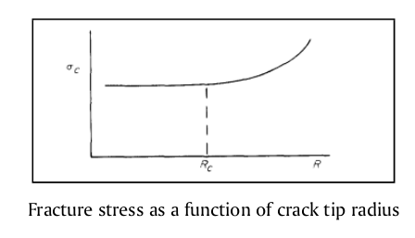
Sharp Notch Analysis
All crack tips are “blunted,” so sharp notches and cracks can be considered as equivalents. We will consider sharp elleptical notches in large plates under tensile loading in a direction perpendicular to the major axis.
The fracture stress of a notched specimen depends on notch root radius, R, as shown schematically in Figure. σ_{c} decreases with R. However, if the notch root radius is less than a certain value R_{c} ,σ_{c} is no longer R dependent. When a solid contains a sharp notch of initial root radius Ri , the radius increases with the applied load. If the root radius increment, ∆R is much larger than R_{i} , the fracture stress σ_{c} is independent of R_{i} . If the size of the fracture process zone, ρ F is much larger than R_{i} , σ_{c} will also be independent of R_{i} . In our analysis, we assume R is always less than R_{c}

Slide 9
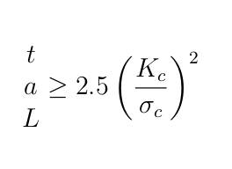
The Theory Of K-characterization
Under the condition of small scale yielding, SSY, K characterizes the crack tip stresses and strains even within r_{p} . Let us illustrate this with two samples of different geometry but they are loaded to the same K-value. These samples are made of the same material and have the same thickness
The crack tip σ_{ij} and ε_{ij} are not only affected by the planar dimensions of “a” and “L”. They are also strongly affected by the specimen thickness, t.The size requirements needed to satisfy the condition of SSY and that of plane strain are

Slide 10
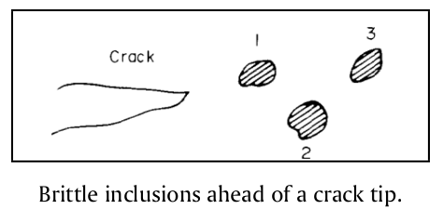
Fracture Process Zone
Materials are inhomogeneous. They contain brittle and ductile phases, inclusion particles, grain boundaries, etc. Fracture initiation in a cracked solid is often in the interior of a specimen, where the high tensile stress exists at the locations of brittle and weak materials. Once a local fracture is initiated, it spreads out. For example, local fracture may start at inclusion 1 (Figure below). The fracture at inclusion I increases the stress at inclusion 2, and the increased stress causes the fracture of inclusion 2. Ductile fracture takes place be tween the brittle particles. If the brittle inclusions are large and closely spaced, it may cause an avalanche effect, one particle fracturing rapidly after the other. The fracturing process stops when the crack is out of the zone of the high tensile stress in the plane strain triaxial state of tension. The crack extension could be sizable and could cause noticeable load drop. This is the well known phenomenon of pop-in and is a local instability. Hence, K_{lc} is the result of a local instability phenomenon, not a global instability.

Slide 11
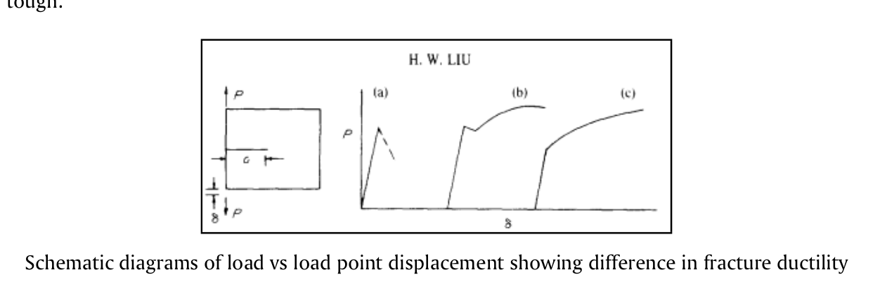
Fracture Toughness And Fracure Ductility
The initiated local fracture will continue to propagate. The extent of fracture propagation varies according to the “brittleness” of the material. The fracturing processes can be classified in three categories.
(1) Once initiated, the localized fracture will continue to grow rapidly across the specimen without further increase in σ∞ or K. It is very brittle .
(2) Once initiated, the localized fracture will continue to grow to a sizable extent in a rapid manner while (σ∞ and K drop. After the initial fracture, it needs to increase K in order to continue to grow further. Fracture is initiated in the interior in the plane strain region, and the initial fracturing process will stop when the crack is out of the zone of triaxial state of tension.
(3) If fracture initiation is caused by brittle particles and if the brittle particles are small and far apart, once the local fracture is initiated, it needs a considerable amount of plastic deformation to grow across the regions

Slide 12
Numerical Methods For Solution Of Fracture Problems
The problems may involve both material and geometric non-linearities, which complicate the formulation and render prediction of convergence extremely difficult. Because little can be done with these problems analytically, numerical methodologies are required.
The finite difference method is the oldest technique for the solution of boundary value problems. The method directly involves the solution of the governing differential system in an approximate manner by subdividing the domain of interest into a connected series of discrete points called nodes. These nodes are the sampling points for the solution and are linked using the finite difference operators to the governing equations. Employment of the finite difference operators results in a system of algebraic equations for the discrete nodal values of the field variable. The finite difference method can be used to discretize both space and time. The finite difference method is difficult to use for irregularly shaped domains or for problems involving singularities, because the fine meshing required near a singularity cannot easily be reduced for the rest of the domain

Slide 13
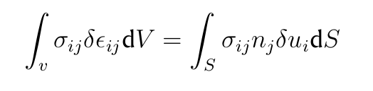
Numerical Methods For Solution Of Fracture Problems
Integral equation methods basic approach employed involves an analytic formulation of the elasticity problem to the point of a singular integral equation. The singularity is then extracted and the result is a non-singular integral equation which can be solved quite accurately with any number of techniques. This approach yields excellent solutions; however, it requires an extensive analytic formulation which is different for each new problem. The method is quite useful, nonetheless, for establishing benchmark solutions to compare with other methods as the degree of accuracy can be guaranteed. The method is only applicable to elasticity problems (without non-linearities). For three-dimensional problems, th++e derivation of the integral equations becomes quite laborious.
The Boundary Integral Equation Method (BIEM) is a numerical approach to the solution of linear boundary value problems with known Green’s function solutions. The boundary of the domain of interest is discretized using ”elements” which are interconnected at discrete points called nodes.
The Finite Element Method is the most widely employed numerical method for fracture mechanics problems. The formulation of the FEM is based on a variational statement of the governing physics. For the problems of linear elasticity, the Principle of Virtual Work, given by

Slide 14
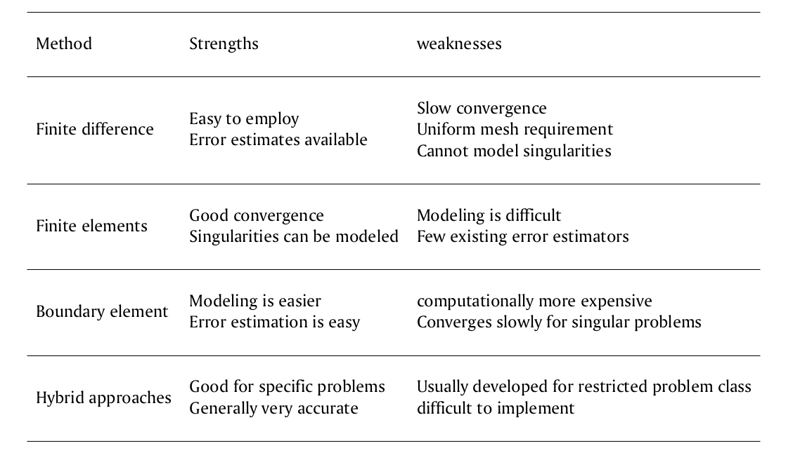
Numerical Methods For Solution Of Fracture Problems

Slide 15
Probabilistic Fracture Mechanics
The interest in applying statistics to assess structural reliability has continued to increase. This is evident from the large amount of work in probabilistic fracture mechanics (PFM) and associated topics. Many factors contribute to reliability and these often change both systematically and at random. In the past, structures have been designed using a simple factor of safety approach to calculate a safe lifetime over which the applied loads will be sustained. Each variable in the equations governing the operation of the system was given a reasonable value drawn from past results or even just human intuition, and a predicted life obtained. This was then divided by a factor of safety which reduced it to give a ’safe’ maximum operating life. It is conceivable that this is unrealistically conservative but simple.
So that there is a demand, particularly from industry, for a statistical justification behind the calculations, since many parameters may influence the behaviour of a structure and in practice each will be subject to both random and systematic variations.
One approach is to use historical data from past failures and non-failures to evaluate the reliability of current productions.
An alternative approach has been sought, namely the development and application of engineering models based on an understanding of the failure modes and statistical distributions of the controlling parameters.

Slide 16
Probabilistic Fracture Mechanics
Ideally, a combination of the two methods is necessary so that past experience and results plus specially designed laboratory tests can be used to obtain statistical distributions which best fit these data, but also, hopefully provide predictions about altered or new systems. The problem is then divided:
1. The basic problem: The two main considerations are the distribution of crack-like defects (or flaws) introduced during the fabrication of a structure and the critical crack length distribution for the material under service conditions, the latter being controlled primarily by the fracture toughness.In general, there is a lack of data for the initial distribution of defects in a structure so the distribution is often assumed to be lognormal or exponential. From a failure point of view, it is importanl to know how this distribution compares with that of the critical crack size, which is controlled by the material properties, and applied loading. The probability of failure is then given by the probability of interaction of the actual crack or flaw a_{i} , and a critical crack length a_{c}.
2. Further considerations: Closely linked with the as-fabricated flaw size distribution is the role played by non-destructive testing in detecting defects which may, or may not, be repaired.
In situations where fatigue cracking occurs, the defect distribution will tend to alter with the number ofapplied cycles.This problem may be reduced by in-service inspection at fixed intervals of time, and by repairing the defects so found.

Slide 17
Probabilistic Fracture Mechanics
In the probabilistic treatment, the random variations are described using distributions of values for the parameters rather than one deterministic value. The distribution may be thought of as a curve combining the possible values and the likelihood (probability) they will occur. The introduction of distributions of values necessarily complicates an analysis, but the end result is likely to be more accurate and hence of more use. In some cases, neat analytical expressions for the reliability are impossible and numerical approximations are required. Approximate interactive algebraic procedures are used to determine an estimate of the failure probability ( = 1 - reliability), whereas in the latter, the approximation is at a later stage, after all the exact probabilistic expressions have been obtained for the complete system; this ibe justified by the improvement gained.s, of course, much harder, and the work involved may not be justified by the improvement gained.

Slide 18
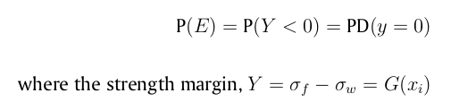
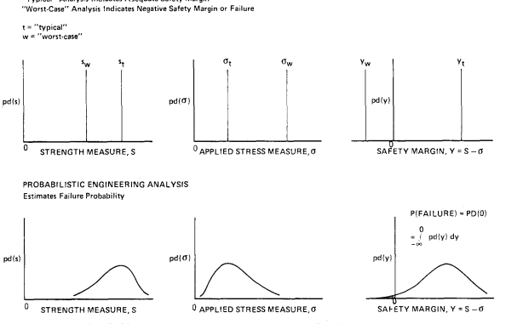
Statistical Basis Of PFM
The basis of PFM is the simple axiom that a given mode of failure event E will occur when the stress σ_{w} associated with the failure mode exceeds the mode governing strength σ_{f} . The probability of failure mode E is given by
with i = 1.....n_{x} , depends on input variables that at affect component stress or strength or both. An alternative definition in terms of a strength ratio Y = σ_{f} /σ_{w} is equally valid and leads to P(E)=P((Y )< 1)

Slide 19
Statistical Basis Of PFM
The basis of PFM is the simple axiom that a given mode of failure event E will occur when the stress σ_{w} associated with the failure mode exceeds the mode governing strength σ_{f} . The probability of failure mode E is given by
with i = 1.....n_{x} , depends on input variables that at affect component stress or strength or both. An alternative definition in terms of a strength ratio Y = σ_{f} /σ_{w} is equally valid and leads to P(E)=P((Y )< 1)

Slide 20
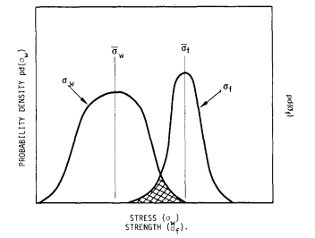
Statistical Basis Of PFM
Here, G is a concise deterministic summary of all prior engineering experience, models, and assumptions. If the engineering analysis does not lead to an obvious functional form, G may be obtained from standard least- squares fitting of the engineering data or by the repetitive analysis procedure.the x_{i} are most realistically described as ran dom variables X_{i} rather than single assigned deterministic values. Statistical interpretation of the X_{i} results in the interpretation of strength margin as a random variable. The statistical interpretation also allows the analyst to quantify his uncertainty of the engineering model G based on judgement, and his previous record of predictive success and failure. This error quantification is done by introducing one or more additional X_{i} to serve as ’error terms’. The cumulative distribution functions of the X_{i} , represented by

Slide 21
PFM by using Monte Carlo simulation
In the probabilistic treatment, the random variations are described using distributions of values for the parameters rather than one deterministic value. The distribution may be thought of as a curve combining the possible values and the likelihood (probability) they will occur. The introduction of distributions of values necessarily complicates an analysis, but the end result is likely to be more accurate and hence of more use. In some cases, neat analytical expressions for the reliability are impossible and numerical approximations are required. Approximate interactive algebraic procedures are used to determine an estimate of the failure probability ( = 1 - reliability), whereas in the latter, the approximation is at a later stage, after all the exact probabilistic expressions have been obtained for the complete system; this ibe justified by the improvement gained.s, of course, much harder, and the work involved may not be justified by the improvement gained.

