Slide 1

Probabilistic Fracture Simulation of Materials
Submitted to
Prof Rajib Chowdhary
Submitted by
Abhinandan Sharma
Enrollment number
20523001
Civil Engineering Department, IIT Roorkee

Slide 2


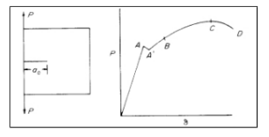
Defining Fracture
For Fracture initiation for brittle materials ∂U_{ε}/∂a ≥ ∂U_{s}/∂a, U_{ε} and U_{S} are strain energy and surface energy; and a, crack length.
Often the point of fracture initiation is not so clearly defined as shown in the figure. In this case, certain degree of arbitrariness has to be introduced in order to define fracture initiation. Fracture can be defined in terms of the above described macrofeatures or in terms of the micro-structural features such as fracture of brittle inclusions, etc

Slide 3

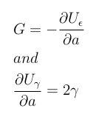
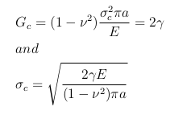

Griffith Criterion
Griffith proposed the criterion of brittle fracture based on the principle of global energy balance.
where U _{ε} is the strain energy and U _{γ} is the surface energy.
which is constant. For a small crack in a large plate, we have, at fracture.
U_{γ} is surface energy; U_{ε} is strain energy; and U_{p} is plastic work
γ, the surface energy per unit area;
.

Slide 4
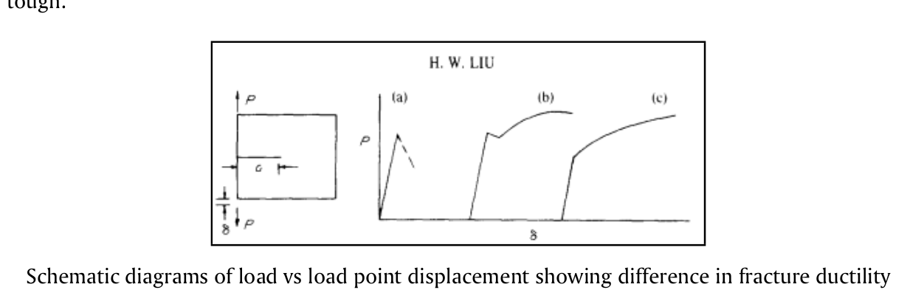
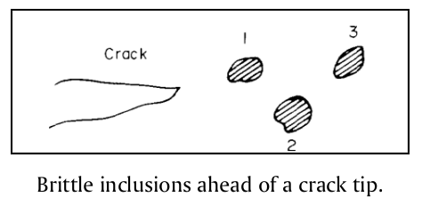
Fracture Process Zone
They contain brittle and ductile phases, inclusion particles, grain boundaries, etc. Fracture initiation in a cracked solid is often in the interior of a specimen, where the high tensile stress exists at the locations of brittle and weak materials.
The fracture at inclusion I increases the stress at inclusion 2, and the increased stress causes the fracture of inclusion 2. Ductile fracture takes place between the brittle particles. If the brittle inclusions are large and closely spaced, it may cause an avalanche effect, one particle fracturing rapidly after the other. The fracturing process stops when the crack is out of the zone of the high tensile stress in the plane strain triaxial state of tension. The crack extension could be sizable and could cause noticeable load drop. This is the well known phenomenon of pop-in and is a local instability. Hence, K_{lc} is the result of a local instability phenomenon, not a global instability.
Materials are inhomogeneous
They contain brittle and ductile phases, inclusion particles, grain boundaries, etc. Fracture initiation in a cracked solid is often in the interior of a specimen, where the high tensile stress exists at the locations of brittle and weak materials.
Once a local fracture is initiated, it spreads out.

Slide 5
Numerical Methods For Solution Of Fracture Problems
Finite difference method is the oldest technique for the solution of boundary value problems. The method directly involves the solution of the governing differential system in an approximate manner by subdividing the domain of interest into a connected series of discrete points called nodes. These nodes are the sampling points for the solution and are linked using the finite difference operators to the governing equations.
methods basic approach employed involves an analytic formulation of the elasticity problem to the point of a singular integral equation. The singularity is then extracted and the result is a non-singular integral equation which can be solved quite accurately with any number of techniques.
is a numerical approach to the solution of linear boundary value problems with known Green’s function solutions. The boundary of the domain of interest is discretized using ”elements” which are interconnected at discrete points called nodes.
Employment of the finite difference operators results in a system of algebraic equations for the discrete nodal values of the field variable. The finite difference method can be used to discretize both space and time. The finite difference method is difficult to use for irregularly shaped domains or for problems involving singularities, because the fine meshing required near a singularity cannot easily be reduced for the rest of the domain
yields excellent solutions; however, it requires an extensive analytic formulation which is different for each new problem. for establishing benchmark solutions to compare with other methods as the degree of accuracy can be guaranteed.
Finite difference
Integral equation
Boundary Integral Equation Method
Finite Element Method

Slide 6
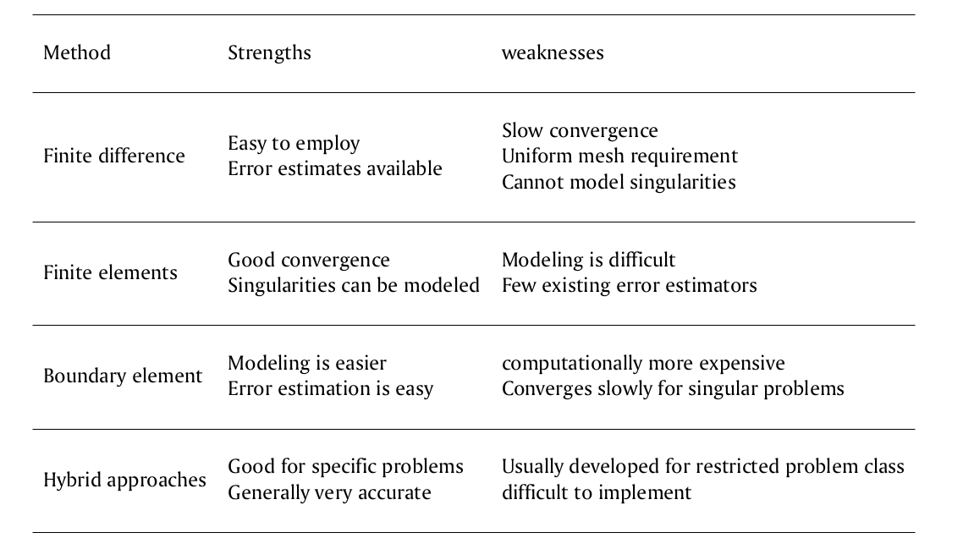
Numerical Methods For Solution Of Fracture Problems

Slide 7
Probabilistic Fracture Mechanics
Many factors contribute to reliability and these often change both systematically and at random. In the past, structures have been designed using a simple factor of safety approach to calculate a safe lifetime over which the applied loads will be sustained. Each variable in the equations governing the operation of the system was given a reasonable value drawn from past results or even just human intuition, and a predicted life obtained. This was then divided by a factor of safety which reduced it to give a ’safe’ maximum operating life. It was conceivable that this is unrealistically conservative but simple.
One approach is to use historical data from past failures and non-failures to evaluate the reliability of current productions.
An alternative approach has been sought, namely the development and application of engineering models based on an understanding of the failure modes and statistical distributions of the controlling parameters.Ideally, a combination of the two methods is necessary so that past experience and results plus specially designed laboratory tests can be used to obtain statistical distributions which best fit these data, but also, hopefully provide predictions about altered or new systems.
In situations where fatigue cracking occurs, the defect distribution will tend to alter with the number of applied cycles.
The problem is divided in:
1. The basic problem: The two main considerations are the distribution of (1) crack-like defects introduced during the fabrication of a structure and (2) the critical crack length distribution for the material under service conditions.
2. Further considerations: Closely linked with the as fabricated flaw size distribution is the role played by non-destructive testing in detecting defects which may, or may not, be repaired.
the latter being controlled primarily by the fracture toughness.
,In general, there is a lack of data for the initial distribution of defects in a structure so the distribution is often assumed to be lognormal or exponential
This problem may be reduced by in-service inspection at fixed intervals of time, and by repairing the defects so found.

Slide 8
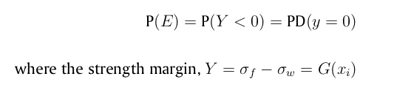
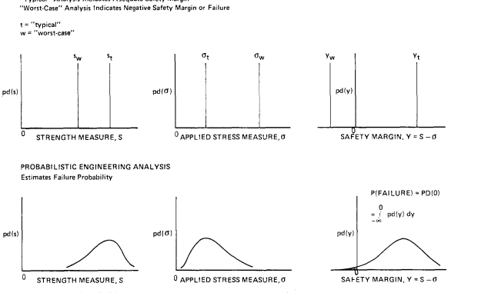
Statistical Basis Of PFM
In the probabilistic treatment, the random variations are described using distributions of values for the parameters rather than one deterministic value. The distribution may be thought of as a curve combining the possible values and the likelihood (probability) they will occur. The introduction of distributions of values necessarily complicates an analysis, but the end result is likely to be more accurate and hence of more use. In some cases, neat analytical expressions for the reliability are impossible and numerical approximations are required. Approximate interactive algebraic procedures are used to determine an estimate of the failure probability ( = 1 - reliability), whereas in the latter, the approximation is at a later stage, after all the exact probabilistic expressions have been obtained for the complete system; this ibe justified by the improvement gained.s, of course, much harder, and the work involved may not be justified by the improvement gained.
with i = 1.....n_{x} , depends on input variables that at affect component stress or strength or both. An alternative definition in terms of a strength ratio Y = σ_{f} /σ_{w} is equally valid and leads to P(E)=P((Y )< 1)
The basis of PFM is the simple axiom that a given mode of failure event E will occur when the stress σ_{w} associated with the failure mode exceeds the mode governing strength σ_{f} . The probability of failure mode E is given by

Slide 9
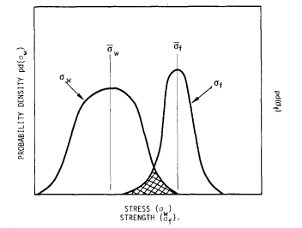
Statistical Basis Of PFM
Here, G is a concise deterministic summary of all prior engineering experience, models, and assumptions. If the engineering analysis does not lead to an obvious functional form, G may be obtained from standard least- squares fitting of the engineering data or by the repetitive analysis procedure.the x_{i} are most realistically described as random variables X_{i} rather than single assigned deterministic values. Statistical interpretation of the X_{i} results in the interpretation of strength margin as a random variable. The statistical interpretation also allows the analyst to quantify his uncertainty of the engineering model G based on judgement, and his previous record of predictive success and failure. This error quantification is done by introducing one or more additional X_{i} to serve as ’error terms’. The cumulative distribution functions of the X_{i} , represented b

Slide 10

Mathematical Techniques
If 108 simulations are obtained, then only 10 failures are
predicted if the failure probability is 1 0 - 7 . In this case, importance sampling
can be very useful to reduce the variance of estimators.
Tests for normality have been proposed by
Stephens ~78 and Lilliefors 179 and both are modifications of the standard
Kolmogorov-Smirnov test. Tables have been produced using Monte Carlo
simulation so that the test is easy to apply, requiring only the calculation of a
parameter from the experimental data and its comparison with a tabulated value.
An approximation to the amount of confidence which can be placed in the minimum of a small sample of results is given by
Using proposed tests for normality
Decreasing the variance in simulations
If 108 simulations are obtained, then only 10 failures are
predicted if the failure probability is 1 0 - 7 . In this case, importance sampling
can be very useful to reduce the variance of estimators.

Slide 11
PFM by using Monte Carlo simulation and Scaled Boundary Finite Element Method
For each of the Monte Carlo samples, the SIFs, which are sensitive to the randomness of the variables, are computed. The resulting SIFs are compared with the material toughness to evaluate whether failure will occur.
For Monte Carlo simulation (MCS) method , uncertainties in the applied load, material properties, and crack geometry are modeled as random variables described by specific probability distribution functions.
The scaled boundary finite-element method is employed to investigate the shape sensitivity of the stress intensity factors of a crack to the size and orientation of the crack. Only a single boundary mesh is required. The variation of the crack size and orientation can be represented by simply changing the position of the crack tip without the need for remeshing the boundary.
Therefore, the repetitive deterministic analysis is made simple, elegant, and highly efficient as compared to most other numerical methods. Thus, it becomes feasible to use the brute force MCS method for the reliability analysis of a cracked structure.

Slide 12
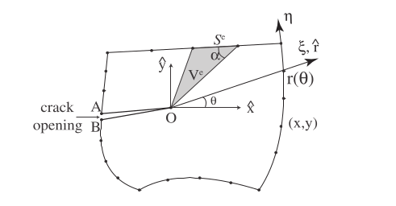
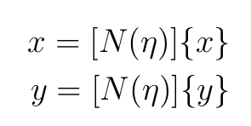
Scaled Boundary Finite Element Method
The boundary is discretized with line elements. The nodal coordinates at the boundary are denoted {x} and {y}, with shape functions [N (η)] in the local coordinate η . Thus for any point on the boundary the Cartesian coordinates (x, y), can be interpolated by
The geometry of the domain satisfies the scaling requirement, i.e., the whole boundary of the domain is directly visible from the crack tip.
Problems of more complex geometry can be divided into such smaller subdomains. The scaling center O is selected at the crack tip.
Without loss of generality, the origin of the Cartesian coordinates x̂ and ŷ is defined at the scaling center.

Slide 13
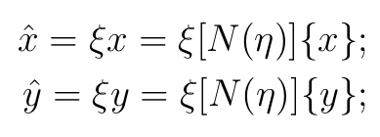
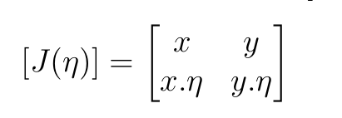
Scaled Boundary Finite Element Method
The coordinates of any point within the domain (x̂, ŷ) can then expressed as:
where the scaling factor ξ takes the value of 0 at the scaling center and 1 on the boundary.
ξ and η are called the scaled boundary coordinates.
To avoid the Jacobian of the scaled boundary coordinate transformation approaching zero, the acute angle formed by a radial line and the boundary should not be too small.

Slide 14

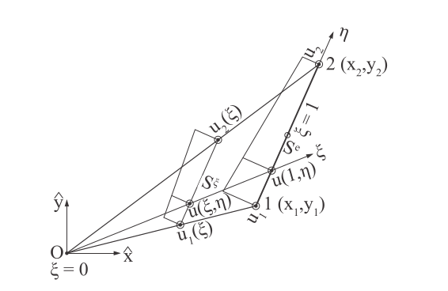
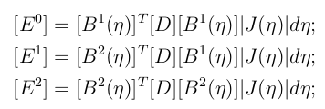
Scaled Boundary Finite Element Method
Applying a weighted residual technique in the η direction leads to the following scaled boundary finite element equation in displacement
The global coefficient matrices [E⁰], [E¹]and [E²]
are obtained by assembling the element coefficient
matrices same manner as for the stiffness matrices
where [D] is the elasticity matrix. where [B¹(η)] and [B²(η)] describe the strain-displacementt
As shown in Figure below for a single 2-node element, nodal displacement functions u(ξ) are introduced along the radial lines passing through the scaling center O and a node on the boundary. Along the circumferential direction η , the displacements is obtained by interpolating the nodal displacement functions

Slide 15

Scaled Boundary Finite Element Method
The displacement functions u(ξ) are expressed as
where [S_{i} ](i = 1, 2, ..., N ) are diagonal blocks of the real Schur matrix, [Ψ_{i}^{(u)} ] the corresponding displacement modes and c integration constants, which are determined from the displacements on the boundary u(ξ = 1)

Slide 16
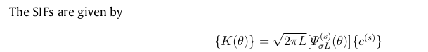
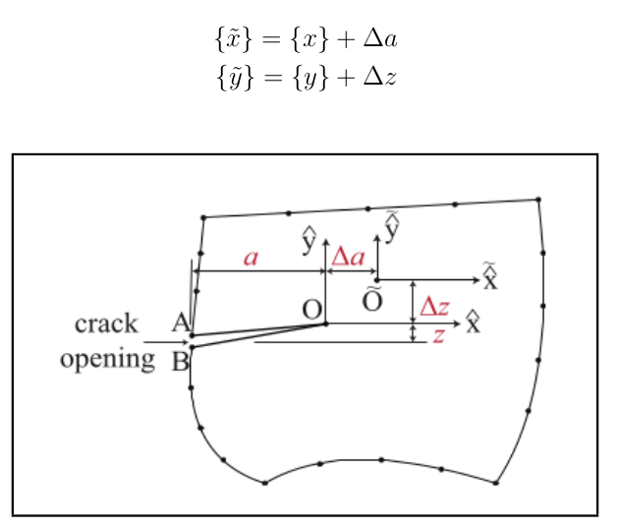

Scaled Boundary Finite Element Method
When the real parts of the eigenvalues of a diagonal block [S_{i}] are between -1 and 0, the matrix power function leads to a stress singularity. The diagonal block is denoted as [S^{(s)} ] (superscript (s) for singular) and −1 < λ[S^{(s)}] < 0 applies. The corresponding displacement modes and integrationconstants are denoted as [Ψ^{(s)}] and {C^{(s)}}Their contribution to stresses vanishes when the limit ξ→0 is performed and thus are not needed for the definition of stress intensity factors. The singular stress field is expressed as
Evaluation of stress intensity factors:
Shape Sensitivity:

Slide 17
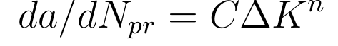


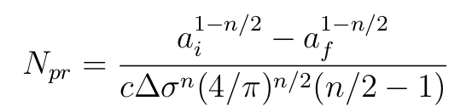
Monte-Carlo Simulation
where C, n are empirically determined constants, a is the radius of a circular crack in the fracture plane, ∆K is the range of stress intensity factor, and N_{pr} is the number of fatigue cycles.
For the case of a buried circular crack remote from the surface and extending through the uniform tensile stress field, we have
where ∆σ is the range of stress If these equations are combined and integrated, the following expression for fatigue life N_{pr} is obtained:
We now consider a buried elliptical crack of fracture plane area A_{i} = πcb where c ≤ b are the major and minor semi-axes of the elliptical projection of the flaw on the fracture plane. The results of a more advanced analysis, shows that eq. is reasonably accurate for the elliptical crack, with b/c≪40, as well as the circular crack of equal area for which eq. is derived. For the purpose of the PFM analysis below, we compact the notation and take the logarithm of eq. to obtain
The deterministic fracture mechanics problem:
Assume a high toughness material with crack growth relation given by
Range of Stress Intesity is given by
From this we get number of cycles as,
Now we compact and take the logrithmic equation

Slide 18

Monte-Carlo Simulation
Distributions of the input random variables C, ∆σ, A_{i} :
The relationship is obtained from Cr-Mo -V steel crack growth data and is used to compute median crack growth rates in in./cyc. For this steel the mean yield stress is σ̄ = 85ksi. The above assumptions can be compacted into the notation
The probabilistic stress distribution shown is formulated from three assumptions. These are
(1) log-normality;
(2) 95% of the spindle material, by volume, will encounter ∆σ < 0.80σ̄ _{y};
(3) 95% of the material volume will encounter ∆σ > .25σ̄ _{y}. Finally we assume the flaw size
distribution that is used to determine A_{i} obeys the relation log A_{i} = N (−0.9586, 0.750).
that is, log C is a normal random variable with median and mean μ_{c} = log(6.76X10 −11 ) and standard deviation S_{c} . For the example, we further assume a log-normal stress variation of log ∆σ=N̄ (1.5799, 0.1535), which means that Ao has a median value of 38 ksi with 0.1535 standard deviation on log σa due to stress gradients, and spindle-to-spindle design and usage variations.

Slide 19

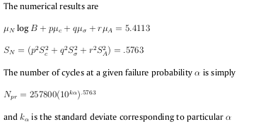
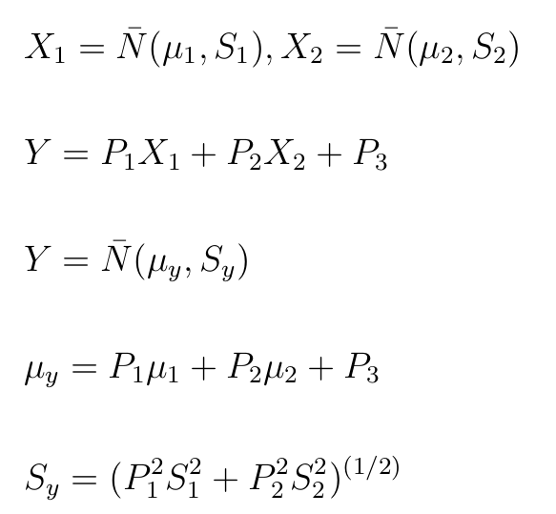
Monte-Carlo Simulation
The probabilistic analysis: The assumption of constant usage allows a simple definition of Y such as
S standard deviations

Slide 20
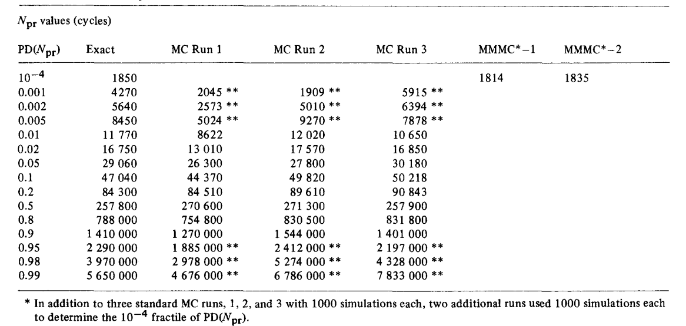
Monte-Carlo Simulation

Slide 21
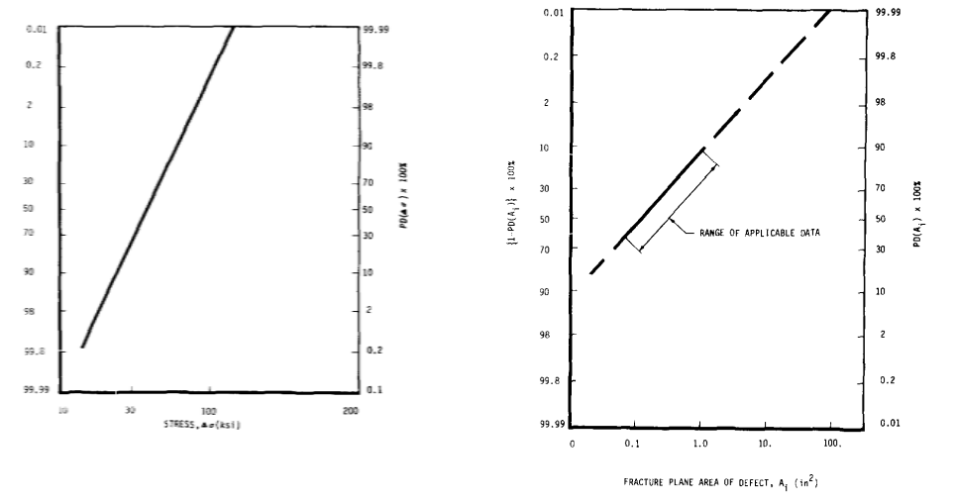
Monte-Carlo Simulation
that is, log C is a normal random variable with median and mean μ_{c} = log(6.76X10 −11 ) and standard deviation S_{c} . For the example, we further assume a log-normal stress variation of log ∆σ=N̄ (1.5799, 0.1535), which means that Ao has a median value of 38 ksi with 0.1535 standard deviation on log σa due to stress gradients, and spindle-to-spindle design and usage variations.

Slide 22
Thank You

