Slide 1
Sobol Indices method

Slide 2


Sobol Indices method
Assume a model y = f(x) where input x = (x₁,x₂,...,x_{n}) where all the members of x are orthogonal. The function can be consider as an integrable equation:
To show the orthogonality of variables:

Slide 3
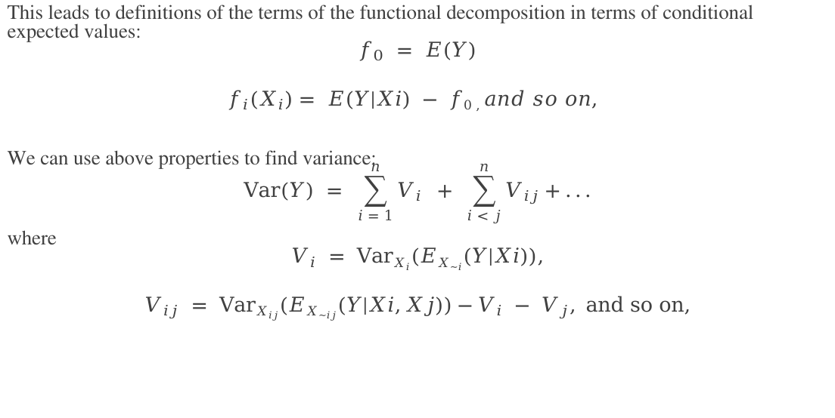
Sobol Indices method
This leads to definitions of the terms of the functional decomposition in terms of conditional expected values:
$$f_{0} = E(Y)$$
$$f_{i}(X_{i})= E(Y|Xi) − f0 ,and so on,$$
We can use above properties to find variance:
$$Var(Y) = \sum_{i = 1}^{n}{V_{i}} + \sum_{i < j}^{n}{V_{ij}+...}$$
where
$$V_{i} = VarX_{i}(EX_{\sim i}(Y|Xi)),$$
$$V_{ij} = VarX_{ij}(EX_{\sim ij}(Y|Xi,Xj))−V_{i} − V_{j}, and so on,$$

Slide 4

Sobol Indices method
From the above variances we can find the variance-based measure of sensitivity i.e. first-order indices:
$$Si =\frac{Vi}{Var(Y)}$$
$$0 ≤Si ≤ 1$$
Second-order indices is used to compute the contribution from interaction between i^{th} and j^{th} parameters.
$$Sij =\frac{Vij}{Var(Y)}$$

Slide 5
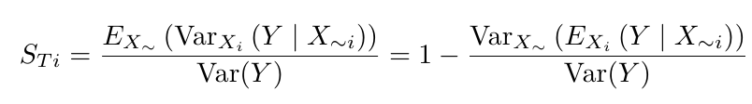
Sobol Indices method
Higher order sobol indices exist, and give the sensitivity due interactions between a parameter x_{i} and various other parameters. The total Sobol sensitivity index S_{Ti} includes the sensitivity of both first order effects as well as the sensitivity due to interactions (covariance) between a given parameter x_{i} and all other parameters. It is given by:

