Slide 1

Presentation
on
“Ecommerce platform integration: synchronization between Reac.tjs file and Node.js backend”
DEPARTMENT OF COMPUTER SCIENCE & ENGINEERING
2024-2025
Presented by:
Abhinandan Gaikwad 2JH21CS002
Trainer by:
Prof. Padma Dandin
Dept of Computer Science
& Engineering

Slide 2
Contents
INTRODUCTION
LITERATURE SURVEY
MOTIVATION
OBJECTIVES
PROBLEM STATEMENT
REQUIREMENT ANALYSIS
METHODOLOGY
RESULTS AND DISCUSSION
CONCLUSION
FUTURE WORK
REFERENCES
Dept of CSE, JCET, Hubballi 2024-2025 1

Slide 3
INTRODUCTION
E-commerce Growth: E-commerce is rapidly expanding, offering users convenience and flexibility in online shopping.
Frontend–Backend Synchronization: Seamless synchronization between React.js (frontend) and Node.js (backend) is essential for a smooth and responsive user experience.
Limitations of Traditional Systems: Older systems often suffer from data inconsistency, latency, and security issues, which affect performance.
MERN Stack Advantage: The MERN stack—MongoDB, Express.js, React.js, and Node.js—provides a robust and modern framework for building full-stack web applications.
Secure & Scalable Features: With integrated payment gateways (BrainTree, PayPal), JWT authentication, and MongoDB storage, the system ensures real-time updates, data security, and efficient admin control.
Dept of CSE, JCET, Hubballi 2024-2025 2

Slide 4
LITERATURE SURVEY
Author(s) | Focus | Methods/Tools | Outcome
Sharma etal. (2021) | Performance optimization in MERN stack-based applications | MongoDB indexing, React virtual DOM, Express middleware | Improved performance and reduced server response time
Kumar & Singh (2020) | Real-time data synchronization in full-stack applications | REST APIs, React Context API | Achieved real-time updates and enhanced user experience
Ahmed et al. (2019) | Secure authentication in Node.js-based web applications | JWT, Bcrypt.js, HTTPS | Ensured secure login and user session management
Dept of CSE, JCET, Hubballi 2024-2025 3

Slide 5
MOTIVATION
The motivation behind this project was to create a reliable and secure e-commerce solution that addresses issues like:
Real-time data inconsistency between the front and back ends.
Admin control over the system.
Security concerns in payment processing.
Performance bottlenecks in user authentication and product management.
Future enhancement like control panels and payment gateways.
Dept of CSE, JCET, Hubballi 2024-2025 4

Slide 6
OBJECTIVES
To establish a reliable data synchronization mechanism between the frontend (React.js) and backend (Node.js).
To design and implement a dynamic, responsive, and user-friendly interface using React.js.
To secure user authentication and data handling using JWT and bcrypt.
To integrate secure and seamless payment gateways using BrainTree and PayPal.
To refine and structure the database using MongoDB schemas for users, products, and categories.
To deploy a fully functional e-commerce website on GitHub with quality assurance and testing.
Dept of CSE, JCET, Hubballi 2024-2025 5

Slide 7
PROBLEM STATEMENT
Building an e-commerce platform involves several challenges including ensuring data synchronization between the frontend and backend, managing user sessions securely, integrating trustworthy payment gateways, and providing a responsive UI/UX. The problem addressed by this project is to design and develop an e-commerce solution that resolves these challenges using the MERN stack, while also providing administrative functionality and a seamless user experience.
Dept of CSE, JCET, Hubballi 2024-2025 6

Slide 8
REQUIREMENT ANALYSIS
Software Requirements
Frontend:
- ReactJS
- Axios / Fetch API
Backend:
- NodeJS + ExpressJS
- MongoDB for data storage
- JWT for authentication
Other Tools:
- Postman (API testing)
- GitHub (Version control)
MongoDB Compass for database
Dept of CSE, JCET, Hubballi 2024-2025 7

Slide 9
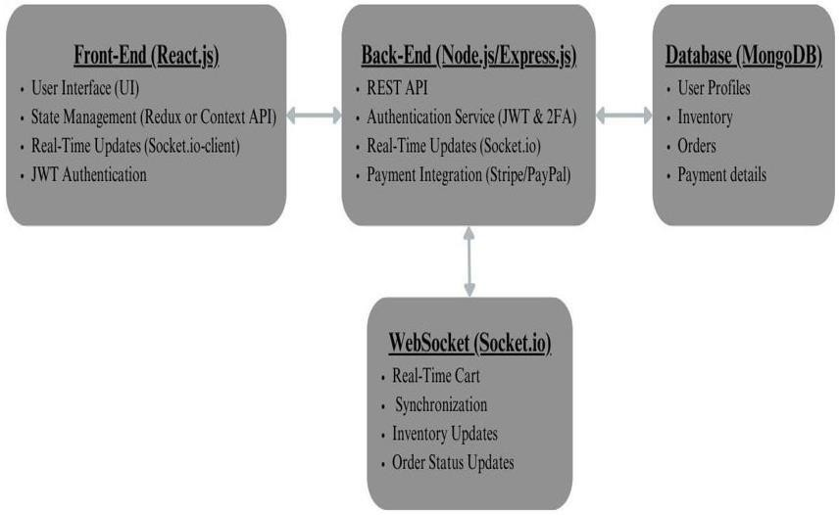
METHODOLOGY
Create frontend React components for login, product list, cart, and orders.
Set up backend APIs with ExpressJS and connect to MongoDB.
Use Axios in React to call backend routes.
Secure routes using JWT for login-protected actions.
Figure 1: Methodology
Dept of CSE, JCET, Hubballi 2024-2025 8

Slide 10
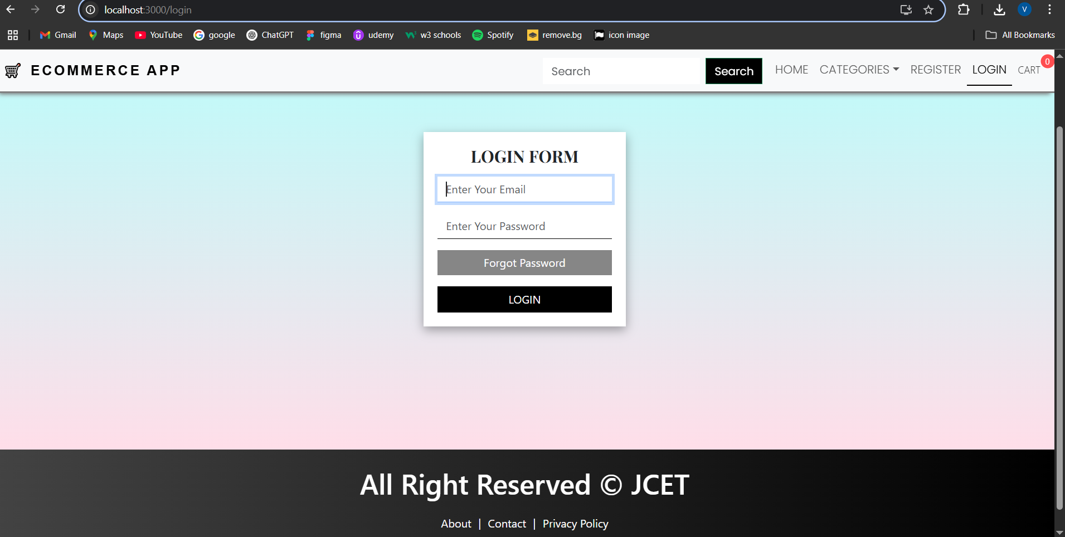
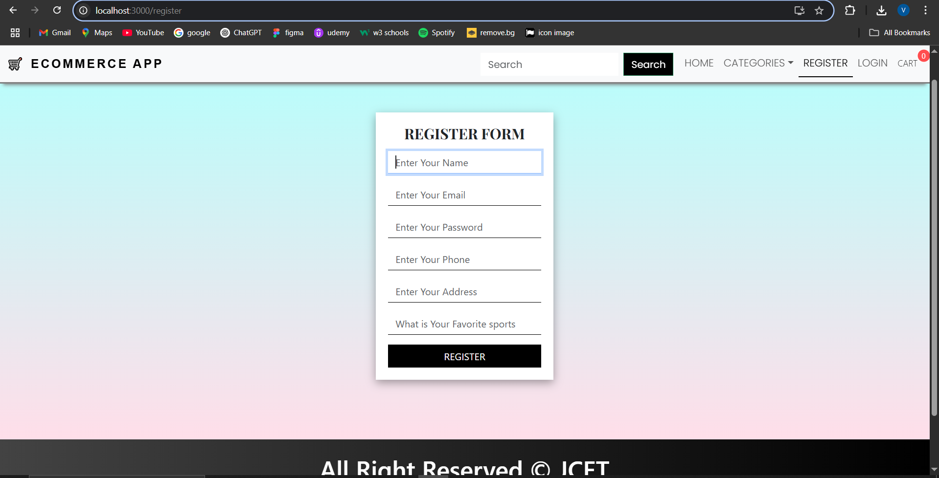
RESULTS AND DISCUSSIONS
Fig 1: Login Page
Fig 2: Register Page
Dept of CSE, JCET, Hubballi 2024-2025 9

Slide 11
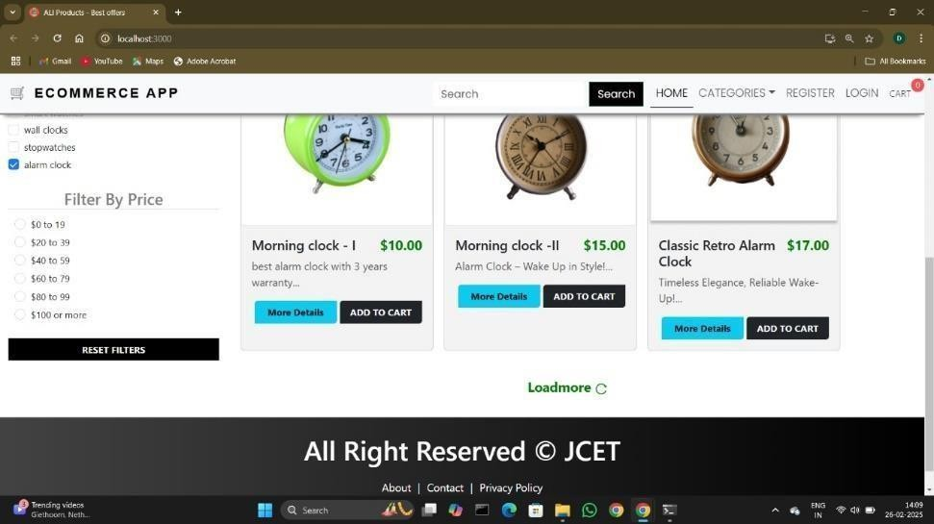
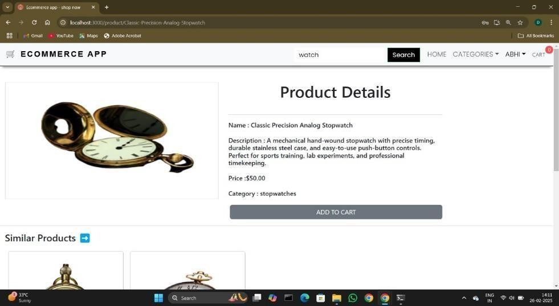
RESULTS AND DISCUSSIONS
Fig 3: E-commerce page Fig 4: Product details
Dept of CSE, JCET, Hubballi 2024-2025 10

Slide 12
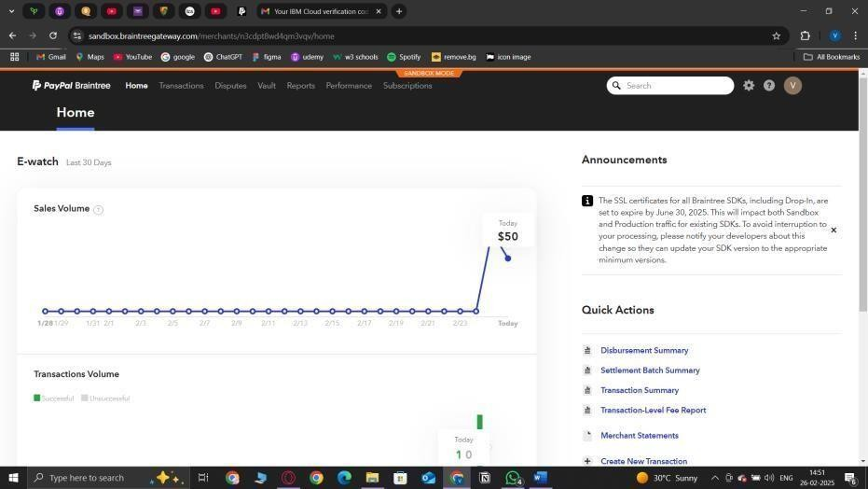
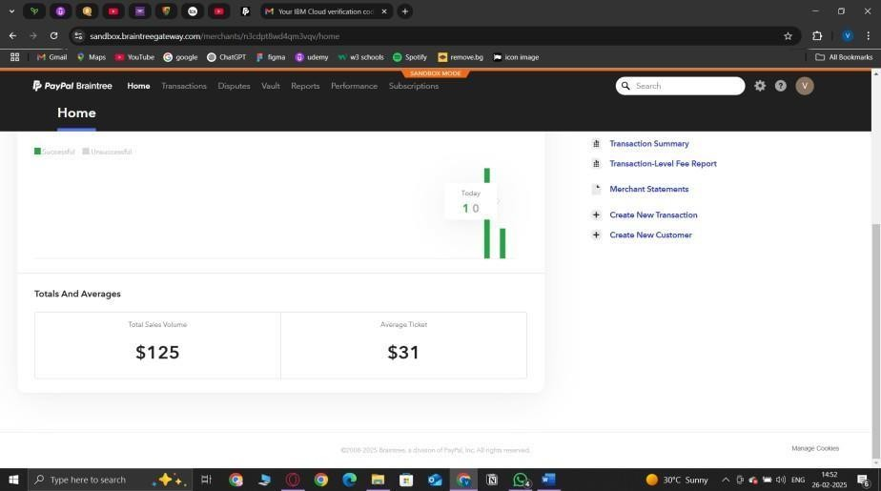
RESULTS AND DISCUSSIONS
Fig 5: Displays all saled product volume in graph and calender ,with transaction summary.
Dept of CSE, JCET, Hubballi 2024-2025 11

Slide 13
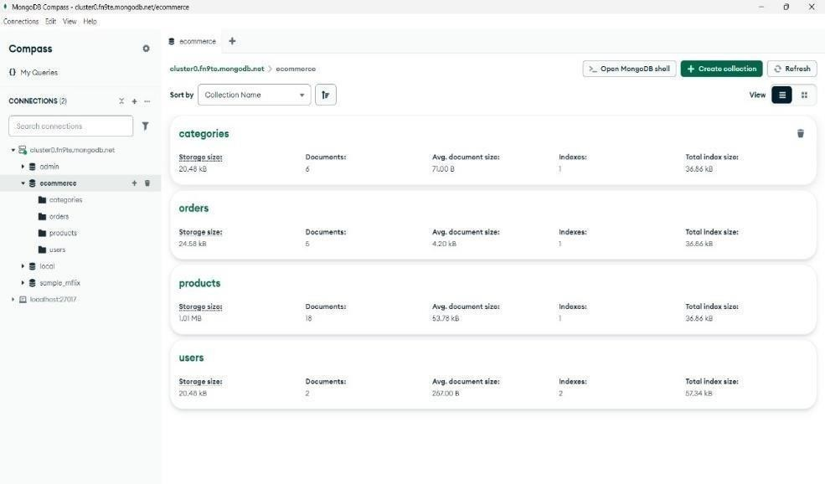
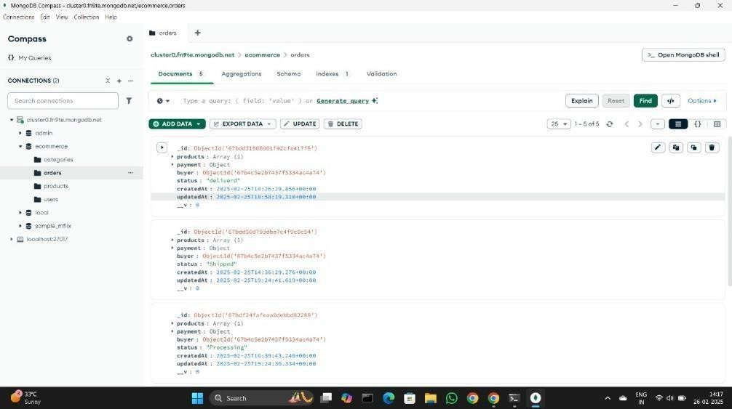
RESULTS AND DISCUSSIONS
Fig 6: database of products, orders, category and user
Dept of CSE, JCET, Hubballi 2024-2025 12

Slide 14
CONCLUSION
The project shows how a basic ecommerce platform can be built using the MERN stack with simple API synchronization. The system is modular, testable, and scalable for small-to-medium businesses. Avoiding unnecessary complexity made development faster and easier to maintain.
Dept of CSE, JCET, Hubballi 2024-2025 13

Slide 15
FUTURE SCOPE
Integrate real-time notifications using Socket.IO.
Use GraphQL for more efficient data querying.
Deploy on cloud with CI/CD pipelines (e.g., AWS, Vercel).
Add AI-based recommendations using backend ML services.
Dept of CSE, JCET, Hubballi 2024-2025 14

Slide 16
REFERENCES
[1] Sharma, R., & Verma, S. Performance Optimization in MERN Stack Applications. International Journal of Research Publication and Reviews, 132–137, 2021.
[2] Kumar, A., & Singh, R. Real-Time Data Synchronization in Full-Stack Applications, 2020.
[3] Li, S., & Chen, Y. Payment Gateway Integration and Subscription Management Build. Bachelor’s Thesis, LAB University of Applied Sciences, 2022.
[4] Ahmed, A. Authentication in Node.js Using JWT. Medium, 2019.
Dept of CSE, JCET, Hubballi 2024-2025 15

Slide 17
Thank you

