Slide 1
Movie Adda

Slide 2
Movie Adda
The project is a movie description application built with React. It allows users to search for movies by title, browse movie results, view detailed information about specific movies, and navigate between different pages using client-side routing. The application fetches movie data from the OMDb API and displays it in a user-friendly format.
React
React Router
State Management
API Fetching
Reusable Components
App.js
MovieCard.js
MovieDetails.js
Navbar.js
Footer.js
Styling
Home

Slide 3

Movie Adda
The project is a movie description application built with React. It allows users to search for movies by title, browse movie results, view detailed information about specific movies, and navigate between different pages using client-side routing. The application fetches movie data from the OMDb API and displays it in a user-friendly format.
Home
React
React Router
State Management
API Fetching
Reusable Components
App.js
MovieCard.js
MovieDetails.js
Navbar.js
Footer.js
Styling
Serach for movies

Slide 4
Movie Adda
React
React Router
State Management
API Fetching
Reusable Components
App.js
MovieCard.js
MovieDetails.js
Navbar.js
Footer.js
Styling
Serach for movies

Slide 5
Movie Adda
React
React Router
State Management
API Fetching
Reusable Components
App.js
MovieCard.js
MovieDetails.js
Navbar.js
Footer.js
Styling
Batman

Slide 6
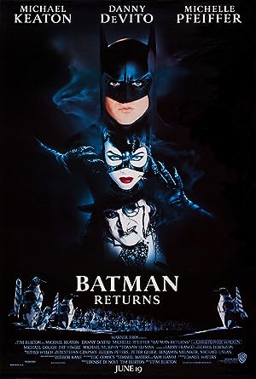



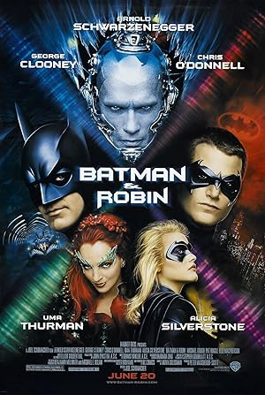

Movie Adda
React
React Router
State Management
API Fetching
Reusable Components
App.js
MovieCard.js
MovieDetails.js
Navbar.js
Footer.js
Styling
Batman

