Slide 1
Presentation
by
Abhinandan Karanth K U (2447101)
Project Guide
Dr.
Department of Computer Science
CHRIST(Deemed to be University), Bengaluru

Slide 2
Introduction
.
Project Idea:
Development of a secure screen-sharing application that incorporates AI-driven intrusion detection to monitor network traffic for threats.
Requirement Analysis:
Essential features include screen-sharing, user management, real-time monitoring, and AI threat detection.
Viability:
Feasible within a LAN network, enabling secure screen sharing in local environments.
Novelty:
Combines machine learning-based intrusion detection with traditional screen-sharing functionalities.

Slide 3
Need Analysis
Challenges in Existing Systems:
Dependency on the internet for collaboration tools.
Limited secure options for local LAN environments.
High latency and performance issues in real-time sharing.
Opportunities:
Closed LAN networks ensure enhanced data security.
Increasing demand for cost-effective, localized collaboration solutions.
Potential to integrate AI for advanced features like threat detection.

Slide 4


Social impact
Improved Collaboration and Learning:
Enhances teamwork in educational institutions, enabling virtual classrooms and project discussions.
Promotes increased productivity through real-time collaboration in workplaces.
Bridging the Digital Divide:
Provides an alternative to internet-based tools for resource-constrained environments.
Empowers users in areas with limited or no internet connectivity.
Enhanced Productivity in Communities:
Reduces communication barriers within small-scale organizations and community setups.
Sustainability:
Promotes efficient use of existing LAN infrastructure, minimizing additional resource consumption.

Slide 5
Alignment with SDG goals
Promotes innovation through AI-powered IDS and real-time collaboration technology.
Builds resilient infrastructure with scalability, reliability, and cross-platform compatibility.
Supports digital transformation for industries, education, and organizations.
Enhances security with AI-powered threat detection, reducing cybercrime.
Ensures transparency and accountability through admin-controlled logs.
Strengthens institutions by providing a secure platform for decision-making and collaboration.
Promotes safe and fair digital interactions via controlled permissions and encryption.

Slide 6
Existing systems and Limitations
Limitations of Existing Systems:
Basic screen-sharing tools lack integrated security, making them vulnerable to MITM and other attacks.
Rule-based threat detection is limited and often generates false positives.
Limited scalability and flexibility for local LAN networks.
Examples:
Zoom, Microsoft Teams – while widely used, do not inherently provide robust, AI-based security for LAN-only environments.

Slide 7
Proposed work and advantages
Frontend Development:
Utilize html/css/js to create a user-friendly and dynamic interface for screen-sharing operations.
Ensure responsive design for seamless usage across devices.
Backend Development:
Employ Node.js for managing server-side logic, client-server communication, and API endpoints.
Integrate WebRTC for real-time communication.

Slide 8
Proposed work and advantages
Secure Data Transmission:
Use TLS for encrypting data during client-server communication to prevent unauthorized access.
Screen Capture and Streaming:
Incorporate FFmpeg for efficient screen capture and processing.
Utilize H.264 codec to compress video streams for low-latency performance.
Database Management:
Choose between MongoDB (NoSQL) for flexibility or SQL databases for structured data storage, based on the project needs.

Slide 9
Proposed work and advantages
Enhanced Security:
End-to-end encryption with TLS ensures secure data sharing.
AI-based intrusion detection adds an additional layer of protection.
Seamless Real-Time Performance:
Low-latency streaming achieved through H.264 codec and FFmpeg integration.
Scalable and Flexible Design:
MongoDB offers scalability, while SQL ensures structured, reliable data management.

Slide 10

Cross-Platform Compatibility:
The Node.js ensures support for various devices and operating systems.
Cost-Effective Solution:
Utilizes existing LAN infrastructure, reducing the need for external internet-based tools.

Slide 11
Requirement description
FUNCTIONAL REQUIREMENTS:
Real-Time Screen Sharing
Multi-User Support
User Authentication
Session Management
Database Operations
NON-FUNCTIONAL REQUIREMENTS:
Intrusion Detection
Data Encryption
Cross-Platform Compatibility

Slide 12
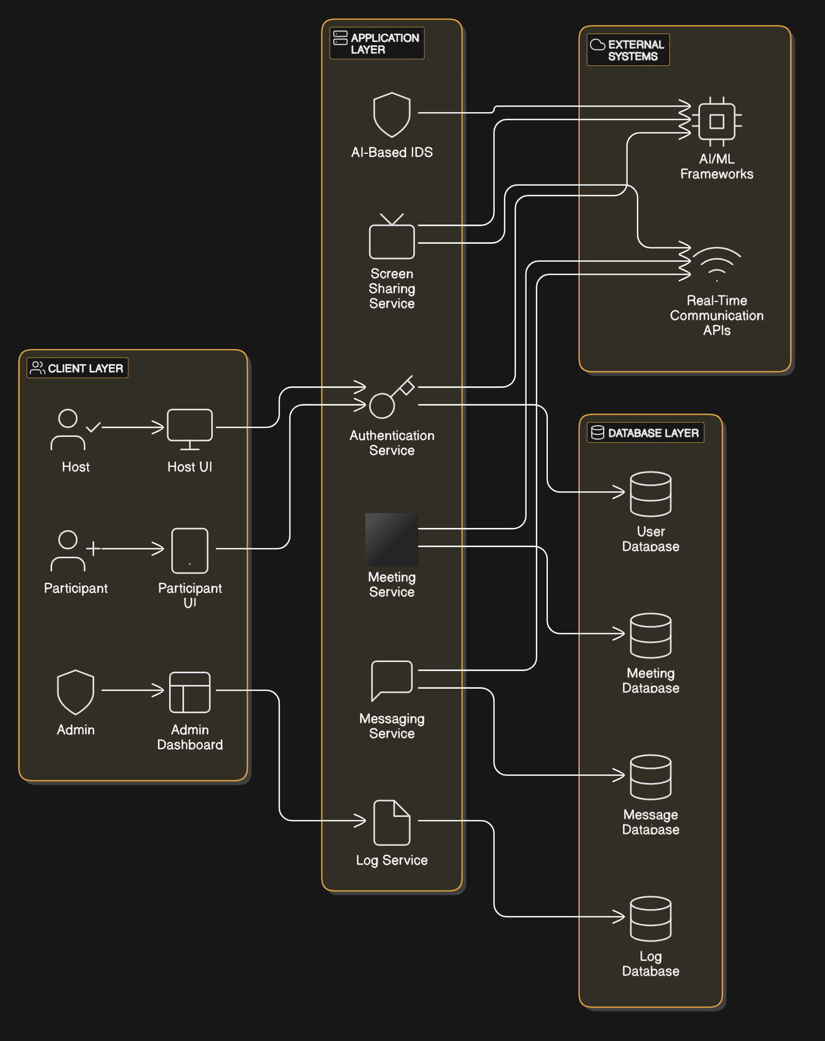
Analysis modelling
ARCHITECTURE DIAGRAM

Slide 13
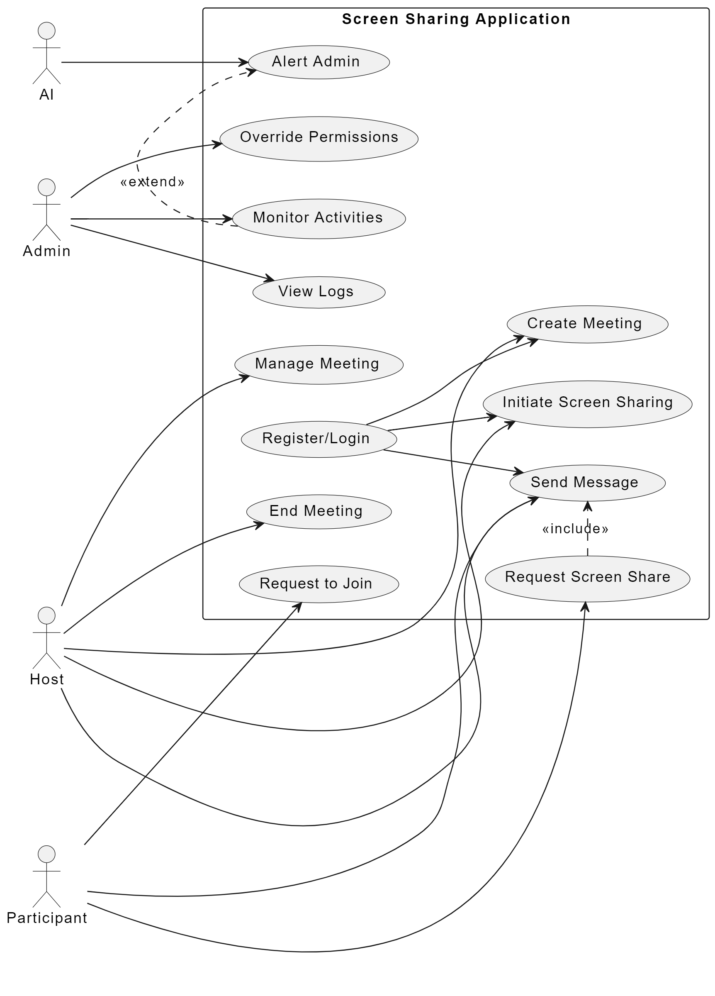
Use-CaseDiagram

Slide 14
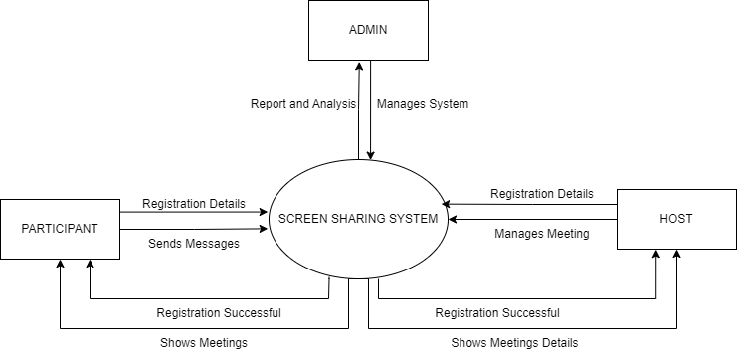
Data flow diagram

Slide 15
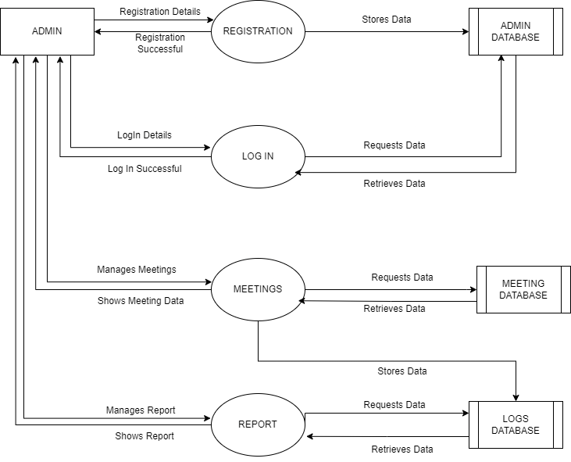
Data flow diagram

Slide 16
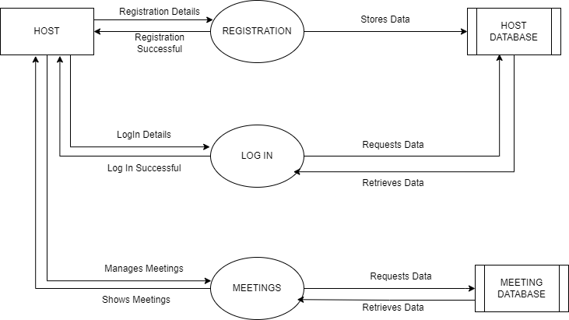
Data flow diagram

Slide 17
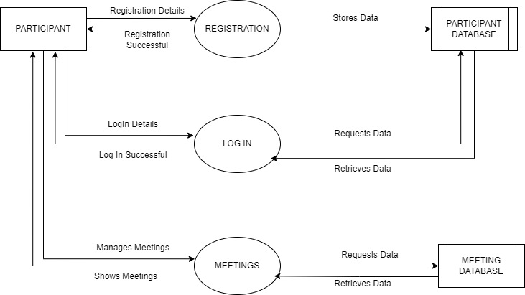
Data flow diagram

Slide 18
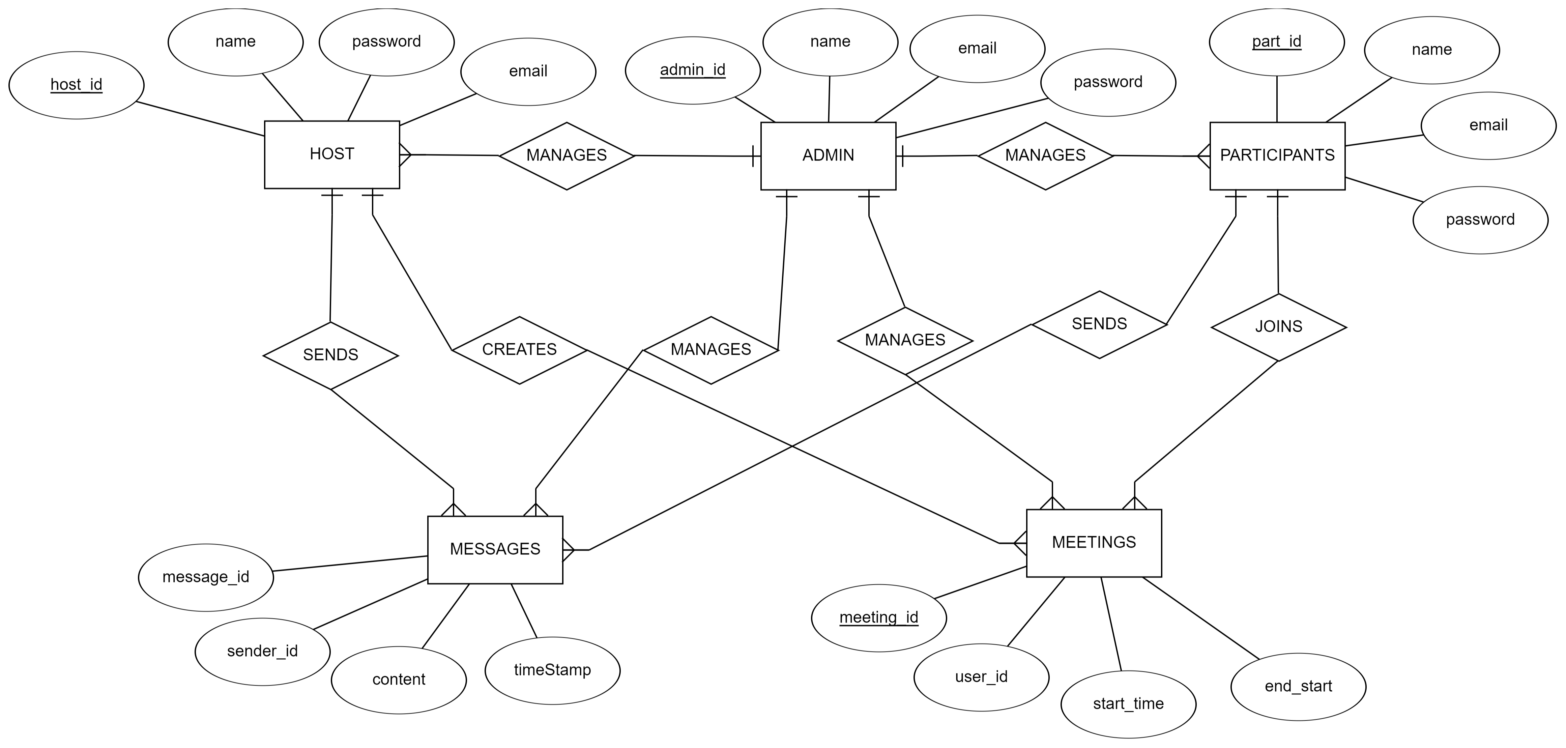
ER diagarm

Slide 19
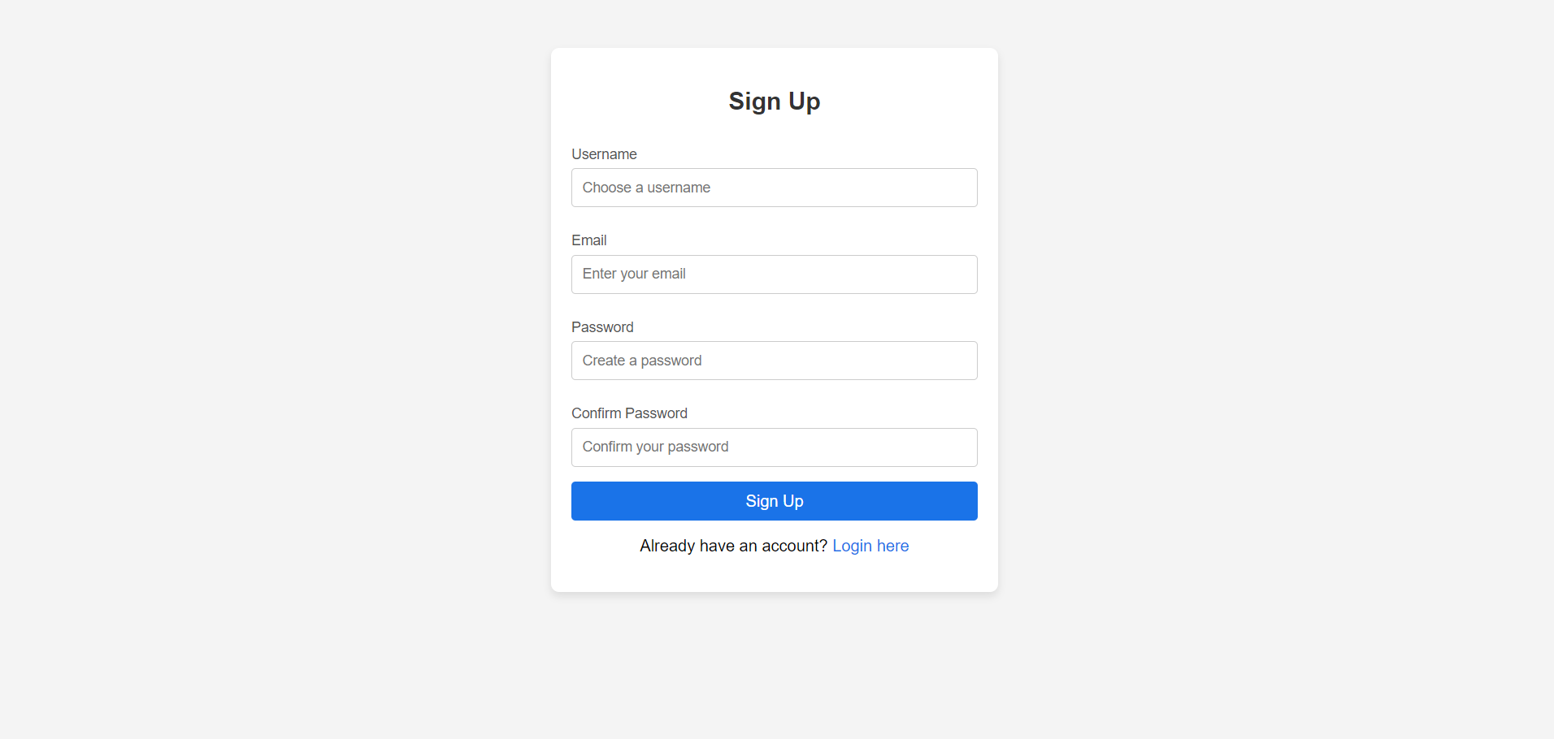
UI Implementation

Slide 20
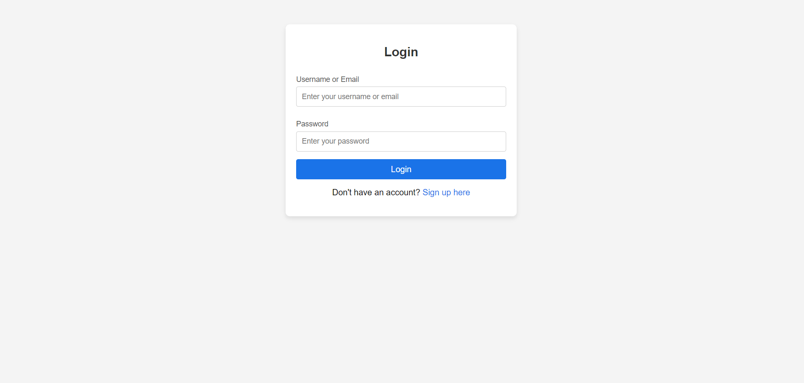
UI Implementation

Slide 21
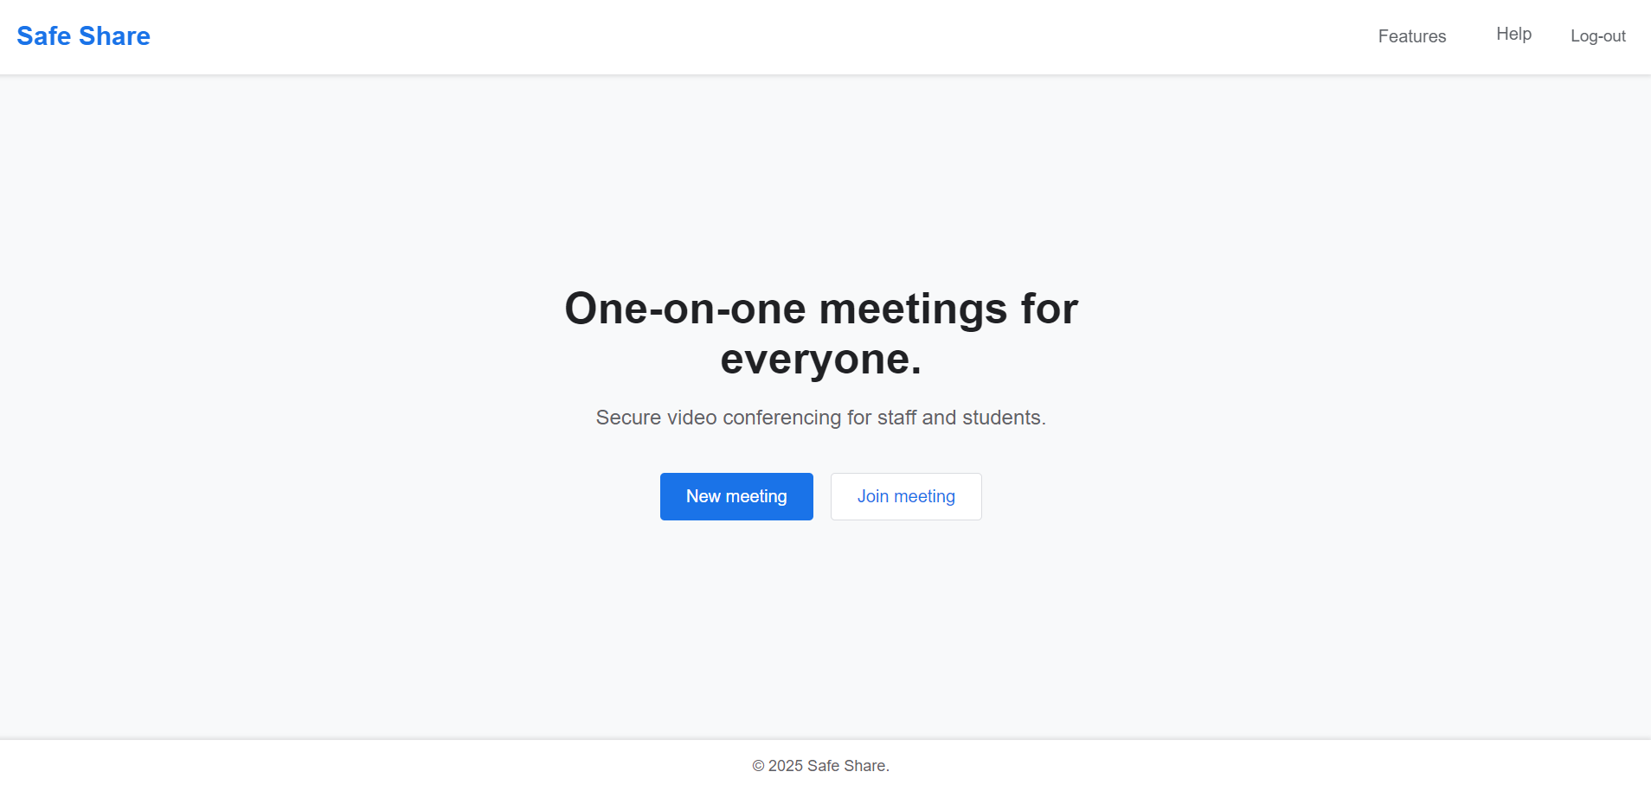
UI Implementation

Slide 22
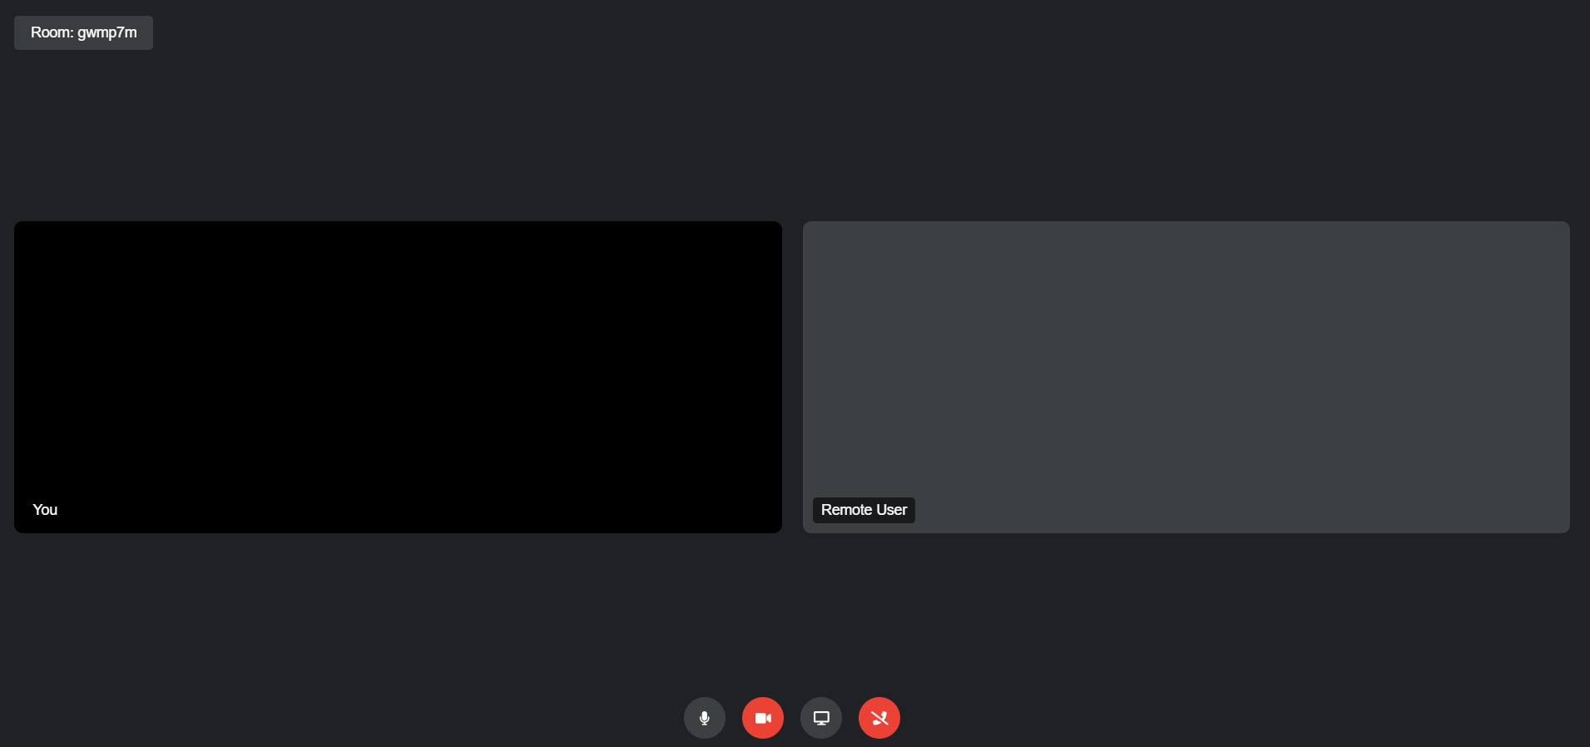
UI Implementation

Slide 23
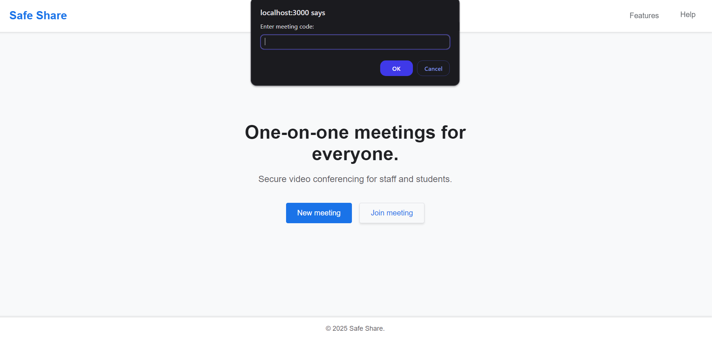
UI Implementation

Slide 24
Implementation of modules
Screen Sharing Module:
Real-time video and audio sharing using WebRTC.
Connection establishment and data transfer over secure LAN.
Includes control features like session management.

Slide 25
Project plan
Project Overview
Objective:
Develop a secure, scalable, and user-friendly screen-sharing application with real-time collaboration.
Duration:
~6 months

Slide 26
Project plan
Phase 1: Requirement Analysis (2 Weeks)
Gather functional and non-functional requirements.
Define user roles: Host, Participant, Admin.
Deliverable: Requirements Specification Document (RSD).
Phase 2: System Design (3 Weeks)
Create system architecture, database schema, and diagrams (EER, Use Case, Sequence).
Design APIs for integrating front-end, back-end, and AI components.
Deliverable: Different Models and Design diagrams.

Slide 27
Project plan
Phase 1: Requirement Analysis (2 Weeks)
Gather functional and non-functional requirements.
Define user roles: Host, Participant, Admin.
Finalize technical stack and tools.
Deliverable: Requirements Specification Document (RSD).
Phase 2: System Design (3 Weeks)
Create system architecture, database schema, and diagrams (EER, Use Case, Sequence).
Design APIs for integrating front-end, back-end, and AI components.
Deliverable: Different Models and Design diagrams.

Slide 28
Project plan
Phase 3: Development (10 Weeks)
a. Front-End Development (4 Weeks)
Develop user interfaces for Host, Participant, and Admin.
Ensure cross-platform compatibility.
b. Back-End Development (4 Weeks)
Implement user authentication, meeting management, and logging.
Connect database for secure operations.
Deliverable: Fully functional application components.

Slide 29
Project plan
Phase 4: Testing (4 Weeks)
Conduct unit, integration, performance, and security testing.
Validate system scalability and threat detection accuracy.
Deliverable: Test cases and results.
Phase 5: Deployment (2 Weeks)
Deploy the application on a cloud platform.
Conduct beta testing and collect user feedback.
Deliverable: Deployed system and feedback report.
Phase 6: Maintenance and Updates (Ongoing)
Monitor performance, update features, and improve IDS accuracy.
Ensure system stability and resolve issues promptly.
Deliverable: Regular updates and maintenance logs.

Slide 30
Expected Outcome
By developing this application, we plan to develop a secure, reliable, and user-friendly screen-sharing application that:
Enables efficient collaboration through real-time screen sharing and messaging.
Maintains system security through AI-powered intrusion detection and encrypted communication.
Provides a seamless experience across multiple devices and platforms.

Slide 31
Conclusion
The proposed secure screen-sharing application, integrated with AI-driven intrusion detection, addresses critical gaps in existing systems by enhancing security within LAN environments. By combining real-time threat detection with robust screen-sharing capabilities, this project offers a novel solution to mitigate cybersecurity risks such as MITM attacks.
The user-friendly design ensures accessibility, while the incorporation of AI ensures adaptability to evolving threats. Successful implementation will result in a powerful tool for secure remote collaboration, setting a benchmark for privacy and security in localized networks

Slide 32
References​
[1] C. Yin and et al., “Rnn-ids: Recurrent neural networks for intrusion detection sys-tems,” Journal of Network Security, 2017.​
[2] I. Ullah and Q. H. Mahmoud, “Design and development of rnn anomaly detectionmodel for iot networks,” IEEE Access, 2022.​
[3] Khan and et al., “Multistage intrusion detection for iovs using bilstm,” IEEE Trans-actions on Vehicular Technology, 2020.​
[4] Desta and et al., “Lstm-based intrusion detection for connected vehicles,” Automo-tive Cybersecurity Journal, 2020.​
[5] Alkahtani and et al., “Hybrid cnn-lstm model for botnet attack detection,” Journalof IoT Security, 2020.​
[6] Al-Haija and et al., “Hybrid detection system using adaboost and decision trees,”Journal of Network and Security, 2020.​

Slide 33
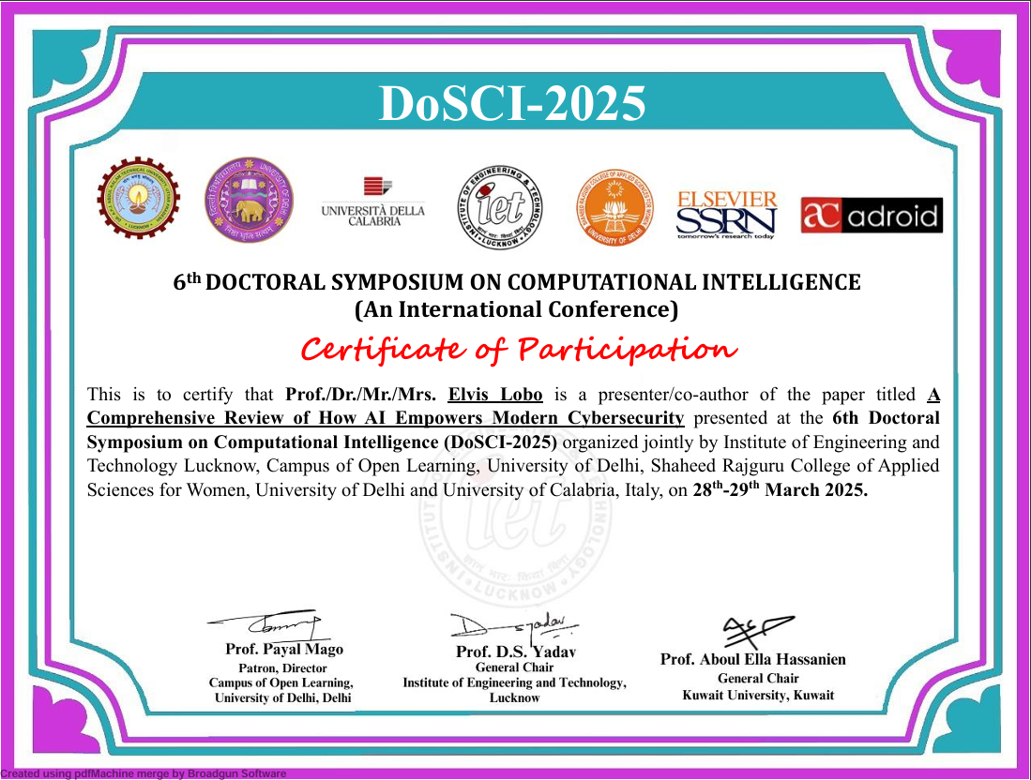

Slide 34
