Slide 1

DEPARTMENT OF MECHANICAL ENGINEERING,
SIET VIJAYPUR
INTERNSHIP PRESENTATION
on
“SUGAR INDUSTRY”
Presented By:
ABHINANDAN B PATIL
2SA16ME402
Guide:
Dr. Syed Abbas Ali
Department of Mechanical Engineering.
SECAB Institute of Engineering and Technology, Vijayapur

Slide 2
CONTENTS
Introduction to sugar industry
Company profile
Different sections in production of sugar
Flowchart showing process of feed section ,mill section&juice section
Feed section
Mill section
Juice section
Flow chart showing process parameters in pan and Centrifugal section
Pan section
Centrifugal section
Products of sugar cane

Slide 3
INTRODUCTION
SOVEREIGN INDUSTRIES LIMITED, TERDAL was established in January 2009 by SHRI Ningappa Tippanna Huggi.
The plant capacity is 2500TCD and 6MW of Co-gen plant.
During the first season 2015-2016 the factory has crushed 3,37,838.402 tons of sugar cane and production 41,600 tons of sugar with an average recovery 12.34%
Second season 2016-2017 the factory has crushed 1,44,092.133 tons of sugar cane and production 15,028 tons of sugar with an average recovery of 10.43%.
season 2017-2018 the factory has crushed 270022.335 tons of sugar cane and production 30,782 tons of sugar with an average recovery 11.40%.

Slide 4
COMPANY PROFILE
Year of incorporation | January 2009
Organization | SOVEREIGN INDUSTRIES LIMITED,TERDAL
Address | A/P: Terdal-587315 Tq: Jamakhandi Dist Bagalkot, KARNATAKA
Manpower | 350-During season 100-During off-season
Total Area | 148.36 Acres
Built Area | Spread over an area of 7 acres
Green belt Area\Plantation Area | 100 acres
Vacant Area | 41.36 acres

Slide 5
DIFFERENT SECTIONS IN PRODUCTIN OF SUGAR
Feed section
Mill section
Juice section
Pan section
Centrifugal section

Slide 6
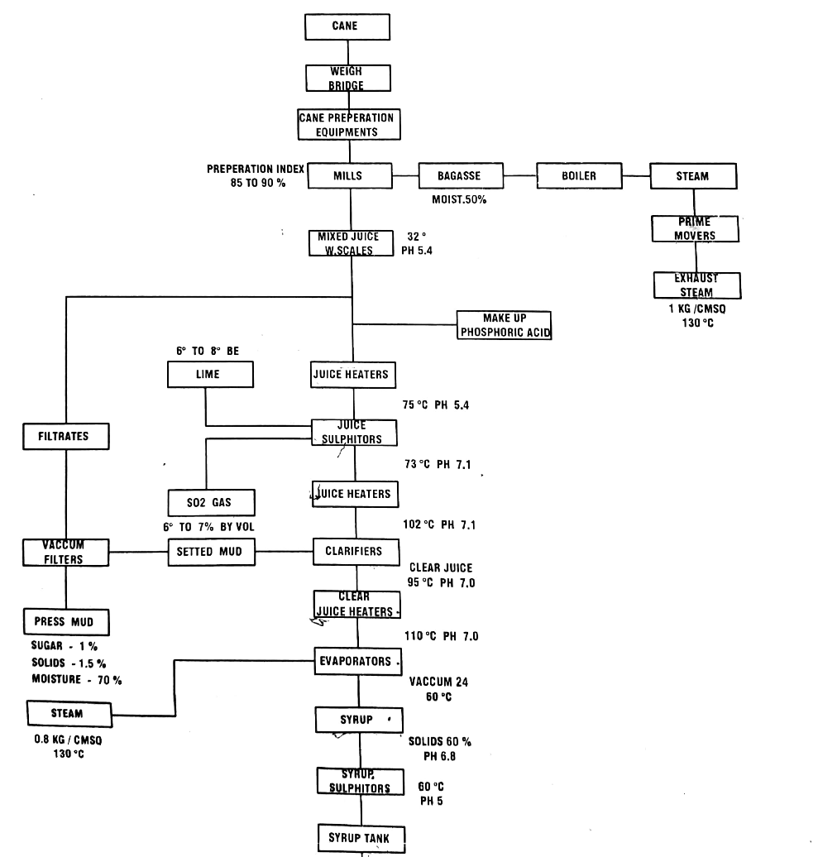
FLOWCHART SHOWING PROCESS of Feed section, Mill section & Juice section

Slide 7
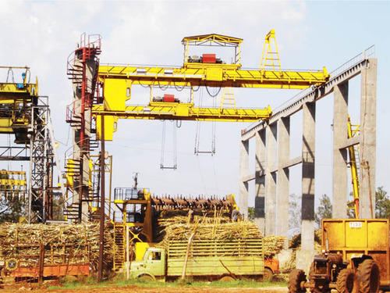
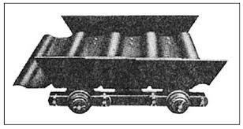
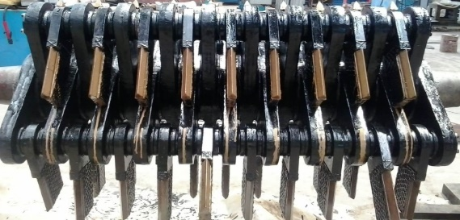
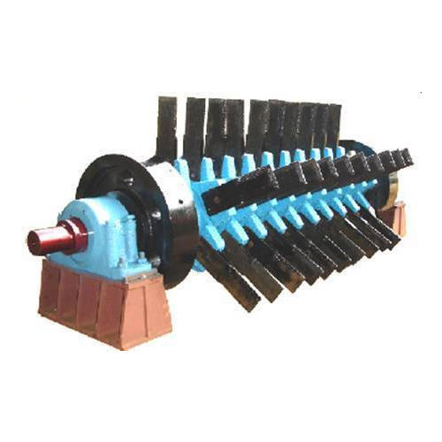
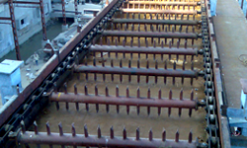
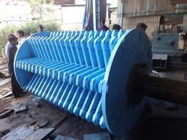
FEED SECTION
1.Components of Feed section
Cane Unloader
Feeder Table
Chopper
Leveler
Fibrizer
Rake Elevator

Slide 8
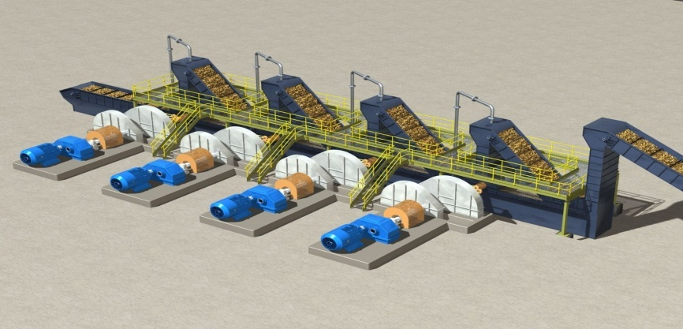
MILL SECTION
There are mainly four mills those are Underfeed roller,Feed roller,Top roller&Discharge roller
There are inter carrier in between mills which carry crushed cane to next mill these are of rake elevator type carriers which are 3 in number.
Each mill have a 100 HP DC motor rotates the drive gear which has 38 teeth then drives master gear which has 130 teeth rotates the coupling in turn to rotate the pinion of roller

Slide 9
JUICE SECTION
Juice heaters:
Juice coming from mill section have a trmperature of 32⁰c and PH 5.4 is first taken to the juice heaters of shell and tube heat exchanger and these juice heaters are five in numberwhere juice is heated to a temperature of 75⁰c and have PH 5.4 . Juice is heated because the chemical reactions at further stage should take place correctly.
Juice sulphitors:
Juice from juice heaters is taken to the juice sulphitors where lime and sulphur gas are added to remove the non sugar &maintain PH 7.0-7.1, SO₂ gas will be 6 to 7% by volume of juice . Juice is heated again before sending to clarifiers , it is heated upto 102⁰c and have PH 7.9 .
Clarifiers:
A clarifier is used to separate out the solids suspended in the cane juice.These solids originate from sand adhering to the cane stalksas well as from material inherent in the cane stalk. The separation takes place by allowing the solid particles to settle onto a tray .The solids are swept from the tray into a mud compartment . The clarified juice is the clear juice which is having temperature 95⁰c with PH 7.0.

Slide 10
Vacuum filter:
Mixture of mud and bagasse is brought to vaccum filter, the main function of vaccum filter is to remove sweetness from the mud
Vacuum filter consist of drums which rotates at a speed of 0.3 rpm means it rotates slowly for
good filtration.
When drum rotates mud becomes attached with walls and at same time mud is treeated with hot water from top.
The filtrate area is 58 m².
The press mud consist of
Sugar -1%
Solids-1.5%
Moisture-70%
EVAPORATORS:
An evaporator is equipment that is used to concentrate the solution by evaporating the solvent(water).
Falling film type evaporator:
The type of evaporator used is long tube or falling film type evaporators. Working of this type of evaporators is solution enters the lower tube sheet and flows up inside the tubes, steam on the outside of tubes cause evaporation of solution so that evaporated gas moves upward and the remaining solution will fall downwards by gravity as a continuous film . The solution will create a film along the tube walls progressing downwards(falling) hence the name is falling film evaporator. These are mainly two in number which are connected in series.

Slide 11
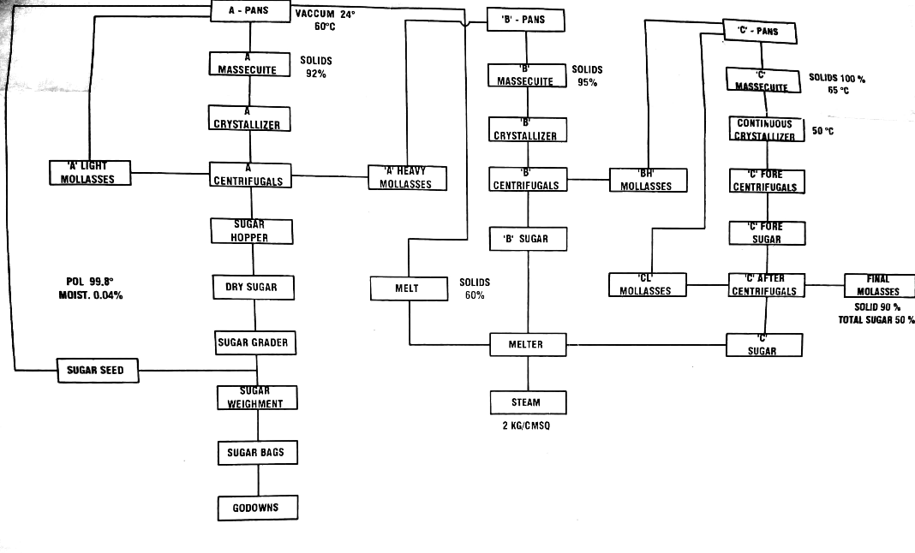
FLOW CHART SHOWING PROCESS PARAMETERS IN PAN AND
CENTRIFUGAL SECTION.

Slide 12
FAN SECTION
Syrup from juice section is pumped to a pan section.
Small grains of brown sugar (size 60-70 microns) are added to the pan from slurry tank.These small grains called seed, for the formation of sugar crystals
The growth of the crystals continues until the pan is full.
Vacuum pans are specified for different boiling of different massecuite and seeds.

Slide 13
CENTRIFUGAL SECTION
The high speed centrifugal action used to separate the massecuite into raw sugar crystals and molasses is done in revolving machines called centrifuge.
A centrifuge machine has a cylindrical basket suspended on a spindle, this cylindrical basket is having monitor case on outside then bearing housing is placed in it with screen.
The basket revolves at a speed from 1100 to 2000 RPM.
Molasses is passes through the lining because of centrifugal force.

Slide 14
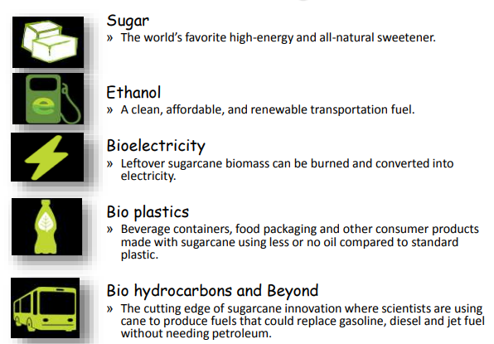
PRODUCTS OF SUGARCANE

Slide 15


