Slide 1

Branch Accounts Classification and Setting Target Using Decision Tree
Classification of branches based on income and expense and setting target amount for non profitable branches

Slide 2

CONTENTS
Abstract
Literature Survey
Introduction
Methodology
Result and Discussion
Conclusion
References

Slide 3
ABSTRACT
This project focuses on enhancing branch account management through the implementation of machine learning techniques for classification and target setting. By leveraging Decision Tree algorithm, the system effectively classifies branch accounts as profitable or not profitable based on historical financial data. Additionally, it incorporates a feature to set targets for branches categorized as not profitable, considering factors such as expense and the number of workers. The system aims to provide actionable insights into branch performance to facilitate informed decision-making and strategic planning. It offers a robust backend system capable of generating valuable insights to optimize resource allocation and financial management across the organization. Through the utilization of machine learning for classification and target setting, organizations can enhance budgeting, risk management, and strategic planning processes, leading to improved operational efficiency and financial outcomes

Slide 4
Literature Survey
I. Met, A. Erkoç and S. E. Seker et al. [1] Setting targets and distributing them to bank branches and portfolio managers is crucial for strategic planning. This study focuses on predicting performance using machine learning algorithms, achieving 98% accuracy. The approach, applied at Ziraat Bank, resolves seasonality issues and boosts branch target success by 10%. Awarded for innovation, it offers a practical solution for the banking sector.
C.A. Knox Lovell, Jesús T. Pastor et al. [2] This paper evaluates the target setting process in a Spanish financial institution. It assesses branch performance against set targets and suggests reducing the target list without losing vital information. This streamlined approach enhances management evaluation of branch performance.
F. Yin et al. [3] This paper discusses the design and implementation of an accounting information system based on the decision tree classification algorithm. Decision trees offer advantages in classification tasks, requiring less training time and iterations compared to neural networks and Bayesian methods, making them suitable for large-scale datasets. The study proposes innovative event-driven accounting information systems, enhancing their application in accounting processes.

Slide 5
W. Zhengjun, D. Zhiting, and D. Na et al. [5] This paper examines strategies for optimizing the application environment of management accounting in commercial banks. Despite the importance of management accounting in modern enterprise management, its application in Chinese enterprises faces challenges, leading to suboptimal application environments. The study analyzes these challenges and proposes counter measures to enhance the application of management accounting in commercial banks, aiming to a drive progress and development in this area.
H. D. Narudin, U. Subramanian, and F. Kawi et al. [6] This study investigates the effectiveness of management accounting systems in Brunei's Small and Medium Enterprises (SMEs). By analyzing responses from 250 participants, the study explores how management accounting influences decision-making processes and aids in achieving business goals within the context of SMEs in Brunei.

Slide 6
INTRODUCTION
This project focuses on the classification of branches of a service provider based on profitability and the setting of targets for non-profitable branches. By utilizing machine learning algorithm such as Decision Tree Classifier, the system aims to accurately classify branches as profitable or non-profitable using historical financial data. For non-profitable branches, the system will dynamically set targets based on factors such as expenses and workforce size.
The project seeks to streamline branch account management processes, enabling service providers to make informed decisions, allocate resources effectively, and enhance overall organizational efficiency. By harnessing the power of machine learning, the system aims to optimize branch performance, drive profitability, and ensure long-term sustainability in the competitive service industry.

Slide 7
METHODOLOGY
The methodology for branch classification and setting target using decision tree classifier which typically involves the following steps:
Data Collection
Data Pre-processing
Model Building
Result
Data collection: The first step is to collect relevant data from the database, including historical income data expense data and number of workers.
Data pre-processing: In this step, the collected data is cleaned and pre-processed. This involves handling missing values, removing outliers, and transforming the data into a suitable format for analysis.
Machine learning: Branch classification using decision tree is a popular machine learning technique that can help manage branches more accurately. This technique involves building predictive models that analyse historical accounts data and other relevant factors to make accurate predictions about future organization management.

Slide 8
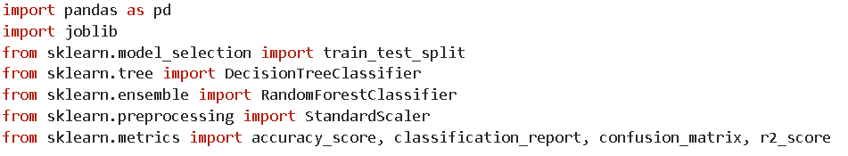

Import the required libraries
Load the dataset
Split the data into training and testing datasets.
Train a decision tree model

Slide 9
5. Make predictions on the testing data
6.Evaluate the model using the R-squared matric

Slide 10

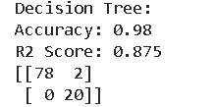
RESULTS AND DISCUSSION
This system uses more accurate decision tree classification algorithm

Slide 11
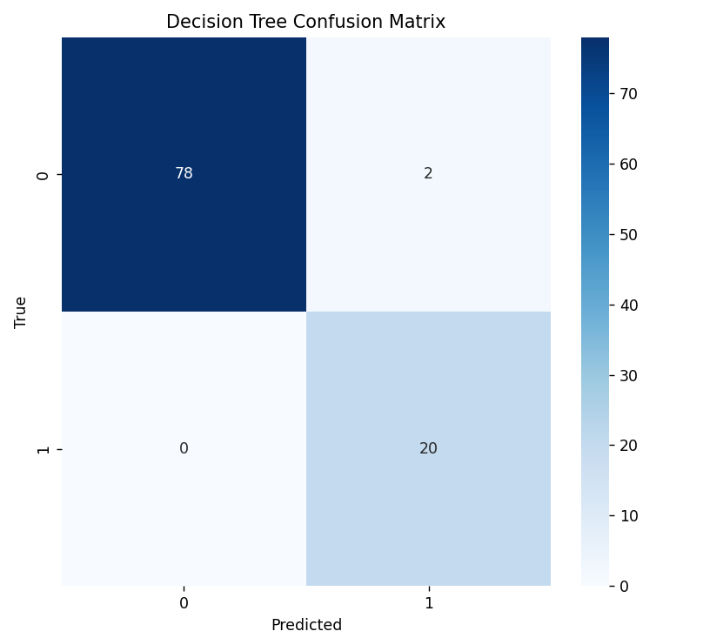
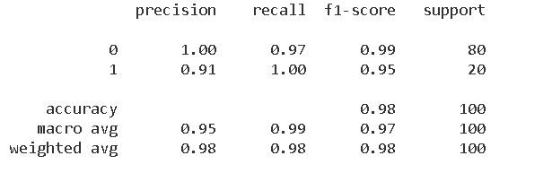
Figure 1. Confusion matrix
Figure 2. Classification report

Slide 12
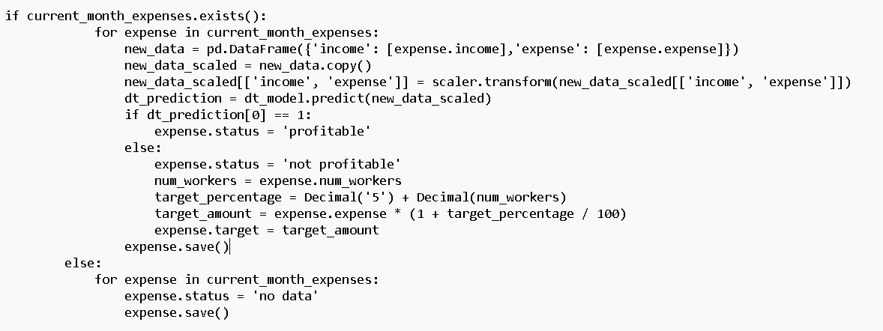
Implementation in project and setting target amount to non-profitable branches

Slide 13
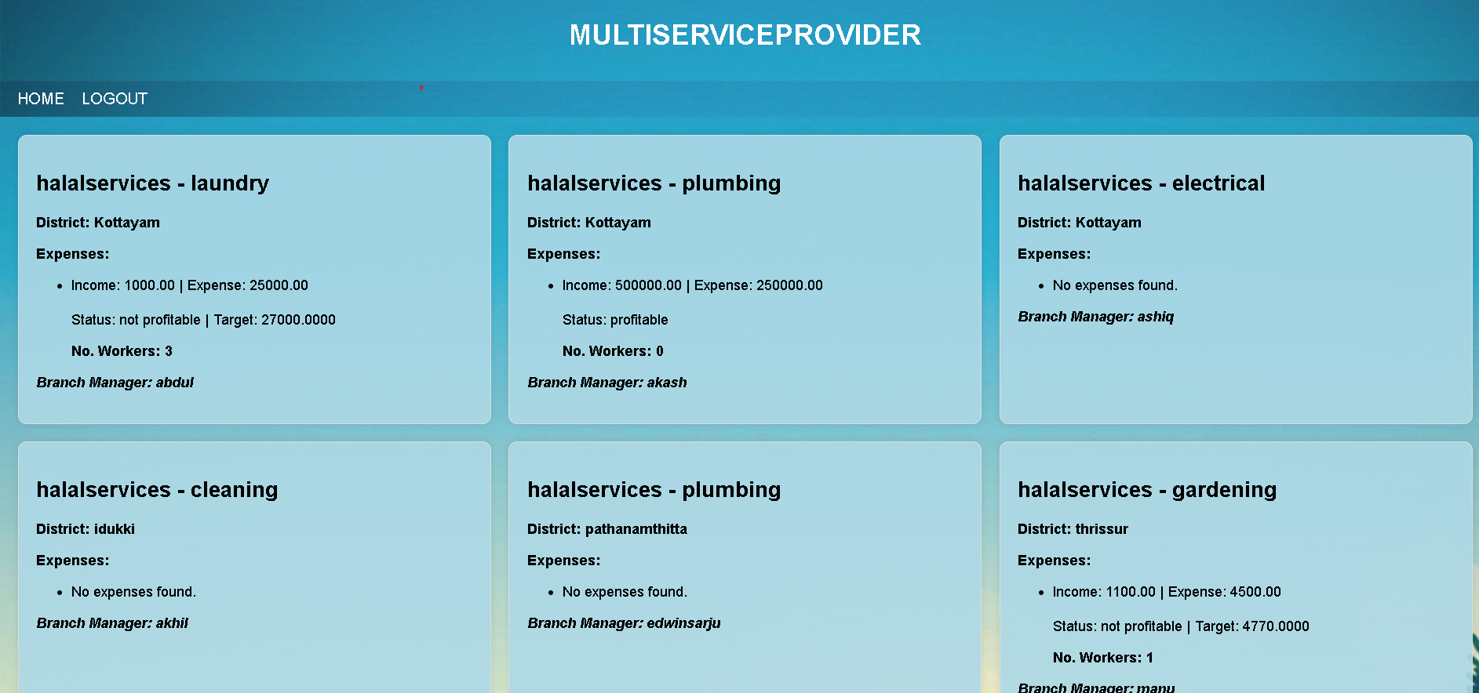

Slide 14
CONCLUSION
In conclusion, while conventional methodologies often fall short in fostering profitability within commercial enterprises, the integration of machine learning approaches emerges as a pivotal solution for crafting robust business strategies. By leveraging machine learning algorithms, organizations can meticulously analyze various factors influencing branch profitability and inform the development of comprehensive business plans. Instead of focusing solely on traditional metrics, this entails discerning factors such as branch income, expenses, number of workers, and historical performance to classify branch profitability and establish achievable targets. Through the utilization of historical data and pertinent factors, businesses can adeptly forecast profitability and set actionable targets. This informed approach enables enterprises to implement effective strategies, fostering sustainable growth and facilitating their success in competitive markets with confidence and agility.

Slide 15
REFERENCES
I. Met, A. Erkoç and S. E. Seker, "Performance, Efficiency, and Target Setting for Bank Branches: Time Series With Automated Machine Learning," in IEEE Access, vol. 11, pp. 1000-1010, 2023, doi: 10.1109/ACCESS.2022.3233529.
C.A. Knox Lovell, Jesús T. Pastor, "Target setting: An application to a bank branch network," European Journal of Operational Research, vol. 98, no. 2, pp. 290-299, 1997, ISSN 0377-2217, doi: 10.1016/S0377-2217(96)00348-7..
F. Yin, "Design and Implementation of Accounting Information System Based on Decision Tree Classification Algorithm," 2023 Asia-Pacific Conference on Image Processing, Electronics and Computers (IPEC), Dalian, China, 2023, pp. 481-484, doi: 10.1109/IPEC57296.2023.00089

Slide 16
W. Zhengjun, D. Zhiting and D. Na, "Strategies for Optimizing the Application Environment of Management Accounting in Commercial Banks," 2021 International Conference on Public Management and Intelligent Society (PMIS), Shanghai, China, 2021, pp. 345-349, doi: 10.1109/PMIS52742.2021.00084.
H. D. Narudin, U. Subramanian and F. Kawi, "The Effectiveness of Management Accounting Systems in Brunei Small and Medium Enterprises," 2022 International Conference on Information Management and Technology (ICIMTech), Semarang, Indonesia, 2022, pp. 155-160, doi: 10.1109/ICIMTech55957.2022.9915080

Slide 17
THANK YOU

