Slide 1

Organization Name : Dte of IT & Cyber Security, DRDO
Problem Statement : Video based dynamic human authentication system for access control
Problem Statement Number : CK107
Team Name : Aryavarta
Team Leader Name : Abhinash Singh
College Code : 1-491997703
Team Members Name :
Anish Gond
Nyasha
Praveen Kumar
Rajkumari
Shruti Sharma

Slide 2
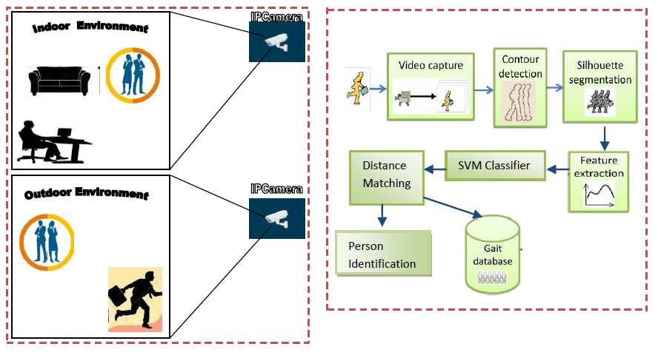
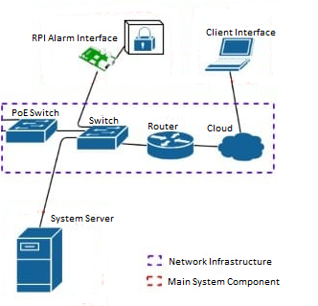
Project Overview
>> Security :
In surveillance, human activity recognition system retrieve and process contextual(environment, spatial, temporal etc.) data to understand the human behaviour.

Slide 3


Idea Of Approach
Technology Stack :
Front End:
Object Segmentation
Feature Extraction
Feature Learning
Activity Detection
&
Classification
Person Identified
Tkinter, XML
Background Subtraction Algorithm
Foreground object can be obtained by subtracting the current image of background image followed by a thresholding to obtain segmentation mask
SHAPE BASED
Static Feature
Stride Length
Degree of Toe-out
Knee-Knee
Distance & Ankle-Ankle Distance
Dynamic Feature
Leg-Hip angle
Leg-Knee angle
Leg-Ankle angle
SVM
Classifier
Dynamic Time Warping(DTW) Algorithm
Measure distance between two sequences.
Include the Non-Euclidean space to match the shape sequences for human moments.
Recognize various human activities such as waving, walking .
Alert
Back End:
python, OpenCv,
TensorFlow, Artificial Intelligence
Gait Database
Feature level fusion
>> Innovation : Till now face recognition is available, but in this we are doing a dynamic human recognition system, by combining-face recognition and gait recognition technology.
>> We are using three cameras for proper recognition of human.
>> Camera will be self-learner
Database:
MongoDB/mysql

Slide 4
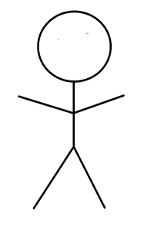
Use Case Diagram
Feasibility & Feature:
SVM algorithm optimization to find solution (i.e. hyperplane) with few errors.
Suggested method presented 91.83% of accuracy of cycle time measurement
Use kernel trick to make large feature spaces computationally efficient.
Cycle time measurement method required limited significant efforts like additional observer, time and cost.
It measures the activities by using internal measurement units(IMU signals is used as additional features in classification) because of simultaneous action of multiple parts
Future Scope : In future, a technology can be made by which we can get all the information of a person that is passing through the camera.
Human Recognition
Gait Recognition
Movement of foot
Movement of knee
System
Movement of arm
Person
Face recognition
Person allow
Security
Person restrict

