Slide 1
WENSA: WhatsApp Emotion and Sentiment Analyzer Using LSTM and BI-LSTM Paper ID/ Batch No.
AUTHOR(S)
R V Sanjay- CS21B1040, Abhinav kumar na- CS21B1001
AFFILIATION
Department of Computer Science and Engineering, National Institute of Technology Puducherry

Slide 2
Outline/Agenda
Title
Introduction
Motivation
Literature Survey
Outcome of Literature Survey/Drawbacks
Objectives
Proposed Method
Architecture/Block Diagram
Algorithm/Flowchart
Dataset
Experimental Setup
Performance Metrics
Results
Conclusion
Future Work
References

Slide 3
Introduction
Curiosity serves as a powerful motivator that has driven many individuals to accomplish remarkable feats. People are naturally curious about how they are perceived by others based on their conversations, whether one-on-one or in group settings. To enhance the efficiency of our model, we require a substantial amount of data. For this purpose, we have turned to one of Meta's data-rich assets – WhatsApp. WhatsApp boasts an impressive statistic of nearly 85 billion messages exchanged daily, with the average user dedicating over four hours a week to the platform and participating in numerous group chats. The solution presented by this study involves applying exploratory data analysis and sentiment analysis to messages extracted from WhatsApp chats.

Slide 4
Introduction
These messages are obtained through WhatsApp's built-in export feature and require preprocessing to optimize computation. Emotion detection, or sentiment analysis, refers to the techniques, methods, and tools used for identifying and extracting subjective information, including attitudes and opinions, from text. Historically, the main focus of sentiment analysis has been to classify text into positive, negative, or neutral. However, these three classifications might not adequately convey the complex implications of the underlying sentiment in the given text.

Slide 5
Motivation
On a personal level, it enables users to gain insights into the emotional dynamics of their conversations, potentially aiding in mental health and relationship management. In a professional context, it offers businesses valuable tools for customer feedback analysis, brand reputation management, market research, and customer support automation. Sentiment analysis in WhatsApp chats can also facilitate productivity enhancement, language learning, parental control, security threat detection, HR insights, educational assessments, and personal growth tracking. In summary, such an application serves a multitude of purposes, from enhancing personal well-being to improving business operations and insights.

Slide 6
Literature Survey
Article | Approach/ Method | Dataset | Pros | Cons
Twitter based sentimental analysis of Covid-19 observations | Based on sentiment polarity. | Twitter Web App Twitter for Android Twitter for iPhone | Content on the Internet is inspected at three astonishing granularity levels: documentation level, sentence level, and feature level with the documentation level being the most detailed. | Sentiment analysis models might struggle to accurately detect sarcasm, irony, or other forms of figurative language, leading to misinterpretation of sentiment.
Sentiment analysis of Indian regional languages on social media | The model is tested with a different set of classifiers which included a support vector machine (SVM) algorithm. | Focused on Twitter data collection Amazon reviews Medical documents Social media tweets | Model deals with different Indian regional languages (i.e., English, Kannada, Malayalam, Tamil, Telugu, and Hindi) simultaneously. | Due to the low resource of data these languages are mostly unnoticed. additional information like emojis and pictures are not considered for this dataset

Slide 7
Literature Survey
Article | Approach/ Method | Dataset | Pros | Cons
An optimal support vector machine based classification model for sentimental analysis of online product reviews | Support Vector Machine (SVM) based Classification | iPod dataset | The major benefits of SVM are which if the data point is linearly separable, it has a unique value and the values are very less | Its inability to effectively process OOV words, which can limit its comprehension and response accuracy This model does not do well for resource-poor languages
Transformer-based deep learning models for the sentiment analysis of social media data | An BERT based Convolution Bi-directional Recurrent Neural Network | Airline reviews: Us-airline dataset. Self-driving car reviews US presidential election reviews IMDB movie review dataset | Bi-LSTM model is used to take advantage of learning long-term dependencies in both directions between word sequences in along text | It fails to recognize and interpret emoticons during sentiment analysis which may lead to inaccurate results

Slide 8
Objectives
The objective of the proposed exploratory data analysis tool and emotion detection model is as follows :
• To visualize and explore WhatsApp chats to obtain insights by applying text mining techniques.
• To understand how the proposed LSTM and BI-LSTM model acts and respond to word embedding techniques such as FastText word embedding.
• To detect emotion of the given text data in terms of joy, sadness, anger and fear.

Slide 9
Proposed Method
Modules:
a) Data Collection Module
1)Via Mobile
2)Via PushBullet API
b) Preprocessing Module
1)Time-Stamp separation(Splitting Fields)
2)Data Frame Creation
3)Date and Time Format conversation
4)Using Regular Expression patter splitting message user
5)Feature extraction
6)Final Data Frame
c) Exploratory Data Analysis Module
1)Fetch_stats sub-module
2)Timeline sub-module
3)Total message and average word length sub-module
4)Activity Map
5)Weekly and Monthly Activity
6)Stop Words & Word Cloud
d ) LSTM Module

Slide 10

Architecture/Block Diagram
LSTM
Model Fitting
Evaluation
Model Building
Activation Layer
Read Dataset
Dense Layer
Uses sigmoid activation to make 0 1 predictions for each emotions
LSTM Layer
To classify, process and make predictions
Pre-Processing
Max Pooling Layer
To extract salient features, to get fixed size that captures important information from the sentence.
Convolution Layer
Feature extraction with respect to filters, detect and extract local features
Label Encoding
Drop Out Layer
Prevents overfitting, helps in accuracy, noise introduction in training process
Tokenization
Embedding Layer
Converting tokens 200 length vectors
Padding

Slide 11

Input
Structured Text data
User & Messages
User + Message Separation
Splitting fields
(Regular Expression)
API
Chat
Data
Time & Date
Format Detection
Format Conversion
PushBullet
WhatsApp
Export Chat
Txt File
Day/Time based Features
Final Data Frame Creation
Cleaning
New Features Addition
Data Collection
Message Based Features
Output [1]
Pre-Processing
Output
[2]
URL Module
(Shared links info)
User Wise Total sent Msg along with average message length
Involvement Module
(Most active User/ Time/ Weekday)
Clustering different chats into File, text , emoji
Read Dataset
OUTPUT
Pre-Processing
Evaluation
Emoji Module
Timeline Module
(Month/Year wise activity)
Classify as English or Non English
Activity Map Module
[Weekly/Daily]
Label Encoding
Model Fitting
User_wise_Emoji
[Most used emoji by Each user]
fetch_stats module
(Total Msg, words, users, links, Media)
Tokenization
Model Building
Word Cloud
Common Words Module
Stop Words
Word Cloud
Padding
Exploratory Data Analysis (EDA)
Emotion detection
Exploratory Data Analysis (EDA)

Slide 12
Algorithm(s)/ Flowchart
Proposed algorithm for EDA
1: Start
2: Import NumPy, Pandas, Matplotlib etc.
3: Read Dataset()
4: Split the dataset into timestamp and message
5: Split the timestamp into time and date
6: Split the message into user and the actual message(msg)
7: pre data ← This is the modified dataset after Pre-Processing
8: Check for any urls in msg

Slide 13
Algorithm(s)/ Flowchart
9: Check for any emoji's in msg
10: Analyze the sentiment of msg
11: Time Series of msg
12: Activity Map per day/week
13: Statistic Calculation of msg
14: Scatter plot of user activity
15: Word Cloud(most common word)
16: End

Slide 14
Algorithm(s)/ Flowchart
Proposed algorithm for LSTM
1: Start
2: Import NumPy, Pandas, LabelEncoder, train_test_split, Tokenizer
3: From Keras.layers import Dense, LSTM, Embedding, Dropout, Activation, Conv1D, MaxPooling1D
4: Read the csv file ”train.txt” into df_train
5: Apply Label Encoding on y train
6: Initialize Tokenizer() as tokenizer
7: Fit tokenizer on X train & X test on axis=0
8: Apply padding to X train
9: Initialize Sequential() as model

Slide 15
10: Add Embedding Layer to the model
11: Add Dropout Layer to the model
12: Add one dimensional Convolutional Layer to the model
13: Add Max Pooling Layer to the model
14: Add LSTM Layer to the model
15: Add more hidden layers to the model
16: Add Softmax Activation Layer to the model
17: Predict the emotion
18: End

Slide 16
Algorithm(s)/ Flowchart
Proposed algorithm for Bi-LSTM
1: Start
2: Import Bidirectional, Tokenizer, Dense,
Embedding, Dropout
3: Read the csv file ”train.txt” into df_train
4: Apply Label Encoding on y train
5: Initialize Tokenizer() as tokenizer
6: Apply padding to X train
7: Initialize Sequential() as model
8: Add Embedding Layer to the model
9: Add Bidirectional LSTM Layer(128)
10: Add Dropout Layer to the model
11: Add Bidirectional LSTM Layer(256)
12: Add Dropout Layer to the model
13: Add Bidirectional LSTM Layer(128)
14: Add more hidden layers to the model
15: Compile the model
16: Predict the emotion

Slide 17
DataSet
The dataset we used plays a key role in our implementation as we need to be aware of the source of the data and whether it is imbalanced or not.
1. Train.txt: Model will be trained with this dataset which contains 16000 records.
2. Val.txt: Provide an unbiased evaluation of a model fit on the training dataset while tuning model hyperparameters. It contains 2000 records.
3. Test.txt: Provide an unbiased evaluation of a final model fit on the training dataset.

Slide 18
Experimental Setup
Data Collection and Preprocessing:
Extracted data set from Kaggle consisting 20000 records
Data Splitting
Train
Text
Val
Model Architecture:
Embedding, Dropout, 1D conv, 1D MaxPooling
LSTM, Dense, SoftMax
Training Configuration:
Vocab Size: 14980
Embedding Size: 200 Length vectors
Batch Size: 256
Epochs: 30
Model Training:
Early Stopping: Patience=3,Monitor=Val_Loss
Codes and Tools:
NumPy, Matplotlib, TensorFlow

Slide 19
Performance Metrics
Class Label | Precision | Recall | F1-score | Support
Anger | 0.90 | 0.92 | 0.91 | 275
Fear | 0.96 | 0.88 | 0.92 | 224
Joy | 0.96 | 0.99 | 0.97 | 695
Sadness | 0.95 | 0.94 | 0.95 | 581
Evaluation Metric of LSTM
Class Label | Precision | Recall | F1-score | Support
Anger | 0.91 | 0.94 | 0.92 | 275
Fear | 0.95 | 0.93 | 0.94 | 224
Joy | 0.99 | 0.98 | 0.99 | 695
Sadness | 0.95 | 0.95 | 0.95 | 581
Evaluation Metric of BI-LSTM

Slide 20
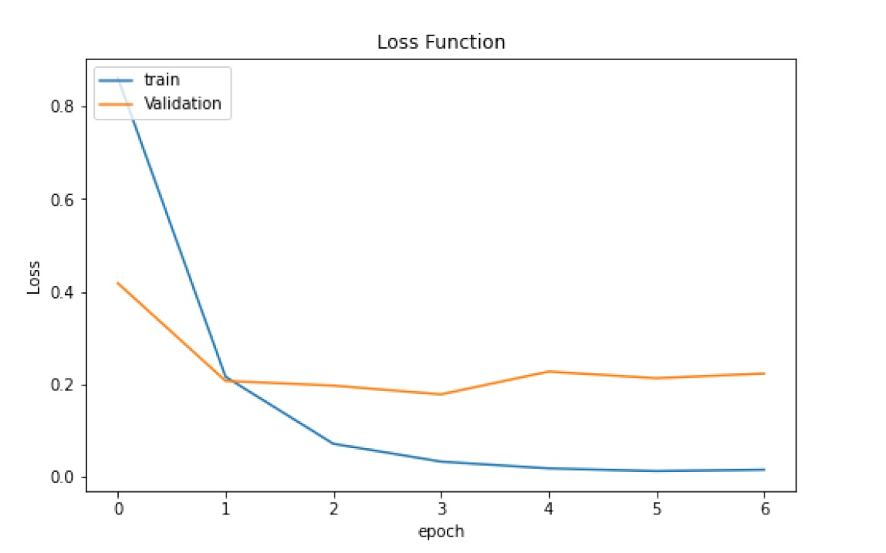
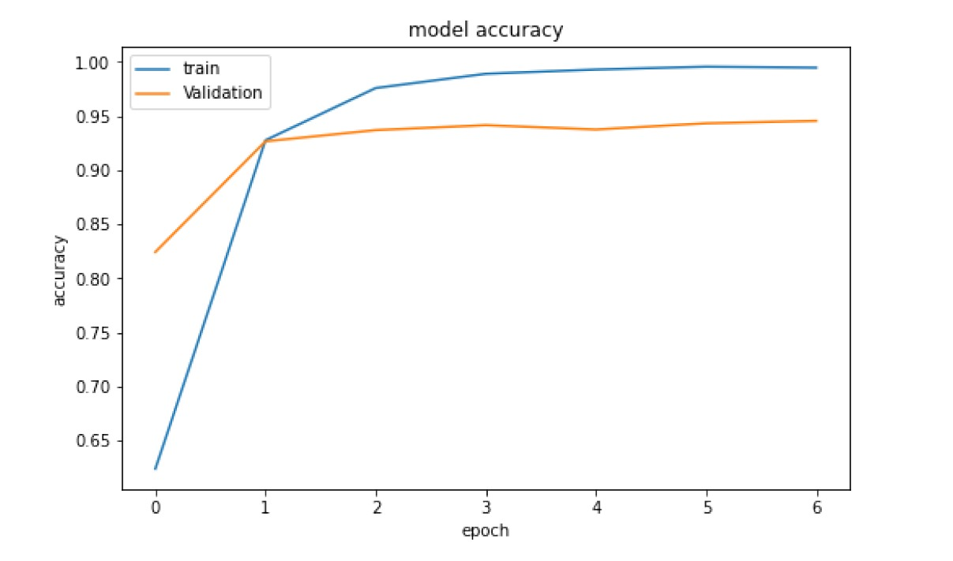
Results
Model Accuracy in each Epoch
Model Loss in each Epoch

Slide 21
Conclusion
The significance of social network analysis is explored throughout this study. This research asserts that exploratory data analysis provides a gateway to the undiscovered world of WhatsApp Chats and successfully was able to use the necessary tools to develop an analysis of a WhatsApp group chat and visually depict the top 15 people in the chat group, analyze the emojis and most active day/month/year, and so on. Ultimately, the analysis produced the desired results and was able to demonstrate the level of engagement of all participants in the exported WhatsApp chat. Emotion Detection using LSTM model needed several intermediate layers for passing memory to get the desired output. In this project, seven intermediate layers are used to make the sequential model and to predict the emotion in four different categories ['sadness', 'anger', 'joy', 'fear']. A dataset of 16,000 records has been used, but most of the records have either 'joy' or 'sadness'. In this sequential model, a word embedding layer needs to be employed to understand how the model works and responds to the reviews or textual data. The unsupervised word embedding learning algorithm is used.

Slide 22
Future Work
Although we observed a lot of insights in exploratory data analysis, such as day-by-day messages, most active time in the group, most used terms during the conversation, and so on, in addition, we noticed a spike in hate speech, cyberbullying, heckling, and greater impudence on social media. This study lacks in features like time-wise topic modeling (which will indicate the conversations about topics between two periods), code recognition (in case programming language code is provided in chat), and product feature extraction (to collect specifics if the user discusses purchasing any product). Majority records in Emotion detection relate to either joy or sadness; consequently, additional records need to be included for more accurate and diverse output. Furthermore, it now predicts emotions in four separate categories; it must be improved to categorize at least 15 emotions. In addition, the use of some Google API for emotion detection in any language can be implemented. Deep learning models' performance can be enhanced by varying word embedding algorithms and hyperparameters. It can produce the most accurate results by applying pre-trained NLP called Bi-directional Encoder Representation from Transformer (BERT).

Slide 23
References
A.Vijayaraj, K.Bhavana, S.SreeDurga, and S. Lokesh. Naik, “Twitter based Sentimental Analysis of Covid-19 Observations,” Materials Today: Proceedings, May 2022
D. Kanojia and A. Joshi, “Chapter 3 - Applications and challenges of SA in real-life scenarios,” ScienceDirect, Jan. 01, 2023. (accessed Nov. 05, 2023).x
G. Rao, W. Huang, Z. Feng, and Q. Cong, “LSTM with sentence representations for document-level sentiment classification,” Neurocomputing, vol. 308, pp. 49–57, Sep.2018
Huang Zou, Xin hua Tang, Bin Xie and Bing Liu, ”Sentiment classification using machine learning techniques with syntax features”, pages 175–179, 2015.
I. N. Khasanah, “Sentiment Classification Using fastText Embedding and Deep Learning Model,” Procedia Computer Science, vol. 189, pp. 343–350, 2021
IS Srajan, K Ravishankara, and Vaisakh Dhanush, ”Whatsapp chat analyzer”, International Journal of Engineering Research & Technology, 9(5):897–900, 2020.
J.Samuel, G.G. Ali, M. Rahman, E. Esawi, Y. Samuel, ”Covid-19 public sentiment insights and machine learning for tweets classification”, Information, 11 (6) (2020) 314.
K. Rakshitha, R. H M, M. Pavithra, A. H D, and M. Hegde, “Sentimental analysis of Indian regional languages on social media,” Global Transitions Proceedings, vol. 2, no. 2, pp. 414–420, Nov. 2022
M. Arbane, R. Benlamri, Y. Brik, and A. D. Alahmar, “Social media-based COVID-19 sentiment classification model using Bi-LSTM,” Expert Systems with Applications, vol. 212, p. 118710, Feb. 2023
S. Tabinda Kokab, S. Asghar, and S. Naz, “Transformer-based deep learning models for the sentiment analysis of social media data,” Array, p. 100157, Apr. 2022 S. Tabinda Kokab, S. Asghar, and S. Naz, “Transformer-based deep learning models for the sentiment analysis of social media data,” Array, p. 100157, Apr. 2022

Slide 24
References
S. Sadiq, A. Mehmood, S. Ullah, M. Ahmad, G. S. Choi, and B.-W. On, “Aggression detection through deep neural model on Twitter,” Future Generation Computer Systems, vol. 114, pp. 120–129, Jan. 2021
S. Zeng, C. Ma, J. Liu, M. Li, and H. Gui, “Sequenceto- sequence based LSTM network modelling and its application in thermal error control framework,” Applied Soft Computing, vol. 138, p. 110221, May 2023
Sunil Joshi, ”Sentiment analysis on whatsapp group chat using r”, Data, Engineering & Applications, pages47–55,2019
U. B. Mahadevaswamy and P. Swathi, “Sentiment Analysis using Bidirectional LSTM Network,” Procedia Computer Science, vol. 218, pp. 45–56, 2023
W. Zhang, L. Li, Y. Zhu, P. Yu, and J. Wen, “CNNLSTM neural network model for fine-grained negative emotion computing in emergencies,” Alexandria Engineering Journal, vol. 61, no. 9, pp. 6755–6767, Sep. 2022
Z. Ahmed and J. Wang, “A fine-grained deep learning model using embedded-CNN with Bi-LSTM for exploiting product sentiments,” Alexandria Engineering Journal, vol. 65, pp. 731–747, Feb. 2023
P. Vijayaragavan, R. Ponnusamy, and M. Aramudhan, “An optimal support vector machine based classification model for sentimental analysis of online product reviews,” Future Generation Computer Systems, vol. 111, pp. 234–240, Oct. 2020
R. K. Behera, M. Jena, S. K. Rath, and S. Misra, “Co-LSTM: Convolutional LSTM model for sentiment analysis in social big data,” Information Processing & Management, vol. 58, no. 1, p. 102435, Jan. 2021
S. Aslan, “A deep learning-based sentiment analysis approach (MF-CNN-BILSTM) and topic modelling of tweets related to the Ukraine-Russia conflict,” Applied Soft Computing, vol. 143, pp. 110404–110404, Aug. 2023

