Slide 1
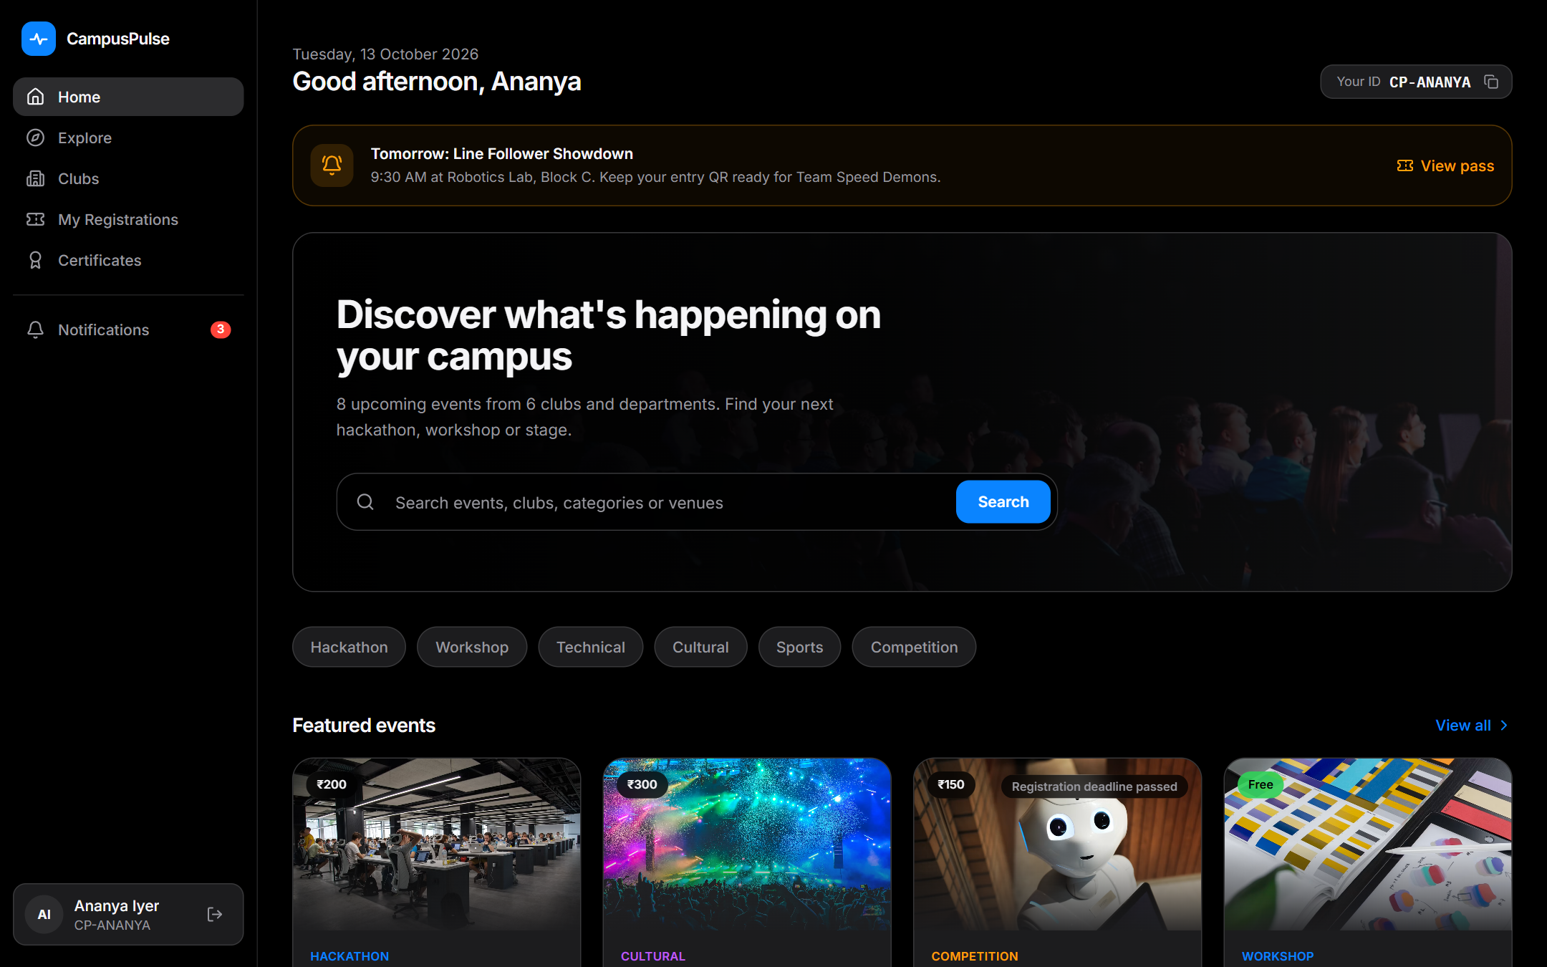
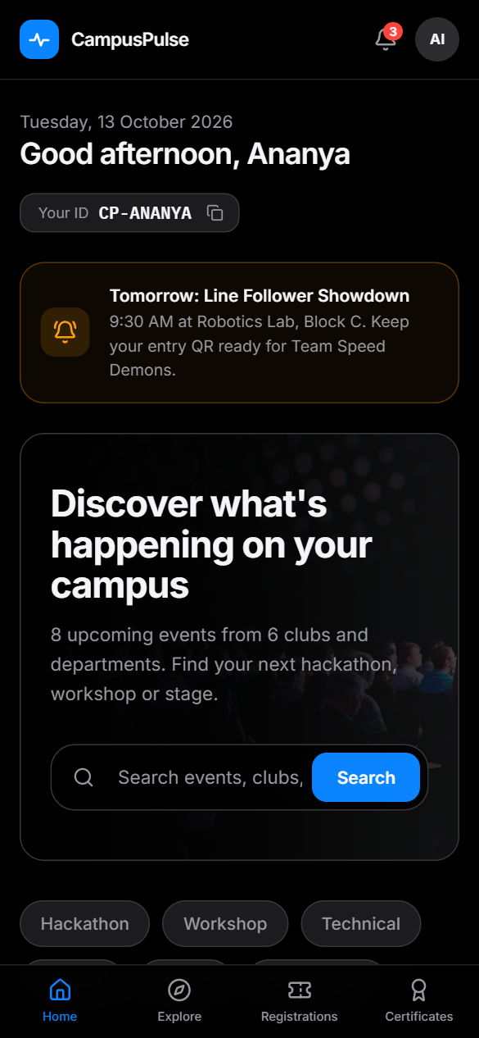
CampusPulse
SYNESIS'26 · SRM RAMAPURAM · SMART CAMPUS PS-1
The two-sided smart event hub & hosting pipeline for your campus
Discover Better. Organize Smarter. Connect Campus.
Team FNATIC
Abhinava Ashwin R · Divesh N · Leema S · Mrudhula B
Notes:
Introduce the team. CampusPulse is our answer to Problem Statement 1: one platform where students find and register for events and organizers host them, from poster to certificate.

Slide 2
Campus events are scattered and manual
Instagram posts
WhatsApp groups
Paper posters
Google Forms & sheets
= missed events, lost registrations, venue clashes, paperwork
S
Students
O
Organizers
No single place to look
Events live in feeds and group chats; deadlines slip by.
Data split across sheets
Every event re-invents the form and the spreadsheet.
Registration is guesswork
Forms, DMs and screenshots; no confirmation or ticket.
Manual payment checks
Scrolling UPI history to match screenshots by hand.
No reminders, late certificates
Venue changes and day-before info get lost; certificates arrive weeks later.
Clashes, paper approvals, no numbers
Venues double-booked, approvals on paper, no live attendance.
Notes:
Today events are discovered by luck. Students track registrations across forms and chats. Organizers rebuild spreadsheets for every event, verify UPI payments by hand, and find venue clashes on the day.

Slide 3
One platform, three roles
1
Student
Finds, registers, attends
2
Club / Dept admin
Hosts the event
3
Portal admin
Governs the portal
Sign up once
Register no. + college; gets a unique CampusPulse ID
Create events
Poster, rules, venue, fee, payment QR
Approve events
Request changes with notes
Discover & register
Search, filter, register a team
Verify payments
Approve or reject with a reason
Create clubs & admins
Department-wise logins
Pay & get a QR pass
Club's UPI QR, transaction ID
Check in by QR
Live attendance at the gate
Complaints inbox
Requests from club admins
Certificates
Delivered to the team leader
Export & certify
Excel sheets, feedback, certificates
Control
Broadcasts, suspend, reset passwords
Notes:
Three roles, each with its own login. Students sign up with register number and college so certificates are accurate. Club and department admins are created by the portal admin.

Slide 4
From poster upload to live attendance, end to end
CLUB
ADMIN
STUDENT
CLUB
STUDENT
CLUB
BOTH
1
2
3
4
5
6
7
Creates event
Poster, venue, fee, payment QR
Approves
Or requests changes
Registers team
By CampusPulse ID
Verifies payment
Team gets WhatsApp link
Gets QR ticket
Reminder 1 day before
Scans at gate
Live attendance
Feedback & certificate
Verifiable by QR
Problem Statement goal: "demonstrated end to end from poster upload and approval to QR check-in and live attendance analytics for organizers." Our live demo walks exactly this path.
Notes:
This is the whole journey in seven steps. Colors show who acts at each step. This matches the goal sentence of the problem statement, and it is the path we will demo.

Slide 5
Find an event in seconds
One search box
Events, clubs, categories and venues
Smart filters
Category, club, free / paid, open now, past
Club & department pages
Every event a club runs, in one place
Internal-only events
Tagged and limited to own-college students
Day-before reminder
Notification + "Tomorrow" banner on home
Notes:
The student home shows what is relevant now: tomorrow alerts, search, featured events, events this week and closing deadlines.

Slide 6
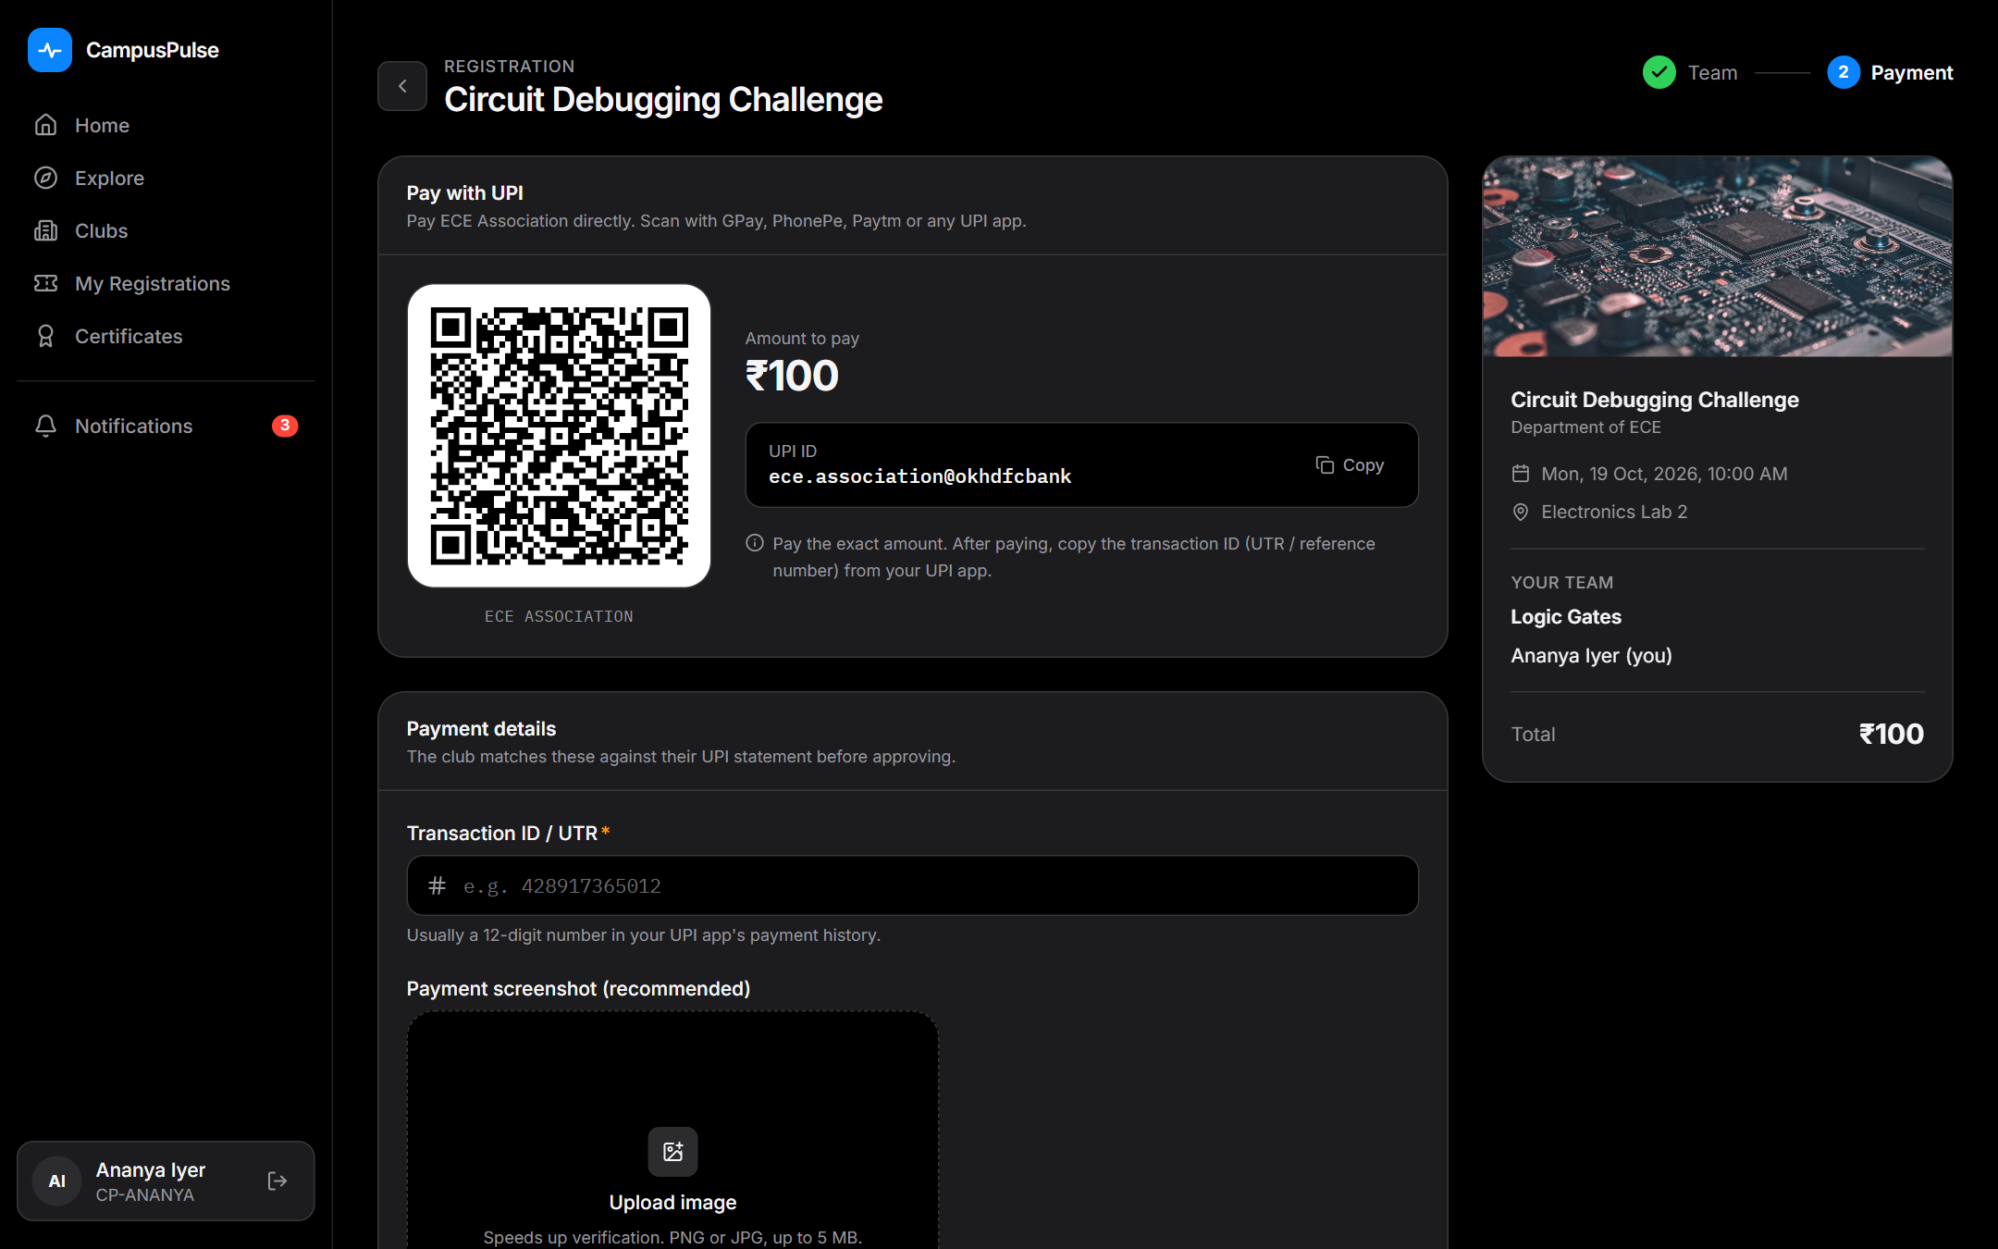
Register a team and pay in one flow
Teammates by CampusPulse ID
Name, register no. and college filled in and verified
Pay the club's own UPI QR
Generated with the exact amount if only a UPI ID is given
Transaction ID + screenshot
Submitted for the club to verify
Fraud & mistakes blocked
Reused transaction IDs, duplicate members, full events
Notes:
The leader adds teammates by their CampusPulse ID. Payment uses the club QR. The student enters the UPI transaction ID; the same ID cannot be used twice.

Slide 7
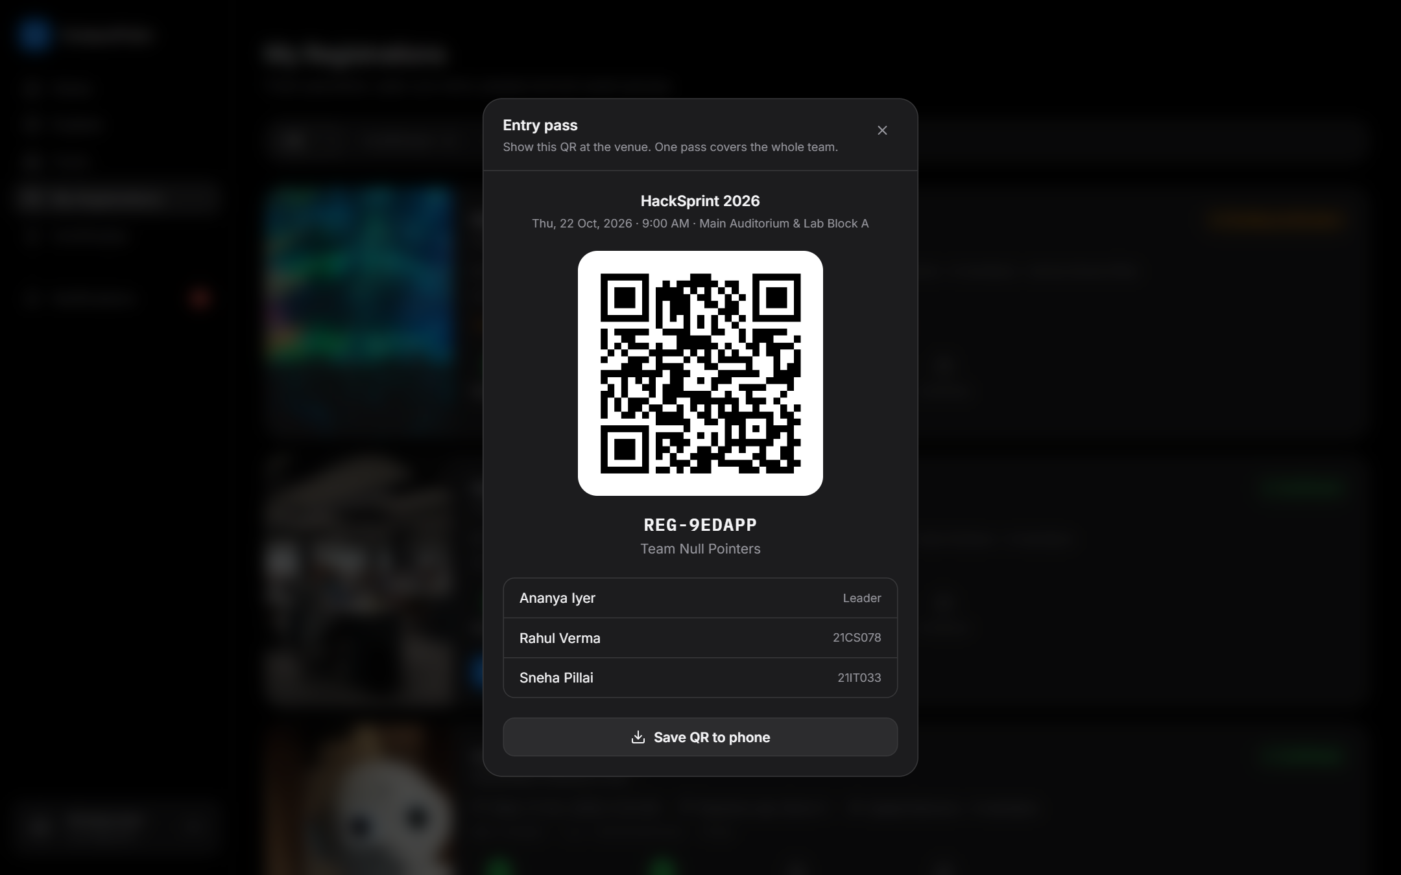
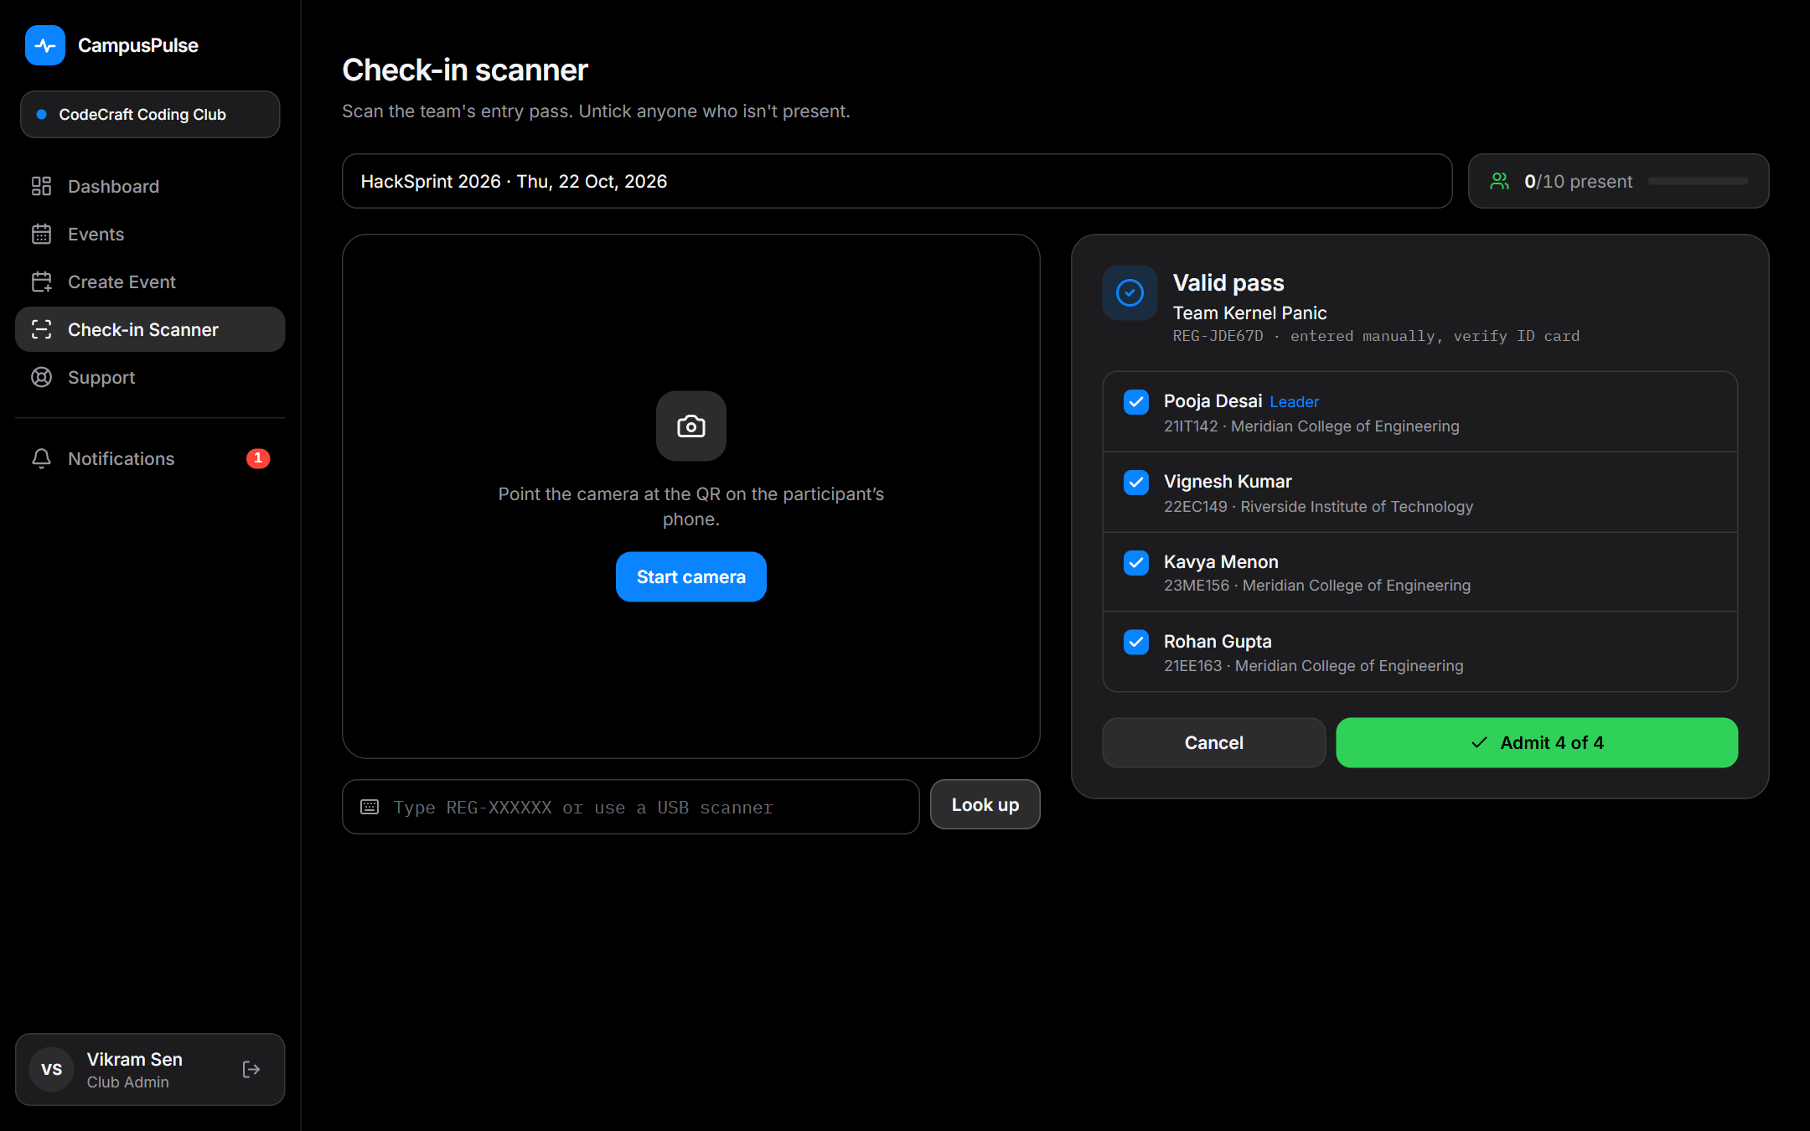
QR ticket at the gate, live attendance for organizers
Student One signed QR pass per team, saved to the phone
Volunteer Scan, tick who's present, admit. Forged QR = rejected
Notes:
Every confirmed team gets a QR pass. At the gate the volunteer scans it with a phone camera, unticks anyone absent and admits the team. The QR is cryptographically signed, so an edited QR is rejected. Attendance updates live on the organizer dashboard.

Slide 8
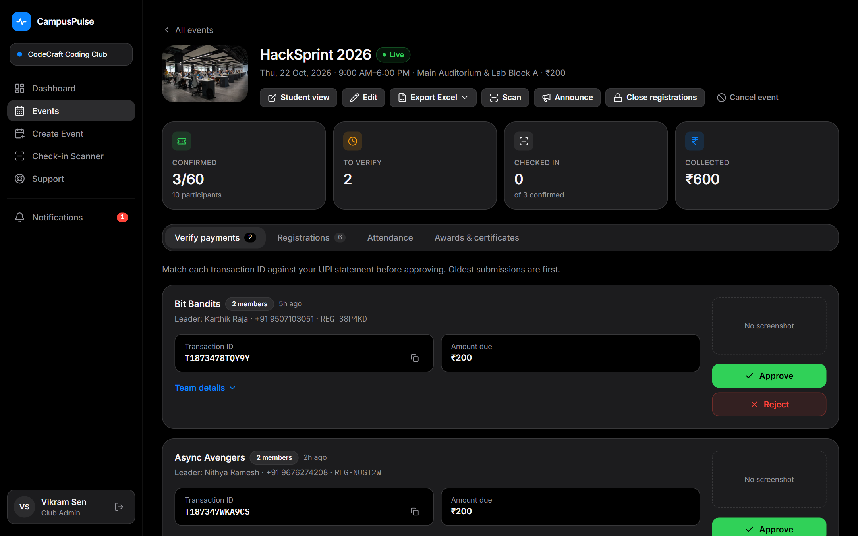
Host an event without spreadsheets
Complete event form
Poster, rules, schedule, team size, fee, QR, WhatsApp link
Venue clash alert
Warned while saving if the venue is already booked
Verify payments
Approve, or reject with a reason; team can resubmit
Auto WhatsApp link
Sent to the team the moment they are approved
One-click Excel export
Teams sheet + Participants sheet
Notes:
Organizers create the event once. Payments come into a queue with transaction ID and screenshot. One click approves and sends the WhatsApp group link. The full registration list exports to Excel.

Slide 9
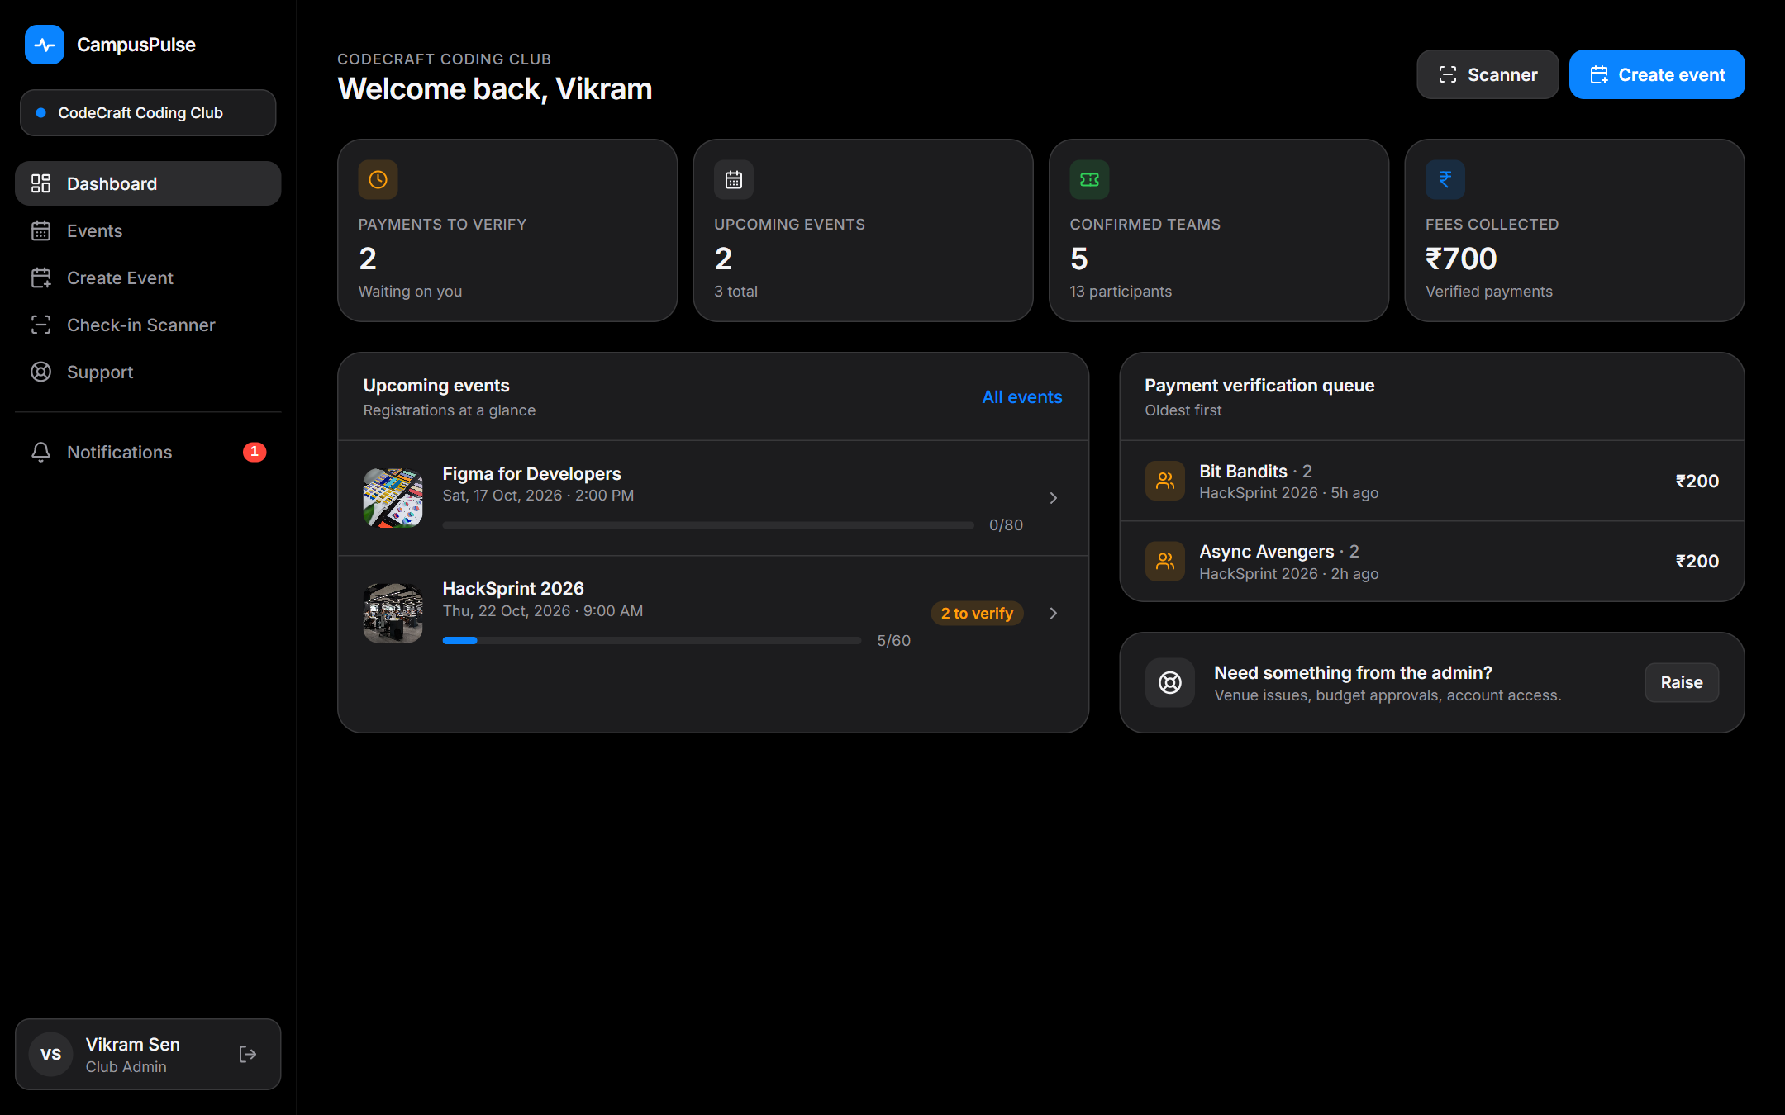
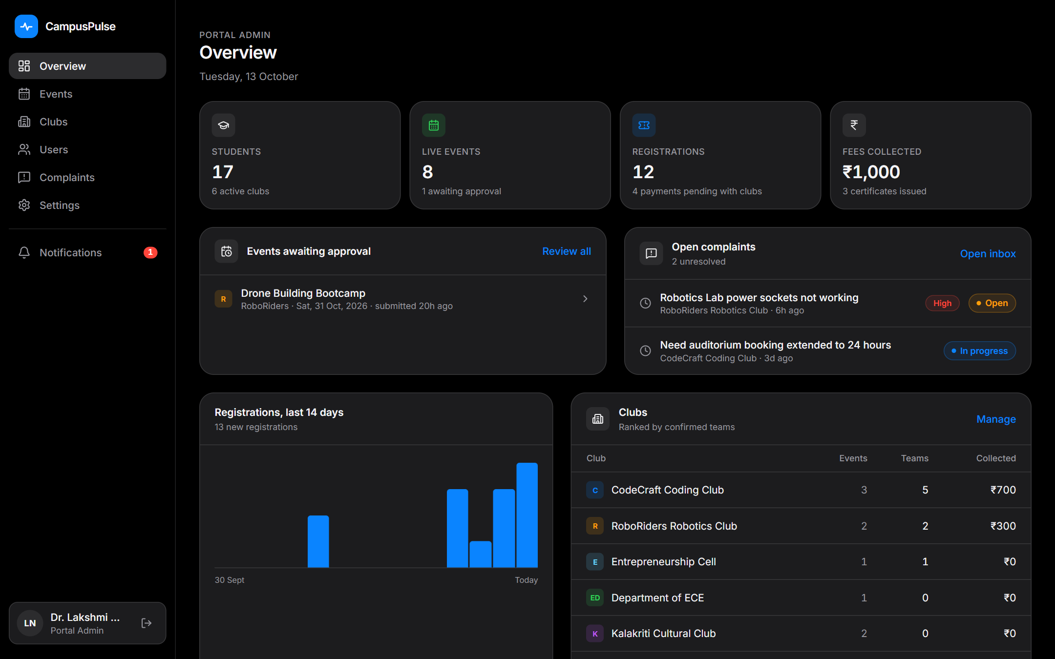
Organizer dashboard and live analytics
Club Payments to verify, confirmed teams, fees, capacity per event
Admin Portal-wide registrations, per-club ranking, open complaints
Notes:
Each club sees its own numbers; the portal admin sees every club, registrations over the last 14 days and open complaints.

Slide 10
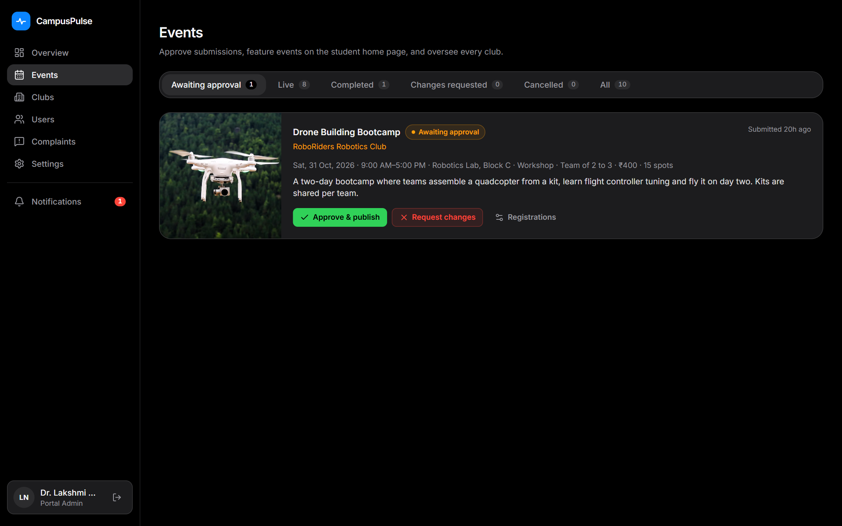
Digital approvals and portal-wide control
Approve or request changes
With notes; the club edits and resubmits
Clashes flagged
Overlapping venue bookings shown in the queue
Feature events
Pin the best events to every student home
Department-wise admins
Create clubs and their admin logins
Complaints & broadcasts
Reply to clubs, announce to everyone
Notes:
Approvals are digital. The admin approves or requests changes with a note, sees venue clashes before approving, and can feature events, create department-wise admins and handle complaints.

Slide 11
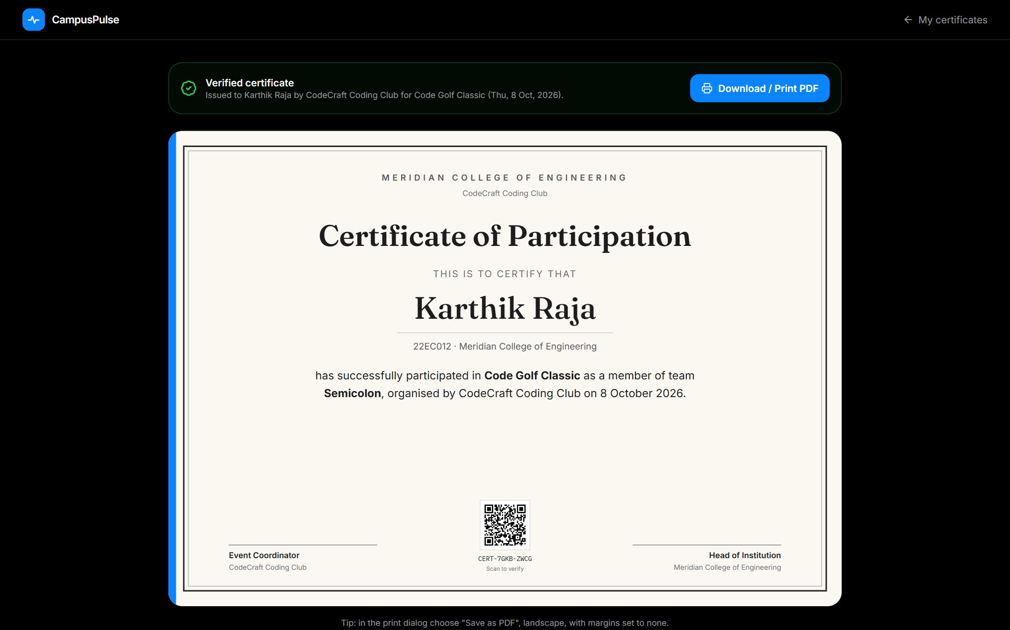
After the event: feedback and certificates
Feedback by QR
Shown on screen at the end; registered students rate the event
Awards
Winner, Runner-up, Special Mention
Certificates for attendees
Generated from QR check-in data
Sent to the team leader
Every member's certificate, printable as PDF
Verifiable
Scan the certificate QR to confirm it is genuine
Notes:
After the event the organizer shows a feedback QR. Awards turn participation certificates into achievement certificates. Certificates go to the team leader and anyone can verify them by scanning the QR.

Slide 12
Problem Statement 1: what CampusPulse covers
Suggested in the problem statement | In CampusPulse | Status
Event discovery with smart filtering | Search + 5 filters, club & department pages, featured events | Built
QR tickets, reminders, QR check-in | Signed QR per team, day-before reminder, camera scanner | Built
Venue conflict detection | Alert on save + flag in the approval queue | Built
Digital approval workflow | Approve / request changes / resubmit, with notes | Built
Organizer dashboard & analytics | Registrations, payments, live attendance, Excel | Built
Personalized recommendations | Based on clubs and past events attended | Next
AI flyer-to-event extraction | Upload a poster, get an event draft | Next
Notes:
Mapping to the problem statement. Five of the suggested capabilities are fully built. Recommendations and AI flyer extraction are our next phase.

Slide 13
Built to run on campus today
Security & trust
FRONTEND
React + Tailwind CSS
Responsive: laptop and phone
BACKEND
Node.js + Express
REST API, role-based access
Captcha on login & sign-up
Checked on the server, single use
Hashed passwords, rate-limited login
scrypt; session cookies
DATABASE
SQLite
Zero setup, one file
RUNS ANYWHERE
One command
npm run dev, demo data seeded
Tamper-proof QR
HMAC-signed tickets; fakes rejected at the gate
One payment, one registration
Transaction IDs can never be reused
Notes:
A simple, reliable stack: React, Node, SQLite. It runs on any laptop. Security basics are built in from day one.

Slide 14
What's next
1
2
3
4
Ask CampusPulse AI
Answers students' questions about events, rules, deadlines and their registration, instead of coordinators.
AI poster → event draft
Upload a poster; the event form fills itself for the organizer to check.
Personalized feed
Recommendations from clubs followed and events attended.
Smarter scheduling
Suggest free venues and slots on a clash; add-to-calendar for students.
Notes:
Next we add AI: a CampusPulse assistant for student questions and poster-to-event extraction, plus personalized recommendations and venue suggestions.

Slide 15
Thank you
Live demo logins
Student
ananya@student.edu / Student@123
Club admin
codecraft@campuspulse.edu / Club@1234
Portal admin
admin@campuspulse.edu / Admin@1234
Discover Better.
Organize Smarter.
Connect Campus.
Team [Team name] · CampusPulse · SYNESIS'26, SRM Ramapuram
Notes:
Thank the jury and move to the live demo, or take questions.

