Slide 1
DFT Optimizations
-Jayati Singh
-Abhinav Singh

Slide 2
Motivation
Application of DFT
Thus, optimize the Algorithm for DFT
Aspects include: run-time, area on silicon chip, power consumed by the designed hardware, memory used by the algorithm.

Slide 3
DFT
With respect to Image Processing – 2D DFT is applied on the signal.
DFT (Discrete Fourier transform) is sampled DTFT with length same as the time domain signal.

Slide 4
DFT ALGORITHIM

Slide 5
Goal…
Our ultimate goal is optimize DFT & DCT calculations for image processing
Design a hardware based on optimized DFT and simulations from HDL

Slide 6
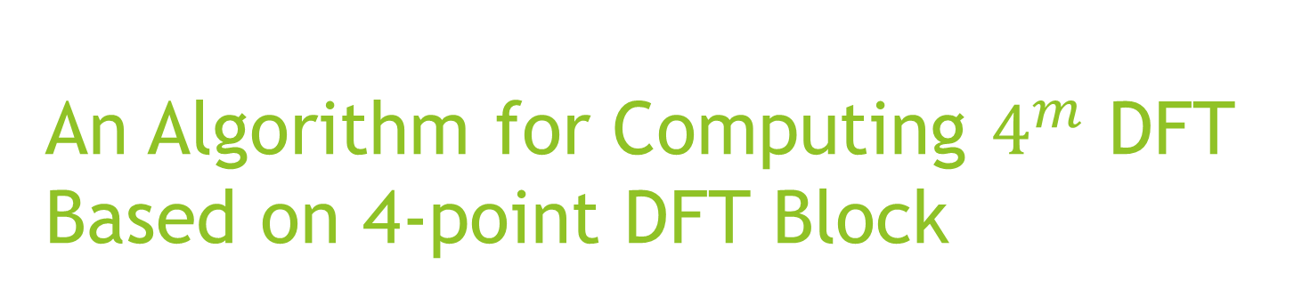
An Algorithm for Computing $4^{m}$ DFT Based on 4-point DFT Block
-Haijun Li, Hongbo Zou, Peirong Ji, and Xuejun Zhou

Slide 7
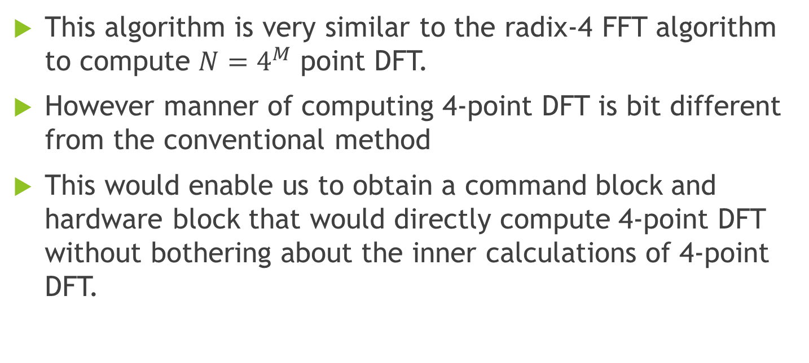
Ideas & Assumption
This algorithm is very similar to the radix-4 FFT algorithm to compute ${N=4}^{M}$ point DFT.
However manner of computing 4-point DFT is bit different from the conventional method
This would enable us to obtain a command block and hardware block that would directly compute 4-point DFT without bothering about the inner calculations of 4-point DFT.

Slide 8
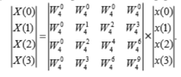
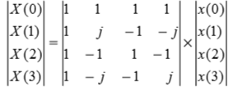

Conventional procedure to Calculate 4-point DFT
Our conventional 4-point DFT:-
$$W_{N}^{nk}=e^{\frac{−j2πnk}{N}}$$
-
|
|
-

Slide 9
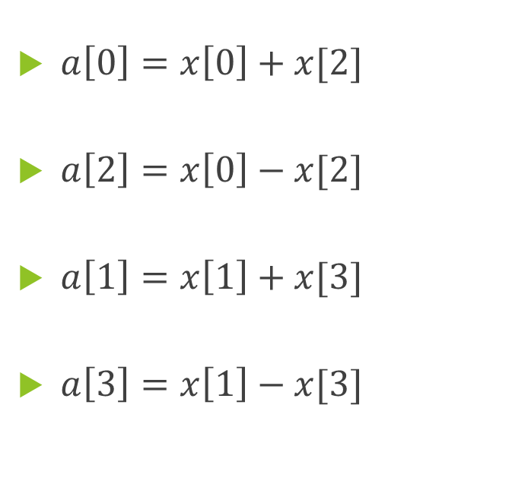
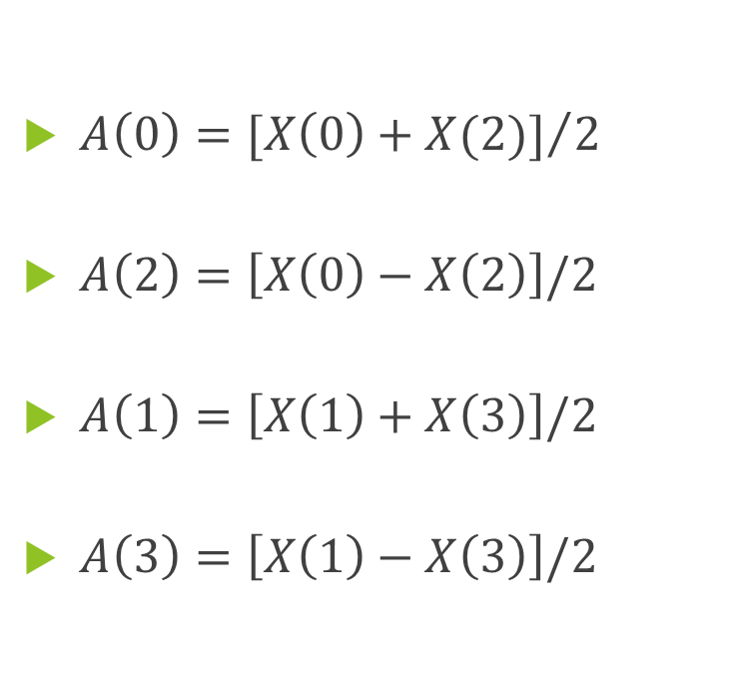
Procedure to directly Calculate 4-Point DFT
$A\left(0\right)={[X\left(0\right)+X(2)]}/2$
$A\left(2\right)=\left[X\left(0\right)−X\left(2\right)\right]/2$
$A\left(1\right)=\left[X\left(1\right)+X\left(3\right)\right]/2$
$A\left(3\right)=\left[X\left(1\right)−X\left(3\right)\right]/2$
$a\left[0\right]=x\left[0\right]+x[2]$
$a\left[2\right]=x\left[0\right]−x[2]$
$a\left[1\right]=x\left[1\right]+x[3]$
$a\left[3\right]=x\left[1\right]−x[3]$

Slide 10
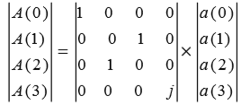
Contd..
After the aforesaid transformations we get a matrix:-
-

Slide 11
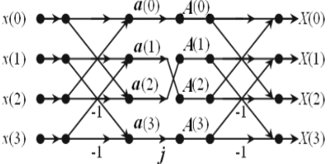
Contd..
If represented through a signal flow graph we have:-
-

Slide 12
Flow Chart
x[n]; n=0,1,2,3
X(k); k=0,1,2,3
For radix 4-FFT doing these computations would have required 16 real additions(if all x[n]’s are complex, worst case scenario)
Find a[n]
Find A(k)
Find X(k)

Slide 13
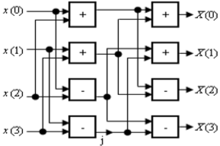
The Hardware Block for Calculating 4-point DFT
-

Slide 14
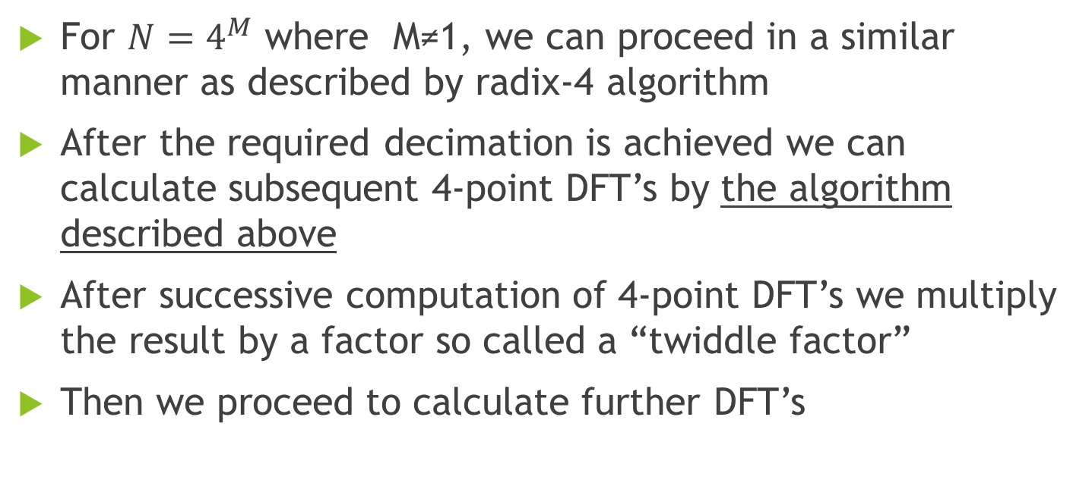
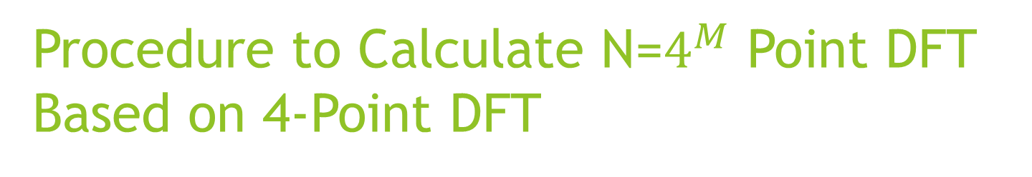
Procedure to Calculate N=$4^{M}$ Point DFT Based on 4-Point DFT
For $N=4^{M}$ where M≠1, we can proceed in a similar manner as described by radix-4 algorithm
After the required decimation is achieved we can calculate subsequent 4-point DFT’s by the algorithm described above
After successive computation of 4-point DFT’s we multiply the result by a factor so called a “twiddle factor”
Then we proceed to calculate further DFT’s

Slide 15
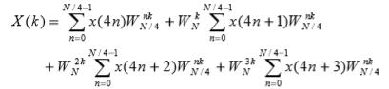

Mathematics…
Let N=$4^{M}$, where M is a positive integer then:-
Where:-
$$W_{N}^{nk}=e^{\frac{−j2πnk}{N}}$$

Slide 16
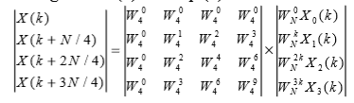
Contd..
Let n=k=0,1,2,…N/4-1, X0(k)=DFT[x(4n)], X1(k)= DFT[x(4n+1)], X2(k)=DFT[x(4n+2)], and X3(k)=DFT [x(4n+3)], where Xi(k), for i=0:3, denote 4 N/4-point DFTs, respectively then:-

Slide 17
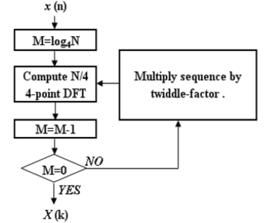
Generalized Simplified Flow Chart

Slide 18
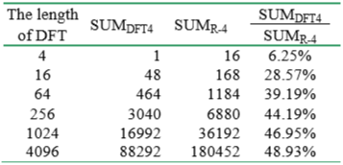
Computational Stats…

Slide 19
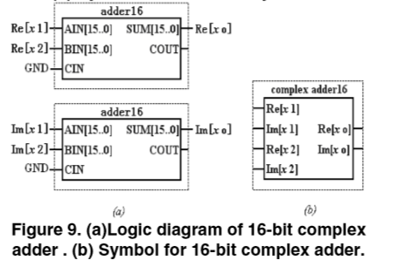
Hardware Realization of a 4-point DFT Block

Slide 20
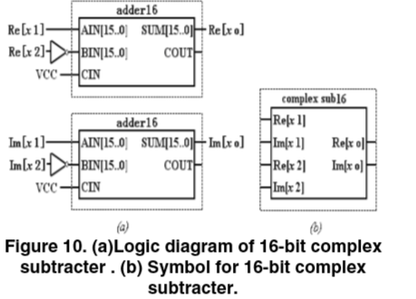
Contd..

Slide 21
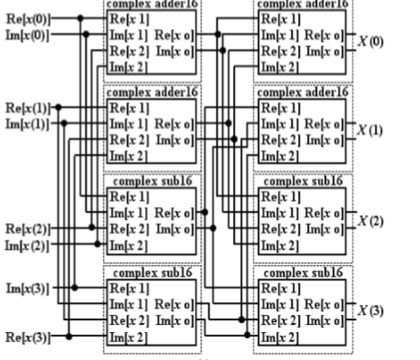
Contd..

Slide 22
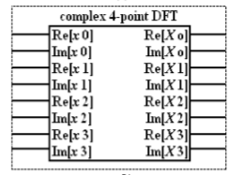
Contd..

Slide 23
Verilog implementation
Main Code
Butterfly2
Butterfly1
Complex Adder1
Complex Subtractor1
Complex Multiplier1
Complex Adder2
Complex Subtractor2
Complex Multiplier

Slide 24
Our Implementation
We have assumed that size input vector x[n] is N=16
Firstly we are going to need a floating point architecture since we are going to deal with real data
Secondly we are going to need entire signal flow graph for implementing Verilog code

Slide 25
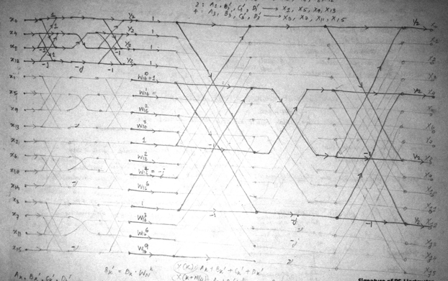
Signal Flow Graph

Slide 26
Optimisation
Removed the imaginary calculations and exploited the fact that all these butterflies had only real inputs.
Calculated only the first two outputs and found the rest using conjugates.
the number of complex additions by removing them wherever unnecessary.

Slide 27
References
Algorithm for computing 4^M DFT based on 4-DFT block(2008)
Haijun Li, Hongbo Zou, Peirong Ji, and Xuejun Zhou
Efficient Moving window DFT Algorithm(1998)
J. A. Rosendo Macias and A. Gomez Exposito

Slide 28
Contd..
An Efficient Bit Reduction Binary Multiplication Algorithm using Vedic Methods - M.E.Paramasivam, Dr.R.S.Sabeenian
VHDL IMPLEMENTATION OF FAST NXN MULTIPLIER BASED ON VEDIC MATHEMATIC - Shamim Akhter
Some New Parallel Fast Fourier Transform Algorithms -Zhong Cui-xiang , Han Guso-qiang, Huang Ming-he

