Slide 1
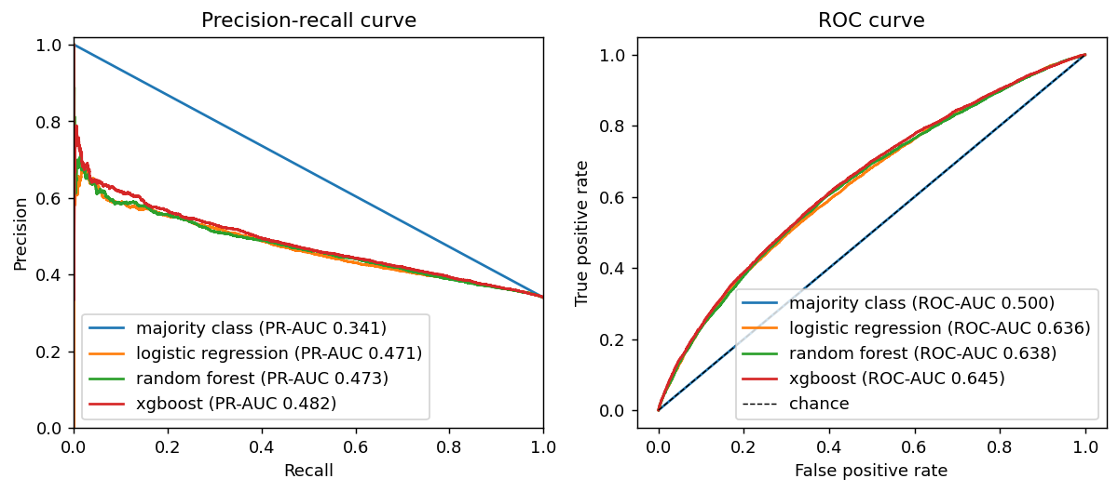
XGBoost scores best, only narrowly: validation PR-AUC 0.48 vs 0.47 for logistic regression and 0.34 for no skill
Model | Precision | Recall | F1 | PR-AUC | ROC-AUC
Majority class | 0.000 | 0.000 | 0.000 | 0.341 | 0.500
Logistic regression (Member 4 features) | 0.357 | 0.909 | 0.513 | 0.394 | 0.579
Logistic regression | 0.389 | 0.808 | 0.525 | 0.471 | 0.636
Random Forest | 0.386 | 0.813 | 0.524 | 0.473 | 0.638
XGBoost | 0.400 | 0.782 | 0.529 | 0.482 | 0.645
Chosen by highest validation PR-AUC; threshold 0.37, tuned for F1 on validation only. Share resolved is 34%, so no-skill PR-AUC is 0.34.
Feature gain (logistic regression): title text features change F1 by +0.007 and PR-AUC by +0.027.
Tuned on time-series folds with a 7-day gap, training period only; XGBoost trees by early stopping on validation (628 trees).
Validation period: Jan to Jun 2025. 'Resolved' = accepted answer within 7 days is the positive class.
Notes:
We compared the models on the validation period (Jan to Jun 2025) with the same metrics. The majority-class baseline has no skill (PR-AUC equals the share resolved, 0.34). Logistic regression is the interpretable baseline; Random Forest and XGBoost are the advanced models, tuned with time-series folds inside the training period only. We select on PR-AUC because it is threshold-free and sensitive to class balance, then tune the decision threshold on validation only. The differences between the three real models are small (0.471 to 0.482), so we say gradient boosting is only slightly better. Title text features raise logistic-regression PR-AUC from 0.444 to 0.471. The test period had not been touched at this point.

Slide 2
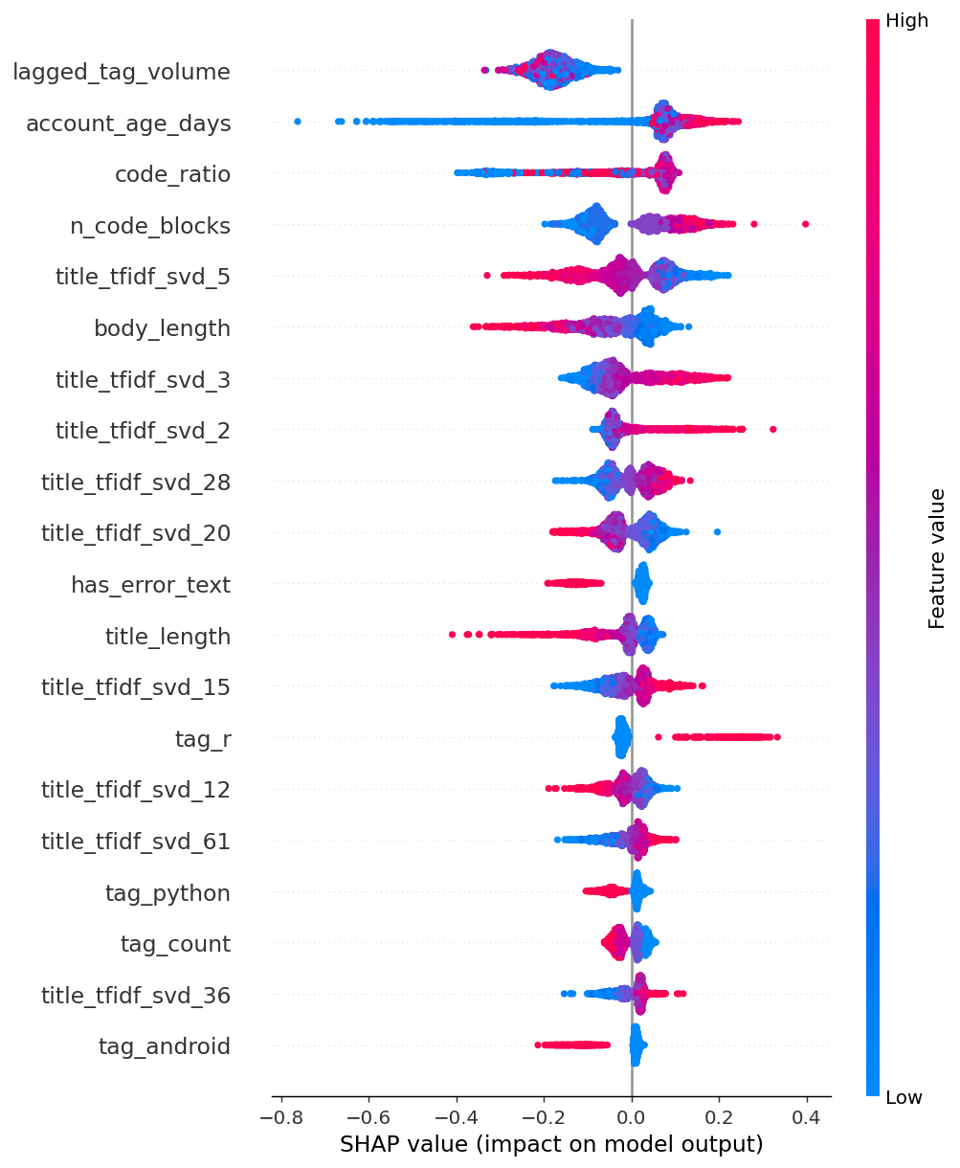
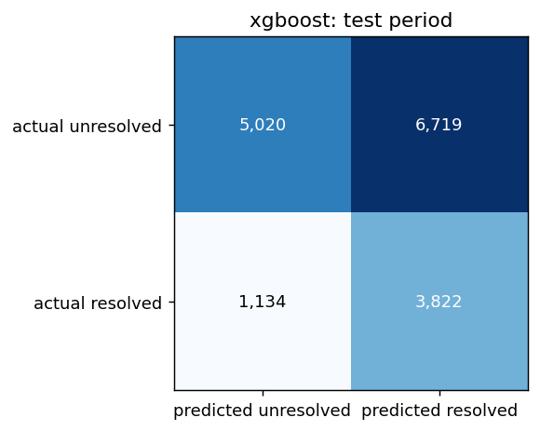
On the untouched test period the model reaches PR-AUC 0.43 (no skill: 0.30) and ROC-AUC 0.65; tag volume and account age matter most
Test metric | Value
Questions | 16,695
Share resolved (no skill) | 0.297
Precision | 0.363
Recall | 0.771
F1 | 0.493
PR-AUC | 0.431
ROC-AUC | 0.655
Capture rate (20% flagged) | 0.241
What the model relies on:
tag volume in the previous 4 weeks: higher: less often resolved
asker account age: higher: more often resolved
share of code in the body: higher: more often resolved
number of code blocks: higher: more often resolved
title wording (component 5): higher: less often resolved
From the SHAP plots:
Brand-new accounts and questions with no code blocks are the least often resolved; the effect levels off for older accounts.
Resolution rises with some code, then falls again for questions that are almost all code.
Error text, longer titles and longer bodies are associated with fewer accepted answers in the test period; the r tag with more, python and android with fewer.
Tag volume stays in one narrow, low range in the test period (volume has fallen since 2022), so it stands in for the period and tag mix, not for the question itself.
Test period used once, after all tuning. SHAP computed on a random sample of test questions.
Notes:
The test period (Jul 2025 to Jul 2026, 16,695 questions) was evaluated exactly once, after the model, hyperparameters and threshold were fixed on earlier data. Precision 0.36, recall 0.77, F1 0.49, PR-AUC 0.43, ROC-AUC 0.65. Only 30% of test questions are resolved, so predicting 'resolved' for everything would give precision 0.30 and F1 0.46; the model is above that but not by a wide margin. The result is modest and we report it as such. SHAP shows which features move the predicted probability; tag volume probably reflects which tag and which period a question belongs to.

Slide 3
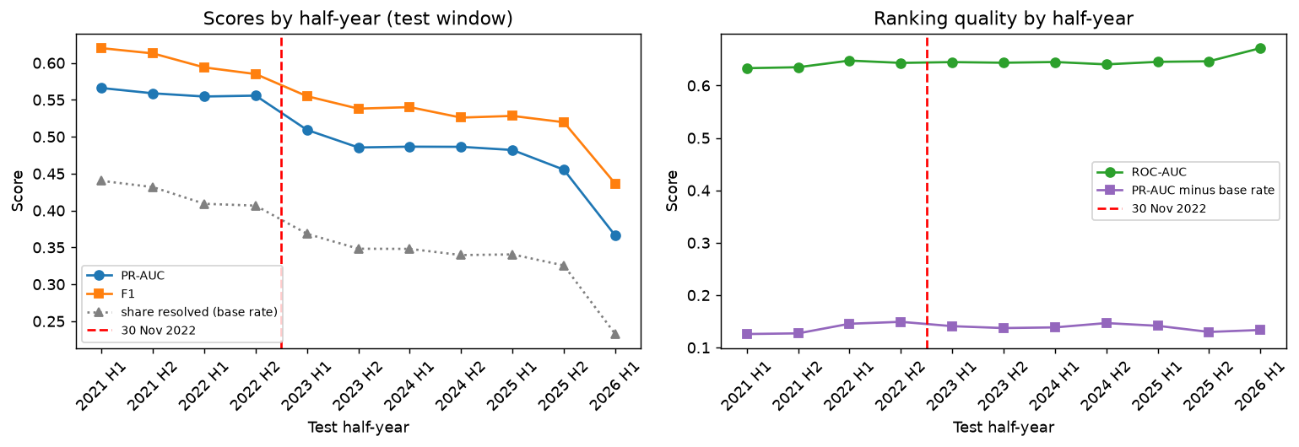
Flagging the 20% of questions with the lowest predicted resolution catches 24% of unresolved ones, a modest 1.2x lift over random
24%
of unresolved questions are in the lowest-scored 20% (random flagging: 20%)
Act on it: route flagged questions to experts, or prompt askers to add code to their question before posting.
Use the score to prioritise, not to decide: the lift over random flagging is modest.
Limits: an accepted answer within 7 days is a proxy for resolved (it depends on the asker returning); recent data is smaller than the sampled early years.
Results are associated with, not caused by, the platform changes after November 2022.
Ranking quality is stable across November 2022: mean ROC-AUC 0.64 before, 0.65 after.
PR-AUC is 0.56 before and 0.47 after, but the share resolved also moved (42% to 33%); PR-AUC minus that base rate is 0.14 before and 0.14 after.
Any answer within 7 days (secondary target): ROC-AUC 0.67 vs 0.65 for an accepted answer.
Rolling-origin: train on all data before each half-year, test on that half-year, 2021 H1 to 2026 H1.
Notes:
Rolling-origin evaluation trains on everything before each half-year and tests on that half-year, from 2021 H1 to 2026 H1, so we can compare before and after November 2022, which the single test period cannot show. Ranking quality is stable across November 2022: mean ROC-AUC 0.64 before, 0.65 after. PR-AUC is 0.56 before and 0.47 after, but the share resolved also moved (42% to 33%); PR-AUC minus that base rate is 0.14 before and 0.14 after. Any answer within 7 days (secondary target): ROC-AUC 0.67 vs 0.65 for an accepted answer. Business use: a forum manager who can only act on 20% of questions flags the lowest-scoring ones and routes them to experts, or prompts askers to add code or error text before posting; the lift is modest, so the score should prioritise, not decide. Limits: acceptance is a strict proxy for resolved because it depends on the asker returning; recent data is smaller than the sampled early years. We say 'associated with', not 'caused by'.

