Slide 1
23CSE452 BUSINESS ANALYTICS Final Presentation TEAM 7
STACK OVERFLOW
OUR TEAM
Abhinav G
IN THE AI ERA
CB.SC.U4CSE23201
Rishiikesh S K
CB.SC.U4CSE23236
Question resolution, changing demand
and the content behind the trends
Akshay Krishna P S
CB.SC.U4CSE23403
Nishanth K
CB.SC.U4CSE23523
302K
14
2
Adhikkesh S K
CB.SC.U4CSE23101
cleaned questions
weekly series
advanced methods
01 / 25
Notes:
Presenter: Abhinav G (M1)
Time: 15 seconds
Good evening. We are Team 7. Our project connects original Stack Overflow API data, prediction, time series and text mining in one working dashboard. We will focus on what the results support and how a forum team could use them.
Sources:
/home/adhikkesh/adhikkesh/SEM7/BA/stackoverflow-ai-era/reports/review2/final_report.md
Visual reference: /home/adhikkesh/Downloads/BA Final Project - Review 1.pdf (style only).
Figures: Matplotlib from saved project evidence.

Slide 2
PROJECT PROGRESS
Progress from Review 1 to Review 2
Area | Review 1 foundation | Review 2 additions
Data | API collection, cleaning and exploratory analysis | Validated data integrated across advanced methods
Methods | Resolution classification and feature interpretation | Time-series forecasting and text mining
Evaluation | Classifier comparisons and chronological testing | Forecast backtests, NMF–LDA comparison and tone checks
Business use | Initial findings and support priorities | Suggested pilots with KPIs and a public dashboard
Review 2 extends the analysis and application. Classifier results retain the locked test.
Notes:
Presenter: Abhinav G (M1). Suggested time: 25 seconds. Insert immediately after the title slide.
In Review 1, we built the data foundation and compared models for question resolution. Review 2 adds two advanced methods: forecasting and text mining. We now compare their alternatives, disclose validation limits, and connect the evidence to suggested pilots in a public dashboard. This is progress in scope and evaluation, not a claim that classifier accuracy increased. Tone checks still lack the original second human rater.
Sources: /home/adhikkesh/adhikkesh/SEM7/BA/stackoverflow-ai-era/Review_2_Work_Plan.pdf; /home/adhikkesh/adhikkesh/SEM7/BA/stackoverflow-ai-era/reports/review1/m5/results.json; /home/adhikkesh/adhikkesh/SEM7/BA/stackoverflow-ai-era/reports/review2/final_report.md; /home/adhikkesh/adhikkesh/SEM7/BA/stackoverflow-ai-era/docs/review2_submission_guide.md. Generic stage comparison summarises the project progression; the team coauthored deck keeps its existing content.
Style reference: /home/adhikkesh/adhikkesh/SEM7/BA/stackoverflow-ai-era/submission/presentation/redesign/output/Team_7_Review_2_White_25_Final.pptx

Slide 3
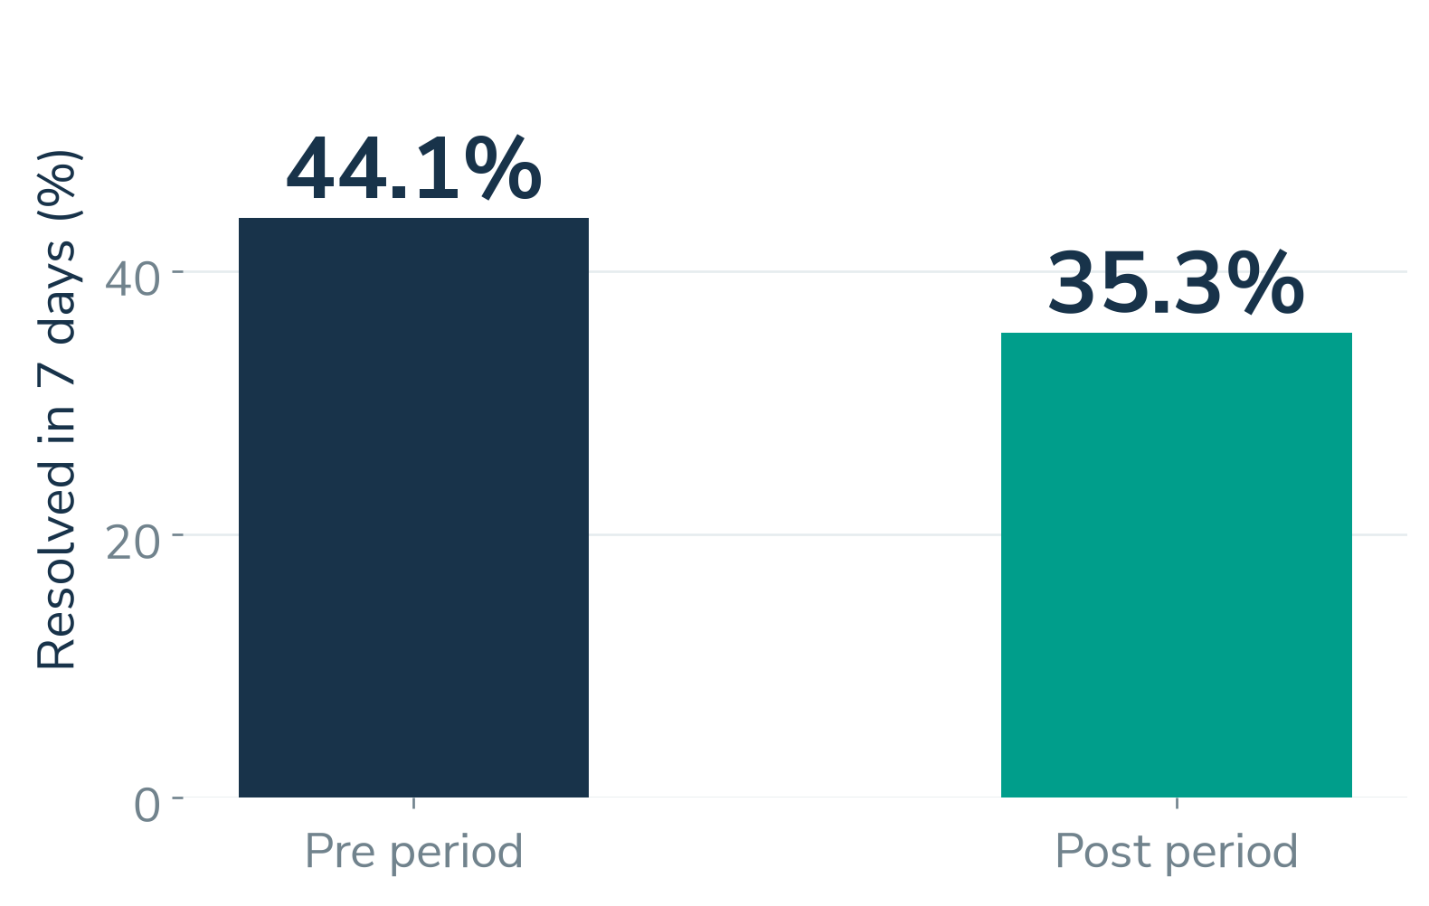
BUSINESS PROBLEM AND OBJECTIVES
A changing Q&A community
THE DECISION
Where should human
expertise go next?
Prioritise questions at risk of remaining unresolved. Plan support using demand forecasts and changing topics.
Pre: 2019–Oct 2022. Post: 2023–Aug 2026.
Predict seven-day resolution. Forecast demand. Identify support priorities.
Abhinav G
02 / 25
Notes:
Presenter: Abhinav G (M1)
Time: 25 seconds
The business question is where a developer forum should direct human expertise. In our weighted sample, seven-day resolution falls from 44.1 percent in the pre period to 35.3 percent in the post period. We combine early prediction, demand forecasts and topic evidence to suggest support priorities. The comparison is descriptive, so it does not prove that AI caused the change.
Sources:
/home/adhikkesh/adhikkesh/SEM7/BA/stackoverflow-ai-era/reports/review2/final_report.md
/home/adhikkesh/adhikkesh/SEM7/BA/stackoverflow-ai-era/data/processed/questions_clean_v1.parquet
Visual reference: /home/adhikkesh/Downloads/BA Final Project - Review 1.pdf (style only).
Figures: Matplotlib from saved project evidence.

Slide 4
UNITS 1, 2 AND 3
The complete project workflow
01
02
03
04
Unit 1
Unit 2
Unit 3
Application
Collect and validate
Predict resolution
Analyse change
Support decisions
API records, weights,
cleaning and EDA
Posting-time inputs.
Chronological evaluation.
Time series and
text mining
Interactive dashboard
and measured pilots
One dataset foundation, two advanced methods and seven connected dashboard pages
Abhinav G
03 / 25
Notes:
Presenter: Abhinav G (M1)
Time: 20 seconds
The project has four connected stages. Unit 1 creates the validated data foundation. Unit 2 evaluates resolution prediction. Unit 3 studies time-based patterns and question content. The final dashboard brings these outputs together so that users can inspect the evidence behind a proposed action.
Sources:
/home/adhikkesh/adhikkesh/SEM7/BA/stackoverflow-ai-era/README.md
/home/adhikkesh/adhikkesh/SEM7/BA/stackoverflow-ai-era/reports/review2/final_report.md
Visual reference: /home/adhikkesh/Downloads/BA Final Project - Review 1.pdf (style only).
Figures: Matplotlib from saved project evidence.

Slide 5
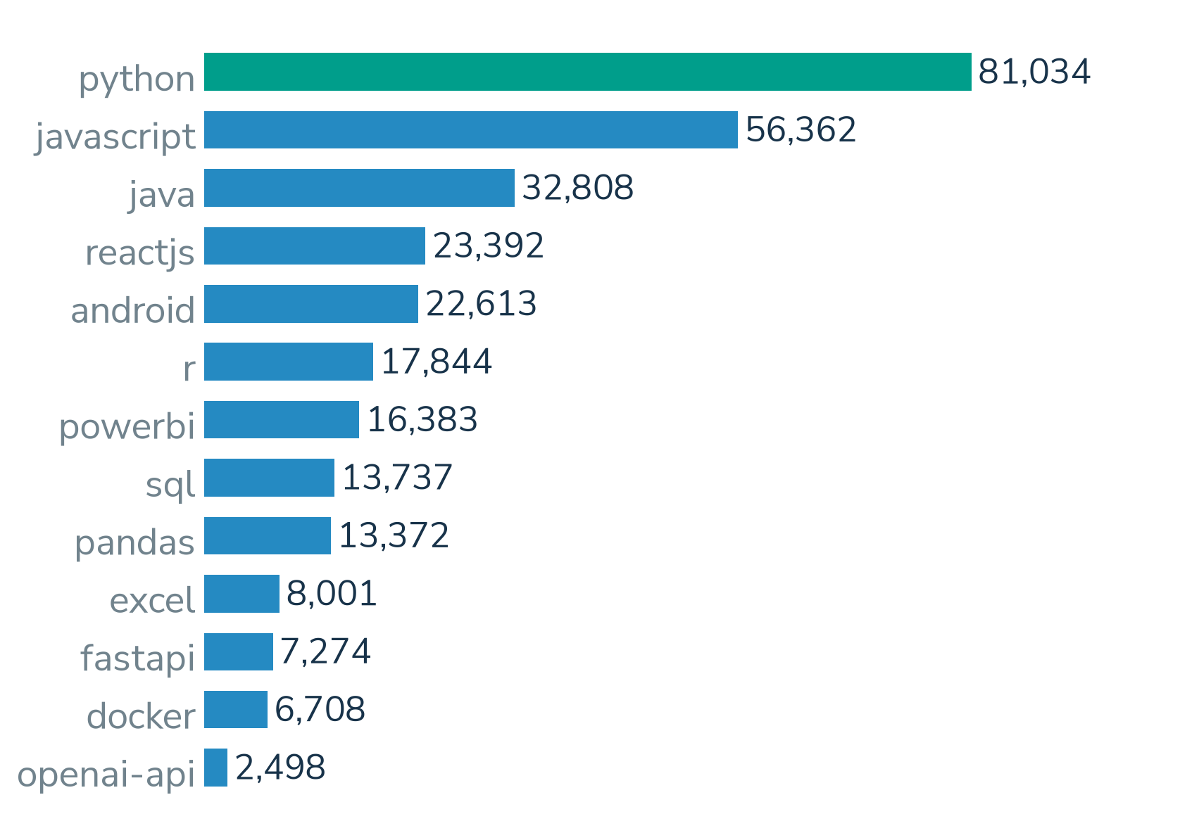
OVERALL DATASET DESCRIPTION
Original API data, with a clear scope
302,026
unique question records
39 variables
13 collection tags
January 2019 to August 2026
Stack Exchange API 2.3
Separate weekly API totals cover ALL plus 13 tags, with 400 weeks per series.
Abhinav G
04 / 25
Notes:
Presenter: Abhinav G (M1)
Time: 25 seconds
The cleaned table contains 302,026 unique questions and 39 variables. We collected the records directly from the Stack Exchange API across thirteen technology tags, covering January 2019 to August 2026. The chart shows exclusive collection-tag strata in the cleaned table. Forecasting uses a separately collected set of fourteen weekly API totals, including the sitewide ALL series. The sampled questions and weekly totals have different roles.
Sources:
/home/adhikkesh/adhikkesh/SEM7/BA/stackoverflow-ai-era/reports/review2/dataset/dataset_validation.json
/home/adhikkesh/adhikkesh/SEM7/BA/stackoverflow-ai-era/data/processed/questions_clean_v1.parquet
/home/adhikkesh/adhikkesh/SEM7/BA/stackoverflow-ai-era/reports/review2/ts/series_manifest.json
Visual reference: /home/adhikkesh/Downloads/BA Final Project - Review 1.pdf (style only).
Figures: Matplotlib from saved project evidence.

Slide 6
KEY RECORDS AND VARIABLES
A sample of the final dataset
Question ID | Created (UTC) | Weight | Resolved in 7d
54160622 | 2019-01-12 | 8 | Yes
75066008 | 2023-01-10 | 22 | Yes
79976443 | 2026-07-07 | 1 | No
Question ID
Sampling weight
Prediction target
Integer key linked to the original post
Positive number representing the collection design
Accepted answer within seven days
Rishiikesh S K
05 / 25
Notes:
Presenter: Rishiikesh S K (M2)
Time: 25 seconds
These are three real cleaned records from different years, with linked question IDs. The sampling weight represents the collection design. The primary target records whether a question receives an accepted answer within seven days. Answer outcomes define the later target, while prediction features must be available when the question is posted.
Sources:
/home/adhikkesh/adhikkesh/SEM7/BA/stackoverflow-ai-era/reports/review2/dataset/final_dataset_sample.csv
/home/adhikkesh/adhikkesh/SEM7/BA/stackoverflow-ai-era/docs/data_dictionary.md
Visual reference: /home/adhikkesh/Downloads/BA Final Project - Review 1.pdf (style only).
Figures: Matplotlib from saved project evidence.

Slide 7
DATASET VALIDATION AND PREPARATION
Dataset quality checks and corrections
309,179
7,153
302,026
raw records
duplicate or invalid rows removed
final unique records
Quality issue | Correction | Evidence retained
7,147 repeated IDs | Keep one record per question | 302,026 unique questions
6,319 missing user ages | Impute and retain a flag | Training-period median
6 invalid records | Remove invalids, flag long text | 8 final checks pass
A missing accepted answer is a valid unresolved outcome, not a row to remove.
Rishiikesh S K
06 / 25
Notes:
Presenter: Rishiikesh S K (M2)
Time: 35 seconds
We remove 7,147 repeated IDs and six invalid records, leaving 302,026 unique questions. We impute missing user ages using the training period and retain a missingness flag. Long-body truncation also remains flagged. Eight final dataset checks pass. Crucially, we keep questions without accepted answers because those unresolved outcomes are the target we need to model.
Sources:
/home/adhikkesh/adhikkesh/SEM7/BA/stackoverflow-ai-era/reports/review2/dataset/dataset_validation.json
/home/adhikkesh/adhikkesh/SEM7/BA/stackoverflow-ai-era/reports/review2/final_report.md
Visual reference: /home/adhikkesh/Downloads/BA Final Project - Review 1.pdf (style only).
Figures: Matplotlib from saved project evidence.

Slide 8
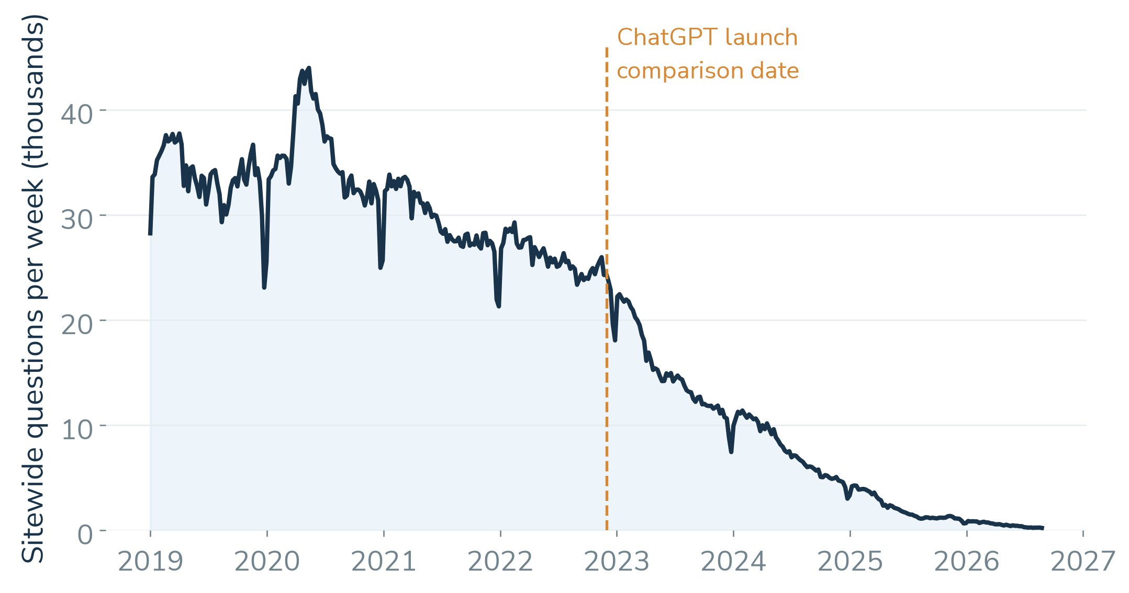
EXPLORATORY ANALYSIS
Weekly activity declines across the period
400
weekly points
per series
ALL is a sitewide
API total
The November 2022 event line marks a comparison date, without establishing causality.
Akshay Krishna P S
07 / 25
Notes:
Presenter: Akshay Krishna P S (M3)
Time: 30 seconds
This is the separately collected sitewide weekly API total. It shows a sustained decline across the study window. Every one of the fourteen series contains four hundred complete weeks. The November 2022 line marks the fixed comparison date. The plot alone cannot establish why activity changed, and these totals are not weighted counts of our sampled question records.
Sources:
/home/adhikkesh/adhikkesh/SEM7/BA/stackoverflow-ai-era/reports/review2/ts/series_long.csv
/home/adhikkesh/adhikkesh/SEM7/BA/stackoverflow-ai-era/reports/review2/ts/series_manifest.json
Visual reference: /home/adhikkesh/Downloads/BA Final Project - Review 1.pdf (style only).
Figures: Matplotlib from saved project evidence.

Slide 9
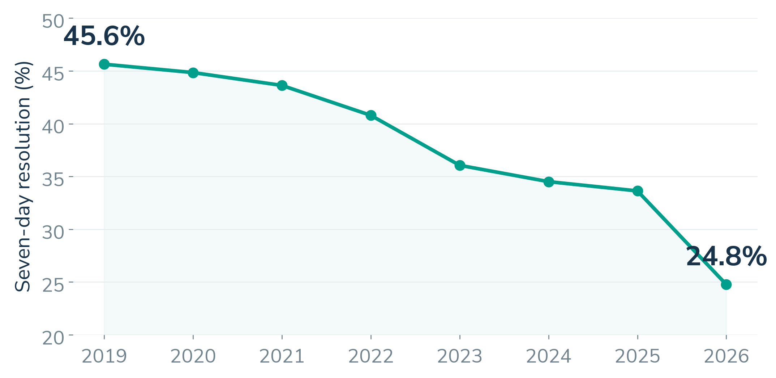
EXPLORATORY ANALYSIS
Resolution falls in the weighted sample
Acceptance measures recorded resolution. It does not directly measure asker satisfaction.
Akshay Krishna P S
08 / 25
Notes:
Presenter: Akshay Krishna P S (M3)
Time: 30 seconds
The question sample gives a second view: seven-day accepted-answer resolution declines over time. We apply the collection weights when calculating these rates. The combined post-period rate is 35.3 percent, compared with 44.1 percent in the pre period. The 2026 annual point covers January to August. Acceptance is a useful observed outcome, but it does not directly measure satisfaction or question difficulty.
Sources:
/home/adhikkesh/adhikkesh/SEM7/BA/stackoverflow-ai-era/data/processed/questions_clean_v1.parquet
/home/adhikkesh/adhikkesh/SEM7/BA/stackoverflow-ai-era/reports/review2/final_report.md
Visual reference: /home/adhikkesh/Downloads/BA Final Project - Review 1.pdf (style only).
Figures: Matplotlib from saved project evidence.

Slide 10
UNIT 2 PREPARATION
Prediction follows chronological splits
TRAIN
VALIDATE
LOCKED TEST
Before 2025
Jan–Jun 2025
Jul 2025–Jul 2026
248,294 rows
28,132 rows
16,695 rows
Posting-time inputs
Leakage controls
Question structure, account age, title text and lagged tag history
Exclude later votes, views and answers. Fit preprocessing on training data.
Choose the model and decision threshold on validation. Preserve the locked test.
Adhikkesh S K
09 / 25
Notes:
Presenter: Adhikkesh S K (M5)
Time: 30 seconds
We train on earlier questions, use January to June 2025 for validation and preserve July 2025 to July 2026 as the locked test. Inputs describe question structure, account age, title text and lagged tag activity at posting. We exclude later votes, views and answer information. Preprocessing learns from training data, and validation selects the model and decision threshold. August 2026 is outside this classifier test but remains in Unit 3.
Sources:
/home/adhikkesh/adhikkesh/SEM7/BA/stackoverflow-ai-era/reports/review1/m5/results.json
/home/adhikkesh/adhikkesh/SEM7/BA/stackoverflow-ai-era/docs/feature_spec.md
Visual reference: /home/adhikkesh/Downloads/BA Final Project - Review 1.pdf (style only).
Figures: Matplotlib from saved project evidence.

Slide 11
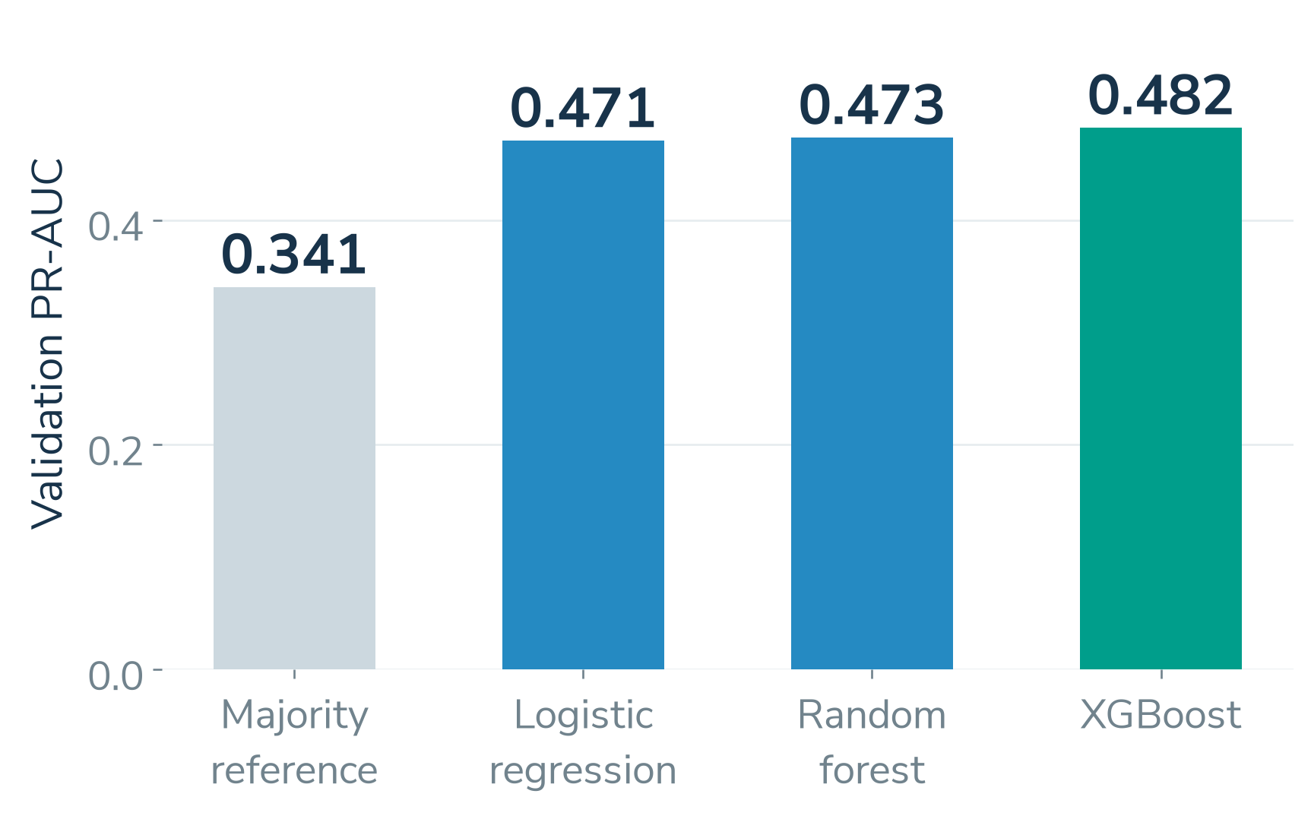
UNIT 2 FINAL EVALUATION
XGBoost gives modest predictive value
LOCKED TEST
Metric | XGBoost
PR-AUC | 0.432
ROC-AUC | 0.655
F1 | 0.493
16,695 questions
Positive rate: 29.69%
Decision threshold: 0.3669
Validation PR-AUC selects XGBoost. The same test reference PR-AUC is 0.297.
Adhikkesh S K
10 / 25
Notes:
Presenter: Adhikkesh S K (M5)
Time: 40 seconds
The chart compares models on the same validation set. XGBoost performs best there, with PR-AUC 0.482, so validation selects it. On the locked test, its PR-AUC is 0.432, ROC-AUC 0.655 and F1 0.493. The constant-score reference PR-AUC equals the positive prevalence of 0.297. This is modest predictive value, and the metrics should retain their names rather than being reported as generic accuracy.
Sources:
/home/adhikkesh/adhikkesh/SEM7/BA/stackoverflow-ai-era/reports/review1/m5/results.json
Visual reference: /home/adhikkesh/Downloads/BA Final Project - Review 1.pdf (style only).
Figures: Matplotlib from saved project evidence.

Slide 12
UNIT 3 METHOD SELECTION
Two advanced methods answer different questions
METHOD 1
METHOD 2
Time Series
Analysis
Text
Mining
Activity patterns and future demand
14 weekly series, 400 weeks each
Question themes, tone and structure
302,026 question records
Compare alternatives within each method under the same evaluation conditions.
Akshay Krishna P S
11 / 25
Notes:
Presenter: Akshay Krishna P S (M3)
Time: 25 seconds
We selected time series analysis and text mining because they address complementary business questions. Time series studies activity patterns and future demand. Text mining studies what those questions contain and how writing patterns change. Each method uses the appropriate records from our validated project data and compares alternatives under consistent conditions.
Sources:
/home/adhikkesh/adhikkesh/SEM7/BA/stackoverflow-ai-era/reports/review2/final_report.md
Visual reference: /home/adhikkesh/Downloads/BA Final Project - Review 1.pdf (style only).
Figures: Matplotlib from saved project evidence.

Slide 13
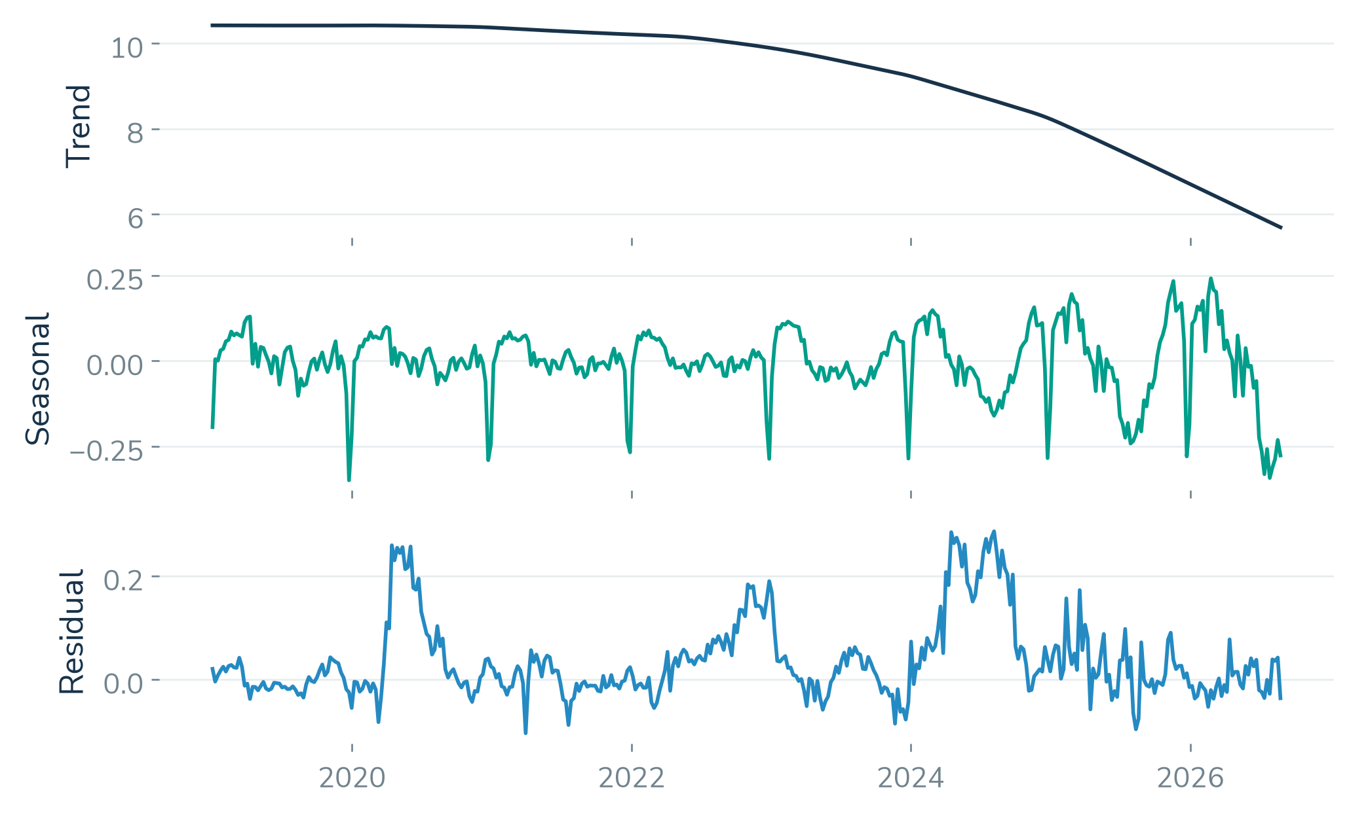
METHOD 1 IMPLEMENTATION
Trend dominates the weekly activity signal
PREPARATION
Regular Tuesday weeks
No missing weeks
log1p count scale
STL DECOMPOSITION
STL with period 52
Strong influence of trend
Seasonality influence limited
ALL trend strength: 0.997. Decomposition separates trend, seasonality and residuals.
Akshay Krishna P S
12 / 25
Notes:
Presenter: Akshay Krishna P S (M3)
Time: 40 seconds
We prepare regular Tuesday-start weekly totals and transform counts with log one plus count. STL uses a fifty-two-week seasonal period. The chart shows actual trend, seasonal and residual components for ALL. Its trend strength is 0.997, indicating that long-run trend dominates the signal. We also apply ADF and KPSS stationarity tests and PELT change-point detection. Detected breaks are penalised mean shifts, so their proximity to an event is not a significance test.
Sources:
/home/adhikkesh/adhikkesh/SEM7/BA/stackoverflow-ai-era/reports/review2/ts/stl_components.csv
/home/adhikkesh/adhikkesh/SEM7/BA/stackoverflow-ai-era/reports/review2/ts/stl_summary.csv
/home/adhikkesh/adhikkesh/SEM7/BA/stackoverflow-ai-era/reports/review2/ts/stationarity.csv
/home/adhikkesh/adhikkesh/SEM7/BA/stackoverflow-ai-era/reports/review2/ts/changepoints_summary.csv
Visual reference: /home/adhikkesh/Downloads/BA Final Project - Review 1.pdf (style only).
Figures: Matplotlib from saved project evidence.

Slide 14
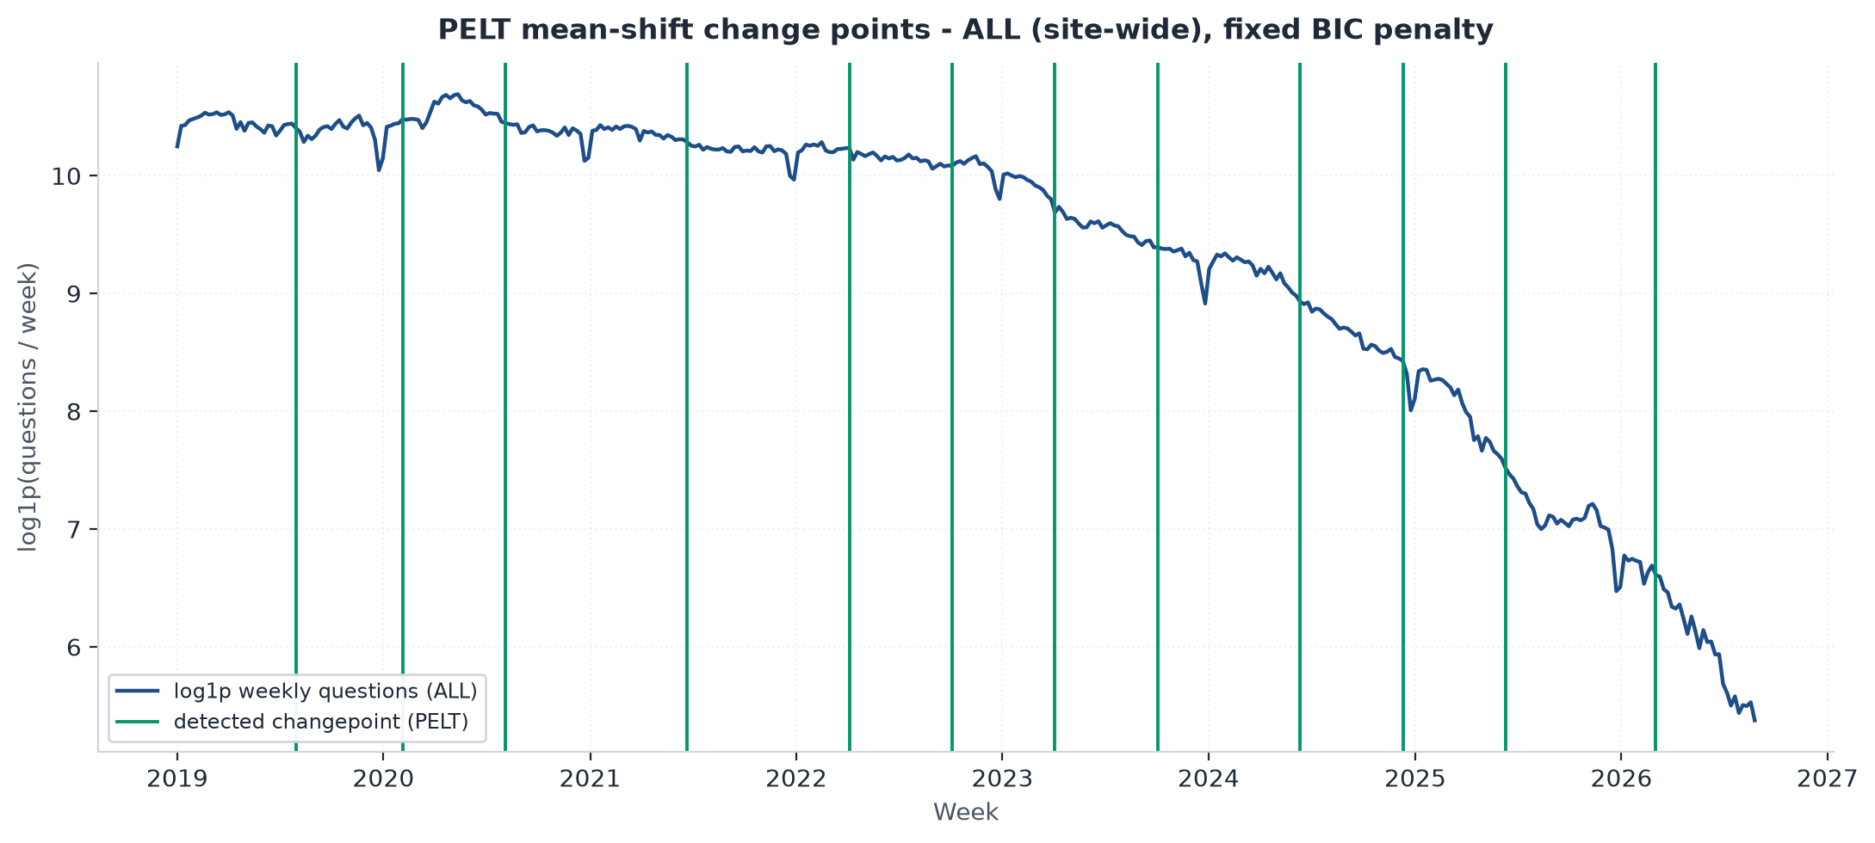
METHOD 1 IMPLEMENTATION
Stationarity and Changepoint Detection
STATIONARITY
Both ADF and KPSS
Non-stationary for d=0 in both
Stationary by ADF at d=1
KPSS aligned after break-adjustment
CHANGEPOINTS
PELT Change points
BIC Penalty fixed in advance
26 weeks minimum distance
Stationary at d=1 by ADF. Changepoints throughout the collected period.
Akshay Krishna P S
12 / 25
Notes:
Presenter: Akshay Krishna P S (M3)
Time: 40 seconds
We prepare regular Tuesday-start weekly totals and transform counts with log one plus count. STL uses a fifty-two-week seasonal period. The chart shows actual trend, seasonal and residual components for ALL. Its trend strength is 0.997, indicating that long-run trend dominates the signal. We also apply ADF and KPSS stationarity tests and PELT change-point detection. Detected breaks are penalised mean shifts, so their proximity to an event is not a significance test.
Sources:
/home/adhikkesh/adhikkesh/SEM7/BA/stackoverflow-ai-era/reports/review2/ts/stl_components.csv
/home/adhikkesh/adhikkesh/SEM7/BA/stackoverflow-ai-era/reports/review2/ts/stl_summary.csv
/home/adhikkesh/adhikkesh/SEM7/BA/stackoverflow-ai-era/reports/review2/ts/stationarity.csv
/home/adhikkesh/adhikkesh/SEM7/BA/stackoverflow-ai-era/reports/review2/ts/changepoints_summary.csv
Visual reference: /home/adhikkesh/Downloads/BA Final Project - Review 1.pdf (style only).
Figures: Matplotlib from saved project evidence.

Slide 15
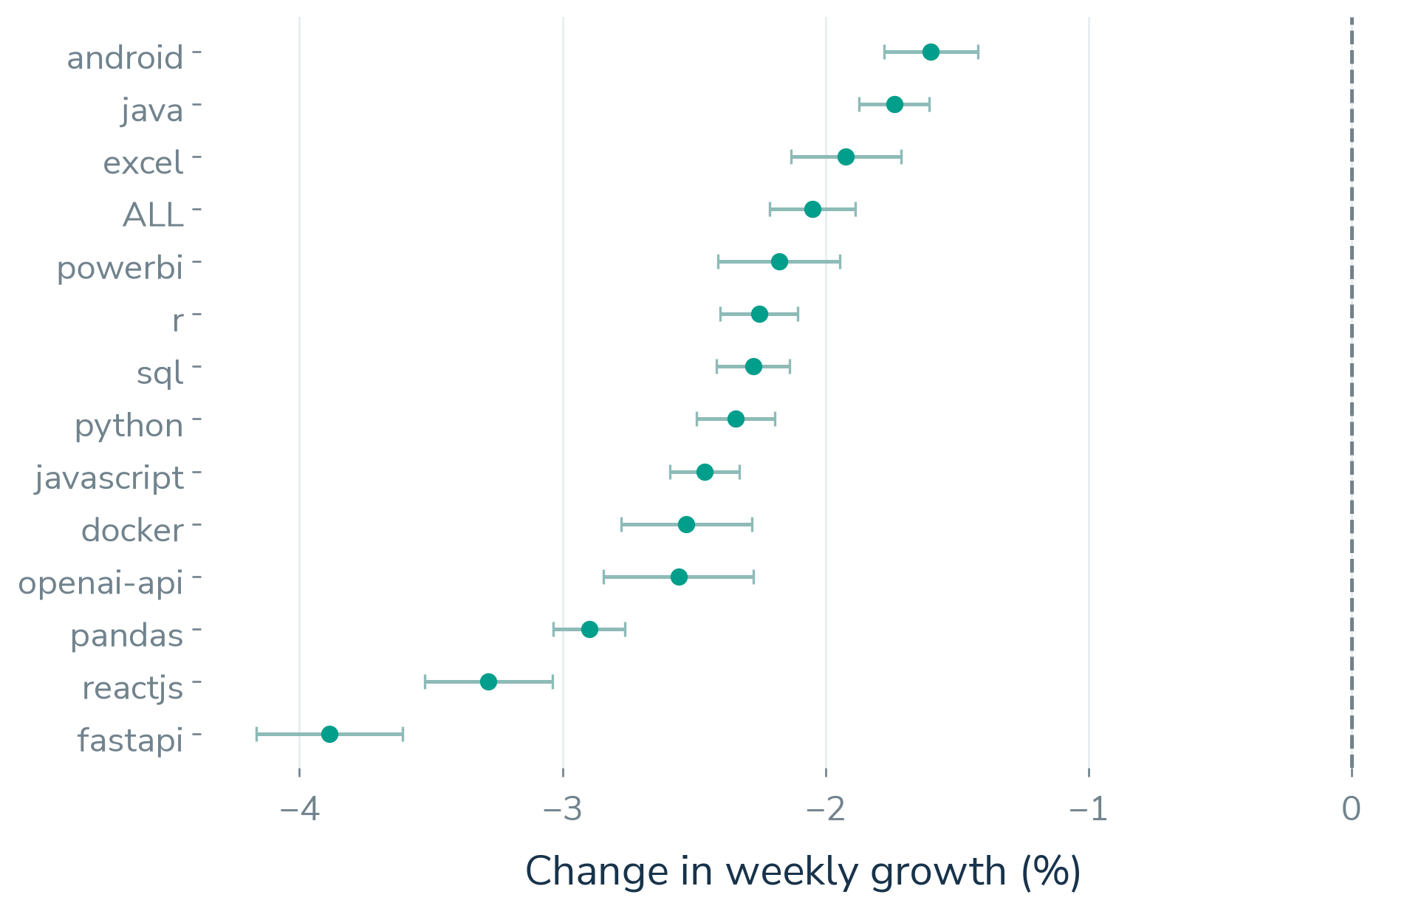
METHOD 1 INTERPRETATION
Post-2022 growth shifts are negative
14 / 14
series with negative growth shifts
13 / 14
exceed their 2021 placebo
slope magnitude
95% HAC confidence intervals. Python growth shift: −2.34% per week.
Adhikkesh S K
13 / 25
Notes:
Presenter: Adhikkesh S K (M5)
Time: 35 seconds
Interrupted time series estimates a weekly growth-rate shift at the fixed November 2022 boundary, with HAC uncertainty. All fourteen estimated shifts are negative. Thirteen exceed the magnitude of their corresponding 2021 placebo slope. Python has a shift of about minus 2.34 percent per week. The confidence intervals describe uncertainty under this model. The placebo is a robustness check, and causal attribution to AI remains unestablished.
Sources:
/home/adhikkesh/adhikkesh/SEM7/BA/stackoverflow-ai-era/reports/review2/ts/its_results.csv
Visual reference: /home/adhikkesh/Downloads/BA Final Project - Review 1.pdf (style only).
Figures: Matplotlib from saved project evidence.

Slide 16
METHOD 1 EVALUATION AND COMPARISON
Backtests favour SARIMAX at 26 weeks
Model | MASE | Log RMSE | 95% cover
Seasonal naive | 2.098 | 1.668 | 19.5%
Naive | 0.723 | 0.940 | 70.8%
Drift | 0.564 | 0.792 | 83.3%
ETS | 0.584 | 0.794 | 59.7%
SARIMAX | 0.324 | 0.560 | 52.0%
55.9%
mean skill against naive
52.0%
observed coverage for
nominal 95% intervals
Matched evaluation: 14 series. Lower MASE and log RMSE are better.
Select on 2024 H2. Evaluate later rolling origins at 1, 4, 13 and 26 weeks.
Adhikkesh S K
14 / 25
Notes:
Presenter: Adhikkesh S K (M5)
Time: 40 seconds
We select on the second half of 2024 and evaluate later rolling origins at four forecast horizons. This table compares the same fourteen series at twenty-six weeks. SARIMAX has the lowest mean MASE and log RMSE, with mean skill of 55.9 percent against naive. Skill is relative error reduction, not classification accuracy. Its nominal ninety-five-percent intervals cover only about fifty-two percent of test endpoints, so the intervals are too narrow. The experiments also disclose ten fitting failures.
Sources:
/home/adhikkesh/adhikkesh/SEM7/BA/stackoverflow-ai-era/reports/review2/ts/backtest_summary_matched.csv
/home/adhikkesh/adhikkesh/SEM7/BA/stackoverflow-ai-era/reports/review2/ts/fit_failures.csv
Visual reference: /home/adhikkesh/Downloads/BA Final Project - Review 1.pdf (style only).
Figures: Matplotlib from saved project evidence.

Slide 17
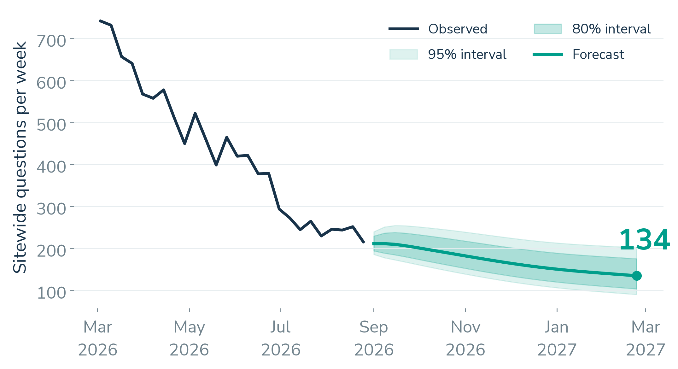
METHOD 1 FORECAST OUTPUT
A provisional forecast for February 2027
−37.6%
ALL change at 26 weeks
215 to 134
questions per week
by 23 February 2027
Six tags meet the steep-decline rule. Two zero-baseline tags cannot support percent classes.
Adhikkesh S K
15 / 25
Notes:
Presenter: Adhikkesh S K (M5)
Time: 45 seconds
The selected sitewide point forecast falls from the last observed 215 questions per week to about 134 by 23 February 2027, a decrease of 37.6 percent. The chart shows both eighty- and ninety-five-percent intervals, whose backtest undercoverage remains a limitation. Six study tags meet the fixed steep-decline rule and five are declining. Two tags have zero baselines and cannot support percentage classes. These are provisional planning estimates.
Sources:
/home/adhikkesh/adhikkesh/SEM7/BA/stackoverflow-ai-era/reports/review2/ts/forecasts_26w.csv
/home/adhikkesh/adhikkesh/SEM7/BA/stackoverflow-ai-era/reports/review2/ts/tag_classes.csv
Visual reference: /home/adhikkesh/Downloads/BA Final Project - Review 1.pdf (style only).
Figures: Matplotlib from saved project evidence.

Slide 18
METHOD 2 PREPARATION AND IMPLEMENTATION
Text mining preparation and outputs
01
02
03
Prepare
Model
Summarise
Remove code from prose.
Lemmatise text and
protect technical terms.
NMF with TF-IDF.
LDA with counts.
VADER with overrides.
Weighted topic shares.
Seven-day outcomes.
Writing-structure flags.
302,026 records
Weights preserve the sample design.
Code remains available for complexity measures.
Rishiikesh S K
16 / 25
Notes:
Presenter: Rishiikesh S K (M2)
Time: 35 seconds
We use all 302,026 records for question-level text outputs. Code is excluded from prose before lemmatisation, with technical words protected. NMF uses TF-IDF and LDA uses counts. VADER has documented overrides, while structural flags and code measurements remain separate. We then join weighted topic shares to seven-day outcomes. Code removal prevents programming syntax from dominating the prose topics, while keeping the code available for complexity analysis.
Sources:
/home/adhikkesh/adhikkesh/SEM7/BA/stackoverflow-ai-era/reports/review2/text/text_preprocessing.json
/home/adhikkesh/adhikkesh/SEM7/BA/stackoverflow-ai-era/reports/review2/text/corpus_stats.json
/home/adhikkesh/adhikkesh/SEM7/BA/stackoverflow-ai-era/reports/review2/text/complexity_method.json
Visual reference: /home/adhikkesh/Downloads/BA Final Project - Review 1.pdf (style only).
Figures: Matplotlib from saved project evidence.

Slide 19
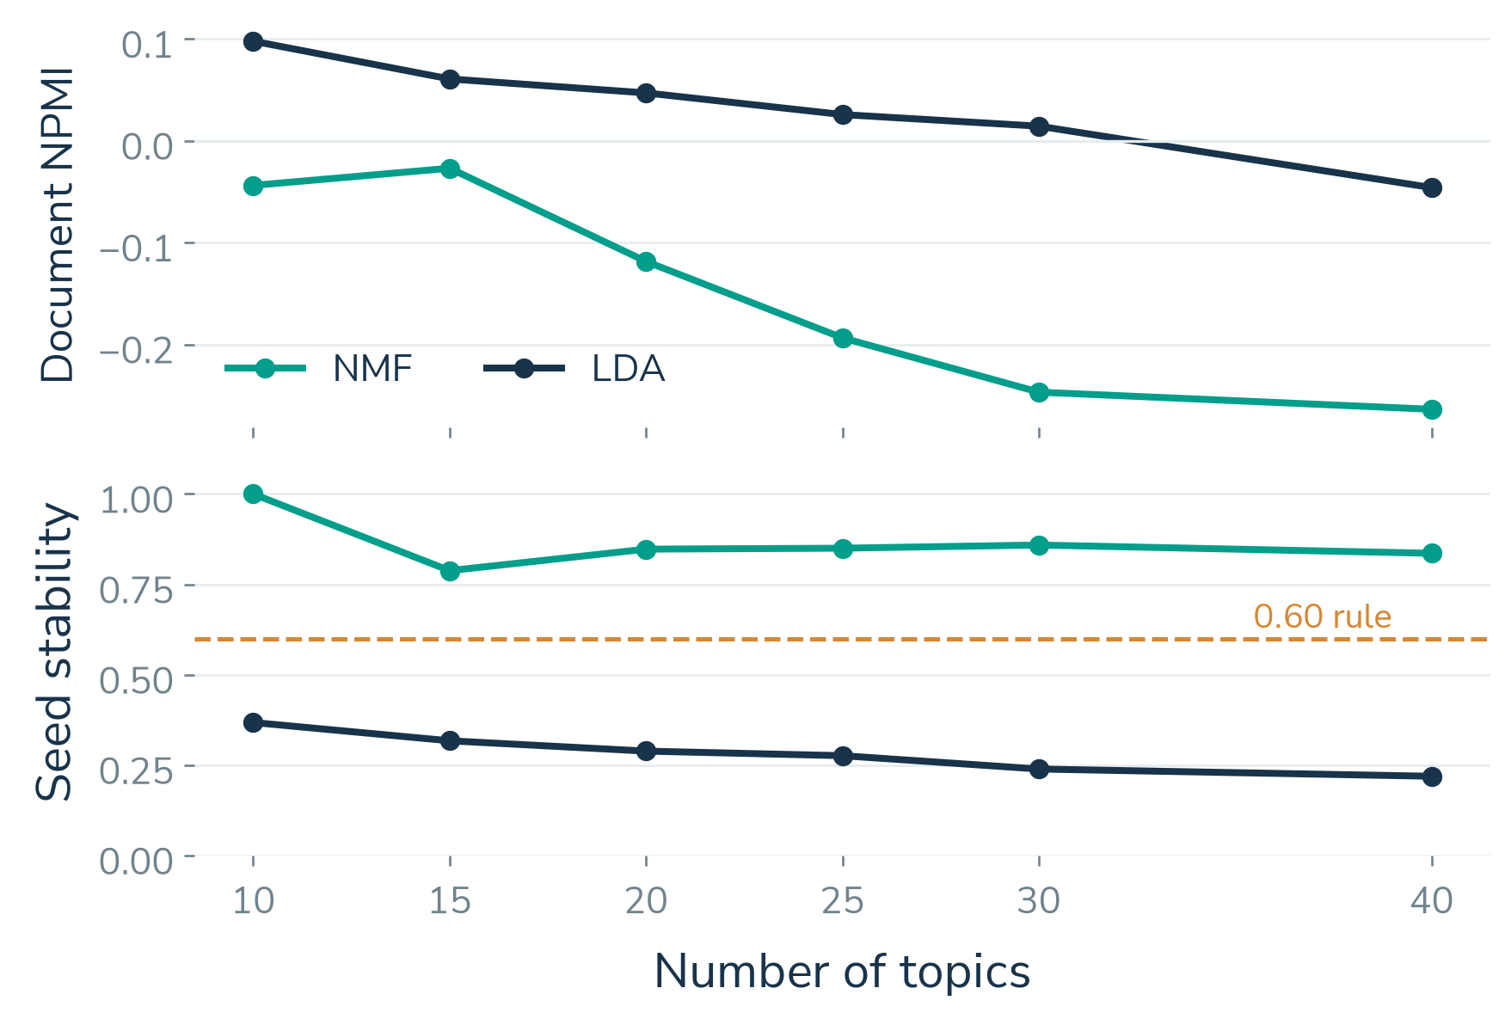
METHOD 2 EVALUATION AND COMPARISON
Measured selection chooses NMF with 15 topics
Model | NPMI | Diversity | Stability
NMF 10 | −0.044 | 0.800 | 1.000
NMF 15 | −0.027 | 0.735 | 0.788
LDA 10 | 0.098 | 0.715 | 0.368
36 actual fits
75,814 shared training IDs
20,000 disjoint reference IDs
Rule: diversity ≥ 0.70 and stability ≥ 0.60, then maximum document NPMI.
Nishanth K
17 / 25
Notes:
Presenter: Nishanth K (M4)
Time: 45 seconds
This comparison uses thirty-six actual fits: two families, six topic counts and three seeds. All share the same 75,814 training questions and a disjoint 20,000-document coherence reference. The rule requires diversity at least 0.7 and stability at least 0.6, then selects the highest coherence. It chooses NMF with fifteen topics. LDA with ten topics has higher coherence but fails stability. We report exact document-cooccurrence NPMI, a disclosed change from the original sliding-window plan. Negative NMF coherence and automatic names limit semantic validity.
Sources:
/home/adhikkesh/adhikkesh/SEM7/BA/stackoverflow-ai-era/reports/review2/text/topic_model_selection.csv
/home/adhikkesh/adhikkesh/SEM7/BA/stackoverflow-ai-era/reports/review2/text/topic_grid_manifest.json
/home/adhikkesh/adhikkesh/SEM7/BA/stackoverflow-ai-era/docs/review2_topic_evaluation.md
Visual reference: /home/adhikkesh/Downloads/BA Final Project - Review 1.pdf (style only).
Figures: Matplotlib from saved project evidence.

Slide 20
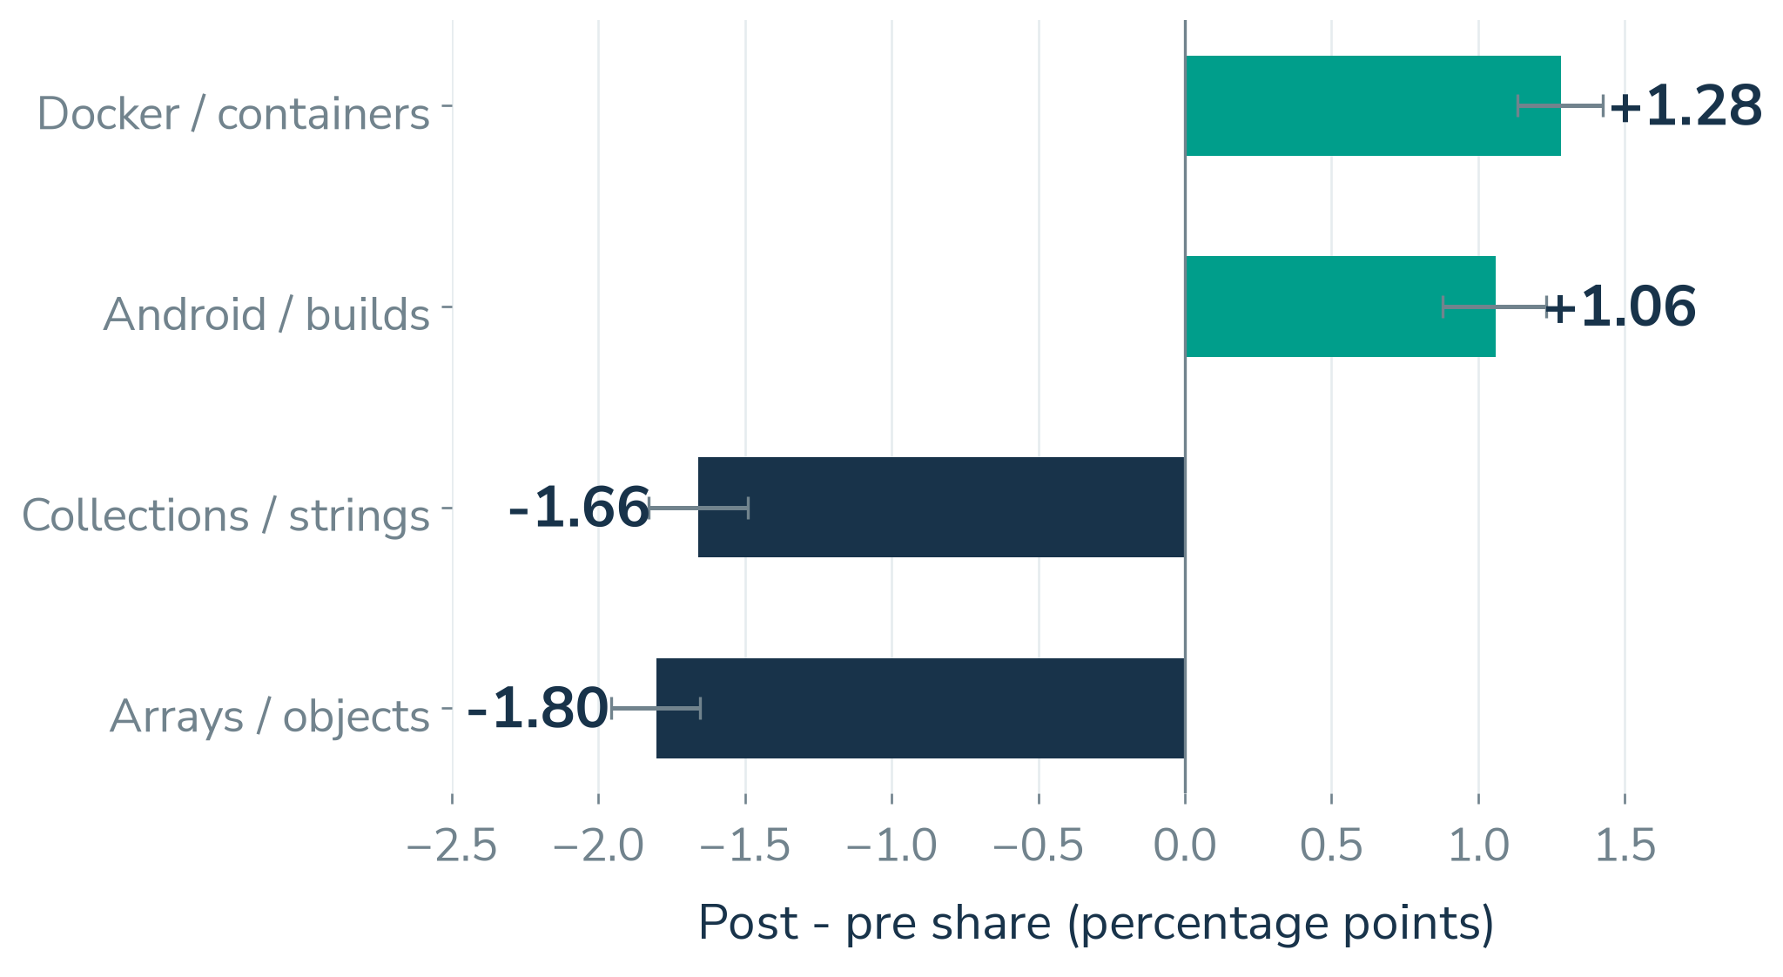
METHOD 2 TOPIC OUTPUTS
Topic shares shift within the sample
32%
Docker-topic seven-day resolution
+1.28 pp
Docker share change
8,598 dominant-topic
questions
Intervals use 1,000 weighted bootstrap resamples. Topic names are automatic descriptions.
Nishanth K
18 / 25
Notes:
Presenter: Nishanth K (M4)
Time: 35 seconds
Docker and Android gain weighted topic share, while arrays and collections lose share. The chart shows percentage-point changes with one thousand weighted bootstrap resamples. Docker gains 1.28 percentage points, and only about thirty-two percent of its dominant-topic questions resolve within seven days, across 8,598 questions. This makes it a candidate for investigation. Its automatic topic name remains provisional, and share growth alone does not demonstrate difficulty or migration from AI tools.
Sources:
/home/adhikkesh/adhikkesh/SEM7/BA/stackoverflow-ai-era/reports/review2/text/topic_prepost.csv
/home/adhikkesh/adhikkesh/SEM7/BA/stackoverflow-ai-era/reports/review2/text/topic_outcomes.csv
/home/adhikkesh/adhikkesh/SEM7/BA/stackoverflow-ai-era/reports/review2/text/topic_labels.csv
Visual reference: /home/adhikkesh/Downloads/BA Final Project - Review 1.pdf (style only).
Figures: Matplotlib from saved project evidence.

Slide 21
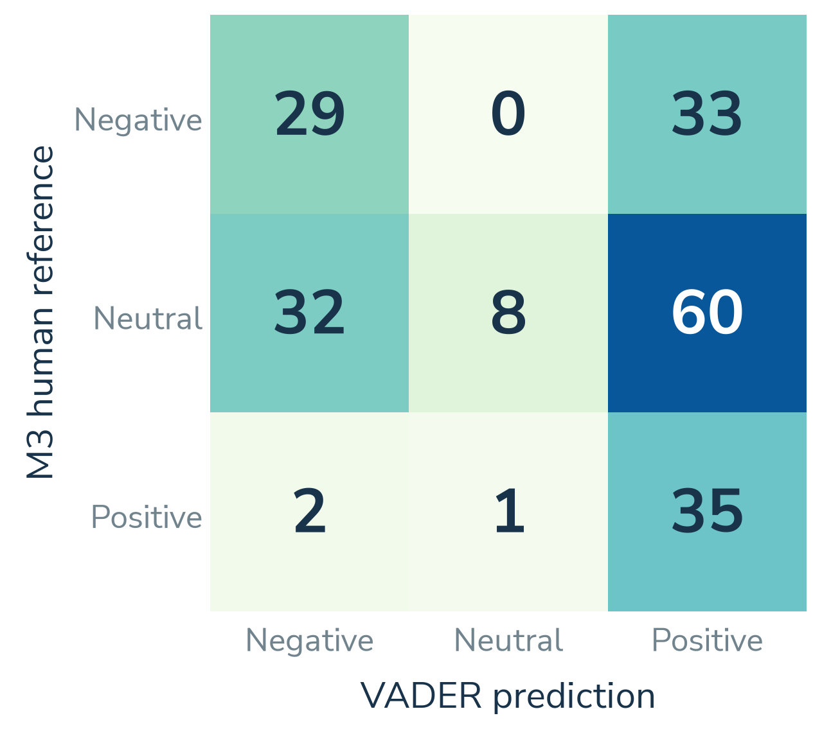
METHOD 2 TONE EVALUATION
Tone validation exposes a clear limitation
36%
VADER accuracy on 200 M3 human labels
58% agreement
AI versus M3 human labels
Cohen’s κ = 0.214
Original two-human validation is incomplete. AI labels remain separately disclosed.
Rishiikesh S K
19 / 25
Notes:
Presenter: Rishiikesh S K (M2)
Time: 35 seconds
The confusion matrix compares VADER with Akshay’s two hundred human labels. VADER reaches only thirty-six percent accuracy and macro-F1 0.344 against that single-human reference. Separate AI annotations agree with the human labels fifty-eight percent of the time, with Cohen’s kappa 0.214. AI annotations are not a second independent human rater. The original two-human adjudication and independent human topic-naming requirement remains incomplete in issue 126. Tone should remain exploratory.
Sources:
/home/adhikkesh/adhikkesh/SEM7/BA/stackoverflow-ai-era/reports/review2/text/tone_confusion.csv
/home/adhikkesh/adhikkesh/SEM7/BA/stackoverflow-ai-era/reports/review2/text/tone_validation_status.json
/home/adhikkesh/adhikkesh/SEM7/BA/stackoverflow-ai-era/reports/review2/text/ai_annotation_manifest.json
Visual reference: /home/adhikkesh/Downloads/BA Final Project - Review 1.pdf (style only).
Figures: Matplotlib from saved project evidence.

Slide 22
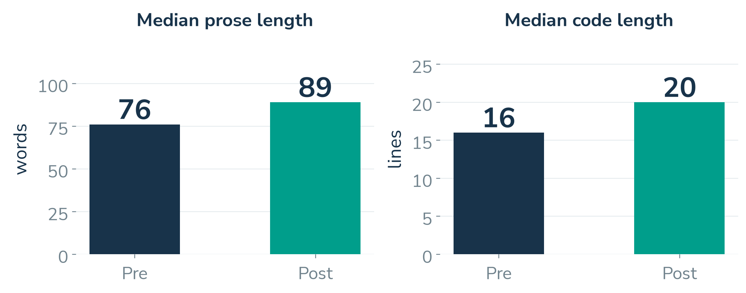
METHOD 2 WRITING COMPLEXITY
Questions are longer after the boundary
Prose grows by 13 words
Code grows by 4 lines
Weighted median: 76 to 89 words
Weighted median: 16 to 20 lines
Rishiikesh S K
20 / 25
Notes:
Presenter: Rishiikesh S K (M2)
Time: 35 seconds
The writing-structure measures are more directly observable than tone. Median prose length increases from seventy-six to eighty-nine words, and median code length from sixteen to twenty lines. These are weighted medians across the fixed pre and post periods, excluding the transition. Longer text does not prove higher difficulty. It suggests an experiment with clearer question templates, whose effect should be measured prospectively.
Sources:
/home/adhikkesh/adhikkesh/SEM7/BA/stackoverflow-ai-era/reports/review2/text/complexity_prepost.csv
/home/adhikkesh/adhikkesh/SEM7/BA/stackoverflow-ai-era/reports/review2/text/complexity_method.json
Visual reference: /home/adhikkesh/Downloads/BA Final Project - Review 1.pdf (style only).
Figures: Matplotlib from saved project evidence.

Slide 23
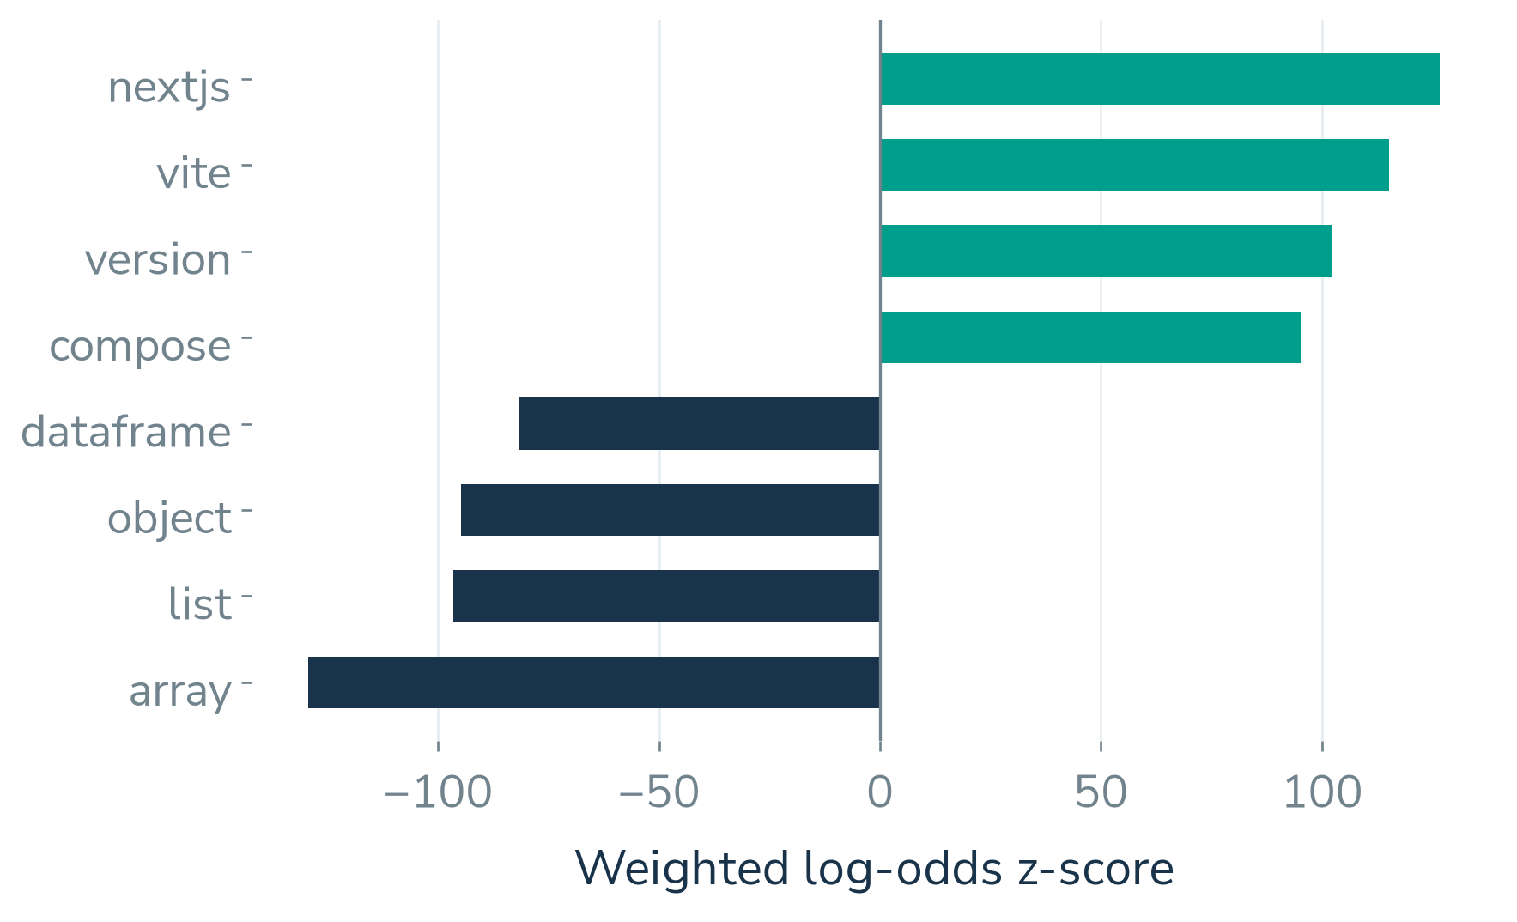
COMBINED BUSINESS INSIGHTS
Demand and vocabulary guide documentation pilots
−37.6%
ALL forecast change at 26 weeks
Next.js and Vite
rising vocabulary suggests
examples to inspect for
a documentation pilot
Keyword shifts are proxies. A controlled pilot must establish whether a guide helps.
Nishanth K
21 / 25
Notes:
Presenter: Nishanth K (M4)
Time: 30 seconds
Time series suggests lower overall activity, while text mining identifies changing vocabulary. Next.js and Vite are rising terms in the saved weighted log-odds analysis. Together, those signals suggest inspecting linked questions and testing focused documentation. Keyword frequency is a proxy and does not establish migration to AI or a proven documentation need. A guide should earn its value through measured use and repeat-question rates in a controlled pilot.
Sources:
/home/adhikkesh/adhikkesh/SEM7/BA/stackoverflow-ai-era/reports/review2/text/keywords_prepost.csv
/home/adhikkesh/adhikkesh/SEM7/BA/stackoverflow-ai-era/reports/review2/ts/forecasts_26w.csv
/home/adhikkesh/adhikkesh/SEM7/BA/stackoverflow-ai-era/reports/review2/insight_matrix.csv
Visual reference: /home/adhikkesh/Downloads/BA Final Project - Review 1.pdf (style only).
Figures: Matplotlib from saved project evidence.

Slide 24
COMBINED RECOMMENDATIONS
Three actions with measurable outcomes
Evidence from both methods | Proposed pilot | Success measure
Python growth shift −2.34%/week. Docker topic share +1.28 pp and 32% resolution. | Send rising, low-resolution topics to an expert routing queue with topic tags | Seven-day resolution and first-answer time versus a control queue
ALL forecast: 215 to 134/week. Next.js keyword z-score 126.7. | Focused documentation with reusable examples for rising vocabulary topics | Documentation use and repeat-question share
95% forecast bands cover about 52%. Arrays topic share falls 1.80 pp. | Trigger a review when tags fall below forecast band; adjust intervals if false-alert | Shares flagged and reviewed per quarter and recovery
Suggested pilots are derived from the experimental results. Benefits and intervention effects remain untested.
Akshay Krishna P S
22 / 25
Notes:
Presenter: Akshay Krishna P S (M3)
Time: 40 seconds
Our recommendations connect both advanced methods. A negative Python growth shift and a growing, low-resolution Docker topic support an expert-queue pilot. Lower sitewide forecast volume and rising Next.js vocabulary support a documentation pilot. Forecast undercoverage and changing topic shares support calibration before automated alerts. For each proposal, we name a measurable outcome and a control or prospective evaluation. These are recommendations to test, not claimed intervention effects.
Sources:
/home/adhikkesh/adhikkesh/SEM7/BA/stackoverflow-ai-era/reports/review2/insight_matrix.csv
/home/adhikkesh/adhikkesh/SEM7/BA/stackoverflow-ai-era/reports/review2/recommendations.csv
Visual reference: /home/adhikkesh/Downloads/BA Final Project - Review 1.pdf (style only).
Figures: Matplotlib from saved project evidence.

Slide 25
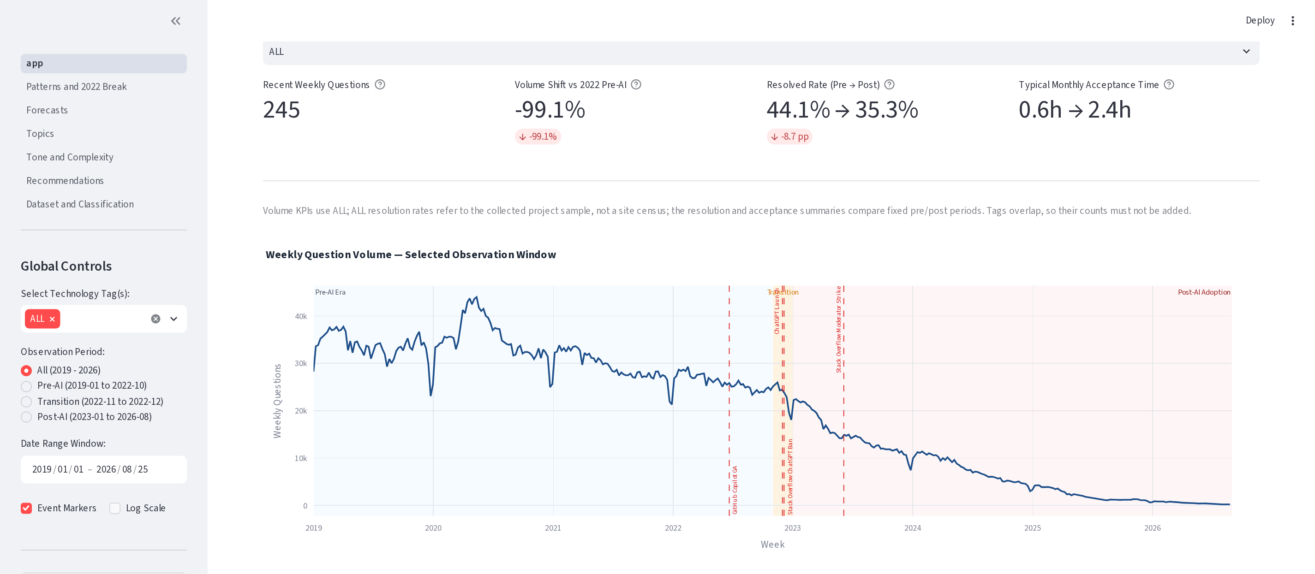
MANDATORY INTERACTIVE APPLICATION
A live dashboard connects the evidence
Filter a tag
Inspect forecasts
Open source posts
Abhinav G
23 / 25
Notes:
Presenter: Abhinav G (M1)
Time: 95 seconds
Use the live application for about ninety-five seconds. Start in Overview and change the tag and period filters. Open Forecasts, choose a horizon and explain the uncertainty bands and their undercoverage. Open Topics, inspect Docker and follow a source-post link. Finally, open Dataset and classification to show validation and the locked evaluation. The scenario is choosing a support pilot using the actual evidence. The app has seven pages and runs locally. The screenshot is a fallback reference, and a default Streamlit launch uses port 8501, so launch with server.port 8502 to match this link.
Sources:
/home/adhikkesh/adhikkesh/SEM7/BA/stackoverflow-ai-era/dashboard/app.py
/home/adhikkesh/adhikkesh/SEM7/BA/stackoverflow-ai-era/submission/presentation/redesign/assets/screenshot_provenance.txt
Visual reference: /home/adhikkesh/Downloads/BA Final Project - Review 1.pdf (style only).
Figures: Matplotlib from saved project evidence.

Slide 26
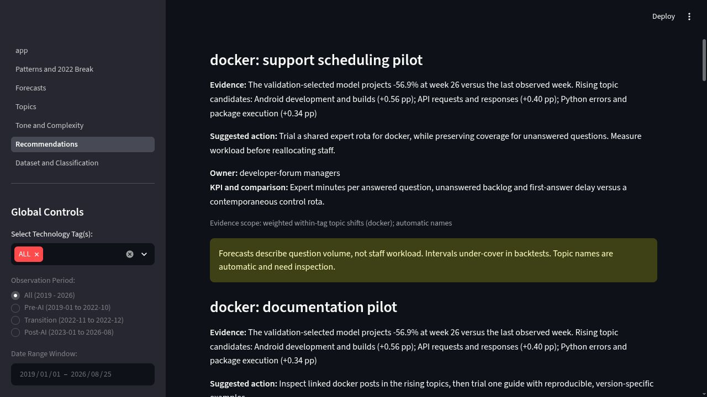

LIVE APPLICATION AND DEMONSTRATION
A public dashboard with suggested actions
Open the public app
Overview
Forecasts and topics
Suggested action and KPI
https://stackoverflow-ai-era.streamlit.app/
Team 7 Review 2
Notes:
Presenter: dashboard demonstrator (Abhinav G / M1). Suggested live demonstration: 90–120 seconds, within the existing demo allocation. Insert immediately after the current dashboard slide.
Open the linked public app. Change an Overview period or technology, then open Forecasts and change the tag, model or horizon. Explain that forecast bands under-cover and the values are saved forecast medians. Open Topics, inspect a topic and a linked source question. Finally choose Docker in Recommendations and show a suggested action, the tag-specific numerical evidence, owner and measurable KPI. The suggestions are deterministic rules and untested pilots, not a trained recommender or proven intervention.
The screenshot shows corrected LOCAL code inspected on 19 October 2026. Redeploy these changes to the public app before recording. Public pages were inspected earlier on the same date. Keep the local app as a fallback if the hosted service sleeps. A recording backs up the required live interactions.
Resolution proxy: the answer accepted in the collected record was posted within 168 hours, not necessarily accepted by then.
Sources: /home/adhikkesh/adhikkesh/SEM7/BA/stackoverflow-ai-era/dashboard/decision_support.py; /home/adhikkesh/adhikkesh/SEM7/BA/stackoverflow-ai-era/dashboard/pages/6_Recommendations.py; /home/adhikkesh/adhikkesh/SEM7/BA/stackoverflow-ai-era/dashboard/data/insight_matrix.csv; https://stackoverflow-ai-era.streamlit.app/. Screenshot: browser capture from http://127.0.0.1:8502/Recommendations, 19 October 2026. QR encodes the public URL exactly.
Style reference: /home/adhikkesh/adhikkesh/SEM7/BA/stackoverflow-ai-era/submission/presentation/redesign/output/Team_7_Review_2_White_25_Final.pptx

Slide 27
COMPLETION AND PROJECT HISTORY
Individual contributions are traceable
Team member | Project responsibility | Published evidence
Abhinav G CB.SC.U4CSE23201 | API collection and dashboard integration | PRs 161–168, 173
Rishiikesh S K CB.SC.U4CSE23236 | Corpus preparation, tone and complexity | PRs 129–131, 171
Akshay Krishna P S CB.SC.U4CSE23403 | Patterns, ITS and combined insights | PRs 146–148, 150
Nishanth K CB.SC.U4CSE23523 | Topics, keywords and model comparison | PRs 140, 170
Adhikkesh S K CB.SC.U4CSE23101 | Forecasts, backtests and ITS integration | PRs 137–139, 172
Project board
Repository and pull request history
Nishanth K
24 / 25
Notes:
Presenter: Nishanth K (M4)
Time: 30 seconds
The repository and board preserve each member’s contribution. Abhinav collected data and integrated the dashboard. Rishiikesh prepared the corpus and tone and complexity analysis. Akshay handled patterns, interrupted time series and combined insights. Nishanth supplied topic and keyword analysis. Adhikkesh supplied forecasts, backtests and ITS integration. PR 175 records the final corrections under their actual authorship. The integrated verification record has 147 passing tests and three executed notebooks. Original two-human validation remains disclosed as incomplete.
Sources:
/home/adhikkesh/adhikkesh/SEM7/BA/stackoverflow-ai-era/reports/review2/contribution_member1.md
/home/adhikkesh/adhikkesh/SEM7/BA/stackoverflow-ai-era/reports/review2/contribution_member2.md
/home/adhikkesh/adhikkesh/SEM7/BA/stackoverflow-ai-era/reports/review2/contribution_member3.md
/home/adhikkesh/adhikkesh/SEM7/BA/stackoverflow-ai-era/reports/review2/contribution_member4.md
/home/adhikkesh/adhikkesh/SEM7/BA/stackoverflow-ai-era/reports/review2/contribution_member5.md
/home/adhikkesh/adhikkesh/SEM7/BA/stackoverflow-ai-era/reports/review2/test_results.txt
Visual reference: /home/adhikkesh/Downloads/BA Final Project - Review 1.pdf (style only).
Figures: Matplotlib from saved project evidence.

Slide 28
FINAL PROJECT OUTCOME
Conclusion and next steps
A working system
Business value
Evidence limits
Original API data
Validated question table
Prediction and two methods
Seven-page dashboard
Expert-routing pilot
Documentation pilot
Calibrated demand alerts
Prospective evaluation
Observational design
Narrow forecast intervals
Weak tone validation
Automatic topic names
Thank you
Nishanth K
25 / 25
Notes:
Presenter: Nishanth K (M4)
Time: 30 seconds
We now have a working workflow from API collection to a dashboard that links prediction, time series and text mining. The findings suggest measurable expert-routing and documentation pilots. Our main limits remain observational causality, narrow forecast bands, weak VADER results and automatic topic names. The original two-human validation is incomplete. Next, we would calibrate intervals and evaluate proposed interventions against controlled outcomes. Thank you.
Sources:
/home/adhikkesh/adhikkesh/SEM7/BA/stackoverflow-ai-era/reports/review2/final_report.md
Visual reference: /home/adhikkesh/Downloads/BA Final Project - Review 1.pdf (style only).
Figures: Matplotlib from saved project evidence.

