Slide 1
ADHIKKESH / MEMBER 5
Compare forecasts against baselines at four horizons
DESIGN
SARIMAX vs naive / matched successful origins
400 complete weekly observations per series
Validation: July–December 2024
Backtest: January 2025 onward
Expanding training window; refit every 4 weeks
Naive · seasonal naive · drift
Damped ETS · SARIMAX
Weeks | MASE | Skill | 95% coverage
1 | 0.179 | 15.7% | 62.6%
4 | 0.211 | 19.3% | 65.2%
13 | 0.293 | 36.4% | 56.2%
26 | 0.324 | 55.9% | 52.0%
Skill = reduction in scaled error relative to naive.
Measured coverage is below the nominal 95%; bands are too narrow.
STACK OVERFLOW IN THE AI ERA / REVIEW 2
1
Notes:
I prepared complete weekly counts for all 14 series. Model settings were chosen using 2024 validation data, before the 2025 onward backtest. At each origin the training window expands and the models refit. We evaluate one, four, thirteen and twenty-six weeks ahead, comparing against three simple baselines. This table uses identical successful origins. A higher skill value means lower scaled error than naive. The interval coverage is much lower than its nominal level, which is a limitation we report.

Slide 2
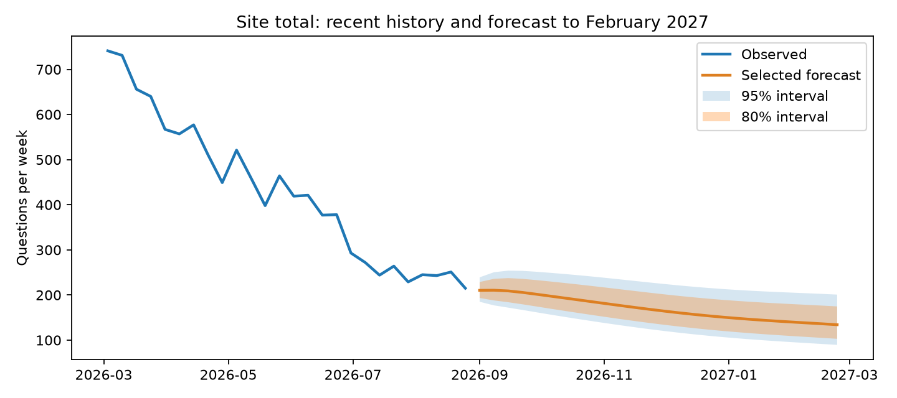
ADHIKKESH / MEMBER 5
Forecasts extend to February 2027; uncertainty remains
SITE TOTAL
SARIMAX
215 → 134 per week
-37.6% at week 26
26 weeks: September 1, 2026
to February 23, 2027
Steep decline: docker, excel, fastapi, javascript, pandas, reactjs
Declining: android, java, python, r, sql
Zero baseline: openai-api, powerbi — percentage change undefined.
Thresholds: < −40% steep decline; −40% to −10% declining; > −10% stabilising.
STACK OVERFLOW IN THE AI ERA / REVIEW 2
2
Notes:
The final model selected from validation is refitted on all 400 weeks. The forecast runs through February 2027, with eighty and ninety-five percent intervals. The point forecast is the back-transformed median. We classify tag changes by fixed thresholds; a zero initial count cannot support a percentage change. Forecasts are integrated with Akshay’s structural-break ITS findings, confirming significant post-AI slope declines across all 14 series (mean -2.3%/wk). Emerging AI/data tooling gained relative share while legacy stacks declined. These are uncertain projections and their association with AI adoption does not establish cause.

