Slide 1
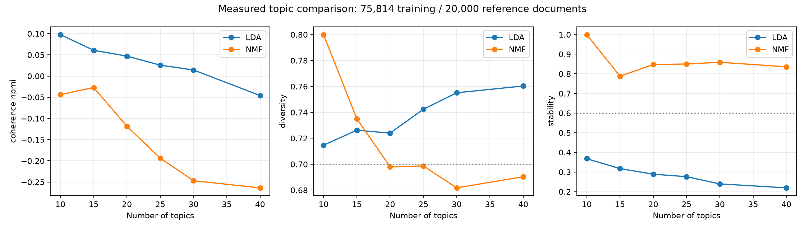
NISHANTH / MEMBER 4 — CORRECTED REFERENCE
Measured topic comparison and selection
NMF k=15 selected by the written rule
Document NPMI -0.0270 | diversity 0.735 | stability 0.788
Same training IDs and vocabulary; 3 seeds. Document NPMI differs from sliding-window c_npmi. Names are automatic; no human agreement claimed.
STACK OVERFLOW IN THE AI ERA / REVIEW 2
1
Notes:
This reference replaces the superseded hardcoded grid. Read current per-seed results and protocol. Coherence is not accuracy.

Slide 2
NISHANTH / MEMBER 4 — CORRECTED REFERENCE
Observed topic share changes
T8: Arrays and object manipulation
-1.80 pp; 95% CI [-1.96, -1.66] pp
T13: Collections and programming operations
-1.66 pp; 95% CI [-1.83, -1.49] pp
T12: Docker containers and images
+1.28 pp; 95% CI [+1.13, +1.43] pp
T9: Android development and builds
+1.06 pp; 95% CI [+0.88, +1.23] pp
Weighted question bootstrap: 1,000 resamples. Pre/post excludes transition. Changes do not demonstrate AI substitution, difficulty or causality.
STACK OVERFLOW IN THE AI ERA / REVIEW 2
2
Notes:
Topic names are automatic descriptions from this fitted model. Original topic IDs and human/AI labels are archived and cannot be transferred.

