Slide 1
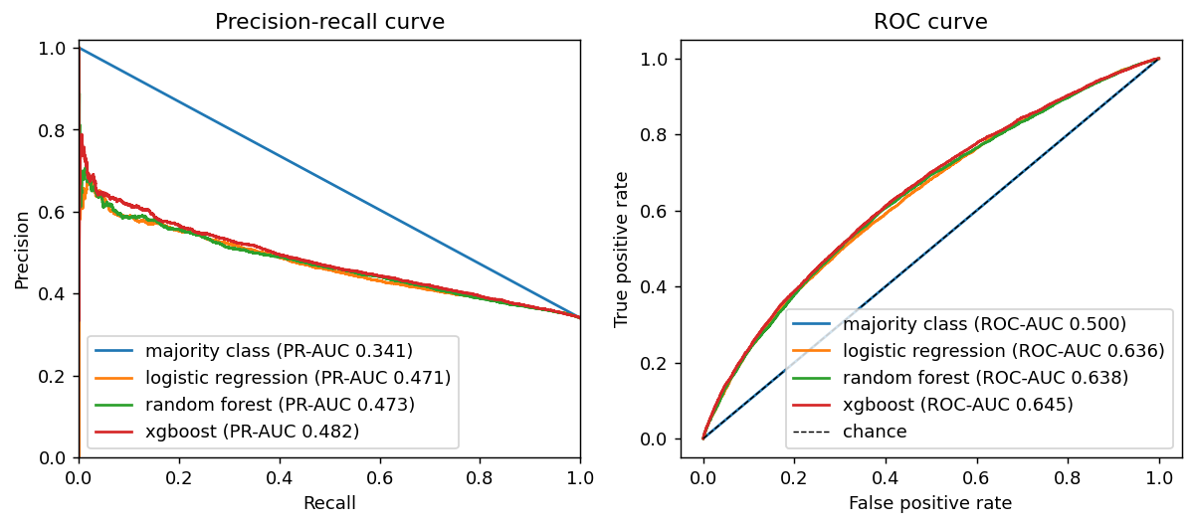
Xgboost is the best of four models: validation PR-AUC 0.48 against 0.34 for the majority-class baseline
Model | Precision | Recall | F1 | PR-AUC | ROC-AUC
Majority Class | 0.000 | 0.000 | 0.000 | 0.341 | 0.500
Logistic Regression | 0.389 | 0.808 | 0.525 | 0.471 | 0.636
Random Forest | 0.386 | 0.813 | 0.524 | 0.473 | 0.638
Xgboost | 0.400 | 0.782 | 0.529 | 0.482 | 0.645
Chosen by highest validation PR-AUC; decision threshold 0.37, tuned for F1 on validation only.
Feature gain (logistic regression): title text features change F1 by +0.007 and PR-AUC by +0.027.
Tuned by RandomizedSearchCV on time-series folds with a 7-day gap; training period only. XGBoost trees chosen by early stopping on validation (628 trees).
Validation period: Jan to Jun 2025. Metrics treat 'resolved within 7 days' as the positive class.
Notes:
We compared four models on the validation period (Jan to Jun 2025) with the same metrics. The majority-class baseline has no skill. Logistic regression is the interpretable baseline; Random Forest and XGBoost are the advanced models, tuned with time-series folds inside the training period only. We pick on PR-AUC because it is threshold-free and sensitive to class balance, then tune the decision threshold on validation only. Adding title text features changes logistic-regression PR-AUC from 0.444 to 0.471. The test period has not been touched at this point.

Slide 2
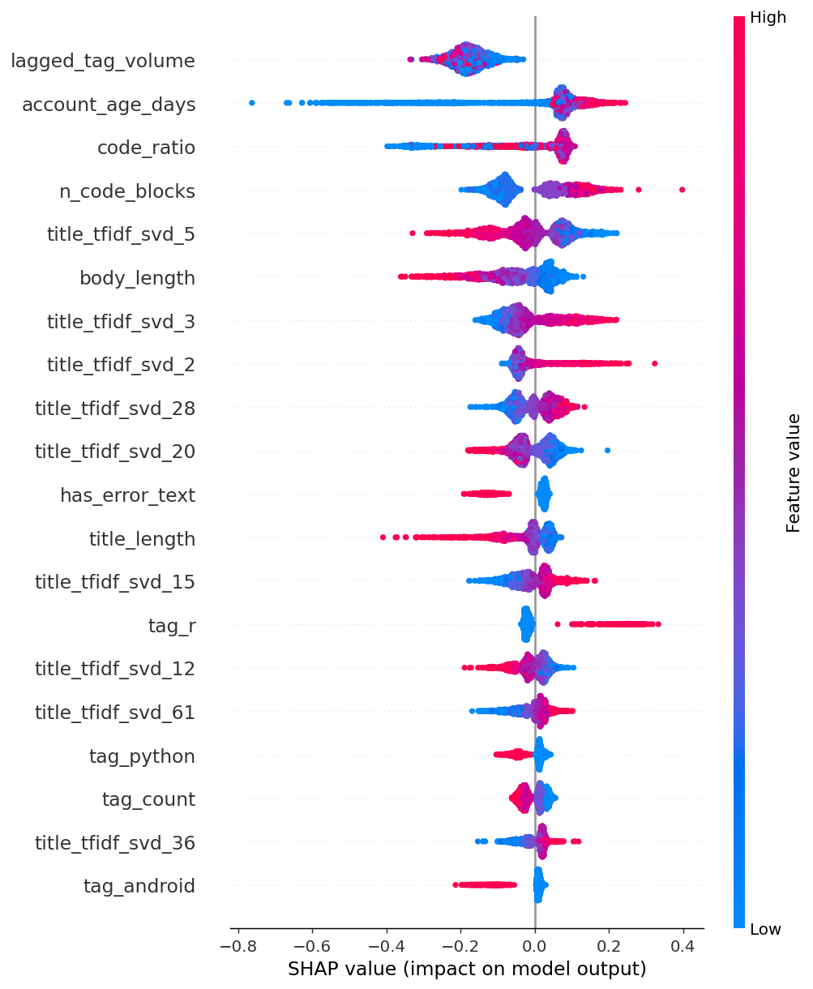
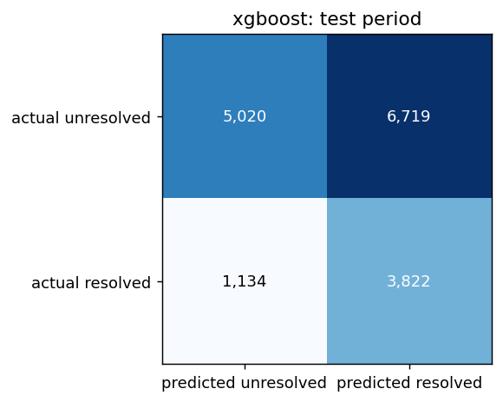
On the untouched test period the model reaches PR-AUC 0.43; tag volume in the previous 4 weeks and asker account age drive its predictions
Test metric | Value
Questions | 16,695
Precision | 0.363
Recall | 0.771
F1 | 0.493
PR-AUC | 0.431
ROC-AUC | 0.655
What the model relies on:
tag volume in the previous 4 weeks: higher value → less likely resolved
asker account age: higher value → more likely resolved
share of code in the body: higher value → more likely resolved
number of code blocks: higher value → more likely resolved
title wording (component 5): higher value → less likely resolved
Test period used once, after all tuning. SHAP computed on a random sample of test questions.
Notes:
The test period (Jul 2025 to Jul 2026, 16,695 questions) was evaluated exactly once, after the model, hyperparameters and threshold were fixed on earlier data. Precision 0.36, recall 0.77, F1 0.49, PR-AUC 0.43, ROC-AUC 0.65. SHAP shows which features move the predicted probability of resolution; each is explained in plain words on the slide.

Slide 3
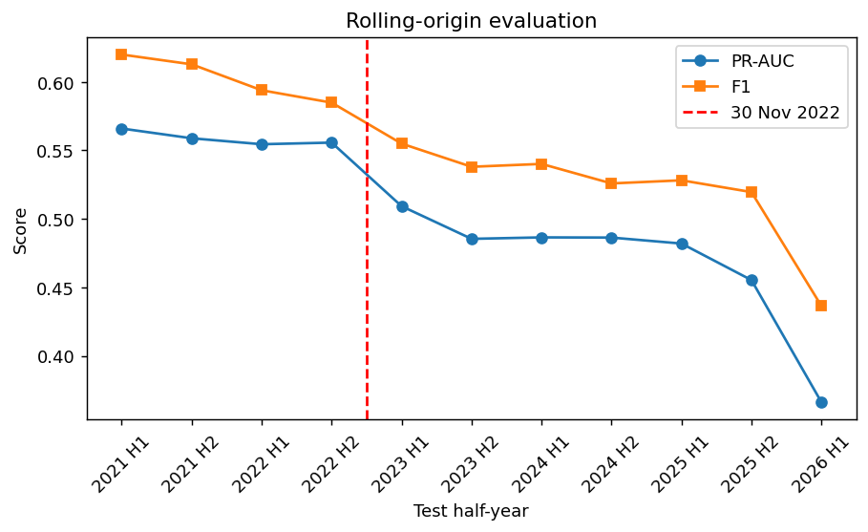
Flagging the 20% of questions with the lowest predicted resolution catches 24% of unresolved questions (1.2x random)
24%
of unresolved questions are in the lowest-scored 20% (random flagging: 20%)
Act on it: route flagged questions to experts, or prompt askers to add code or error text before posting.
Limits: accepted answer within 7 days is a proxy for resolved (it depends on the asker returning); recent data is smaller than the sampled early years.
Wording: results are associated with, not caused by, changes after November 2022.
Mean PR-AUC is 0.56 before and 0.47 after November 2022, lower after the break.
Secondary target (any answer in 7 days): PR-AUC 0.83 vs 0.43 for the main target.
Rolling-origin: train on all data before each half-year, test on that half-year, 2021 H1 to 2026 H1.
Notes:
Rolling-origin evaluation trains on everything before each half-year and tests on that half-year, from 2021 H1 to 2026 H1, so we can compare before and after November 2022, which the single test period cannot show. Mean PR-AUC is 0.56 before and 0.47 after November 2022, lower after the break. Business use: a forum manager who can only act on 20% of questions flags the lowest-scoring ones and routes them to experts, or prompts askers to add code or error text before posting. Limits: acceptance is a strict proxy for resolved because it depends on the asker returning; the secondary target (any answer within 7 days) gives PR-AUC 0.83; recent data is smaller than the sampled early years. We say 'associated with', not 'caused by'.

