Slide 1
Human Activity Recognition from Videos: - Minor Project Update 1
Date: - 1st April 2024
Abhinav Mahajan IMT2020553
Agastya Thoppur IMT2020528

Slide 2
Problem Statement: -
“Human Activity Recognition from Videos”
Understanding semantic knowledge from images and videos invokes the usage of Computer Vision techniques, and this problem can be thought of as an augmentation of Object Detection from Images, except there would be a temporal dimension in videos, and Human activity recognition involves higher order semantic understanding.
Our starting point would be the following paper: “DCapsNet: Deep capsule network for human activity and gait recognition with smartphone sensors” [1].
Over the course of the project, we would go through an extensive literature survey, identify the fallacies and shortcomings of the forerunning projects by conducting experiments and adding our contributions from the inferences made.

Slide 3
Problem Motivation: -
There has been a definite plateau in Computer Vision when it comes to static Images, as we have achieved a point where for every niche task, we have models for it. Be it detection, segmentation or for generative purposes. However, for Videos, we are lagging behind. Human activity analysis is one such example, where this problem cannot be solved by a single frame(Image) but the underlying temporal relations have to be accounted for as well.
Human Activity Recognition is imperative in many applications such as AI virtual instructors (rehabilitation instructors, gym instructors etc.). In fact, this was our project once (we implemented the work done by Ziyi Zhao et al [6])!
Other use cases involve: enhancing Surveillance Systems, Healthcare Monitoring, Behaviour Analysis and Understanding and Assistive Technologies for benefiting individuals with disabilities or elderly populations by providing context-aware assistance.

Slide 4
Literature Survey: -
Our starting point was the work done by Ahmadreza Sezavar et al. [1]. However, since we don’t have the ScienceDirect membership and there are no pre-prints available anywhere else, we identified the dataset they are working on and the methodologies and found the closest match: “Human Activity Recognition Based on a Modified Capsule Network” [2]. As this works on the same dataset (UCI-HAR) and uses Capsule networks as well.
To extend our understanding, we also read the following survey papers on Human Activity Recognition: -
“Video-based Human Action Recognition using Deep Learning: A Review” [7]
“Deep Learning in Human Activity Recognition with Wearable Sensors: A Review on Advances” [8]

Slide 5
Literature Survey: -
These survey papers act as treasure trove of information, as it summarizes the work done by 100-200 projects along with their inferences and what scope there is left to improve on and what papers have pushed the needle.
In our exploration, we further stumbled upon the following research papers: -
“Virtual Fusion with Contrastive Learning for Single Sensor-based Activity Recognition” CVPR 2024’ [4]
“BCL: A Branched CNN-LSTM Architecture for Human Activity Recognition Using Smartphone Sensors” [3]
“Human activity recognition from sensor data using spatial attention-aided CNN with genetic algorithm” [5]
We will summarize our inferences through the course of the presentation. But a very blatant observation was that state of the art models have achieved 97% Accuracy and F1 scores on the UCI-HAR dataset, so the scope of improvement is not much, however, we have a few experiments in mind to see if we can even slightly improve it.

Slide 6
Dataset Analysis (UCI-HAR): -
The dataset chosen by us is extremely apt, as this is not a conventional Video dataset, but instead it is a dataset of various signals (and not the videos themselves) worn by subjects while making the dataset. The advantage is that we tremendously reduce the size of the dataset, and our corresponding models will also be smaller. This is pivotal for us students, as we do not have access to big storage Computing resources as well as high end GPUs and is ideal for running these small models and dataset locally or on google colab/Kaggle cloud servers.
Each entry in the dataset corresponds to one of six labels. Each label represents one of the following actions: Walking, Walking Upstairs, Walking downstairs, Sitting, Standing and Laying down.
The raw UCI-HAR dataset consists of 561 features. After referring to some of the solutions presented by the papers mentioned below and conducting some preliminary data analysis, we came to the conclusion that only nine of these features are essential for accurate activity recognition (Acceleration measured by accelerometer in all three directions, body acceleration signal in all three directions, angular velocity measured by gyroscope in all three directions).

Slide 7
Experiments: -
Our first step would be to run and validate our baseline: “Human Activity Recognition Based on a Modified Capsule Network”[2]. To make sure it runs and whether the numbers reported by them are correct or not (95% accuracy on UCI-HAR dataset).
The above step is important as Capsule networks are relatively underused in literature and have a slightly different methodology than other Deep Learning methods, as they try to establish a hierarchy, make dynamic routes etc.
Interestingly, Capsule Networks were introduced in 2011, and the idea came from none other than Geoffrey E. Hinton, the father of Computer Vision. And only in 2017, was he able to actually implement it! (“Dynamic Routing Between Capsules” [9])
We have familiarised ourselves with how Capsule networks work, and the following links were extremely helpful: -
“Capsule Networks (CapsNets) – Tutorial” : YouTube tutorial
“A Deep Dive into Capsule Networks” : medium article
“Dynamic Routing Between Capsules” [9]

Slide 8
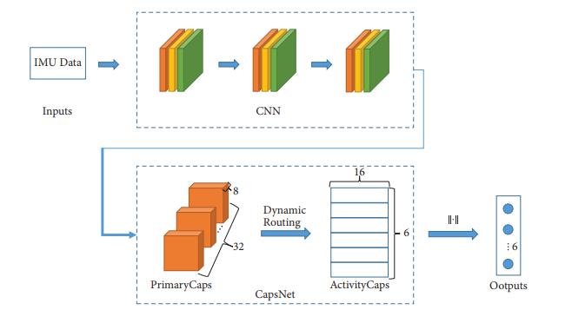
Experiments: -
Once we validate our findings, we will experiment with different models we have come across in our literature survey.
The model used by our baseline “Human Activity Recognition Based on a Modified Capsule Network”[2], is simple and looks like: -
Not to be confused with 2D conv nets, we are using 1D conv nets as we are working on a time varying signal, and not on the spatial domain.

Slide 9
Experiments: -
Capsule networks are harder to train, as the dynamic routing algorithm is slower but at the same time its shown to give good performance on classifying tasks, and additionally, its been observed that capsules can be explainable and the embedding space represent abstract quantities which is a HUGE thing, as explainability in neural networks is still a open problem.
To compare the performance of Capsule Networks, we would use the ideas of branch CNN-LSTM networks as in “BCL: A Branched CNN-LSTM Architecture for Human Activity Recognition Using Smartphone Sensors”[4], try Contrastive Unsupervised learning techniques such as “Virtual Fusion with Contrastive Learning for Single Sensor-based Activity Recognition”[3] and further experiment with appropriate feature selection techniques like “Human activity recognition from sensor data using spatial attention-aided CNN with genetic algorithm”[5].
Furthermore, since Capsule networks are also representing embedding space, an autoencoder structure can be implemented as well, by adding a decoder to the model, and weighting the reconstruction loss to the classification loss. This promotes learning global features and prevents overfitting as the model has to retain all necessary information to reconstruct the input.

Slide 10
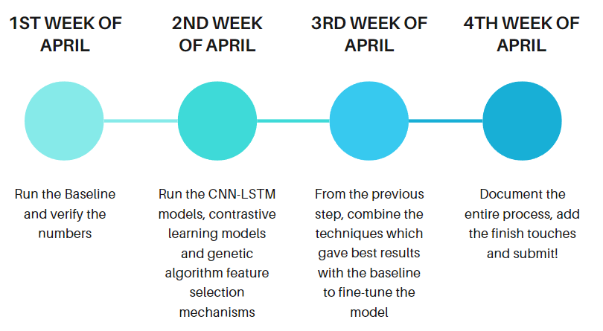
Approximate Timeline: -
1
2
3
4

Slide 11
Bibliography: -
[1] “DCapsNet: Deep capsule network for human activity and gait recognition with smartphone sensors”
[2] “Human Activity Recognition Based on a Modified Capsule Network”
[3] “BCL: A Branched CNN-LSTM Architecture for Human Activity Recognition Using Smartphone Sensors”
[4] “Virtual Fusion with Contrastive Learning for Single Sensor-based Activity Recognition”
[5] “Human activity recognition from sensor data using spatial attention-aided CNN with genetic algorithm”
[6] “3D Pose Based Feedback For Physical Exercises”
[7] “Video-based Human Action Recognition using Deep Learning: A Review”
[8] “Deep Learning in Human Activity Recognition with Wearable Sensors: A Review on Advances”
[9] “Dynamic Routing Between Capsules”

Slide 12

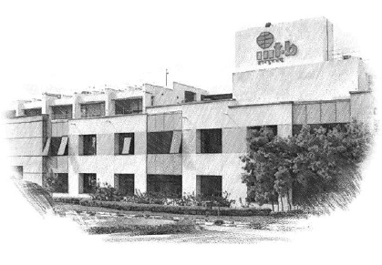






International Institute of Information Technology Bangalore
26/C, Electronics City, Hosur Road,
Bengaluru – 560 100, Karnataka, India
www.iiitb.ac.in
https://www.facebook.com/IIITBofficial/
https://twitter.com/IIITB_official
https://www.linkedin.com/school/iiit-bangalore/
https://www.youtube.com/user/iiitbmedia
https://www.instagram.com/iiitb_official/

