Slide 1
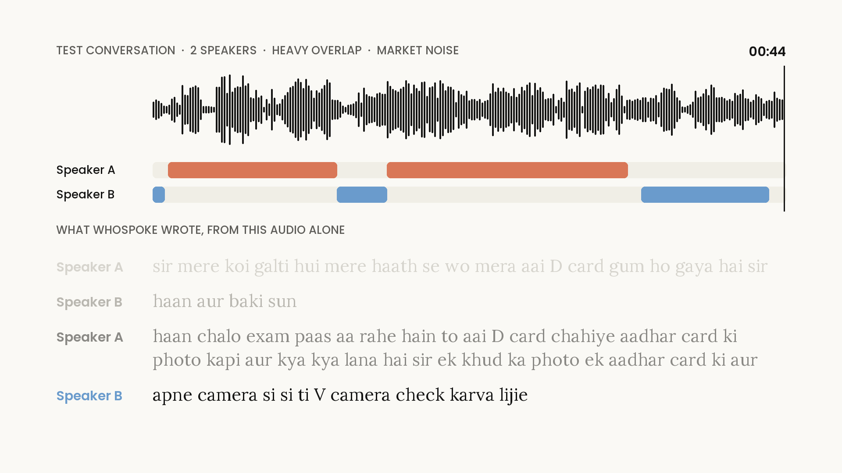
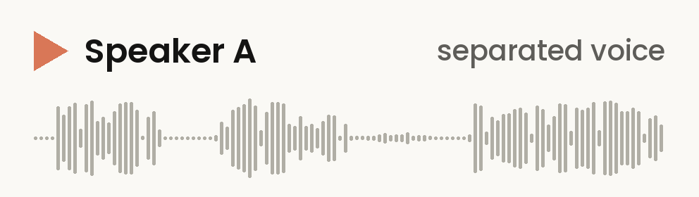
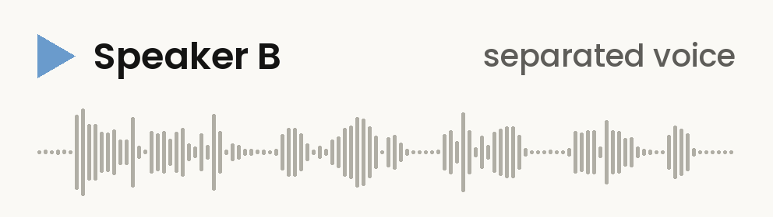
TEAM vismAI / CS F407
Separated voices and speaker timelines
Simulated test conversation: real Hindi speech, two speakers, heavy overlap and 5 dB market noise.
M1 Separation / Vismay
M2 Diarization / Darshan
1 Mixed recording
Actual timeline.json output (excerpt)
Start (s) | End (s) | Speaker
26.85 | 31.75 | Speaker_A
31.75 | 33.20 | Speaker_B
33.20 | 40.20 | Speaker_A
26.4–44.8 s
Original mixture
Click to play
2 Speaker A
3 Speaker B
20.3% DER
Spectral clustering, 72 test conversations
GMM: 20.3% / pyannote 3.1: 18.4%
+9.6 dB SI-SDR improvement on 245 test overlap regions
whospoke 1 / 3
Notes:
Slide 1 — Vismay: opening and separation
[DO NOT READ ALOUD: Start on slide 1.]
Good morning. We are team vismAI. Our project, whospoke, identifies who spoke what and when in noisy Hindi–English conversations.
This simulated test conversation combines real Hindi speech, overlapping voices and market noise.
I handled Milestone One, separation. First, the mixed recording. Then, the two separated voices from an overlapping stretch within it.
[DO NOT READ ALOUD: Play Mixed recording first, about 18 seconds. Then play Speaker A and Speaker B, about 7.5 seconds each. If PC audio fails, read the fallback sentence below, then play the downloaded clips from YOUR OWN phone. Keep slide 1 visible. Do not replay a clip that already worked. Return here after playback. If both playback methods fail, continue immediately.]
[DO NOT READ ALOUD: Say the following sentence ONLY if switching to phone audio.]
We'll play the same clips from the phone.
[DO NOT READ ALOUD: RESUME HERE after playback.]
Separation improves S-I-S-D-R by nine point six decibels across two hundred and forty-five test overlap regions. Darshan will explain the speaker timeline.
Slide 1 — Darshan: your M2 output
I handled Milestone Two: who spoke when. This actual timeline labels Speaker A, then B, then A again, with start and end times.
We detect speech, extract short-window voice embeddings, and cluster similar embeddings into speaker groups. The labels are anonymous.
Our spectral configuration has twenty point three percent diarization error. The pyannote baseline gets eighteen point four; we do not beat it.
Our design decision was to diarize first, then separate detected overlaps. The next slide shows the difference.
[DO NOT READ ALOUD: Advance to slide 2. Vismay speaks next.]
Sources: see DATA_AND_SOURCES.md in docs/presentation/2026-10-16. Project evidence from commit 8465f0b.

Slide 2
TEAM vismAI / CS F407
What the system actually transcribes
M3 / Abhinav IndicConformer speech recognition, Hinglish text and subtitle files
SAVED HINGLISH TRANSCRIPT
21.0% word error
00:27–00:32 Speaker_A
IndicWav2Vec: 38.0%
400 Vaani clips, single-speaker ASR
sir mere koi galti hui mere haath se wo mera aai D card gum ho gaya hai sir
FULL PIPELINE / 72 CONVERSATIONS
00:32–00:33 Speaker_B
haan aur baki sun
Order | cpWER
A: separate first | 55.8%
B: diarize first | 49.5%
00:51–00:54 Speaker_A
to ab kab tak kitne baje tak office khula hai sir apna
B wins in 50 of 72 conversations.
cpWER measures words and speaker attribution. Lower is better.
Devanagari + Hinglish + SRT + JSON
whospoke 2 / 3
Notes:
Slide 2 — Vismay: transcript output
Abhinav handled Milestone Three. These saved Hinglish lines retain speakers and timestamps. We also output Devanagari and subtitles.
For speech recognition alone, IndicConformer gets twenty-one percent word error on four hundred Vaani clips, compared with thirty-eight percent for IndicWav2Vec.
Darshan will explain the full-pipeline comparison on the right.
Slide 2 — Darshan: the main result
We tested both orders on the same seventy-two simulated conversations, about eighty-three minutes across eight speaker groups.
Our metric, C-P-W-E-R, measures word errors and speaker attribution errors. Lower is better.
Separating first gives fifty-five point eight percent. Diarizing first gives forty-nine point five, and wins in fifty of the seventy-two conversations.
The order matters. We implemented both and chose using measured outputs. Errors remain substantial; the problem is not solved.
[DO NOT READ ALOUD: Advance to slide 3. Vismay speaks next.]
Sources: see DATA_AND_SOURCES.md in docs/presentation/2026-10-16. Project evidence from commit 8465f0b.

Slide 3
TEAM vismAI / CS F407
The report output, and what remains
M4 / Shrivaths Airavata 7B, quantised to 4 bits and run locally
ACTUAL REPORT EXCERPTS
Measured limits
Key point
Transcript repair adds 0.9 cpWER points
(paired mean across 63 conversations).
No accepted action items in 252 reports.
“Speaker A lost his ID card”
Line 13 / Speaker_A / 00:51–00:54
Next steps
“The office is open until what time?”
Improve Hindi speaker embeddings.
Evaluate a larger LLM for action items.
Retrain separation on Indian voices and noise.
Produces a summary, keywords and translated dialogue. Speakers and times pass through unchanged.
These are planned extensions, not measured results.
whospoke 3 / 3
Notes:
Slide 3 — Vismay: report output and its limits
Shrivaths handled Milestone Four. Airavata produces summaries, keywords and translated dialogue. These saved excerpts concern a lost ID card and office hours.
Speaker labels and times stay unchanged. But transcript repair adds zero point nine C-P-W-E-R points on average across sixty-three conversations. No accepted action items remain in the two hundred and fifty-two evaluated reports.
So the original transcript remains the record, and the report needs checking.
Slide 3 — Darshan: closing
Our next steps are to improve Hindi speaker embeddings, evaluate a larger language model for action items, and retrain separation on Indian voices and noise.
These are proposed experiments. Today we have shown every stage's output, the measured benefit of changing the order, and the remaining limitations. Thank you.
[DO NOT READ ALOUD: End. Vismay answers M1 questions, Darshan M2, Abhinav M3 and Shrivaths M4.]
Sources: see DATA_AND_SOURCES.md in docs/presentation/2026-10-16. Project evidence from commit 8465f0b.

