Slide 1

SMART INDIA HACKATHON 2026
MANTLE
Well-to-Surface Digital Twin for CSS + SRP Heavy-Oil Wells
Problem Statement ID – SIH26120
Problem Statement Title – Digital Twin for Well-to-Surface Optimization of Cyclic Steam Stimulation (CSS) and Sucker Rod Pump (SRP) Operations for Heavy Oil Wells of Baghewala Field
Theme – Smart Automation
PS Category – Software
Team ID – [from SIH portal]
Team Name (Registered on portal) – [team name]

Slide 2
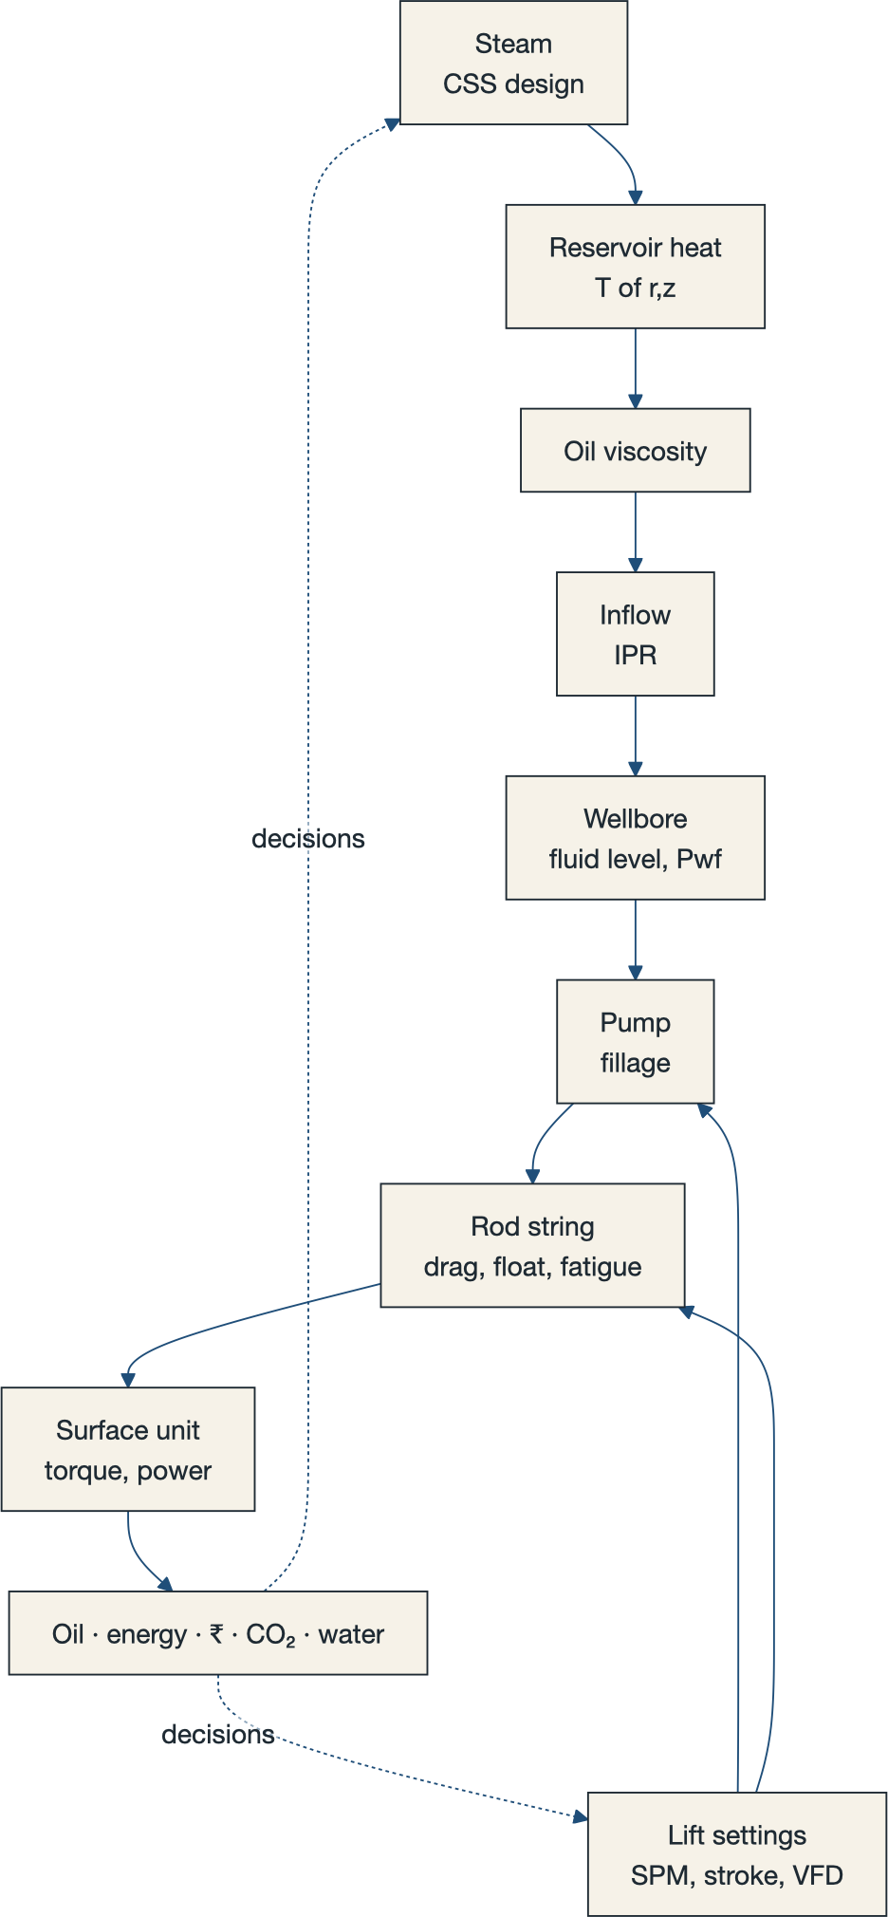
IDEA TITLE — MANTLE
TEAM
MANTLE
MANTLE a flight simulator and autopilot for a heavy-oil well — steam and lift decided as one.
WHAT IT IS
• One live physics twin of the whole chain — steam → reservoir heat T(r,z) → viscosity → inflow → pump → 1.1-km rod string → oil · energy · ₹ · CO₂ — synced to telemetry by an EnKF (P10–P90 on every forecast).
• Joint optimizer screens ~5,000 CSS + SRP plans → full-physics verify → deterministic Safety Gate vetoes unsafe plans → recommended schedule with its drivers named.
HOW IT ANSWERS THE PS
• Kills the statement's core flaw — “optimized separately”: steam + lift become ONE decision; the Coupling Dividend (Vjoint − Vseq, ₹ + bbl, Shapley) prices what silos lose.
• Predicts heating / cooling / production; re-plans SPM · stroke · VFD as viscosity climbs; float margin + wave-equation impact + dynocard classifier catch failures early.
WHAT'S NEW
• Physics-rendered 3D twin ⇄ living Blueprint · Stroke Shaper in-stroke VFD profiling · Strategy Arena vs 8 baselines + oracle · hash-chained decision ledger · provenance on every number.
The coupled chain — the steam plan sets the viscosity path; viscosity sets the safe pumping envelope.

Slide 3
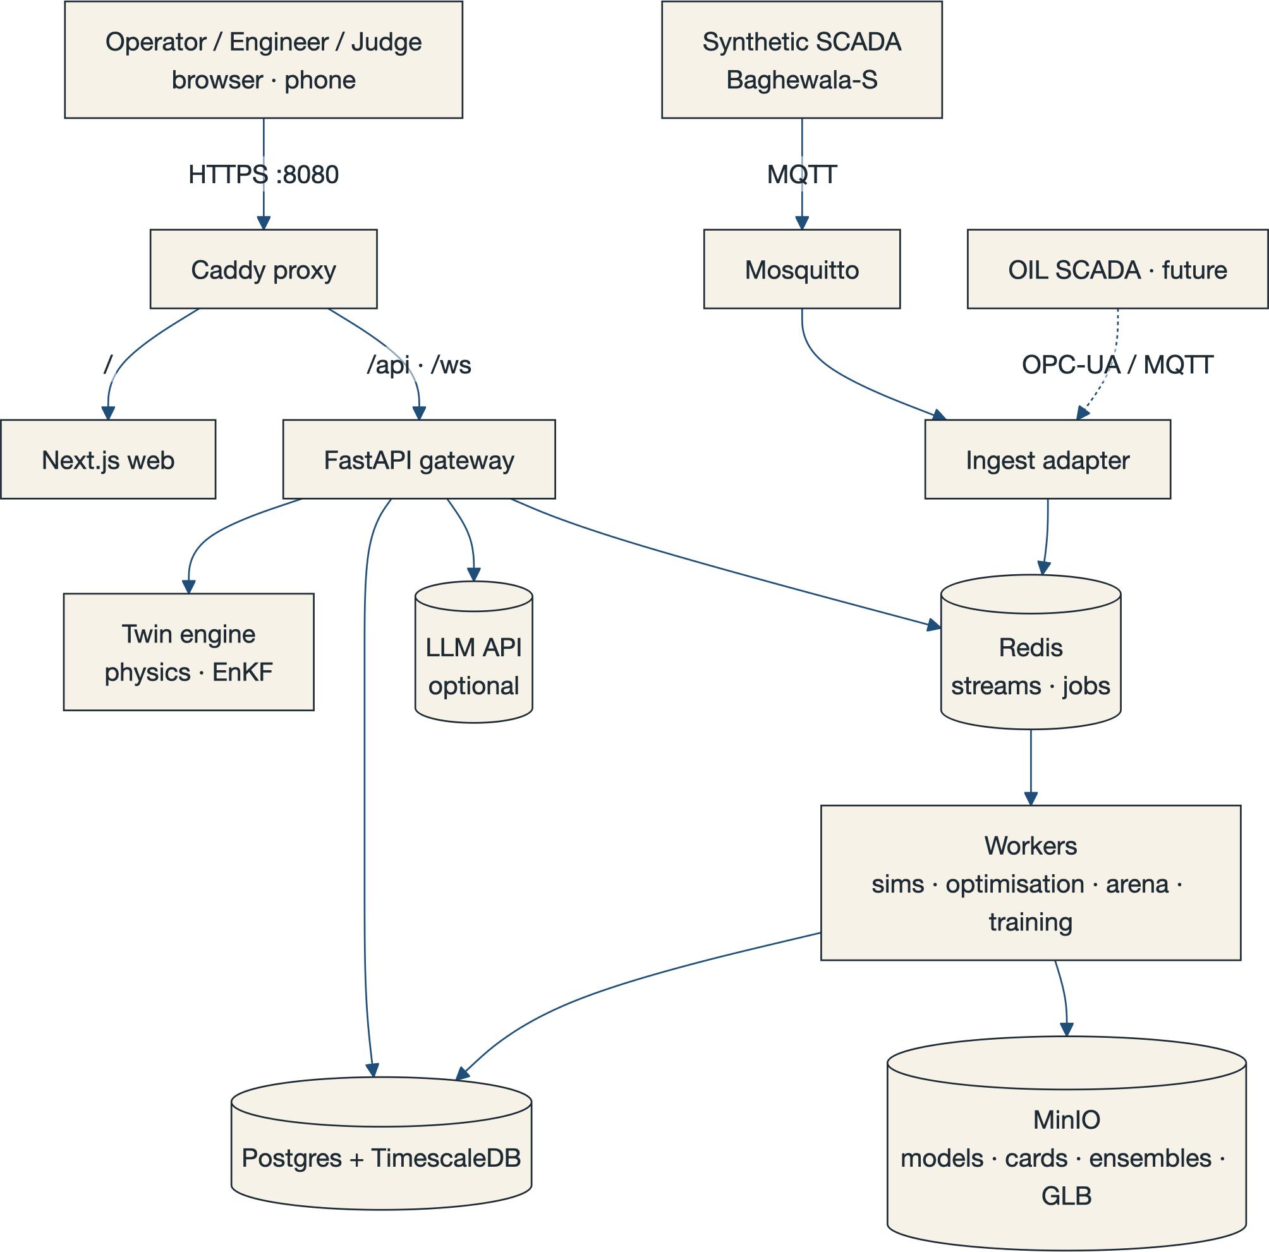
TECHNICAL APPROACH
TEAM
MANTLE
FRONTEND
Next.js + React + TypeScript · React Three Fiber / Three.js 3D twin · D3 / visx charts · GSAP
ENGINE — PYTHON (uv)
FastAPI · NumPy / SciPy / Numba physics · LightGBM + 1D-CNN dynocard classifier · custom EnKF · pymoo NSGA-III · OR-Tools CP-SAT · Stable-Baselines3 PPO
PLATFORM
PostgreSQL + TimescaleDB · Redis streams · MinIO · Mosquitto MQTT (OPC-UA ready) · Caddy · Docker Compose — one command, fully offline
METHOD — ONE CLOSED LOOP, EVERY CYCLE
Telemetry
MQTT
Data-quality
audit
EnKF twin
P10–P90
Forecast
fan
NSGA-III
~5k plans
Physics +
Safety Gate
Schedule →
ledger score
ENGINEERING RIGOUR
• All physics from published standards — IAPWS-IF97, Ramey / Willhite, Marx–Langenheim + r–z thermal grid, Walther / ASTM D341, Boberg–Lantz, Gibbs wave equation, API RP 11L, Modified Goodman — each unit-tested against its worked example.
PROTOTYPE PROOF
• Strategy Arena races 9 strategies — static, tuned, heuristic, pump-off, greedy, sequential-silo, shielded RL, Mantle joint MPC, oracle bound — on identical simulated wells with paired confidence intervals.
System context — synthetic SCADA today; OIL SCADA via the same MQTT / OPC-UA path.

Slide 4
FEASIBILITY AND VIABILITY
TEAM
MANTLE
NO RESEARCH RISK
Every model is a published standard or paper; open-source stack; runs fully offline on one laptop — docker compose up.
NO PUBLIC WELL DATA
So we built Baghewala-S: a physics-synthetic field (30 wells × 3 yrs, noise, faults, failures) calibrated to OIL anchors — 17–19° API · 46–48 °C · ~10–13 kcP · 14–21 d steam.
REAL-DATA READY
Canonical schema maps 1:1 to the PS's 7 data categories; MQTT / OPC-UA / CSV adapters need no code change; EnKF is the calibration path; anomaly pipeline validated on real Petrobras 3W data.
CHALLENGES → HOW WE BEAT THEM
RISK / CHALLENGE | MITIGATION
Venue machine can't run the 3D twin | Own laptop · auto-quality ladder · pre-rendered transition video · whole demo runs offline
Judges challenge synthetic data | SIM tag on every number · source + assumption registries · Petrobras 3W real-data validation · never sold as field results
Physics too slow for a live demo | Surrogates pre-screen, full physics verifies · pre-computed official Arena run + < 30 s live mini-run
Scope sprawl / nothing polished | 13 phases, each with a demoable exit · main always green · golden-scenario tests
RL contender underperforms | RL is only a benchmarked Arena contender — the MPC core never depends on it; the Arena reports either result honestly

Slide 5
IMPACT AND BENEFITS
TEAM
MANTLE
TARGET AUDIENCE Oil India production engineers & field managers on Baghewala CSS + SRP wells — and, at fleet scale, India's domestic heavy-oil output (India imports most of its crude).
ECONOMIC
• ↑ oil recovered per cycle & per 180 d
• Coupling Dividend — measurable ₹/cycle from joint optimization
• ↓ lifting cost ₹/bbl (steam + power + water + maintenance)
• fewer rod failures, unsettings, workovers, deferred oil
• longer equipment life (tracked Goodman fatigue)
• field scheduler sends scarce steam-days to highest-value wells
ENVIRONMENTAL
• ↓ SOR → less fuel gas burned per barrel
• ↓ CO₂e/bbl (IPCC + CEA emission factors)
• ↓ fresh water/bbl — the scarcest resource in the Thar
• solar-thermal steam hybrid (Rajasthan DNI) option
• fewer workovers → less diesel, less waste
SOCIAL
• fewer high-risk states → fewer emergency interventions
• fewer unplanned site visits in 45–48 °C heat (heat-stress exposure)
• senior operators' judgement captured as institutional memory
• Challenge mode = safe training sim for young engineers
• every decision auditable → field–office trust
METHOD every figure is Mantle-vs-baseline on identical simulated wells (Baghewala-S, N seeds, mean ± sd), tagged SIM — never presented as field results.

Slide 6
RESEARCH AND REFERENCES
TEAM
MANTLE
FIELD & PROBLEM
• SIH 2026 Problem Statement SIH26120 (Oil India Limited)
• Oil India — Rajasthan Fields (Baghewala viscosity, CSS durations, VIT, completions)
• ACT SHARP consortium D4.1 (2022) — Baghewala geological characterization
• SPE papers on Baghewala CSS (e.g. APOG 2023)
PHYSICS — FROM PRIMARY SOURCES
• Marx & Langenheim (1959) reservoir heating · Boberg & Lantz (1966) stimulated productivity · Ramey (1962) + Willhite (1967) wellbore heat · Vogel (1968) inflow
• Gibbs (1963) rod-pump wave equation · Everitt & Jennings (1992) downhole cards · API RP 11L / Spec 11E / RP 11BR · ASTM D341 · IAPWS-IF97
ESTIMATION, ML & OPTIMIZATION
• Evensen (2009) Ensemble Kalman Filter · Deb et al. (2002) NSGA-II · Angelopoulos & Bates (2021) conformal prediction · Lundberg & Lee (2017) SHAP
• Hansen et al. (2018) model-predictive sucker-rod-pump control (BYU-PRISM)
DATA & STANDARDS
• Vargas et al. (2019) — Petrobras 3W dataset (Apache-2.0): real well-event data validating the anomaly pipeline
• ISA-101 HMI · ISA-18.2 alarms · ISO 128 drawing · ISO/PAS 12835 thermal casing connections
• Prior-art review — 25 public SIH26120 repos surveyed (29 Sep 2026); MIT data reused only with attribution
SOURCE TRUTH every constant carries a tag — PUB (published) · SIM (simulated) · ASSUM (assumption registry) · EST (estimated) · MEAS (measured). Full bibliography + verification status: plan.md Appendix D.

