Slide 1

Voice assistant for user
Submitted in the partial fulfillment for the award of the degree of
BACHELOR OF ENGINEERING
IN
Computer Science(Cloud Computing)
Submitted by:
Group 6
Under the Supervision of:
Ms. Deeksha Kumari
Department of AIT-CSE
DISCOVER . LEARN . EMPOWER

Slide 2
Group Members
Name | UID
Shalin Dashora | 20BCS4079
Milind Pal Singh Tanwar | 20BCS4117
Abhinav Singh | 20BCS4126

Slide 3
Index
Introduction
Components required
Libraries or modules
Functional Requirements
Existing systems
Proposed system
Workflow
Workflow diagram
Results
Conclusion and future scope
References

Slide 4
Introduction
Need of changing times
Efficient
Number of advantages
Platform independent

Slide 5
Components required
Hardware Specification:
Requirement: PC/Laptop
Processor: Any (Intel core, AMD Ryzen, etc)
RAM: 2GB and above
Hard Disk Drive: 100 MB or more
Software Specification:
Operating System: Windows/Linux
Programming Language: Python
Software version: 3.9
IDE: VS Code

Slide 6
Libraries or Modules Involved
pyttsx3 :A python library which will help us to convert text to speech
speech_ recognition: Library for performing speech recognition, with support for several engines and APIs, online and offline.
wikipedia: To do Wikipedia searches, we need to install and import the Wikipedia module into our program.
import pyttsx3
import speech_recognition
import wikipedia

Slide 7
Functional requirements
Libraries or Modules Involved:-
webbrowser :The webbrowser module provides a high-level interface to allow displaying Web-based documents to users.
OS: The OS module in python provides functions for interacting with the operating system.
Datetime: The datetime module supplies classes for manipulating dates and times.
import webbrowser
import os
import datetime

Slide 8
Existing systems
Reference number | Algorithm | Advantages | Disadvantages | Parameters
1 | gTTS, Linux OS, Python | Linux user interface made more interactive. | OS limitation, weak AI, Requires Net connectivity every time | Speech segmentation/ Reorganisation
2 | gTTS, Playsound, ASR | Acoustic Modelling, Pronunciation Modelling, Language Modelling | Time consuming to recognize and playing the audio O/P, Requires Net connectivity every time | Working of ASR
3 | Voice technology, TTS engine | Modular nature, Platform independent, flexible | Cloud access required for speech recognition | Cloud, Backend, API calls
4 | Java library Sphinx-4, MaryTTS | Offline working modules | Profanity Filter absent | IPA

Slide 9
Proposed System
Speech to text
Text analyzing
OCR(Optical character recognition)
Pose estimation

Slide 10
Workflow
→The first and foremost thing is Speech Recognition process.
Digitize the user's speech into a machine-readable format;
Analyse the user's speech for meaning;
Based on past information and algorithms, determine what the user need.
→Initialization of pyttsx3 module and sapi5
→Python Backend

Slide 11
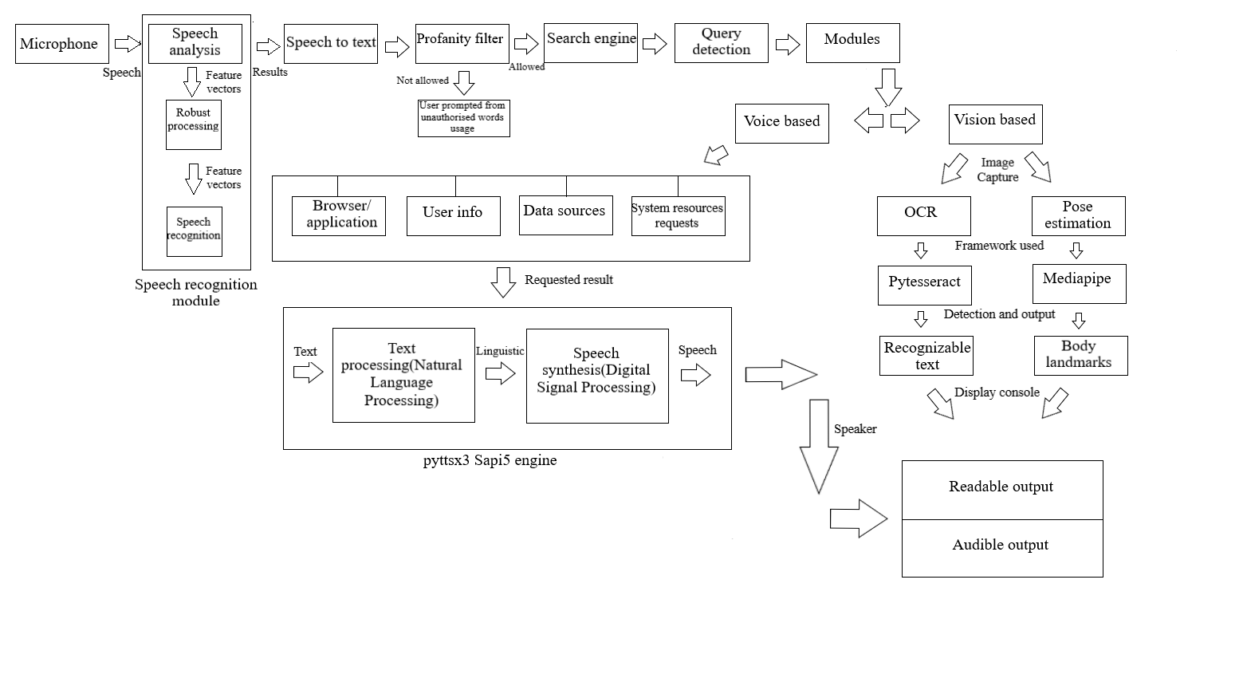
Workflow diagram

Slide 12

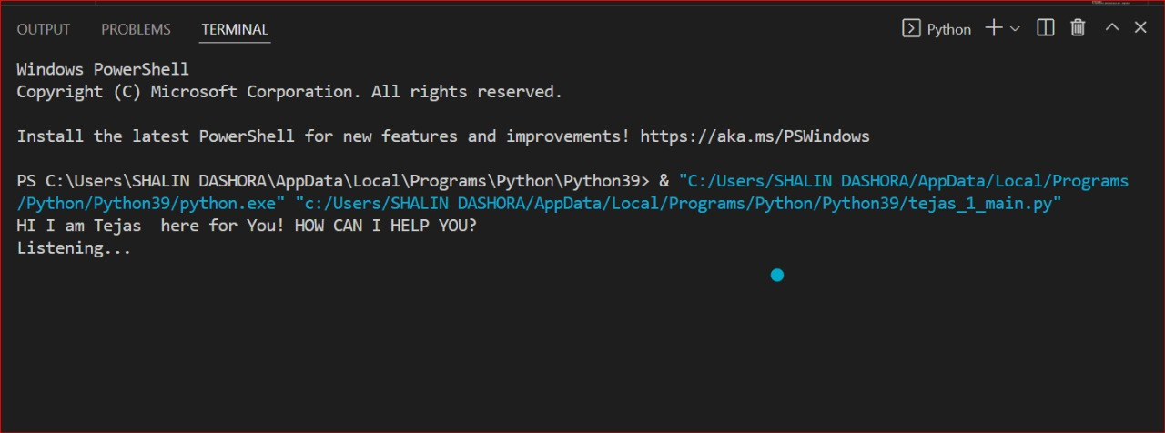
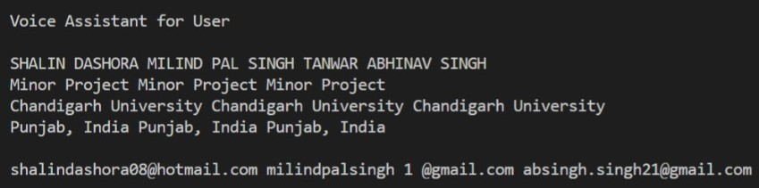
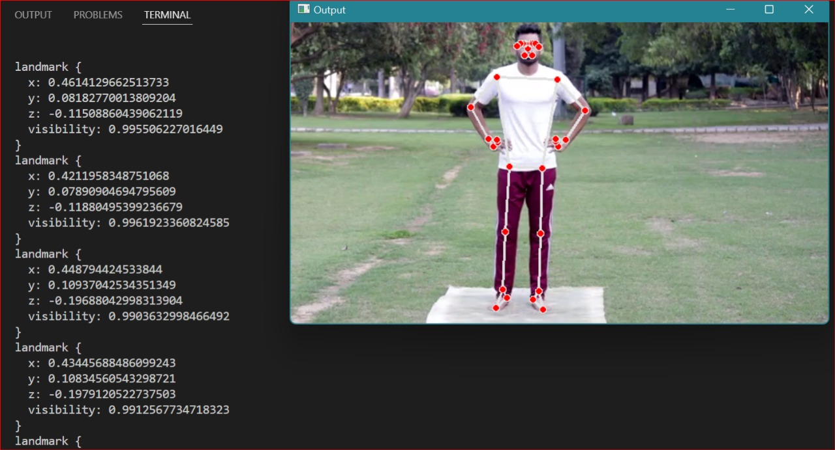
Results

Slide 13
Applications
Training Moves Into The Workflow
Mobile banking.
In Robotics
Control Home Appliances
Speech to Text
Speaker(Alexa)
Speech to search

Slide 14
Conclusion and future scope
Application of digital support
Adaptable and simple
Existing system faults covered
Personalization for a targeted area
IVR can seek customer’s eyes
Voice Cloning

Slide 15
References
Sangpal, R., Gawand, T., Vaykar, S., & Madhavi, N. (2019, July). JARVIS: An interpretation of AIML with integration of gTTS and Python. In 2019 2nd International Conference on Intelligent Computing, Instrumentation and Control Technologies (ICICICT) (Vol. 1, pp. 486-489). IEEE.
Subhash, S., Srivatsa, P. N., Siddesh, S., Ullas, A., & Santhosh, B. (2020, July). Artificial intelligence-based voice assistant. In 2020 Fourth World Conference on Smart Trends in Systems, Security and Sustainability (WorldS4) (pp. 593-596). IEEE.
AI Based Voice Assistant Using Python", International Journal of Emerging Technologies and Innovative Research (www.jetir.org | UGC and issn Approved), ISSN:2349-5162, Vol.6, Issue 2, page no. pp506-509, February-2019.
Pandey, A., Vashist, V., Tiwari, P., Sikka, S., & Makkar, P. (2020). Smart Voice Based Virtual Personal Assistants with Artificial Intelligence. Artificial & Computational Intelligence/Published Online: June.

Slide 16
Thank You

