Slide 1
Visual Re-Identification of Wildlife using MegaDescriptor.
Abhinav Ujjawal (2021120)
Abhishek Sushil (2021441)
Aditya Jain (2021511)

Slide 2
Problem statement
This project aims to explore and evaluate the performance of two MegaDescriptors (Swin image feature models), on wildlife datasets.
Specifically, we will replicate the results of recent papers in this domain by conducting inference using pre-trained models on one of the datasets used in the papers.
Additionally, we will design and execute an analysis experiment to assess the performance differences and types of errors between the two approaches using an alternative wildlife dataset.

Slide 3
Dataset
Training
Dataset Name: wildlife-datasets. It is a collection of 33 publicly available dataset each containing one or more animals.
Publication Year: 2024
Testing
Dataset Name: MPDD. MPDD is a dataset of various dog breeds with 1657 images of 192 dogs.
Publication Year: 2023

Slide 4
Class distribution
Dataset | Training and Testing set classes in dataset
MacaqueFaces | 34
FriesianCattle2015 | 94
LionData | 40

Slide 5
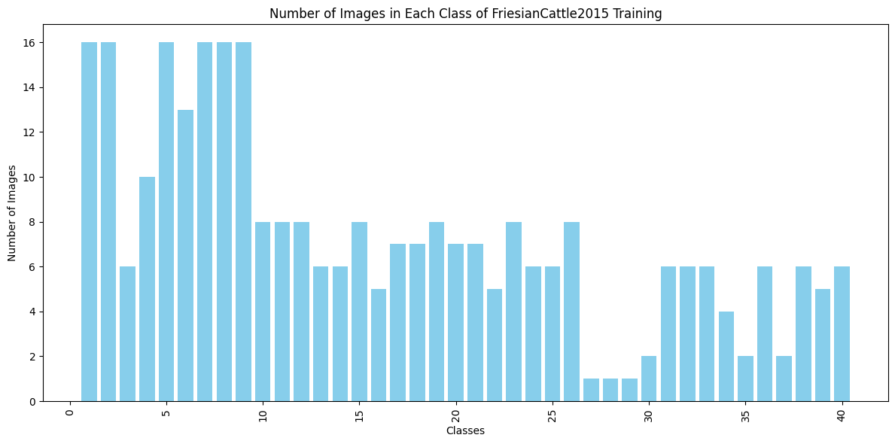
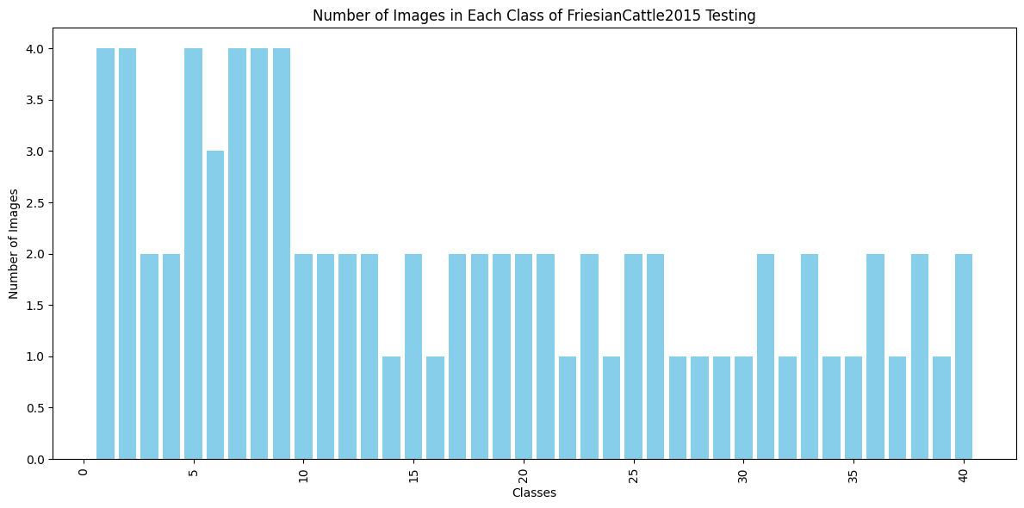
Dataset for FriesianCattle2015
297 images 80 images

Slide 6
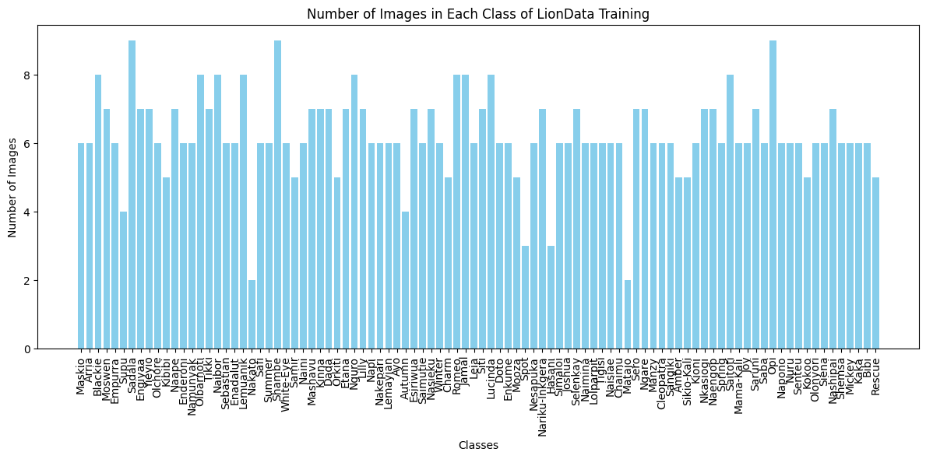
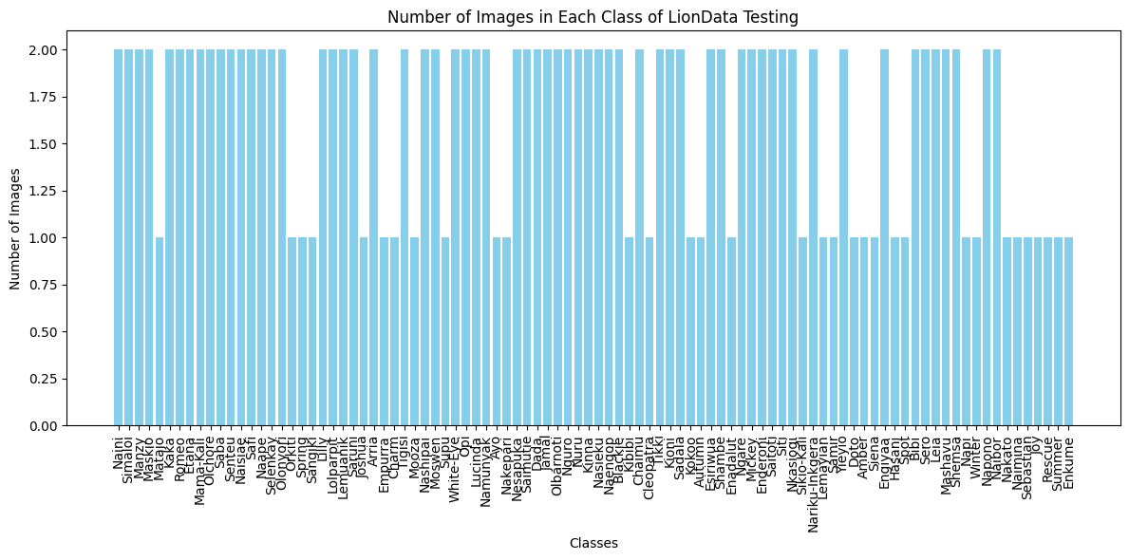
Dataset for LionData
585 images 155 images

Slide 7
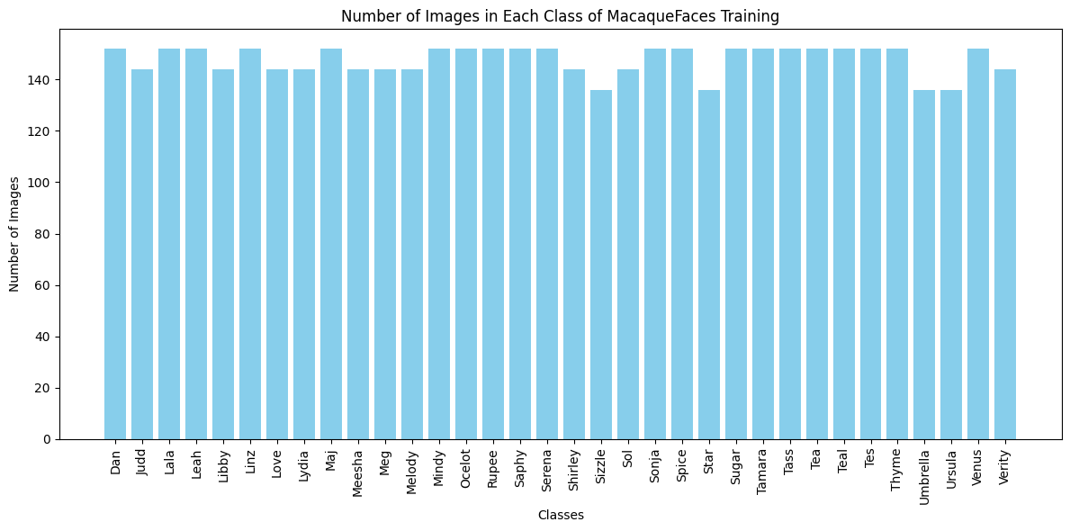
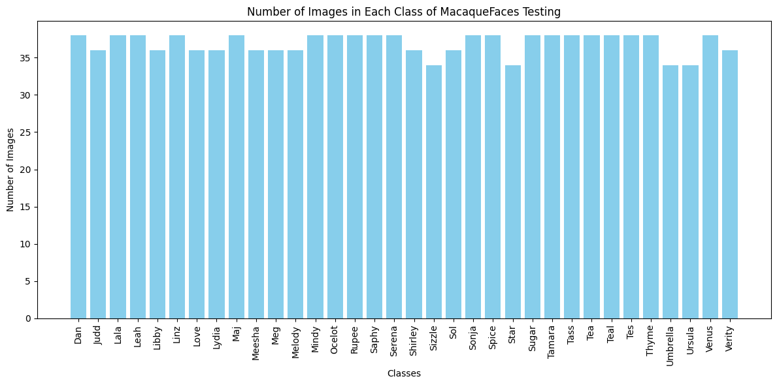
Dataset for MacaqueFace
5024 images 1256 images

Slide 8
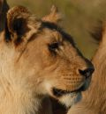
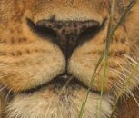
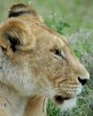

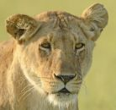
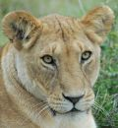
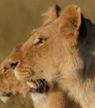
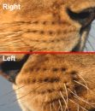
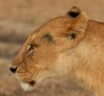
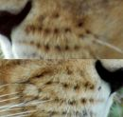
Dataset samples
Charm from LionData
Cleopatra from LionData

Slide 9
Approaches investigated (Papers)
The main Wildlife MegaDescriptor paper uses 2 approaches :
Local Features Approaches: SIFT and Superpoint descriptors, in wildlife re-identification. The process involves the following steps:
Keypoint Extraction and Descriptor Calculation: Keypoints and their corresponding descriptors are extracted from all images in both the reference and query sets.
Descriptor Distance Computation: The distances between descriptors of all possible pairs of reference and query images are computed.
Ratio Test: A ratio test with a threshold is employed to eliminate potentially false matches. The optimal threshold values are determined by evaluating the matching performance on the reference set.
Identity Determination: The identity is determined based on the absolute number of correspondences. The identity with the highest number of correspondences from the reference set is predicted.

Slide 10
Approaches investigated (Papers)
Metric Learning Approaches:
Further two methods, ArcFace and Triplet loss, are selected for ablation studies. (Explained later) These methods are inspired by (then) recent advancements in human and vehicle re-identification. ArcFace and Triplet loss both aim to learn a representation function that maps objects into a deep embedding space, where the distance reflects visual similarity.
Matching Strategy : To determine the identity of query (i.e., test) images, relying solely on the closest match within the reference set. Essentially, creating a 1NN algorithm.
Training : Models were optimized using the SGD optimizer with momentum (0.9) for 100 epochs using the cosine annealing learning rate schedule and mini-batch of 128.

Slide 11
SWin Transformers
It attempts to adapt Transformers as the backbone for computer vision, as it does for NLP and as CNNs do in vision.
The Swin Transformer introduces a hierarchical architecture that divides the input image into non-overlapping patches at different scales, allowing for efficient processing of large images. It also allows the model capture both local and global information.

Slide 12
Architecture
Input RGB Image is divided into non-overlapping patches of 4x4 by a patch splitting module.
Linear Embedding layer: Patches are embedded to a lower-dimensional representation.
Hierarchical Processing: Patches are grouped into windows at each stage. Shifted Window Mechanism allows patches to attend to nearby patches within the same window.
SWin Transformer blocks are applied for feature transformation.
At the end, Classification head is used to predict the output labels.

Slide 13
Evaluation metrics
The paper majorly uses two losses
Triplet loss: It compares triplet of images, an anchor image(xₐ), a positive image(xₚ) and a negative image (xₙ). xₐ shares the same label as xₚ but different from xₙ. It tries to learn an embedding where distance between xₐ and xₚ is smaller than xₐ and xₙ by at least a margin m. So the model learns embeddings where similar images have low distance while dissimilar images have large distance.
ArcFace: It adds an angular margin to the standard softmax loss to improve the discriminative power of the learned embeddings. The embeddings are normalized and scaled to place them at a hypersphere of radius s which is selected as hyperparameter.

Slide 14
Evaluation metric (used by us)
We have used three evaluation metrics majorly in our evaluation.
Accuracy (benchmark given in the paper as well)
F1 Score
Sensitivity

Slide 15
T-224
Dataset | Accuracy | F1 score | Sensitivity
FriesianCattle2015 | 0.55 | 0.54333333333333333 | 0.55
LionData | 0.14838709677419354 | 0.14046082949308755 | 0.14838709677419354
MacaqueFaces | 0.9904458598726115 | 0.990449728379437 | 0.9904458598726115

Slide 16
L-224
Dataset | Accuracy | F1 score | Sensitivity
FriesianCattle2015 | 0.55 | 0.5416666666666666 | 0.55
LionData | 0.2064516129032258 | 0.18795698924731183 | 0.2064516129032258
MacaqueFaces | 0.9904458598726115 | 0.990449728379437 | 0.9904458598726115

Slide 17
Results for MPDD (Testing dataset)
Model | Accuracy | F1 Score | Sensitivity
T-224 | 0.841 | 0.828 | 0.841
L-224 | 0.919 | 0.914 | 0.919
*The model was not trained over MPDD dataset. So these are the evaluation metrics on new data.

Slide 18
Experiments
To try to find a correlation we at random selected a subset of test and train sample embeddings in an 20:80 ratio and plotted the highest cosine similarities with in each class (intra-class similarity), in an attempt to discover any obvious correlation with the accuracies. The results of both these experiments are discussed below.
Whether the dataset accuracy would be affected by the size of dataset alone. Essentially, how much of Macaque class's accuracy can be attributed to the fact that it has more entries in its database to match images against. We independently conducted a KNN matching (with k=1) for using the subsets of the train and test sets as the database and test set respectively.

Slide 19
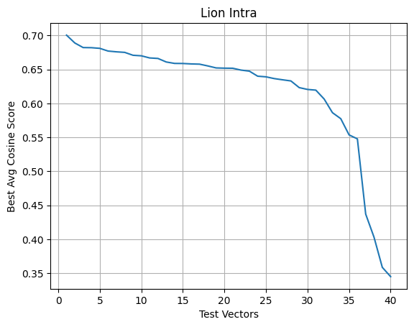
Experimental Results
High Cosine Similarity Scores

Slide 20
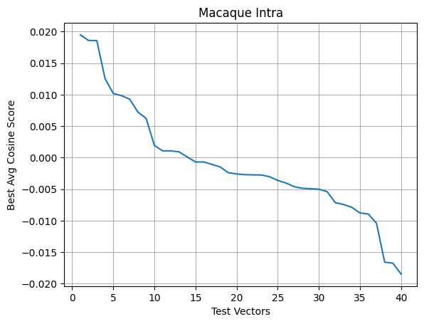
Experimental Results
Low Cosine Similarity Scores

Slide 21
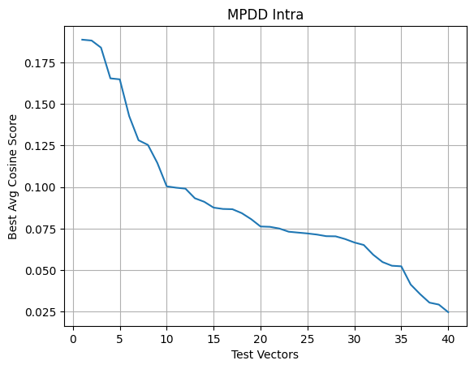
Experimental Results
Relatively Low Cosine Similarity Scores

Slide 22
Experimental Results
In the case of testing whether the frequency difference was the cause of the increased accuracy, we cant report that this alone cannot be a factor for the high accuracy reported by the macaque class. As the accuracy on the Macaque Subset was also 1.0, whereas that of the Lion Subset was 0.1875.

Slide 23
Inference time hardware requirements
CPU
GPU P100
30 GB RAM
50 GB Disk space
(*We tried to perform the evaluations on the L-384 model as well but the RAM on local system but it was not enough).

Slide 24
Individual contribution
All the group members participated equally in the project.
Abhishek - Read the research paper and helped in hypothesis testing
Aditya - Helped in inference and in hypothesis testing and did EDA
Abhinav - Helped in inference and in hypothesis testing and read research paper.
All three members helped in creating report.

Slide 25
References
Link to paper
Training dataset
Testing dataset
Architecture

