Slide 1
OOAD – Module 2 (PART 1)

Slide 2
Concepts of Object Orientation: Object Modelling Technology, Basic Principles of Object Orientation: Abstraction Encapsulation, Polymorphism, Modularity, Hierarchy. UML Modelling Mechanisms. Structural Modelling: Classes and Interfaces, Attributes and Operations, Relationships: Association, Dependency, Generalization, Multiplicity, Aggregation, Interface, Types and Roles, Instances. UML Notation: Things, Relationships, Extensibility, Diagrams. UML Standard Elements: Stereotypes, Tagged Values, Constraints.

Slide 3
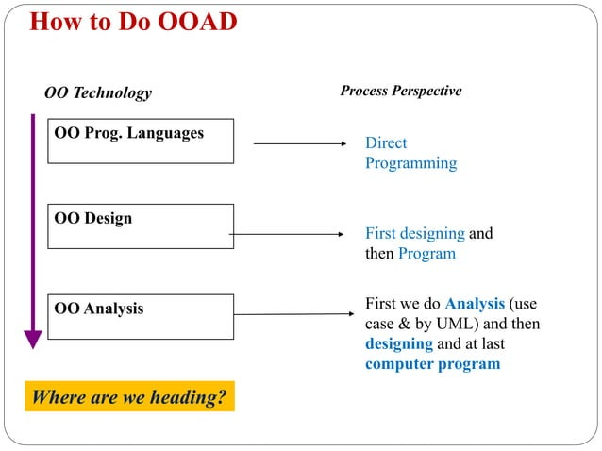

Slide 4
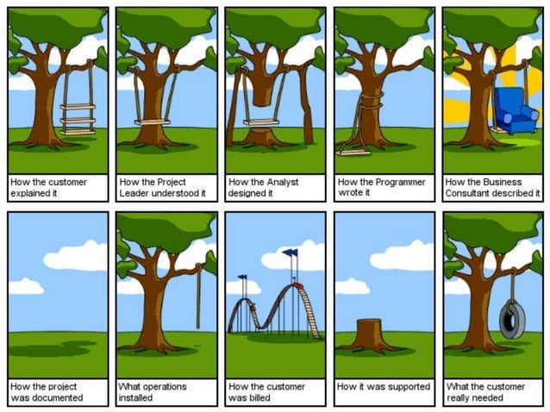

Slide 5
Object Modelling Technology
Three analysis techniques that are used in conjunction with each other for object-oriented analysis are
Object modelling
Dynamic modelling
Functional modelling
The process of object modelling can be visualized in the following steps −
Identify objects and group into classes
Identify the relationships among classes
Create user object model diagram
Define user object attributes
Define the operations that should be performed on the classes

Slide 6
Dynamic Modeling
“A way of describing how an individual object responds to events, either internal events triggered by other objects, or external events triggered by the outside world”.
The process of dynamic modelling can be visualized in the following steps −
Identify states of each object
Identify events and analyze the applicability of actions
Construct dynamic model diagram, comprising of state transition diagrams
Express each state in terms of object attributes
Validate the state–transition diagrams drawn

Slide 7
Functional Modelling
Processes that are performed within an object and how the data changes as it moves between methods.
It specifies the meaning of the operations of object modelling and the actions of dynamic modelling.
The functional model corresponds to the data flow diagram of traditional structured analysis.
The process of functional modelling can be visualized in the following steps −
Identify all the inputs and outputs
Construct data flow diagrams showing functional dependencies
State the purpose of each function
Identify constraints
Specify optimization criteria

Slide 8
Concepts of Object Orientation
Basic Principles of Object Orientation :
The conceptual framework of object–oriented systems is based upon the object model.
There are two categories of elements in an object-oriented system: Major elements and minor elements.
Five major elements
Abstraction
Encapsulation
Polymorphism
Modularity
Hierarchy
Three minor elements
Typing
Concurrency
Persistence

Slide 9
Abstraction
Grady Booch, “An abstraction denotes the essential characteristics of an object that distinguish it from all other kinds of objects and thus provide crisply defined conceptual boundaries, relative to the perspective of the viewer.”
eg., Employee.
An abstraction isolates use from implementation: an abstraction can be used without knowledge of its implementation and implemented without knowledge of its use.

Slide 10
A way or mechanism to represent complex reality using simplified model.
The behavior of the data objects were completely characterized by the set of operations. Classical example is definition of stack cluster using only push and pop operations.
Dependency relationship that relates two elements or sets of elements (called client and supplier) representing the same concept but at different levels of abstraction or from different viewpoints.
Realization is a specialized abstraction relationship between two sets of model elements, one representing a specification (the supplier) and the other represents an implementation of the latter (the client).

Slide 11
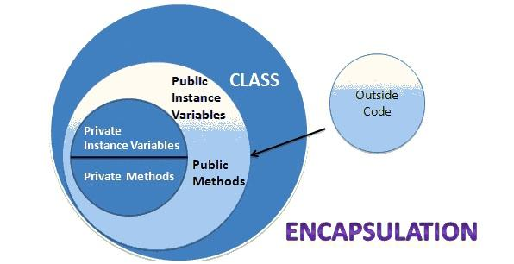
Encapsulation
Encapsulation is the process of binding both attributes and methods together within a class.
Internal details of a class can be hidden from outside.
The class has methods that provide user interfaces by which the services provided by the class may be used.
Encapsulation is a development technique which includes creating new data types (classes) by combining both information (structure) and behaviors, and restricting access to implementation details.

Slide 12
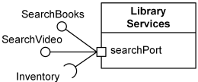
Object is defined as an entity with a well defined boundary and identity that encapsulates state (attributes and relationships) and behavior (operations, methods, and state machines).
Elements in peer packages are encapsulated and are not a priori visible to each other.
Component represents a modular part of a system that encapsulates its contents and whose manifestation is replaceable within its environment.
Component is encapsulated and as a result, Components and subsystems can be flexibly reused and replaced by connecting ("wiring") them together.

Slide 13
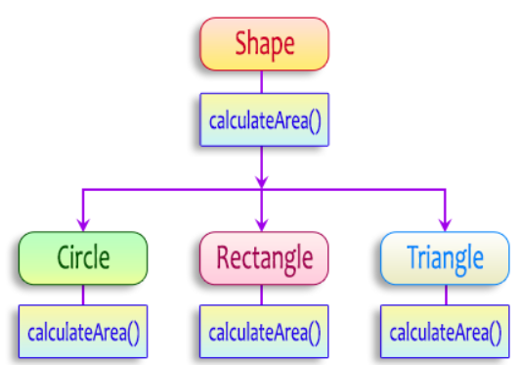
Polymorphism
Implies using operations in different ways, depending upon the instance they are operating upon.
Ability to apply different meaning (semantics, implementation) to the same symbol (message, operation) in different contexts.
Allows objects with different internal structures to have a common external interface.
Particularly effective while implementing inheritance.
Example : Circle and rectangle.

Slide 14
When context is defined at compile time, it is called static or compile-time polymorphism.
Eg. Overloading, Parametric polymorphism : templates.
When context is defined during program execution, it is dynamic or run-time polymorphism.
Eg. Dynamic binding or late binding
Operations are specified in the model and can be dynamically selected only through polymorphism.
Notes:
Defines multiple methods with the same name but different parameters - a class where the "+" operator is defined to handle different data types, adding numbers when given numeric operands and joining strings when given string operands

Slide 15
Modularity
Process of decomposing a problem (program) into a set of modules so as to reduce the overall complexity of the problem.
Booch has defined modularity: “Modularity is the property of a system that has been decomposed into a set of cohesive and loosely coupled modules.”
Modularity is intrinsically linked with encapsulation.
Modularity can be visualized as a way of mapping encapsulated abstractions into real, physical modules having high cohesion within the modules and their inter–module interaction or coupling is low.

Slide 16
Hierarchy
Booch, “Hierarchy is the ranking or ordering of abstraction”.
System can be made up of interrelated subsystems, which can have their own subsystems and so on until the smallest level components are reached.
It uses the principle of “divide and conquer”. Hierarchy allows code reusability.
Two types of hierarchies
“IS–A” hierarchy − hierarchical relationship in inheritance, example, if we derive a class Journal, Magazine and Study material from a class Book, we can say that a OOAD “is–a” Book.
“PART–OF” hierarchy − hierarchical relationship in aggregation by which a class may be composed of other classes. For example, a Book is composed of author name, publisher, edition, No, of copies. It can be said that a publisher is a “part–of” Book.

Slide 17
Typing
Enforcement of the notion that an object is an instance of a single class or type.
A variable is associated with a datatype. It defines how an object should behave.
Enforces that objects of different types may not be generally interchanged; and can be interchanged only in a very restricted manner if absolutely required to do so.
Strong Typing − Operation on an object is checked at the time of compilation.
Weak Typing − Messages may be sent to any class.
Operation is checked only at the time of execution.
Notes:
the language enforces that only compatible data types can be used in operations, preventing errors by catching type mismatches during compilation or runtime, essentially ensuring type safety throughout the program

Slide 18

Concurrency
Two types: active and inactive objects.
Active objects have independent threads of control that can execute concurrently with threads of other objects.
Active objects synchronize with one another as well as with purely sequential objects.
Persistence
An object occupies a memory space and exists for a particular period of time.
Lifespan of an object was typically the lifespan of the execution of the program that created it.
Object lifespan is longer than the duration of the process creating the object.
Object continues to exist even after its creator ends to exist.

Slide 19
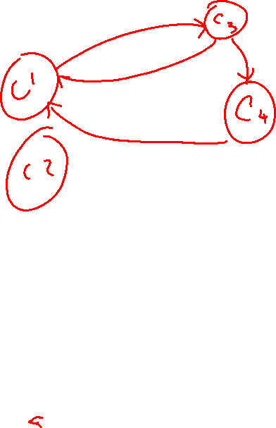

Slide 20
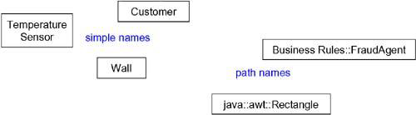
Structural Modeling: Classes, Relationships, Common mechanism and Diagrams
1. Classes:
A class is a description of a set of objects that share the same attributes, operations, relationships, and semantics.
Names
Every class must have a name that distinguishes it from other classes.
A name is a textual string.
Name alone is known as a simple name; a path name is the class name prefixed by the name of the package in which that class lives.
A class may be drawn showing only its name

Slide 21
Attributes
An attribute is a named property of a class that describes a range of values that instances of the property may hold.
A class may have any number of attributes or no attributes at all.
An attribute represents some property of the thing you are modeling that is shared by all objects of that class.
For example, every wall has a height, width, and thickness; you might model your customers in such a way that each has a name, address, phone number, and date of birth

Slide 22
Operations
An operation is the implementation of a service that can be requested from any object of the class to affect behavior.
An operation is an abstraction of something you can do to an object that is shared by all objects of that class.
A class may have any number of operations or no operations at all.
Invoking an operation on an object changes the object's data or state.
Specify an operation by stating its signature, which includes the name, type, and default value of all parameters and (in the case of functions) a return type

Slide 23
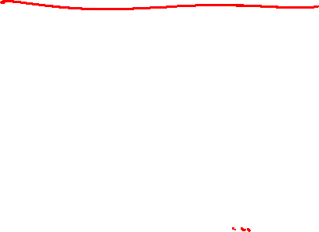
Organizing Attributes and Operations
When drawing a class, you don't have to show every attribute and every operation at once.
choose to show only some or none of a class's attributes and operations.
Indicate that there are more attributes or properties than shown by ending each list with an ellipsis ("...").

Slide 24
Responsibilities
A responsibility is a contract or an obligation of a class.
When you create a class, you are making a statement that all objects of that class have the same kind of state and the same kind of behavior.
At a more abstract level, these corresponding attributes and operations are just the features by which the class's responsibilities are carried out.
A Wall class is responsible for knowing about height, width, and thickness
FraudAgent class, as you might find in a credit
card application, is responsible for processing
orders and determining if they are legitimate,
suspect, or fraudulent
TemperatureSensor class is responsible for measuring temperature and raising an alarm if the temperature reaches a certain point.

Slide 25
Modeling the Vocabulary of a System
To model the vocabulary of a system,
Identify those things that users or
implementers use to describe the
problem or solution.
Use , use case-based
analysis to help find these abstractions.
For each abstraction, identify a set
of responsibilities.
Make sure that each class is crisply
defined and that there is a good balance
of responsibilities among all your classes.
Provide the attributes and operations that are needed to carry out these responsibilities for each class.

Slide 26
Modeling the Distribution of Responsibilities in a System
To model the distribution of responsibilities in a system,
Identify a set of classes that work together closely to carry out some behavior.
Identify a set of responsibilities for each of these classes.
Split classes that have too many responsibilities into smaller abstractions, collapse tiny classes that have trivial responsibilities into larger ones, and reallocate responsibilities so that each abstraction reasonably stands on its own.
Redistribute their responsibilities
accordingly so that no class within
a collaboration does too much or
too little.

Slide 27
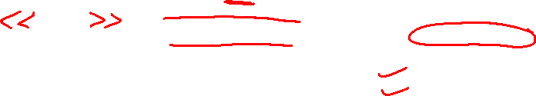
Modelling Primitive Types
To model primitive types, such as integers, characters, strings, and even enumeration types, that you might create .
Model the thing you are abstracting as a class or an enumeration, which is rendered using class notation with the appropriate stereotype.
If you need to specify the range of values associated with this type, use constraints.

Slide 28
2.Relationships:
In UML, the way that things can connect to one another ,either logically or physically are modelled as relationships.
In object-oriented modeling, the three most important relationships are i) dependencies
ii) generalizations
iii) associations

Slide 29
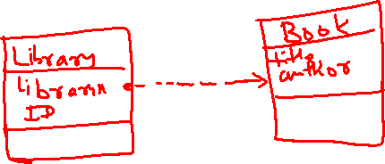
i) Dependencies
Relationship that states that one thing uses the information and services of another thing , but not necessarily the reverse.
I. Imagine a simple scenario for a library system with two classes:
Library class
Book class
Draw the dependency between the classes.
II. Imagine a School Management System with two key classes: Teacher and Subject. Draw the dependency between the classes.

Slide 30
Generalizations
A generalization is a relationship between a general kind of thing and a more specific kind of thing.
Generalization is sometimes called an "is-a-kind-of" relationship: one thing (class Journal) is-a-kind-of a more general thing (the class Book).

Slide 31
Using generalization, model the hierarchy of vehicles in an object-oriented system with base class as vehicle

Slide 32
Associations
An association is a structural relationship that specifies that objects of one thing are connected to objects of another.
Given an association connecting two classes, you can relate objects of one class to objects of the other class.
An association that connects exactly two classes is called a binary association.
Although it's not as common, you can have associations that connect more than two classes; these are called n-ary associations.
There are four adornments that apply to associations : Name, Role, Multiplicity and Aggregation.

Slide 33
Name:
An association can have a name, which is used to describe the nature of the relationship.
Role :
Class has a specific role that it plays in that relationship; a role is just the face the class at the far end of the association presents to the class at the near end of the association.
Explicitly name the role a class plays in an association.

Slide 34
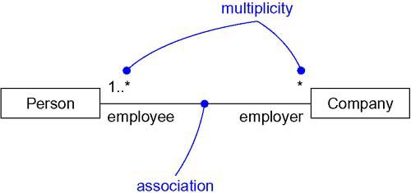
Multiplicity:
An association represents a structural relationship among objects.
Represents a range of integers specifying the possible size of the set of related objects.
The number of objects must be in the given range-show a multiplicity of exactly one (1), zero or one (0..1), many (0..*), or one or more (1..*).
Integer range (such as 2..5). You can even state an exact number (for example, 3, which is equivalent to 3..3).

Slide 35

Scenario
- An Author writes Books.
- A Book can be written by multiple Authors, especially in the case of co-authorship.
- An Author can write multiple Books.

Slide 36
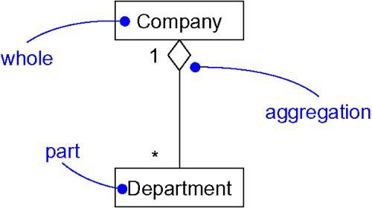
Aggregation:
Plain association between two classes represents both classes are conceptually at the same level, no one more important than the other.
Model a "whole/part" relationship, in which one class represents a larger thing (the "whole"), which consists of smaller things (the "parts").
This kind of relationship is called aggregation, which represents a "has-a" relationship.

Slide 37
Common Modeling Techniques

Slide 38
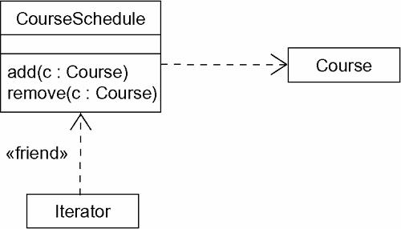
Modelling Simple Dependencies
The most common kind of dependency relationship is the connection between a class that only uses another class as a parameter to an operation.
To model this using relationship,
Create a dependency pointing from the class with the operation to the class used as a parameter in the operation.
<<friend>> -It is a type of dependency. This relationship essentially allows a class to access private members of another class.

Slide 39
Modelling Single Inheritance
To model inheritance relationships,
Given a set of classes, look for responsibilities, attributes, and operations that are common to two or more classes.
Elevate these common responsibilities, attributes, and operations to a more general class. If necessary, create a new class to which you can assign these elements (but be careful about introducing too many levels).
Specify that the more-specific classes inherit from the more-general class by placing a generalization relationship that is drawn from each specialized class to its more-general parent.
Notes:
An abstract class is a class that has no direct instances but whose descendant classes have direct instances
An abstract operation defines the signature of an operation for which each concrete subclass must provide its own implementation.

Slide 40
Information system for a school
There are classes named Student, Course, Instructor, School and Department
1)There's an association between Student and Course, specifying that students attend courses. Furthermore, every student may attend any number of courses and every course may have any number of students.
2) There is an association between Course and Instructor, specifying that instructors teach courses. For every course there is at least one instructor and every instructor may teach zero or more courses.
3) The relationships between School and the classes Student and Department are a bit different. Here you have aggregation relationships. A school has zero or more students, each student may be a registered member of one or more schools, a school has one or more departments, each department belongs to exactly one school.
4) There are two associations between Department and Instructor.
-One of these associations specifies that every instructor is assigned to one or more departments and that each department has one or more instructors.
- The other association specifies that for every department, there is exactly one instructor who is the department chair. The way this model is specified, an instructor can be the chair of no more than one department and some instructors are not chairs of any department.

Slide 42
Modelling Structural Relationships
To model structural relationships,
For each pair of classes, if you need to navigate from objects of one to objects of another, specify an association between the two. This is a data-driven view of associations.
For each pair of classes, if objects of one class need to interact with objects of the other class other than as local variables in a procedure or parameters to an operation, specify an association between the two. This is more of a behavior-driven view of associations.
For each of these associations, specify a multiplicity (especially when the multiplicity is not *, which is the default), as well as role names (especially if they help to explain the model).
If one of the classes in an association is structurally or organizationally a whole compared with the classes at the other end that look like parts, mark this as an aggregation by adorning the association at the end near the whole with a diamond.

Slide 43
Common Mechanisms
The UML is made simpler by the presence of four common mechanisms that apply consistently throughout the language:
specifications,
adornments,
common divisions, and
extensibility mechanisms.

Slide 44
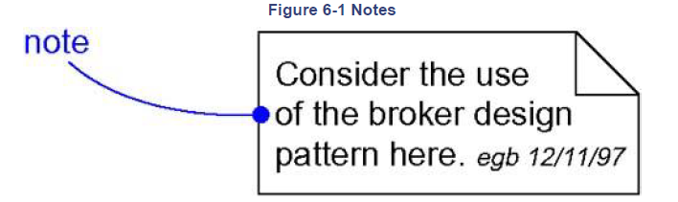
Adornment
Notes are the most important kind of adornment.
A note is a graphical symbol for rendering constraints or comments attached to an element or a collection of elements.
Use notes to attach information to a model, such as requirements, observations, reviews, and explanations.

Slide 45
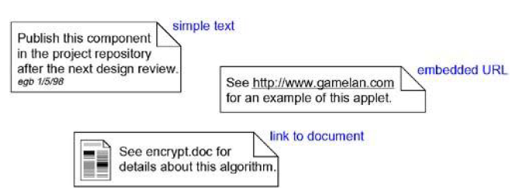
Notes
A note that renders a comment has no semantic impact, meaning that its contents do not alter the meaning of the model to which it is attached.
This is why notes are used to specify things like requirements, observations, reviews, and explanations, in addition to rendering constraints.
Notes may be attached to more than one element by using dependencies
A note may contain any combination of text or graphics.
You can put a live URL inside a note, or even link to or embed another document

Slide 46
Other Adornments
Adornments are textual or graphical items that are added to an element's basic notation and are used to visualize details from the element's specification.
For example, the basic notation for an association is a line, but this may be adorned with such details as the role and multiplicity of each end.
In using the UML, the general rule to follow is this: Start with the basic notation for each element and then add other adornments only as they are necessary to convey specific information that is important to your model.
Most adornments are rendered by placing text near the element of interest or by adding a graphic symbol to the basic notation

Slide 47
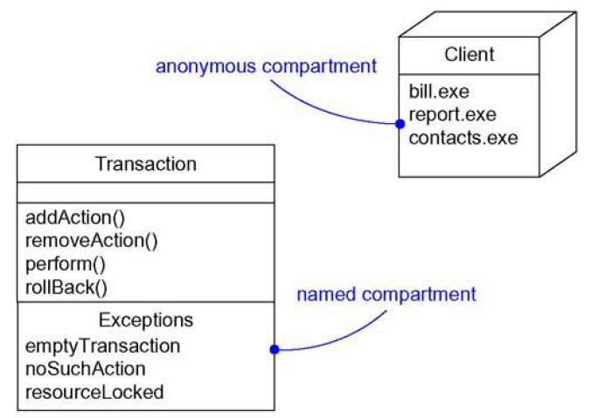
In the case of classes, components, and nodes, you can add an extra compartment below the usual compartments to provide more details.

Slide 48
Extensibility mechanism
The UML's extensibility mechanisms permit you to extend the language in controlled ways.
These mechanisms include stereotypes, tagged values, and constraints.
A stereotype extends the vocabulary of the UML, to create new kinds of building blocks that are derived from existing ones but that are specific to your problem.
A tagged value extends the properties of a UML building block, to create new information in that element's specification.
A constraint extends the semantics of a UML building block, to add new rules or modify existing ones.

Slide 49
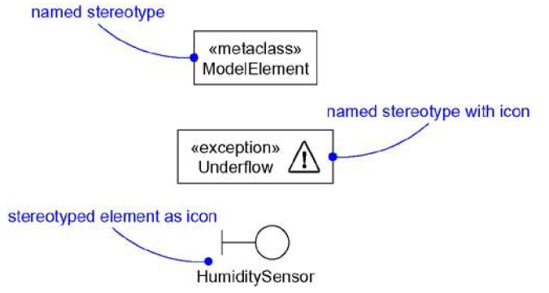
Stereotypes
Introduce new things that speak the vocabulary of your domain and look like primitive building blocks.
metatype, equivalent of a new class in the UML's metamodel.
each stereotype may provide its own set of tagged values, semantics (each stereotype may provide its own constraints), and notation (each stereotype may provide its own icon). Stereotype is rendered as a name enclosed by guillemets (<< metaclass>>).

Slide 50
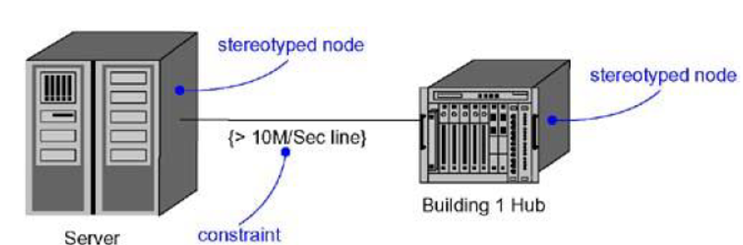
For example, if you are modeling a network, you might want to have symbols for routers and hubs; you can use stereotyped nodes to make these things appear as primitive building blocks.
Notes:
The constraint is specifying that the data rate for a particular link or connection in the network must be greater than 10 megabits per second (Mbps).

Slide 51
Tagged Values
Define tags for existing elements of the UML, or define tags that apply to individual stereotypes so that everything with that stereotype has that tagged value.
A tagged value is not the same as a class attribute.
Tagged value is a metadata because its value applies to the element itself, not its instances.
Tagged value is rendered as a string enclosed by brackets and placed below the name of other element.

Slide 52
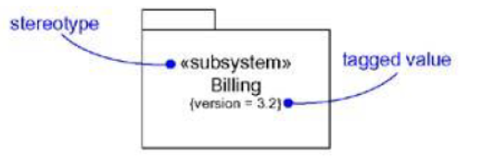
if you are part of your project's release team, responsible for assembling, testing, and then deploying releases, you might want to keep track of the version number and test results for each major subsystem. You can use tagged values to add this information to your models.
Notes:
Package

Slide 53
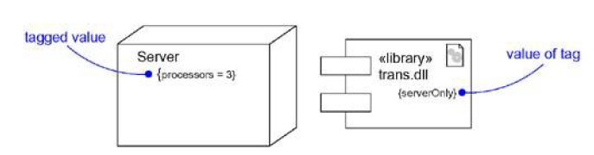
For example, to specify the number of processors installed on each kind of node in a deployment diagram, or you might want to require that every component be stereotyped as a library if it is intended to be deployed on a client or a server.

Slide 54
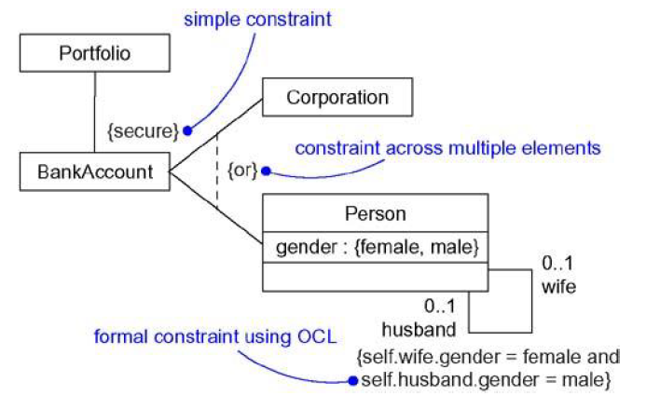
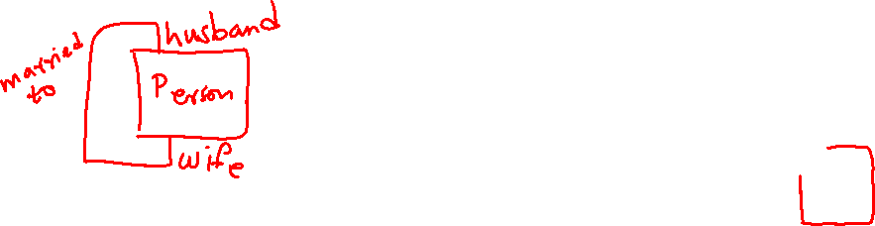
Constraints
With constraints we can add new rules or modify existing ones.
A constraint specifies conditions that must be held true for the model to be well-formed.
OCL- Object Constraint Language

Slide 55
Standard Elements
The UML defines a number of standard stereotypes for classifiers, components, relationships, and other modeling elements.
There is one standard stereotype, mainly of interest to tool builders, that lets you model stereotypes themselves.
stereotype - Specifies that the classifier is a stereotype that may be applied to other elements
The UML also specifies one standard tagged value that applies to all modeling elements.
documentation - Specifies a comment, description, or explanation of the element to which it is attached

Slide 56
Common Modeling Techniques

Slide 57
Modelling Comments
To model a comment,
Show a more explicit relationship by connecting a note to its elements using a dependency relationship.
Expose your comments in your diagrams only in so far as you need to communicate that information in that context.
If your comment is lengthy or involves something richer than plain text, consider putting your comment in an external document and linking or embedding that document in a note attached to your model.
As your model evolves, keep those comments that record significant decisions that cannot be inferred from the model itself, and unless they are of historic interest discard the others.

Slide 58
Modelling Comments (Cont.)

Slide 59
Modeling New Building Blocks
The UML's building blocks - classes, interfaces, collaborations, components, nodes, associations, and so on - are generic enough to address most of the things you'll want to model.
If you want to extend your modeling vocabulary or give distinctive visual cues to certain kinds of abstractions that often appear in your domain, use stereotypes.

Slide 60
To model new building blocks,
Make sure there's not already a way to express what you want by using basic UML.
If you have a common modeling problem, chances are there's already some standard stereotype that will do what you want.
If not, identify the primitive thing in the UML to model (for example, class, interface, component, node, association, and so on) and define a new stereotype for that thing.
Remember that you can define hierarchies of stereotypes so that you can have general kinds of stereotypes along with their specializations (but as with any hierarchy, use this sparingly).
Specify the common properties and semantics that go beyond the basic element being stereotyped by defining a set of tagged values and constraints for the stereotype.
If you want these stereotype elements to have a distinctive visual cue, define a new icon for the stereotype.

Slide 61
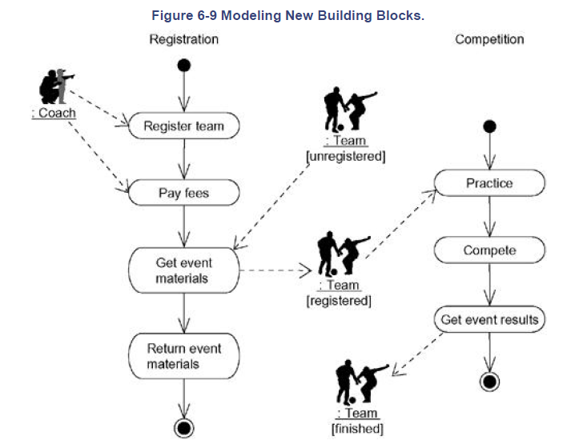
Notes:
Activity diagram- Flow of coaches and teams through a sporting event

Slide 62
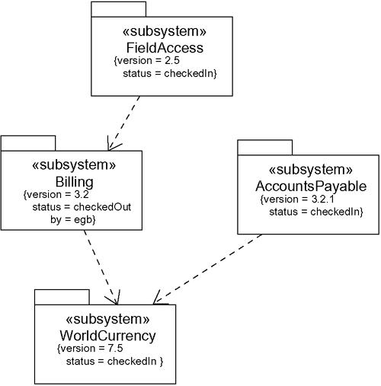
Modelling New Properties
To model new properties,
First, make sure there's not already a way to express what you want by using basic UML.
If you are convinced there's no other way to express these semantics, define a stereotype and add the new properties to the stereotype.
The rules of generalization apply tagged values defined for one kind of stereotype apply to its children.

Slide 63
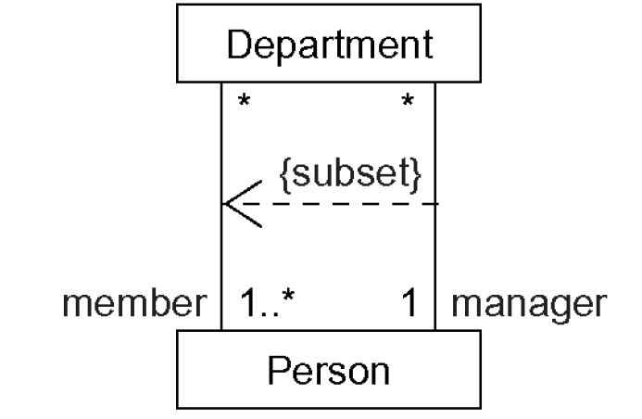
Modelling New Semantics
To model new semantics,
First, make sure there's not already a way to express what you want by using basic UML.
If you re convinced there's no other way to express these semantics, write your new semantics in a constraint placed near the element to which it refers. You can show a more explicit relationship by connecting a constraint to its elements using a dependency relationship.
If you need to specify your semantics more precisely and formally, write your new semantics using OCL.

