Slide 1


Suspicious Activity Detection from Videos using YOLOv5
PROJECT TEAM MEMBERS NAME OF PROFESSOR
Mokshada Barahate(BT19ECE073) Dr. Vishal Satpute
Rajdeep Tanwar(BT19ECE091)
Sanket Sannake(BT19ECE097)
Prajwal Shinde (BT19ECE102)
Abhinav Walunj(BT19ECE121)

Slide 2
Contents
Problem Statement
Introduction
Theory
Results
References
Conclusion

Slide 3
Suspicious Activity Detection from Videos using YOLOv5
Nipunjita Bordoloi1 , Anjan Kumar Talukdar2 , Kandarpa Kumar Sarma3 123Dept. of Electronics and Communication Engineering Gauhati University, Guwahati, Assam, India 1nipunjitabordoloi@gmail.com, 2 anjantalukdar@gauhati.ac.in, 3kandarpaks@gauhati.ac.in

Slide 4
Abstract
Abstract—Human activity detection for video system is an automated way of processing video sequences and making an intelligent decision about the actions in the video. It is one of the growing areas in Computer Vision and Artificial Intelligence. Suspicious activity detection is the process of detecting unwanted human activities in places and situations. This is done by converting video into frames and analyzing the activities of persons from the processed frames. Human detection has always been a challenging problem as human bodies are non-rigid and changes shape arbitrarily. Human recognition and detection in indoor as well as outdoor environment is a quite complex task due to the various problems that arises such as- poor lightening conditions, variation of poses etc. In this paper, YOLOv5 is used to detect different suspicious activities like bag-snatching, lockbreaking etc. Our system has a very good processing speed as well as good accuracy of detection. Index Terms—Suspicious behaviour, Deep learning, Anomaly detection, YOLOv5

Slide 5
Most of the current surveillance systems are human operated
We are trying to implement an algorithm to get a better result of detection, recognition and tracking.
Our main motive is to create an automatic computerized system for human action recognition for suspicious movements that will be robust and can work fast and accurately in every environment.

Slide 6
Works carried out by different scholars on this problem till now.
Sultani et al. [4] used a general model of anomaly detection using deep MIL (Multiple Instance Learning) framework. Frame based receiver operating characteristics (ROC) curve and corresponding area under the curve (AUC) are used to evaluate the performance of the method. Their experimental results showed that the MIL method for anomaly detection achieves significant improvement on detection performance as compared to the state-of-the-art approaches.
Nurhopipah and Harjoko [5] considered mainly four processes: Motion detection process, Face detection process, Data training process and Face Identification process. Motion segmentation was carried out using ADI (Accumulative Differences Images). Haar cascade classifier was used for detection. Experimental results showed 92.655% success rate for motion detection, 76% for face detection and 60% for face identification.
Eamthanakul et al. [6] used background subtraction method for computation. Noise was removed by using median filter. The system used an image processing technique to analyze for a traffic condition. It detects how many objects or cars on the road.

Slide 7
Works carried out by different scholars on this problem till now.
Zaidi et al. [1] formulated real-time tracking and anomaly motion detection for security system. The object was tracked using background subtraction from video data.
Basha et al. [7] used CNN-DBNN algorithm for detecting suspicious human activity and acquired accuracy of 90%. Humans were identified using foundation subtraction technique where seven casings were chosen in which region of bounding boxes for people were bigger. Discriminative Deep Belief Network (DDBN) is used to recognize activities as normal or suspicious.

Slide 8
PROPOSED WORK
Recording of anomaly videos in various backgrounds The first stage of suspicious action recognition is collecting video data for input. We prepared our own dataset consisting of 3 anomalies performed by different persons in different backgrounds.
The videos were then converted to frames The next step is converting the videos to frames for further processes. The videos were converted at 30 fps. The frames were then resized as per required.
Extracting region proposals The third step is annotation. Here, the frames were annotated according to the region of interest.
Implementing YOLOv5- This is the stage where YOLOv5 model was used for training our dataset and later testing.
Detection of the activities The last step is the detection step. Here, the YOLOv5 model helps in detecting whether the input data for testing has suspicious actions or is it normal.
5

Slide 9
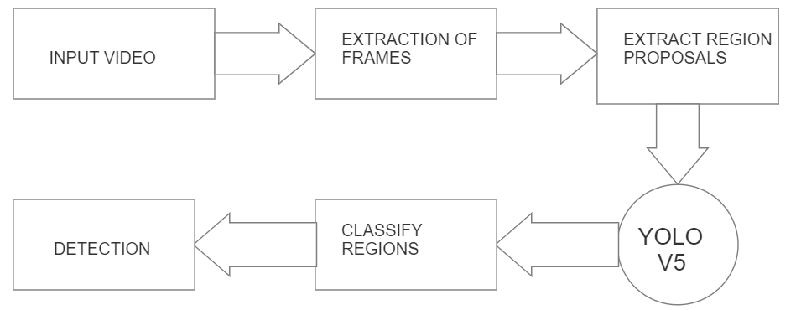
Basic block diagram of suspicious activity detection.
6

Slide 10
Dataset Preparation
We reviewed the existing video anomaly detection datasets for the project. However, we prepared our own Dataset.
Since we use YOLOv3 model for our project so we went for the YOLO format for annotation.
YOLO (You Only Look Once) is a format for detecting objects. It is saved in .txt format. The annotated file for each image consists of 5 values.
The first value gives the class ID, second and third value give the x-axis and y-axis respectively and the fourth and the fifth value give the width and height of the bounding box. All the values (except the class ID) is in the range 0-1.
7

Slide 11
Architecture Of YOLOv5
The network architecture of Yolov5. It consists of three parts: (1) Backbone: CSPDarknet, (2) Neck: PANet, and (3) Head: Yolo Layer. The data are first input to CSPDarknet for feature extraction, and then fed to PANet for feature fusion.
Fig. 2
Fig. 3
9

Slide 12
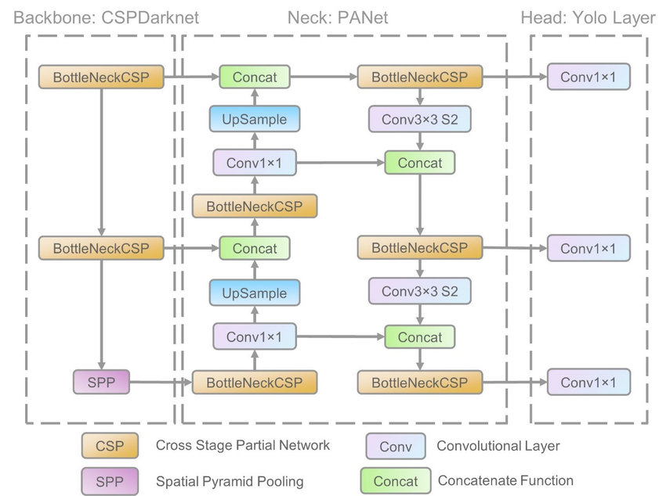
8

Slide 13
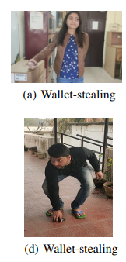
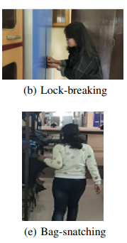
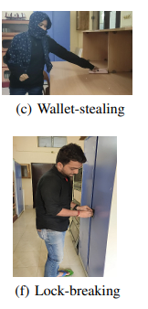
Sample Images
10

Slide 14
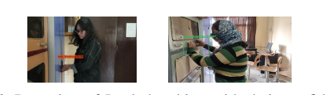
Detection of Lock breaking

Slide 15
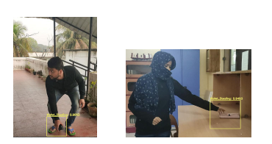
Detection of Wallet stealing
12

Slide 16
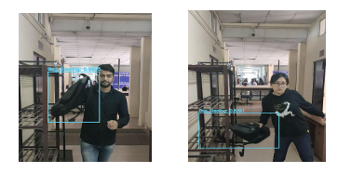
Detection of Bag stealing

Slide 17

Results

Slide 18
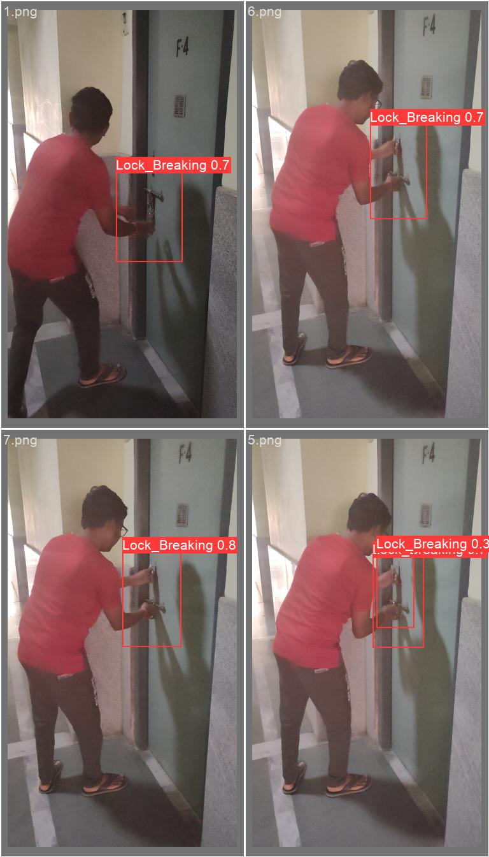
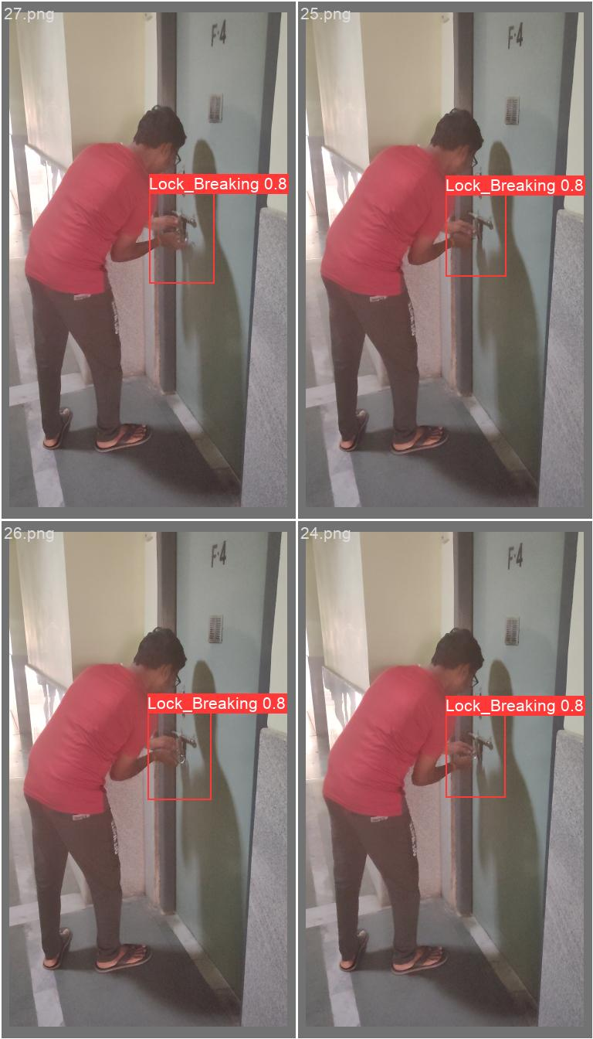
Results on Test-Frames:

Slide 19
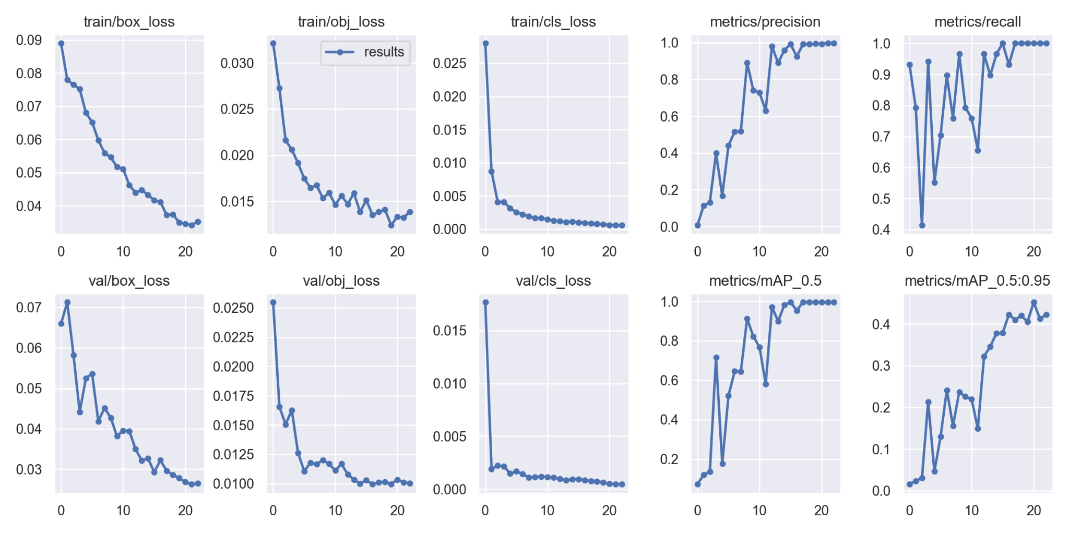
Results
14

Slide 20
References
Research Paper Implemented:
Suspicious Activity Detection from Videos using YOLOv3 Nipunjita Bordoloi1 , Anjan Kumar Talukdar2 , Kandarpa Kumar Sarma3 123Dept. of Electronics and Communication Engineering Gauhati University, Guwahati, Assam, India 1nipunjitabordoloi@gmail.com, 2 anjantalukdar@gauhati.ac.in, 3kandarpaks@gauhati.ac.in
Code Explaination with execution documentation(link):
https://medium.com/mlearning-ai/training-yolov5-custom-dataset-with-ease-e4f6272148ad
Dataset Formation Method:
https://www.youtube.com/watch?app=desktop&v=bSAjikqlM2M

Slide 21
Conclusion
Successfully able to implement this paper using YOLOV5 model for object detection.
Also dataset was made by ourselves for this problem statement.
On complete execution for three different types of suspicious activities which are lock breaking,bag stealing and pocket stealing get results which are shown in previous slides.
For this we get accuracy as :- 95%.

