Slide 1

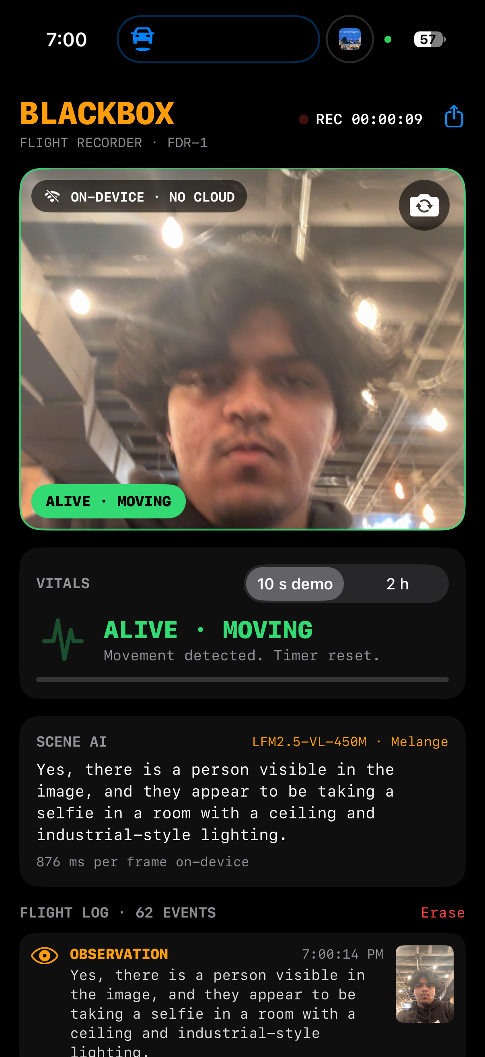
Blackbox
Houston, we have a heartbeat.
Blackbox: an on-device flight recorder for astronauts.
HOUSTON, WE HAVE NO CLOUD · ZETIC × LIQUID AI × SF TECH WEEK
Notes:
Planes carry a black box so we know what happened to the crew. Astronauts don't. We built one that lives on a phone and needs no cloud.

Slide 2
01 · THE PROBLEM
Planes have black boxes. Astronauts don't.
LOSS OF SIGNAL
NO VISIBILITY
NO RECORD
Far side of the Moon, solar storms, deep space.
Mission control can't tell whether the crew is okay.
Nothing captures what happened while the link was down.
Notes:
When comms drop — far side of the Moon, solar storms, deep space — mission control can't tell whether the crew is okay, and there's no record of what happened.

Slide 3
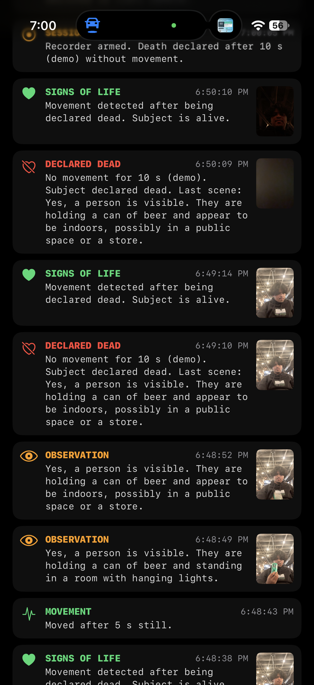
02 · WHAT BLACKBOX DOES
It watches the crew and keeps the log.
Detects the crew
Logs what it sees
Knows when a living crew member is in view.
A snapshot and a plain-English description.
Logs bathroom breaks
Declares "no signs of life"
Yes, astronauts need those too.
After a period of no movement (10 s in today’s demo). Logs "signs of life" when they move again.
Notes:
Four jobs. Detect the crew, log what it sees, log bathroom breaks, and declare no signs of life after a period with no movement — hours on a real mission, 10 seconds today.

Slide 4
03 · HOW IT WORKS
Two models, one phone.
NO CLOUD
→
→
→
Apple Vision
Vitals state machine
Person, face, body pose + motion · ~5×/sec
Alive · still · declared dead
Flight log
Timestamped events + JPEG snapshots, stored on the phone
Camera
→
→
→
LFM2.5-VL-450M
Liquid AI vision-language model, on-device via ZETIC Melange
Scene description
One sentence · every ~3 sec
Notes:
Two parallel paths off the camera. Apple Vision runs about 5 times a second into a vitals state machine. Liquid AI's LFM2.5-VL-450M runs on-device via ZETIC Melange and writes a one-sentence description every ~3 seconds. Both land in a flight log stored on the phone.

Slide 5
04 · WHY ON-DEVICE
In space, the cloud is 384,000 km away.
01
02
03
04
Crew data never leaves the device
No connectivity needed
Instant response
No cost per inference
Notes:
Same four reasons from the workshop — they just matter more in orbit.

