Slide 1
Introducing the HP ProBook and EliteBook series, designed for professionals who prioritize performance and portability. With models supporting upgradeable 16 GB RAM and UMA or discrete graphics, you can seamlessly tackle demanding tasks. Choose the ultra-lightweight EliteBook 820 G1 for maximum mobility or the ProBook 650 G1 for a larger display and enhanced productivity. Elevate your business efficiency with these stylish and reliable laptops.
Generated by HP AI Sales Assistant

Slide 2
Customer Requirements
User Query:
We need 10 laptops for a design team, around ₹1 lakh each, lightweight, 8GB RAM, and good graphics.
Extracted Requirements:
• product_category
• quantity
• budget_per_unit
• specific_requirements
• user_intent
Customer Requirement Analysis

Slide 3

HP ProBook 640 G1
Specification | Details
Ram | Upgradeable to 16 GB
Cpu | Intel® technology
Gpu | UMA or discrete graphics
Display | 35.5 cm diagonal
Weight | Starting at 2.0 kg
Ports | 2 USB 3.0; 2 USB 2.0; 1 DisplayPort; 1 stereo microphone in; 1 stereo headphone/line-out; 1 1394a; 1 AC power; 1 RJ-45; 1 docking connector; 1 secondary battery connector; 1 VGA; 1 serial; 1 RJ-11 (optional)
Os | Windows 8 Pro
Description:
Tailored for business. Optimised for Windows 8 Pro, 2 this configurable notebook features a 35.5 cm diagonal display and UMA or discrete graphics. From the professional design to Intel® technology, you're ready for business.
HP ProBook 640 G1 — Product Details

Slide 4
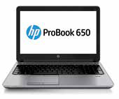
HP ProBook 650 G1
Specification | Details
Ram | Upgradeable to 16 GB
Cpu | Intel® technology
Gpu | UMA or discrete graphics
Display | 39.6 cm diagonal
Weight | Starting at 2.32 kg
Ports | 2 USB 3.0; 2 USB 2.0; 1 DisplayPort; 1 stereo microphone in; 1 stereo headphone/line-out; 1 1394a; 1 AC power; 1 RJ-45; 1 docking connector; 1 secondary battery connector; 1 VGA; 1 serial; 1 RJ-11 (optional)
Os | Windows 8 Pro
Description:
Tailored for business. Optimised for Windows 8 Pro, 2 this configurable notebook features a 39.6 cm diagonal display and UMA or discrete graphics. From the professional design to Intel® technology, you're ready for business.
HP ProBook 650 G1 — Product Details

Slide 5
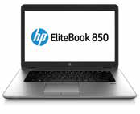
HP EliteBook 820 G1
Specification | Details
Ram | Upgradeable to 16 GB
Display | 31.8 cm (12.5")
Battery | 3-cell (26 WHr) HP Long Life; 3-cell (46 WHr) HP Long Life
Weight | Starting at 1.33 kg
Ports | 2 USB 3.0; 1 USB 3.0 charging; 1 DisplayPort 1.2; 1 VGA; 1 combo stereo headphone/mic jack; 1 AC power; 1 RJ-45; 1 side docking connector
Os | Windows 8 Pro or other operating systems available
Description:
Now employees can hit the road with a travel pro. The HP EliteBook 820 industry leading thin and light notebook is ultra-mobile in and out of the office. Work with confidence thanks to proven enterprise technologies and enterprise security, performance and management features.
HP EliteBook 820 G1 — Product Details

Slide 6
Product Comparison
Feature | HP ProBook 640 G1 | HP ProBook 650 G1 | HP EliteBook 820 G1
Battery | N/A | N/A | 3-cell (26 WHr) HP Long Life; 3-cell (46 WHr) HP Long Life
Cpu | Intel® technology | Intel® technology | N/A
Display | 35.5 cm diagonal | 39.6 cm diagonal | 31.8 cm (12.5")
Gpu | UMA or discrete graphics | UMA or discrete graphics | N/A
Os | Windows 8 Pro | Windows 8 Pro | Windows 8 Pro or other operating systems available
Ports | 2 USB 3.0; 2 USB 2.0; 1 DisplayPort; 1 stereo microphone in; 1 stereo headphone/line-out; 1 1394a; 1 AC power; 1 RJ-45; 1 docking connector; 1 secondary battery connector; 1 VGA; 1 serial; 1 RJ-11 (optional) | 2 USB 3.0; 2 USB 2.0; 1 DisplayPort; 1 stereo microphone in; 1 stereo headphone/line-out; 1 1394a; 1 AC power; 1 RJ-45; 1 docking connector; 1 secondary battery connector; 1 VGA; 1 serial; 1 RJ-11 (optional) | 2 USB 3.0; 1 USB 3.0 charging; 1 DisplayPort 1.2; 1 VGA; 1 combo stereo headphone/mic jack; 1 AC power; 1 RJ-45; 1 side docking connector
Ram | Upgradeable to 16 GB | Upgradeable to 16 GB | Upgradeable to 16 GB
Weight | Starting at 2.0 kg | Starting at 2.32 kg | Starting at 1.33 kg
Comparison Across Recommended Products

Slide 7


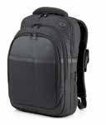

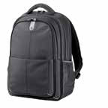
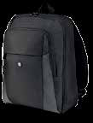
Upsell Recommendations — Page 1
Mouse
Keyboard
Backpack
HP X4000b Bluetooth Mouse
HP Slim Bluetooth Keyboard
HP Business Nylon Backpack
Be more productive on the go with the sleek, stylish HP X4000b Bluetoo
The HP Slim Bluetooth Keyboard is a thin and light wireless keyboard t
HP Business Nylon Backpack offers a sturdy, all-purpose backpack for m
HP Bluetooth TTP Mouse
HP Professional Backpack Case
Combining comfort and function, the HP Pro-fessional Backpack Case is
HP Mouse
HP Essential Backpack
The HP Essential Backpack is a great notebook carrying solution for bo

Slide 8
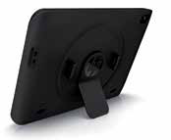


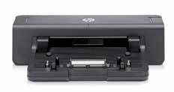
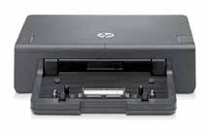
Upsell Recommendations — Page 2
Sleeve
Docking Station
HP ElitePad Case
HP ElitePad Productivity Jacket
Sophistication. Durability. We've got you covered. Carry your HP Elite
Expand your potential by choosing from a complete suite of thoughtfull
HP ElitePad Rugged Case
HP 2012 230W Advanced Docking Station
Help protect your HP ElitePad when you work with a business rugged env
HP offers a full line of docking stations designed exclusively for sel
HP 2012 230W Docking Station
HP offers a full line of docking stations designed exclusively for sel

Slide 9
Recommended next steps
Thank You — HP Sales Team

