Slide 1
NOTE FLUTTER
ONLINE NOTES SHARING SYSTEM
Group Members:-
Abhinav R Nair
Anuja Praveen
Pavithra Vijeshkumar
Group Guide:-
Mrs. Divya R

Slide 2
SYNOPSIS
WHAT ARE THE PRIMARY OBJECTIVES OF NOTES SHARING SYSTEM ?
FROM THE PERSPECTIVE OF ADMINISTRATORS
FOR USERS

Slide 3




INTODUCTION NOTE FLUTTER IS A WEB BASED NOTES SHARING AND MANAGEMENT SYSTEM WHICH HELPS THE USERS TO SHARE THE NOTES EFFECTIVELY. MULTIPLE USERS CAN WORK IN THE SYSTEM AT THE SAME TIME UNDER CENTRALIZED SUPERVISION BY ADMINISTRATOR. IT IS VERY USEFUL NOTE MANAGEMENT SYSTEM FOR COLLEGES,SCHOOLS AND OTHER INSTITUTES

Slide 4
SYSTEM ANALYSIS

Slide 5
EXISTING SYSTEMS
WHATSAPP
GOOGLE CLASSROOM

Slide 6

DRAWBACKS OF EXISTING SYSTEM

Slide 7
PROPOSED SYSTEM & ADVANTAGES
EASY TO USE WEB BASED SYSTEM
USERS CAN REGISTER ONLINE
NOTES ARE ACCESSIBLE FROM ANYWHERE
CENTRALIZED CONTROL BY ADMINISTRATOR
MANAGED NOTES IN A SECURE MANNER

Slide 8
MODULES
ADMINSTRATIVE MODULE
USER MANAGEMENT MODULE

Slide 9
FEASIBILITY STUDY
TECHNICAL FEASIBILITY
ECONOMIC FEASIBILITY
SOCIAL FEASIBILITY

Slide 10
TABLE DESIGN

Slide 11
ADMIN
Field name | Datatypes | Constraints | Description
admin_id | INT | Primary key, Auto increment | Unique admin ID
user_name | VARCHAR(100) | Not null | User name of admin
password | VARCHAR(255) | Not null | Admin’s password
email | VARCHAR(100) | Unique, Not null | Admin’s e-mail.

Slide 12
USER
Field name | datatype | Constraints | description
user_id | INT | Primary key, Auto increment | Unique user ID
User_name | VARCHAR (100) | Unique,not null | User’s username
name | VARCHAR (100) | Not null | User’s name
email | VARCHAR (100) | Unique,not null | User’s email
phone no. | INT | Unique,not null | User’s phone no
password | VARCHAR (255) | Not null | Password of user
status | ENUM (active,banned,Suspected) | Default ‘active’ | User’s status changed from active If admin decides
Reputation_score | INT | Default 0 | Contribution score
created_at | DATETIME | Default current_time stamp | Account creation date and time

Slide 13
STUDY GROUP
Field name | Datatype | Constraints | Description
group_id | INT | Primary key, Auto increment | Unique group ID
group_name | VARCHAR(100) | Not null | Study groups name
user_id | INT | Not null, Foreign key→users | Creator of the groups
approved | BOOLEAN | Default false | Approval of admin
created_at | DATETIME | Default current_timestamp | Group creation timestamp

Slide 14
GROUP MEMBERS
Field name | Datatype | Constraints | Description
members_id | INT | Primary key, Auto increment | Unique ID of group
group_id | INT | Not null,foreign key→study group | Associated group in question
user_id | INT | Not null,foreign key→user | Member of the group
role | ENUM (members,moderator) | Default ‘member’ | Member or moderator
status | ENUM(pending, Joined) | Default ‘pending’ | ‘pending’, ‘joined’

Slide 15
GROUP MESSAGES
Field name | Datatype | Constarints | Description
message_id | INT | Primary_key, Auto increment | Message_ID
group_id | INT | Not null,foreign key→study groups | Liked group
user_id | INT | Not null,foreign key→users | Sender of message
content | TEXT | Not null | Message content
time_stamp | DATETIME | Default current_timestamp | When it user sent

Slide 16
NOTES
Field name | Datatype | Constraints | Description
note_id | INT | Primary key, Auto increment | Note ID
group_id | INT | Not null,foreign key→study group | Related group
user_id | INT | Not null,foreign key→users | Who uploaded
title | VARCHAR (100) | Not null | Title of the note
file_path | VARCHAR (255) | Not null | File location
upload_time | DATETIME | Default current_timestamp | Time of upload

Slide 17
REPORTS
Field name | Datatype | Constraints | Description
report_id | INT | Primary key, Auto increment | Report ID
user_by | INT | Not null,foreign key→users | Who reported
target_type | ENUM (user,message,note) | Not null | User,message or note
target_id | INT | Not null | ID of reported item
reason | TEXT | Not null | Reason for flopping
status | ENUM (open,resolved,under_review) | Default ‘open’ | Open or Resolved or Under review
created_at | DATETIME | Default current_timestamp | Report time

Slide 18
ANNOUNCEMENTS
Field name | Datatype | Constraints | Description
annoucement_id | INT | Primary key, Auto increment | Announcement_ID
admin_id | INT | Not null,foreign key→admin | sender
title | VARCHAR (150) | Not null | Title of message
content | TEXT | Not null | Message content
group_id | INT | Foreign key→ Study group | Group target
created_at | DATETIME | Default current_timestamp | When it was set

Slide 19
TO DO
Field name | Datatype | Constraints | Description
to_do_id | INT | Primary key, Auto increment | To do ID
group_id | INT | Not null,foreign key→study group | Associated group
user_id | INT | Not null,foreign key→users | Creator of the task
task | VARCHAR (200) | Not null | Task description
assigned_to | INT | Foreign key→ Users nulloble | Optional asssigned user
status | ENUM | Default ‘open’ | Open,in progress,done

Slide 20
DOWNLOADED NOTES
Field name | Datatype | Constraints | Description
download_id | INT | Primary key, Auto increment | Unique download record
note_id | INT | Not null,foreign key→notes | The note that the user Downloaded
user_id | INT | Not null,foreign key→users | The user who Downloaded it
downloaded_at | DATETIME | Default current_timestamp | When the note Was download

Slide 21
DFD Data Flow Diagram

Slide 22
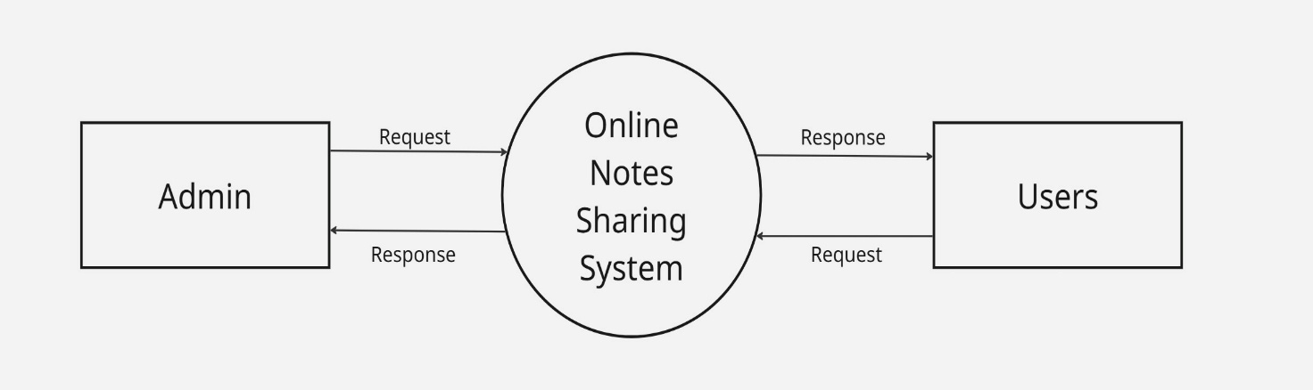
Context level DFD

Slide 23
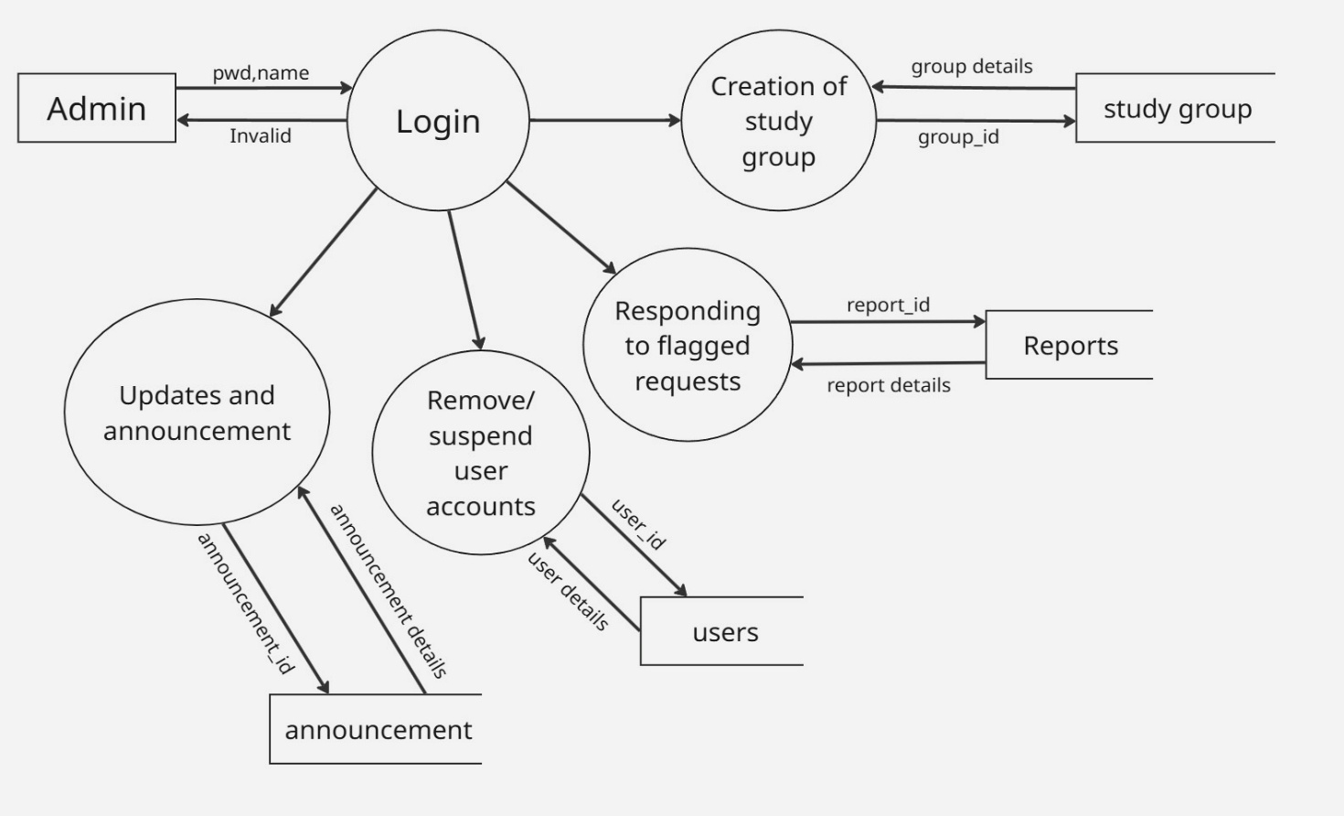
Level 1 DFD ADMIN

Slide 24
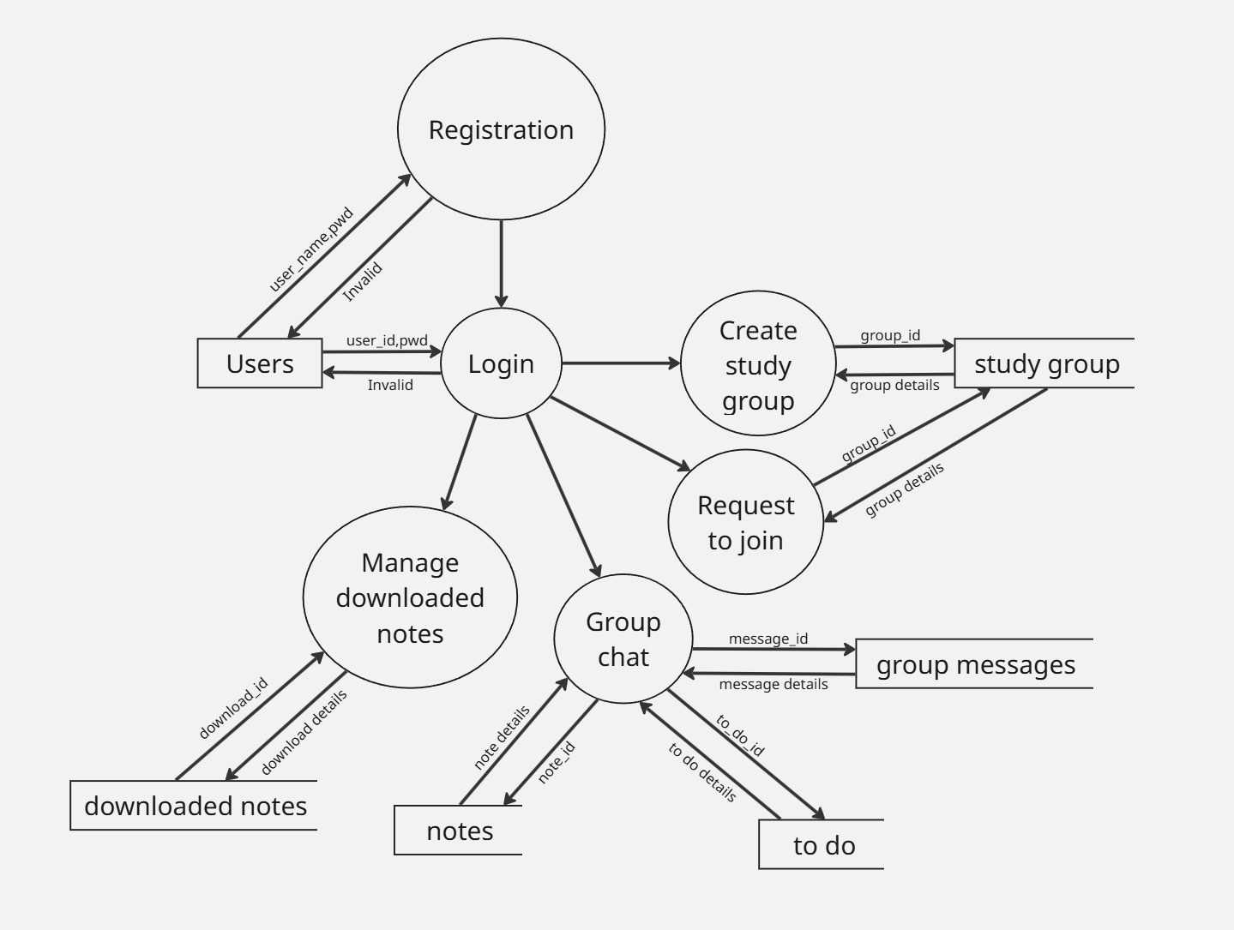
Level 1 DFD USER

Slide 25

CONCLUSION

Slide 26
REFERENCE
https://openai.com
https://roadmap.sh/frontend/projects
https://www.guvi.in
https://miro.com/app/dashboard

Slide 27
THANKYOU

